Slide 1
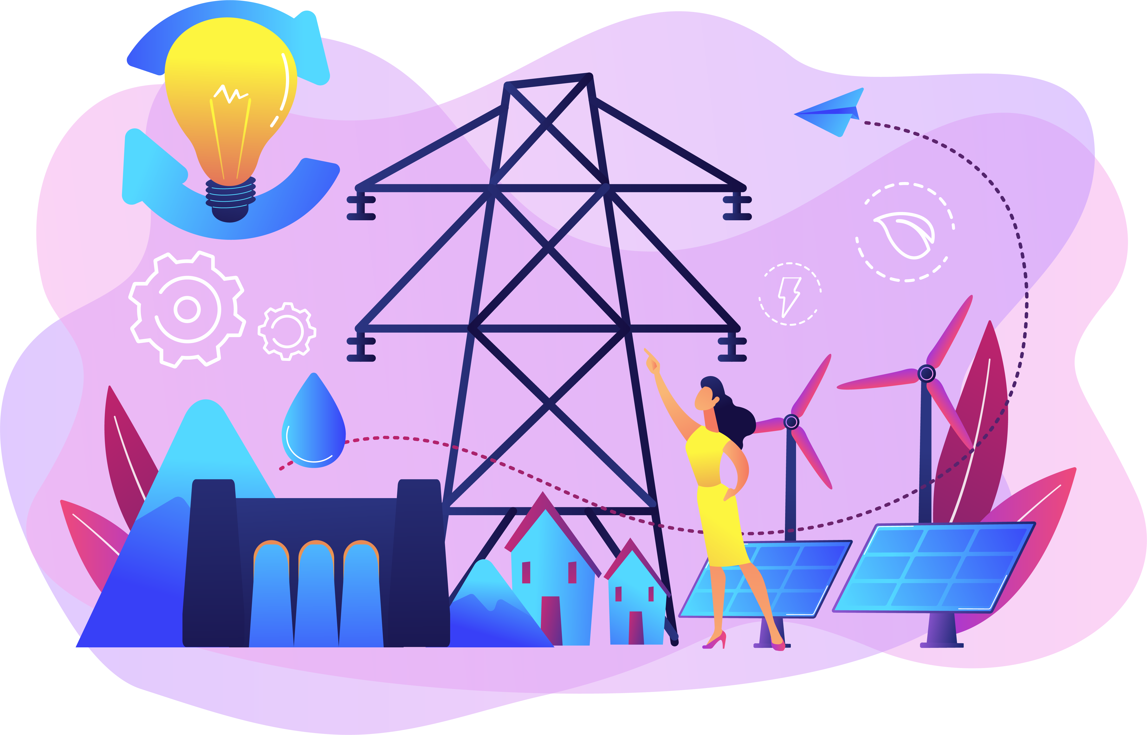
From Power Plant to PlayStation™:
Electricity’s Journey from Producer to Consumer

Slide 2
Raise your hand if you enjoy playing video games, watching TV, or turning on your lights at home.
Notes:
Ask students, “Do you play video games on a video console like PlayStation™, on a computer or laptop or even your phone?” Allow them a few moments to take turns responding. Answers may vary between those three options.

Slide 3
Many of the items you and your family use in your living space, including your video game console or computer, are powered by electricity.
Notes:
Show Slide 3 which reminds them that the video game console, computer, and other items in their homes are powered by electricity. Then ask, “How does this work? Is it magic?” Answers will vary but may include it’s not magic, it’s electricity. Next, ask, “How do electric companies generate and distribute electricity to our homes and people’s businesses?”

Slide 4
THE POWER
PRODUCTIVE RESOURCES!
of
Notes:
Dramatically declare, “It’s the power of productive resources!”

Slide 5
PRODUCTIVE RESOURCES
are the natural resources, human resources, and capital goods available to make goods and services.
Notes:
The next few slides will elaborate on what productive resources are and give examples in the production and distribution of electricity. It is not necessary to spend more than a couple of minutes with each part.

Slide 6
NATURAL RESOURCES
“Gifts of nature” like air, soil, water - present without human intervention.
Notes:
The next few slides will elaborate on what productive resources are and give examples in the production and distribution of electricity. It is not necessary to spend more than a couple of minutes with each part.

Slide 7
ELECTRICITY IS CREATED WITH PRODUCTIVE RESOURCES
Natural Resources
COAL
NATURAL GAS
OIL
NUCLEAR ENERGY
SOLAR ENERGY
WATER
BIOMASS
WIND
Notes:
Tell students that these are examples of natural resources used when producing electricity. Ask students if there are any examples that are surprising. Answers may vary but may include any named on the slide. Note that students may be unfamiliar with biomass. If necessary, define it as renewable, organic materials that come from plants and animals such as wood, crops, manure, compost, and some garbage.

Slide 8
Human Resources (Labor):
The people who do the mental and physical work to produce goods and services.
Notes:
Define human resources as the people who do the mental and physical work to produce goods and services and is sometimes referred to as labor. That labor includes the mental and physical work necessary to do their job. Explain to students that people like teachers trade their labor for income. People use their income – money or salary exchanged for the use of their labor - to trade for the things they do not produce themselves.
Ask if they can think of any other examples of human resources. Answers may vary but may include firefighters, bankers, chefs, delivery drivers, construction workers, etc.

Slide 9
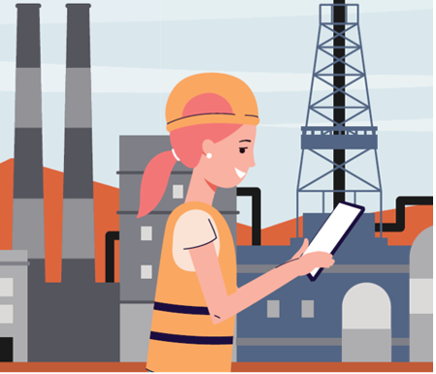
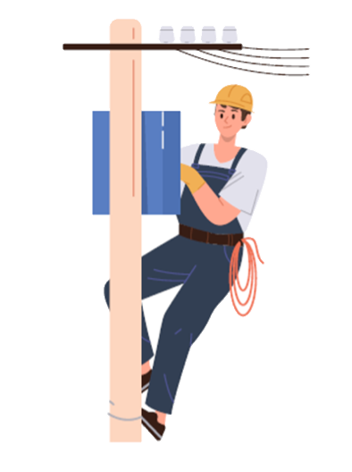
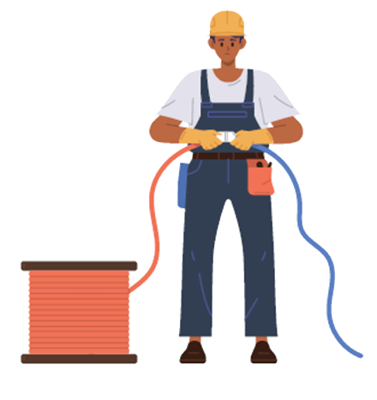
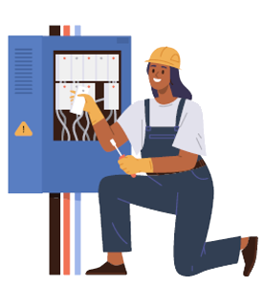
ELECTRICITY IS CREATED WITH PRODUCTIVE RESOURCES
Human (Labor)
POWER PLANT
OPERATOR
METER READER
LINEWORKER
ELECTRICAL
ENGINEER
ELECTRICIAN
Notes:
Tell students these are examples of human resources that perform work in generating and distributing electricity from the power plant to homes and businesses. Review each human resource as follows:
power plant operator - someone who controls, operates, and maintains machinery to generate electricity
lineworker - someone who installs, services, and emergency repairs electrical lines in the case of lightning, wind, ice storm, or ground disruptions
meter reader - someone who works in the field to read the electrical meters on homes to make sure homeowners are paying the correct amount each month for their energy consumption
electrician - someone who specializes in electrical wiring of buildings, transmission lines, stationary machines, and related equipment
electrical engineer - someone who designs, develops, tests, and manages the manufacturing of electrical equipment

Slide 10
Capital Goods:
Goods produced and used to make other goods and services.
Notes:
Define capital goods as goods produced and used to make other goods and services. Tell students that producers use goods that are produced to make other goods and services. Tell them you use a computer to do your work. That computer is a capital good. Ask students for additional examples such as what capital good a carpenter might use Answer: Hammer or saw. What might a baker use? Answer: Oven, mixer.

Slide 11
ELECTRICITY IS CREATED WITH PRODUCTIVE RESOURCES
Capital Goods
POWER PLANT
TURBINE
TRANSFORMER
TRANSMISSION LINES
SUBSTATION
POWER LINES
ELECTRIC METER
Notes:
Tell students these pictures are examples of capital goods (capital resources) used to generate and distribute electricity. Explain we are about to see the sequence or order in which these are used in the production and distribution of electricity. We will learn more about how each one is used in this process.

Slide 12
How does electricity produced at power plants get to your home?
https://youtu.be/20Vb6hlLQSg?feature=shared
Notes:
https://www.youtube.com/watch?v=20Vb6hlLQSg
Tell them they will watch a video on electricity generation to help them answer this question. Instruct them to use the note taking sheet to jot down examples of natural resources, human resources, and capital goods they observe in the video, “Energy 101: Electricity Generation.”

Slide 13
Electricity is made at a generating station by
huge generators. Generating stations can use wind,
coal, natural gas, nuclear power, or water.

Slide 14
The current is sent through station transformers to increase the voltage to push the power long distances.

Slide 15
The electrical charge goes through high-voltage
transmission lines that stretch across the country.

Slide 16
It reaches a substation where the voltage is lowered so it can be sent on smaller power lines.

Slide 17
It travels through distribution lines to your neighborhood.
Smaller transformers reduce the voltage again to make the power safe to use in our homes. These smaller transformers may be mounted on the poles or sitting on the ground.

Slide 18
The electricity connects to your house and passes through a meter that measures how much your family uses.

Slide 19
The electricity goes to the service panel in your basement or garage, where breakers or fuses protect the wires inside your house from being overloaded. (Never touch a service panel!)

Slide 20
The electricity travels through wires inside the walls
to the outlets and switches all over your house...
allowing you to play video games or watch TV!

Slide 21
You will now create a POWER LINE
showing how electricity makes its journey from
producer to consumer using what we know about
PRODUCTIVE RESOURCES.

Slide 22
The first cards to put on our POWER LINE will be CAPITAL GOODS produced by electric companies. There are 8 capital goods cards. You must put them in the correct sequence of
production, distribution, and consumption.

Slide 23
The next set of cards to put on our POWER LINE
will be NATURAL RESOURCES used by electric companies to produce electricity.
There are 4 natural resources cards. You must attach them to the capital resource card they would be used with.

Slide 24
The final set of cards to put on our POWER LINE
will be HUMAN RESOURCES who work to produce and distribute the electricity to consumers.
There are 6 human resources cards. You must attach them to the capital resource card they can work with.

Slide 25
How do electric companies get the
PRODUCTIVE RESOURCES they use to produce electricity for consumers?

Slide 26
PRODUCTIVE
RESOURCES
ELECTRICITY
PAYMENT
(purchases, salaries, wages)
HOMES & BUSINESSES
(consumers)
ELECTRIC
COMPANY
(producer)
PAYMENT
(electric bill)

Slide 27
Because of this voluntary exchange, both the producer of electricity (an electric company) and the consumers (homes and businesses) expect to be better off after the trade.

Slide 28
Discussion Questions:
What are natural resources?
What are human resources?
What are capital resources?
Notes:
What are natural resources? Answer: Natural resources are "gifts of nature," like air, soil, water, present without human intervention.
What are human resources? Answer: Human resources are the people who do the mental and physical work to produce goods and services.
What are capital resources? Answer: Capital resources are goods produced and used to make other goods and services.

Slide 29
Discussion Questions:
What do consumers voluntarily trade with electric companies to get electricity in their homes?
What do electric companies do with the money they receive from consumers?
How are producers and consumers of electricity better off because of this voluntary exchange?
Notes:
What do consumers voluntarily trade with electric companies to get electricity in their homes? Answer: Money
What do electric companies do with the money they receive from consumers? Answer: They pay for the productive resources needed to generate and distribute electricity.
How are electricity producers and consumers better off because of this voluntary exchange? Answer: The producers can pay for the productive resources they must have to generate and distribute electricity and consumers get the electricity they want.

Slide 30
Video game consoles, TVs, and the lights you use in your home are not powered by magic.
As with all goods we consume that require electricity, the electricity must be produced and distributed to consumers who pay a price for it.
This requires a lot of natural resources, human resources (labor), and capital goods to provide consumers with the electricity they want.

