Slide 1
Presented by: Amber Peters (Mizz P.) Email: Apeters@mizzp.nyc Date: 10/01/2024
COLLEGE CASH 101:
College Financing Options
& Resources

Slide 2
About The Presenter
Amber Peters(Mizz P.)
Founder, On Track With Mizz P. Lead College and Career Access Consultant
Mizz P. partners with schools and educational organization leaders to
provide students, parents, and staff with informative yet fun ways to explore
college and career options
www.mizzp.nyc

Slide 3
Tonight’s Agenda
Introduction
Financial Aid Basics
State Funding 101
Other Ways To Pay
Q&A

Slide 4
Objectives
To enhance knowledge of financial aid options
To identify resources for college financing

Slide 5
Expectations
Participate in the chat
Stay on topic (try not to jump ahead)
Ask questions to clarify not derail
Apply and share what you learn

Slide 6
Question For Ya:
How did you pay for college?

Slide 7
🤔If you had to do it all again
what would you do differently?

Slide 8
Let’s Talk Financial Aid Basics…..

Slide 9
💰COLLEGE FUNDING SOURCES
Come in two forms:
Gift Aid
Financial aid that does not require repayment, such as student grants and scholarships.
Self Help Aid
Self-help aid is money awarded to students that must be paid back, or requires something in return, such as volunteer hours or a certain number of work hours. (Loans & Work Study)

Slide 10
To access many of these forms of aid, students must first complete the FAFSA

Slide 11
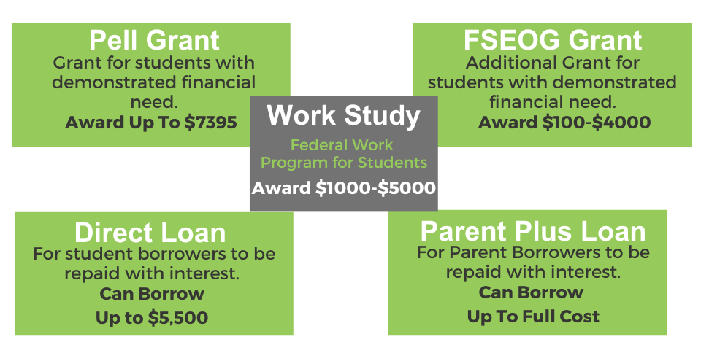
💰FAFSA BASICS
What funding sources can be accessed as a direct result of filing the FAFSA?

Slide 12
💰ELIGIBILITY
🔗Check FAFSA Eligibility
😊Who is eligible to apply?
US Citizens and Eligible Non Citizens
😔Who is not eligible to apply?
Undocumented students, including Deferred Action for Childhood Arrivals (DACA)

Slide 13
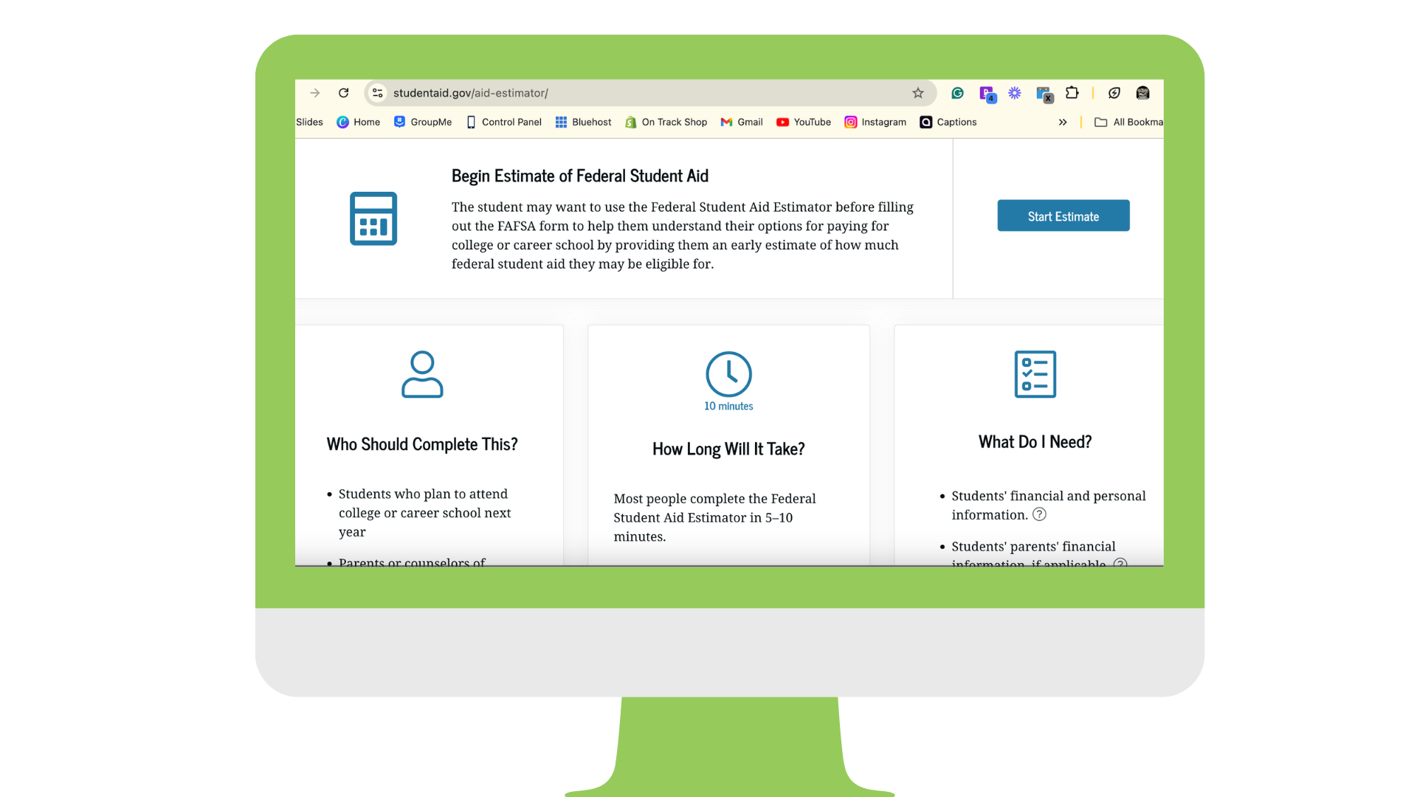
FAFSA Estimator

Slide 14
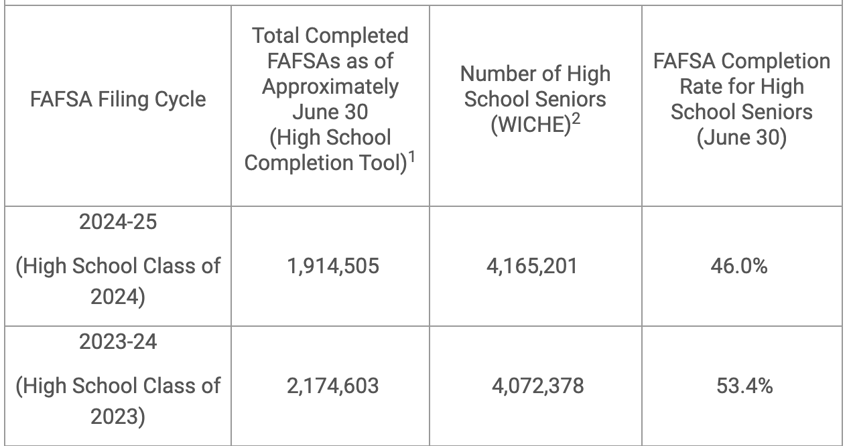
🍵 Here’s The Tea:
According to the National College Attainment Network (NCAN)

Slide 15
💰FAFSA Best Practices
Best practices for getting students ready:
-Create an internal deadline for FAFSA completion
-Have an information session with families early
-Survey your students to see what steps they have completed or need to take
-Set up clinics or office hour days to help students set up ID’s and apply

Slide 16
State Funding

Slide 17
💰State Funding
Additional funds can be accessed through state programs but many students often forget to apply.
GRANTS
SCHOLARSHIPS

Slide 18
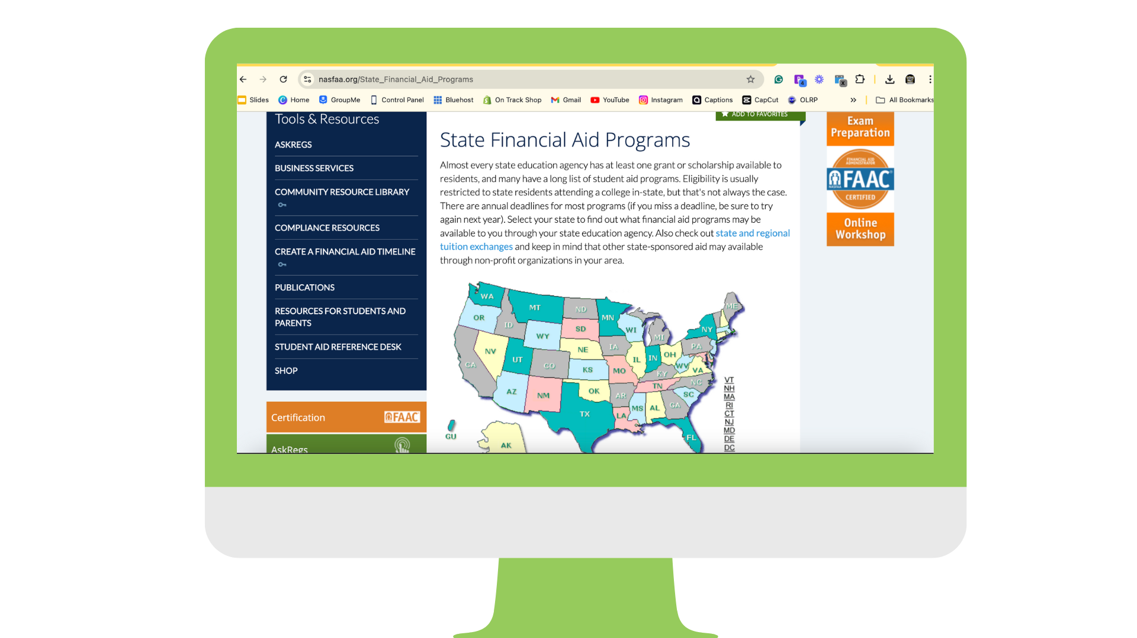
NASFAA State Financial Aid Finder

Slide 19
OTHER WAYS TO KEEP
THINGS AFFORDABLE

Slide 20
💰TRY THESE TO SAVE ON COSTS
Get Institutional Aid (Merit or Need Based Scholarships)
Take AP courses if offered and pass with a 3 or 4
Take advantage of Dual Enrollment (if offered)
Take CLEP exams for basic classes
Take General Ed classes at a community college

Slide 21
Scholarship Search
Resources For Students

Slide 22
JLV SCHOLARSHIPS

Slide 23
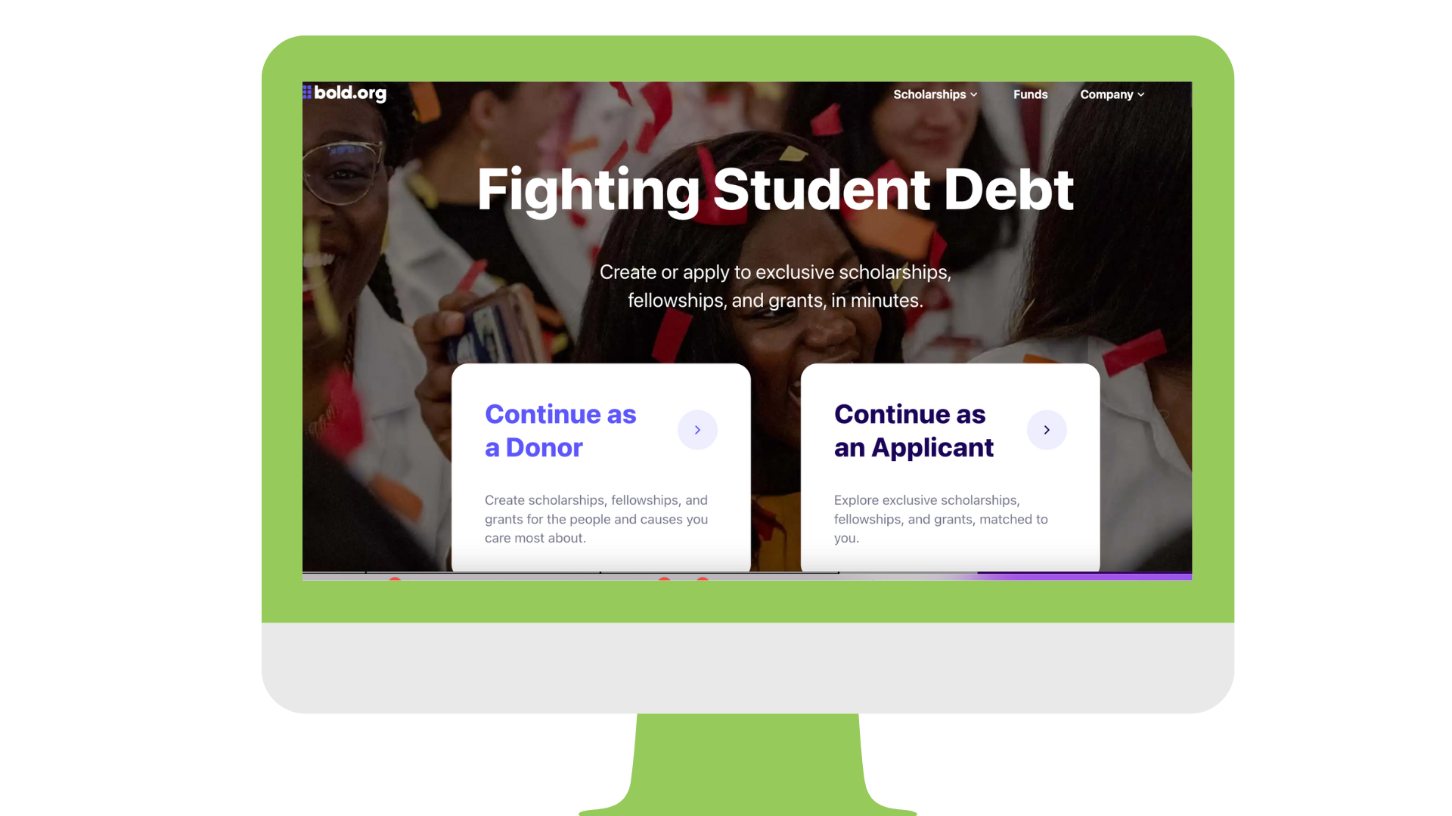
BOLD.ORG

Slide 24
GOING MERRY

Slide 25
SHARING IS CARING
Are there any resources you would
like to share with the group?
🔗ADD YOUR RESOURCE HERE

Slide 26
Q & A

Slide 27
Amber Peters
Apeters@mizzp.nyc
www.mizzp.nyc
https://www.linkedin.com/in/amberpetersnyc/
Thank You

