Slide 1
Election Lessons from the
Council for Economic Education

Slide 2
Many people have an issue that is so important to them that they must agree with a candidate on it before they can vote for them. What issue is a deal-breaker for you when you decide how to vote for president?
Health care
Gun control / 2nd Amendment
Immigration
Abortion / Reproductive rights
Bringing the country together
Leadership / Congressional dysfunction
Racism / Equality / LGBTQ rights
Corruption / Ethics
Jobs / Economy
Climate change / Environment
National security / Terrorism
Ukraine support
Israel and Gaza
Crime

Slide 3
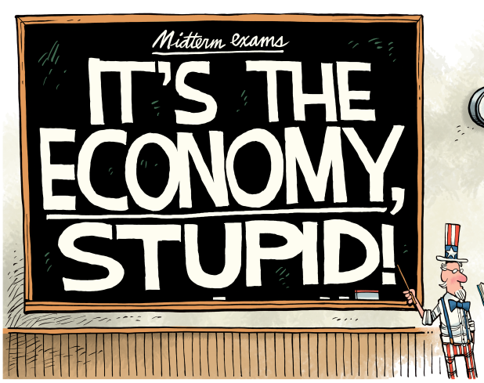

Slide 4
LESSON 8 – ECONOMIC MISERY AND PRESIDENTIAL ELECTIONS
VISUAL 8.1 SOME KEY ECONOMIC INDICATORS
Unemployment Rate: The percentage of people in the labor force who are unemployed
Inflation Rate: The percentage increase in the overall price level
Real GDP: The value of all final goods and services produced in a country in a year, expressed in terms of constant dollars.
Two Statistics Based on These Indicators
Misery Index: The sum of the unemployment rate and the inflation rate.
Growth rate in real GDP per capita: The percentage change in the real GDP per person.
Election Lessons © Council for Economic Education, New York, NY

Slide 5
Election
Winner

Slide 6
Election
Winner

Slide 7
Election
Winner

Slide 8
Election
Winner

Slide 9
Election
Winner

Slide 10
Election
Winner

Slide 11
Election
Winner

Slide 12
Election
Winner

Slide 13
Election
Winner

Slide 14
Election
Winner

Slide 15
Election
Winner

Slide 16
Election
Winner

Slide 17
Election
Winner

Slide 18
Election
Winner

Slide 19
Election
Winner

Slide 20
Election
Winner

Slide 21
LESSON 8 – ECONOMIC MISERY AND PRESIDENTIAL ELECTIONS
SOME ECONOMIC RULES THAT WORK WELL
A Real GDP per capita growth rule:
The incumbent party usually wins if…
The growth rate of real GDP per capita accelerates (is a higher %) in the election year than the previous year.
A Misery Index rule:
The incumbent party usually wins if…
The Misery Index has not increased from the year prior to the election.
Election Lessons © Council for Economic Education, New York, NY

Slide 22
Activity 8.2
Fill in W or L for whether the incumbent party wins the election.
Fill in W or L for whether Real GDP Growth rule predicts W or L.
Fill in W or L for whether Misery Index rule predicts W or L.
How well does the real GDP per capita growth rule in Slide 3 predict election outcomes? (The rule is correct in 13 of 16 elections. It is incorrect for the years 1968, 1976, 1992.)
How well does the Misery Index rule in Slide 3 predict election outcomes? (The rule is correct in 14 of 16 elections. It is incorrect for the years 1976 and 1992.)

Slide 23
GDP GROWTH IN SWING STATES
Among the seven swing states (Arizona, Georgia, Michigan, Nevada, North Carolina, Pennsylvania, and Wisconsin) only Nevada didn’t see growth above the national average.

Slide 24
LESSON 8 – ECONOMIC MISERY AND PRESIDENTIAL ELECTIONS
VISUAL FOR STEP 16 – Predicting the Next Election
Year | Growth in Real GDP per Capita | Unemployment Rate | Inflation Rate | Misery Index | Growth Rule | Misery Index Rule | Candidates | Incumbent Party Wins or Loses?
2017 | 1.7 | 4.4 | 2.1 | 6.5
2018 | 2.3 | 3.9 | 2.4 | 6.3
2019 | 1.8 | 3.7 | 1.8 | 5.5
2020 | -2.44 | 8.0 | 1.2 | 9.2
Election Lessons © Council for Economic Education, New York, NY

Slide 25
LESSON 8 – ECONOMIC MISERY AND PRESIDENTIAL ELECTIONS
VISUAL 8.3 SOME ECONOMIC RULES THAT WORK WELL
A Guaranteed Loss Rule:
The incumbent party has always lost if…
The growth rate of real GDP per capita decelerates - is a lower percentage in the election year than the previous year.
AND
The misery index has increased from the year prior to the election to the year of the election.
Election Lessons © Council for Economic Education, New York, NY

Slide 26
LESSON 8 – ECONOMIC MISERY AND PRESIDENTIAL ELECTIONS
VISUAL FOR STEP 16 – Predicting the Next Election
Year | Growth in Real GDP per Capita | Unemployment Rate | Inflation Rate | Misery Index | Growth Rule | Misery Index Rule | Candidates | Incumbent Party Wins or Loses?
2021 | 5.6 | 5.4 | 4.7 | 10.1
2022 | 1.6 | 3.6 | 8.0 | 11.6
2023 | 1.6 | 3.6 | 4.1 | 7.7
2024 | ??? | ??? | ??? | ???
Current
Election Lessons © Council for Economic Education, New York, NY

Slide 27
LESSON 8 – ECONOMIC MISERY AND PRESIDENTIAL ELECTIONS
VISUAL FOR STEP 16 – Predicting the Next Election
Year | Growth in Real GDP per Capita | Unemployment Rate | Inflation Rate | Misery Index | Growth Rule | Misery Index Rule | Candidates | Incumbent Party Wins or Loses?
2021 | 5.6 | 5.4 | 4.7 | 10.1
2022 | 1.6 | 3.6 | 8.0 | 11.6
2023 | 2.0 | 3.6 | 4.1 | 7.7
2024 | ??? | ??? | ??? | ???
Current | 2.6 | 4.2 | 2.4 | 6.6
Democrat wins the
White House
(% change from a year ago) Growth is strong…
(Misery up or down?) Inflation is dwindling, so if unemployment holds steady…
Election Lessons © Council for Economic Education, New York, NY

