Slide 1
The Future of Batteries

Slide 2
What is a battery?
A container in which chemical energy is converted into electricity and used as a source of power.
Brainstorm as many ways you can think of that you use batteries on any given day.

Slide 3
Types of Household Batteries
Notes:
Picture source: https://www.fairfaxcounty.gov/publicworks/recycling-trash/batteries

Slide 4
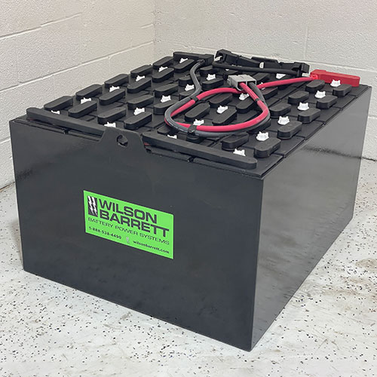
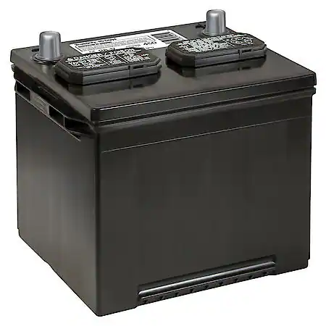
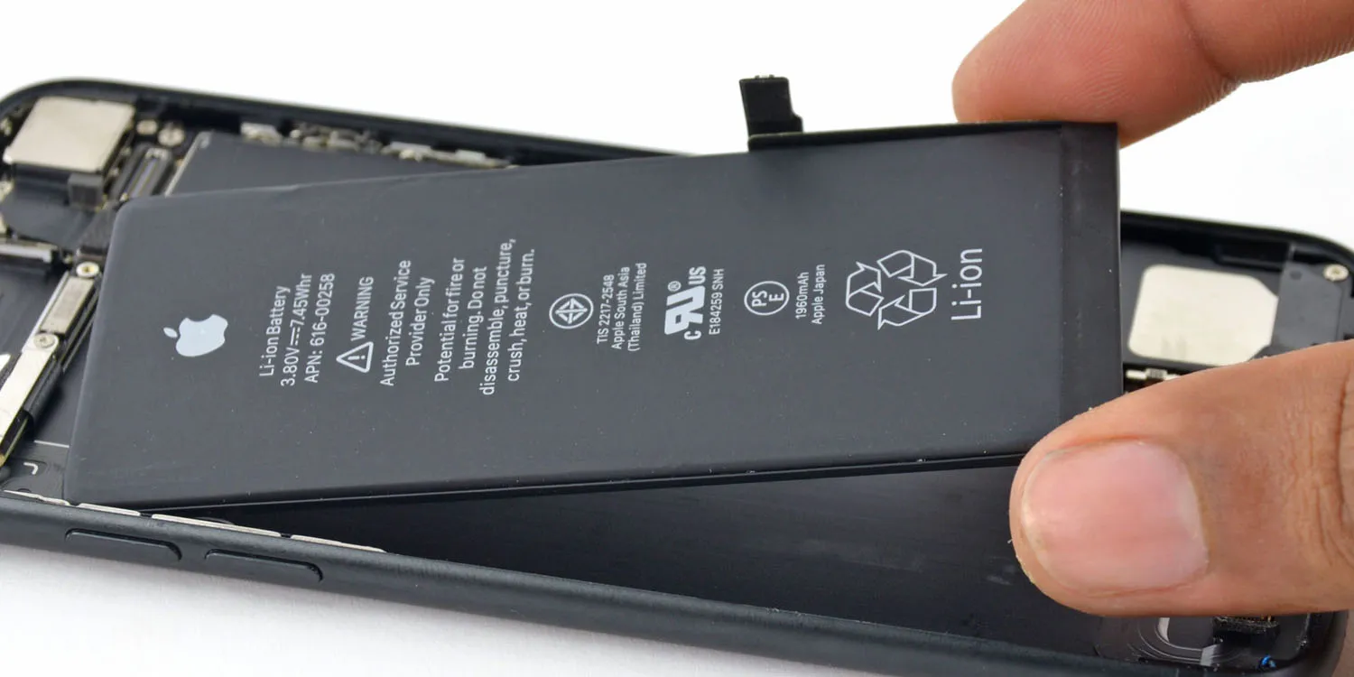
Other Batteries
smartphone
forklift/heavy machinery
car
Notes:
All photos royalty free courtesy of Pixabay.

Slide 5
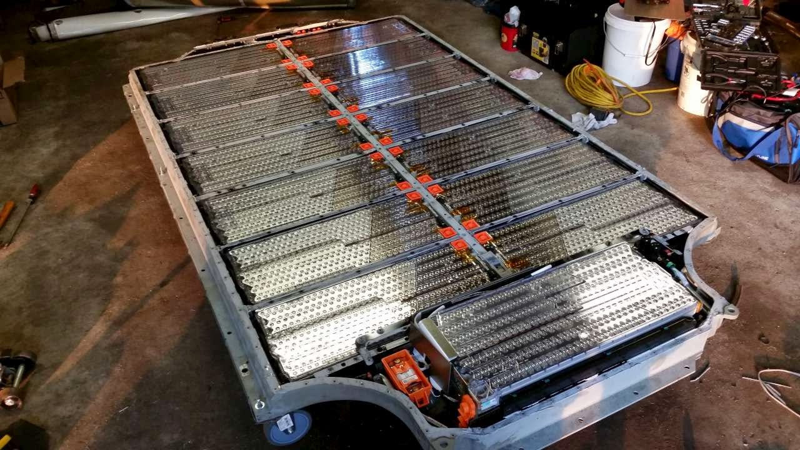
What type of battery is this?
Tesla Model S
Notes:
This is the battery system of a Tesla Model S. While it is referred to as a “battery”, it is actually thousands of little batteries working together as one giant battery. Picture source: https://www.qnovo.com/blogs/peek-inside-the-battery-of-a-tesla-model-s

Slide 6
Did you know?
Batteries have hundreds of uses
energy grid storage (when grid over produces)
backup power for thousands of companies
storing renewable energy (hydro/solar)
tiny medical devices
space/deep sea exploration

Slide 7
Did you know?
Battery industry facts
$100 billion industry world wide
Duracell and Energizer combine for over $4.5 billion in revenue each year
The average household has between 20-60 batteries in use at any given time
It would take around 12,000 AA batteries to power the average house for one day
Notes:
Info source: https://gitnux.org/lithium-ion-battery-industry-statistics/

Slide 8
How do Batteries Work - (when charged)
Electrolyte
SOLUTION
METAL 1
METAL 2
Notes:
This layout is how the human battery simulation should start. The black dots represent students as electrons. They should start in Metal 1 and move through metal 2 to the storage solution in the middle.
The electrolyte in a battery is the substance that allows electrical current to flow between the anode and the cathode. Electrolytes may be fluids or solids. Soluble salts, acids, and bases can generally act as electrolytes.

Slide 9
How do Batteries Work - (powering)
Electrolyte
SOLUTION
METAL 1
METAL 2
Notes:
This layout is how the human battery simulation will look as electrons are moving. The black dots represent students as electrons. They should start in Metal 1 and move through metal 2 to the storage solution in the middle.

Slide 10
How do Batteries Work - (after power)
Electrolyte
SOLUTION
METAL 1
METAL 2
Notes:
This layout is how the human battery simulation should finish. The black dots represent students as electrons. They should start in Metal 1 and move through metal 2 to the storage solution in the middle.

Slide 11
Battery Debrief
Where did the “power” come from?
What would happen if we put more “actions” along the line (yarn)?
What are some ways to improve the design and use of batteries?
Notes:
Where did the “power” come from? Answer: The transfer of electrons between the metals.
What would happen if we put more “actions” (like running programs in the background, checking the weather, etc.) along the line/yarn? Answer: The more things the battery is powering, the quicker it will run out.
What are some ways you can think of that might improve the design and use of batteries? Answers: Answers will vary, but some innovations that have improved the design of batteries are: changing the types of metals and electrolytes used, stacking batteries, using different conductors, and improving recharging speeds

Slide 12
How Batteries Work
Notes:
Direct link to video: https://www.youtube.com/watch?v=9OVtk6G2TnQ

Slide 13
Benefits of batteries?
productivity - amount of output related to one unit of input
*capital productivity - how well physical capital (like a battery) increases the production of goods and services.
efficiency - degree to which waste can be reduced or minimized in production of a good or service
Innovations to batteries have increased both productivity and efficiency!

Slide 14
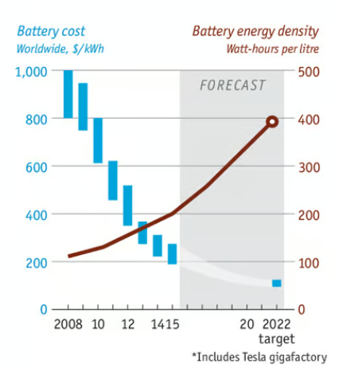
Notes:
This slide from the Economist - available to the public at researchgate here: https://www.researchgate.net/figure/Increase-in-energy-density-and-cost-reduction-of-Lithium-Ion-batteries-26_fig4_339138847 shows how the cost of lithium batteries is decreasing while the amount they can store is increasing. This bodes well for productivity purposes.

Slide 15
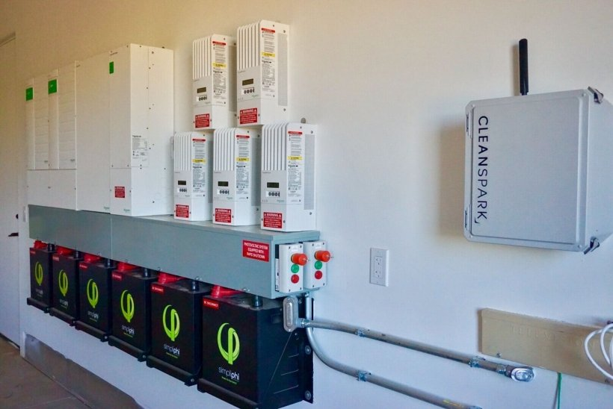
Household battery storage pack in Arizona.
Notes:
This is an example of how a household can store energy from solar panels for future use, which increases the efficiency of solar panels since less energy is wasted. Image available royalty-free from energy.gov: https://www.energy.gov/eere/solar/articles/should-i-get-battery-storage-my-solar-energy-system

Slide 16
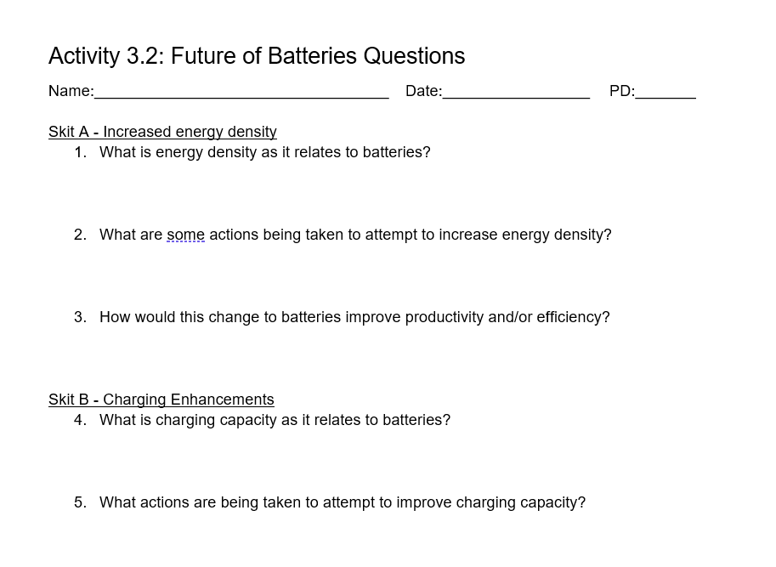
Improving Batteries - Mini Skits

Slide 17
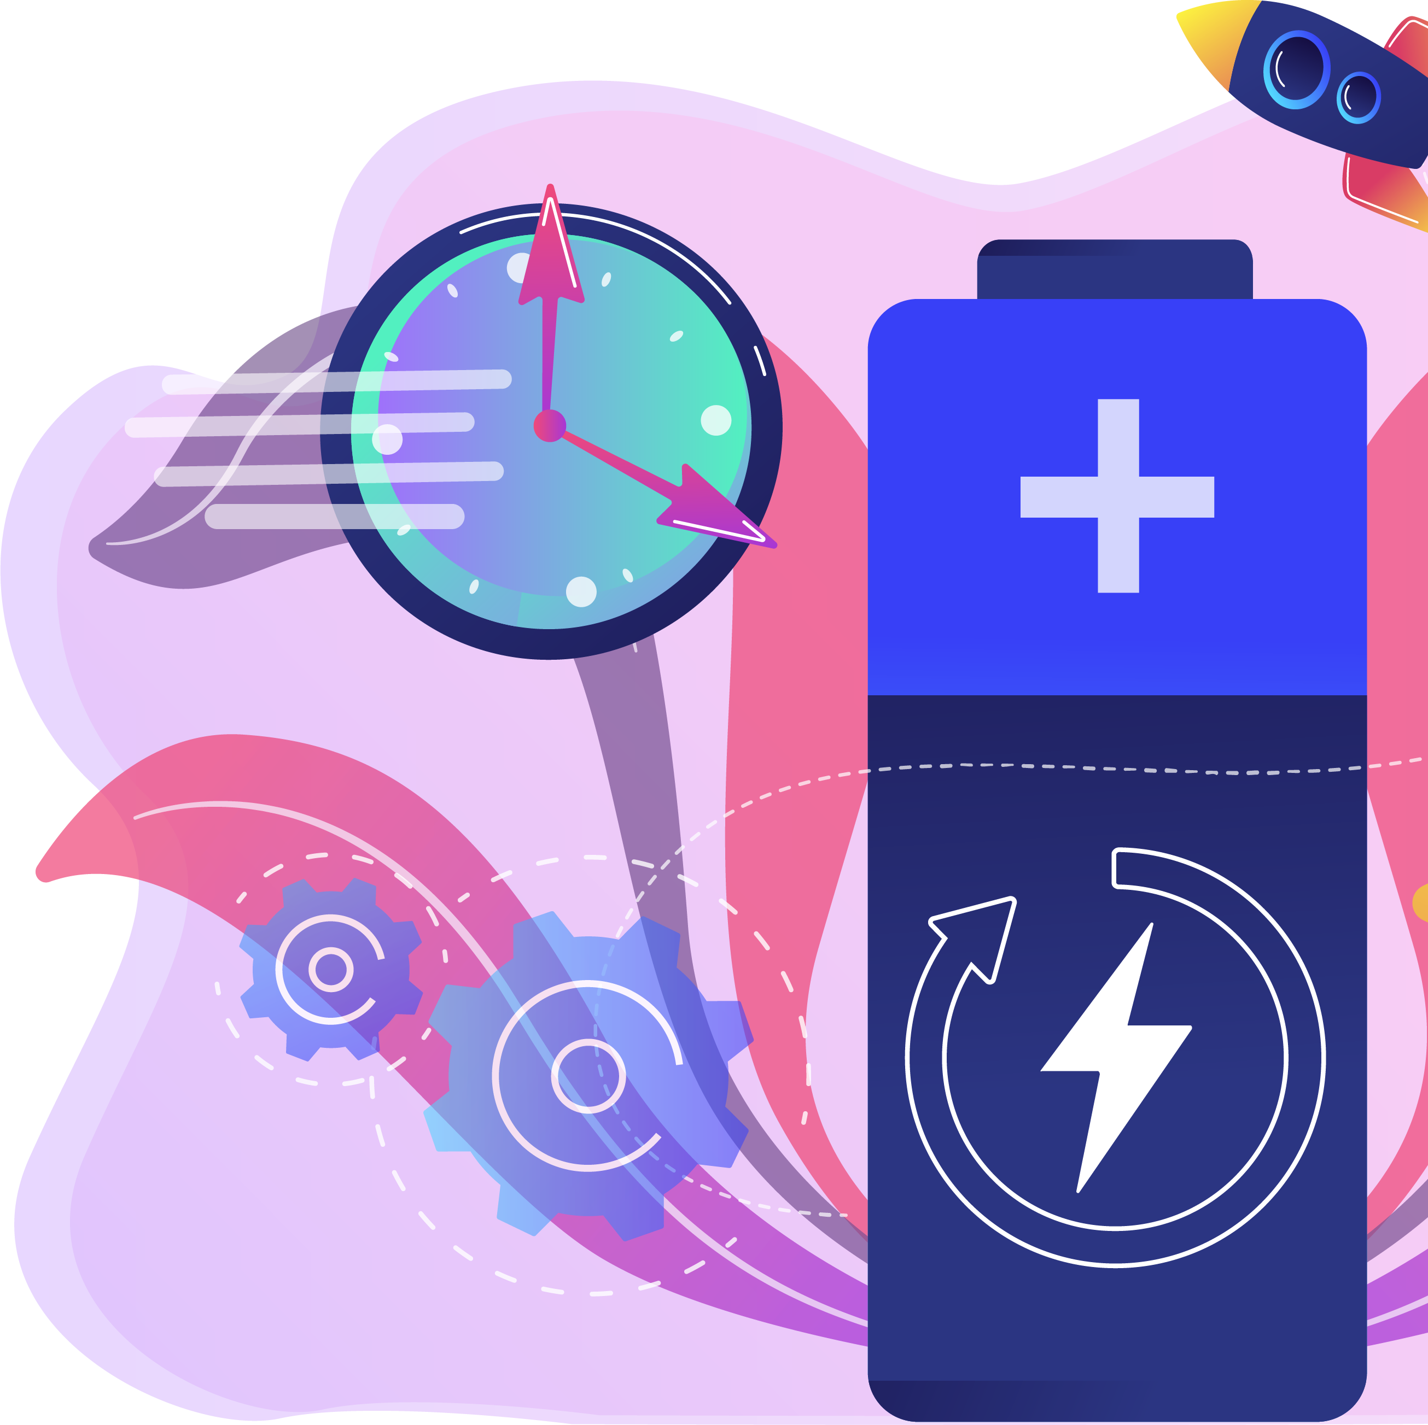
In summary
Batteries come in many forms and have thousands of applications
Batteries make society more productive and efficient
There are numerous ongoing innovations to batteries making them last longer, charge faster, and support larger electric systems worldwide

