Slide 1
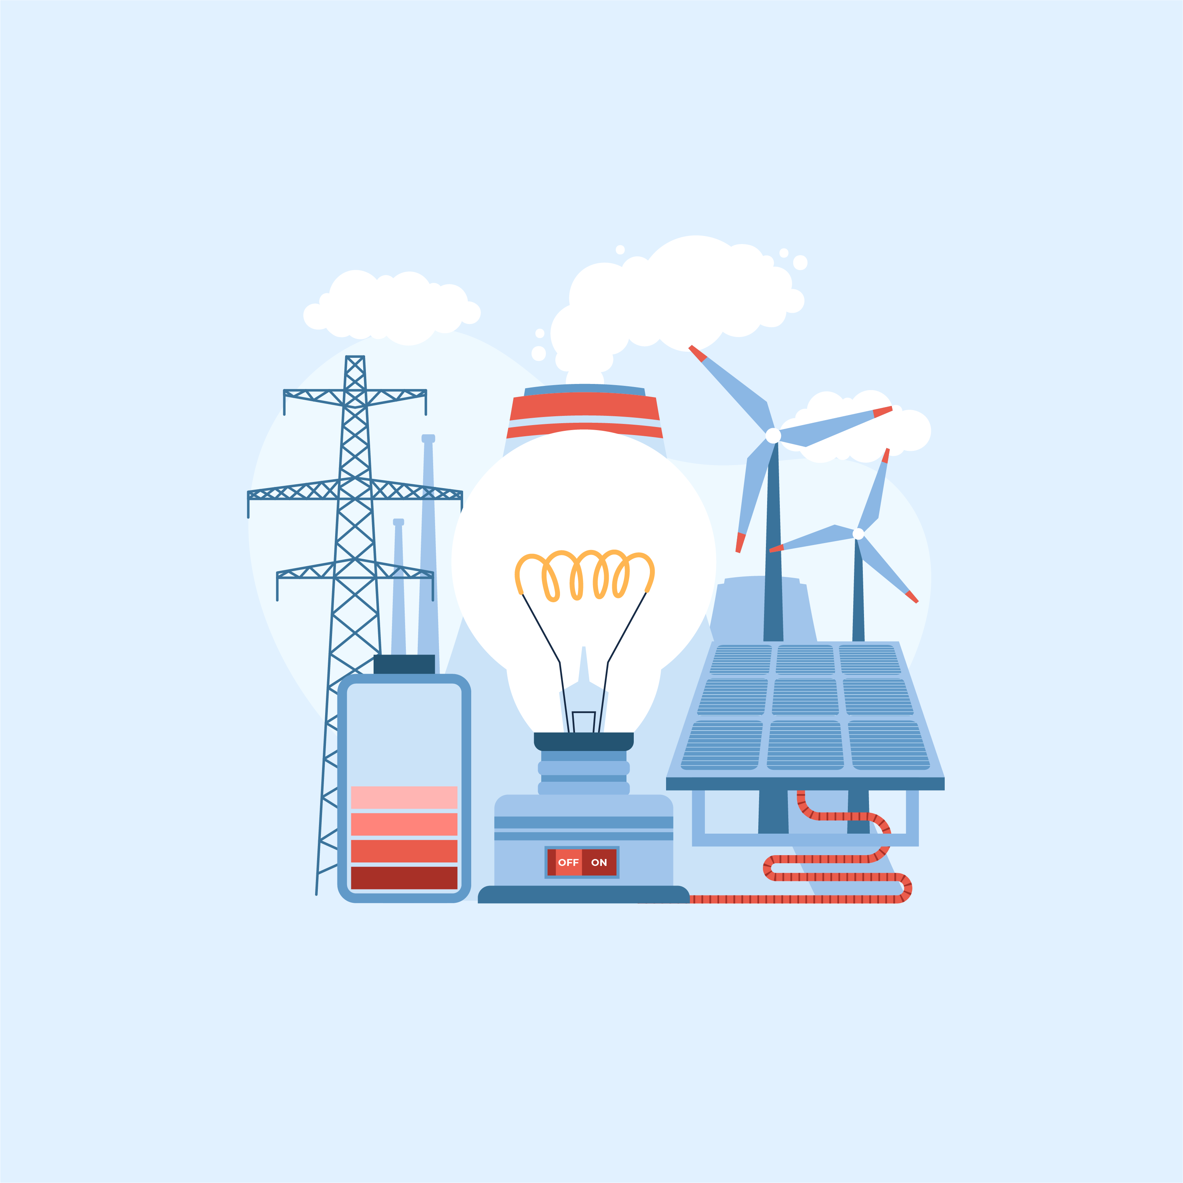
So, You Want to Build A Nuclear Power Plant?

Slide 2
When do you use electricity?
Where does that electricity come from?

Slide 3
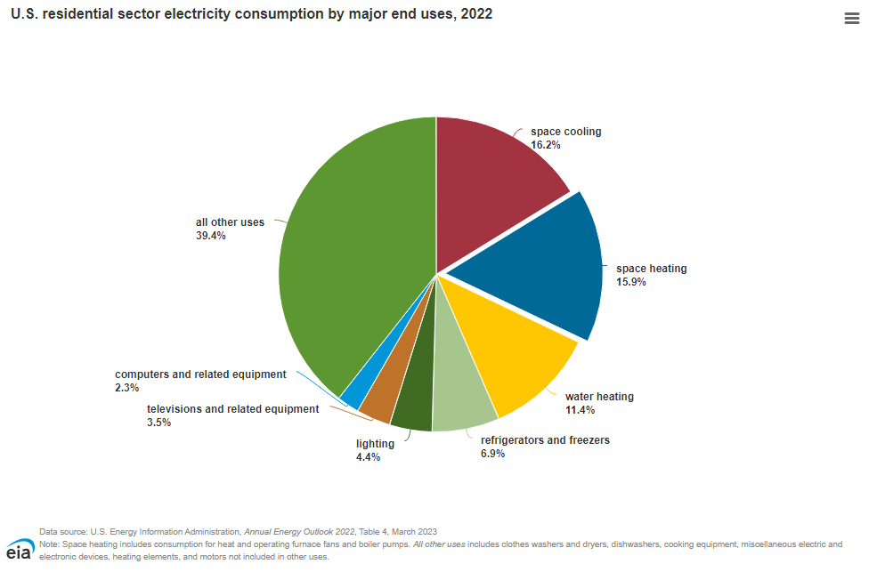
In 2021, the average annual electricity consumption for a U.S. residential utility customer was 10,632 kilowatt-hours (kWh), an average of about 886 kWh per month.
Total U.S. electricity consumption in 2022 was about 4.05 trillion kWh, the highest amount recorded and 14 times greater than electricity use in 1950.

Slide 4
Sources of Energy
Fossil fuels are found in the Earth's crust and contain carbon and hydrogen, which can be burned for energy.
Renewable energy is energy produced from sources like the sun and wind that are naturally replenished and do not run out.
Clean energy is used to refer to the electricity that is generated by facilities that do not directly emit greenhouse gases such as carbon dioxide during the generation process.

Slide 5
Natural Gas 39.9%
Coal 19.7%
Nuclear 18.2%
Wind 10.3%
Hydro 6.0%
Solar 3.4%
Biomass 1.2%
Petroleum .5%
Geothermal .4%
Other gases .3%
Other sources .1%
Where does U.S Electricity come from?
Source: U.S. Energy Information Administration
https://www.eia.gov/tools/faqs/faq.php?id=427&t=3#:~:text=In%202022%2C%20about%204%2C231%20billion,facilities%20in%20the%20United%20States.&text=About%2060%25%20of%20this%20electricity,%2C%20petroleum%2C%20and%20other%20gases.

Slide 6
Fossil fuels Clean energy Renewable energy
Natural Gas Wind Wind
Coal Hydro Hydro
Petroleum Solar Solar
Biomass Biomass
Geothermal Geothermal
Nuclear
Fossil fuels are found in the Earth's crust and contain carbon and hydrogen, which can be burned for energy.
Clean energy is used to refer to the electricity that is generated by facilities that do not directly emit greenhouse gases such as carbon dioxide during the generation process.
Renewable energy is energy produced from sources like the sun and wind that are naturally replenished and do not run out.

Slide 7
Natural Gas 39.9%
Coal 19.7%
Petroleum .5%
Nuclear 18.2%
Wind 10.3%
Hydro 6.0%
Solar 3.4%
Biomass 1.2%
Geothermal .4%
Other gases .3%
Other sources .1%
Where does U.S Electricity come from?
Notes:
https://www.eia.gov/tools/faqs/faq.php?id=427&t=3#:~:text=In%202022%2C%20about%204%2C231%20billion,facilities%20in%20the%20United%20States.&text=About%2060%25%20of%20this%20electricity,%2C%20petroleum%2C%20and%20other%20gases.

Slide 8
Pros and Cons of Nuclear Energy
Reasons for Nuclear Energy
It’s a zero-emissions resource
Requires a very small land footprint
Creates minimal waste
Reasons against Nuclear Energy
Creation of nuclear waste
Potential for accidents
High costs associated with building nuclear power plants.

Slide 9
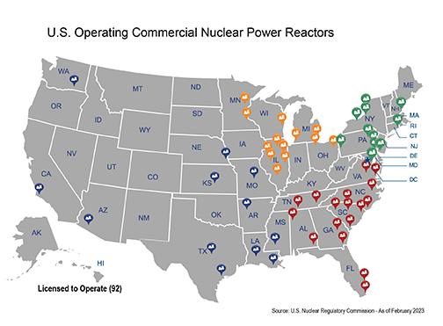
https://www.nrc.gov/reactors/operating/map-power-reactors.html
Notes:
The colors represent Nuclear Regulatory Commission regions. NRC regional offices oversee the major nuclear facilities that the agency regulates.

Slide 10
How is nuclear energy created?

Slide 11
You are a budget manager for a power company interested in constructing a new nuclear power plant and reactor in the U.S.

Slide 12
You will focus on three categories of spending when tracking the budget numbers:
Land, Labor, and Capital
Land - “Gifts of nature" that can be used to produce goods and services; for example, oceans, air, mineral deposits, virgin forests and actual fields of land. Land is also known as natural resources.
Labor - The quantity and quality of human effort available to produce goods and services. Also known as human resources.
Capital - Resources and goods made and used to produce other goods and services. Examples include buildings, machinery, tools and equipment.

Slide 13
Activity 4.1 Nuclear Power Plant Budget
The “Initial Costs” column shows the budget created by a group of accountants, architects, and engineers at a hypothetical energy firm.
The Original Engineering Procurement Costs (EPC) represent the contractual agreement between the project owner and the contractor.
The contractual framework in an EPC contract enables the owner to transfer the complete risk of design, procurement, and construction to the contractor.
The project will take seven years.

Slide 14
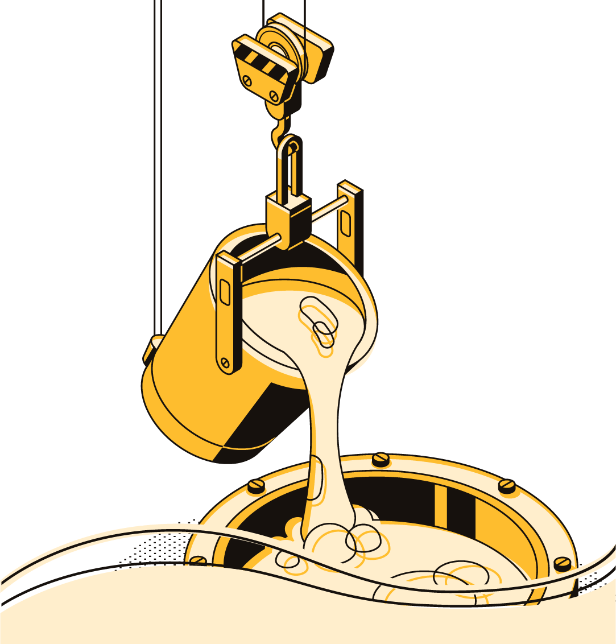
There is a shortage of steel across the globe.
Budget Category Amount of Increase
Steel 40%
Wire and Tubing 60%
General Construction 40%
Cement 40%
Project delayed 24 months

Slide 15
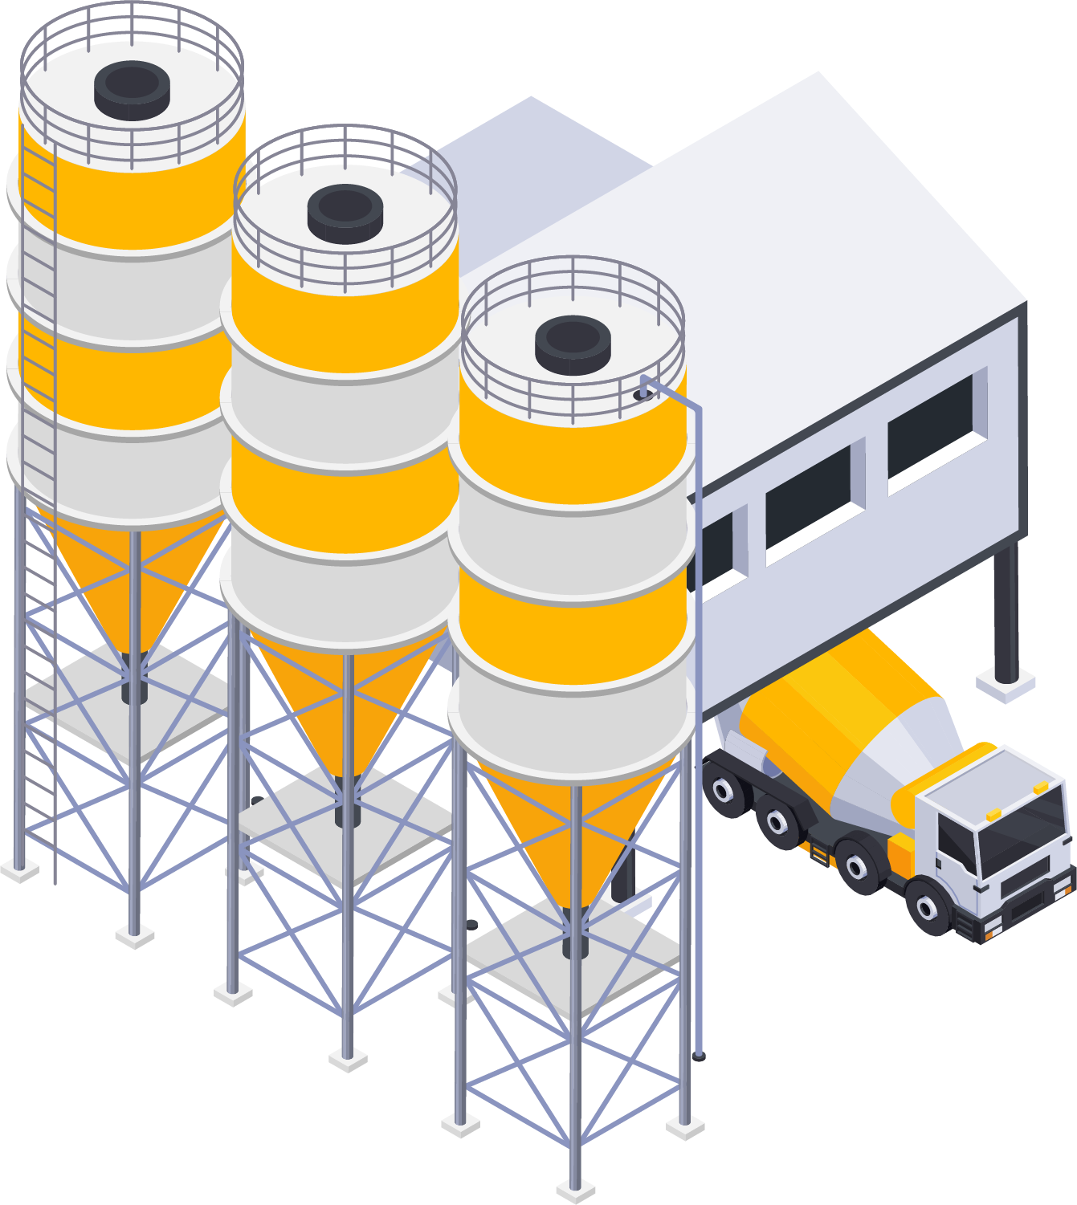
There’s a shortage of workers in the cement industry.
Budget Category Amount of Increase
Cement 20%
Turbines 20%
All Labor Costs 10%
Wire and Tubing 50%
Project delayed 12 months

Slide 16
There’s a shortage of experienced nuclear power plant construction workers.
Budget Category Amount of Increase
General Construction 40%
Engineers/Architects 30%
Cement Workers 50%
Steel 40%
Project delayed 24 months

Slide 17
Project Complete!
What happened to the total project costs after each event card was read?
The costs increased.
How much did your final project cost increase?
$2,194,410,000 or $2,194.41 million
How did government regulations impact final budget costs and the projected completion date?
Regulations increased final budget costs and caused delays
How many years will the project be delayed when finally completed?
Five years

Slide 18
Natural Gas 39.9%
Coal 19.7%
Petroleum .5%
Nuclear 18.2%
Wind 10.3%
Hydro 6.0%
Solar 3.4%
Biomass 1.2%
Geothermal .4%
Other gases .3%
Other sources .1%
Where does U.S Electricity come from?
Notes:
https://www.eia.gov/tools/faqs/faq.php?id=427&t=3#:~:text=In%202022%2C%20about%204%2C231%20billion,facilities%20in%20the%20United%20States.&text=About%2060%25%20of%20this%20electricity,%2C%20petroleum%2C%20and%20other%20gases.

Slide 19
*Images from Canva

Slide 20
Assignment
You have been given the task of creating a brief written report for local elected officials highlighting potential benefits and costs of building a nuclear power facility ten miles outside of their town.
The local officials will be asked by their constituents to comment on a recent proposal to build a nuclear power plant and reactor in their area and they are looking to gather insightful information that will help them form an opinion on whether or not they will support the proposed construction of the nuclear facility.
Each report should include a minimum of three potential benefits and three potential costs of construction and operation of a nuclear power facility near your town.

