Slide 1
Presented by: Amber Peters (Mizz P.) Email: Apeters@mizzp.nyc Date: 3/06/2024
Understanding College
Debts, Loans, and Other Expenses

Slide 2
About The Presenter
Amber Peters(Mizz P.)
Founder, Mizz P. Post-Secondary Success Consulting, LLC Lead College and Career Access Consultant
Mizz P. partners with schools and educational organization leaders to
provide students, parents, and staff with informative yet fun ways to explore
college and career options
www.mizzp.nyc

Slide 3
Objectives
Differentiate Between Loan Types
Analyze the Impact of Student Debt
Budgeting for College Expenses
Provide Advice for Debt Management

Slide 4
Who’s In The Room?
Drop your name, school, and something you wish you new about college financing before attending school

Slide 5
College Cost Landscape

Slide 6
Here’s The Facts:
From 1981-82 to 2021-22, the cost of attending a four-year college in the U.S. has ballooned from $11,840 a year to $30,031 a year-representing a 153 percent increase in the last 40 years. That cost includes tuition and fees, plus room and board and adjusted for inflation.

Slide 7
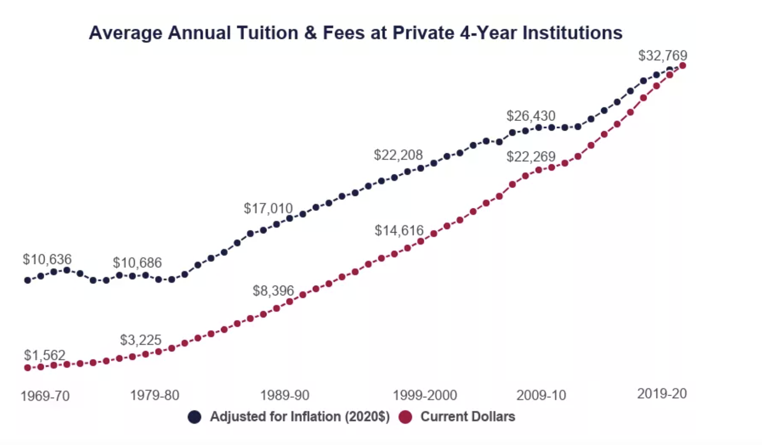
College Cost Trends

Slide 8
Average Cost Per Student
On Campus
Public
Private
Commuter
Public
US News
$10,662
$23,630
$42,162

Slide 9
She Said What She Said:
"Students deserve clear information about the college experience to make informed decisions about the institutions and programs that are right for them ... Students also need clear information about available aid including need-based aid and grants to inform their decisions”
Diane Cheng, Vice President of Research and
Policy at the Institute for Higher Education Policy

Slide 10
What happens if a student can’t pay?
Classes can be dropped
Account can be
put on hold until bill is paid
Student can be dismissed
Impact: Student can end up with a bill that can
break their wallets and spirits

Slide 11
Student Debt Statistics
& Impact

Slide 12
Student Loan Stats
As of September 2023
U.S. student loan debt totals
$1.74 trillion

Slide 13
Student Loan Stats
43
Million Outstanding Loans
1 in 6 American adults today has
some kind of student loan debt

Slide 14
Student Loan Stats
$28,950 owed per borrower on average
About 92% of all student debt are federal student loans; the remaining amount is private student loans
55% of students from public four-year institutions had student loans
57% of students from private nonprofit four-year institutions took on education debt

Slide 15
Just Curious
💰Drop a money bag in the chat if you have or had a student loan.
🤔What could the total of
your student loans buy you?

Slide 16
Federal Direct Loan
For student borrowers to be repaid with interest.
Amount: Up to $5,500 for first year students
Subsidized
Only available to undergraduates
Based on financial need
Interest doesn't accrue until leaving school
Government pays interest while student is enrolled
Lower loan limits
Unsubsidized
Available to both undergraduates and graduates
No financial need required
Interest accrues from time of disbursement
Government doesn't help with interest
Higher loan limits

Slide 17
Parent Plus Loans
For Parent Borrowers to be repaid with interest.
Amount: Can Borrow Up To Full Cost
This loan is usually offered after a gap is identified
Subject to the parent’s credit worthiness

Slide 18
Private Loans
Private student loans — sometimes known as alternative loans — are options for students to pay for college when other sources of funding, like federal and state grants, scholarships, and Direct Stafford Loans are not available.
Funded by banks and private lenders

Slide 19
Loan Comparison
Federal Student Loans | Parent Plus Loans | Private Loans
Interest rates are low and fixed 5.5% | Interest rates are low and fixed 8.05% | Interest rates are variable or fixed (depends on circumstances)
Have both subsidized and unsubsidized options | Often Unsubsidized (interest starts immediately) | Often Unsubsidized (interest starts immediately)
No co-signers or credit needed | Subject to credit worthiness | Require cosigners
Able to get some form of forgiveness | Able to get some form of forgiveness | No loan forgiveness options
Income repayment plans available | Income repayment plans available | Income repayment plans may not be available

Slide 20
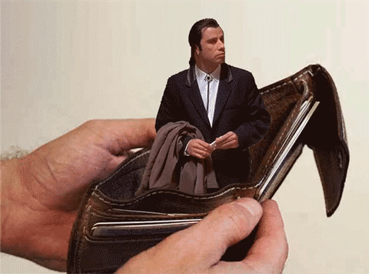
What happens if a student defaults?
Student loans are considered full recourse loans which means the student assumes personal liability. Based on this the following can happen:
The government can garnish their wages.
Their tax refund and Social Security benefits
can be garnished.
They can be brought to court.

Slide 21
How To Avoid Dangerous Debt
Create a (REALISTIC) contribution budget before leaving
Borrow what you need and not a penny more
Find other means to get money for school (scholarships etc.)
🤔What else should we add to the list?

Slide 22
Debt Management Tips
Keep track of how much is owed
Keep track of repayment date
Make at least the minimum payment once payments begin
Ask for an income adjustments if needed
Pay more than the minimum balance to attack the principal (the original amount borrowed) when you have it.
Communicate with your learn servicer if you can't afford to pay

Slide 23
Let’s Put Things In
Perspective

Slide 24
The Goal For Students
🎯To get a return on
their initial investment

Slide 25
Let’s Get Real-Activity
Have your students look up a career and use the salary and education to decide whether it is enough to justify a student loan.
Materials Needed:
OOH Website
College Scorecard

Slide 26
Let’s Get Real Example
Title: Human Services Assistant
Salary: $38,520
Education needed: 2 or 4 year Degree
School: St. Josephs $34,525
Loan Amount Over 4 years: $22,000
Monthly Income: $3210
Student Loan Payment: $272

Slide 27
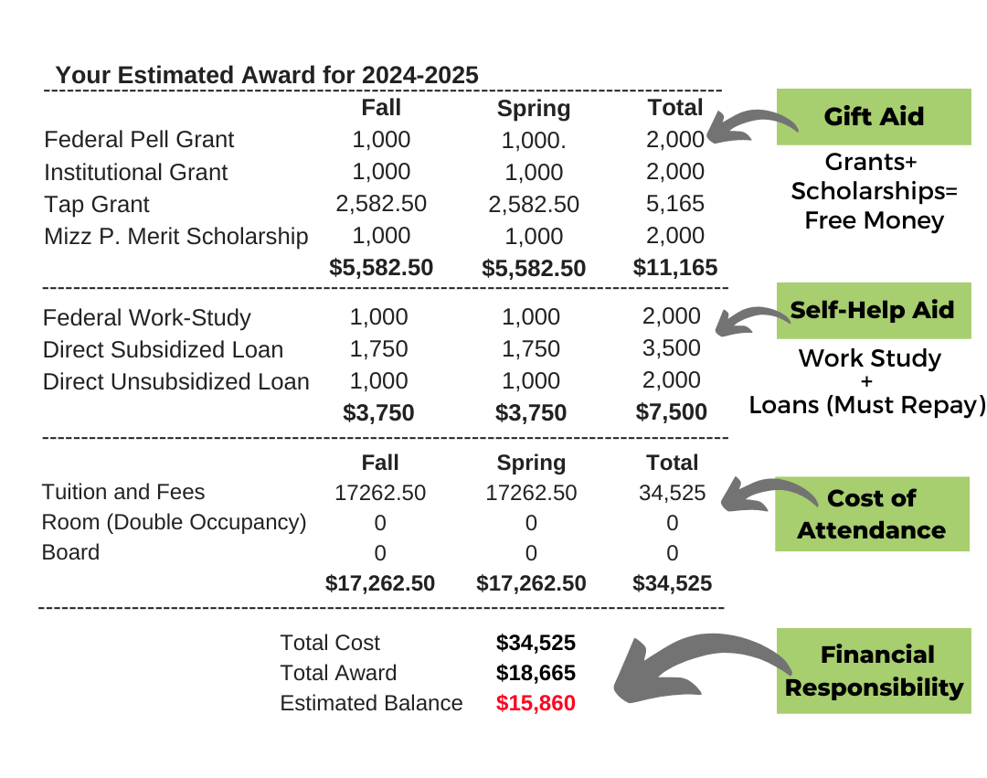
Award Letter
What questions would you want to ask the student?
What concerns you most about this package?
What advice would you give? or What concepts would you teach?
Is there anything that can be done to make this a possibility?

Slide 28
Key Takeaways
Talk to your students about cost it could save them from financial hardship in the future
Pull out the calculators and work alongside them to create a plan
Provide real word examples and have candid conversations about the consequences of DEBT

Slide 29
Resources
Resources for additional learning:
Smart Asset Student Loan
https://smartasset.com/student-loans/student-loan-
calculator#2A233tuoVX
Edconlink (for personal finance and econ lessons)
https://econedlink.org/
Occupational Outlook Handbook
https://www.bls.gov/ooh/
College Scorecard
https://collegescorecard.ed.gov/

Slide 30
Q & A

Slide 31
Amber Peters
Apeters@mizzp.nyc
Thank You

