Slide 1
International Economics Lessons & Resources—Plus a Free Trip to Germany!
Council on Economic Education (CEE) Webinar

Slide 2
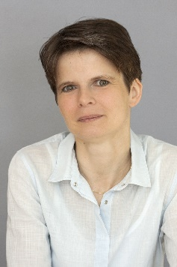
Webinar Presenters
Dr. Cheryl Ayers
Virginia Tech Center for Economic Education
​Virginia Council on Economic Education
National Council on Economic Education
American Association for Adult & Continuing Ed
Coalition on Adult Basic Education
U.S. Economic Empowerment Project
NAEE National Economics Pedagogy Scholar
cheryl42@vt.edu
Colin G Baker
Program Director K-12 Education and Outreach
Center for European and Transatlantic Studies
European Union Jean Monnet Center of Excellence at Virginia Tech
cbakermcps@vt.edu
Dr. Esther K. Bauer
Associate Professor of German and German Program Director
bauere@vt.edu

Slide 3
Webinar Objectives
Learn about the Transatlantic Outreach Program (TOP) study tours to Germany for K-12 social studies and STEM teachers.
Collect a toolkit of free K-12 lessons, resources, and programs to facilitate real-world instruction about international economics.

Slide 4
Founded in 2002
Office at the Goethe-Institut in Washington, DC
TOP IS A PUBLIC / PRIVATE PARTNERSHIP

Slide 5
Study Tours
TOP sends K-12 STEM and Social Studies educators to Germany each summer (55 annually)
All expenses paid ($350 refundable deposit)
Summer study tour duration: two weeks
Applicants from US (50+DC) plus Canada
No TOP study tour has the same itinerary
Participants walk 5ish miles per day

Slide 6
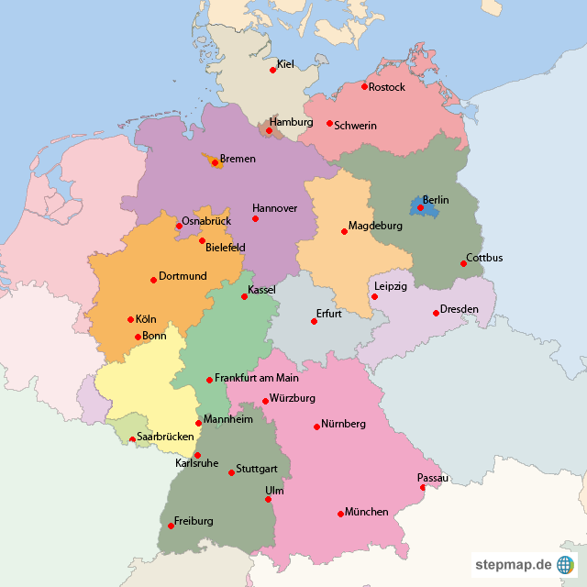

Slide 7
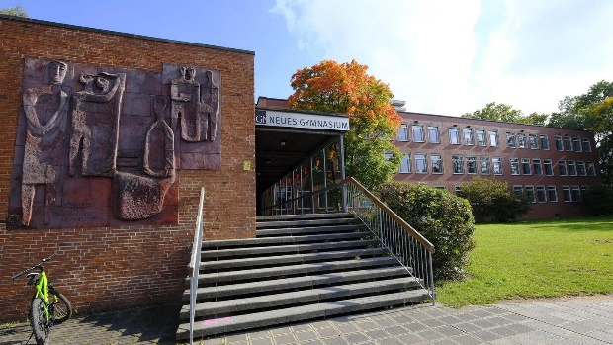
Nürnberg
Nuremberg Trials Museum
Neues Gymnasium
City Walking Tour
Gottfried Wicklein GmbH & Co.

Slide 8
APPLICATIONS
Application published at end of November here:
Due date TBA – beginning of February
My follow-up email to today’s webinar will ask for TOP communication opt-in
Average time requirement: 10 hours +/-
Be prepared to submit a lesson based on a German current events news article
25-33% acceptance rate
STUDY TOUR INFORMATION - Goethe-Institut USA

Slide 9
Over $7,000 USD investment per study tour participant
Post-tour requirements: Inquiry lesson + workshop + multiplier activity
Web: www.goethe.de/top
Social media: @topteachgermany
E-mail: top@goethe.de

Slide 10
https://www.goethe.de/ins/us/en/spr/unt/efd/top.html#anchor-i6957655

Slide 11
Resources for Middle School Educators - Goethe-Institut USA
Resources for High School Educators - Goethe-Institut USA

Slide 12
Exploring STEM in Germany - Transatlantic Outreach Program - Goethe-Institut USA

Slide 13
3 Economic Reasoning Skills & Tools
3 Economic Reasoning Skills & Tools #1 Cost-benefit analysis chart #2 PACED decision making model #3 Economic way of thinking 6 principles
Social Studies, English, Science, Math, Economics, Personal Finance, Entrepreneurship, Controversial Issues, Current Events, Life
Real-world Critical Thinking & Literacy Skills
Economics
Ayers, C. A. (2018). A first step toward a practice-based theory of pedagogical content
knowledge in secondary economics. Journal of Social Studies Research, 42, 61-79.
Ayers, C. A. (2019). Teaching students to ‘think like economists’ as democratic
citizenship preparation. Journal of Social Studies Research, 43(4), 405-419.
Notes:
Dr. Cheryl Ayers will share her research-based, economic-way-of-thinking instructional strategies and tools for making any current event more accessible to students.

Slide 14
3 Economic Reasoning Skills (Ayers, 2019)
Student Learning Outcomes
sharpening critical thinking and critical literacy skills
entertaining multiple perspectives
gaining a deeper, nuanced understanding of subject-specific content
making students’ thinking explicit for assessment purposes
achieving a inter/multidisciplinary understanding of current events
using evidence to draw conclusions and make generalizations
articulating and defending positions using content vocabulary
laying the groundwork for authentic discussions and civil debates
casting informed votes
analyzing and synthesizing primary and secondary sources
comparing and contrasting historical, cultural, and political perspectives
explaining cause-and-effect relationships
practicing citizenship skills such as collaborating, compromising, and reaching consensus
thinking like an economist for authentic disciplinary learning (like historical thinking)
making more productive and prosperous workplace and everyday life decisions

Slide 15
Cost-Benefit Analysis

Slide 16
PACED-O Decision Making Model

Slide 17
Economic Way of Thinking 6 Principles
Open BMW plant in South Carolina

Slide 18
Informed Understanding & Decision-Making
People choose.
People’s choices involve costs.
People respond to incentives in predictable ways.
People create rules and economic systems that influence individual choices and incentives.
People gain when they trade voluntarily.
People’s choices have consequences that lie in the future.
3 Tools Handouts in Google Drive Folder
Linked HERE

Slide 19
Economic Reasoning Tools can be applied to all lessons!
PACED-O Decision Making Grid
Cost-Benefit Analysis Chart
Economic Way of Thinking 6 Principles
Think Like an Economist about _____.

Slide 21
Resources by 20 CEE National Standards
High School Economics | Marginal Revolution University

Slide 22
Colin G Baker
Program Director K-12 Education and Outreach
Center for European and Transatlantic Studies
European Union Jean Monnet Center of Excellence at Virginia Tech
cbakermcps@vt.edu

Slide 23
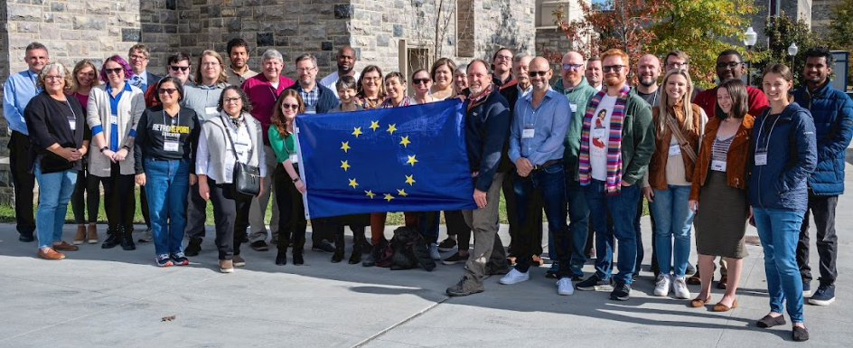
How VT’s EU Center, CEUTS, works for teachers
High School EU Council Debates – VT, VA Beach, Northern VA and Richmond
Educators Conferences - Weekends at VT
…and many
more programs…
https://liberalarts.vt.edu/research-centers/ceuts.html

Slide 24
European Union Resources
Virginia Tech Center for European Union & Transatlantic Studies (fall conference materials)
https://liberalarts.vt.edu/research-centers/ceuts/research-talks/educators-conference-and-resources.html
Parallel Histories (analyze contested histories)
https://parallelhistories.org.uk/
General European Union (educator resources)
https://liberalarts.vt.edu/research-centers/ceuts/HG/K-12.html
European Union External Action Service (current events & policies)
https://www.eeas.europa.eu/_en
EuroClio (cofunded by European Union)
https://euroclio.eu/resource_categories/educational-material/
Historiana (made by and for history educators across Europe)
https://historiana.eu/

Slide 25
Dr. Esther K. Bauer
Associate Professor of German and German Program Director
bauere@vt.edu

Slide 26
Why Study A Language?
Improve Communication Skills
Educational and Professional Opportunities
Expand Understanding of Another Culture and Your Own
Social Connections
Travel
Personal Growth
Cognitive Benefits
Access Information and Texts in Original Language

Slide 27
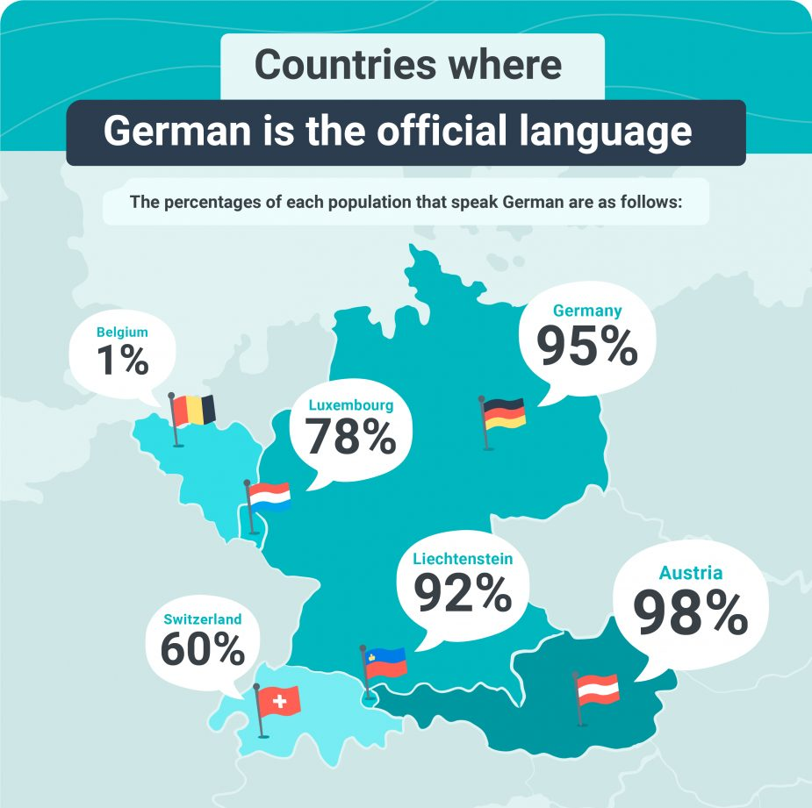
Reasons To Study German
Wide Use of German
Most common first language in the EU
Second most used scientific language worldwide
One of three “working” languages of the European Parliament
5th most studied language in the world
Job Opportunities
Largest European economy
World’s 4th strongest economy
Leader in engineering, science, and technology
1,100+ companies in German-speaking countries have U.S. subsidiaries with 700,000 jobs
U.S. companies provide ~700,000 jobs in Germany
For advertised jobs in the U.S., German skills provide highest salary of any language
Study, Work, Live in a German-Speaking Country
Higher education is mostly free
Germany needs (highly) qualified professionals
https://preply.com/en/blog/german-speaking-countries/
https://www.linkedin.com/pulse/ibm-german-brands-laya-joseph/

Slide 28
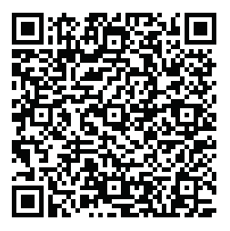
German Studies At Virginia Tech
Undergraduate major (30 credits), undergraduate minor (18 credits)
Courses
Language courses from beginning to advanced
Upper-level courses covering German culture, society, history, politics, economy, art, music, film, literature, and more, with an emphasis on the 19th to 21st centuries
Broad extracurricular program
Language House, monthly coffee hour, German Culture Club, Teach for Jamie, German Honors Society, speakers
Summer internship at the office of student services in Karlsruhe, Germany
Jamie Bishop Scholarship for study, research, or internship abroad
Most courses taught in German
Small class sizes
Most students are double majors
For More Info

Slide 29
Careers of Recent Virginia Tech German Program Alumni
Government lawyer, State Department (international law)
Lawyer, International Court of Justice, The Hague
Army officer, Special Operations Command-Africa, Stuttgart
Economist for international chemical company
Ph.D. student in Bioinformatics, Max Planck Institute, Berlin
Sales and market researcher for STIHL, a German power tool company , Virginia Beach
Technology consultant with the State Department and US embassies
Ph.D. student in Musicology working on German Organ Tablature, Indiana University
Self-employed English teacher and English language camp organizer, Germany
Engineer at Boeing, Philadelphia
Senior Manager, Hapag-Lloyd Sales Support
High school teacher for German (including AP classes) , Northern Virginia
M.A. student in Sociology, Germany

Slide 30
Danke sehr!
AUF WIEDERSEHEN
Dr. Cheryl Ayers
cheryl42@vt.edu

