Slide 1

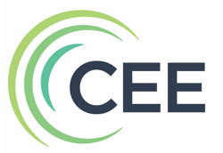
Teaching Economics Using Rockstar Current Events Resources & Strategies
October 17, 2024
7:00-8:00pm ET

Slide 2

Webinar Objectives
Hear from leading economics scholars about their current events resources and instructional practices for successfully teaching current events in real-time with minimal teacher preparation and maximum student engagement.
Receive free lessons, subscriptions, and other resources to contextualize secondary subjects for real-world learning, including economics.
https://www.councilforeconed.org/policy-advocacy/k-12-standards/

Slide 3






Webinar Presenters
Cheryl Ayers, Ph.D.
Director
cheryl42@vt.edu
Ariel Slonim
Curriculum Designer
ariel@mru.org
Joel Miller, Ed.S.
Curriculum Development Manager
jmiller@fee.org
Center for Economic Education

Slide 4
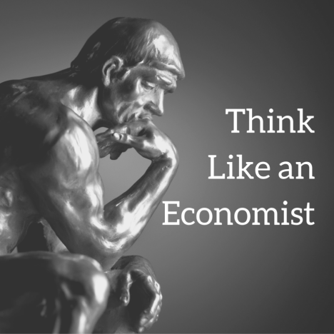

Apply research-based, economic-way-of-thinking instructional strategies and tools for making current events more accessible to students.
Cheryl Ayers, Ph.D.
Director
cheryl42@vt.edu
Center for Economic Education

Slide 5
3 Economic Reasoning Skills & Tools
3 Economic Reasoning Skills & Tools
#1 Cost-benefit analysis chart
#2 PACED decision making model
#3 Economic way of thinking 6 principles
Social Studies,
English, Science, Math, Economics, Personal Finance, Entrepreneurship, Controversial Issues, Current Events,
Life
Real-world
Critical
Thinking & Literacy
Skills
Economics
Ayers, C. A. (2018). A first step toward a practice-based theory of pedagogical content
knowledge in secondary economics. Journal of Social Studies Research, 42, 61-79.
Ayers, C. A. (2019). Teaching students to ‘think like economists’ as democratic
citizenship preparation. Journal of Social Studies Research, 43(4), 405-419.
Notes:
Dr. Cheryl Ayers will share her research-based, economic-way-of-thinking instructional strategies and tools for making any current event more accessible to students.

Slide 6
3 Economic Reasoning Skills (Ayers, 2019)
Student Learning Outcomes
sharpening critical thinking and critical literacy skills
entertaining multiple perspectives
gaining a deeper, nuanced understanding of subject-specific content
making students’ thinking explicit for assessment purposes
achieving a inter/multidisciplinary understanding of current events
using evidence to draw conclusions and make generalizations
articulating and defending positions using content vocabulary
laying the groundwork for authentic discussions and civil debates
casting informed votes
analyzing and synthesizing primary and secondary sources
comparing and contrasting historical, cultural, and political perspectives
explaining cause-and-effect relationships
practicing citizenship skills such as collaborating, compromising, and reaching consensus
thinking like an economist for authentic disciplinary learning (like historical thinking)
making more productive and prosperous workplace and everyday life decisions

Slide 7

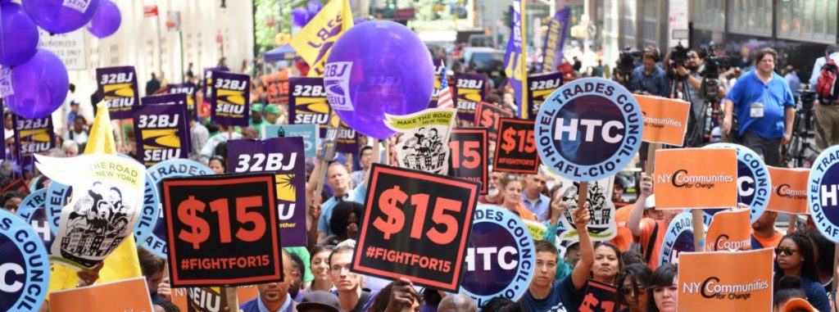
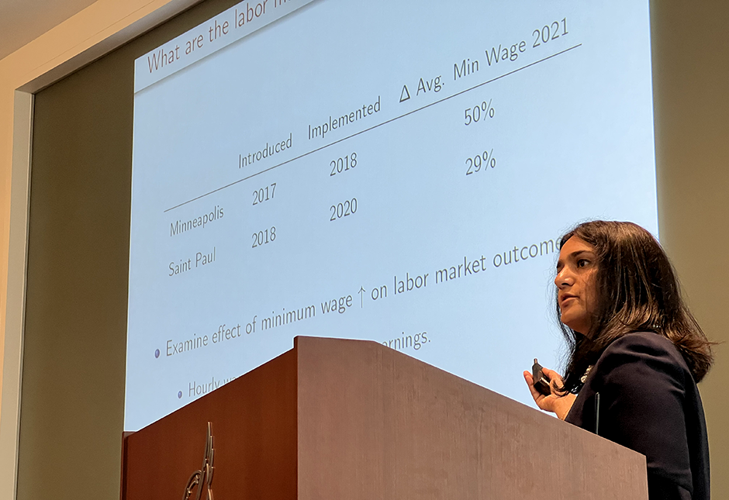
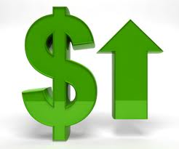
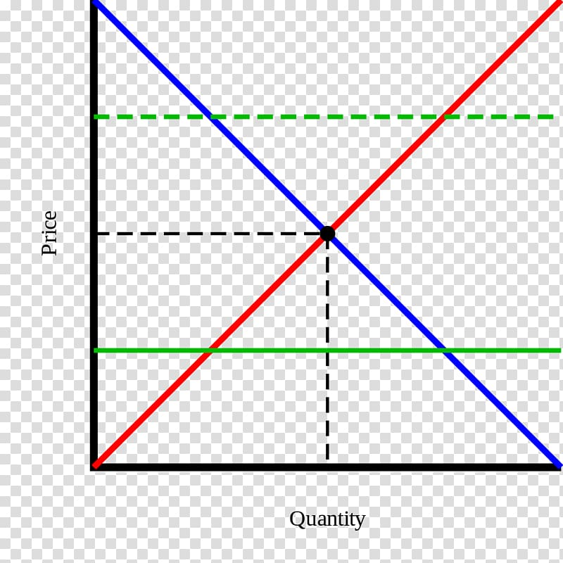
Current Events Research
$15 Minimum Wage COSTS
Many people earning minimum wage are not a family’s primary source of income “Minimum wage in America: how many people are earning $7.25 an hour?” USA Facts March 28, 2023 https://usafacts.org/articles/minimum-wage-america-how-many-people-are-earning-725-hour/
Increases costs for a company with no corresponding increase in productivity “Should the Federal Minimum Wage Be Increased?” ProCon.org, January 12, 2023
https://minimum-wage.procon.org/
History shows that minimum wage increases result in reductions in hours and jobs
Stokes, “Fed researchers: $15 minimum wage in Minneapolis and St. Paul boosted pay – but cost jobs” MinnPost, May 9, 2023
https://www.minnpost.com/metro/2023/05/fed-researchers-15-minimum-wage-in-minneapolis-and-st-paul-boosted-pay-but-cost-jobs/
Increases the price of consumer goods as businesses pass along additional costs “Should the Federal Minimum Wage Be Increased?” ProCon.org, January 12, 2023
https://minimum-wage.procon.org/
Price floors disrupt markets (supply and demand), resulting in inefficiencies
Bourne, “The Case Against a $15 Federal Minimum Wage: Q&A” Cato Institute, February 25, 2021
https://www.cato.org/commentary/case-against-15-federal-minimum-wage-qa?utm_campaign=Regulation%20Roundup%20Newsletter&utm_medium=email&_hsmi=1178...%201/19%20tnemyolpme%20ni%20eb%20lliw%20srekrow%20rewef%20noillim

Slide 8
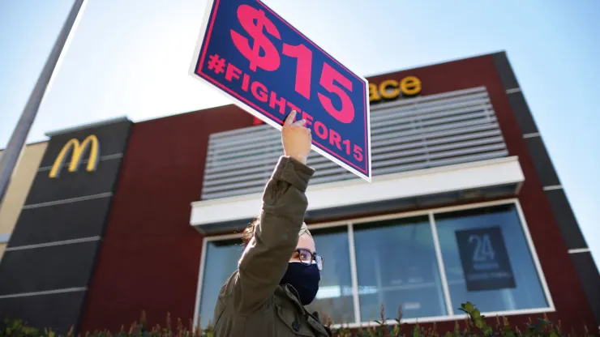



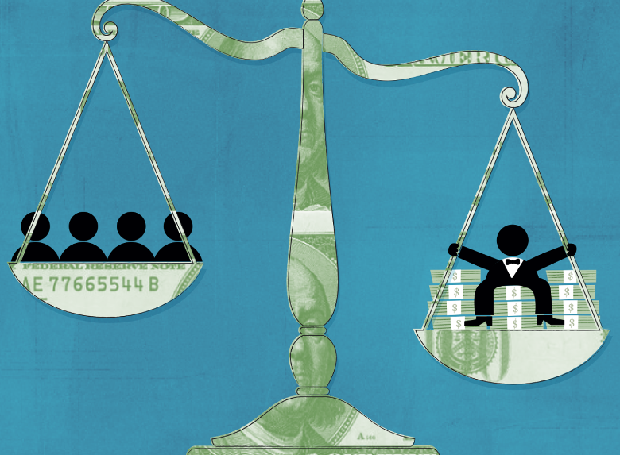
Current Events Research
$15 Minimum Wage BENEFITS
Provides a “living wage” for families and reduces poverty
Leonhardt, “How raising minimum wage to $15 per hour could affect workers and small businesses” CNBC.com, February 24, 2021
https://www.cnbc.com/2021/02/24/minimum-wage-15-dollars-per-hour-brings-benefits-consequences.html
Reduces government welfare spending
Buchwald, “A $15 minimum wage could cut government spending on welfare programs by up to $30 billion, study finds” MarketWatch, February 2, 2021
https://www.marketwatch.com/story/a-15-minimum-wage-could-cut-government-spending-on-welfare-programs-by-up-to-30-billion-study-finds-11612290567
Increases consumer spending and grows the economy “Should the Federal Minimum Wage Be Increased?” ProCon.org, January 12, 2023 https://minimum-wage.procon.org/
Incentivizes more people to enter the workforce “A $15 minimum wage changes more than just take-home pay U.S. Bureau of Labor Statistics” Monthly Labor Report September 2021
https://www.bls.gov/opub/mlr/2021/beyond-bls/a-15-minimum-wage-changes-more-than-just-take-home-pay.htm
Reduces income inequality
Maverick, “What Are the Pros and Cons of Raising the Minimum Wage” Investopedia, August 26, 2023 https://www.investopedia.com/articles/markets-economy/090516/what-are-pros-and-cons-raising-minimum-wage.asp

Slide 9
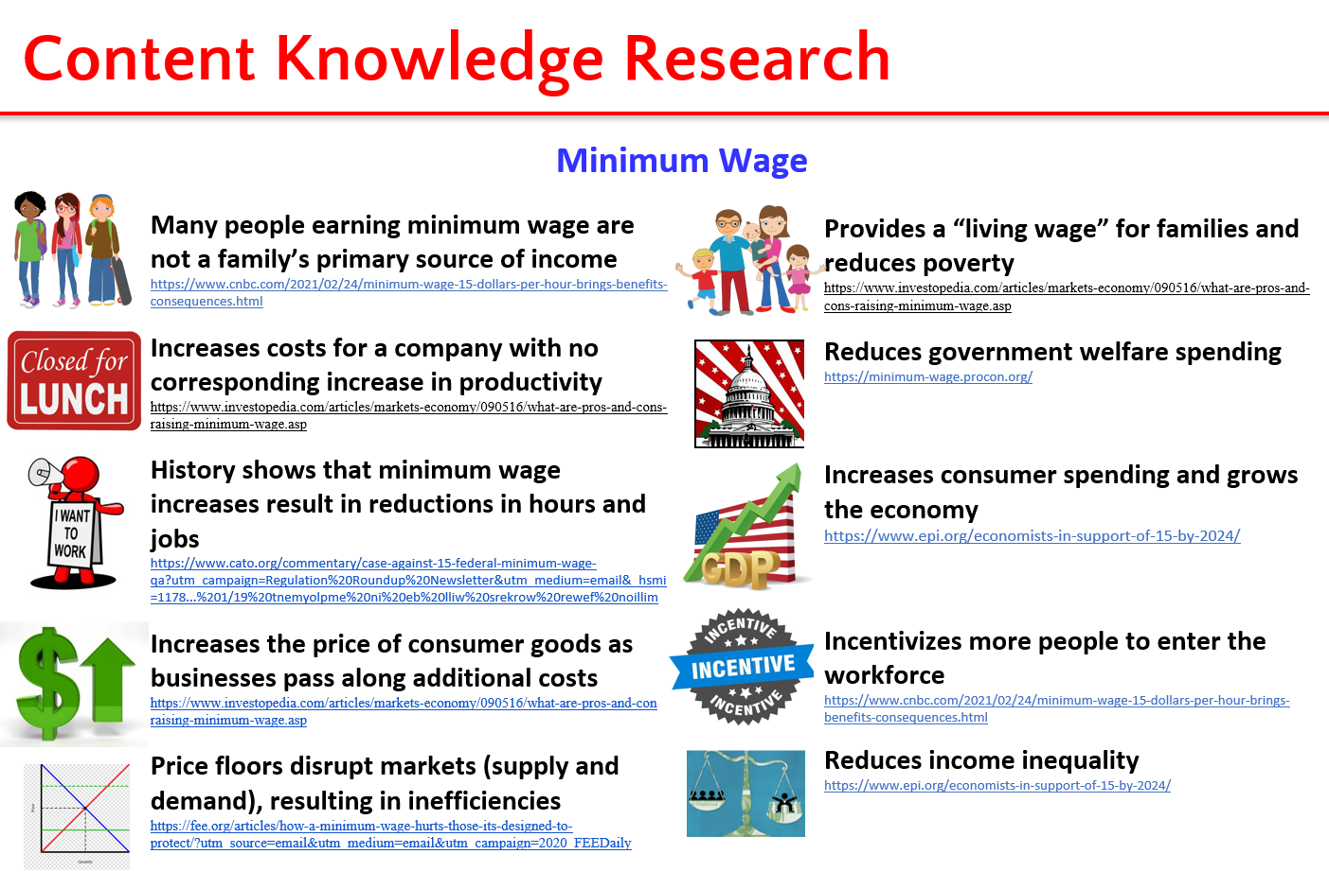
Tool #1 Cost-Benefit Analysis Chart
CHOICE: Raise the minimum wage to $15
1=not at all important 3=average importance 5=very important
COSTS (disadvantages/given up) | 1-5 | BENEFITS (advantages/gained) | 1-5
Totals |  | Totals
DECISION:
OPPORTUNITY COST:

Slide 10
Tool #2 PACED-O Decision Making Model
1. Question/Problem: Which economic system is best for the United States?
3. Criteria 2. Alternatives | Economic Freedom (producers, consumer) | Economic Efficiency (little to no waste) | Economic Growth (revenue, GDP, trade) | Economic Equity (not equality but fairness) | Totals
Capitalism
Socialism
3
2
3
2
10
4. Evaluate the Alternatives
3 = alternative meets criteria
very well
2 = alternative meets criteria
satisfactorily
1 = alternative does not meet
criteria satisfactorily
1
1
2
3
7
Capitalism
5. Decision (highest scoring alternative): _________________________________________
Opportunity Cost (second highest scoring alternative): _______________________
Socialism (equity)

Slide 11
Tool #2 PACED-O Decision Making Model
1. Question/Problem: Which economic system is best for the United States?
3. Criteria 2. Alternatives | Economic Freedom (producers, consumer) | Economic Efficiency (little to no waste) | Economic Growth (revenue, GDP, trade) | Economic Equity (not equality but fairness) | Totals
Capitalism
Socialism
5
5
5
85
3
15
2
3
15
2
170
10
210
4. Evaluate the Alternatives
3 = alternative meets criteria
very well
2 = alternative meets criteria
satisfactorily
1 = alternative does not meet
criteria satisfactorily
10
1
1
2
3
7
5
5
10
255
275
Socialism
5. Decision (highest scoring alternative): _________________________________________
Opportunity Cost (second highest scoring alternative): _______________________
Capitalism (freedom, growth)
Notes:
Perspectives: business owner (not weighted) then Bernie Sanders supporter (weighted)
Cannot use a “0” to evaluate when using weights b/c automatically negates weight value

Slide 12

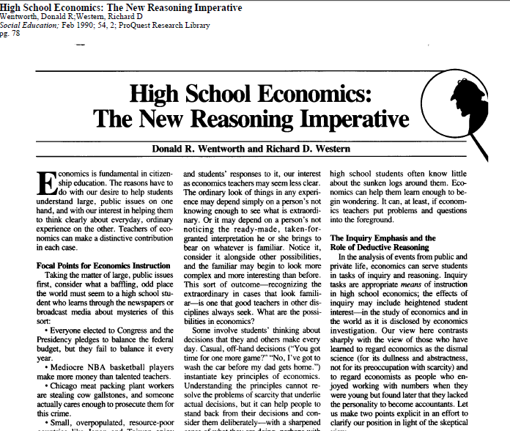
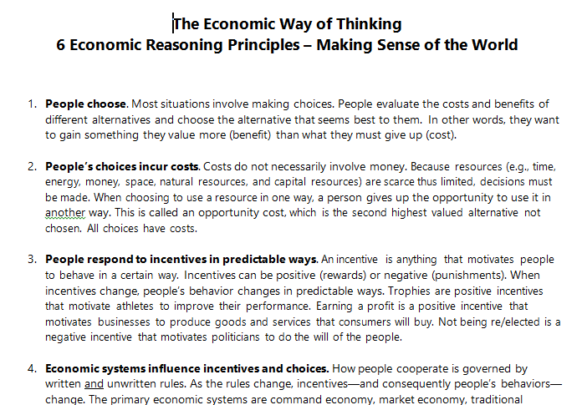
Tool #3 Economic Way of Thinking 6 Principles
Inquiry-based Learning
101
Qualitative framework for
cost-benefit
& PACED-O

Slide 13
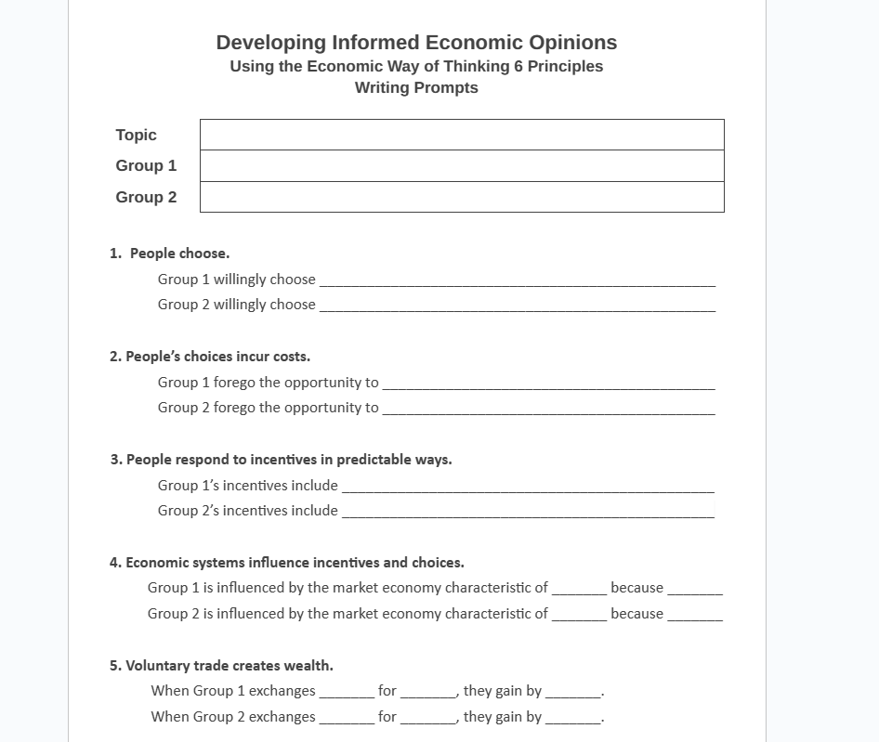
Tool #3 Economic Way of Thinking 6 Principles
Topic = Raise MW to $15
Group 1 = Employees
Group 2 = Employers

Slide 14
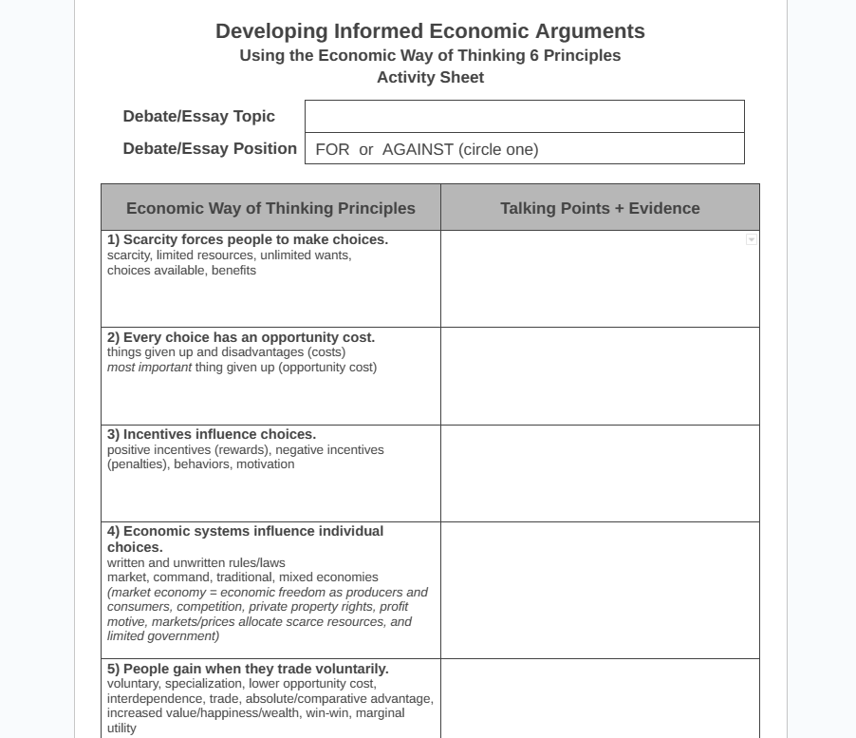
Tool #3 Economic Way of Thinking 6 Principles
Capitalism

Slide 15
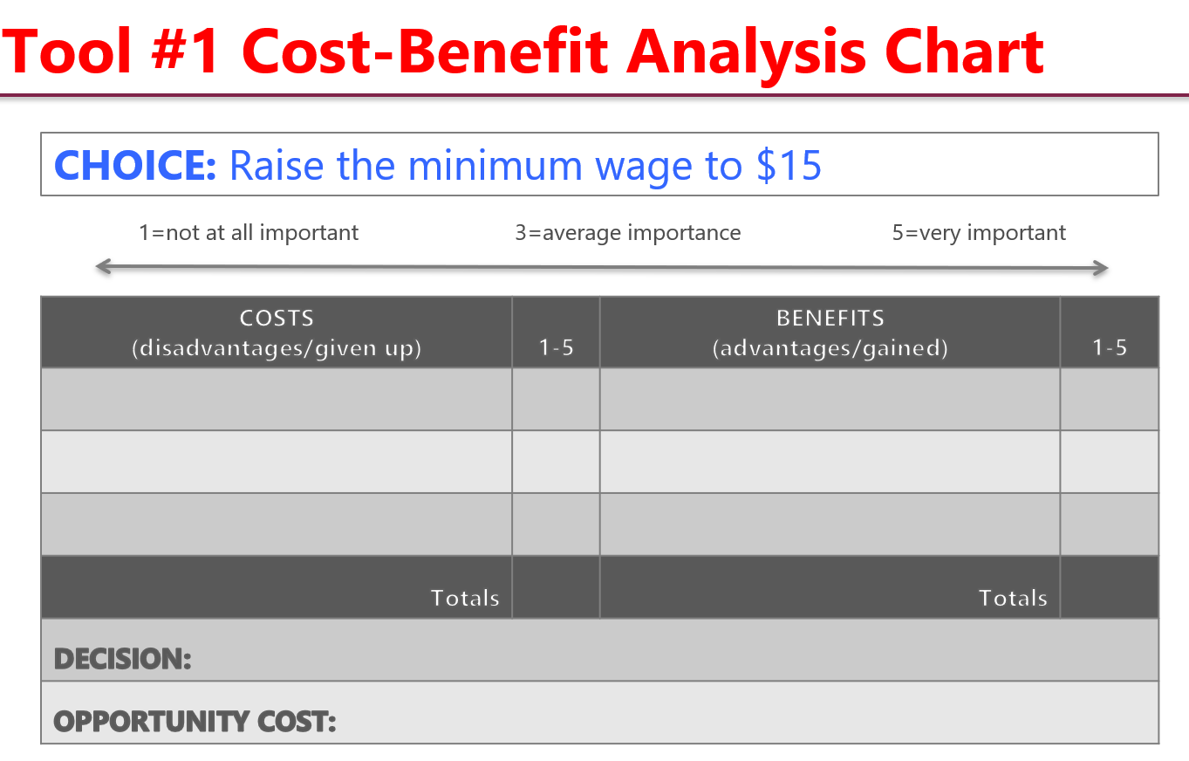
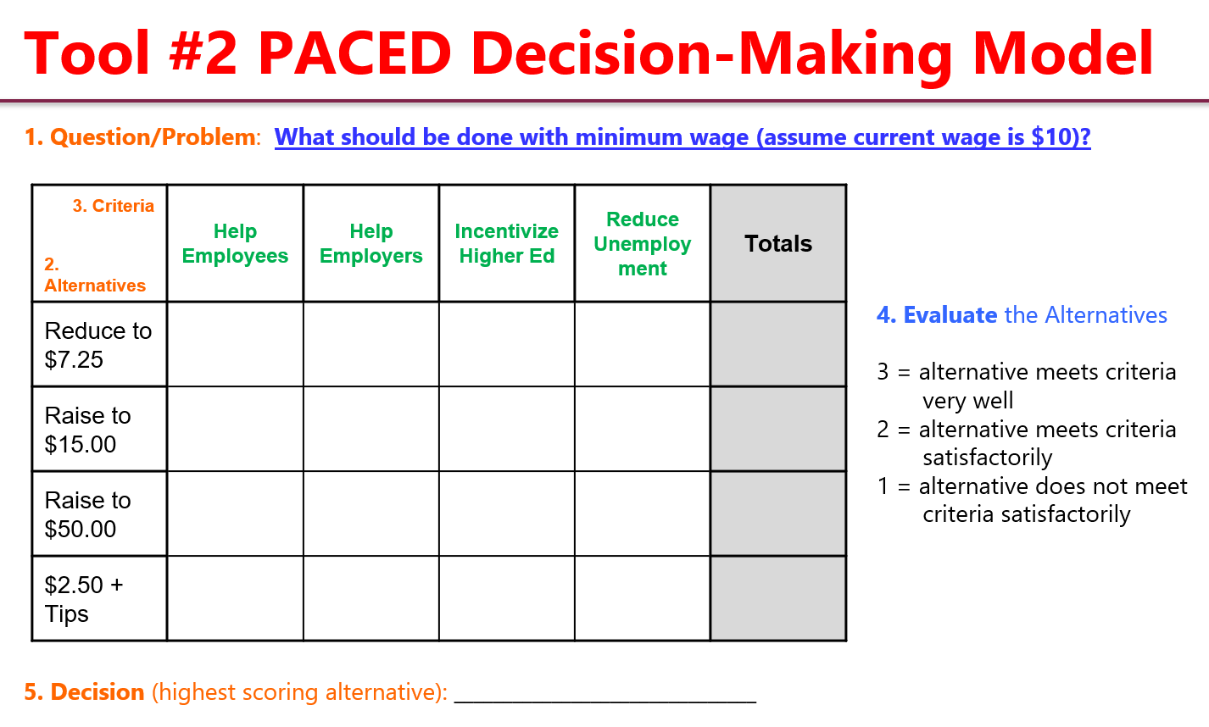
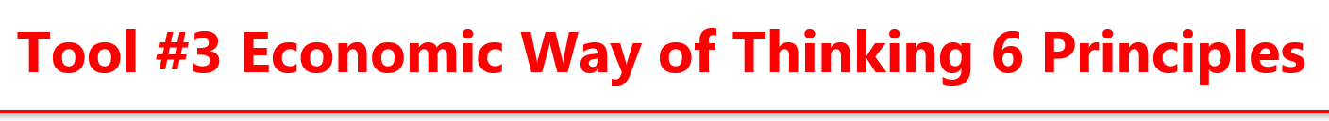
Informed Understanding of Current Events
People choose.
People’s choices involve costs.
People respond to incentives in predictable ways.
People create rules and economic systems that influence individual choices and incentives.
People gain when they trade voluntarily.
People’s choices have consequences that lie in the future.

Slide 16
Entrepreneurship =
Personal Finance + Economics
Entrepreneurship
Personal Finance
Economics

Slide 17
6-12 Economics & Personal Finance
ECONOMICS market economy circular flow buyers and sellers factors of production types of business organizations supply and demand prices standard of living productivity innovation an competition GDP unemployment business cycle Federal Reserve banking institutions tax policy property rights government regulation comparative advantage competition trade exchange rates | PERSONAL FINANCE contracts comparison shopping advertising consumer rights renting spending budgeting banking credit Loans interest rates insurance income taxes income statement balance sheet cash flow investing human capital Inflation fixed vs. variable expenses net worth debt
Notes:
Budgeting = Income Statement
Net Worth = Balance Sheet

Slide 18
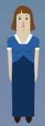

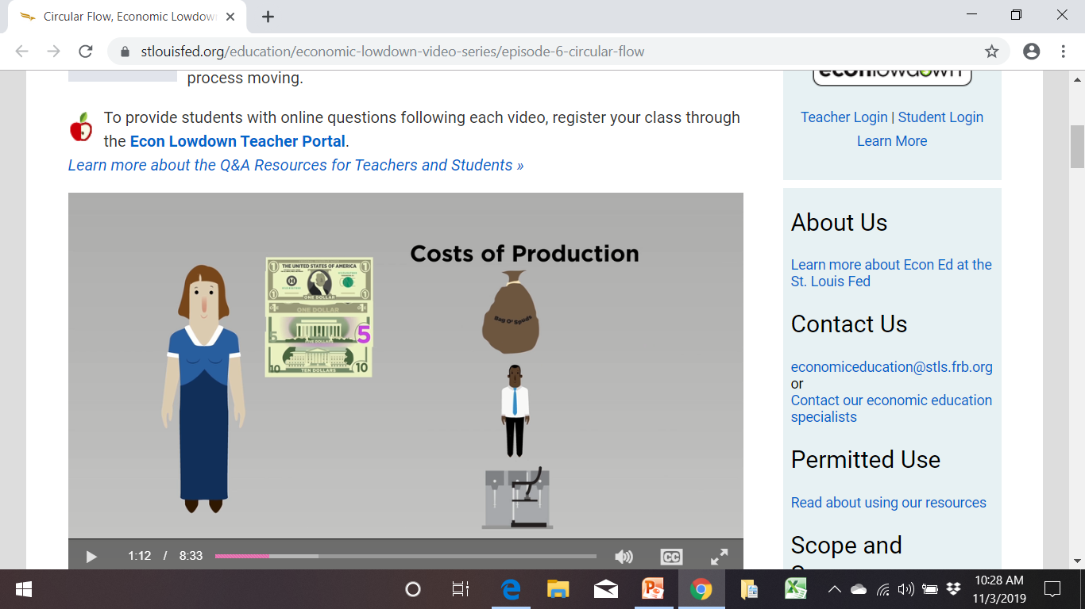
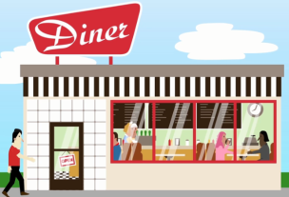
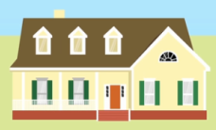

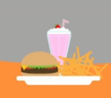
Circular Flow of Economic Activity in a Market Economy
International Market
IMPORT
Market 1
Market for Resources
EXPORT
Costs of Production:
Rent, Wages, Interest, Profit
Income
Factors of Production
Resources: Land, Labor,
Capital, Entrepreneurship
Public Goods
and Services
Public Goods
and Services
Decision-Maker 1
Businesses
Taxes
Taxes
Decision-Maker 2
Households
Entrepreneurship
Savings
and Loans
Savings
and Loans
Personal Finance
Goods and Services
Interest
Interest
Products
Revenue
Market 2
Market for Goods and Services
Prices
Video
Circular Flow - The Economic Lowdown Video Series
Notes:
Simplified macroeconomic model of the basic economic relationships in a market economy.

Slide 19
Entrepreneurship Skills & Mindsets
Modernized Workforce Readiness Skills
for Innovation & Gig Economy!
opportunity recognition
opportunity seeking
opportunity analysis
critical thinking
problem solving
creativity
curiosity
courage
persistence
grit
embracing failure
innovation
adaptability
initiative
self-reliance
future orientation
optimism
communication
collaboration
teamwork
empathy
intrinsic motivation
growth mindset
resourcefulness
flexibility
resiliency
comfort with risk calculated risk-taking agency
idea generation
pitching
public speaking
etc.

Slide 20

Online Entrepreneurship Institute for High School Teachers
Preparation for the Innovation & Gig Economy!
400+ Classroom-Ready Resources & Curriculum
Real-World Context for Teaching CTE Courses, Economics & Personal Finance
Modernized Workforce Readiness Skills Preparation
Live Zoom Breakout Groups for National Networking & Collaboration
Grassroots Entrepreneur Guest Speakers
Optional: 3 Hours of Undergraduate
or Graduate Credit
https://vcee.org/centers/virginia-tech

Slide 21

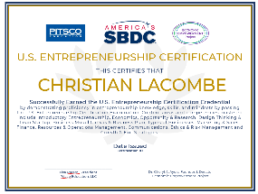


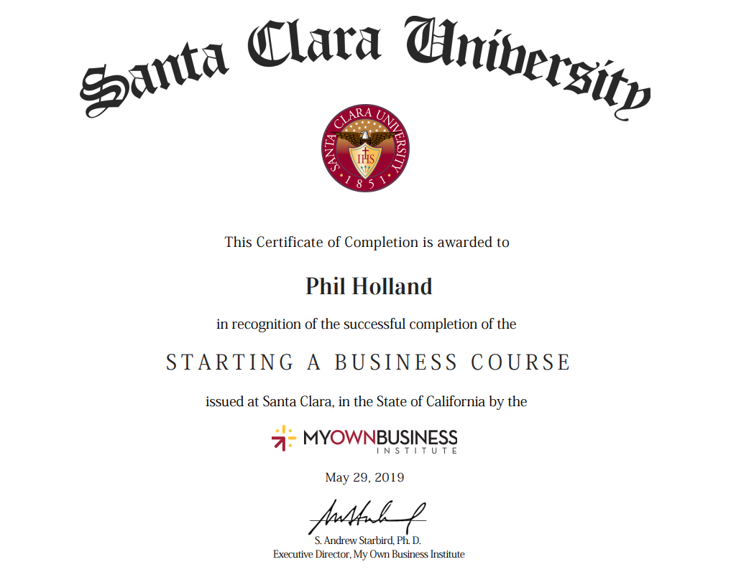
U.S. Entrepreneurship Certification Exam
3:1 Stackable Credentials for the Innovation & Gig Economy!
Entrepreneurship skills and mindsets are modernized workforce readiness skills that today's employers say they want in new hires
Aligned with the
Online Entrepreneurship Institute for High School Teachers
& Santa Clara University’s Entrepreneurship Certificate Program
in Silicon Valley, California
FREE Extensive Exam Resources/Curriculum Package
https://www.pitsco.com/usece

Slide 22

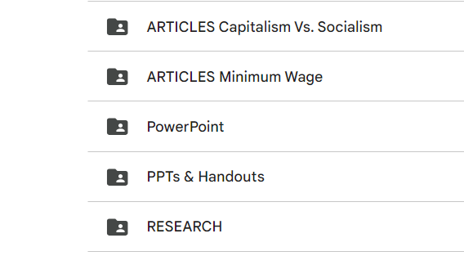
Today’s Webinars 100+ Resources
https://drive.google.com/drive/folders/1kx9iF_BEv_CUMi7rN9dcpceI3BOhR4xL?usp=sharing
Previous Related Webinars
Teaching Economics While Cultivating Civil Dialogue
Minimum Wage
Capitalism vs. Socialism
https://econedlink.org/?s=Teaching+Economics+While+Cultivating+Civil+Dialogue

Slide 23
Thank you!
Please keep in touch ☺
Cheryl Ayers, Ph.D.
Director
cheryl42@vt.edu
Center for Economic Education

Slide 24


Using the News to Teach Economics
Ariel Slonim
Curriculum Designer
Ariel@mru.org
mru.org/VTCEE

Slide 25


Why incorporate news in the classroom?
Relevance
Understanding
Discussion

Slide 26
What are some obstacles keeping you from incorporating news into your classroom?

Slide 27


Slide 28
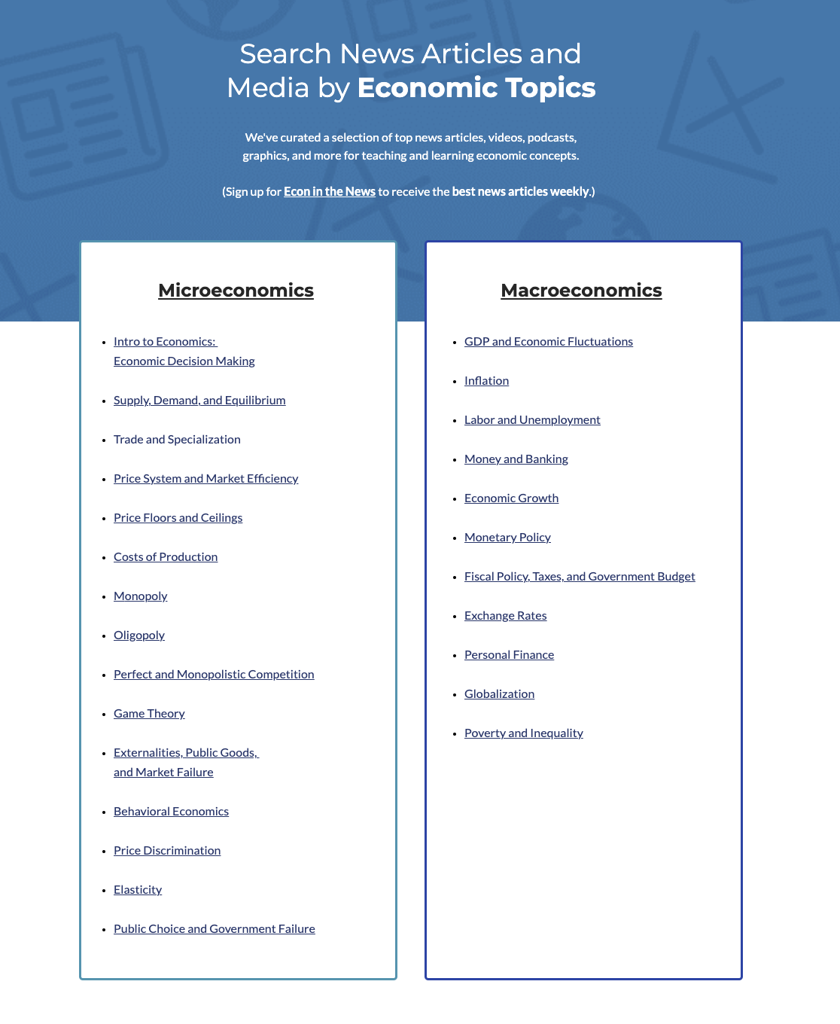

NEW! Econ in the News Webpage
mru.org/VTCEE

Slide 29
Problem 2 - Contextualize/using the content
What topic does this belong to?
How should I use it? Reading? HW? Discussion?

Slide 30
Problem # 2: How do I use content I find?
News Decision Tree
Is this a quick news reference or example? → Bellringer or Class example
Do I want this to be a longer class discussion? → assign in class or for HW the night before
Short news article or fact→ in class, add to worksheets or test questions
Short video→ show in class and discuss
Long video or podcast→ assign for HW or extra credit

Slide 31
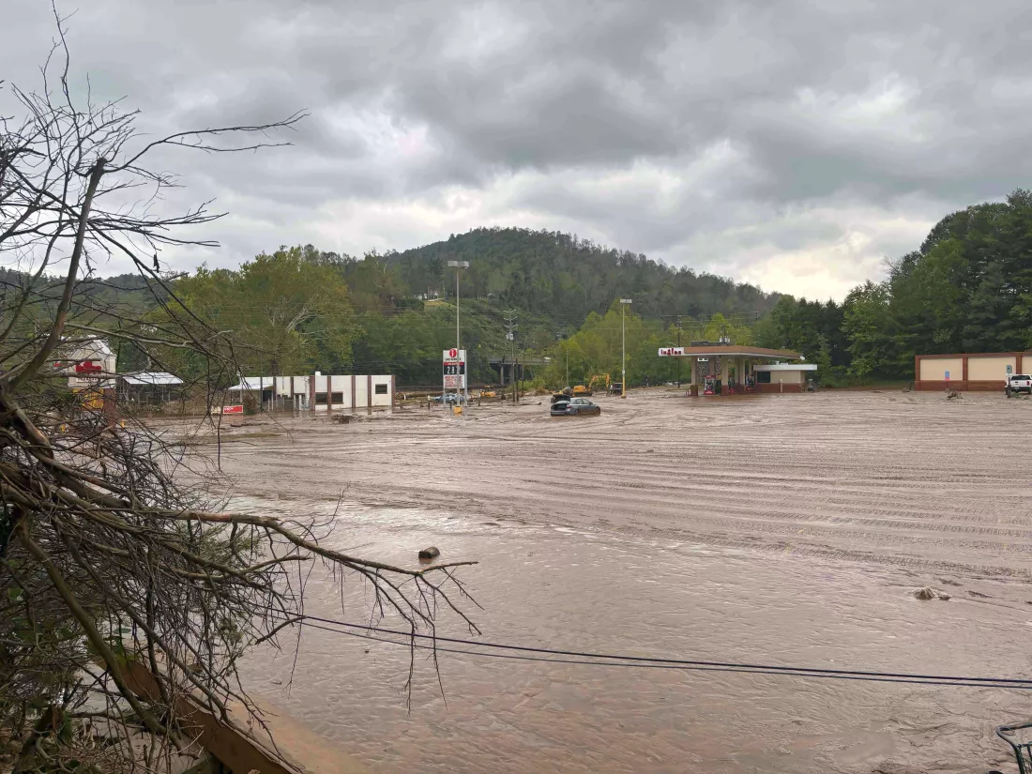
Short News Article:
A tiny town just got slammed by Helene. It could massively disrupt the tech industry
Spruce Pine, NC is currently one of only a few known locations of high purity quartz, an essential component for semiconductors and solar panels.
Hurricane Helene shut down production.
Assuming the plant stays closed for an extended period, use a supply and demand graph to predict what will happen in
  The market for semiconductors
  The Market for Solar Panels

Slide 32
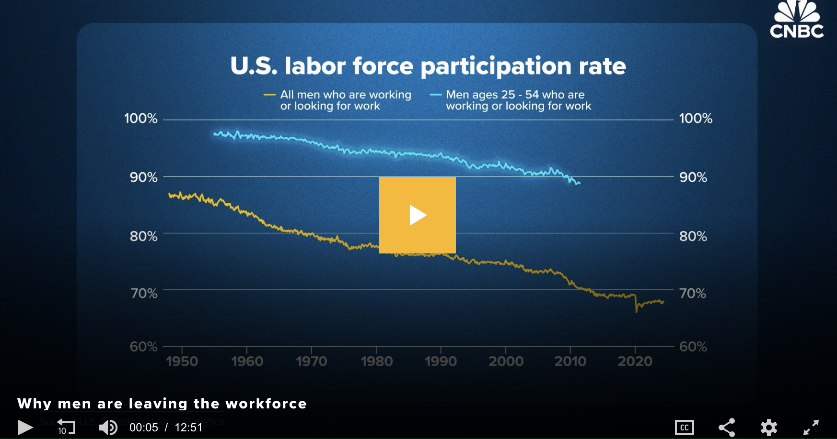
Longer video + Article:
More men in their prime working years are neither working nor looking for jobs — here's why
Assign for HW
Discuss in class

Slide 33

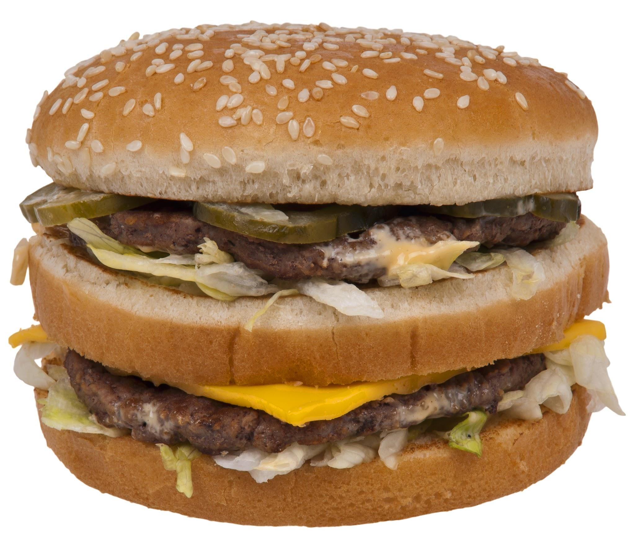
McDonald's accuses beef suppliers of price fixing
The lawsuit argues that the 4 largest slaughterhouses
Drove up the price of beef while
Lowering prices to cattle farmers.
How would you use this article?

Slide 34
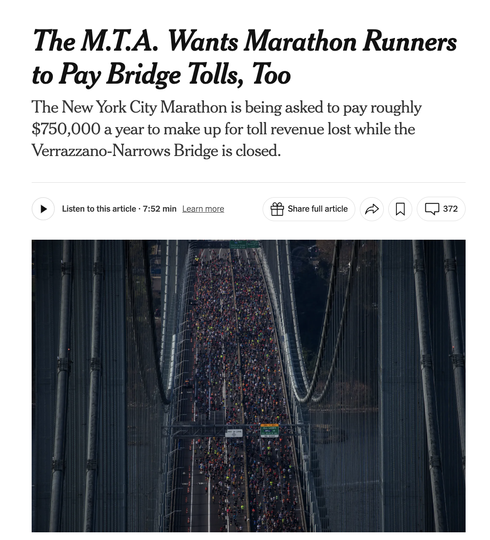

Strategy - SIT
SIT Protocol
Used to process engaging information from a resource
What is significant, interesting, and troubling?
https://www.nytimes.com/2024/04/03/nyregion/marathon-tolls-mta.html

Slide 35
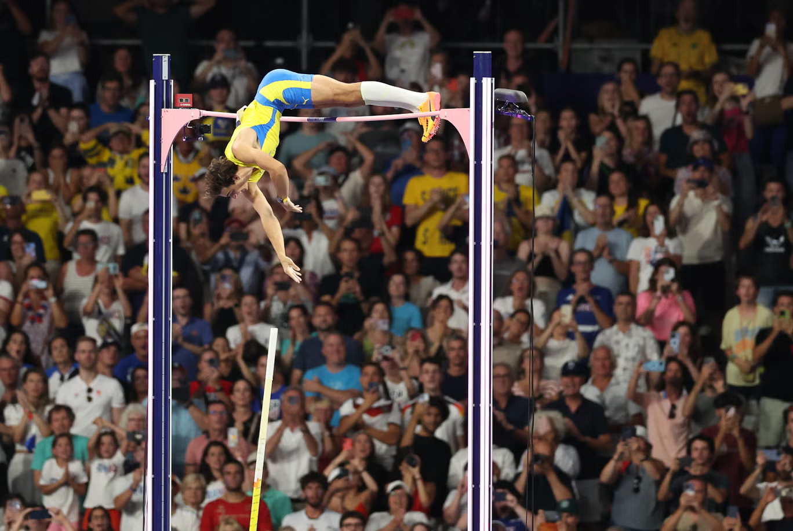
See, Think, Wonder
See, Think, Wonder
Used to promote thoughtful interpretation and stimulate curiosity
What do you see, think, and wonder?
https://www.ladbible.com/news/sport/olympics-2024-paris-mondo-duplantis-pole-vault-world-record-090917-20240807
https://www.independent.co.uk/sport/olympics/armand-duplantis-world-record-pole-vault-olympics-2024-b2591625.html

Slide 36
Problem 3: Making sure it is relevant to students
Take note of what students are discussing before class
Encourage students to pay attention to the news and bring in questions
Ask open ended questions to incorporate students’ interests

Slide 37
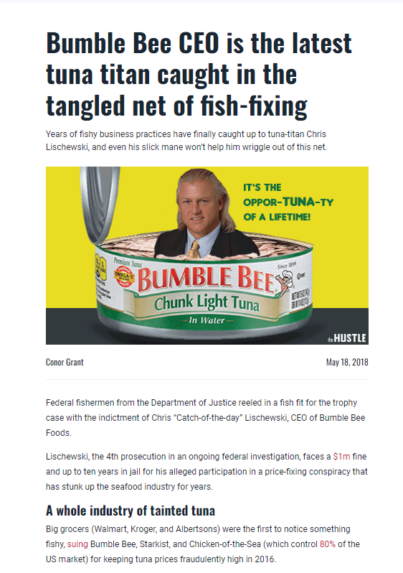
Ask for student submissions
  Assign by week (ask for x submissions each week)
  Assign by topic (ask for students to find an example after covering a topic, respond to article with a letter to the editor)
If you find a good one, please tell us!
  Email: ariel@mru.org and we will add to Econ in the News
https://thehustle.co/tuna-chicken-sea/

Slide 38
Problem 4: I don’t have time
All of our econ news is sorted by topic, available on our website ANYTIME.
We update and add new articles every week.

Slide 39


Thank you!
Questions/Feedback
Ariel Slonim ♦ ariel@mru.org
Stay Connected
@MRevUniversity
facebook.com/mrevuniversity
mru.org/VTCEE

Slide 40




Slide 41



Slide 42
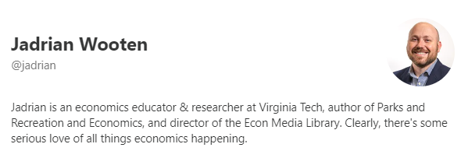
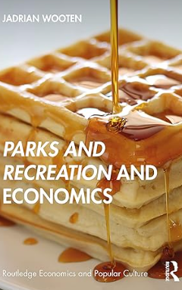
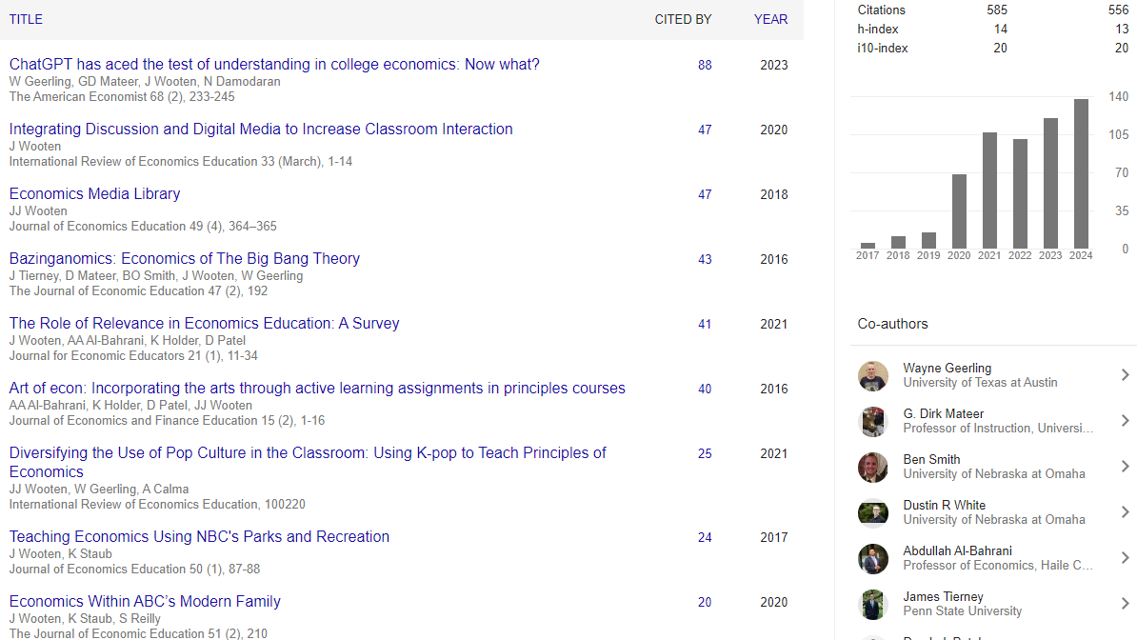
Notes:
https://scholar.google.com/citations?user=FUl4oMsAAAAJ&hl=en
https://economicsofparksandrec.com/
https://www.amazon.com/Recreation-Economics-Routledge-Popular-Culture/dp/0367557339

Slide 43
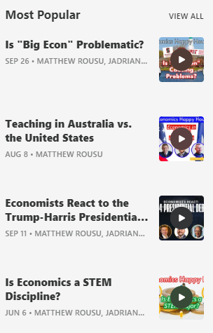
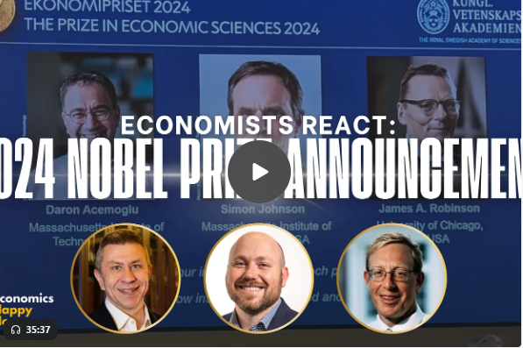
Notes:
https://scholar.google.com/citations?user=FUl4oMsAAAAJ&hl=en
https://economicsofparksandrec.com/
https://www.amazon.com/Recreation-Economics-Routledge-Popular-Culture/dp/0367557339

Slide 44
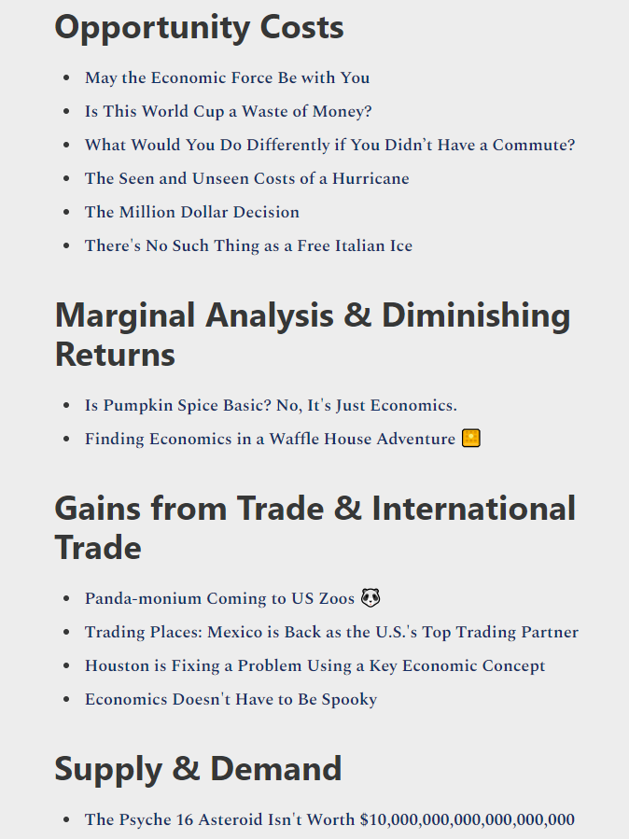
Searchable Articles
Notes:
https://www.mondayeconomist.com/p/teaching-resources

Slide 45



TEACHERS.FEE.ORG

Slide 46

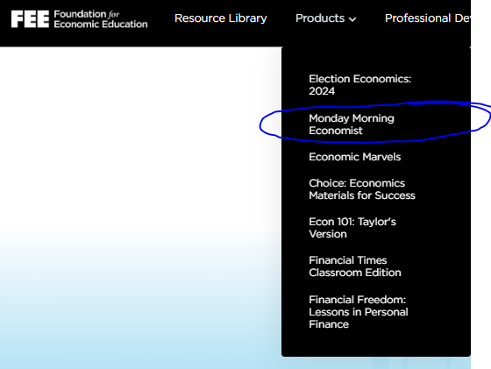

Slide 47
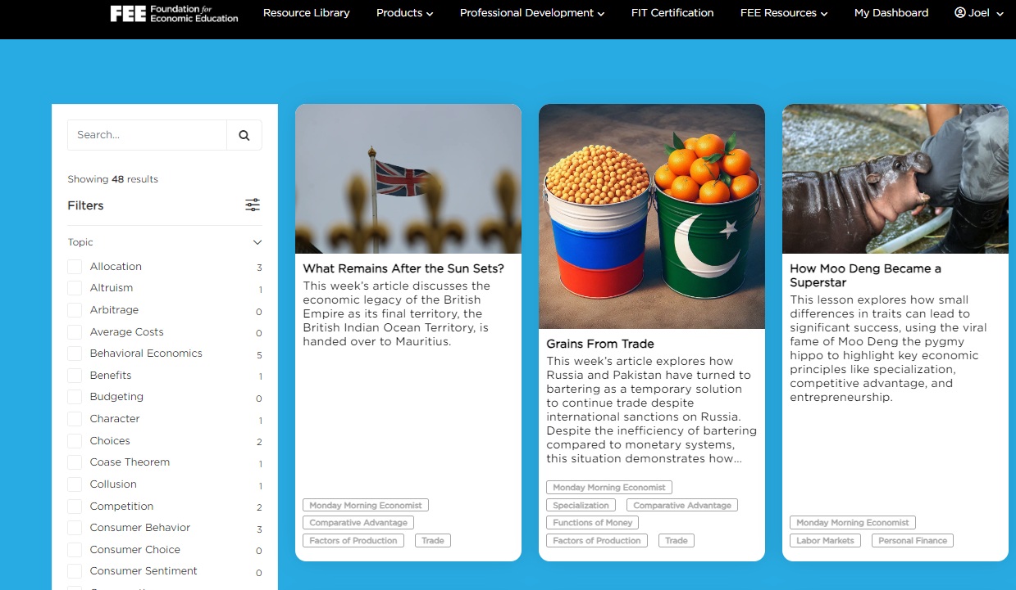

Slide 48

Grains of Trade: Trade Deal or No Trade Deal Activity?
Notes:
MME blog- https://www.mondayeconomist.com/p/grains-from-trade
MME Classroom Edition Lesson Plan-

Slide 49

In simple economic terms:
A trade is a good deal when both parties involved end up better off than they would have been without the trade. This happens when each party values what they are receiving more than what they are giving up.
For a country, a good deal occurs when the value of the imported goods is greater than or equal to the cost or effort of producing the exported goods, often based on their comparative advantage.

Slide 50

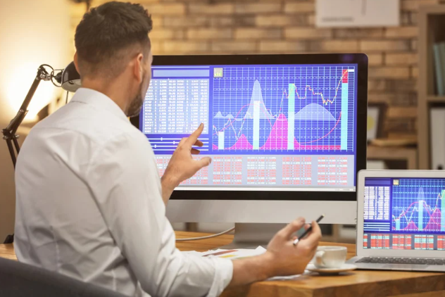
You are the Chief Trade Officer!
Mandarinovia is forced to barter for goods from other countries like trading neighbor, Chickpeastan. As Chief Trade Officer, your task is to choose the best trade deals for your company. You’ll see two goods on each slide in large quantities.
On your handout, mark "Trade Deal" if the exported goods are more valuable than the imported goods, or "No Trade Deal" if they are not. After the slides, we’ll review the answers, and you’ll score yourself using the answer key. Total your points at the end. For each correct deal negotiated you gain (+) points based on the terms of trade provided.

Slide 51
TRADE DEAL OR NO DEAL?
EXPORTING
XXX (quantity) of Good A
This is the good you are supplying.
IMPORTING
XXX (quantity) of Good B
This is the good you are receiving.
Things to consider:
- Does this seem like a reasonable exchange?
-Are the terms favorable given the likely value and use of these goods?
-Is it economical and/or profitable for me to give this in exchange for that?
#Sample Trade

Slide 52
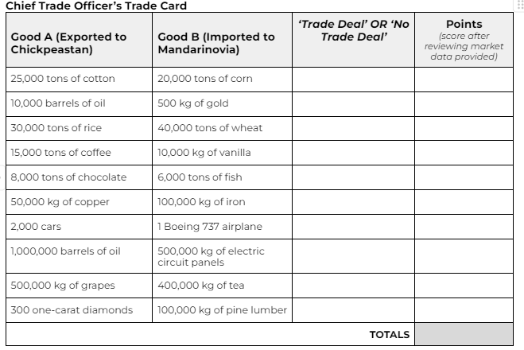
TRADE DEAL OR NO DEAL?
Complete your trade orders by stating “No Trade Deal” or “Deal” for each of the 10 scenarios listed on your trade card:
Trade #1

Slide 53

Proceed after everyone has agreed or rejected all 10 trade scenarios on their score card

Slide 54
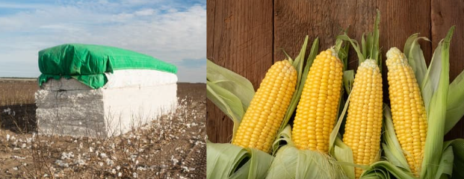
TRADE DEAL OR NO DEAL?
EXPORTING
25,000 tons of cotton
IMPORTING
20,000 tons of corn
Trade #1

Slide 55
Give Yourself: +2 NTD
-3 Deal
Trade #1

Slide 56

TRADE DEAL OR NO DEAL?
EXPORTING
10,000 barrels of oil
IMPORTING
500 kg of gold
Trade #2

Slide 57
Give Yourself: +5 Deal
-3 NTD
Trade #2

Slide 58
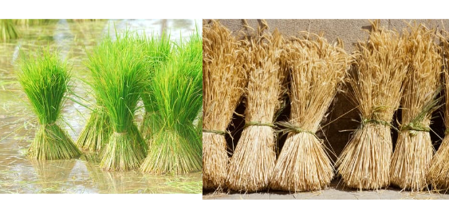
TRADE DEAL OR NO DEAL?
EXPORTING
30,000 tons of rice
IMPORTING
40,000 tons of wheat
Trade #3

Slide 59
Give Yourself: +3 NTD
-3 Deal
Trade #3

Slide 60

TRADE DEAL OR NO DEAL?
EXPORTING
15,000 tons of coffee
IMPORTING
10,000 kg of vanilla
Trade #4

Slide 61
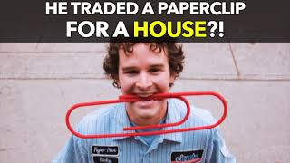
How do you know when a trade is a good deal?
Notes:
https://youtu.be/44DtSp4ZNB0
https://www.youtube.com/watch?v=44DtSp4ZNB0 He Traded a Paperclip for a House?! (Nas Daily) April 4, 2021.

Slide 62
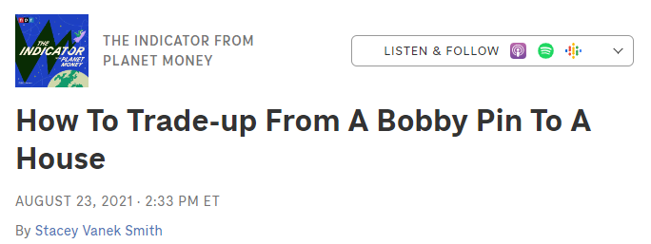
Demi Skipper relied on trading goods directly. Historically, money emerged naturally through the market to solve the limitations of barter. How does Demi’s experience highlight the challenges of bartering, and how might the use of money have made her trades easier?
Demi Skipper's journey shows that persistence and market knowledge are key to trading up in value. How do both the Russian barter system and Demi's trades illustrate the inefficiency of bartering compared to using money as a medium of exchange, and what lessons can be drawn from this about the role of money in modern trade?
Notes:
Access the Podcast (9 mins): Listen to the podcast titled How to Trade-Up from a Bobby Pin to a House by visiting the link: How to Trade-Up from a Bobby Pin to a House.
Complete the Questions: After listening to the podcast, answer the discussion questions provided. Reflect on how Demi Skipper’s trading journey connects with the concepts of barter, subjective value, and trade efficiency discussed in class.

Slide 63

Extension: Money Is Imaginary. Should You Trust It?

Slide 64

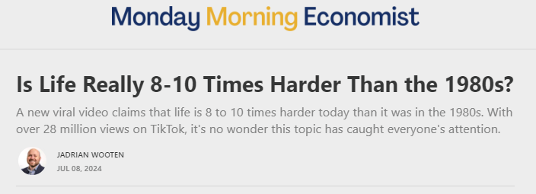
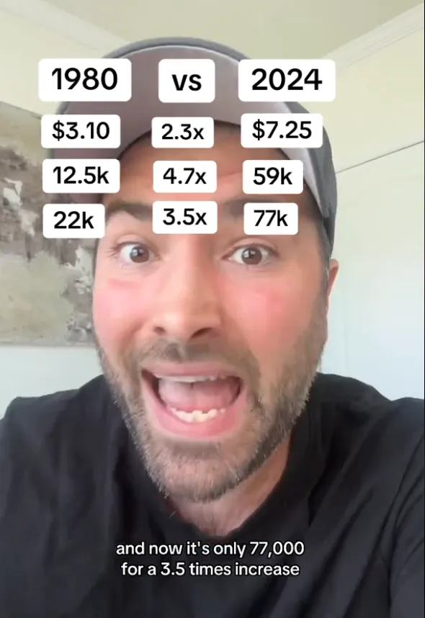
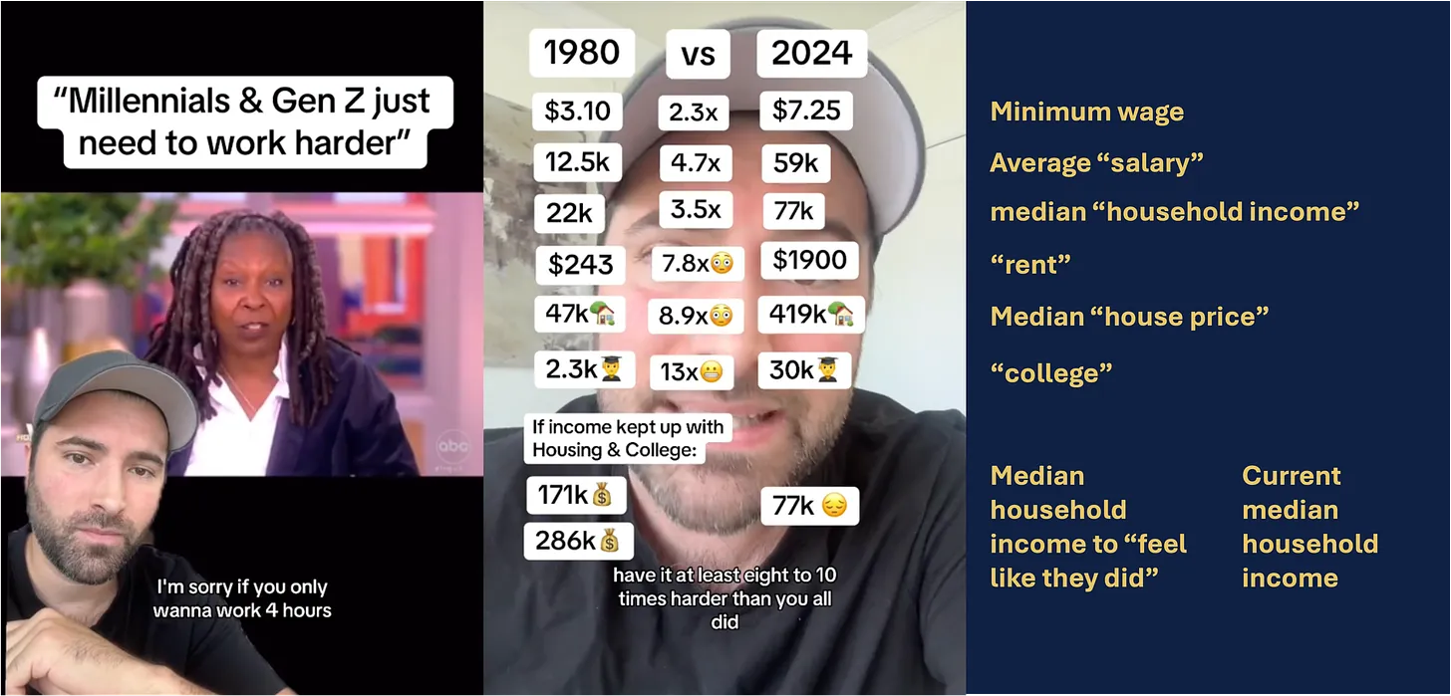


Slide 65
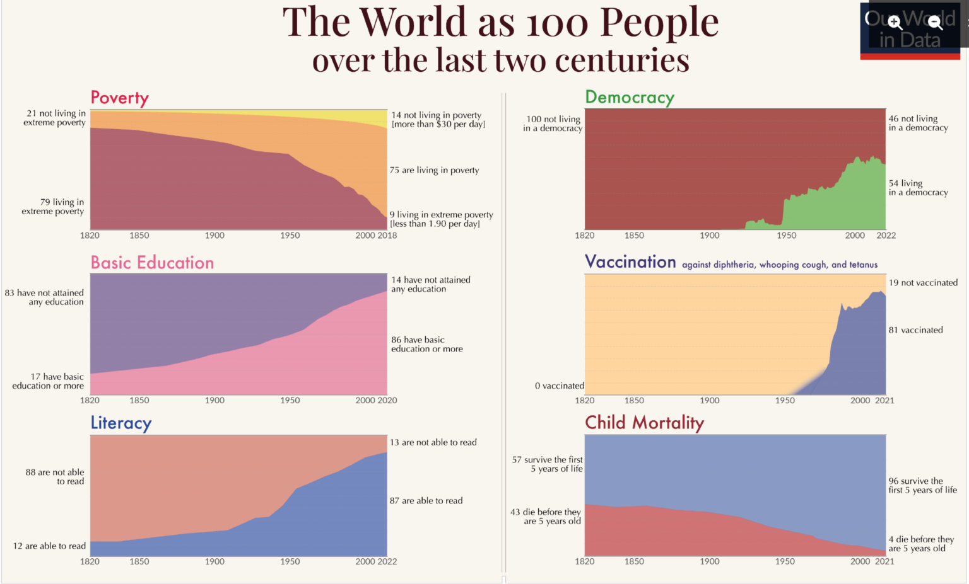

Slide 66
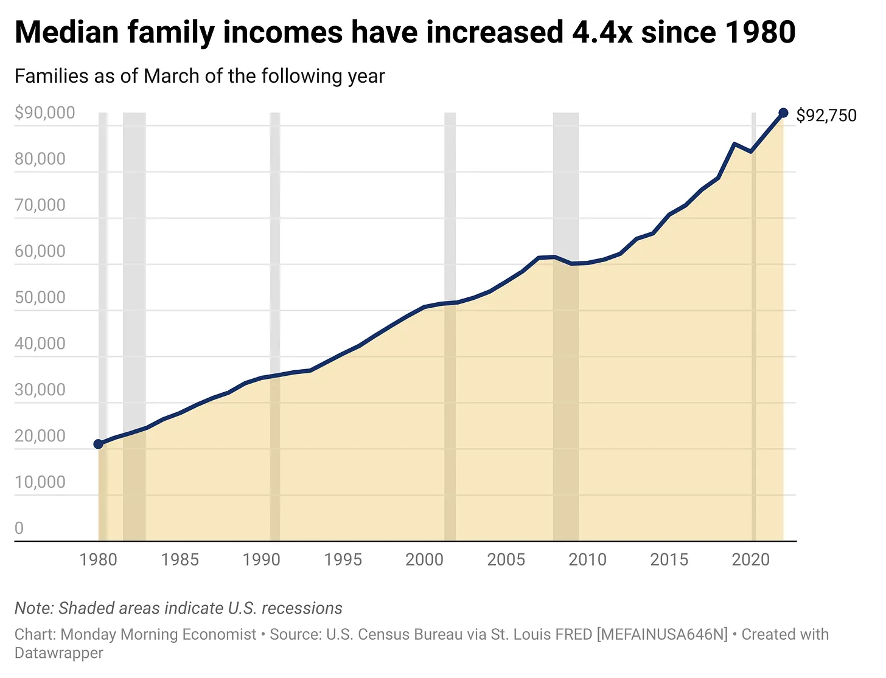
Notes:
https://www.mondayeconomist.com/p/debunking-the-myth-that-life-is-8

Slide 67

Notes:
https://www.fullstackeconomics.com/p/24-charts-that-show-were-mostly-living-better-than-our-parents

Slide 68

Notes:
https://www.fullstackeconomics.com/p/24-charts-that-show-were-mostly-living-better-than-our-parents

Slide 69

Notes:
https://www.fullstackeconomics.com/p/24-charts-that-show-were-mostly-living-better-than-our-parents

Slide 70


Slide 71


Slide 72

Notes:
https://teachers.fee.org/courses/Election-Economics-2024

Slide 73



Slide 74



Slide 75


Notes:
https://projects.fivethirtyeight.com/polls/president-general/2024/national/

Slide 76

Finding Common Ground
Notes:
https://docs.google.com/presentation/d/1XKiNwtEMLcTmyE095WLdM58N0Qm-IpSK2_J2QuZdg28/edit?usp=sharing

Slide 77


Slide 78

Notes:
https://docs.google.com/document/d/1U80Mh6wR1OcomuXkoqqhmQKbVmJxu7rDU7Yaz-hT36w/edit?usp=sharing

Slide 79




FEE.ORG

Slide 80


Slide 81

ECON 101: TAYLOR’S VERSION
30 Lessons on all major economics topics
Notes:
https://teachers.fee.org/courses/taylor

Slide 82

teachers.fee.org
FREE Resources, Webinars,
and On-Demand PD!
FREE Instructional Resources!

Slide 83







FREE LESSONS EMAILED & POSTED EVERY MONDAY!

Slide 84





FREE LESSONS EMAILED & POSTED EVERY TUESDAY!

Slide 85







FREE LESSONS EMAILED & POSTED EVERY WEDNESDAY!

Slide 86





FREE LESSONS EMAILED & POSTED EVERY THURSDAY!
Notes:
Sample FT Classroom Ed. Lesson: https://docs.google.com/document/d/1ae0IXu3v0ByT_piVVtt_HO5QrEtrmtn0XBVpjSL7zHU/edit?usp=sharing

Slide 87






Slide 88




Slide 89


