Slide 1
Buying Electric Appliances
Watt You Need to Know

Slide 2
Activator
What electricity-powered household devices do you use on a daily basis?
Which household devices do you think use the most power?

Slide 3
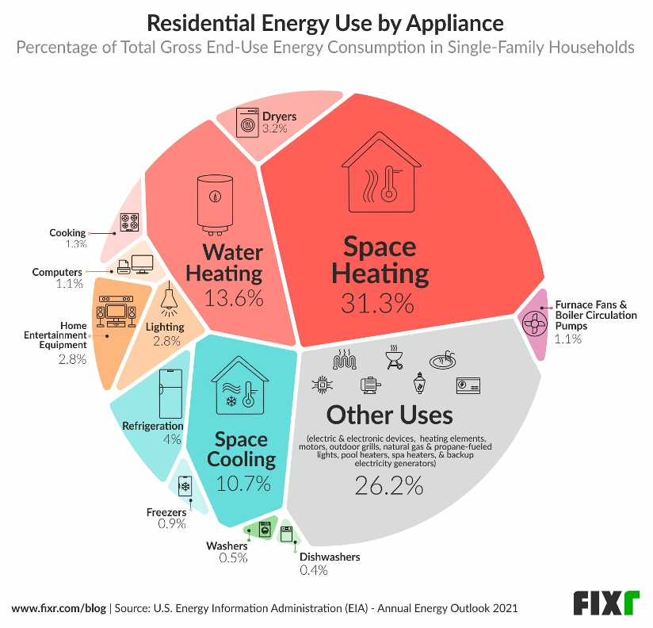
Notes:
https://www.renewableenergyworld.com/energy-efficiency/the-10-home-appliances-that-consume-the-most-energy/#gref

Slide 4
Scenario
You have just secured your first full-time job and are financially ready to move into your own place! A family friend who lives near your employer’s headquarters has offered to rent their 500-square-foot guesthouse to you for the next year. In addition to rent, you will be responsible for paying utilities (the guesthouse has its own water and power meters).

Slide 5
Scenario, continued
The only catch is that the guesthouse has been unused for several years and will need a few things before you can live there comfortably. In exchange for a below-market rental rate for the next 12 months, you will need to purchase the items listed below.
8 light bulbs
Compact refrigerator
Window air conditioner
Electric water heater

Slide 6
Round 1
Sample
Using the information provided on Activity 1.1: Consumer Decision Making, rank your options for each appliance.
 | Ranking Rounds
 | 1 | 2 | 3
Most Preferred
Least Preferred
D
A
C
B

Slide 7
Let’s Debrief
How did you decide on your rankings for each appliance?
What other information would help you make your appliance purchasing decisions?

Slide 8
Key Terms
Economic decision making is the process of reaching a conclusion after considering the alternatives.
Cost/benefit analysis is the process of examining what you gain (benefits) and what you give up (costs) of each available alternative and then using that information to arrive at a decision.
Notes:
https://www.econedlink.org/glossary/

Slide 9
Your Finances
You have carefully reviewed your finances and have determined that you can spend up to $1,100 from your savings account to purchase appliances for the guesthouse. If you spend more than $1,100, you will need to borrow the additional money from your parents. Repaying the loan will mean that, for one or more months, you will have to reduce the amount of income you have allocated to entertainment spending in the budget you developed in line with your wages at your new job.

Slide 10
Price Data
Option | 8 Light Bulbs | Compact Refrigerator | Window Air Conditioner | Electric Water Heater
A | $20 | $329 | $179 | $427
B | $20 | $368 | $229 | $479
C | $23 | $449 | $254 | $483
D | $25 | $600 | $270 | $759

Slide 11
Let’s Debrief
Were your rankings in Round 2 different from those in Round 1? Why or why not?
Did you always rank the option with the lowest price as your most preferred option? Why or why not?
If you purchase each of your most preferred appliances, will you spend more or less than the $1,100 you have allocated for this purpose?

Slide 12
Key Terms
Opportunity cost is the next-best alternative a person gives up when making a choice. It’s not every alternative – it is your second choice.
Imagine you were to spend an hour watching videos on YouTube when you get home from school. What would be your next best use of that hour?
Notes:
https://www.econedlink.org/glossary/

Slide 13
How Much Will Using That Appliance Cost You Each Year?
Step 1: Calculate watt-hours (Wh) per year
device wattage x hours used per day x 365 days per year = Wh per year
Example: 150-watt television used for 4 hours per day
150 watts x 4 hours per day x 365 days per year = 219,000 Wh per year
Step 2: Convert Wh per year to kilowatt-hours (kWh) per year
Wh per year ÷ 1000 = kWh per year
Example: Television using 219,000 Wh per year
219,000 Wh per year ÷ 1000 = 219 kWh per year
Step 3: Calculate annual energy costs
kWh per year x price per kWh = energy cost per year
The average price for one residential kWh in the U.S. as of 2023 rounds to $0.16.
Example: Television using 219 kWh per year at the national average price
219 kWh per year x $0.16 per kWh = $35.04 per year
Notes:
The most current data (including state-level data) is available at https://www.eia.gov/electricity/monthly/epm_table_grapher.php?t=epmt_5_6_a

Slide 14
Conducting Consumer Research
You have 2 minutes to research the energy costs associated with running appliances for one year.
Choose which appliances to research wisely!
Mark your final rankings in the third column on Activity 1.1

Slide 15
Let’s Debrief
For which appliances did you conduct energy cost research? Why?
Were your rankings in Round 3 different from those in Round 2? Why or why not?
Was it worth it to conduct energy cost research?

Slide 16
Consumer Resources
Program | U.S. Government Agency | What It Does
Energy Labeling Rule | Federal Trade Commission | Requires manufacturers of certain appliances to provide information on energy use and energy cost to consumers in an easy-to-read format
ENERGY STAR | Environmental Protection Agency | Applies a special label to appliances that meet strict energy efficiency standards

Slide 17
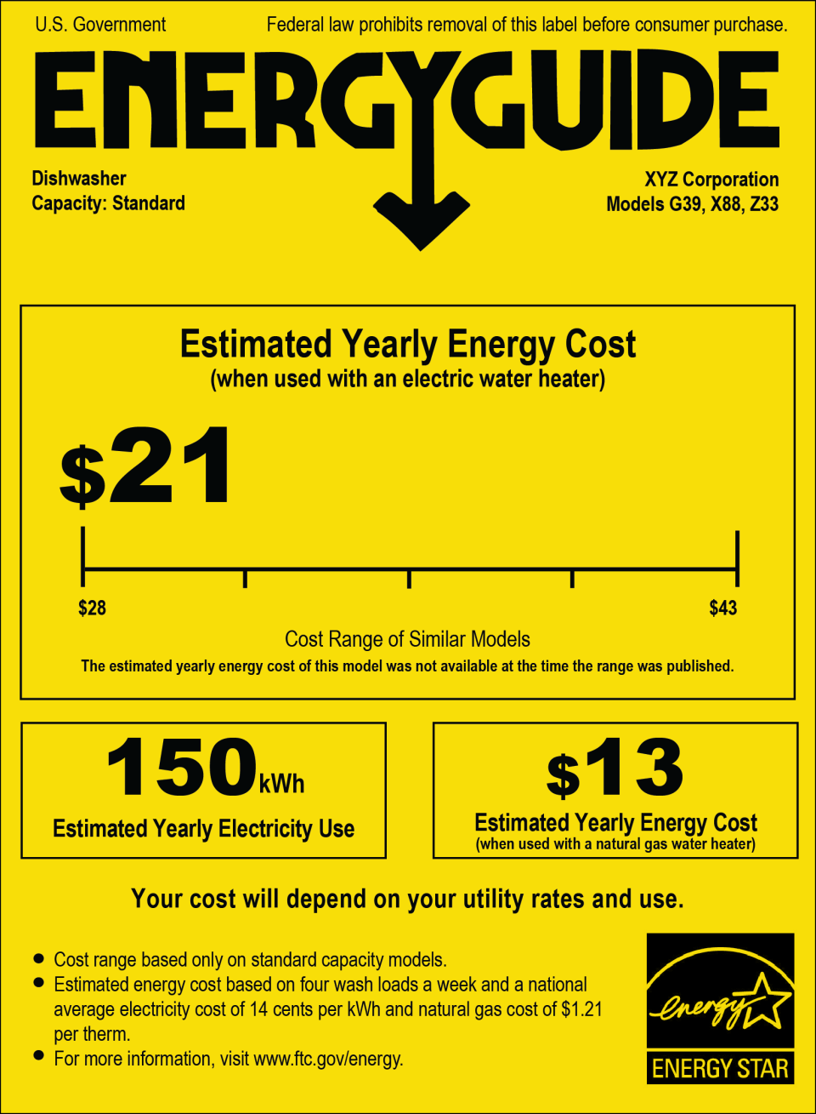
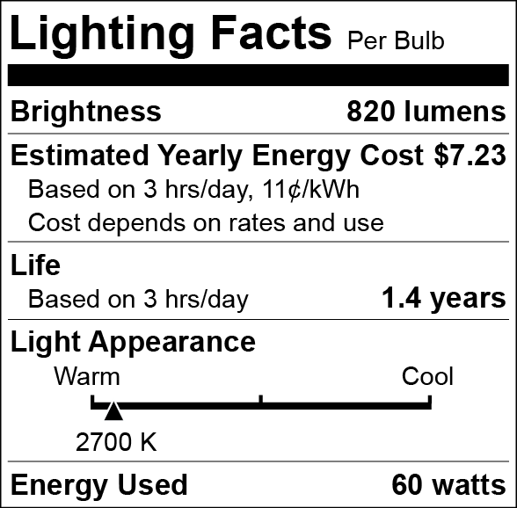
Sample EnergyGuide tag (for a dishwasher)
Lighting Facts box required under
the Energy Labeling Rule.
Notes:
https://consumer.ftc.gov/articles/how-use-energyguide-label-shop-home-appliances#
https://www.ftc.gov/business-guidance/resources/ftc-lighting-facts-label-questions-answers-manufacturers

Slide 18
Let’s Debrief
Were the annual energy costs for the ENERGY STAR certified refrigerator and window air conditioners lower than those of the other options you considered?
In your final rankings, did you rank any of the ENERGY STAR appliances as your most preferred option? Why or why not?
How might your final rankings have been different if you knew you were going to pay to operate these appliances for 5 years instead of 1 year?

Slide 19
Annual Energy Costs Based on $0.16/kWh
Option | 8 Light Bulbs | Compact Refrigerator | Window Air Conditioner | Electric Water Heater
A | $20.96 | $60.00 | $55.36 | $564.96
B | $18.24 | $60.48 | $65.28 | $399.04
C | $13.28 | $47.52 | $59.04* | $390.24
D | $11.20 | $46.72* | $60.00* | $558.88
*ENERGY STAR Certified

