Slide 1


AI Series:
AI Series: Customize Activities and Lesson Plans

Slide 2
Certificate Requirements
To earn professional development hours for webinars, you must:
Watch a minimum of 45-minutes and you will automatically receive a professional development certificate via e-mail within 24 to 48 hours.

Slide 3
Objectives
You will be able to:
Learn AI integration for customized, engaging lesson plans;
Develop interactive activities using an EconEdLink lesson plan that resonates with your learners; and
Master tools for supporting high-need students effectively.

Slide 4

Presenter
Tawni Hunt Ferrarini, PhD
tferrarini@fsu.edu and tawni.ferrarini@gmail.com (preferred)
tawni.org
LinkedIn: tawnihuntferrarini | Facebook: tawni.org | Twitter: Tawni_Ferrarini

Slide 5
Session Agenda
Quick overview of the Status of AI in Education
Use AI to Reduce Prep Time, Unleashing Creativity
Support Critical Thinking while Teaching through AI-enhancements
Foster Self-Esteem and an Effort-Based Mindset in the the “Compound Interest” Session
Encourage Questioning, Reflective Student Thinking, and Impart Agency through Various Assessments, with attention drawn to “High Needs”
Promote Collaborative Learning across Students
Integrate Real-World Problem-Solving
Once Over Lightly
Questions

Slide 6

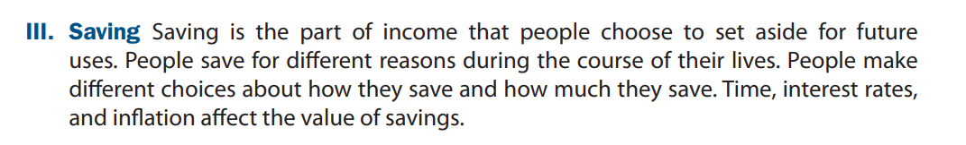
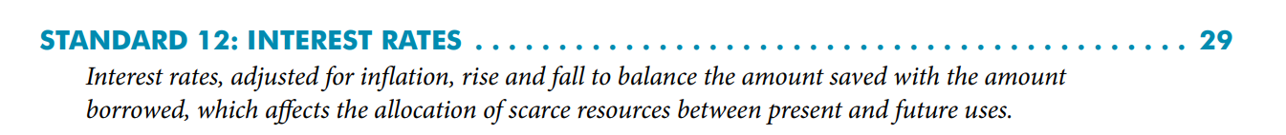
National Standards
https://www.councilforeconed.org/policy-advocacy/k-12-standards/

Slide 7

1. AI: Transforming Education for the Better

Slide 8
Educational Landscape¹
Education has been slow to adopt digital technologies, but AI offers a chance for accelerated transformation.
The pandemic led to a surge in online learning and edtech investment, but this receded as classrooms reopened.
Generative AI, like ChatGPT, is now viewed as a tool for personalized tutoring and automating tasks.
Teachers have advantages over general AI companies because they understand pedagogy and possess personal relationships with students, parents, and schools.
1. Schumpeter. 2024. The Economist “AI can transform education for the better.”

Slide 9
Educational Landscape¹
Challenges to AI adoption include teacher training, budget constraints, concerns about job security, and data privacy, safety, and security. Let’s set these aside for this presentation.
If implemented successfully, AI could provide individualized tutoring, improving learning outcomes and reducing achievement gaps.
AI presents an opportunity to revolutionize education, but careful implementation is key. (Consult with your administration.)
1. Schumpeter. 2024. The Economist “AI can transform education for the better.”

Slide 10
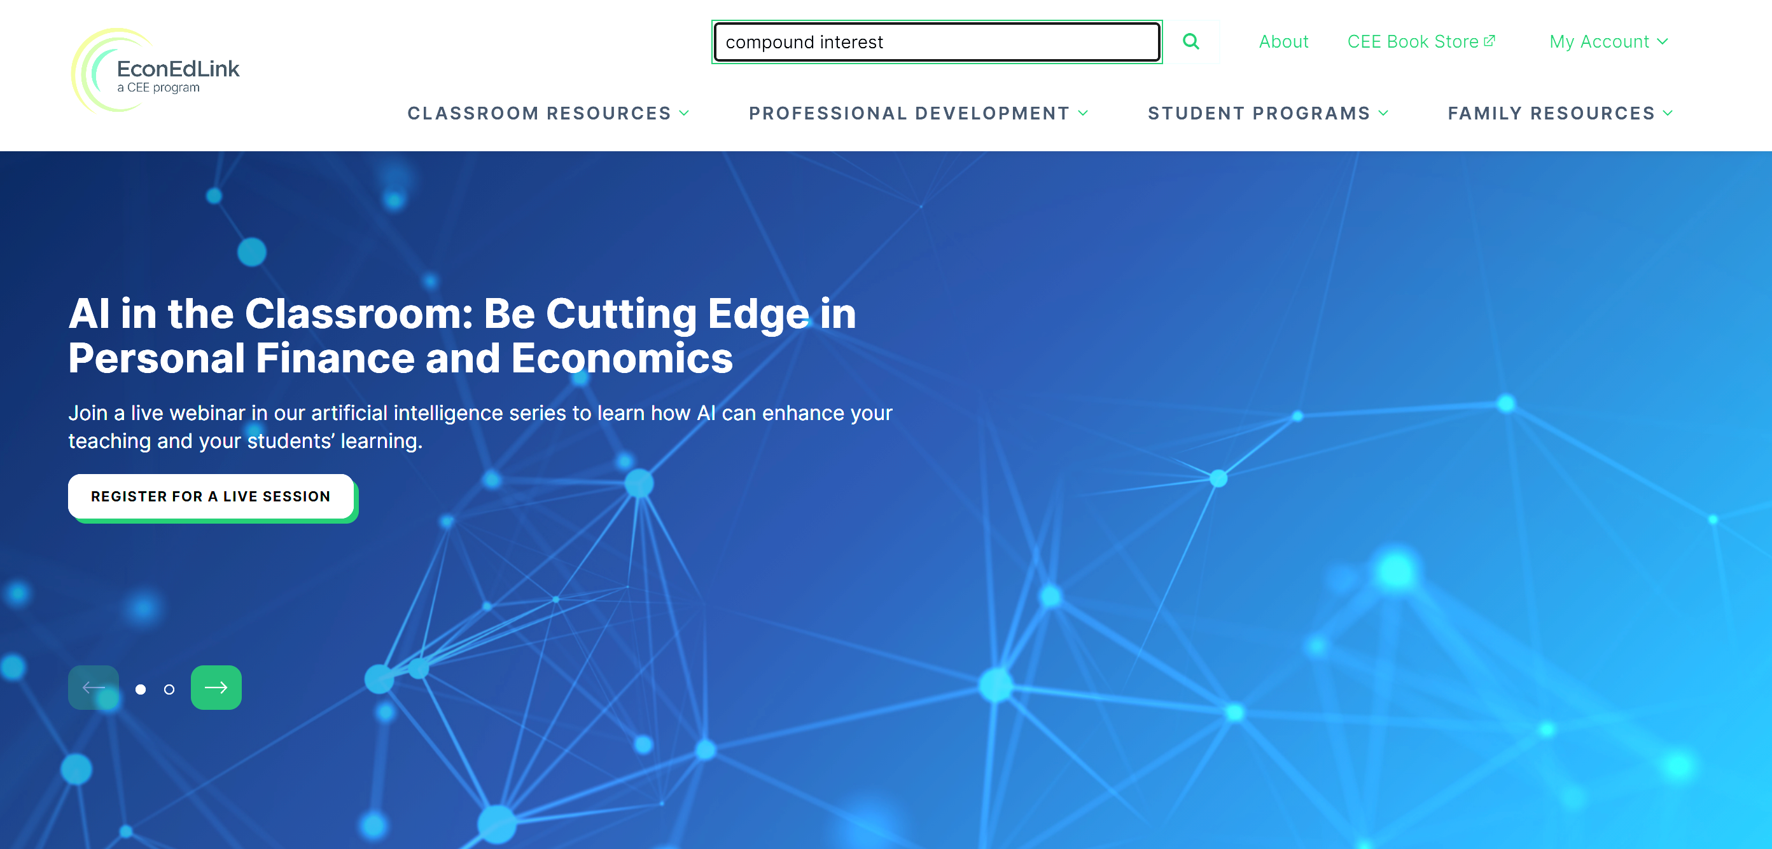
AI-in-action: Compound Interest
Leverage Existing Lesson Plans at https://econedlink.org/
Find a lesson plan on Compound Interest (or another topic)
Save to Google Drive

Slide 11

Let’s unleash the creative you!
Choose any AI tool.
Three (3) Tasks:
1. Select an AI tool. For example, Google’s Gemini will be used in this session because many CEE classrooms are Google Classrooms.
2. Visit EconEdLink.org and select a Lesson Plan for Compound Interest, saving it as a PDF and placing it in Google Drive or your Google Classroom.
3. Use Gemini to generate a PPT outline for the file @The Power of Compound Interest. Assume students have mastered Savings and Consumption.
Google Classroom? Find the Gemini Icon
Gemini Icon

Slide 12
Customizing a Lesson and Transforming a Classroom: Through Gemini
Generate a PPT outline
Create a Student Engagement Activity
Generate Real Life Scenarios that Require Critical Thinking Skills
Empower Students to Answer Their Lingering Questions, Seek Additional Understanding, Form Questions to Submit, and Find Additional Resources

Slide 13
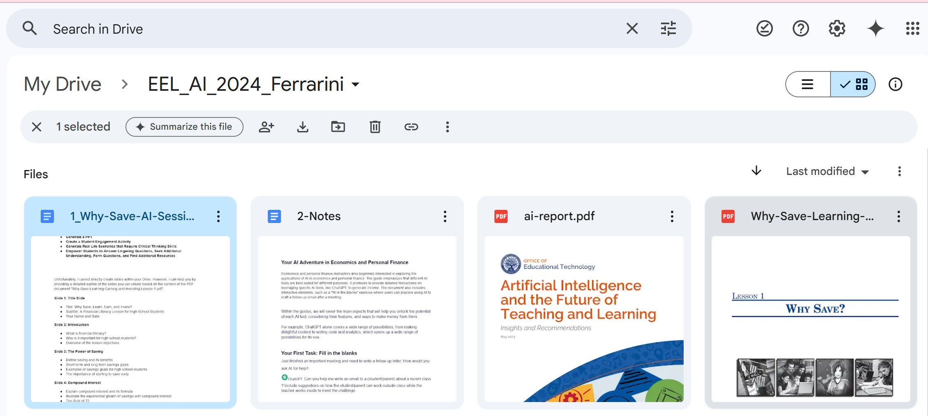
Teacher Prep: In Google Drive

Slide 14
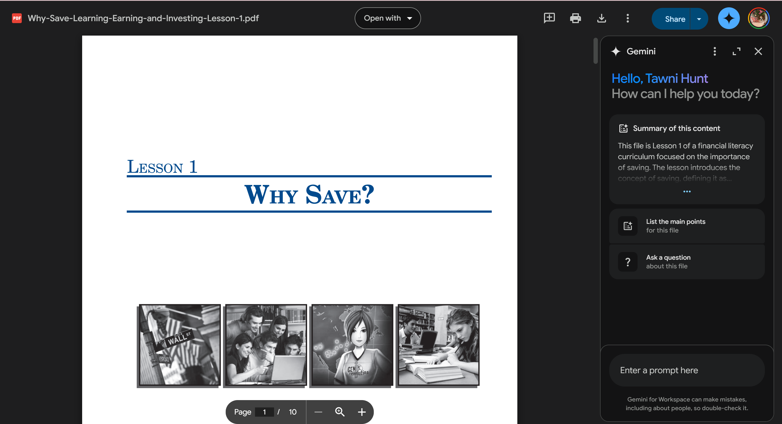
In Google Drive: Class Prep
Enter a well thought out Prompt:
Using @filename generate a PPT slide to teach about simple vs compound interest, illustrating how compounding interest can help you earn interest income
Prompt

Slide 15
PPT OUTLINE PROMPT: Generate a detailed outline of the slides you can create based on the content of the PDF document @Why-Save-Learning-Earning-and-Investing-Lesson-1.pdf

Slide 16
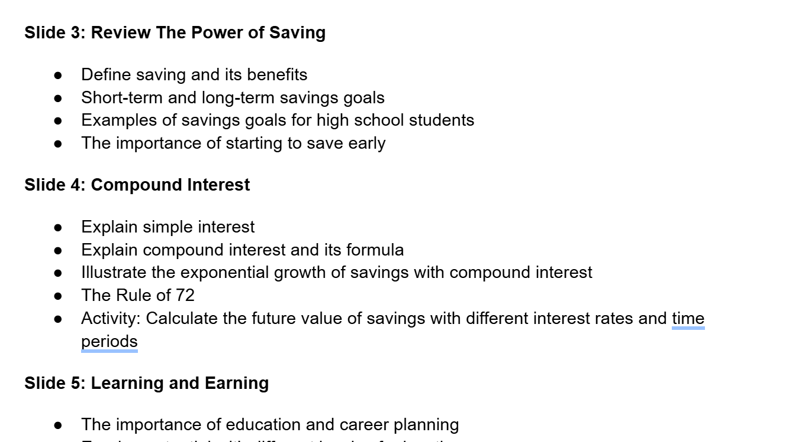
Review and Customize

Slide 17
2. STUDENT ACTIVITY PROMPT: Generate a “Think-Pair-Share” activity based on the content of the PDF document @Why-Save-Learning-Earning-and-Investing-Lesson-1.pdf

Slide 18
2. STUDENT ACTIVITY PROMPT: Generate a “Think-Pair-Share” activity based on the content of the PDF document @Why-Save-Learning-Earning-and-Investing-Lesson-1.pdf

Slide 19
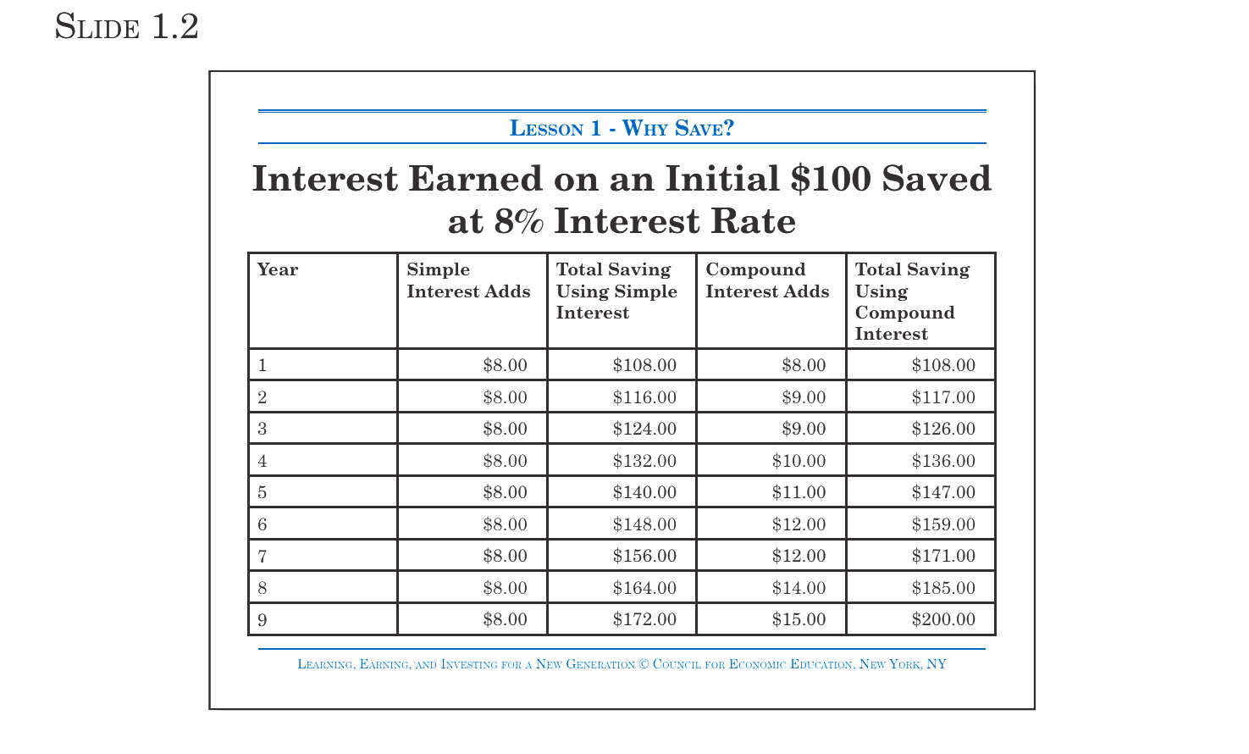
Think-Pair-Share Results
Think-Pair-Share Activity: The Power of Compound Interest
Objective: To help students understand the concept of compound interest and its impact on savings.
Materials: Slide 1.2 from the lesson plan (Interest Earned on an Initial $100 Saved at 8% Interest Rate) and Calculators (optional)
Procedure:
Think:
  Present Slide 1.2 to the students.
  Ask them to individually consider the difference in the "Total Savings" amounts between simple and compound interest over time.
  Have them think about the following question: "Why does the compound interest column grow so much faster than the simple interest column?"
Pair:
  Pair students up.
  Ask them to discuss their observations and try to explain the reason for the difference in growth.
  Encourage them to use the terms "principal" and "interest" in their discussion.
Share:
  Invite pairs to share their explanations with the class.
  Guide the discussion to highlight the key concept: Compound interest earns interest not only on the initial principal but also on the accumulated interest from previous periods. This leads to exponential growth over time.
Extension Activities:
Calculator Exploration: Have students experiment with different interest rates and time periods to see how they affect the growth of savings under compound interest.
Real-Life Scenarios: Present students with scenarios where they need to save for a specific goal (e.g., college, a car). Have them calculate how much they need to save each month to reach their goal, considering the power of compound interest.
The Rule of 72: Introduce the Rule of 72 (Slide 1.4) and have students practice calculating how long it takes for their savings to double at different interest rates.
Assessment:
Observe student participation and understanding during the Think-Pair-Share activity.
Evaluate their ability to explain the concept of compound interest.
Assess their understanding of the impact of compound interest on savings through the extension activities.
Key Takeaway: This activity aims to make the concept of compound interest less abstract and more tangible for students, demonstrating its powerful impact on long-term savings and financial well-being.

Slide 20
3. Critical Thinking and Real-Life ACTIVITY PROMPT: Create a list of "This or That" scenarios in which high school students can choose to use their income earned by doing some work for a neighbor to consume or save using the PDF @ 1_Why-Save-AI-Session

Slide 21
This or That? Tradeoffs and Opportunity Costs
"This or That" Scenarios for High School Students: Consume or Save?
Scenario 1:
This: Use the $50 you earned mowing your neighbor's lawn to buy a new video game.
That: Put the $50 into a savings account to contribute towards a down payment on a car.
Scenario 2:
This: Spend the $30 you earned babysitting on a night out with friends at the movies.
That: Save the $30 towards a new pair of sneakers you've been wanting.
Scenario 3:
This: Use the $20 you made walking the neighbor's dog to buy a new outfit for the weekend.
That: Add the $20 to your savings for a future college textbook.
Scenario 4:
This: Use the $25 you made cleaning out the neighbor's garage to buy a new phone case.
That: Put the $25 towards your emergency fund for unexpected expenses.

Slide 22

Empower Students
Through economic reasoning, you think about your financial goals and make choices that align with them. Choosing to save doesn't mean you can't have fun, but it does mean you are mindful of your spending and place importance on saving, prioritizing your future financial well-being.
From the Provost’s Office at Washington State University: https://provost.wsu.edu/benefits-of-ai/
Student Perspective
From a student’s standpoint, the introduction of AI in their academic journey offers many advantages.
Personalized Learning: AI-based educational tools can provide students with a tailored learning experience. AI can adapt to individual learning approaches, pace, and progress, providing customized feedback, recommendations, and resources.
Efficient Study Tools: AI, like ChatGPT, can serve as an intelligent tutor if used within the appropriate scope. It can assist in learning new concepts, exploring topics, revising content, or even practicing problem-solving skills. Used in combination with developing a student’s ability to critically evaluate output, AI can strengthen learning.
Career Guidance: AI tools can analyze data and predict trends, helping students make informed decisions about their career paths and future job markets. This is especially helpful when used in conjunction with academic advising.
Free/low cost academic support: AI can reduce financial barriers faced by students in their pursuit of education and research. By offering no or low-cost research assistance and editing, generative AI, if used ethically and effectively, increases access to support tools that previously were pay-for-service options.

Slide 23
4. Students Foster Self-Esteem and an Effort-Based Mindset
STUDENT PROMPT: Breakdown the difference between simple interest and compound interest, explaining why the difference matters to a high school student.

Slide 24
Simple Interest vs. Compound Interest: Why It Matters to High School Students
Simple Interest:
How it Works: Simple interest is calculated only on the initial principal amount.
Example: If you deposit $100 in a savings account with a 5% simple interest rate, you'll earn $5 in interest each year.
The Takeaway: Simple interest earnings are steady but limited.
Compound Interest:
How it Works: Compound interest is calculated on both the initial principal and the accumulated interest from previous periods.
Example: If you deposit $100 in a savings account with a 5% compound interest rate, you'll earn $5 in the first year. In the second year, you'll earn interest on the original $100 plus the $5 you earned in interest, and so on.
The Takeaway: Compound interest allows your money to grow exponentially over time.
Why the Difference Matters to High School Students:
Starting Early: The earlier you start saving and investing, the more time your money has to grow through compound interest. Even small amounts can add up significantly over time.
Long-Term Goals: High school students are often saving for long-term goals like college or a car. Compound interest is a powerful tool for reaching these goals faster.
Building Wealth: Compound interest is the foundation of wealth building. By understanding its power, high school students can set themselves up for financial success in the future.
Key Point: While simple interest provides a steady return, compound interest offers the potential for much greater growth over time. This is why it's crucial for high school students to understand the difference and harness the power of compound interest for their financial future.

Slide 25
Personalized Learning Experiences
Personalized Learning Experiences
You , the teacher, can tailor the learning content, pace, and assessment to the individual needs and learning styles of each student, ensuring they receive the most effective and efficient educational experience while learning about demand, supply, and market equilibrium?
Students, using a protected Chatbot?
Student groups?
Parents?

Slide 26
Bonus. Encourage Questioning and Reflective Thinking through Other Types of Assessment
Prompt: Provide a classroom example of how I, as a economics teacher, can Encourage Questioning and Reflective Thinking through Other Types of Assessment when teaching about the importance of saving and compound interest

Slide 27
Anticipate the Struggle for Some Students
PROMPT: For the struggling student completing the Activity: The "Future You" Financial Planning Project, create a template for the financial plan and a set of guiding questions for the reflective essay.
Customize the templates and based on individual student needs and the specific content covered in your class to provide support and guidance while still encouraging independent thinking and reflection.

Slide 28




Applications of AI in Economics Education
Personalized Learning Experiences
“Intelligent” Assessment and Grading
AI-powered adaptive learning systems can tailor course content, difficulty, and pace to individual student needs, enhancing engagement and comprehension of economic concepts.
AI-powered assessment tools can automatically grade student assignments, provide detailed feedback, and identify areas for improvement in the comprehension of economic concepts.
Virtual Tutoring and Feedback
Data Analytics and Visualization (Advanced)
AI chatbots and virtual assistants can provide students with immediate feedback, explanations, and personalized guidance on economic problem-solving, supporting independent learning.
AI can analyze large datasets, identify patterns, and generate interactive visualizations to help students better understand economic trends, models, and relationships.
By leveraging the power of AI, educators can create more engaging, personalized, and data-driven learning experiences, ultimately enhancing the teaching and understanding of economic concepts.

Slide 29
Once Over Lightly
“Developments in AI and Education”
Support Critical Thinking while Compound Interest (or any other topic) through AI-enhancements
FoPromote Collaborative Learning
ster Self-Esteem and an Effort-Based Mindset
Encourage Questioning and Reflective Thinking through Other Types of Assessment
Integrate Real-World Problem-Solving

Slide 30
Carlos J. Asarta (2024) Student engagement and interaction in the economics classroom: Essentials for the novice economic educator, The Journal of Economic Education, 55:1, 54-62, DOI: 10.1080/00220485.2023.2269142
Geerling, W., Mateer, G. D., Wooten, J., & Damodaran, N. (2023). ChatGPT has Aced the Test of Understanding in College Economics: Now What? The American Economist, 68(2), 233-245. https://doi.org/10.1177/05694345231169654
Motoki, F., Pinho Neto, V. & Rodrigues, V. More human than human: measuring ChatGPT political bias. Public Choice 198, 3–23 (2024). https://doi.org/10.1007/s11127-023-01097-2
Stanford University - Using Chatbot as a Teaching Tool

Slide 31

Questions?

Slide 32
Stay in Touch
Tawni Hunt Ferrarini, PhD
tferrarini@fsu.edu and tawni.ferrarini@gmail.com (preferred)
tawni.org
LinkedIn: tawnihuntferrarini | Facebook: tawni.org | Twitter: Tawni_Ferrarini

Slide 33
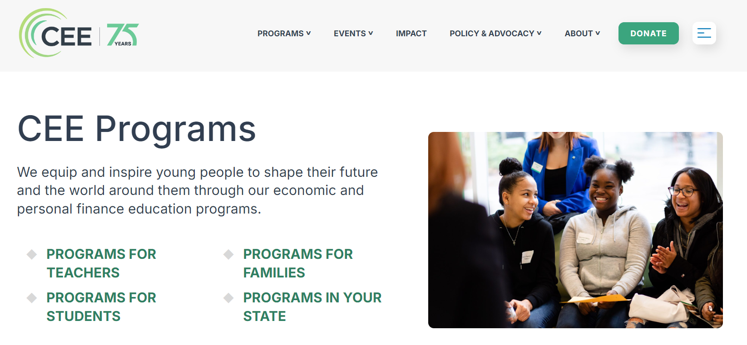

Slide 34


Thank you

Slide 35
