Slide 1
Incentivizing Energy Conservation at Our School

Slide 2
What are some rewards and penalties you have received in your lives?

Slide 3
A reward that makes people better off or a penalty that makes people worse off.
Incentives are used to influence people’s behavior and choices.
Incentive

Slide 4
Why did you receive that reward (or that penalty)?
How did the reward (or penalty) change your behavior?
Incentive
Think about the reward or penalty you shared with your partner.

Slide 5
What is the best way to influence people’s behavior so they conserve energy at our school?

Slide 6
What do you know about energy conservation?

Slide 7
Video - Conserving Non-Renewable Resources PBS Learning Media
https://dptv.pbslearningmedia.org/resource/ee18-sci-nonrenew/conserving-non-renewable-resources/
Notes:
https://dptv.pbslearningmedia.org/resource/ee18-sci-nonrenew/conserving-non-renewable-resources/

Slide 8
Think about what we saw in the video…
What are non-renewable resources?
What are some reasons that we should conserve energy?
What are some ways we can conserve energy the video showed?
What are some incentives for the people in the video to conserve energy?
What are some other ways you know of to conserve energy?

Slide 9
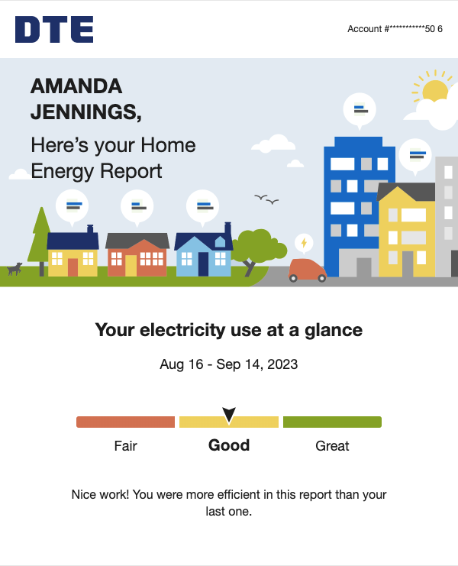
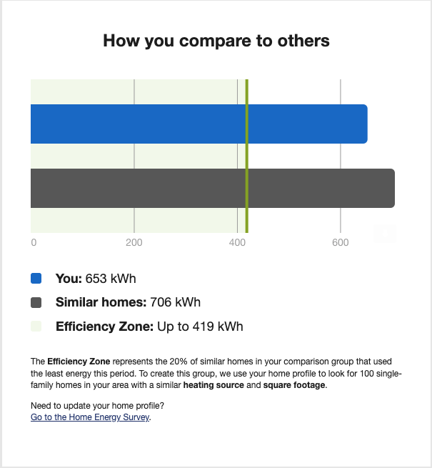
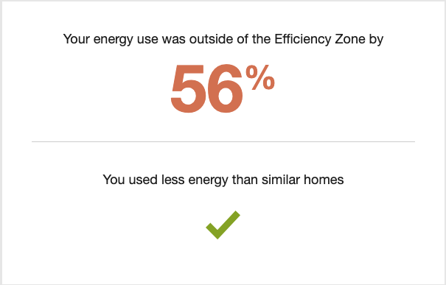
Source 1
What customer behavior is the energy company trying to influence?
How is the energy company trying to influence customer behavior?

Slide 10
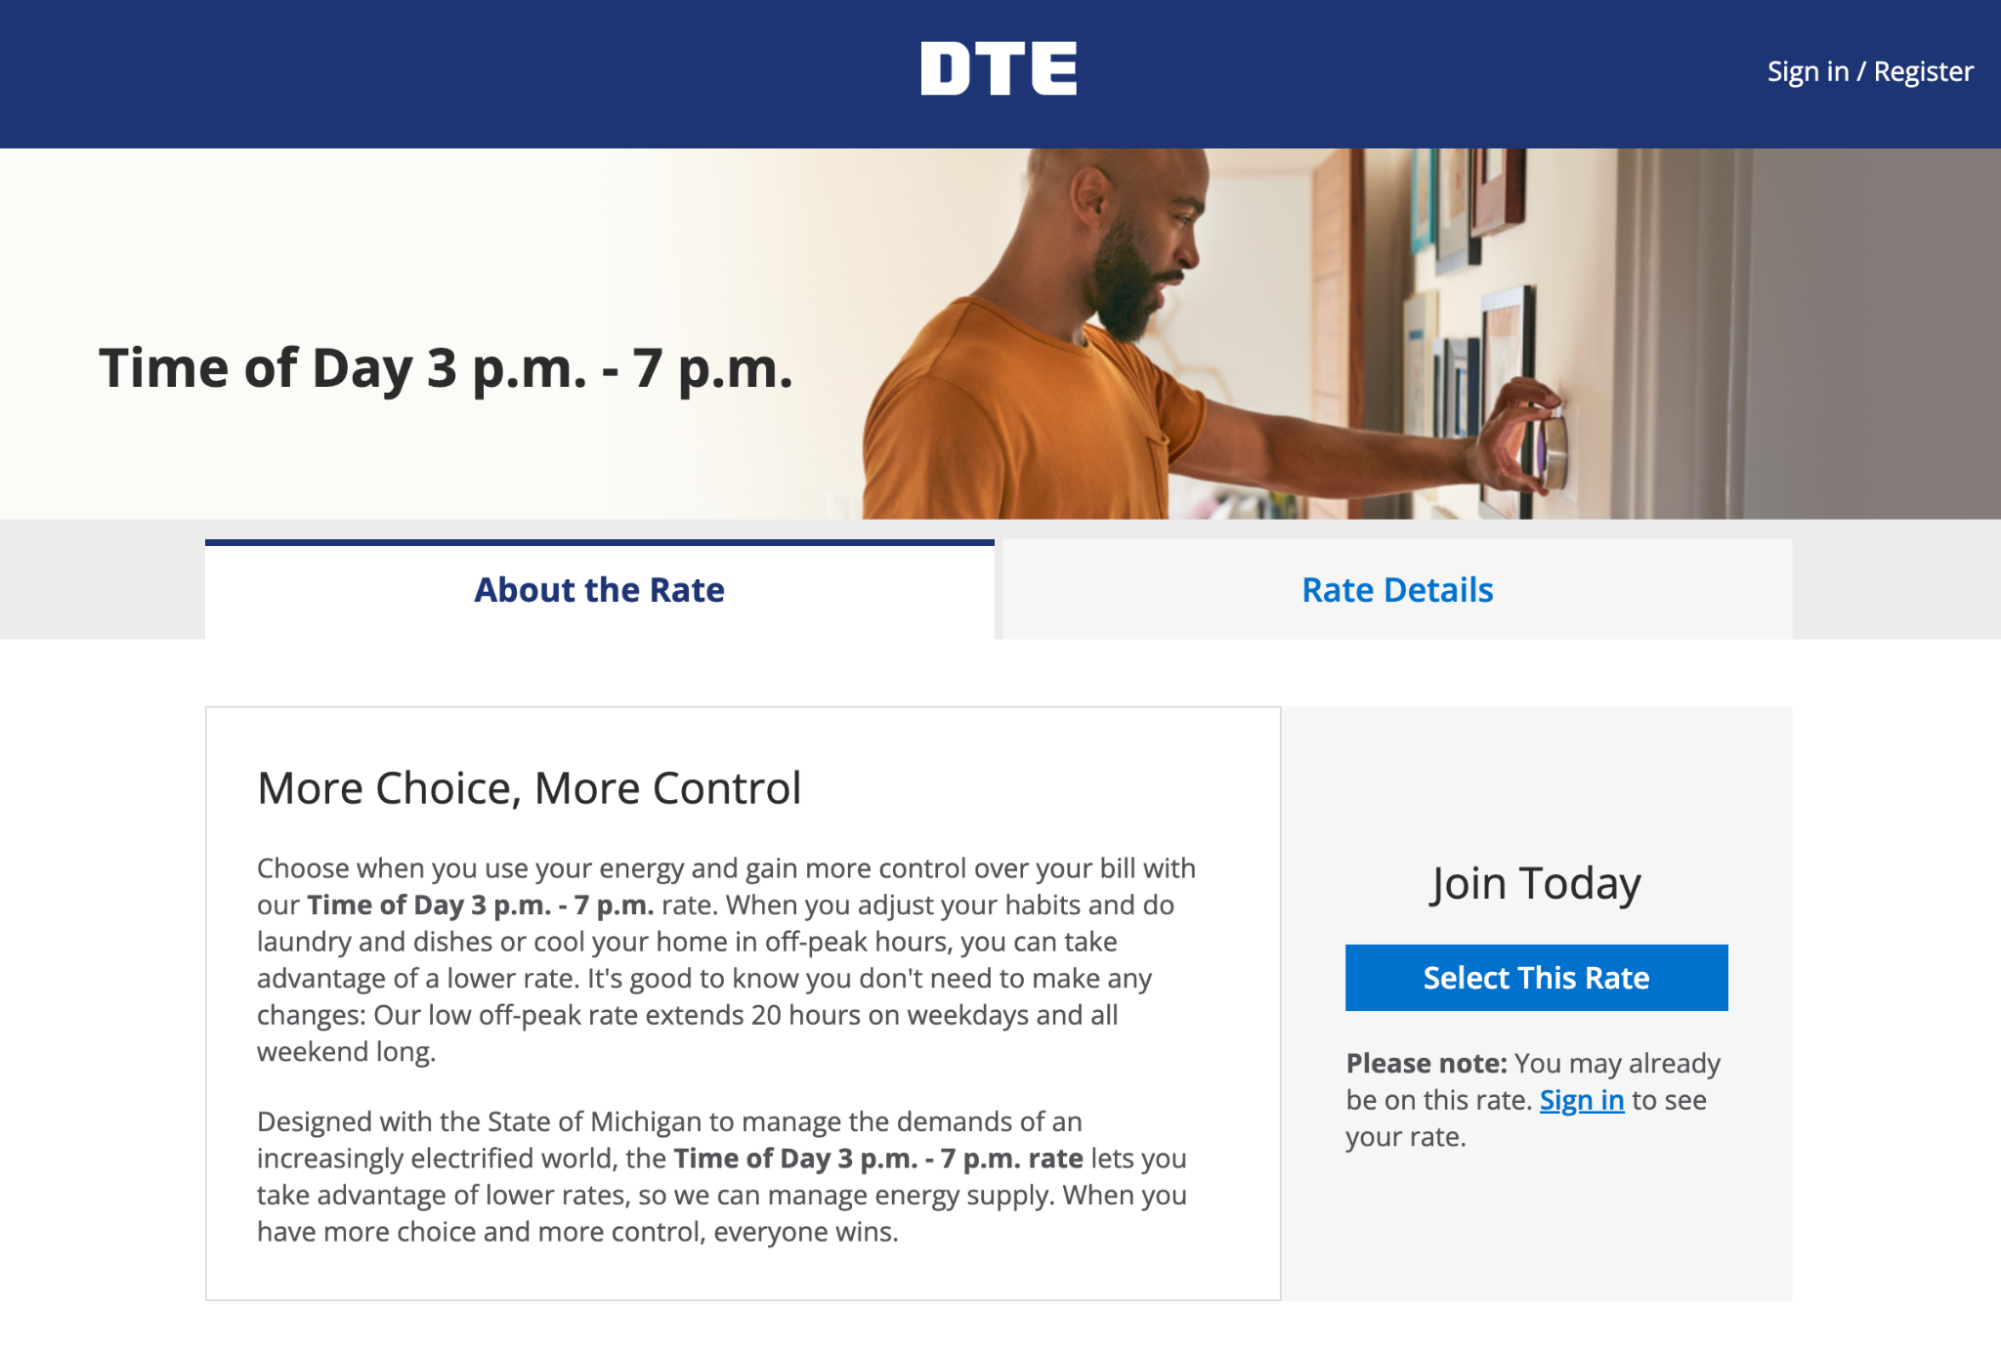
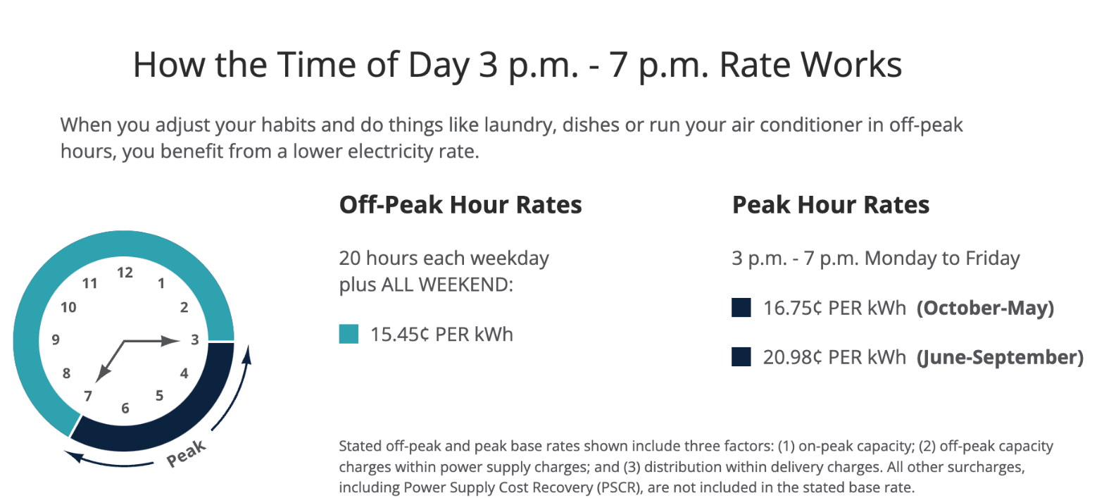
Source 2
What customer behavior is the energy company trying to influence?
How is the energy company trying to influence customer behavior?

Slide 11
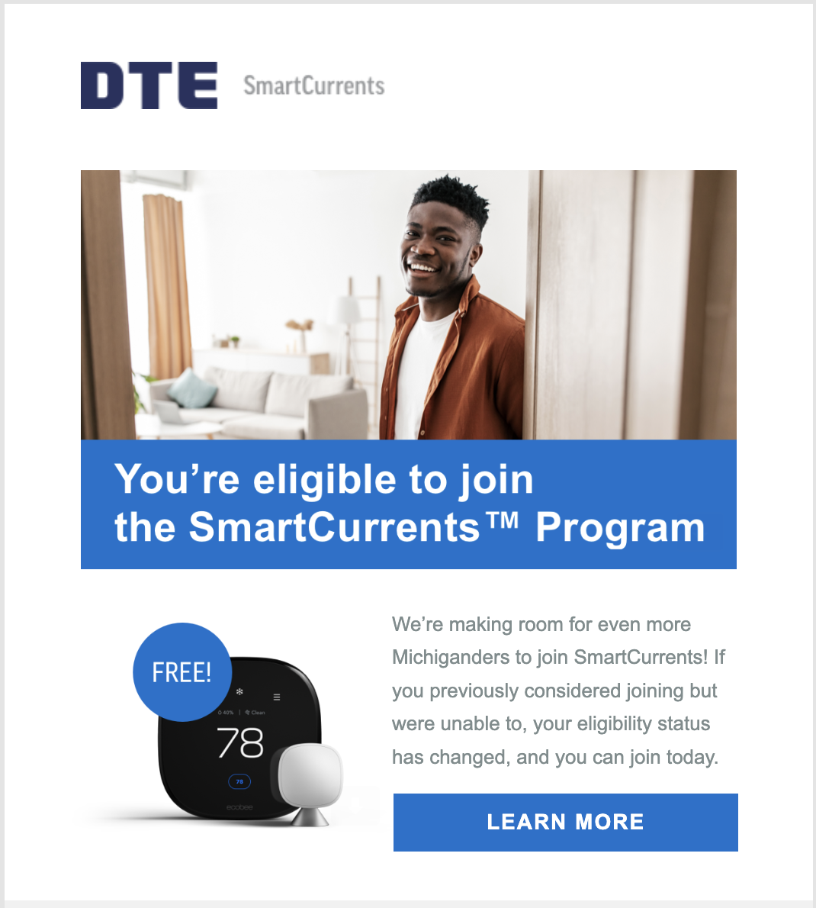
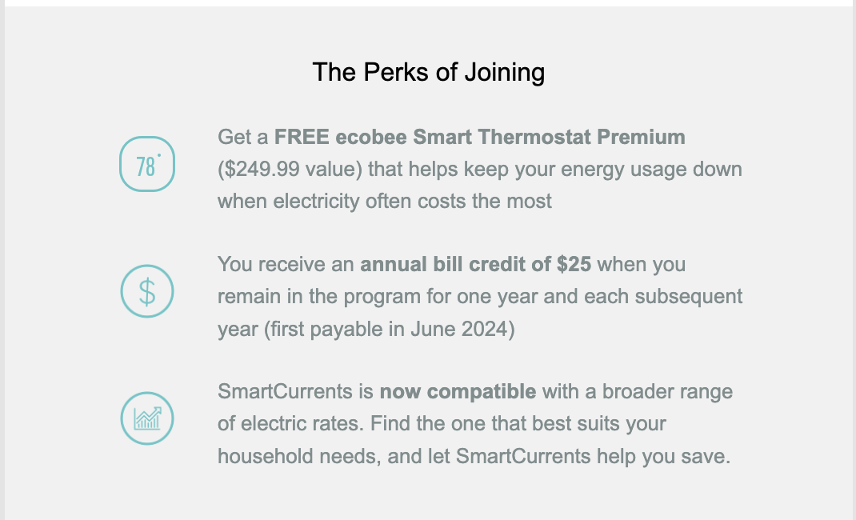
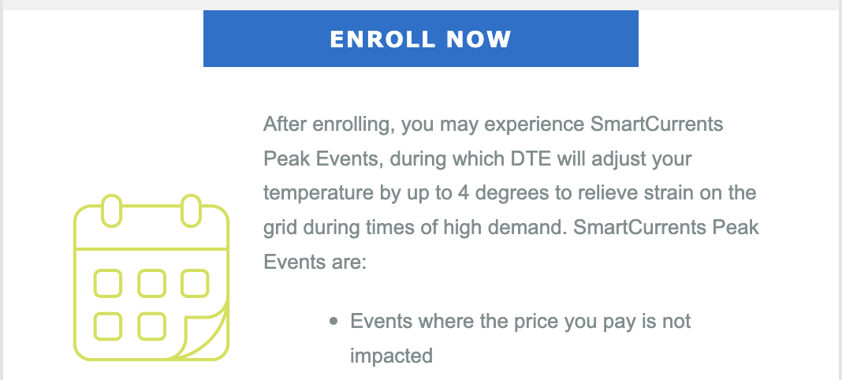
Source 3
What customer behavior is the energy company trying to influence?
How is the energy company trying to influence customer behavior?

Slide 12
Which incentives from Sources 1, 2 & 3 were monetary? Which were non-monetary?
Monetary or non-monetary?
Some incentives are monetary. Monetary incentives involve money.
Some are non-monetary and do not involve money.

Slide 13
Things favorable to a decision maker; rewards gained from an action/activity.
Benefits

Slide 14
What the decision maker must give up when making a choice.
Costs

Slide 15
For each incentive:
describe the incentive
categorize the incentive as positive, negative, monetary, or non-monetary
identify benefits and costs of each incentive
identify the incentive your group thinks is best and be prepared to say why you think so
Cost Benefit Analysis
Energy Conservation in Our Homes

Slide 16
Incentives
What incentive did your group select as most likely to influence customer behavior? Why?
Each of these incentives is offered by the same power company to the same customers. Why do you think they offer multiple incentives at the same time?

Slide 17
What is the best way to influence people’s behavior so they conserve energy at our school?

Slide 18
For each incentive:
Describe the incentive
Describe the behavior the incentive influences
Identify the incentive as positive or negative and monetary or nonmonetary
Influencing energy conservation
Create a poster that describes 2 different incentives to influence people to conserve energy at our school.

Slide 19
Closure
What are incentives?
What is an example of a positive incentive?
What is an example of a negative incentive?
What is an example of how an incentive has changed people’s choices or behaviors?

Slide 20
For each incentive:
describe the incentive
categorize the incentive as positive, negative, monetary, or non-monetary
identify benefits and costs of each incentive
identify the incentive(s) you think are best
Cost Benefit Analysis
Energy Conservation in Our School

Slide 21
Describe the incentive plan you selected as best- including what behavior you are trying to influence.
Categorize the incentive(s) as positive, negative, monetary, or non-monetary.
Use evidence from your cost/benefit analysis to describe why the plan you selected would be the best.
Assessment
Write an argument to answer our central question: What is the best way to influence people’s behavior so they conserve energy at our school?

