Slide 1
Presented by: Susanna Pierce McConnell
Email: Susanna.Pierce.McConnell@gmail.com Date: December 12, 2024
Professional Development
Can’t Stop the Music! Adding AI and Music Into Your Classroom

Slide 2
EconEdLink Membership
You can now access CEE’s professional development webinars directly on EconEdLink.org! To receive these new professional development benefits, become an EconEdLink member. As a member, you will now be able to:
Automatically receive a professional development certificate via e-mail within 24 hours after viewing any webinar for a minimum of 45 minutes
Register for upcoming webinars with a simple one-click process
Easily download presentations, lesson plan materials and activities for each webinar
Search and view all webinars at your convenience
Save webinars to your EconEdLink dashboard for easy access to the event
Access our new Professional Development page here

Slide 3
Professional Development Opportunities
To earn professional development credit for CEE webinars found on EconEdLink, you must:
Watch a minimum of 45-minutes and you will automatically receive a professional development certificate via e-mail within 24 hours.
Attendees can learn how much credit they will earn per workshop.
Accessing resources:
You can now easily download presentations, lesson plan materials, and activities for each webinar from EconEdLink.org/professional-development/
Local resources:
Insert your local professional development opportunities (if applicable)

Slide 4
About Me
Susanna McConnell
AP Microeconomics Teacher, Master Teacher Susanna Pierce McConnell is a curriculum consultant, Master teacher for the Council of Economics Education and the Foundation for Economic Education, and an AP Economics at Westlake High School. She strives to make teaching and learning meaningful for teachers and students. In her past 15 years in education, she has taught social studies in the US and abroad, participated in Harvard’s Globalizing the Classroom Fellowship, and has traveled with US teachers to schools in Japan and South Africa on two remarkable Study Tours. Susanna founded the Teacher Innovation Academy on her high school campus where she facilitated PD for 6 years for 30 educators who strive to share best practices through innovation. Susanna earned degrees in Spanish and International Economics and her Master of Arts in Teaching from Trinity University in San Antonio. Her greatest joys are finding the many connections of economics to the real world, traveling, speaking Spanish, and spending time with her family.

Slide 5
Agenda
Participant Insights
Background: Technology in the Music Industry
Music Industry Today with AI
Classroom Integration
Pedagogy: Teaching AI in the Music Industry
Curriculum: Using AI Music Tools
Reflect + Q + A
Notes:
https://docs.google.com/presentation/d/1uOvxfccWRSrdDm0rMbj2G1-W7RxWbXkIo6-omf9_vCg/edit?usp=sharing

Slide 6
Objectives
Participants will:
understand the economic implications of AI’s growing role in the music industry.
discover digital media that can facilitate student learning about music and AI.
learn ways to integrate AI music tools in the classroom.
reflect on the implementation into their own classroom.

Slide 7
National Standards
Standard 4: Incentives: People respond positively and negatively to incentives.
Standard 7: Markets and Prices: A market exists when buyers and sellers interact. This interaction determines market prices and thereby allocates scarce goods and services.
Standard 8: Role of Government - The role of government in regulating market activities.

Slide 8
Where do you teach + Who is your favorite artist or band?
Let’s Connect:
SEL
Add your response in the Chat box!

Slide 9
What do you know about AI in the music market?
Add your response in the Chat box!

Slide 10
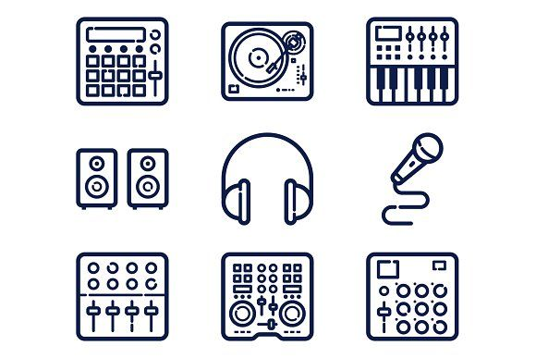
How have technological disruptions shaped the music industry through time? Background

Slide 11
Background: Technology Disruptions
Phonograph
Shift from live music to recording
Streaming
Monetization of user-generated content on YouTube
1970s-2000s
Today
1900s
2010s
Cassette, CD, MP3s
Rise of personal copying and Napster case
Tools generating music can mimic artists
Every technological advancement required new legal frameworks to protect creators.

Slide 12
Setting the Stage: Napster as a Precedent
Napster
Launched in 1999
Peer-to-peer file-sharing platform
Enabled free sharing and downloading
Impact:
Loss of revenue for artists and labels
Legal challenges: lawsuits for copyright infringement by Metallica, Dr. Dre
2001: Court order Napster to shut down
Lesson
Shift to digital distribution (ITunes, Spotify)
Precedents for copyright and compensation regulation

Slide 13
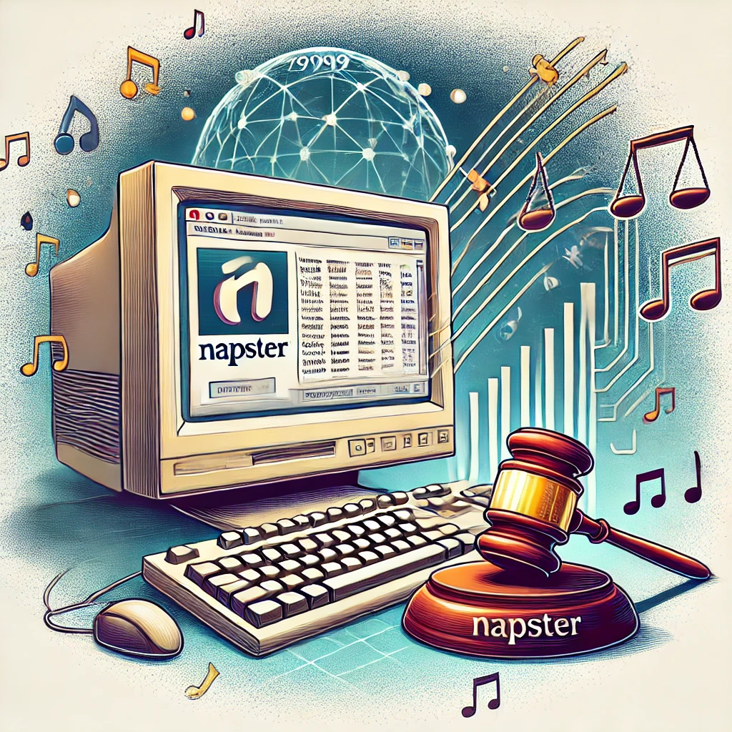
The Ongoing Transformation of Music

Slide 14
Trivia Updates: Present Day Updates

Slide 15
Poll: Which region in the world do you think had the largest recorded music revenue growth?
Asia
Europe
US
Latin America
Sub Saharan Africa

Slide 16
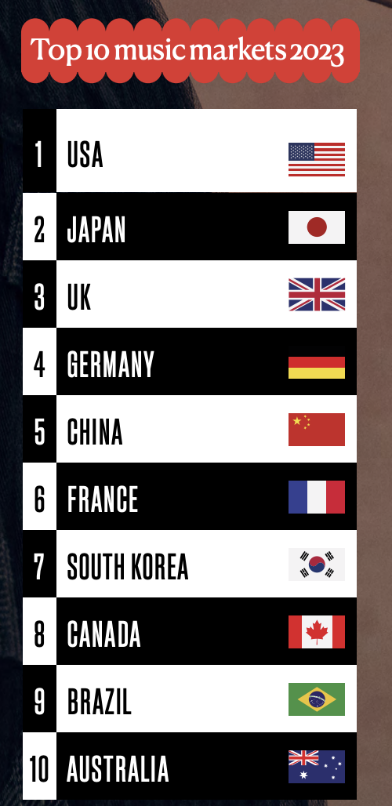
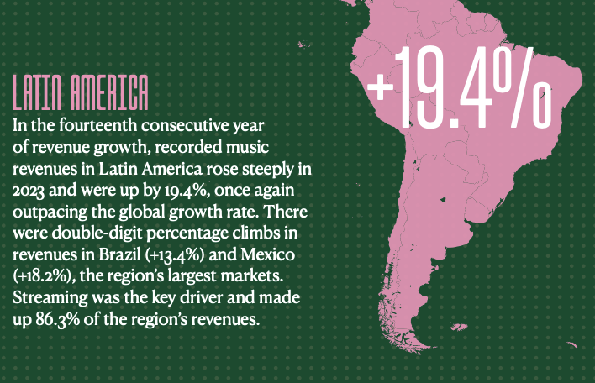
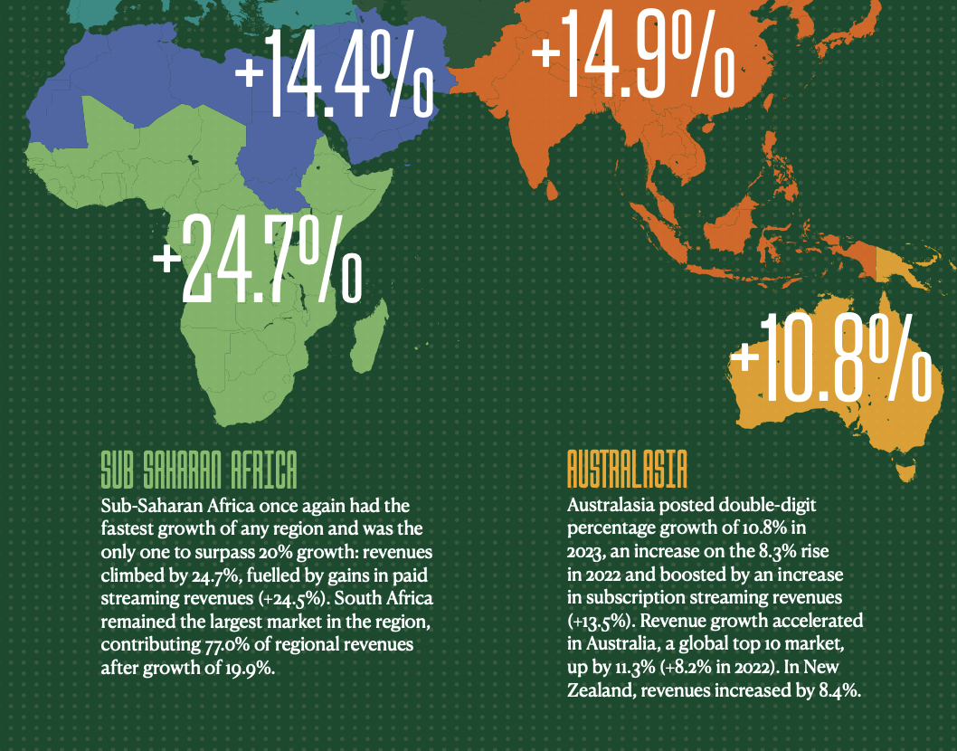
Current Updates in Music
Notes:
source IFPI data

Slide 17
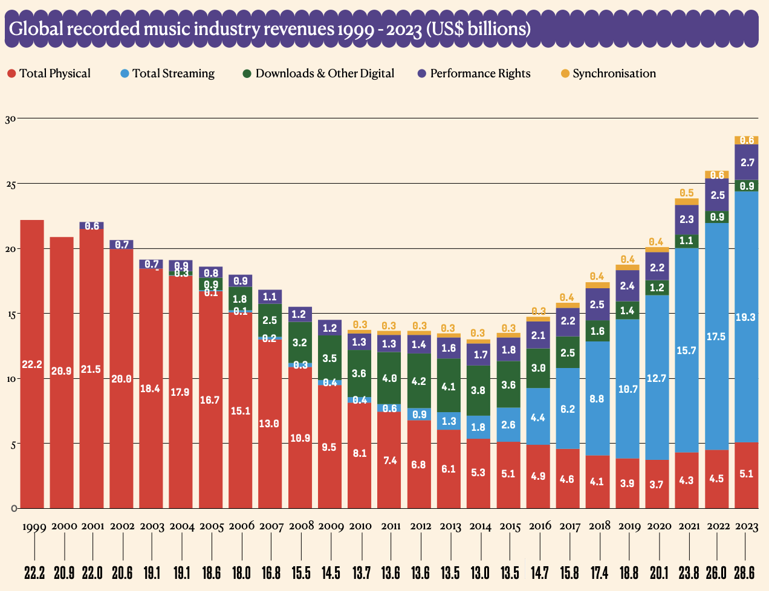
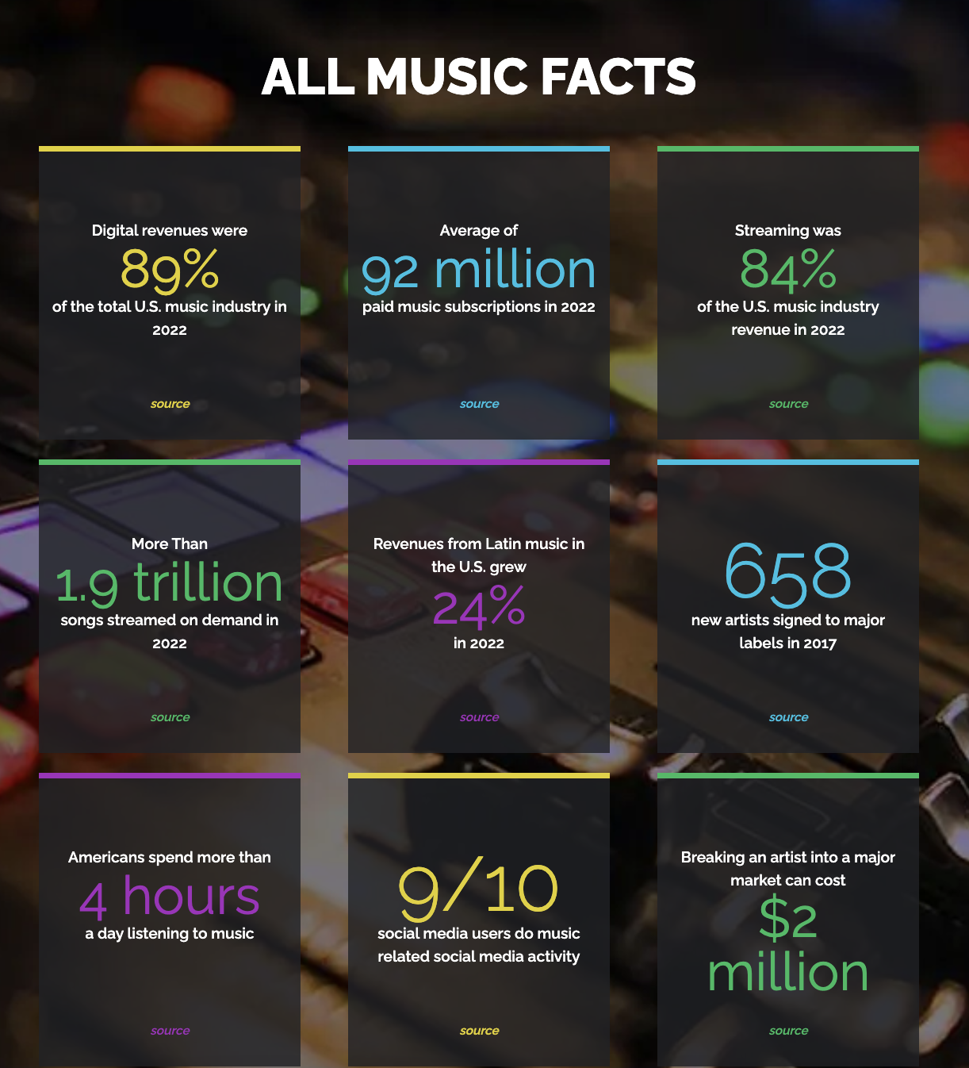
Update on the Music Industry
Notes:
How do these statistics reflect changes in consumer behavior?

Slide 18
Music Trends
Notes:
source IFPI data

Slide 19
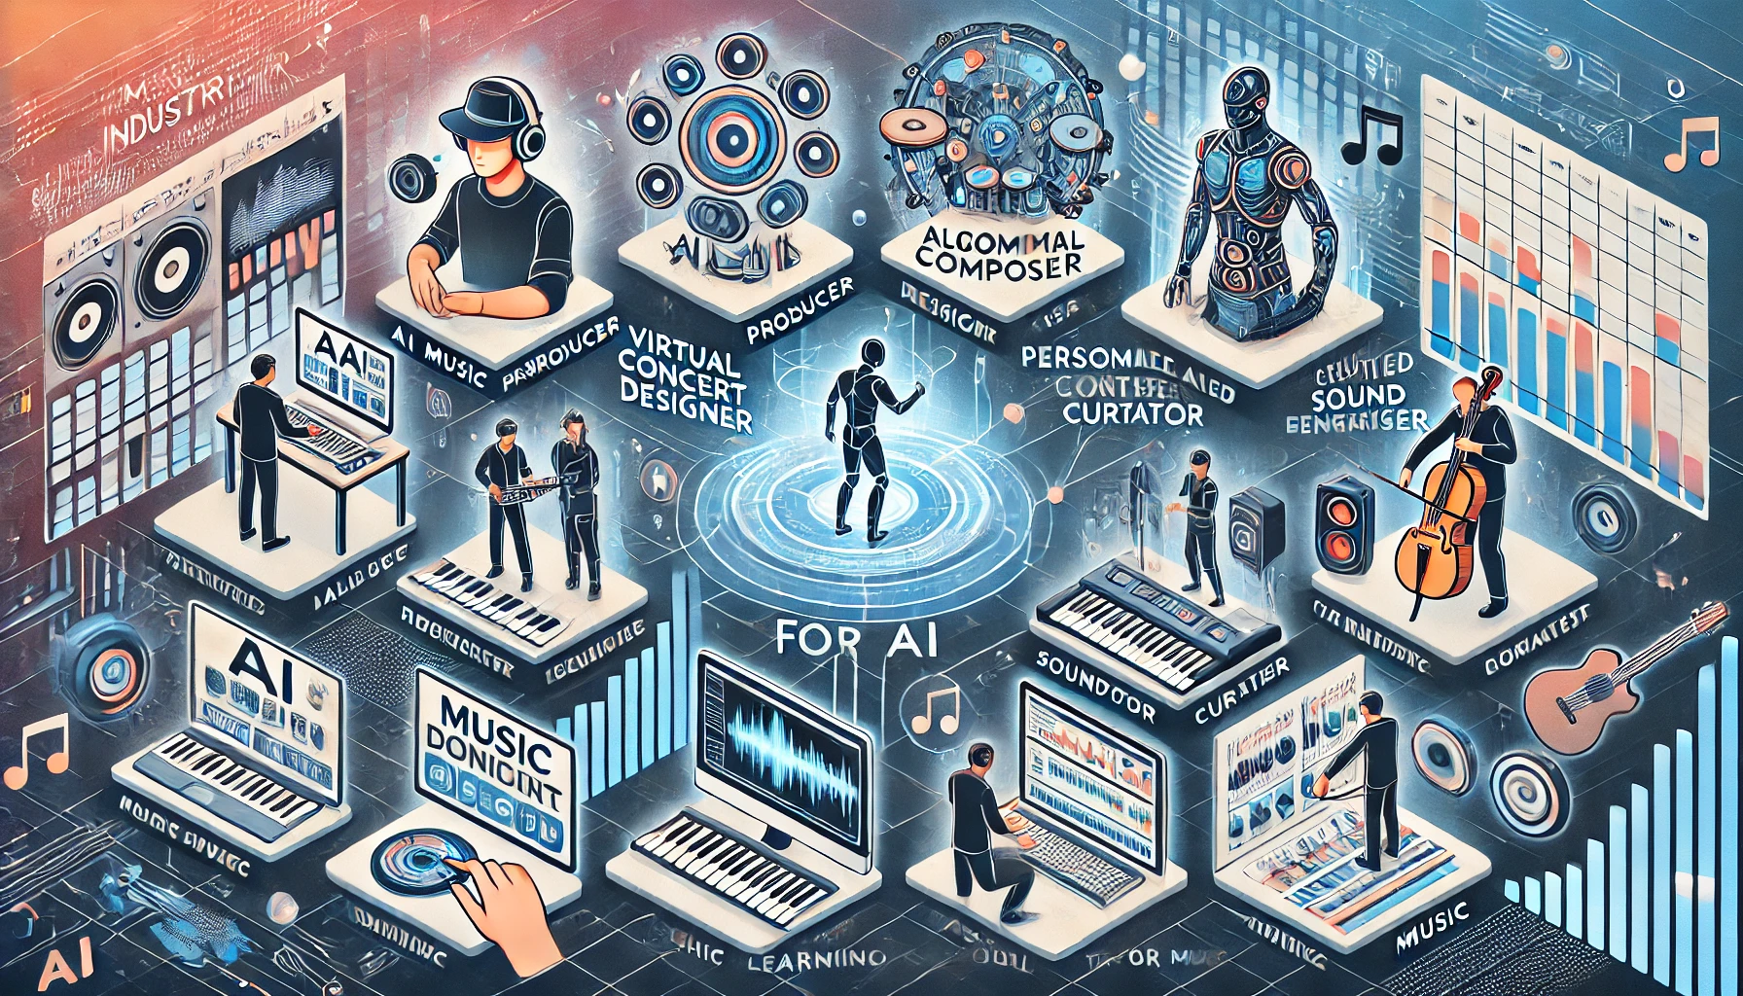
What opportunities is AI bringing the music industry? Benefits of AI

Slide 20
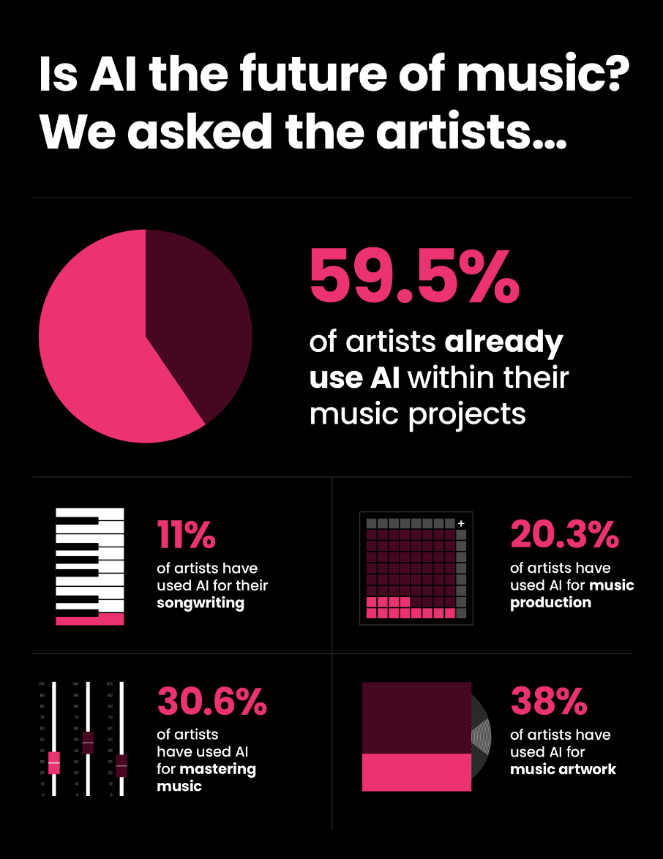
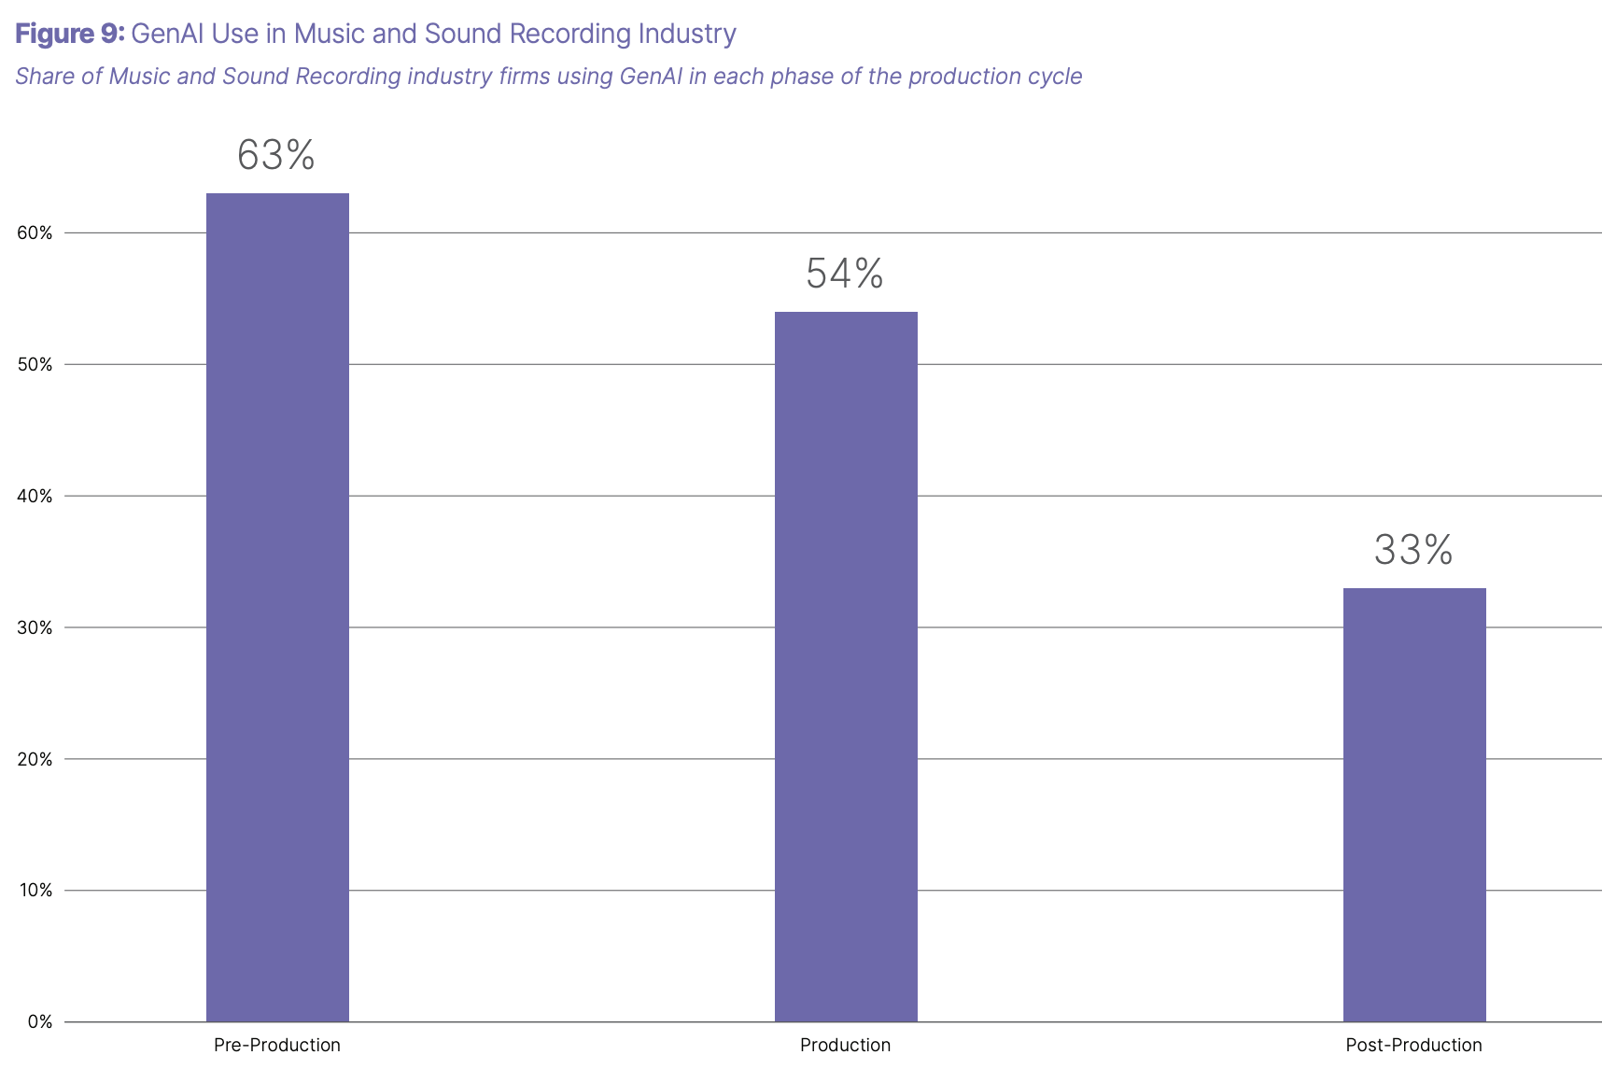
AI’s Benefits to the Market
Artists
Creation: cost of production decrease, variety increases
songwriting on AI
more textures and sounds
Production: efficiency increases with AI tools
time decreases
Distribution: can reach more fans by identifying audiences
Listeners:
Personalized listening
Market:
More competition in the market, “the deluge”

Slide 21
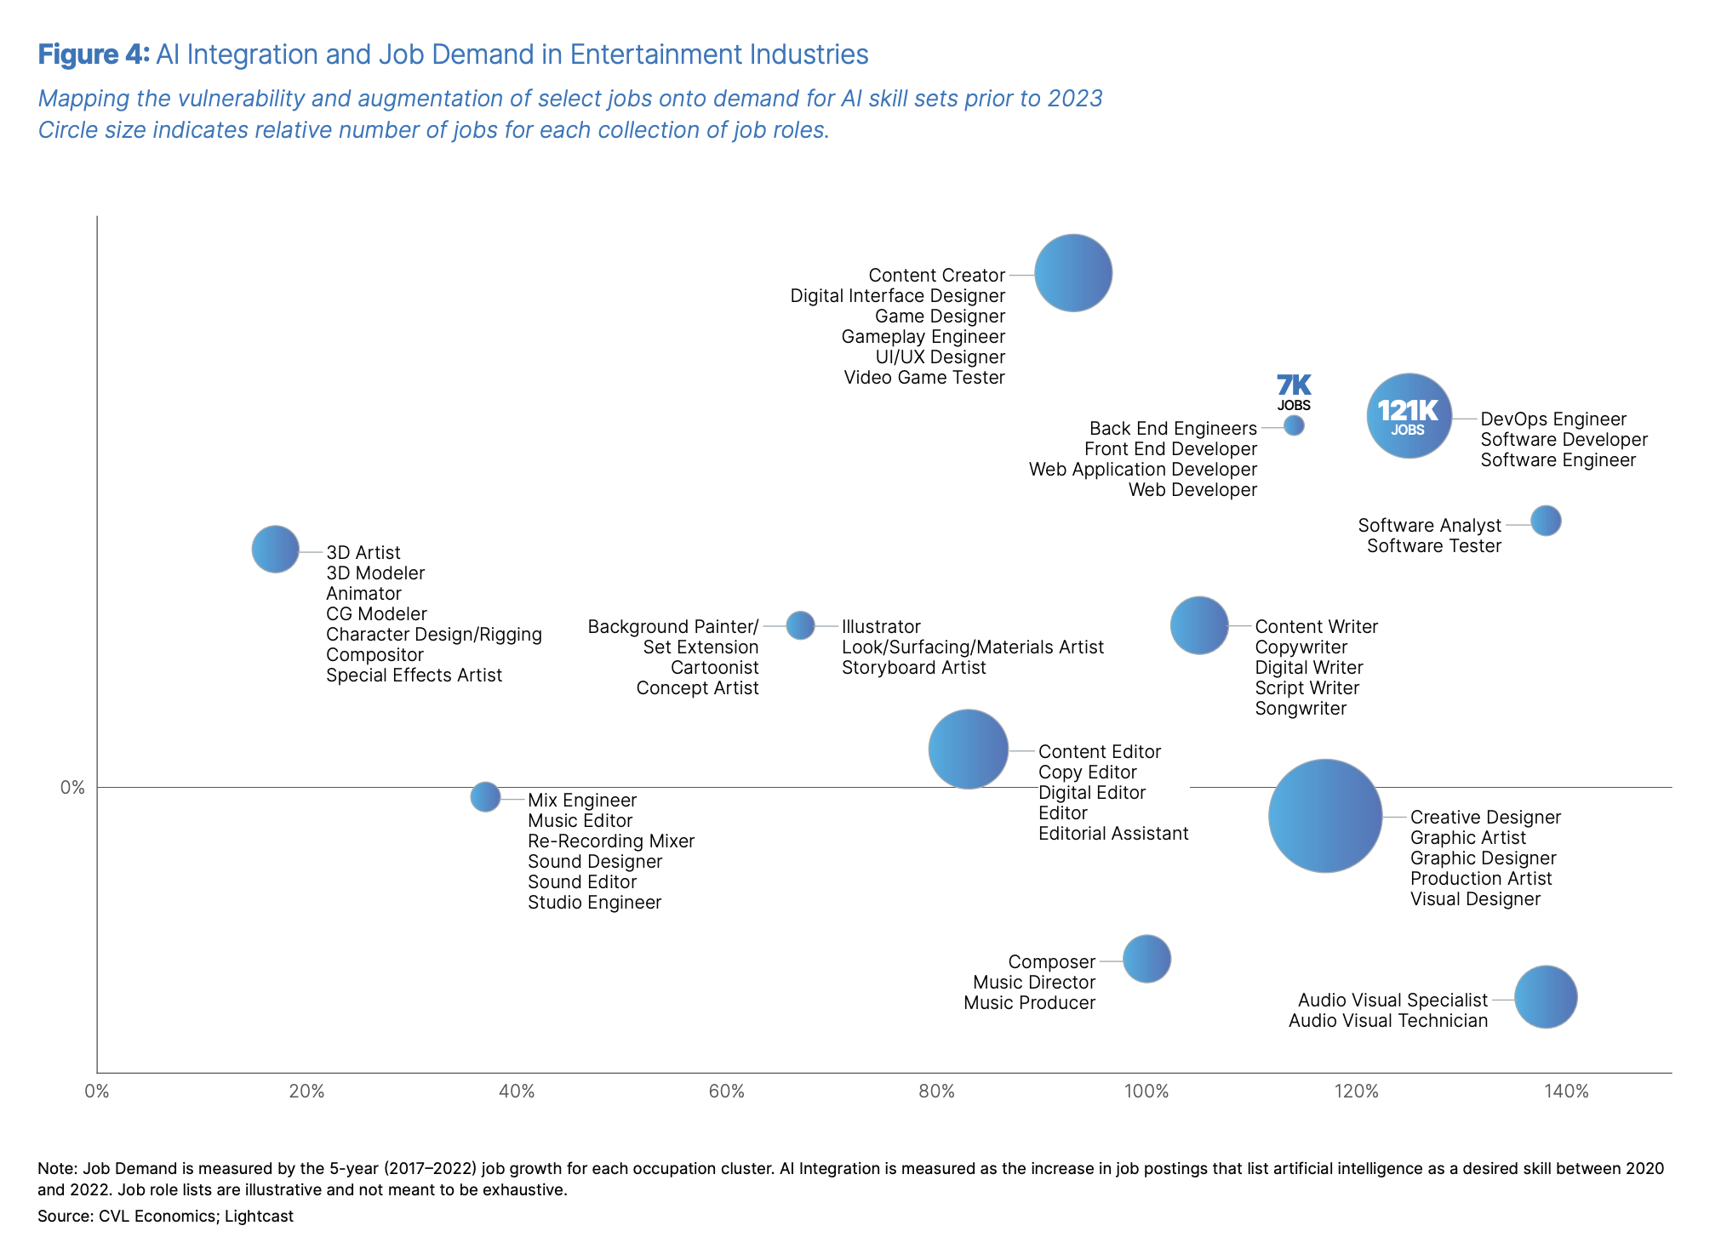
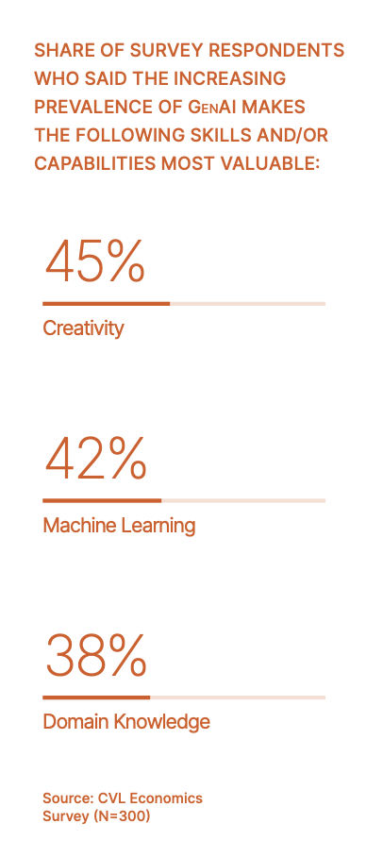
AI Job Demand and Usage
AI is reshaping job roles by increasing demand for AI-related skills while automating repetitive tasks.
augmentation vs. vulnerability
percentage demand increase for AI-related skill sets in the job roles.
Notes:
Pg. 19
Lower left (low AI demand): Jobs like 3D artists, animators, and CG modelers are less dependent on AI skill sets but might still see some automation or augmentation.
Upper right (high AI demand): Jobs like DevOps engineers, software developers, and software engineers require strong AI-related skill sets, with a significant number of jobs available (e.g., "121K jobs").
Middle (moderate AI demand): Jobs like content creators and digital interface designers fall in between, needing some AI skill sets but not as high as software roles.

Slide 22
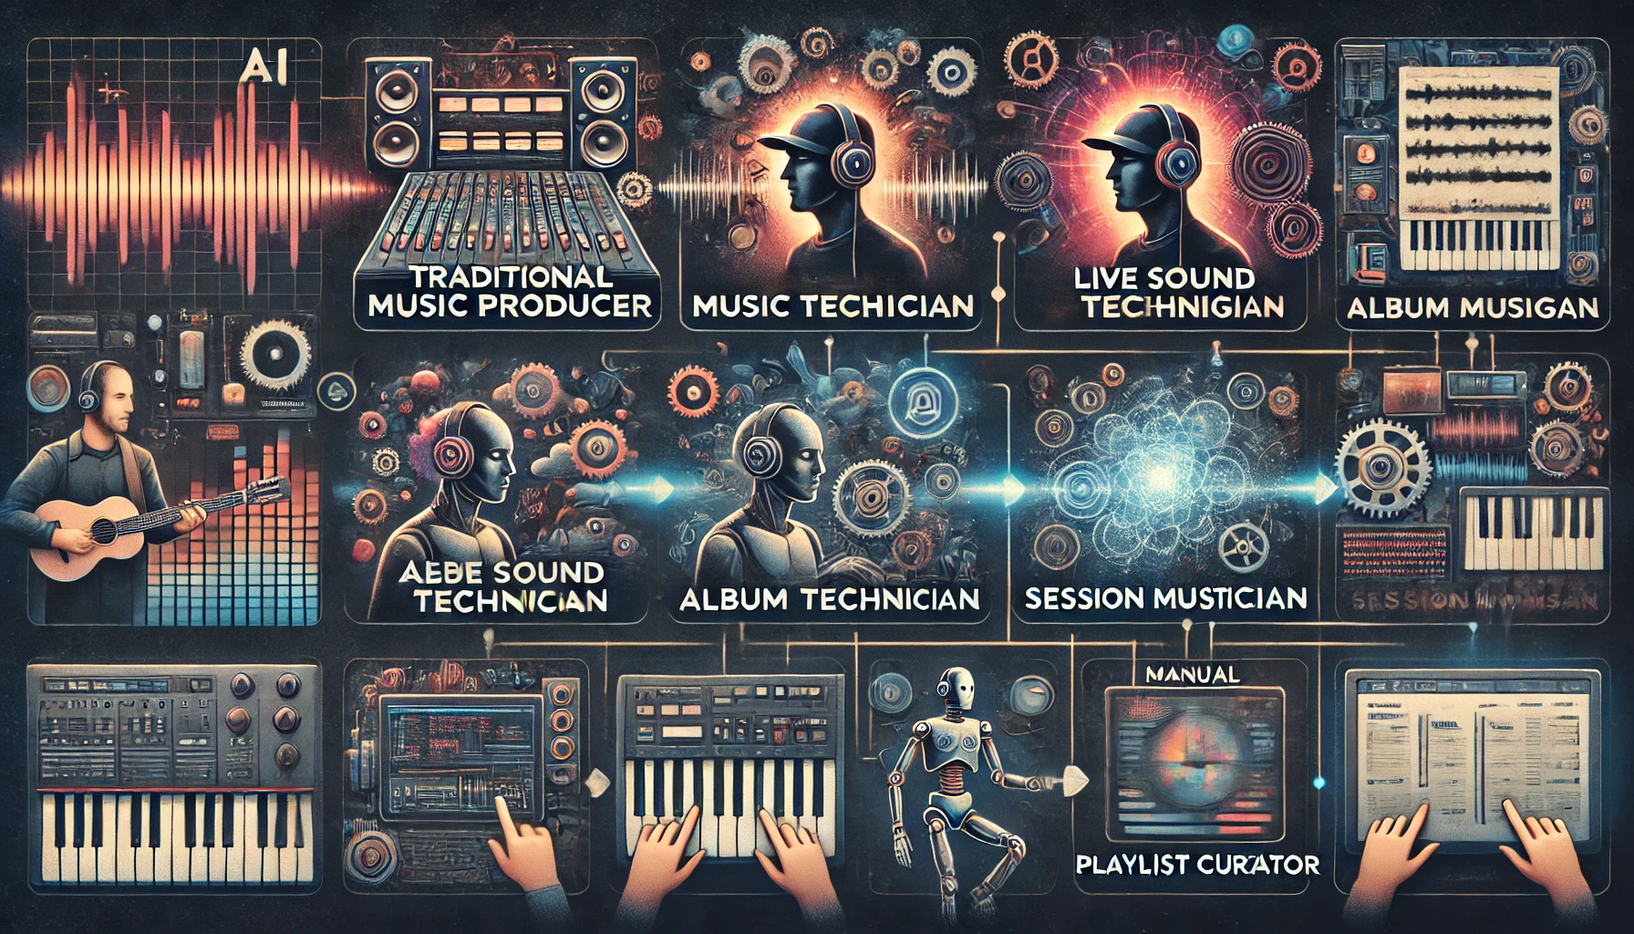
What challenges have arisen?
Challenges with AI

Slide 23
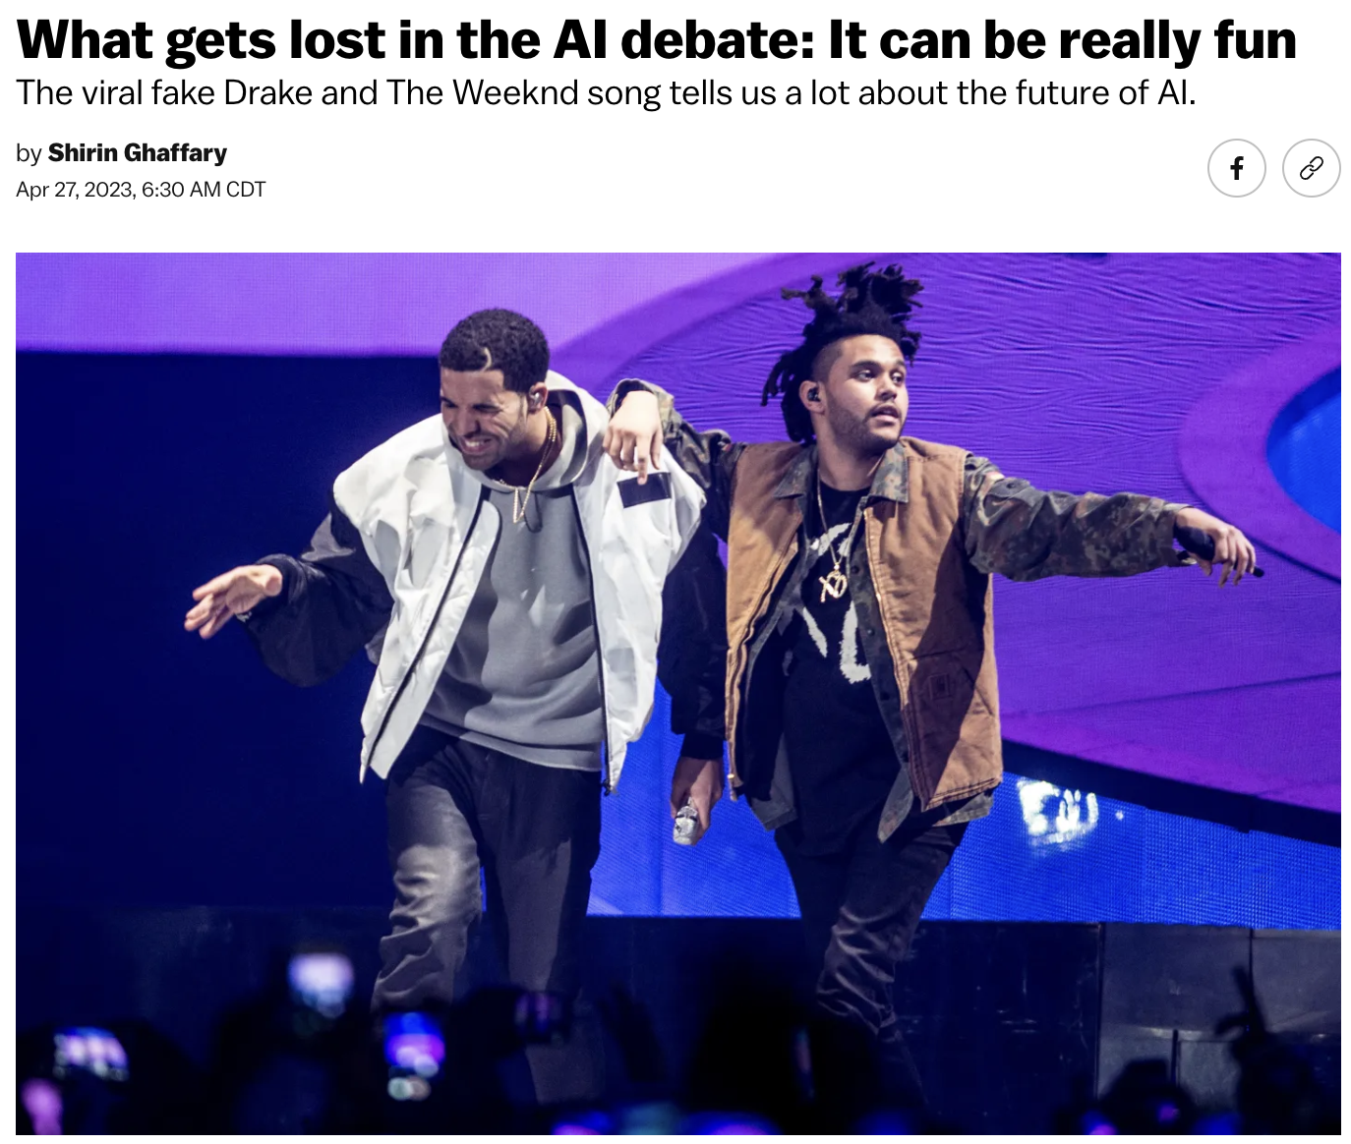
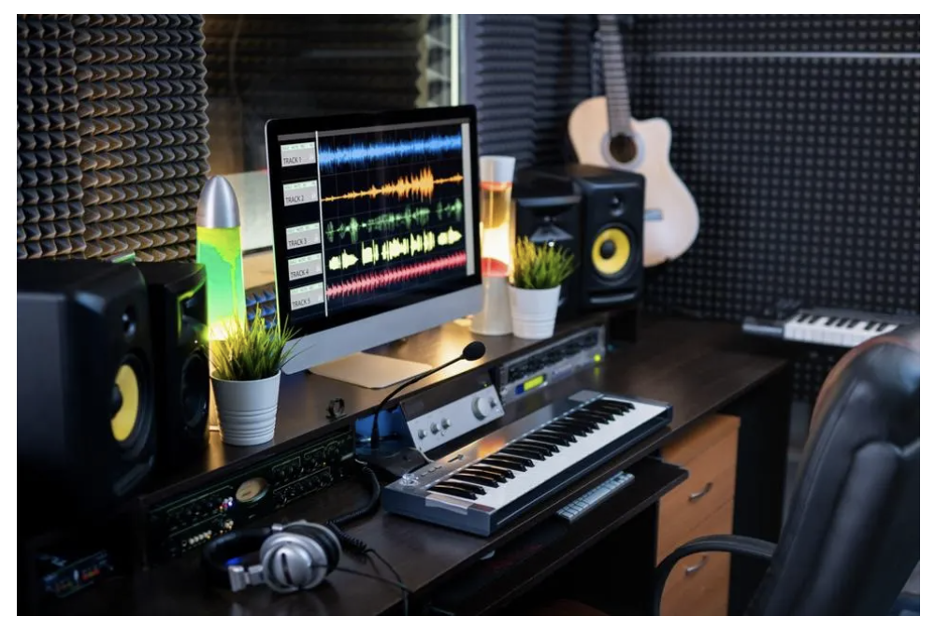
AI’s Challenges in the Market
Job losses
Copyright infringement
Authenticity of music
Artist compensation
Deep fakes

Slide 24
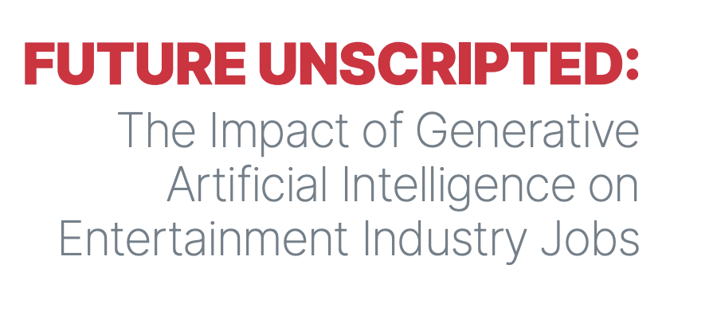
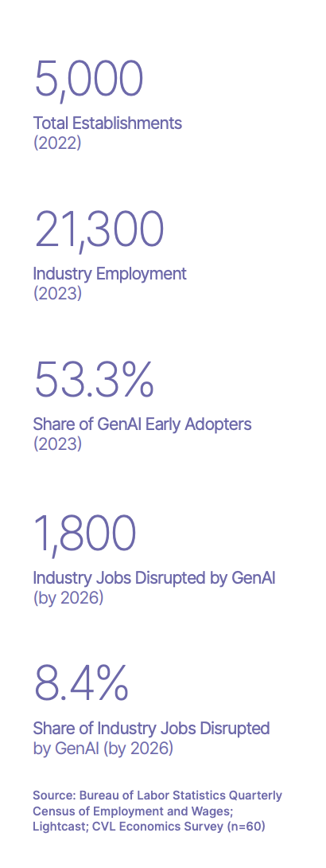
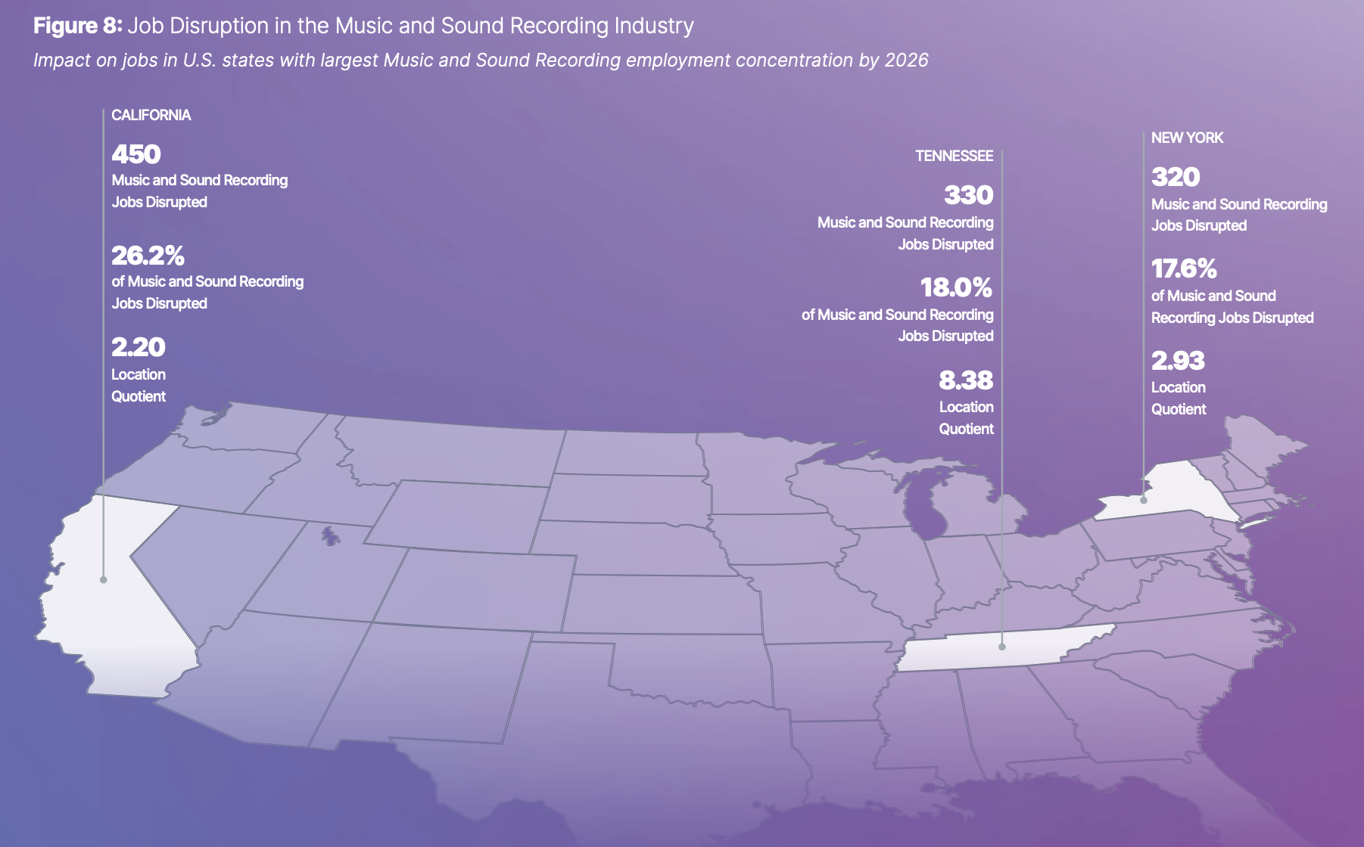
AI Job Impacts
Notes:
https://static1.squarespace.com/static/5ce331b47a39b9000198fffa/t/65b9314fd6198f70b0ec7402/1706635612414/Future+Unscripted+-+The+Impact+of+Generative+Artificial+Intelligence+on+Entertainment+Industry+Jobs+-+pages_compressed.pdf

Slide 25
What stands out to you?

Slide 26
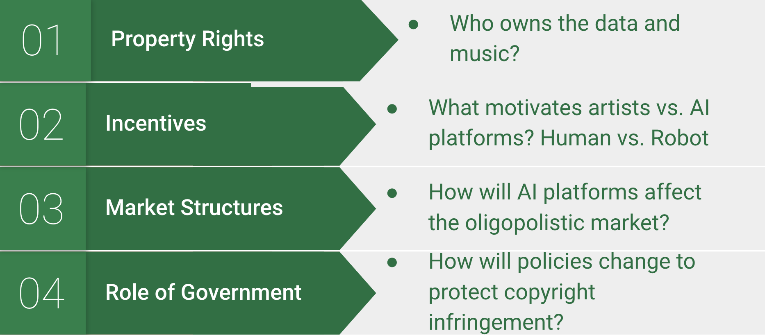
Classroom Integrations: How can you add this into your classroom?
Pedagogical and Curricular Integration

Slide 27
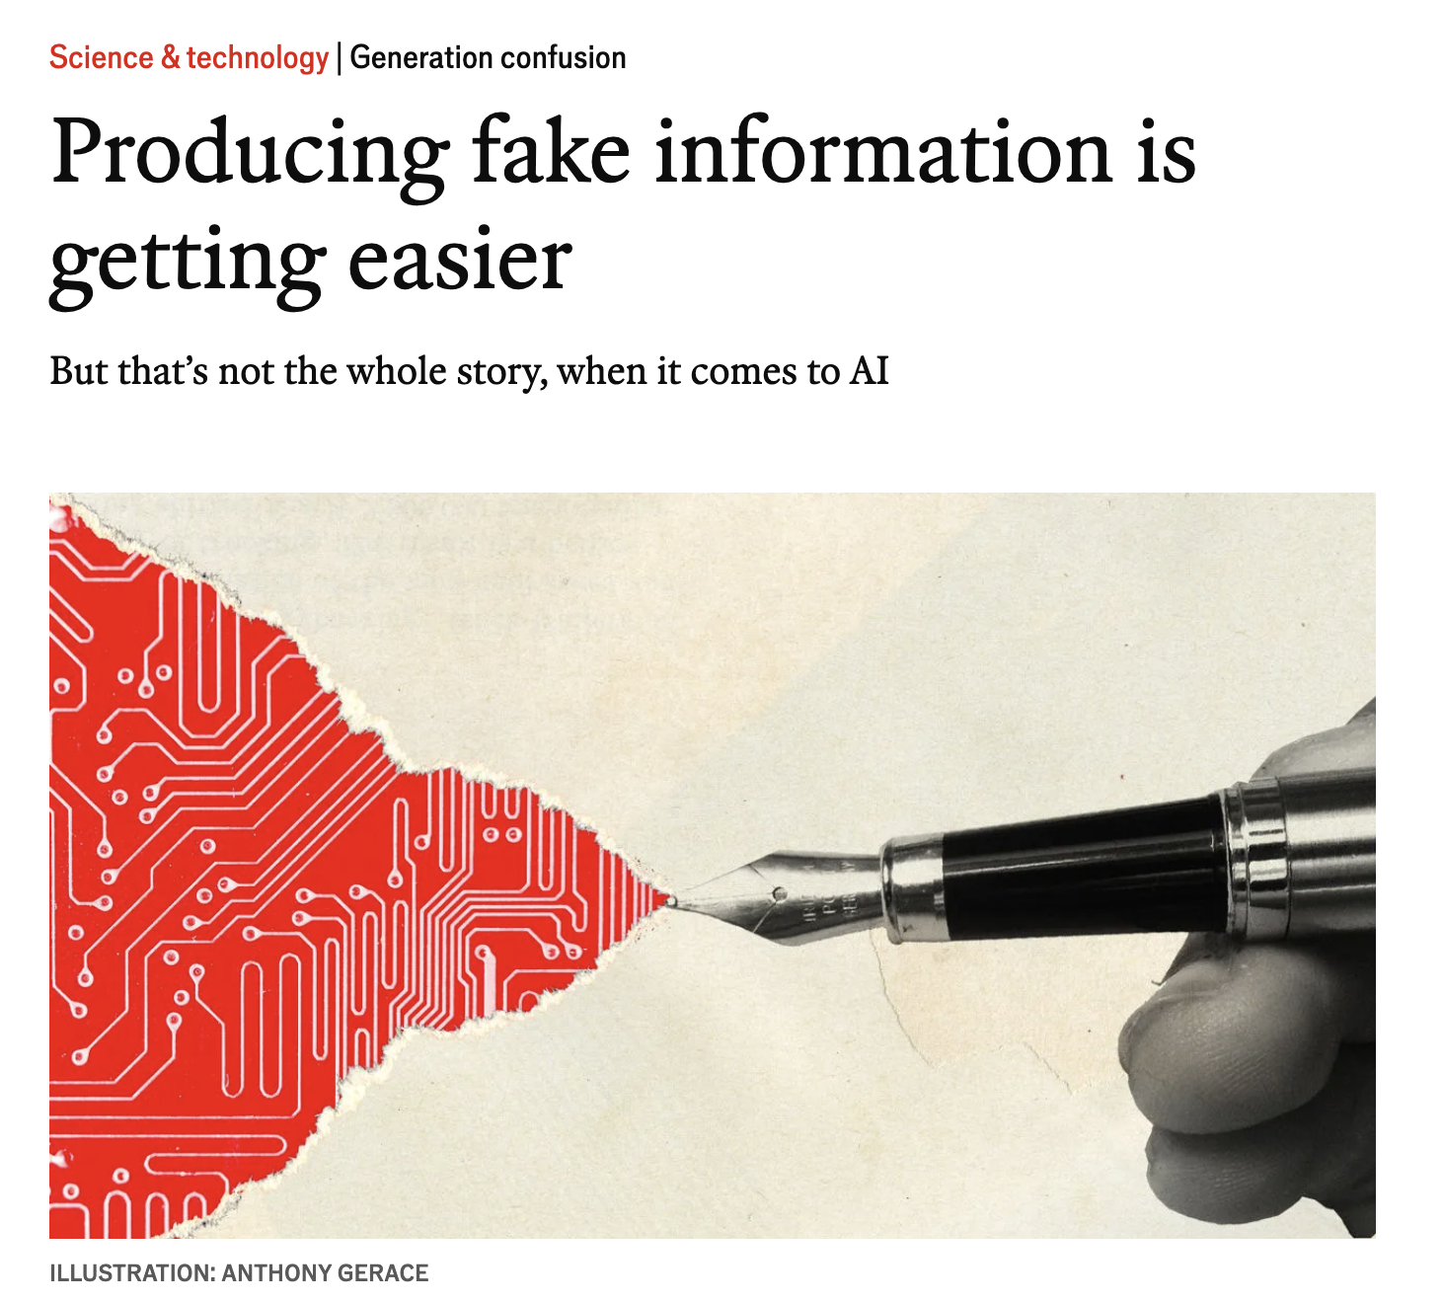
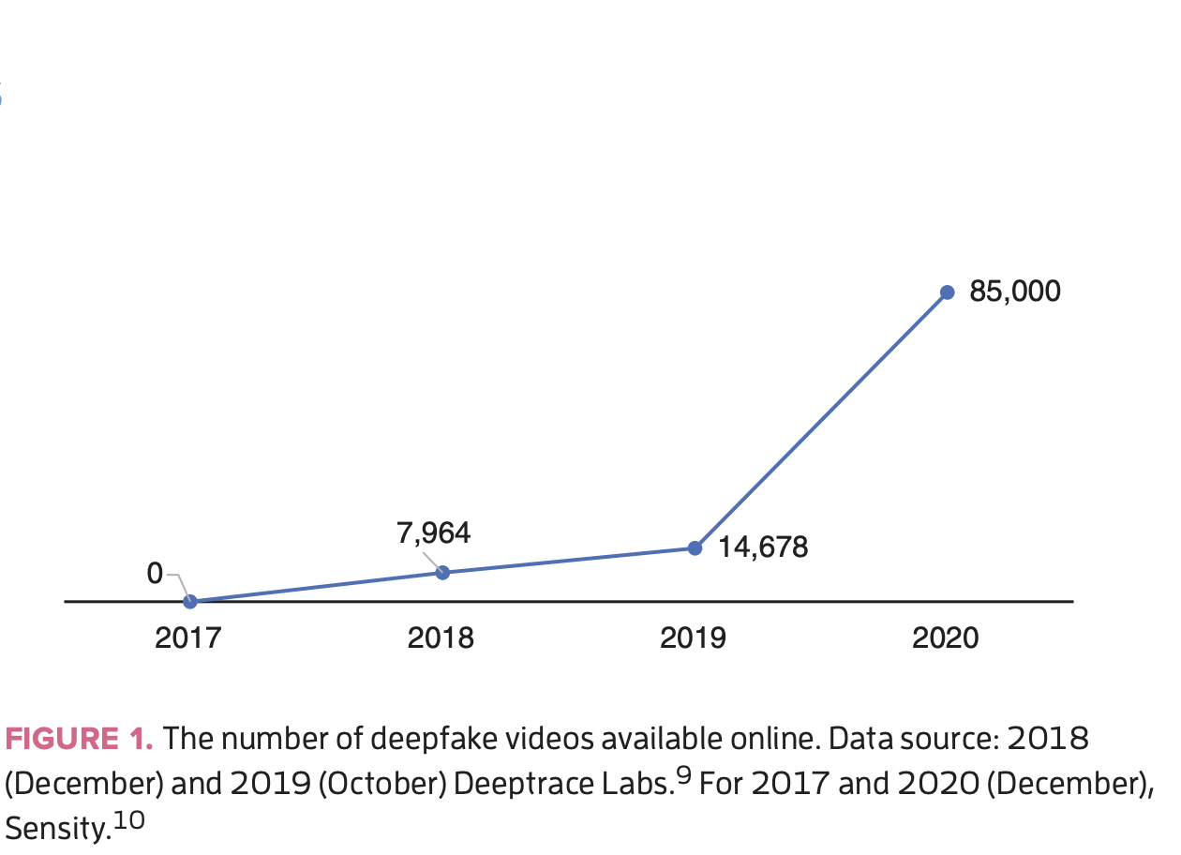
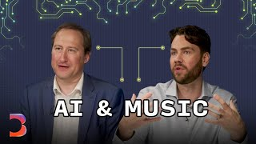
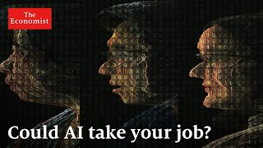
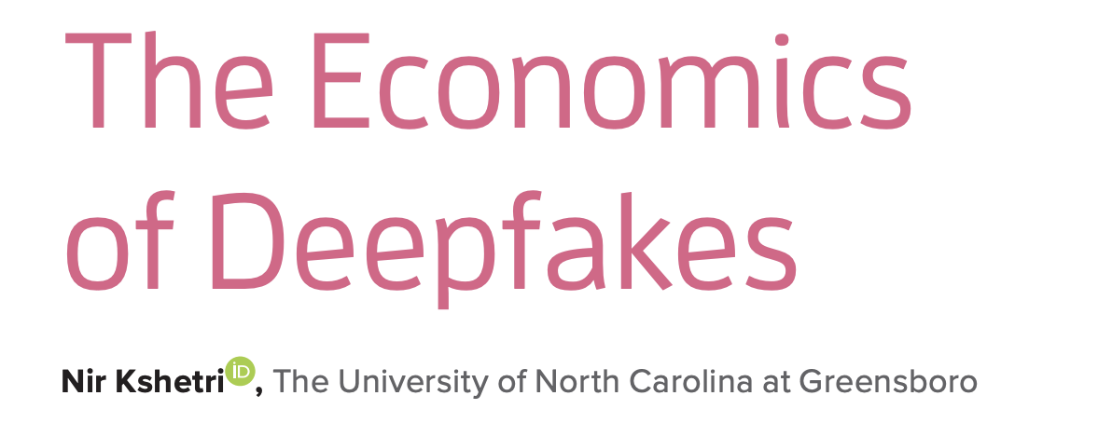
Relevant Media

Slide 28
Video: Deep Fakes in Music
What did you hear in the video?
So what impact does AI have on artists?
Now what do you think is the biggest challenge with AI in the music industry?
DURATION: 10 minutes

Slide 29
Video: Drake vs. Fake Drake
What is something significant you hear in the video?
What interesting connection can you make to economics?
What might be troubling about AI in the music industry?
DURATION: 10 minutes

Slide 30
4 Corners: AI in Music
List a statement on the screen.
Give students a minute to write the degree to which they agree with the statement.
Allow students the opportunity to move to the corner that matches their opinion.
"The rise of AI technology in music creates more costs than benefits for society."
DURATION: 15 minutes
Notes:
Deepfakes: the use of AI to create realistic audio or video content that mimics the voice or performance of a specific artist, often without their consent. This technology can generate new songs, alter existing recordings, or produce music videos that feature an artist's likeness, raising ethical and legal concerns about authenticity and copyright.

Slide 31
“The rise of AI technology in music creates more costs than benefits for society."
Strongly agree
Agree
Neutral
Disagree
Strongly Disagree

Slide 32
Curriculum: Podcast, Student Investigation and Group Product

Slide 33
Podcasts and Videos

Slide 34
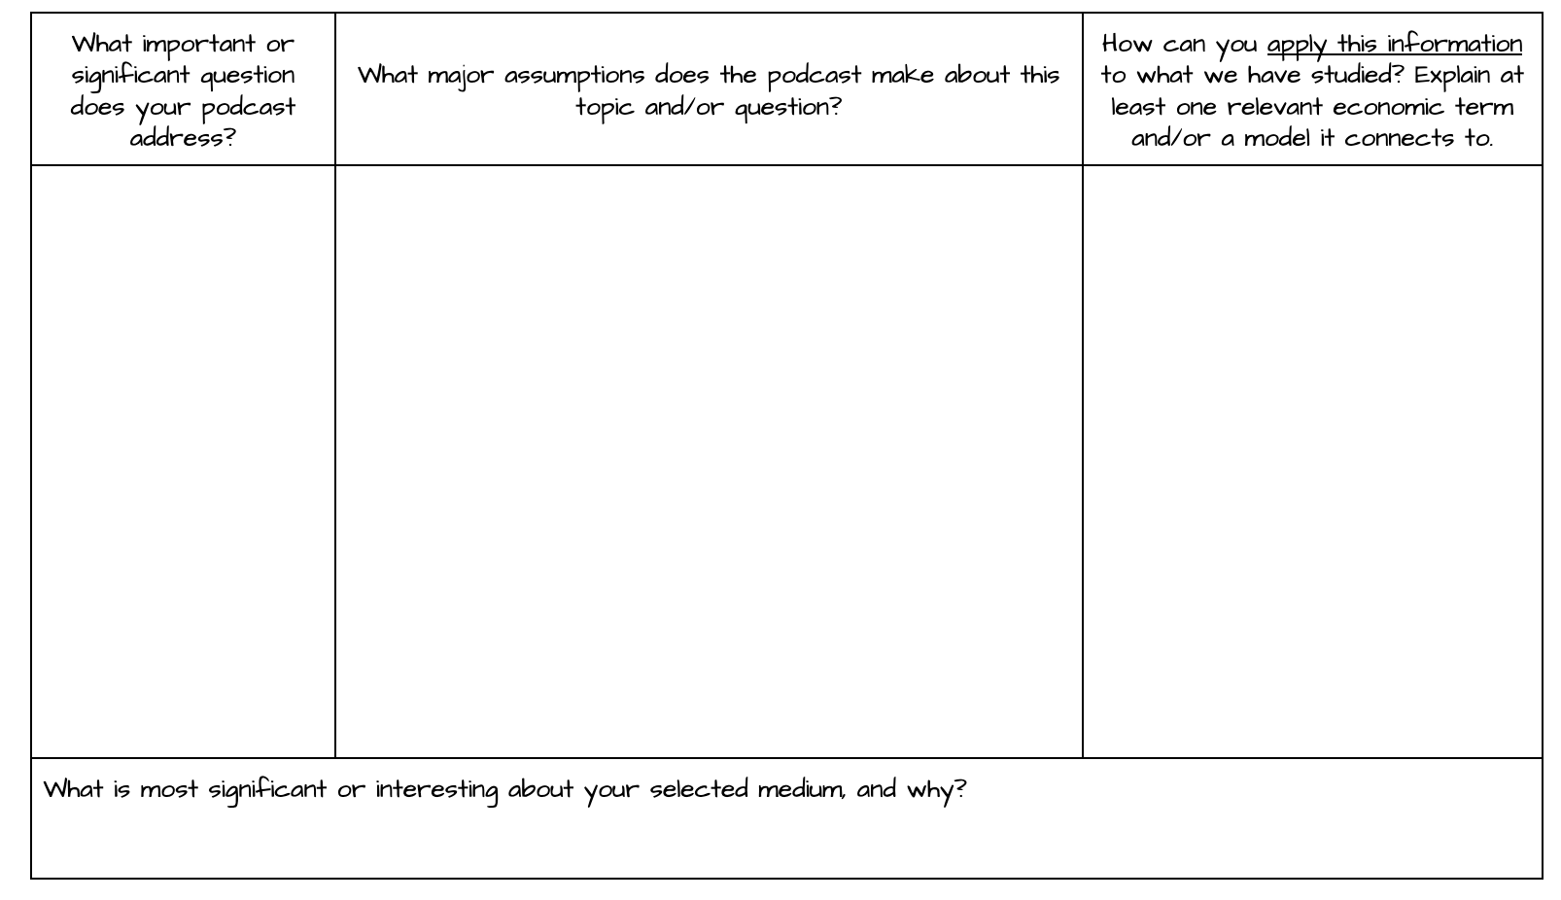
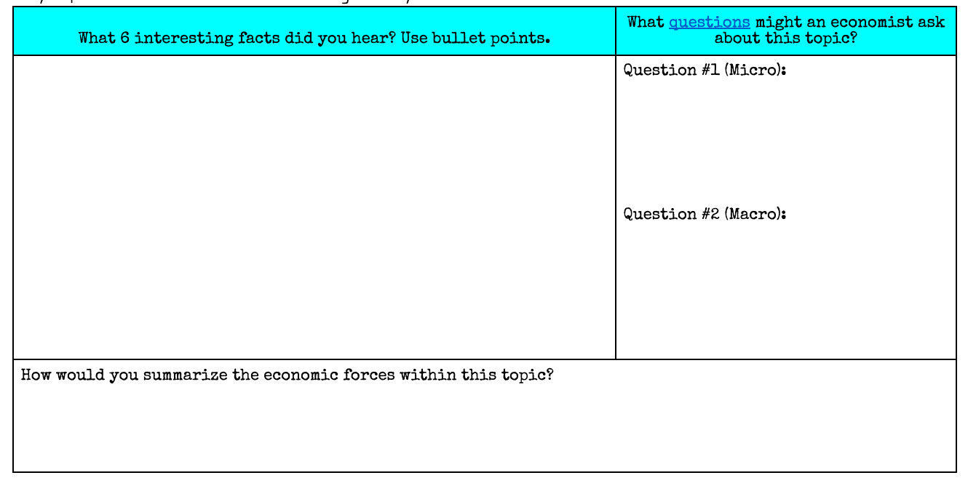
Podcast: AI and Music
Overview
Explain costs, revenue, and market structures.
Explain factors that might change costs, and barriers to entry in markets.
Post template to GC for students to take notes.
Let students listen and take notes.
DURATION: 30 - 45 minutes

Slide 35
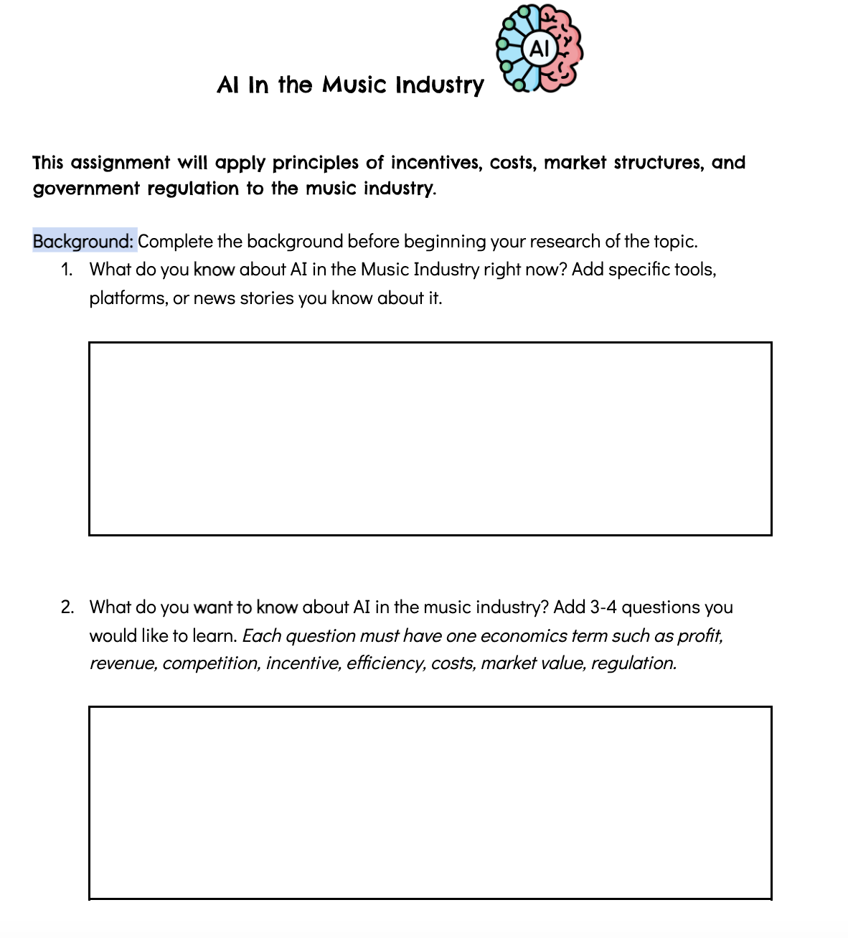
Student Investigation: AI and Music
Overview
Post the task to Google Classroom.
Explain the assignment.
Give time for students to complete the assignment in class (if not blocked) or at home.
*Disclaimer: Many of my students have access to ChatGPT on their phones.
DURATION: 35 - 45 minutes

Slide 36
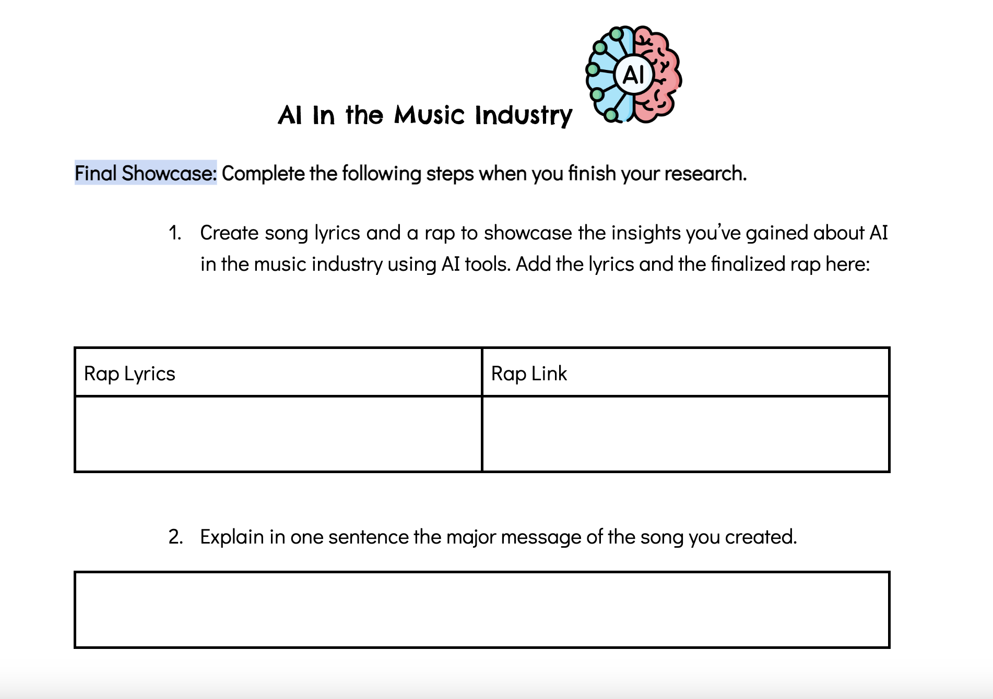
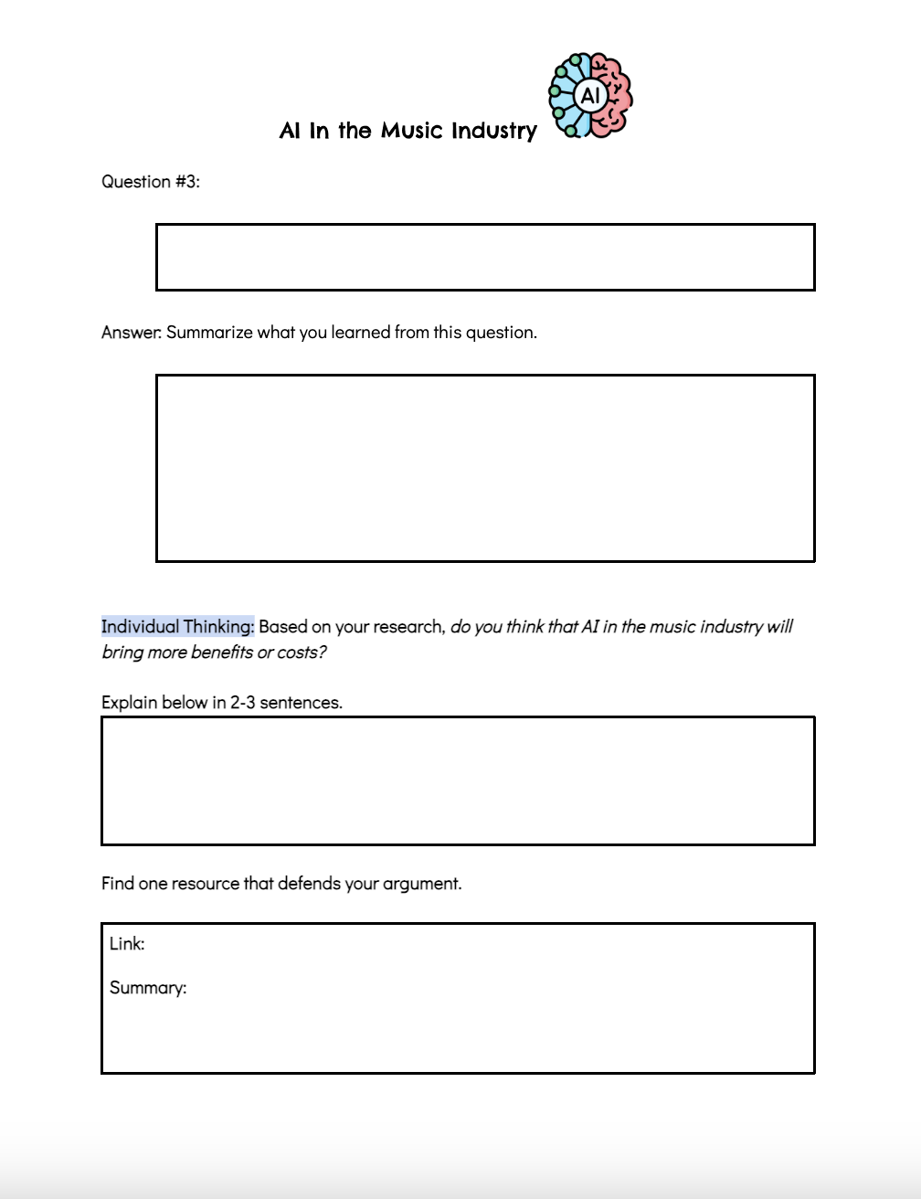
AI and Music Assignment

Slide 37
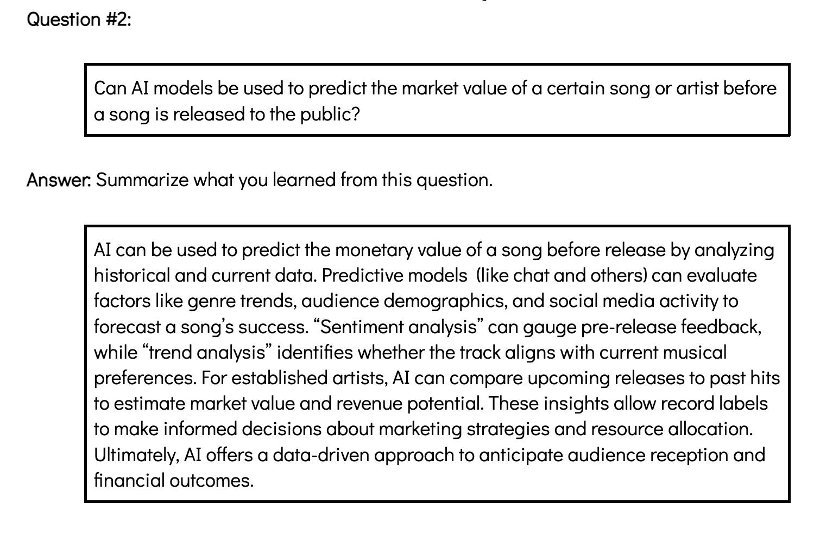
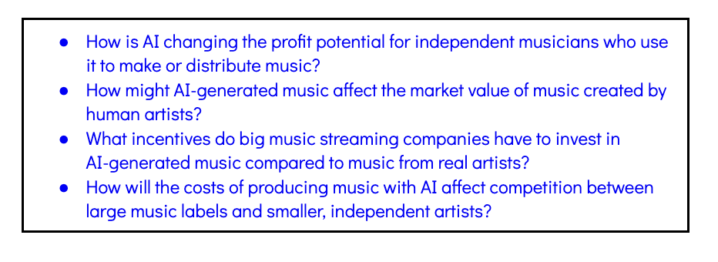
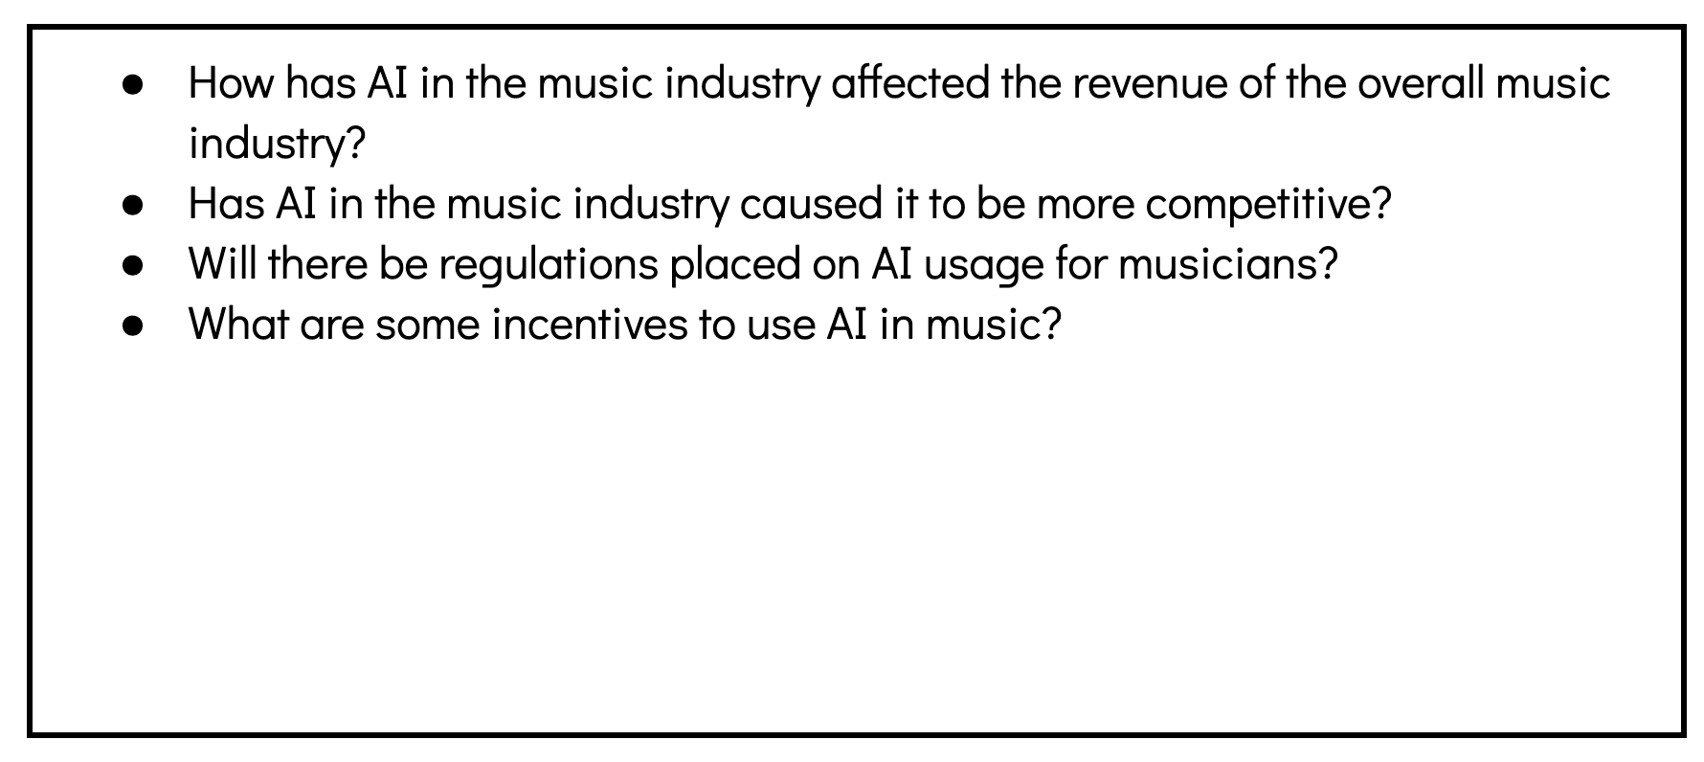
Student
Examples
AI Song

Slide 38
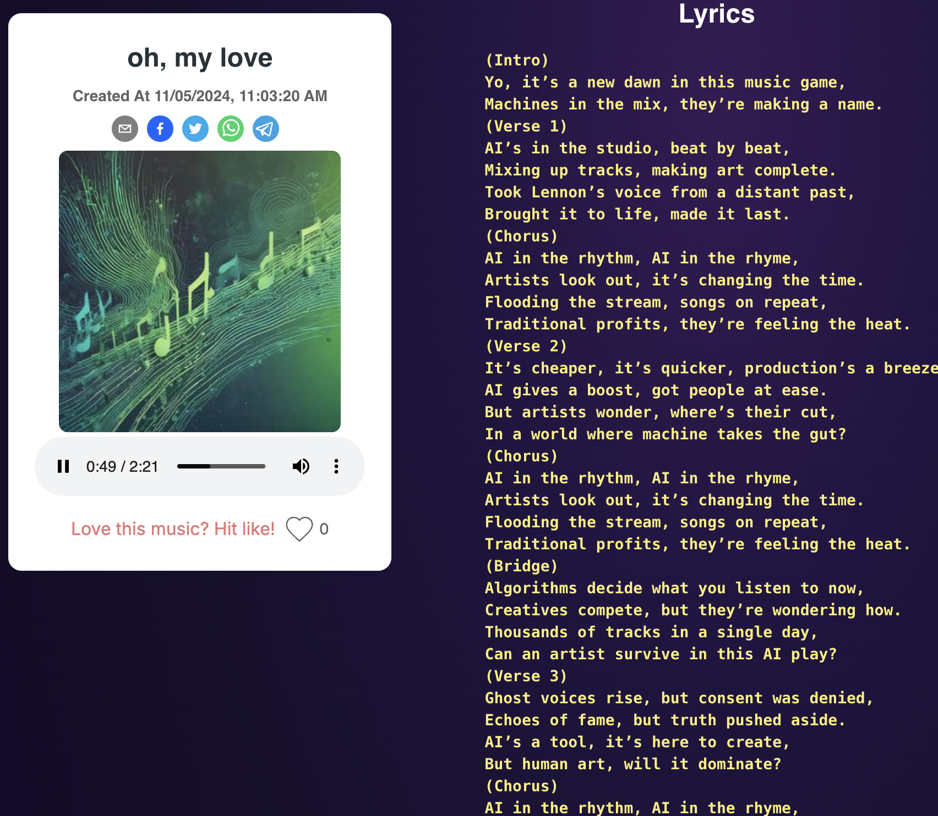
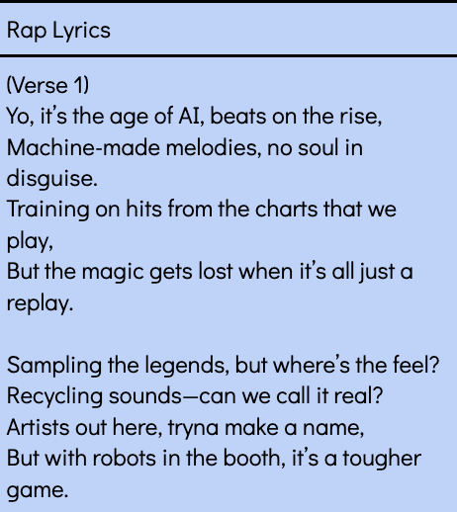
Click the images to hear the songs.
Student AI Songs from AI and Music Assignment

Slide 39
Make Music: Use the AI Tools

Slide 40
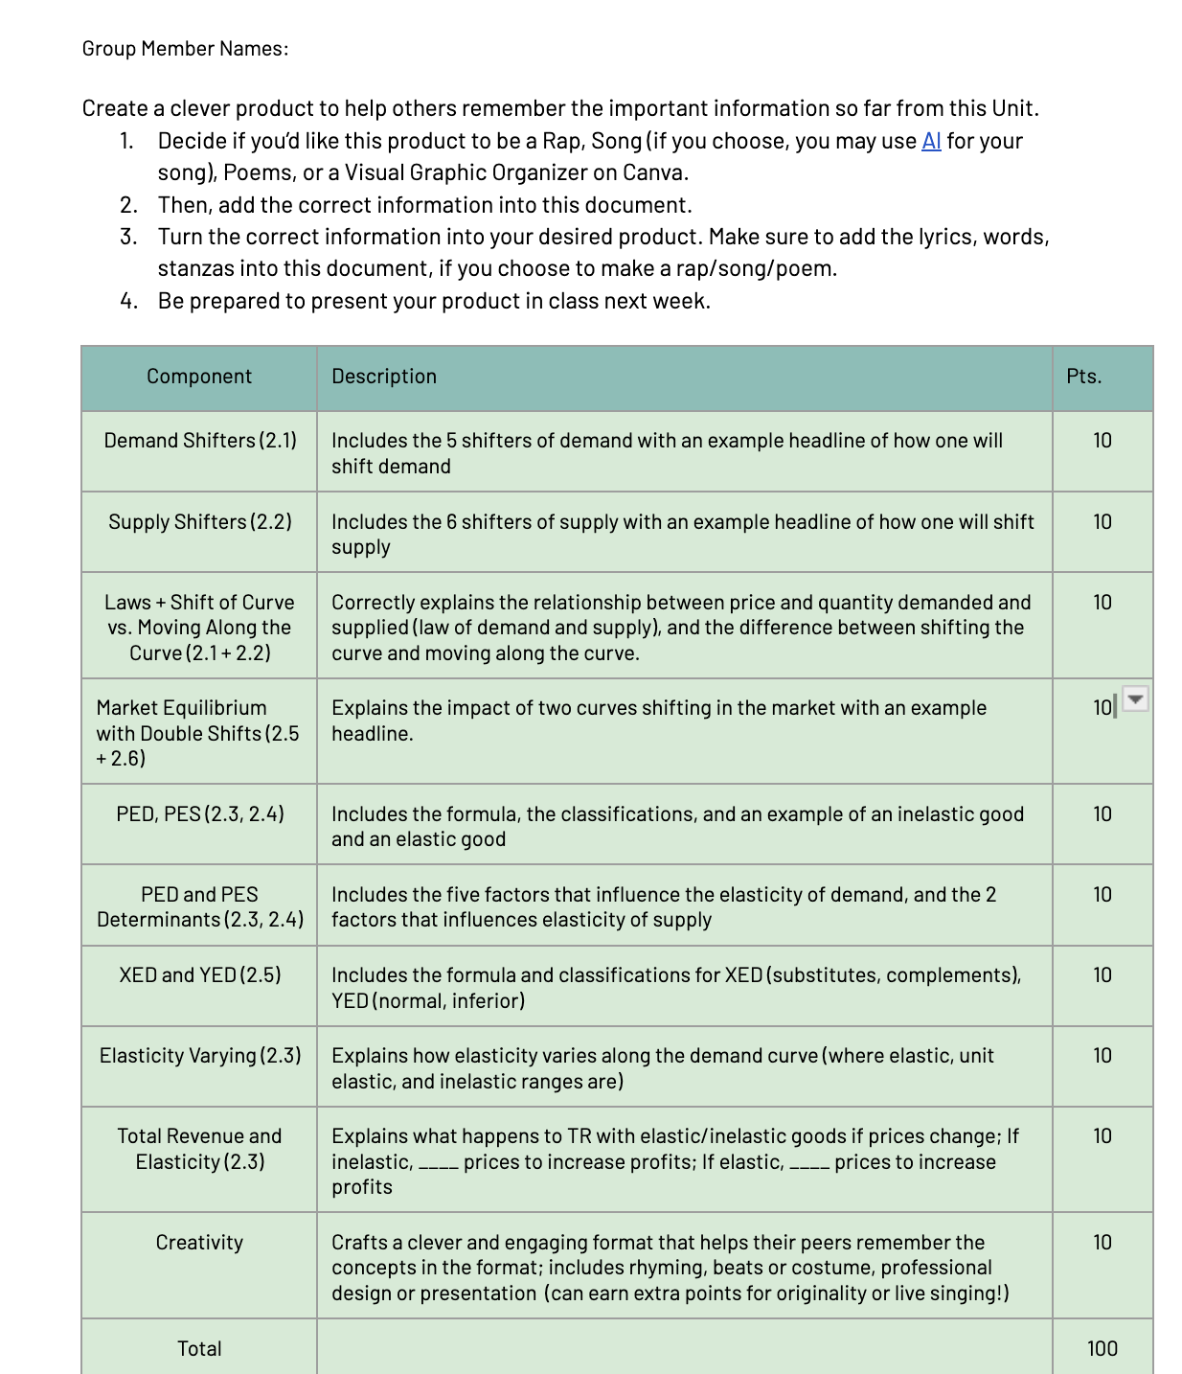
Teach Me! Task with AI Tools
Overview
Go over important topics in a Unit.
Give students a Teach Me! Task where they must convert information into a rap, poem, or song.
Have students add the information from the notes.
Convert it (at home if necessary).
DURATION (2 classes): Individual: 50 mins
Group: 50 minutes

Slide 41
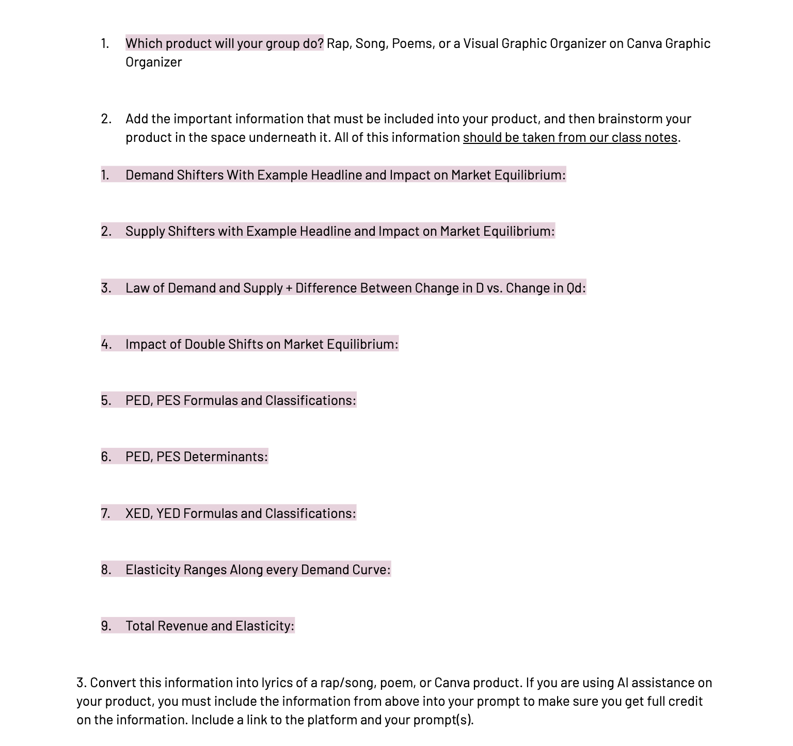
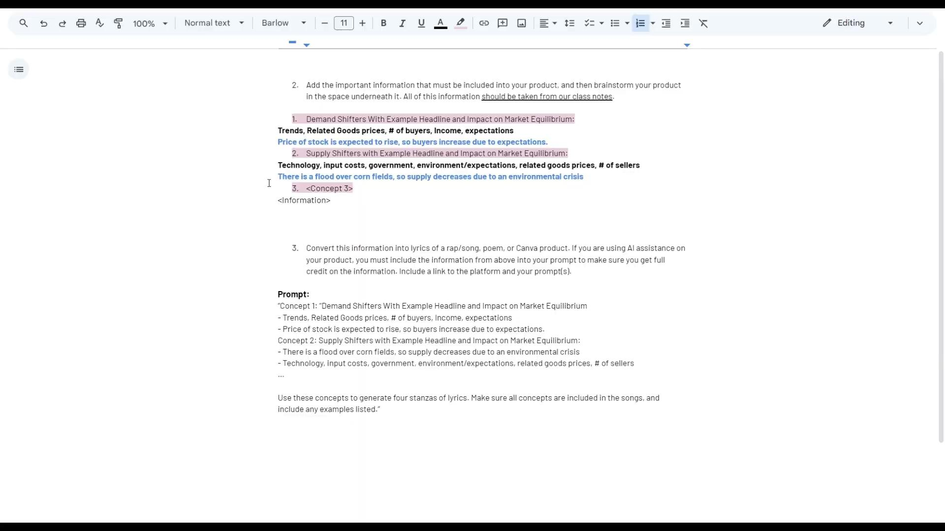
Handout of Information
Student Explanation of Tools
Student Products: Teach Me Task
Sample #1
Sample #2

Slide 42
How can you use the background, pedagogy, or curriculum?
Section | Option #1 | Option #2 | Option #3
Background | Technology Disruptions | Benefits of AI | Costs of AI
Pedagogy | Video: What, So What, Now What | Video: SIT | 4 Corners
Curriculum | Podcast Template | AI and Music | Teach Me Task
Add your response in the Chat box!
Reflect

Slide 43
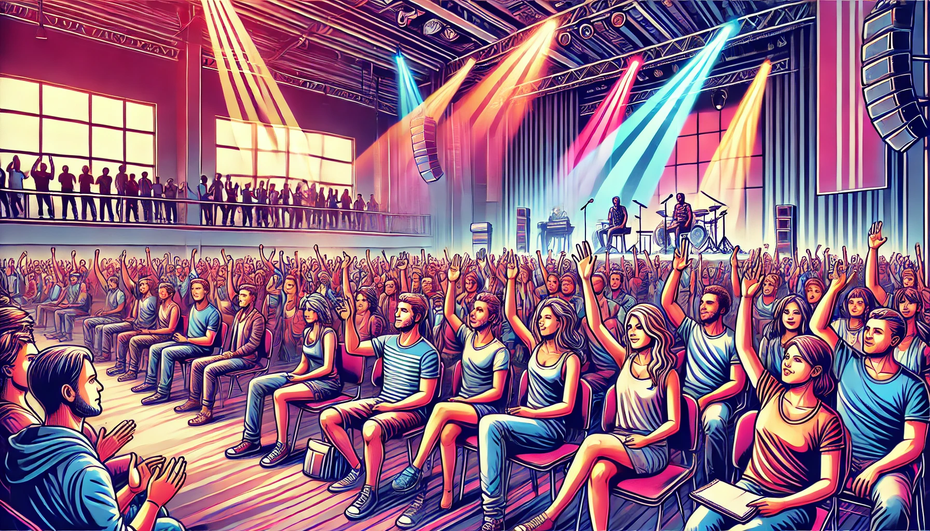
Reflection
Questions

Slide 44
References
The Economist: AI Generating a Revolution
Podcast: Could AI Kill the Radio Star
Bloomberg: The Sound of AI Music
Producing Fake Information is Getting Easier
Billboard: 5 Ways AI is Changing Music
Forbes: Orchestrating the Future with AI
Forbes: Music Rights and The Global Economy
Vox: What AI in Music Can and Can't Do
ABC News Daily Podcast: Ben Lee on the Rise of AI in Music

Slide 45
References
YouTube: The Beatles: Now and Then
IFPI Reports
RIAA Facts on Music
RIAA: Elvis Law in Tennessee
The Indicator: Artist vs. AI
Suno AI
Open AI
Georgetown: Innovation and Artists' Rights in the Age of AI
Time: How AI is Making Difficult Questions

Slide 46
Susanna.Pierce.McConnell@gmail.com
Thank You

