Slide 1


The Future of Batteries

Slide 2
Certificate Requirements
To earn professional development hours for webinars, you must:
Watch a minimum of 45-minutes and you will automatically receive a professional development certificate via e-mail within 24 to 48 hours.

Slide 3
Objectives
You will be able to:
describe how batteries work (at a basic level).
explain efforts to improve batteries.
analyze how technological improvement can impact productivity and efficiency.

Slide 4

Presenter
Dr. Chris Cannon
ccannon11@gsu.edu
@Georgiaecon

Slide 5
Session Agenda
Battery overview
Lesson Walkthrough
Q/A

Slide 6

National Standards
Standard 15 : Economic growth?
Investment in factories, machinery, new technology, and in the health, education, and training of people stimulates economic growth and can raise future standards of living.
https://www.councilforeconed.org/policy-advocacy/k-12-standards/

Slide 7

Future of Batteries

Slide 8
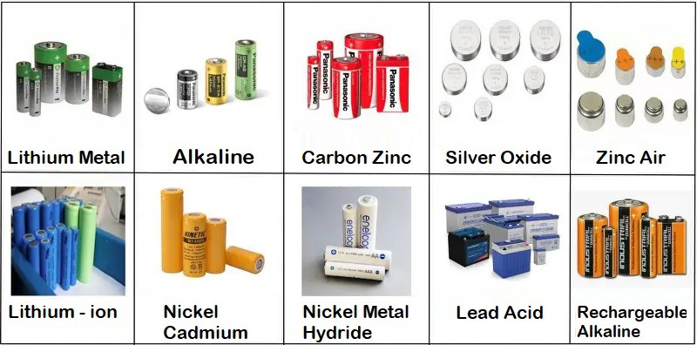
Types of Household Batteries
Notes:
Picture source: https://www.fairfaxcounty.gov/publicworks/recycling-trash/batteries

Slide 9
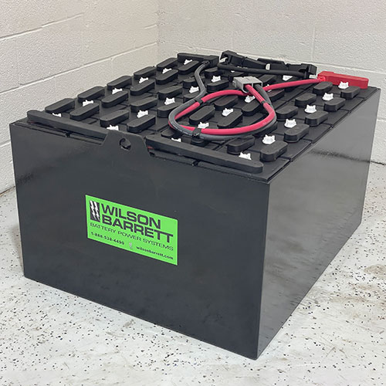
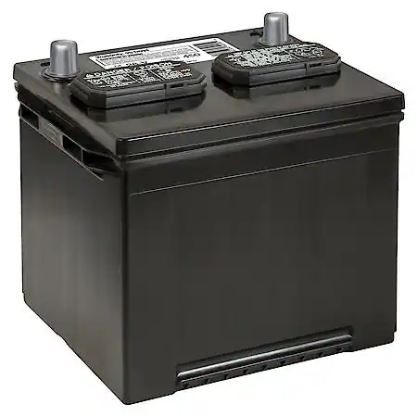
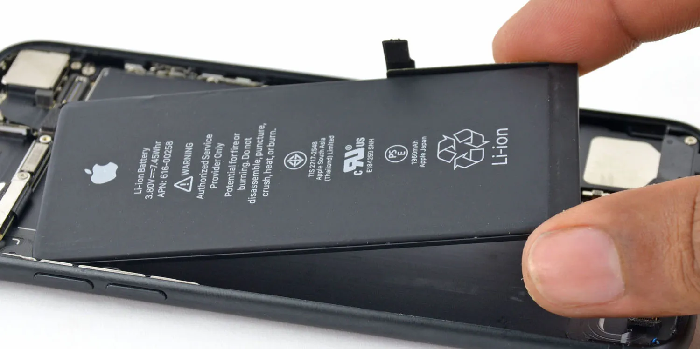
Other Batteries
smartphone
forklift/heavy machinery
car
Notes:
All photos royalty free courtesy of Pixabay.

Slide 10
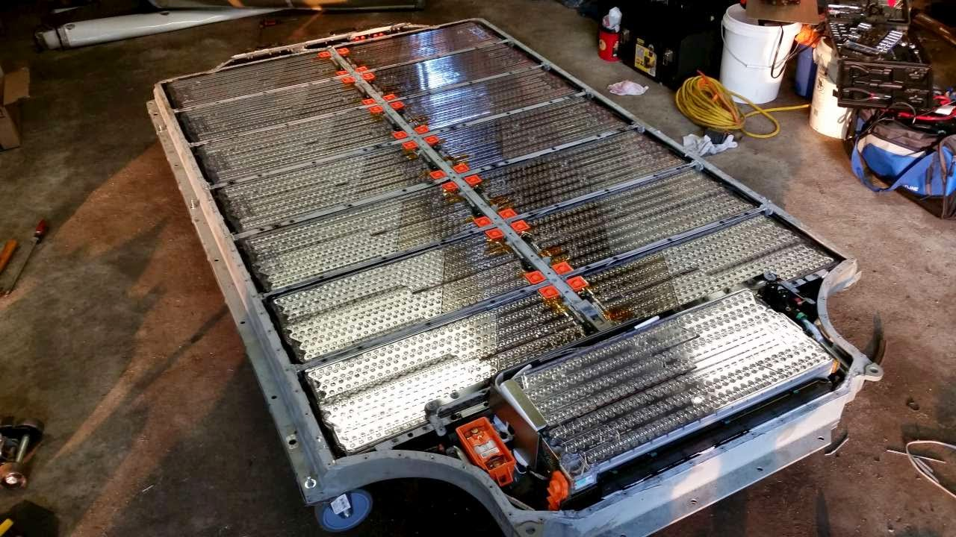
What type of battery is this?
Tesla Model S
Notes:
This is the battery system of a Tesla Model S. While it is referred to as a “battery”, it is actually thousands of little batteries working together as one giant battery. Picture source: https://www.qnovo.com/blogs/peek-inside-the-battery-of-a-tesla-model-s

Slide 11
Did you know?
Batteries have hundreds of uses
energy grid storage (when grid over produces)
backup power for thousands of companies
storing renewable energy (hydro/solar)
tiny medical devices
space/deep sea exploration

Slide 12
Did you know?
Battery industry facts
$100 billion industry world wide
Duracell and Energizer combine for over $4.5billion in revenue each year
The average household has between 20-60 batteries in use at any given time
It would take around 12,000 AA batteries to power the average house for one day
Notes:
Info source: https://gitnux.org/lithium-ion-battery-industry-statistics/

Slide 13
How do Batteries Work - (when charged)
Electrolyte
SOLUTION
METAL 1
METAL 2
Notes:
This layout is how the human battery simulation should start. The black dots represent students as electrons. They should start in Metal 1 and move through metal 2 to the storage solution in the middle.

Slide 14
How do Batteries Work - (powering)
Electrolyte
SOLUTION
METAL 1
METAL 2
Notes:
This layout is how the human battery simulation will look as electrons are moving. The black dots represent students as electrons. They should start in Metal 1 and move through metal 2 to the storage solution in the middle.

Slide 15
How do Batteries Work - (after power)
Electrolyte
SOLUTION
METAL 1
METAL 2
Notes:
This layout is how the human battery simulation should finish. The black dots represent students as electrons. They should start in Metal 1 and move through metal 2 to the storage solution in the middle.

Slide 16
Battery Debrief
What “created” the power?
What would happen if we put more “actions” along the line (yarn)?
What are some ways to improve the design and use of batteries?

Slide 17
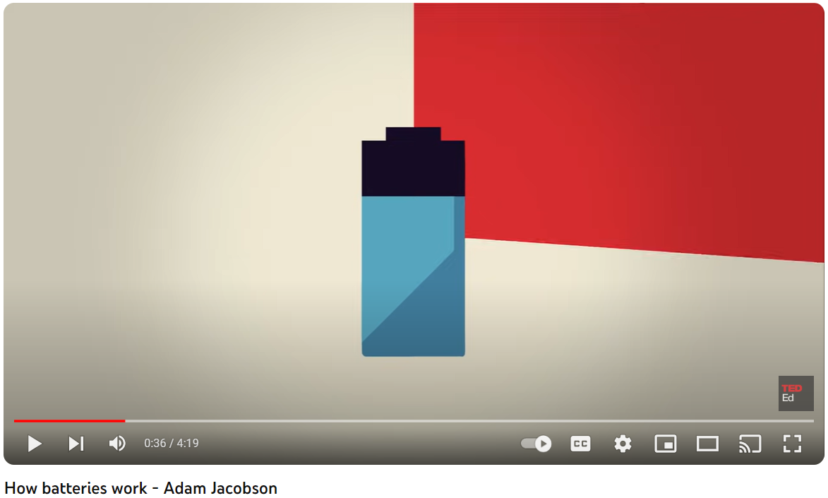
How Batteries Work
Notes:
Direct link to video: https://www.youtube.com/watch?v=9OVtk6G2TnQ

Slide 18
Benefits of batteries?
productivity - amount of output related to one unit of input
efficiency - degree to which waste can be reduced or minimized in production of a good or service
Innovations to batteries have increased both!

Slide 19
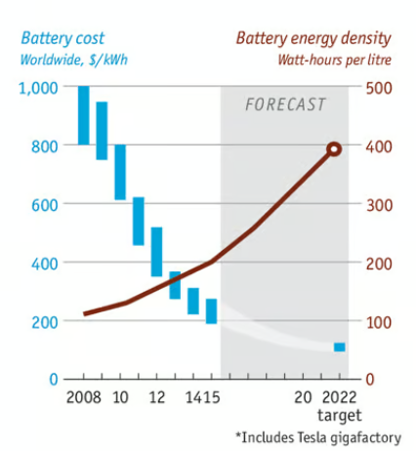
Notes:
This slide from the Economist - available to the public at researchgate here: https://www.researchgate.net/figure/Increase-in-energy-density-and-cost-reduction-of-Lithium-Ion-batteries-26_fig4_339138847 shows how the cost of lithium batteries is decreasing while the amount they can store is increasing. This bodes well for productivity purposes.

Slide 20
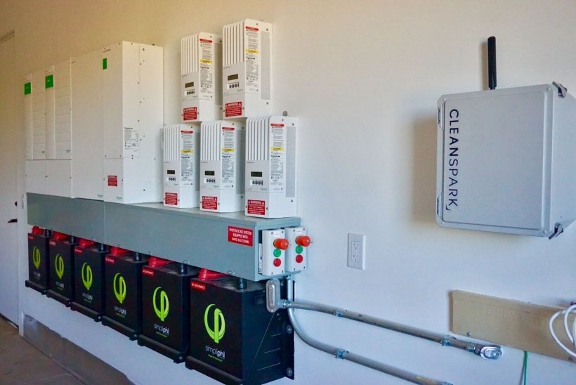
Household battery storage pack in Arizona.
Notes:
This is an example of how a household can store energy from solar panels for future use, which increases the efficiency of solar panels since less energy is wasted. Image available royalty-free from energy.gov: https://www.energy.gov/eere/solar/articles/should-i-get-battery-storage-my-solar-energy-system

Slide 21

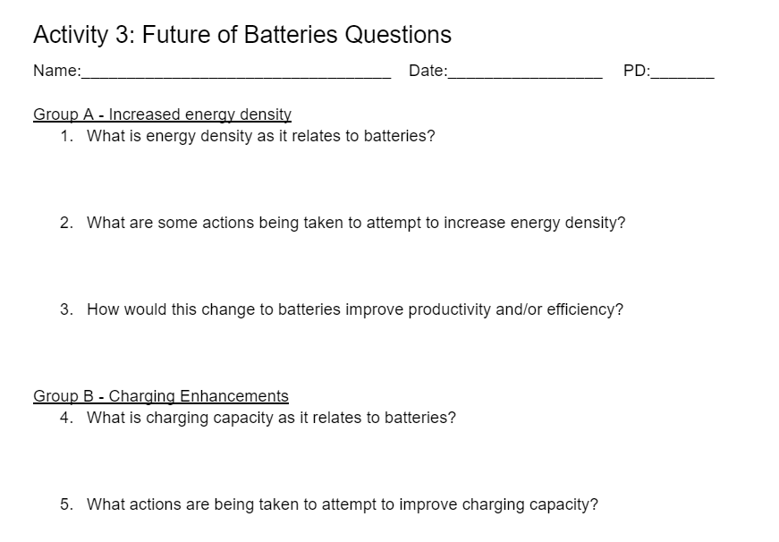
Improving Batteries - Mini Skits

Slide 22
In summary
Batteries come in many forms and have thousands of applications
Batteries make society more productive and efficient
There are numerous ongoing innovations to batteries making them last longer, charge faster, and support larger electric systems worldwide

Slide 23





Find your Local Competition and Register Today!
The National Personal Finance Challenge is a competition that provides
high school students with an exciting and motivating opportunity to build, apply, and demonstrate their knowledge of money management.
Through online exams and a personal finance simulation, teams showcase their expertise in earning income, spending, saving, managing credit, investing, and managing risk.
Teams of up to four students, with one teacher/coach, can qualify to represent their state at the National Personal Finance Challenge by
winning their state competition.
CASH PRIZES
for each member of the winning teams:
1st Place $2,000
2nd Place $1,000
3rd Place $500
4th Place $250
NATIONALS > Finals:
Critical thinking round & Quiz Bowl in Atlanta, Georgia on June 1-2.
Register today: bit.ly/cee-npfc

Slide 24


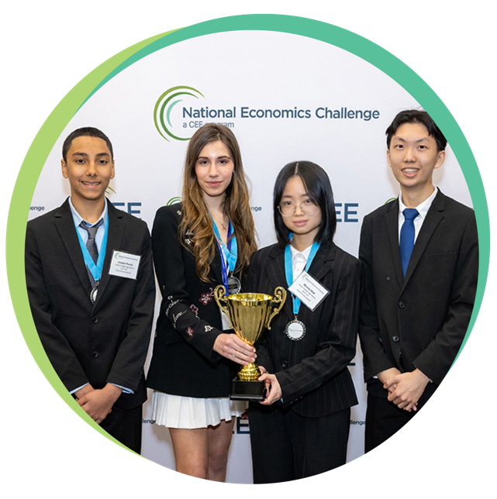


Teach Economics?
Your students may have what it takes to compete in the nation’s only high school economics competition!
Why Play?
• Fun team learning experience
• Great for college applications
• No other challenge like this
• Online participation makes access easy
• Chance for cash prizes
Two divisions based on
experience level
David Ricardo for first-time competitors who have taken no more than one economics course.
Adam Smith for returning competitors, AP, International Baccalaureate, and honors students.
How it Works
Teams register
Teachers enroll team(s) of 3- 4 high school students from the same school. Multiple
teams allowed.
Teams compete within their state
Compete to win your state competition for a
chance to advance to the National Semi-Finals.
National Semi-Finals: April 21-24, 2025
Teams answer multiple-choice questions on macroeconomics, microeconomics, and international & current events.
National Finals: Atlanta, Georgia
May 28-30, 2025
Teams analyze an economic issue and present their solution. Top teams engage in the Finals Quiz Bowl where they face-off answering questions to claim the National Title.
CASH PRIZES
for each member of the winning teams:
1st Place $1,000
2nd Place $500
3rd Place $250
4th Place $200
Register Today at NationalEconomicsChallenge.org

Slide 25



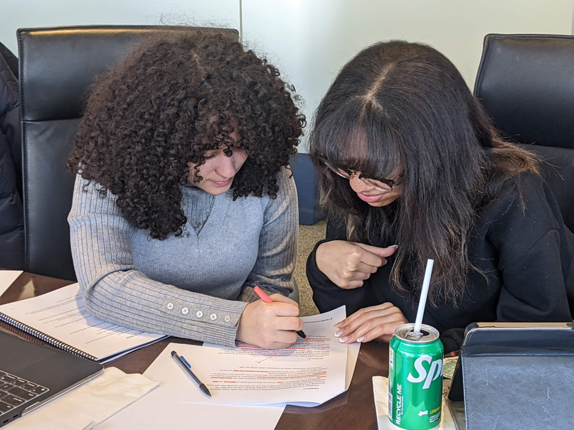








Free Personal Finance Program for High School Girls
Invest in Girls (a program of CEE) invites your high school students to learn about personal finance in a supportive all-girl environment! IIG instructors will teach students the basics of personal finance, how to invest, and help them build professional skills. These programs are online and free to attend.
Share this sign up link with your students
Or visit investingirls.org/for-students/

Slide 26
Thank you

