Slide 1
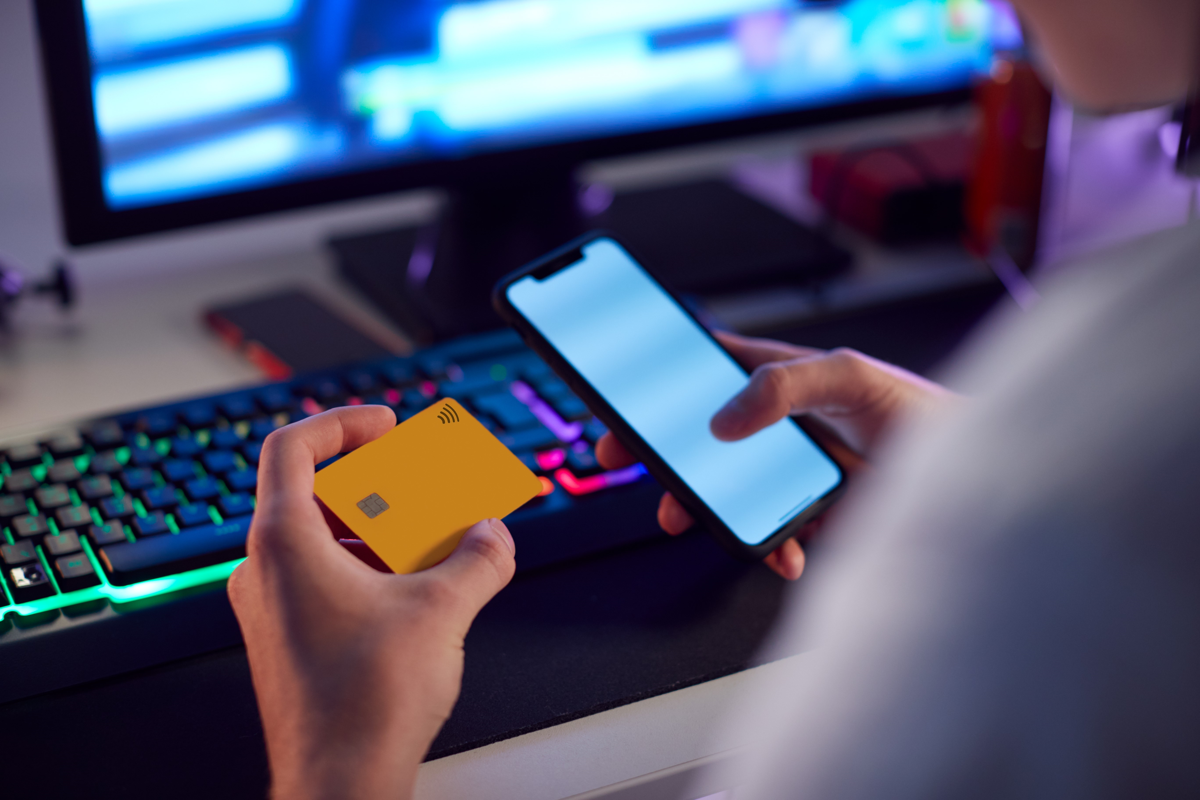
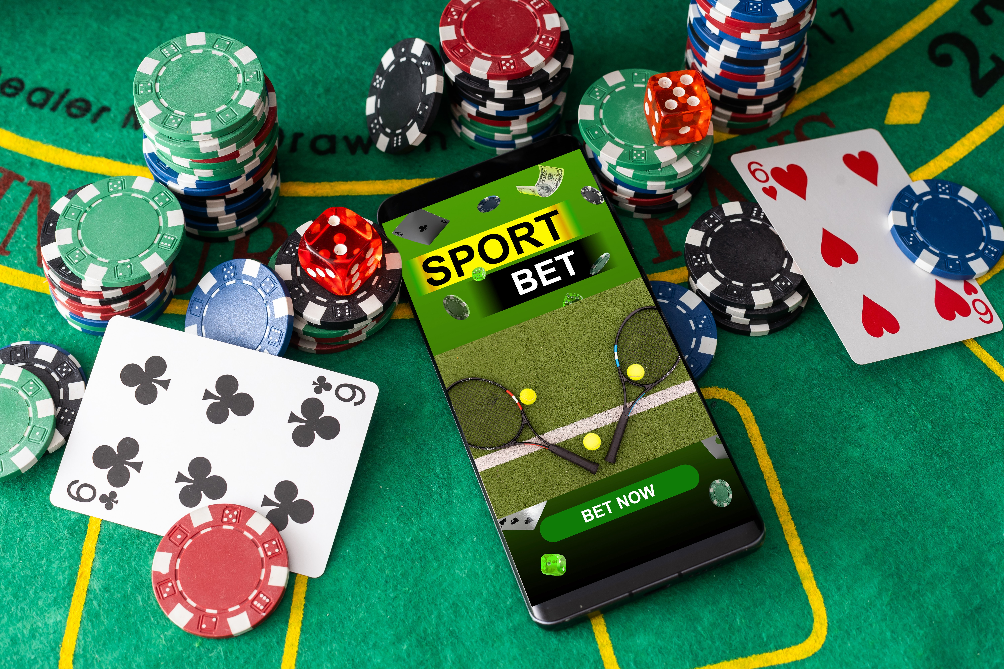
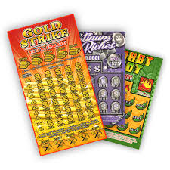
Risky Spending

Slide 2
Have you played an online game with pay-to-play activities where you pay for extra coins, gems, power-ups, loot boxes, and skins? Have you ever spent more money than you intended?
Warm Up

Slide 3
Gambling:
When you risk something
of value, and you don’t know
if you will win or lose.

Slide 4
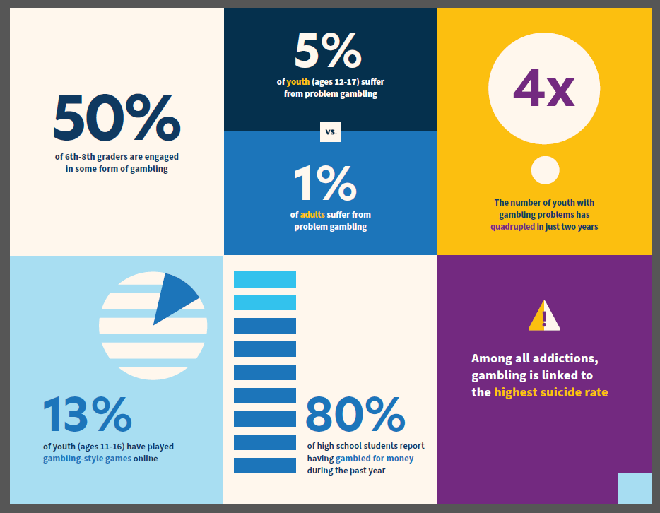
Notes:
What surprises you about these statistics? What doesn’t surprise you?
From Massachusetts Department of Public Health
www.mass.gov/YouthGambling

Slide 5
Teens and Sport Betting
Listen to this podcast, checking off the statements as you hear them.
Sports Betting podcast link
Notes:
https://www.marketplace.org/shows/marketplace-tech/how-teenagers-can-get-hooked-on-sports-betting/ (1:30 – 5:44)
Use with Activity 1 – Active Listening

Slide 6
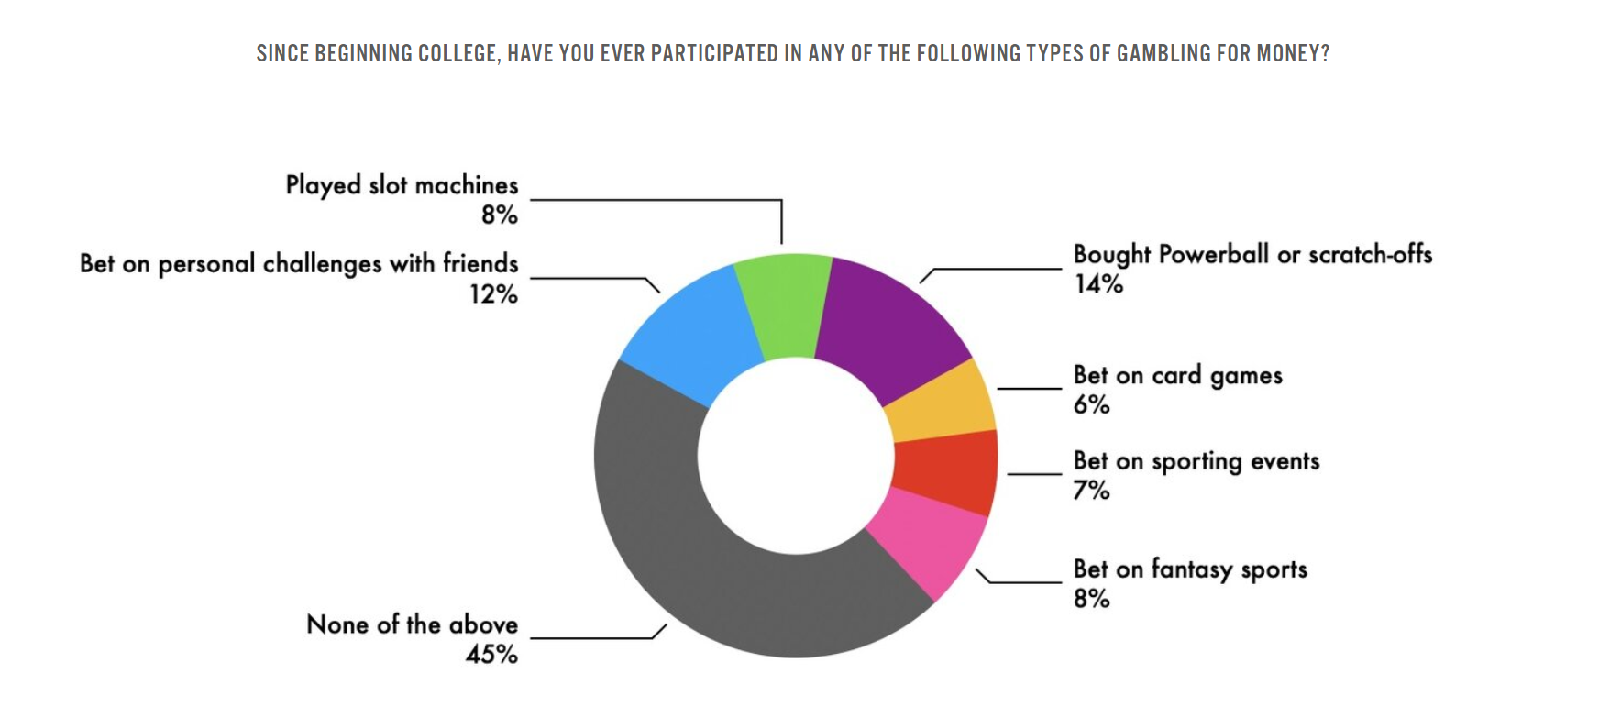
College statistics
Notes:
https://www.1800gambler.net/youth-college

Slide 7
Is this Gambling? For each of the following scenarios, t Thumbs up if you consider it to be gambling or Thumbs down if you would not consider it to be gambling

Slide 8
Accepting a challenge that starts with, “I bet you $5...”
Notes:
Why do you think this situation is or isn’t gambling?
What needs to change in the situation so that it would be considered gambling (or not gambling)?

Slide 9
Playing a card game without money involved.
Notes:
Why do you think this situation is or isn’t gambling?
What needs to change in the situation so that it would be considered gambling (or not gambling)?

Slide 10
Scratching off a lottery ticket that you received as a birthday present.
Notes:
Why do you think this situation is or isn’t gambling?
What needs to change in the situation so that it would be considered gambling (or not gambling)?

Slide 11
Spending $2 in a mobile game to open a loot box
Notes:
Why do you think this situation is or isn’t gambling?
What needs to change in the situation so that it would be considered gambling (or not gambling)?

Slide 13
Create a Public Awareness Poster
Notes:
https://www.1800gambler.net/about-gambling
https://static1.squarespace.com/static/5a01c52df43b55bbaf44c61f/t/65e8a1a268f9c27d9b442985/1709744556283/Youth+Flyer+inv+6A.pdf

Slide 14
Wrap Up
Anybody can reach out to 1-800-GAMBLER.
It’s a hotline that anybody can call and just say, “hey I’m having a problem” or “I have a friend that I noticed is having a problem, I just want to talk to you, and I want to see what I can do and get help” and it’s free.
Talk to someone.
Notes:
https://www.ncpgambling.org/ncpg/ The National Council on Problem Gambling also has state-based resources

