Slide 1


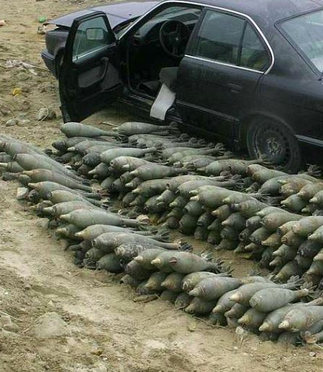
Do Terrorists Follow the Laws (of Supply and Demand)?

Slide 2
Certificate Requirements
To earn professional development hours for webinars, you must:
Watch a minimum of 45-minutes and you will automatically receive a professional development certificate via e-mail within 24 to 48 hours.

Slide 3


Presenter(s)
Jeremy Miller (co- author, presenter)​
jmiller@c-ischools.org
Cynthia Fitzthum (co-author)
Cjfizthum@stcloudstate.edu

Slide 4


Session Agenda
Economics of War Series description
Lesson objectives/Standards/Concepts
Activity description
Q & A

Slide 5
Economics of War Lessons
Please join us for any of the following webinars......... or look for the webinars on demand and lessons on EconEdLink soon!
Date | Topic
2/6- Jeremy | The Copper Issue (A Supply and Demand Lesson)
2/20- Cindy | Why go to war? (A Lesson on Costs and Benefits)
3/6- Cindy | Exchange rates during periods of Conflict (Currency and exchange rates)
3/20- Cindy | What about trade during war? (Geography lesson with focus on re-allocation during periods of conflict)
4/3- Cindy | Oil and the Middle East (Lesson on Prices)
4/17- Jeremy | What would you do with $19,000 a month? (Human capital, risk/reward and personal finance lesson)
5/1- Jeremy | Specialization (Military vs. Contractor pay)
5/8- Jeremy | How big is the military pie? (A Lesson on Budgeting, Taxation and Opportunity Cost)
5/22- Cindy | The Draft Debate (Debate Model)
5/29- Jeremy | Reconstruction: Can it boost an economy? (Broken Window Fallacy)

Slide 6

Objectives & Standards

Slide 7
Objectives
You will be able to:
Show how market prices are derived in free market trade.
Show how people make choices based on market conditions and available alternatives.
Show how the price of inputs affects the supply of a good.

Slide 8

National Standards
Markets and Prices:
  Market prices are determined through the buying and selling decisions made by buyers and sellers.
Role of Prices:
  2. Supply of a product changes when there are changes in either the prices of the productive resources used to make the product, the technology used to make the product, the profit opportunities available to producers from selling other products, or the number of sellers in a market.
https://www.councilforeconed.org/policy-advocacy/k-12-standards/

Slide 9
Economic Concepts
Supply and Demand
Factors of Production
Input prices
Substitute goods
Economic growth
Markets/Trade

Slide 10
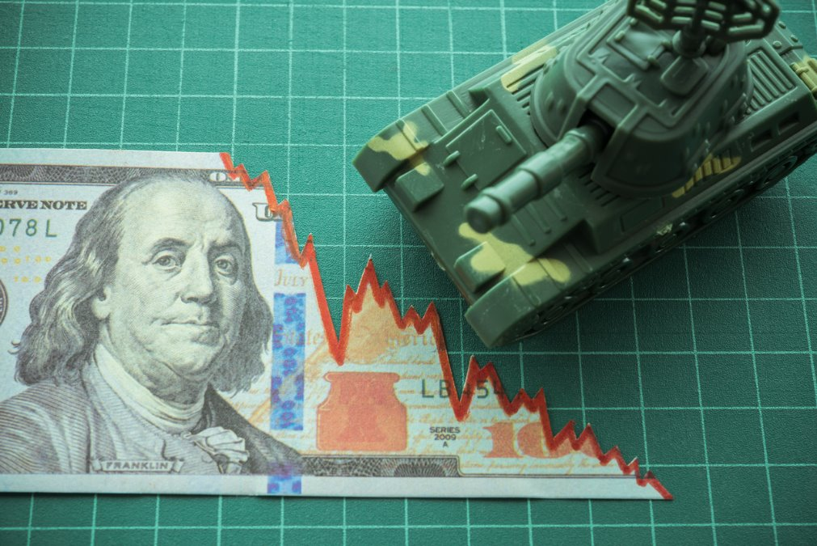
[INSERT FEATURED IMAGE OF WEBINAR SESSION]
Lesson Activity

Slide 11
Lesson Description
This lesson explores the impact of economic growth on prices, specifically on input prices in the context of weapons procurement by insurgent fighters in Iraq.
Explosively formed projectiles (EFPs) were much more effective than improvised explosive devices (IEDs), but used far less frequently. We will explore why.
The final activity in the lesson allows students to create a market for copper, one of the productive inputs for EFPs, to see how market prices are established and the effect of economic growth on prices.

Slide 12
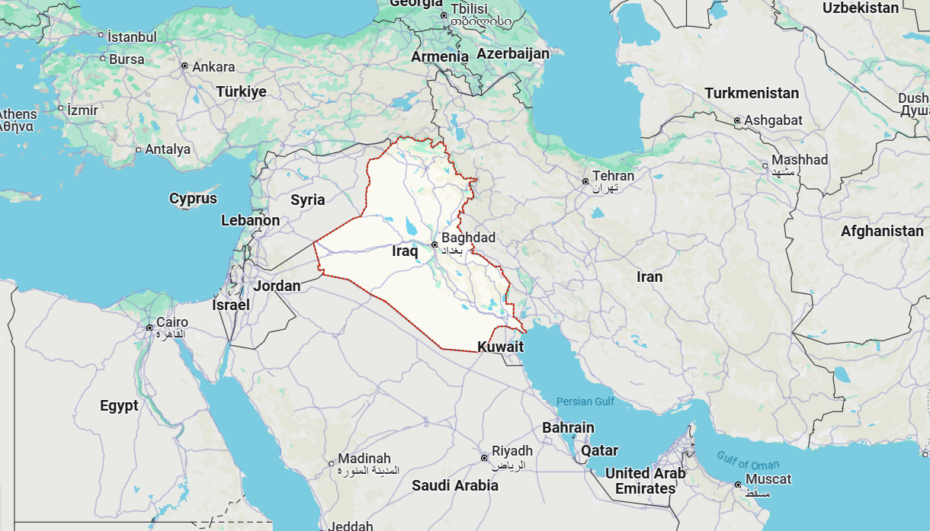
Iraq

Slide 13

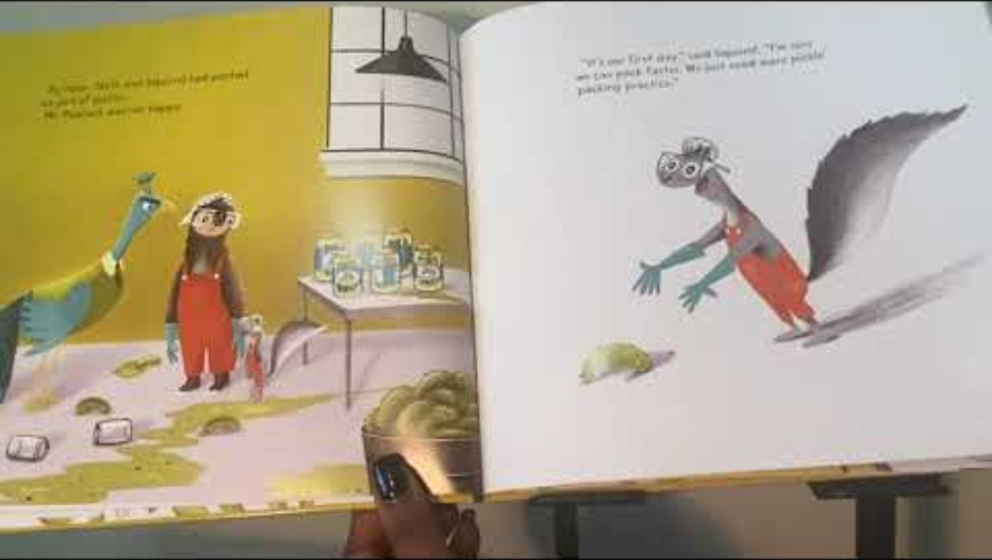
Explosively Formed Projectiles (EFP)
https://www.youtube.com/watch?v=YcejmEbDKng

Slide 14
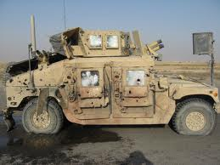
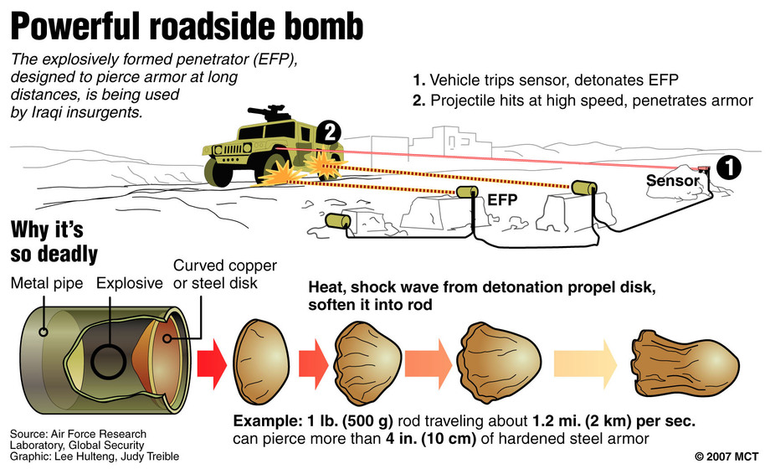
EFPs vs. IEDs
EFPs were used in only 2.5% of IED attacks…
But caused 15% of the casualties!

Slide 15
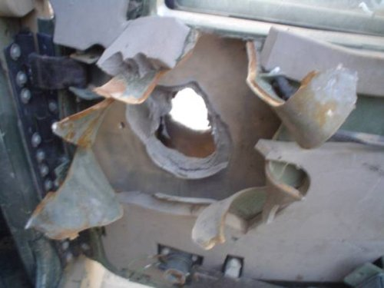
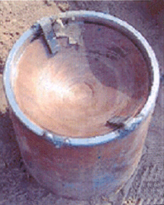
EFPs

Slide 16
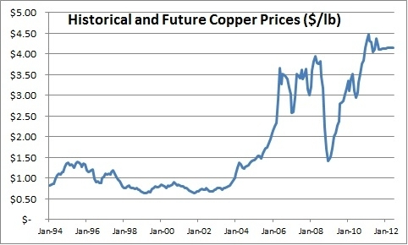
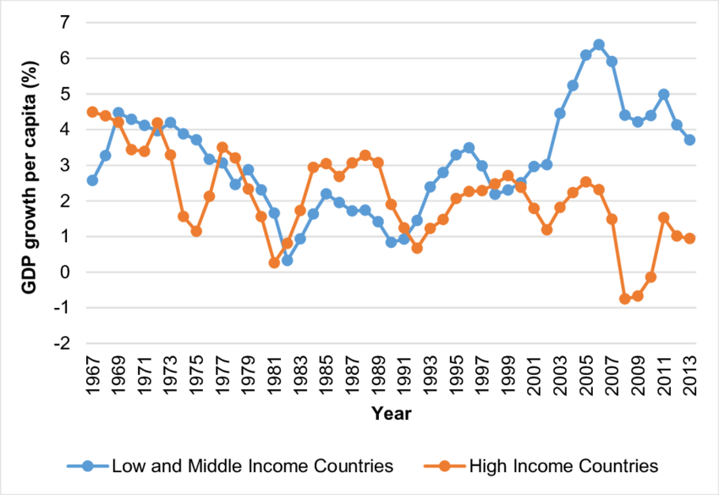
Copper
Intelligence reports were pointing to increasing prices as a contributing factor to the lack of growth in EFP usage in Iraq.

Slide 17
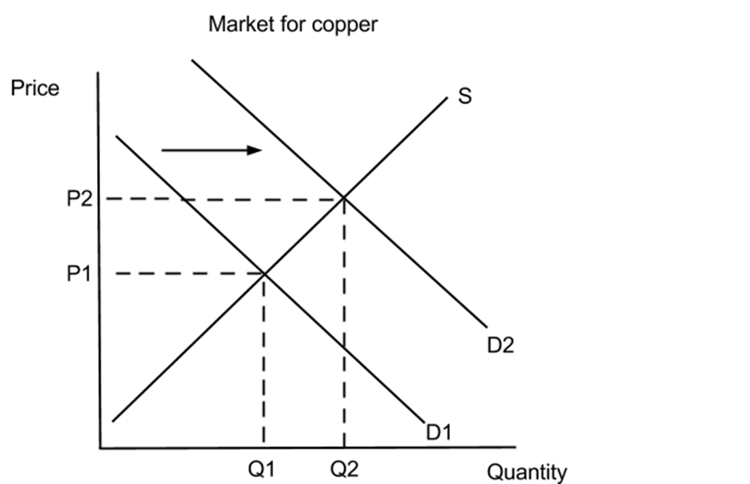
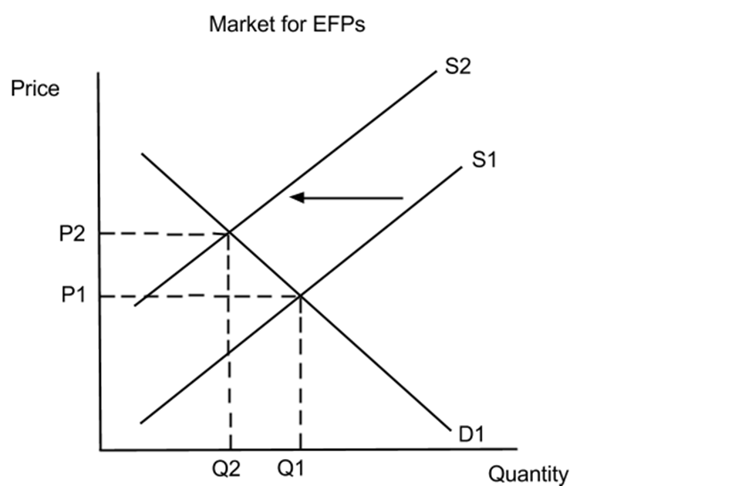
Copper & EFP Markets

Slide 18
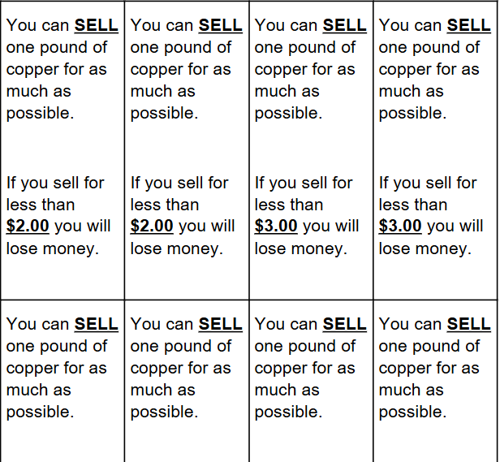
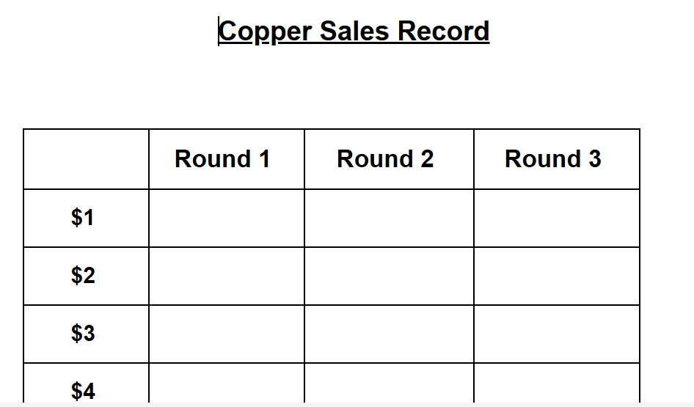
Market for Copper
Lesson Plan
Divide the class into two groups
  Buyers and Sellers
1 student should be designated to collect/handout the buy/sell cards
1 student designated as the sale recorder

Slide 19
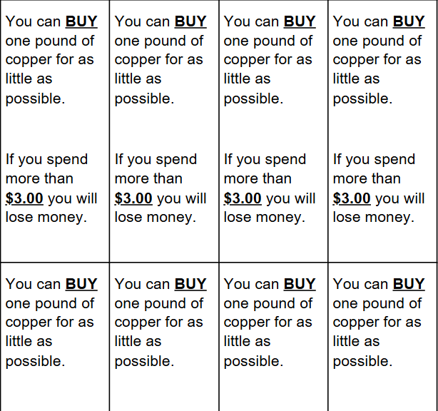
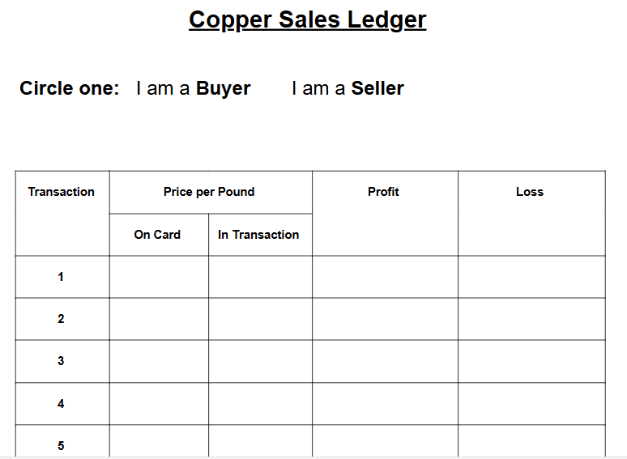
Market for Copper
Lesson Plan
5 minute rounds
  Buyers and sellers negotiate to make trades.
  When the trade is made, they record the trade on their worksheet, report the sale price to the recorder and get a new card.
  The goal is to make the largest profit.

Slide 20
Market for Copper
Lesson Plan
Additional rounds can be played with the set of buyer cards that have higher prices
  Represents a willingness to pay higher prices
    Economic growth/Increase in income
  Will cause market price for copper to increase.

Slide 21
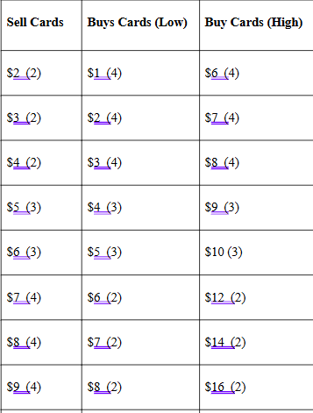
Assessment
Ask the students the following:
How does the supply and demand for goods affect the weapon selection of insurgent fighters in Iraq?
Why did the increased price of copper affect the usage of EFPs in Iraq?
How did economic growth affect the price for copper?
The students should create their own supply and demand graphs for both the copper and EFP markets using the data from the lesson, as well as create a supply and demand graph for the copper market using the card data. They should also be able to describe how the demand for copper affected the insurgent weapon selection.

Slide 22
[INSERT FEATURED IMAGE OF WEBINAR SESSION]
Q&A

Slide 23
Presenter(s)
Jeremy Miller (co- author, presenter)​
jmiller@c-ischools.org
Cynthia Fitzthum (co-author)
Cjfizthum@stcloudstate.edu

Slide 24
[INSERT FEATURED IMAGE OF WEBINAR SESSION]
Thank you

