Slide 1

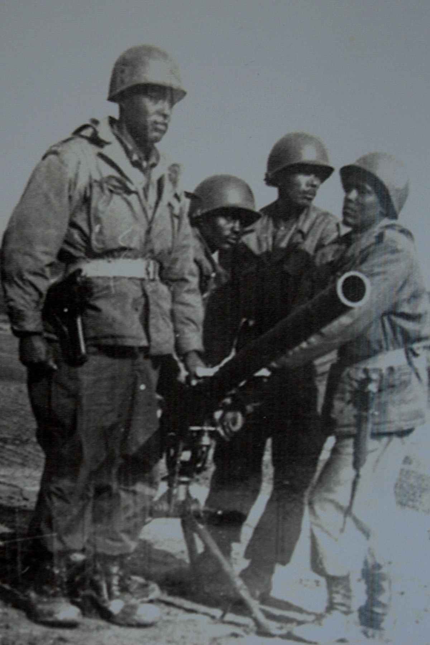

Why Go To War?
A Lesson On Costs and Benefits

Slide 2
Certificate Requirements
To earn professional development hours for webinars, you must:
Watch a minimum of 45-minutes and you will automatically receive a professional development certificate via e-mail within 24 to 48 hours.

Slide 3
Objectives
You will be able to:
Explain the costs and benefits of going to war
Give examples of short-term and long-term effects of entering into a conflict
Analyze and interpret data to make a decision

Slide 4




Presenter(s)
Cynthia Fitzthum (co-author, presenter)
Cjfizthum@stcloudstate.edu
Jeremy Miller (co- author)
Jmiller@c-ischools.org

Slide 5
Economics of War Lessons
Please join us for any of the following webinars......... or look for the webinars on demand and lessons on EconEdLink soon!
Date | Topic
2/6- Jeremy | The Copper Issue (A Supply and Demand Lesson)
2/20- Cindy | Why go to war? (A Lesson on Costs and Benefits)
3/6- Cindy | Exchange rates during periods of Conflict (Currency and exchange rates)
3/20- Cindy | What about trade during war? (Geography lesson with focus on re-allocation during periods of conflict)
4/3- Cindy | Oil and the Middle East (Lesson on Prices)
4/17- Jeremy | What would you do with $19,000 a month? (Human capital, risk/reward and personal finance lesson)
5/1- Jeremy | Specialization (Military vs. Contractor pay)
5/8- Jeremy | How big is the military pie? (A Lesson on Budgeting, Taxation and Opportunity Cost)
5/22- Cindy | The Draft Debate (Debate Model)
5/29- Jeremy | Reconstruction: Can it boost an economy? (Broken Window Fallacy)

Slide 6
In the News...
What conflicts are currently in the news today?

Slide 7
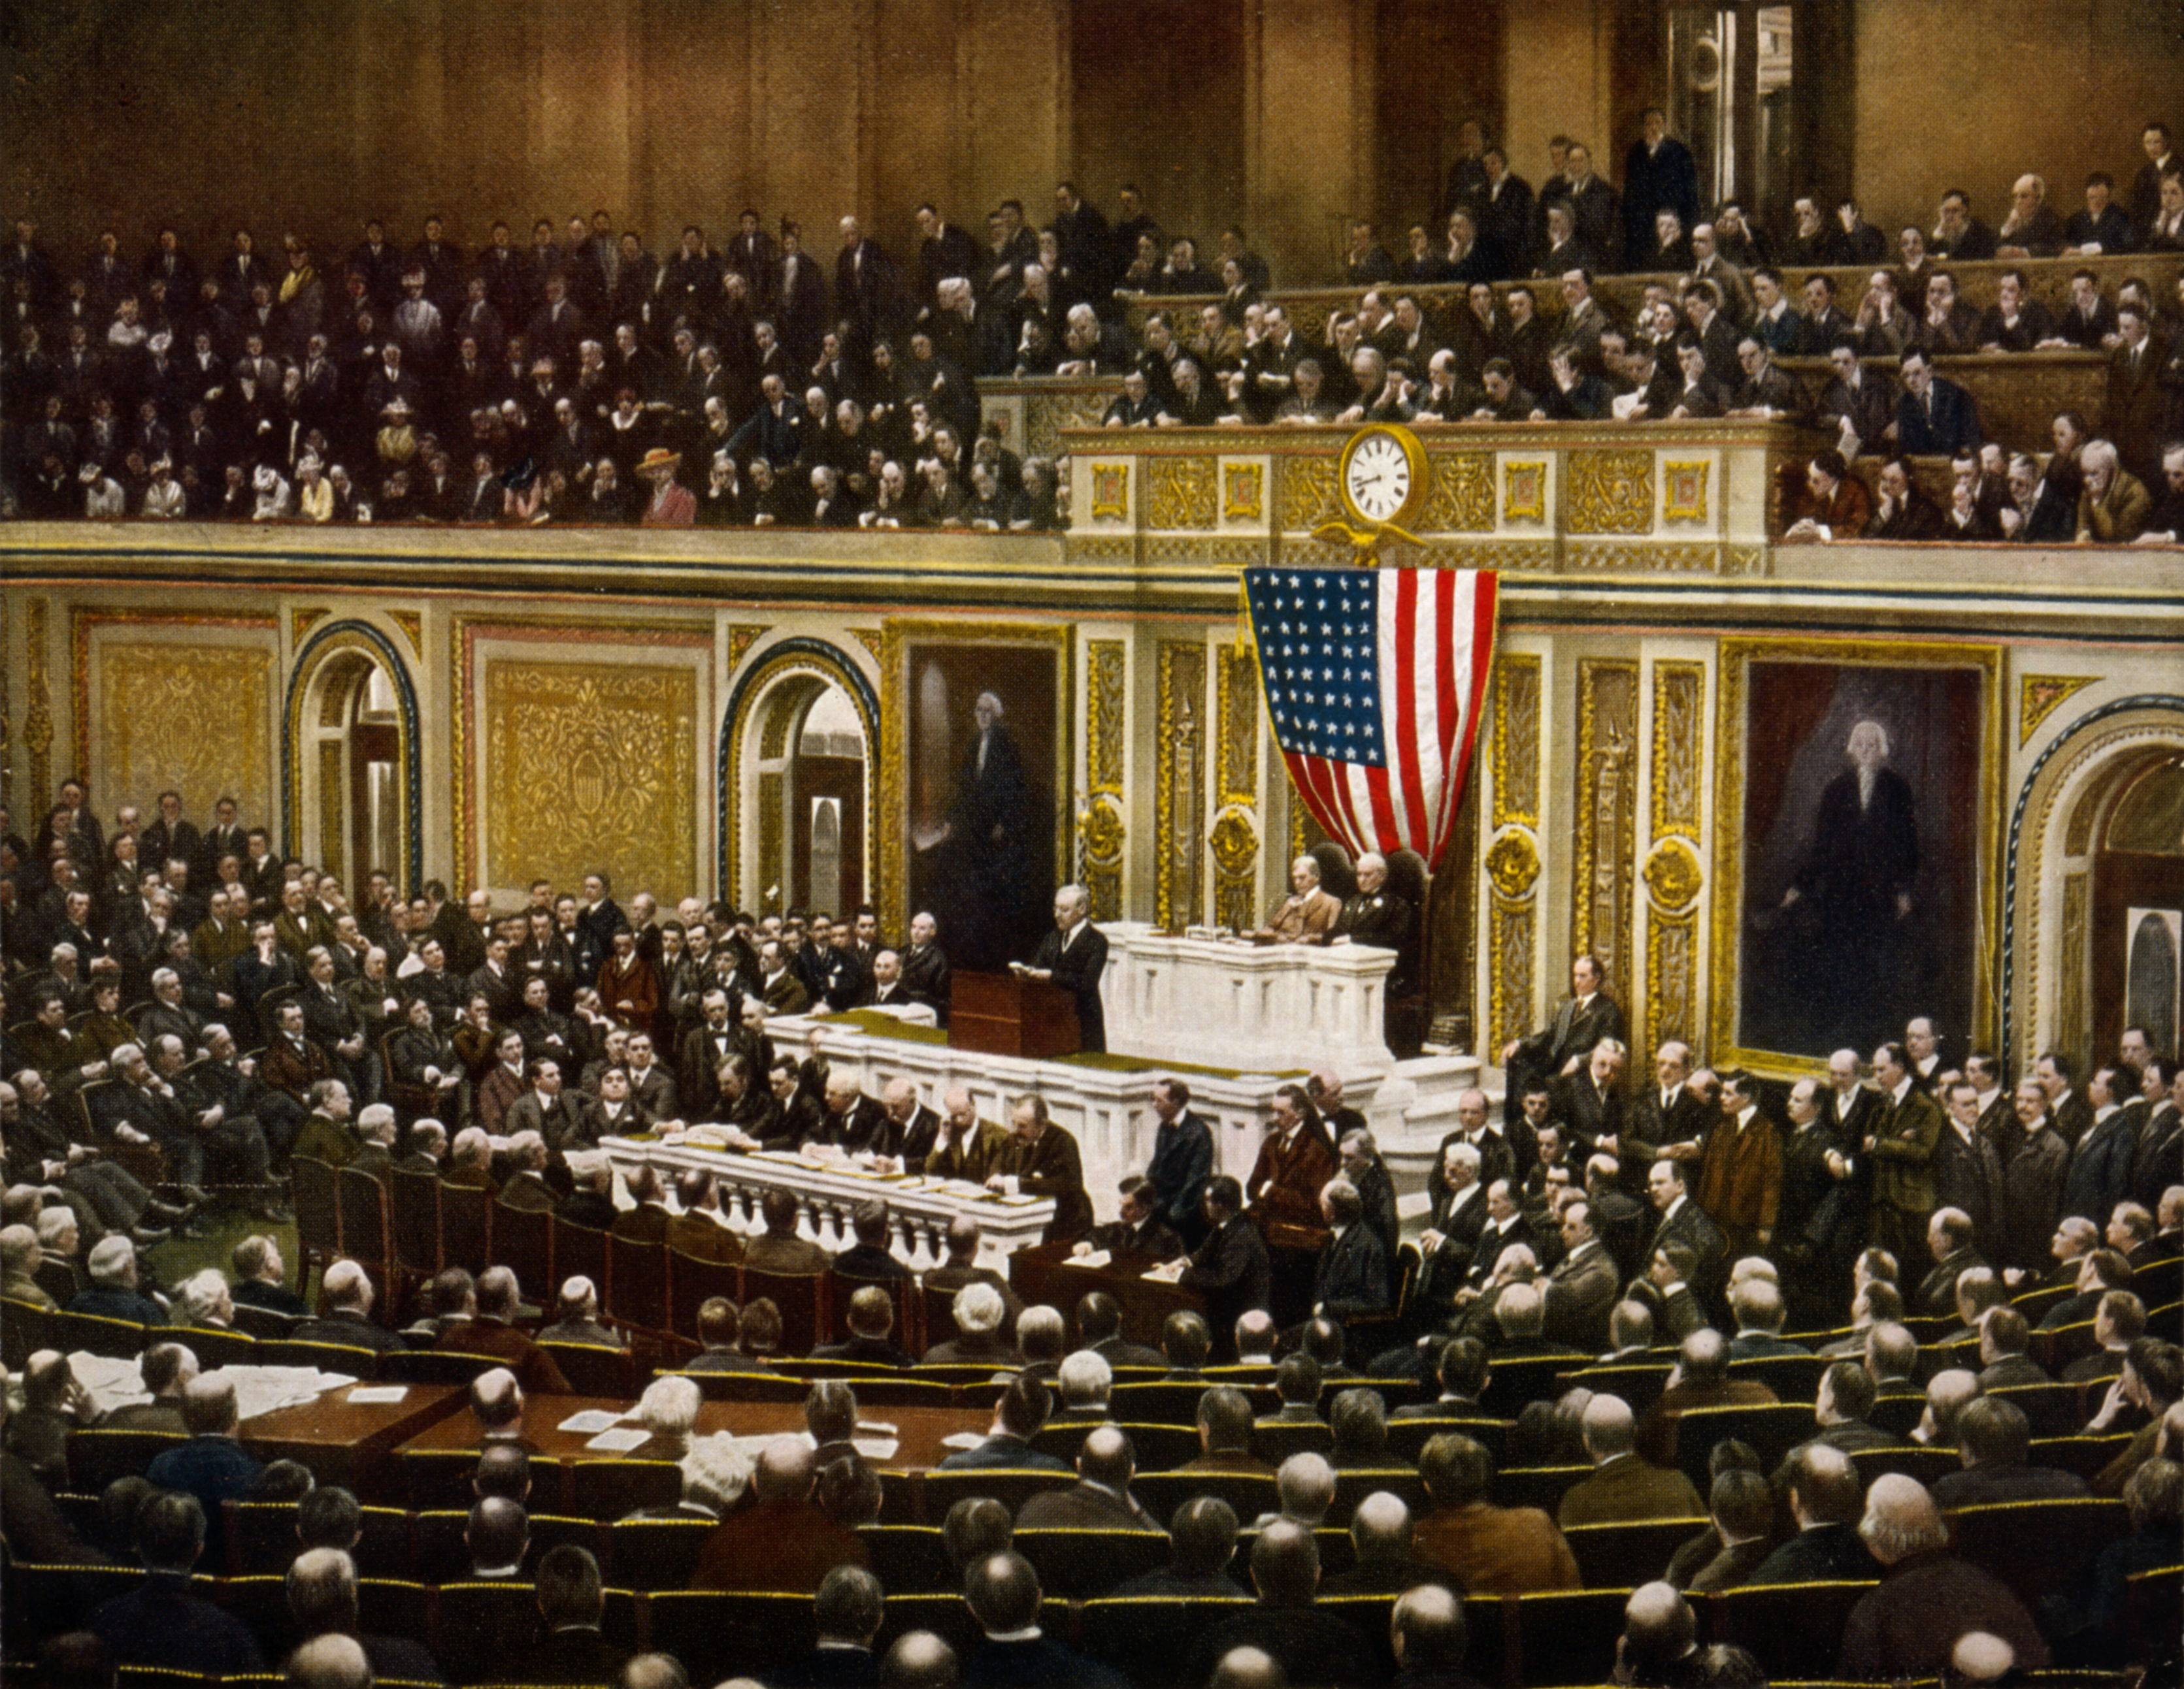
Why Go To War?: Session Agenda
Standards/Concepts
Content (Procedure)
Assessment
Wrap-up/ Q & A

Slide 8
Standards and Concepts

Slide 9

National Standards
DECISION MAKING
  3. To compare marginal benefits with marginal costs that are realized at different times, benefits and costs must be adjusted to reflect their values at the time a decision is made about them. The adjustment reflects expected returns to investment compounded over time.
https://www.councilforeconed.org/policy-advocacy/k-12-standards/

Slide 10
Economic Concepts
Costs:
An amount that must be paid or spent to buy or obtain something--as in How much do those shoes cost? Also the effort, loss, or sacrifice necessary to achieve or obtain something--as in Learning to play that violin will cost you long hours of effort.
Benefits:
Monetary or non-monetary gain received because of an action taken or a decision made.
Cost/Benefit Analysis
A process of examining the advantages (benefits) and disadvantages (costs) of each available alternative in arriving at a decision

Slide 11
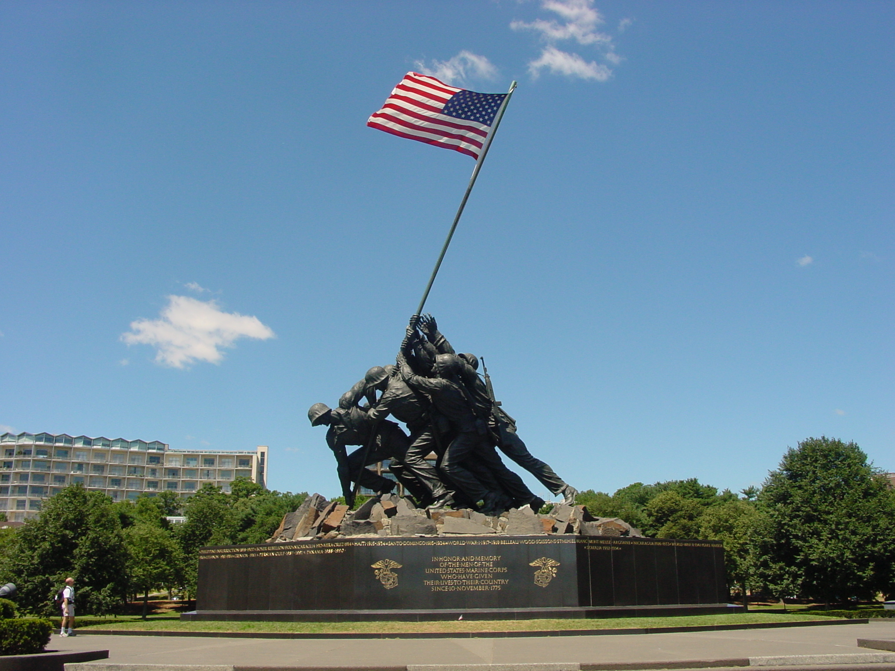
Content

Slide 12
Why Go To War?: Lesson Description
This lesson explores the costs and benefits nations must analyze before they decide to go to war.
War can be a huge cost to a nation in terms of their financials and human lives.
Nations must decide if the benefits outweigh the costs, or vice versa, before they engage in a conflict.

Slide 13
Reflect
"History teaches that war begins when governments believe the price of aggression is cheap."
-Ronald Reagan

Slide 14
Lesson Materials
Visual 1.1 – Costs and Benefits T-Chart​
​
Handout 1.1 – Decision Making Chart​
​
Handout 1.2 – JFK Cuban Missile Crisis Speech​
​
Handout 1.3 – Top Trading Partners of United States​
​
Handout 1.4 – History of Economic Growth​
​
Handout 1.5 – Conflict Slips​

Slide 15
Warm Up
What are some conflicts or wars that are currently happening around the world?​
​
Why do you think these nations went to war?

Slide 16
Group Activity
Read the following out-loud to the class:
You are the leader of a very powerful country named Carlenia in the year 2025. Recently, it has been reported by your intelligence team that another country named Yolsa has been creating weapons of mass destruction. You also are hearing reports that Yolsa has committed human rights violations against their citizens. After being briefed by your intelligence officers, they ask you what Carlenia’s response should be. Do you decide to enter into a war with Yolsa? Or, do you decide against it?
Is there another option?

Slide 17
Group Activity
Economics of War: What happens when there is a conflict? | Political Connections | Trade and Economic Relations | Impact on Citizens | Availability of Resources
Your country goes to war…
Your country does not go to war…
Other…

Slide 18
Political Connections Activity (1.2)
Political Connections: Read out-loud or play the audio version of JFK’s famous Cuban Missile Crisis Speech (Handout 1.2). (NOTE: Due to it’s length, you may want to assign this as homework prior to the lesson.)
Discuss with the students how this impacted the United State’s relationship with the Soviet Union, Cuba and others.
  (Possible answers: Intensified an escalated situation, nuclear war was feared by the government and citizens, halted trade and diplomatic relations between countries, etc. Please note that this is an excellent example of a decision to NOT engage in a war by the President.)

Slide 19
Trade and Economic Relations (1.3)
Trade and Economic Relations: Refer to Handout 1.3 “Top Trading Partners of United States”. Consider any conflicts the United States has entered into recently and compare that to the countries on the list. You will find that the United States has not entered into any recent conflict with any of their top trading partners. Why is this so? (Possible answers: If they entered into a conflict, trading would cease and dramatically decrease their Gross Domestic Product. This would automatically impact their citizens quality of life and lead to decreased economic growth and increased unemployment.)
The United States is the world’s 2nd-largest trading nation, behind only China, with over $7.0 trillion in exports and imports of goods and services in 2022. The U.S. has trade relations with more than 200 countries, territories, and regional associations around the globe. (Office of the United States Trade Representative, 2025).

Slide 20
Impact on Citizens (1.4)
Impact on Citizens: Refer to Handout 1.4 “History of Economic Growth”. War can bring many costs to the country’s citizens. From an economic perspective, public debt and taxation tends to increase during war. Also, consumption and investment tend to decrease. As a result, what do you think happens to the citizen’s quality of life? (Possible answers: Citizens will experience higher taxes, higher unemployment and a lower quality of life.)
Increased government spending
Full (or near full) employment
Resource Allocation
Labor Force Expansion

Slide 21
Availability of Resources
Availability of Resources: Brainstorm with students what resources may be beneficial to have during a period of war. For example, consider transportation of goods and services, access to water, skilled labor, etc.
What happens to these resources when a country enters into a war?
What happens if a country has limited resources prior to entering a conflict? (Possible discussion points: Recall that during World War II, the United States shifted many resources used to make consumer products to creating military products. The workforce also changed to include many more women. Think about the opportunity costs of these decisions.)
Think about it: How does this lead into shortages of certain consumer goods?

Slide 22
T-Chart Activity
Ask the class:
  What are the benefits of entering into a conflict with Yolsa?
  What are the costs?
  What might be some short term economic effects of entering into a conflict? Long term effects?
  List the student’s responses on the t-chart as they respond.

Slide 23
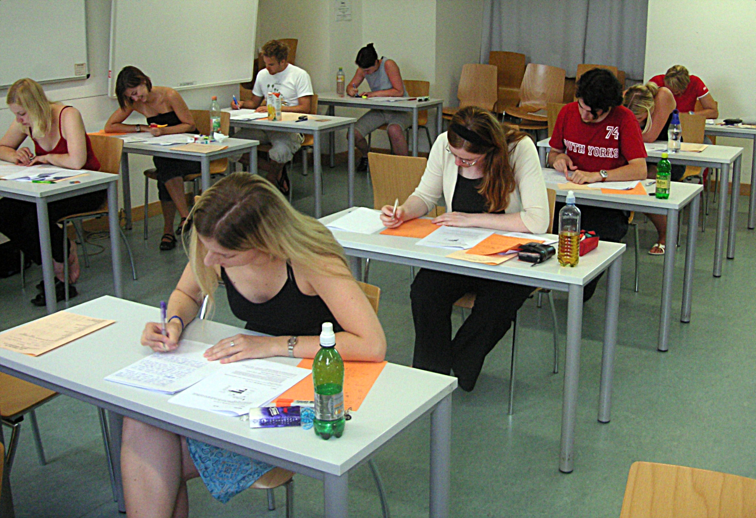
Assessment

Slide 24
Debrief
Ask the students the following:
Why do some nations enter into a war or conflict? (Possible answers could include religious, economic and political examples discussed in class.)
What are some of the costs and benefits of entering into a war or conflict? (Possible answers could include: economic gain or loss, political stability or instability, religious freedom, etc.)
Refer back to the concepts and vocab:
  Cost/Benefit Analysis
    A process of examining the advantages (benefits) and disadvantages (costs) of each available alternative in arriving at a decision

Slide 25
"To be prepared for war is one of the most effective means of preserving peace".
George Washington

Slide 26
Assessment Idea
Students will draw a slip of paper (Handout 1.5) and be assigned a specific war or conflict. Then, they will need to create a T-Chart with at least three costs and three benefits of the particular conflict by conducting research on their own. Finally, they will be expected to write a one-page response explaining the costs and benefits and short and long term economic consequences of their conflict.
(NOTE: You may want to assign this as a group project to discuss initially and for creation of the t-chart, and then have them write their responses individually.)
Alternative ideas: Quote Reflections using key concepts and vocabulary

Slide 27
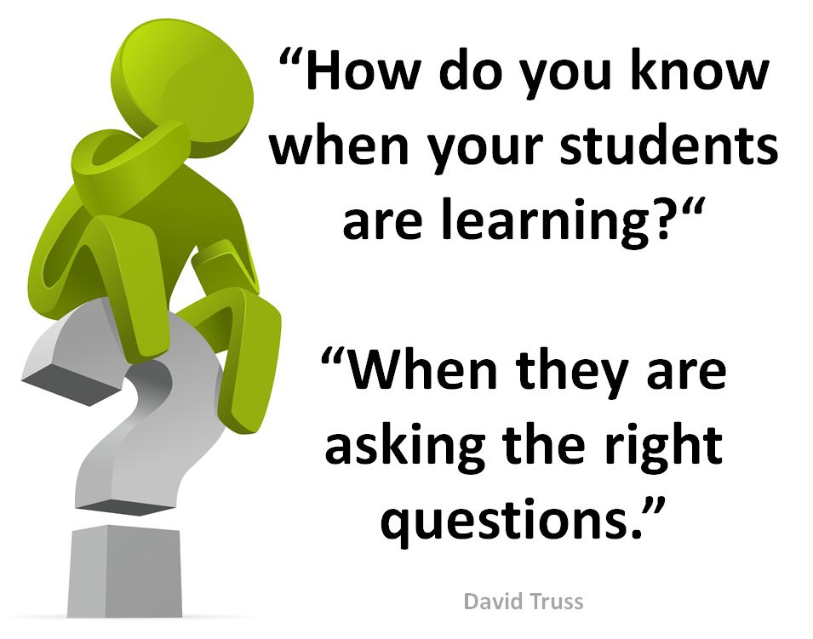
Q & A

Slide 28
Reflect...
How can I use this material in my classroom?
What questions will my students have?
Will my students be able to explain the costs and benefits of going to war?
Can my students give examples of short-term and long-term effects of entering into a conflict (after reviewing data and primary resources in this lesson)?
Will my students be able to analyze and interpret data to make a decision, such as the example of Carlenia?

Slide 29
Contact Us
Cynthia Fitzthum
Cjfitzhum@stcloudstate.edu
Jeremy Miller (co- author)
Jmiller@c-ischools.org

Slide 30





Find your Local Competition and Register Today!
The National Personal Finance Challenge is a competition that provides
high school students with an exciting and motivating opportunity to build, apply, and demonstrate their knowledge of money management.
Through online exams and a personal finance simulation, teams showcase their expertise in earning income, spending, saving, managing credit, investing, and managing risk.
Teams of up to four students, with one teacher/coach, can qualify to represent their state at the National Personal Finance Challenge by
winning their state competition.
CASH PRIZES
for each member of the winning teams:
1st Place $2,000
2nd Place $1,000
3rd Place $500
4th Place $250
NATIONALS > Finals:
Critical thinking round & Quiz Bowl in Atlanta, Georgia on June 1-2.
Register today: bit.ly/cee-npfc

Slide 31





Teach Economics?
Your students may have what it takes to compete in the nation’s only high school economics competition!
Why Play?
• Fun team learning experience
• Great for college applications
• No other challenge like this
• Online participation makes access easy
• Chance for cash prizes
Two divisions based on
experience level
David Ricardo for first-time competitors who have taken no more than one economics course.
Adam Smith for returning competitors, AP, International Baccalaureate, and honors students.
How it Works
Teams register
Teachers enroll team(s) of 3- 4 high school students from the same school. Multiple
teams allowed.
Teams compete within their state
Compete to win your state competition for a
chance to advance to the National Semi-Finals.
National Semi-Finals: April 21-24, 2025
Teams answer multiple-choice questions on macroeconomics, microeconomics, and international & current events.
National Finals: Atlanta, Georgia
May 28-30, 2025
Teams analyze an economic issue and present their solution. Top teams engage in the Finals Quiz Bowl where they face-off answering questions to claim the National Title.
CASH PRIZES
for each member of the winning teams:
1st Place $1,000
2nd Place $500
3rd Place $250
4th Place $200
Register Today at NationalEconomicsChallenge.org

Slide 32








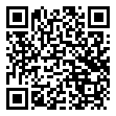



Free Personal Finance Program for High School Girls
Invest in Girls (a program of CEE) invites your high school students to learn about personal finance in a supportive all-girl environment! IIG instructors will teach students the basics of personal finance, how to invest, and help them build professional skills. These programs are online and free to attend.
Share this sign up link with your students
Or visit investingirls.org/for-students/

Slide 33

Thank you for attending today!

