Slide 1


Introduction to AP Macroeconomics: Graphs & Study Skills

Slide 2
Certificate Requirements
To earn professional development hours for webinars, you must:
Watch a minimum of 45-minutes and you will automatically receive a professional development certificate via e-mail within 24 to 48 hours.

Slide 3
Objectives
You will be able to:
Identify important graphs students should know for the AP Microeconomics exam.
Identify the key characteristics of “well dressed graphs” to help students earn maximum points on the FRQ section

Slide 4
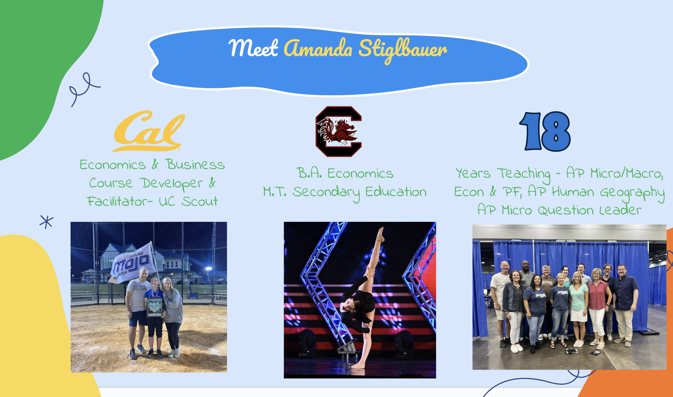

Slide 5
Session Agenda
Overall Strategies
Strategies Explained
Study Strategies
ALL THE GRAPHS (well, most of them)
Final Thoughts and Questions – Ask a Reader!

Slide 6
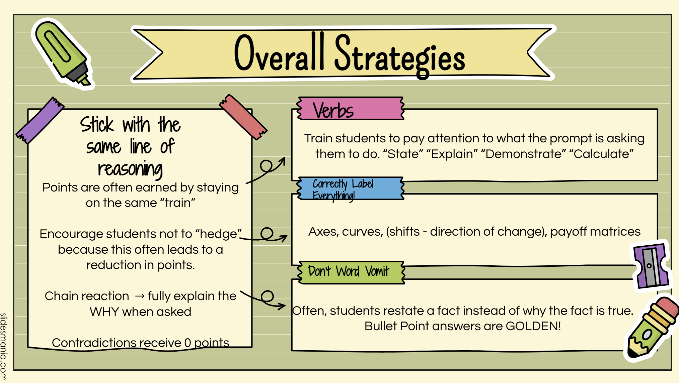

Slide 7
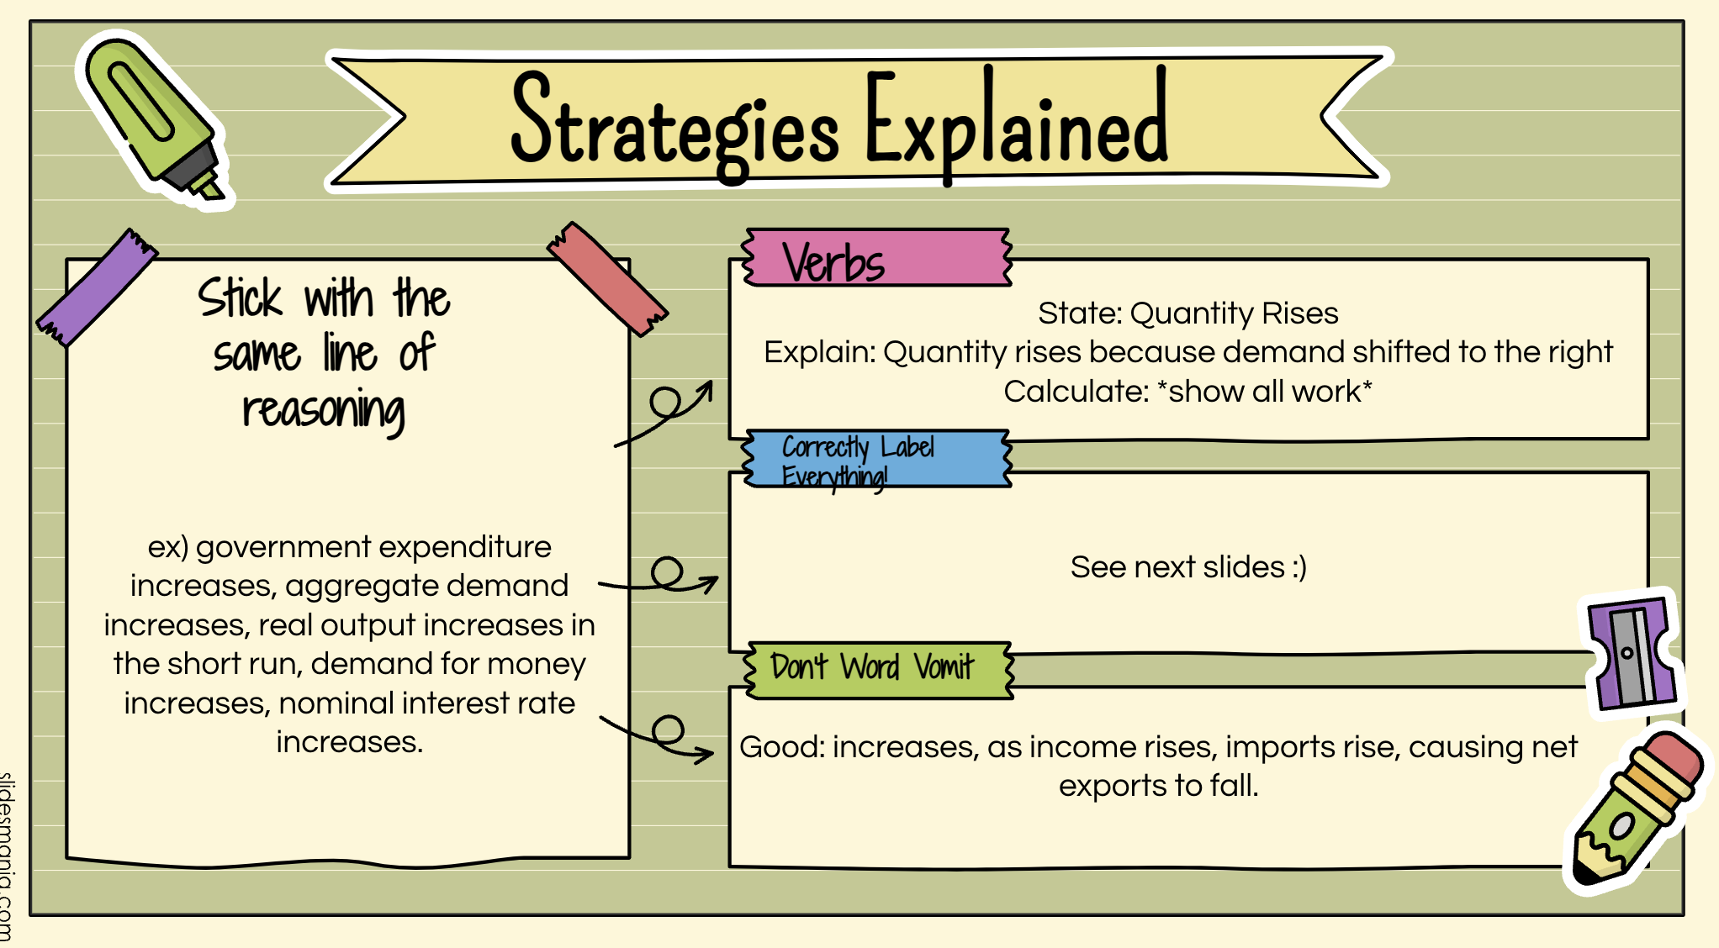

Slide 8

Study Strategies- How to Help Your Kiddos!
AP Classroom Practice Sets – Multiple Choice
AP Classroom FRQ Practice – Student Graded
FRQ Grading in Class
Take the time – give practice exams!
  Test Item Analysis – Topical/based on unit
Test Corrections? Retakes?
  Item analysis:
    Incorrect: Why did you get the question wrong? Why was your answer incorrect?
    Correct: What is the correct answer? Why is it correct?

Slide 9
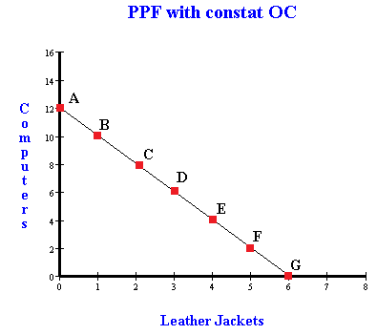
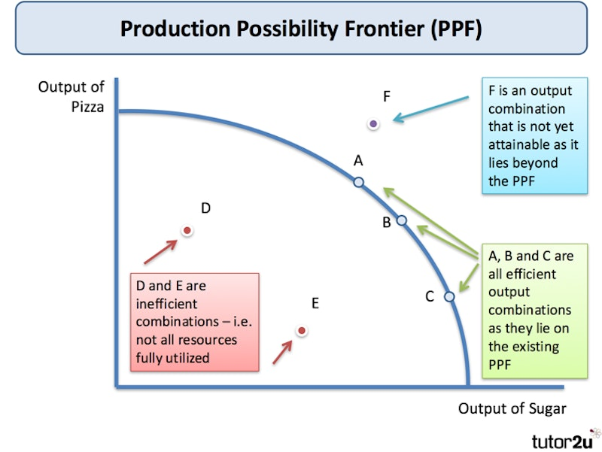
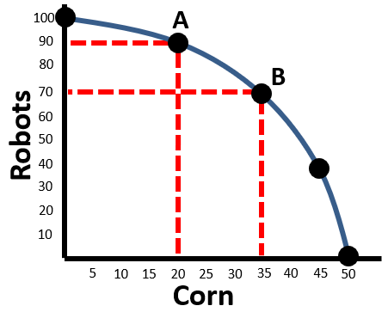
Production Possibilities Curves
Increasing Opportunity Cost

Slide 10
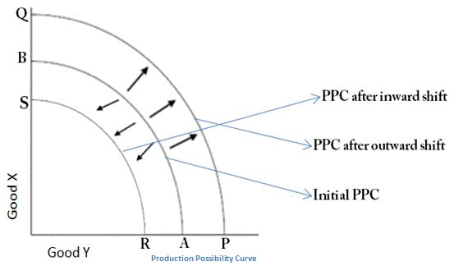

Slide 11
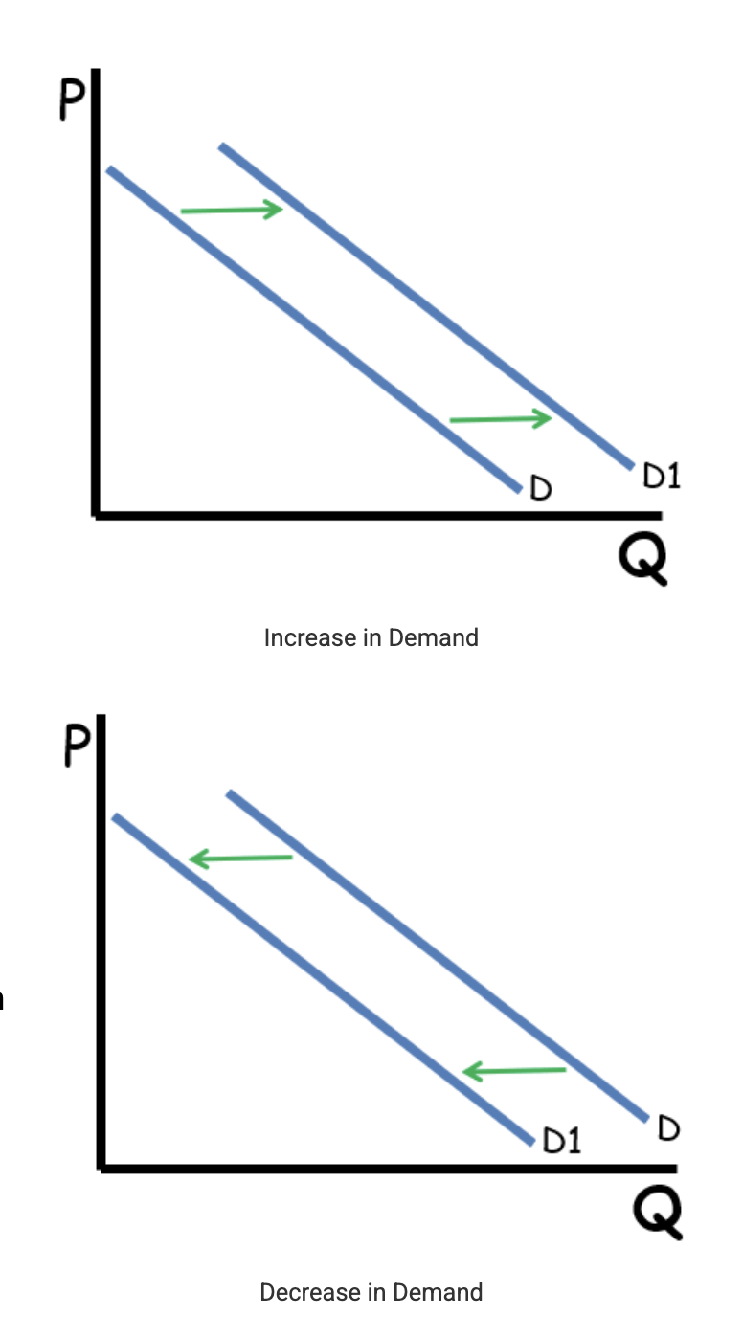
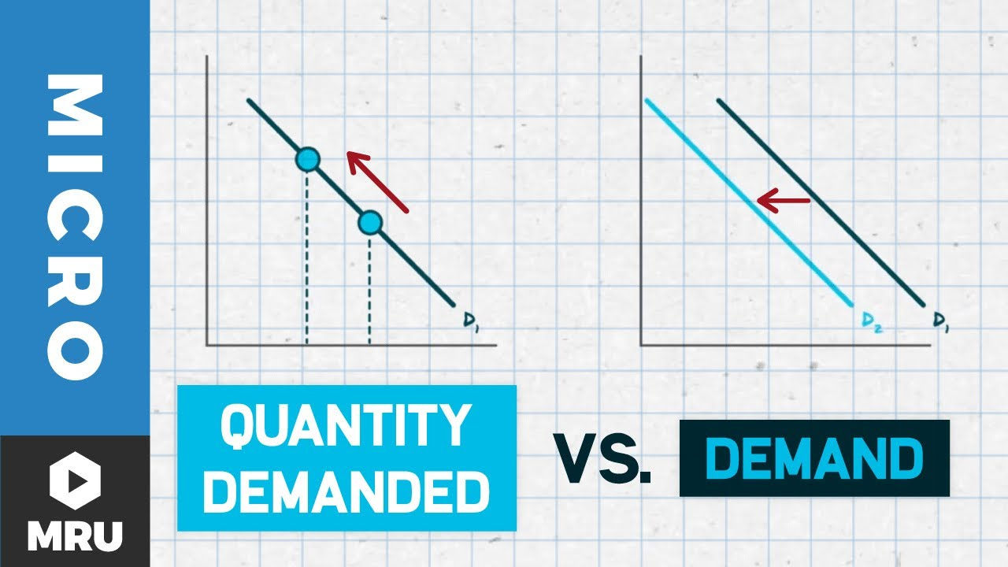
Changes in Demand
T - Tastes
I - Income
M – Market Size
E – Expectations of Future price
R – Related Goods

Slide 12
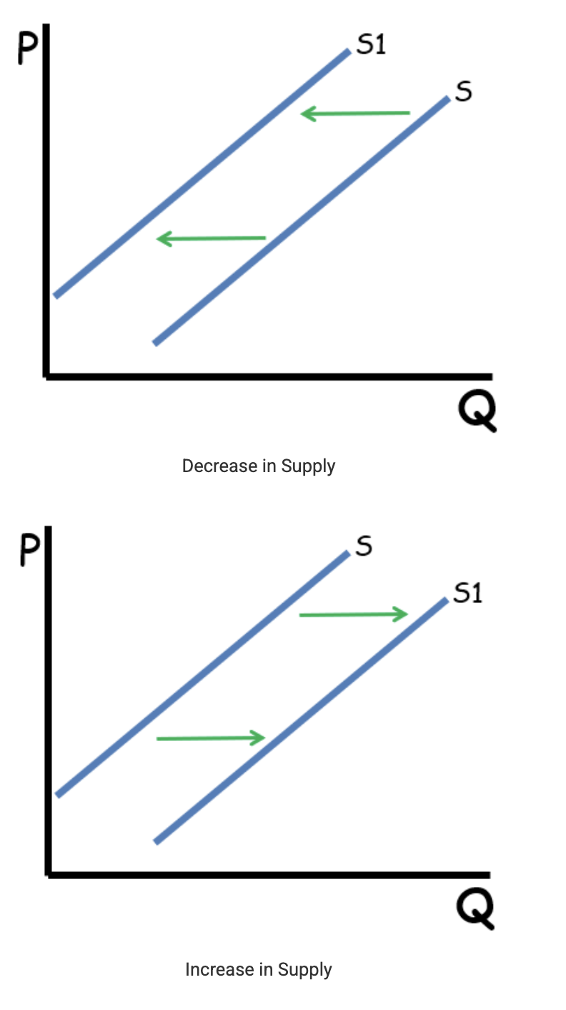
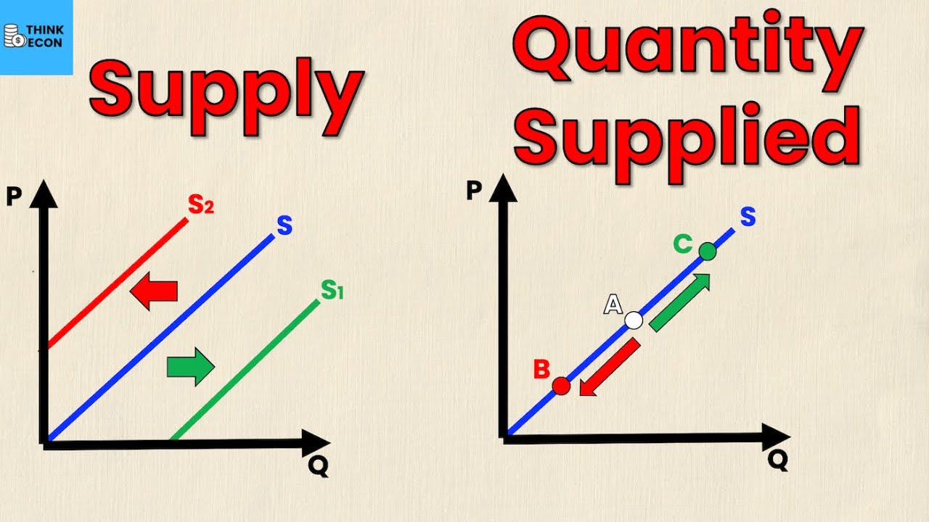
Changes in Supply
R – Resource Prices
O - Other Goods & Their Prices
T - Taxes
T - Technology
E – Expectations of Future Price
N – Number of Sellers

Slide 13
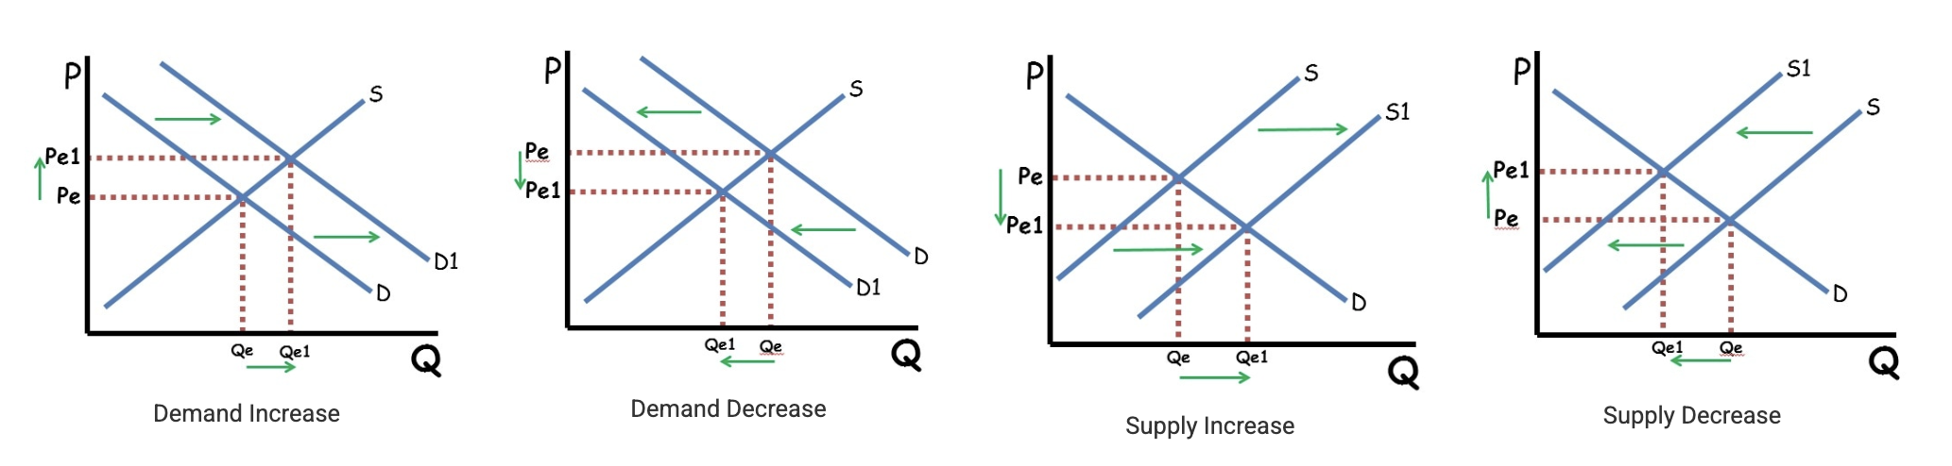
Changes in Demand & Supply

Slide 14
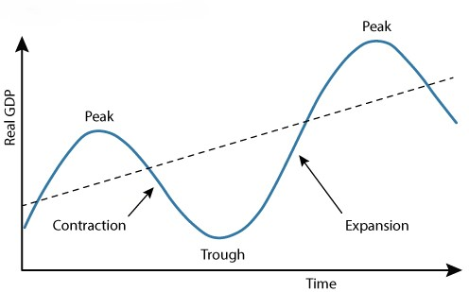
Business Cycle

Slide 15
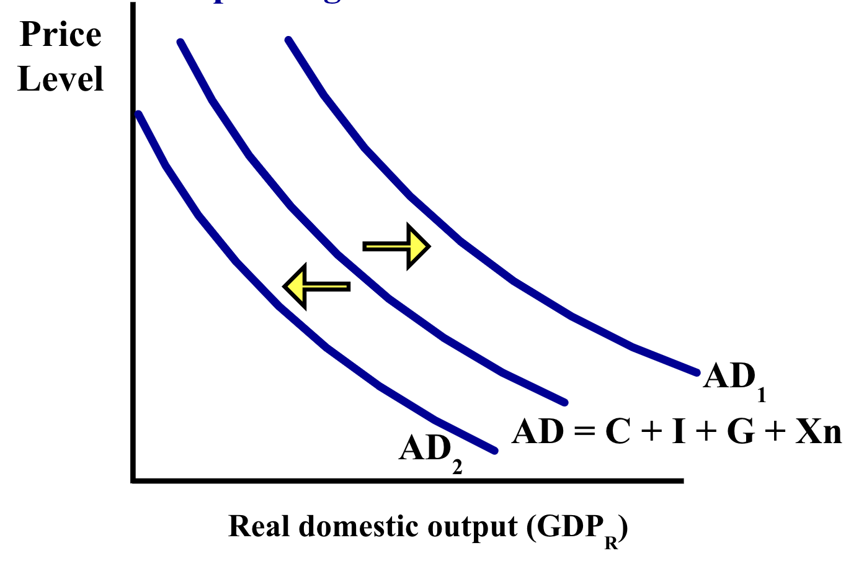
Aggregate Demand

Slide 16
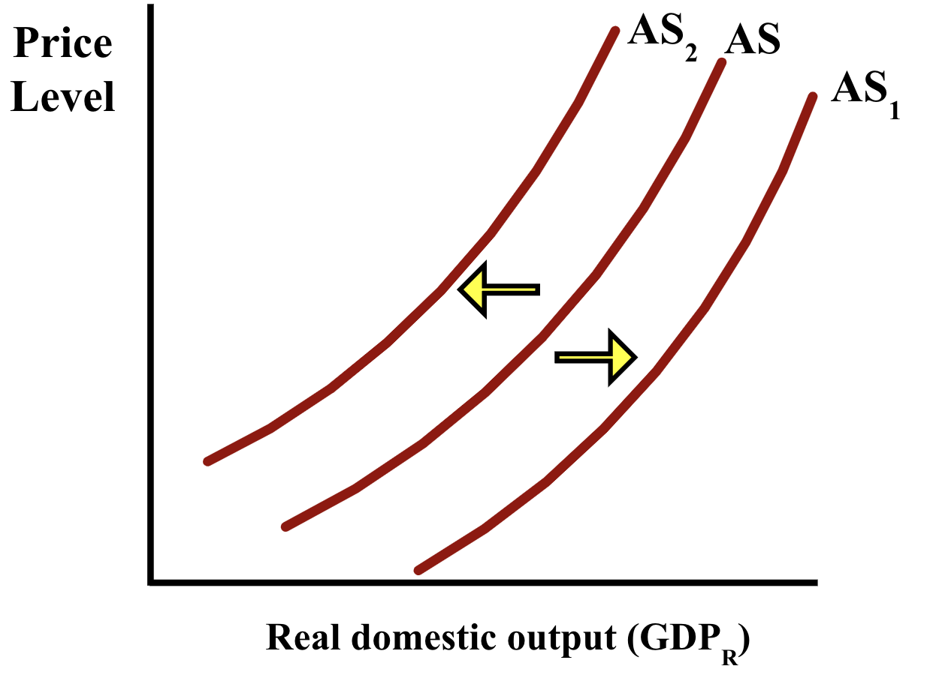
Short Run Aggregate Supply

Slide 17
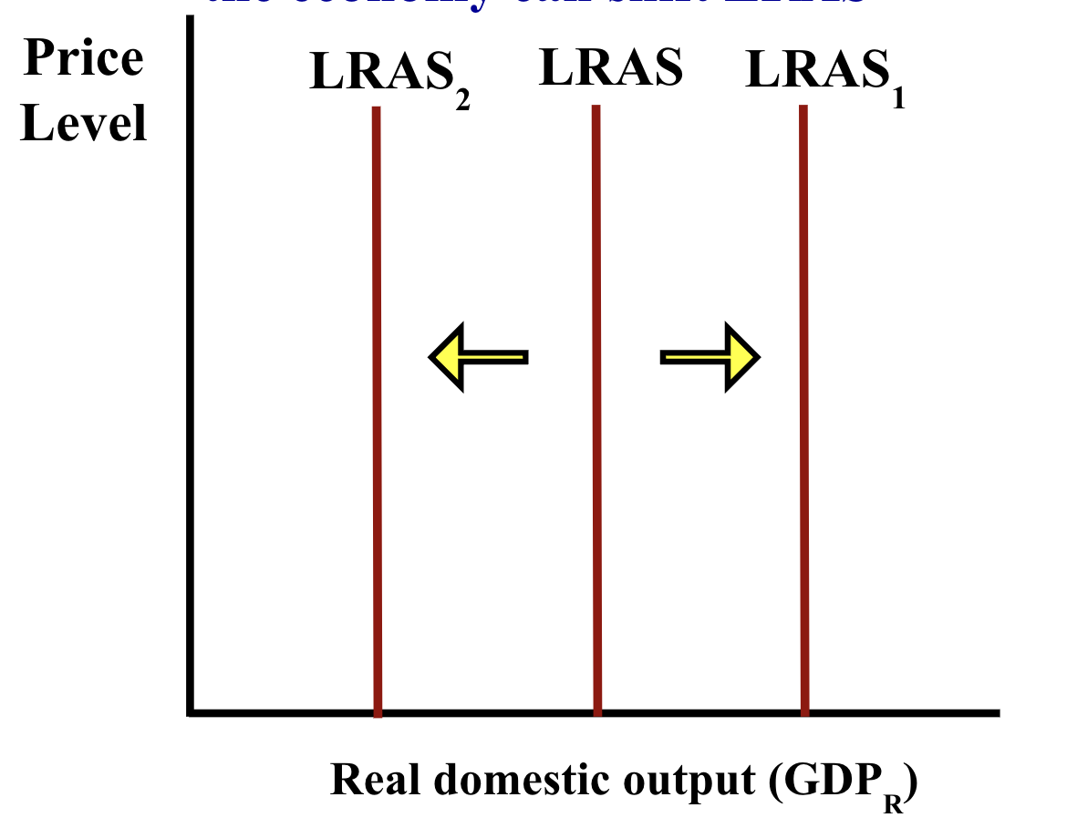
Long Run Aggregate Supply ​

Slide 18
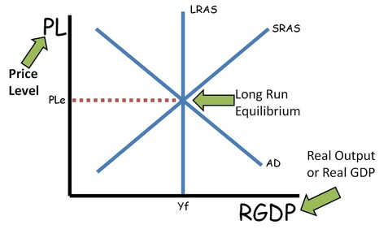

Slide 19
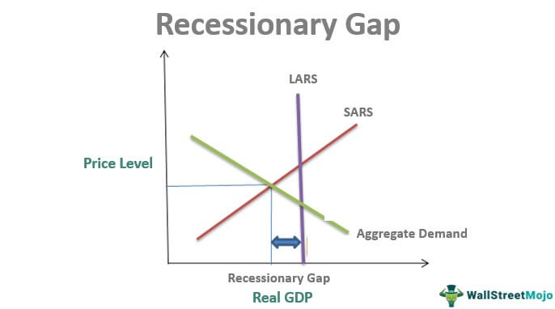

Slide 20
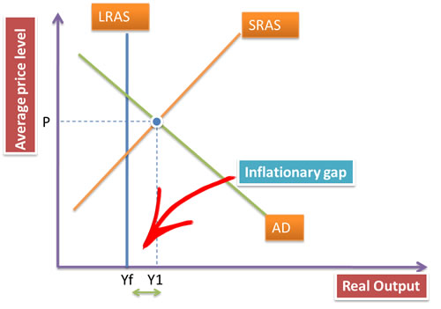

Slide 21
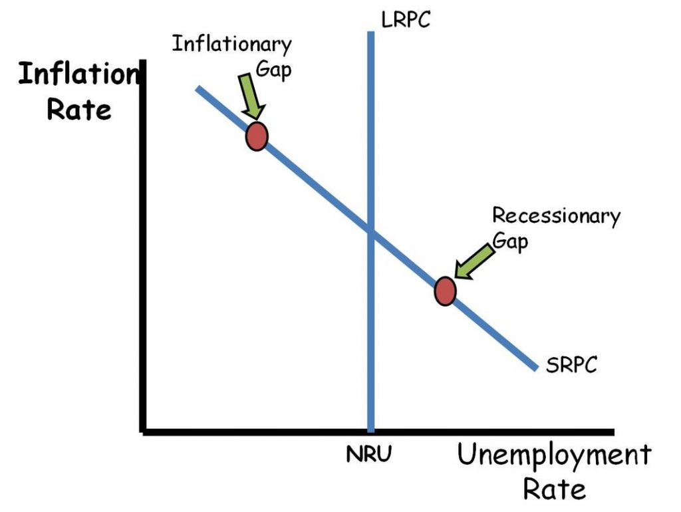
Phillips Curve

Slide 22
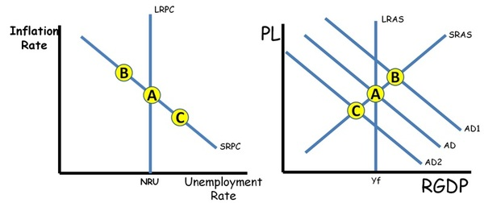
Movements along the SRPC

Slide 23
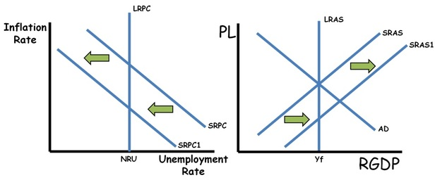
Shifts of the SRPC

Slide 24
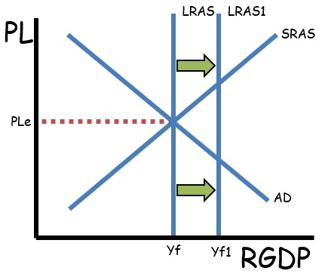
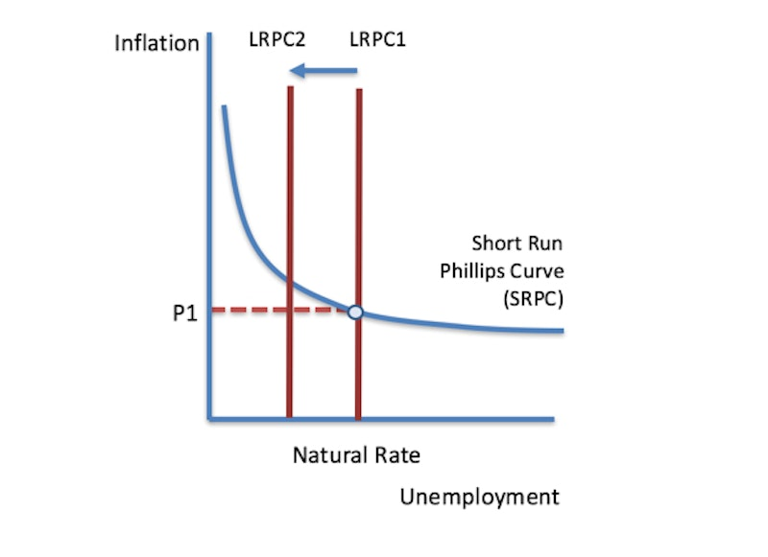
Shifts of the LRPC

Slide 25
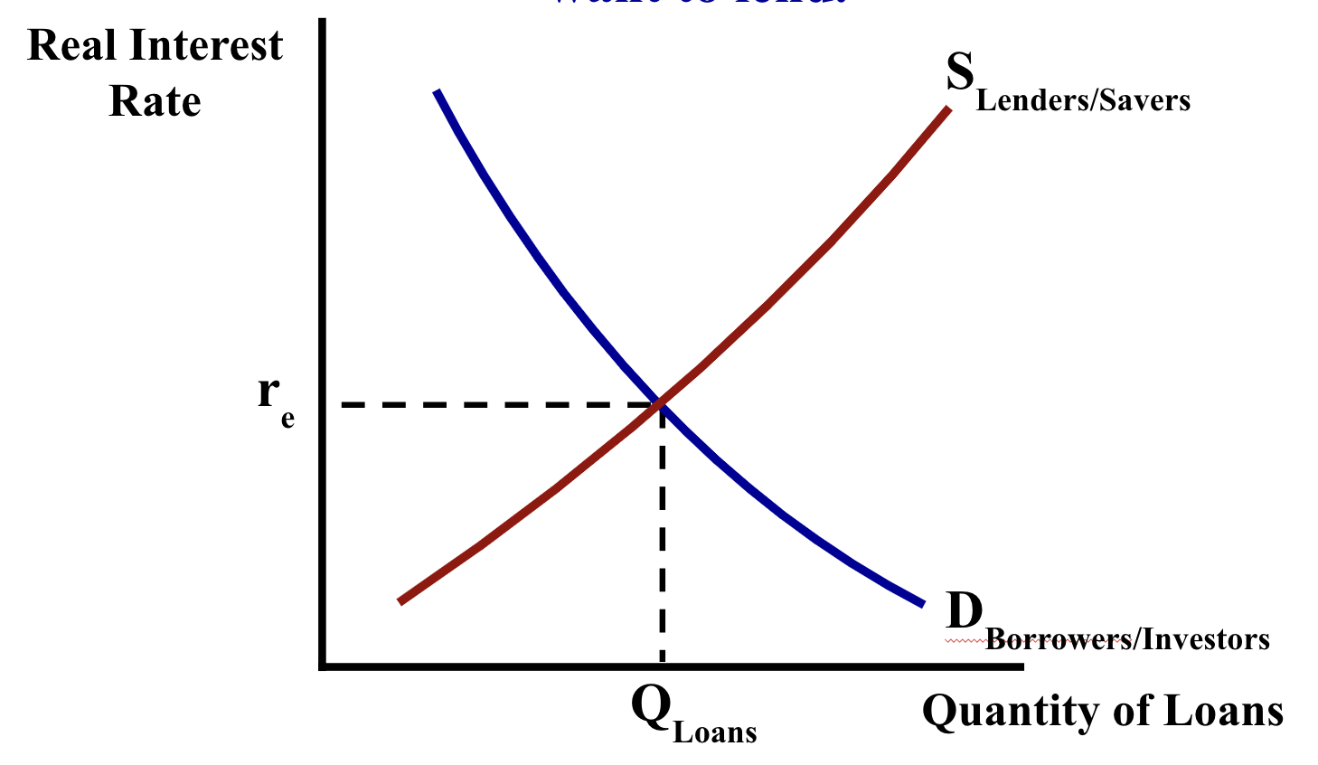
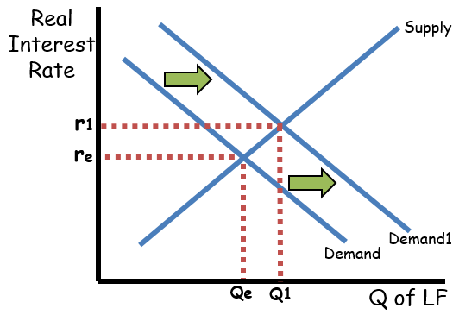
Loanable Funds Market & Crowding Out

Slide 26
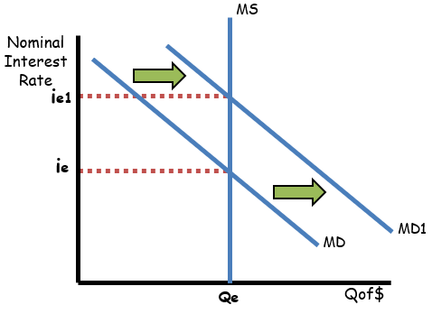
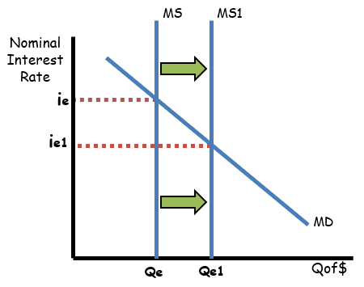
Money Market

Slide 27
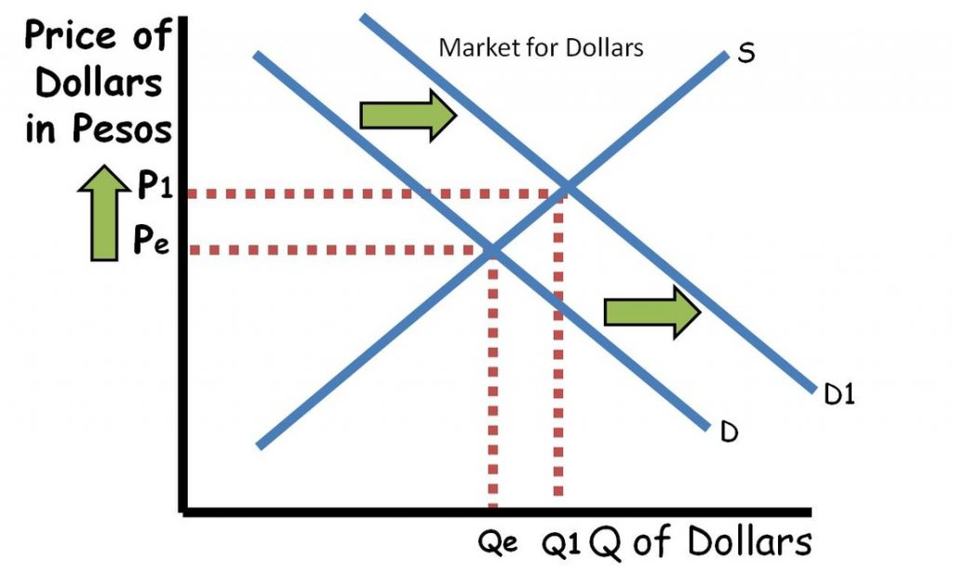
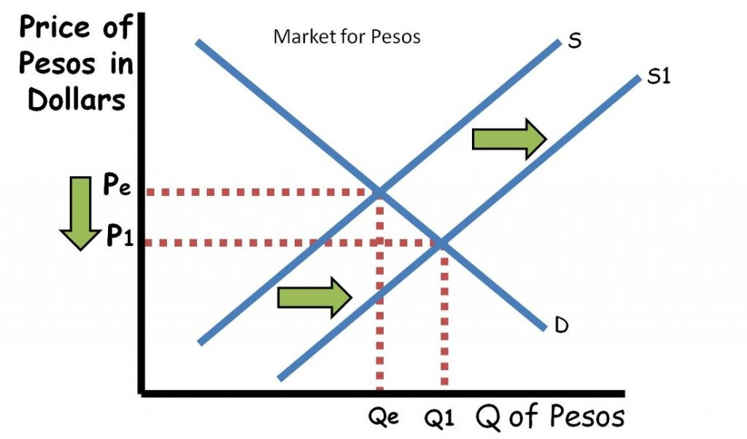
FOREX Markets

Slide 28

Thoughts/Questions - Ask a Reader!

Slide 29
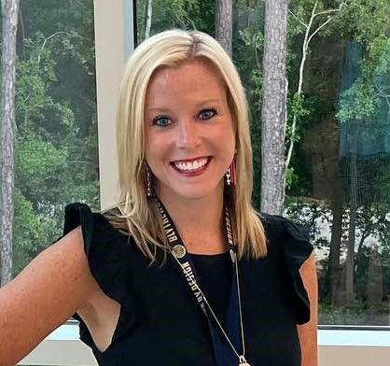
Presenter
Amanda Stiglbauer
Economics & Business Course Developer & Facilitator
UC Scout
Econstig@gmail.com

Slide 30


