Slide 1


Introduction to AP Microeconomics: Graphs & Study Skills

Slide 2
Certificate Requirements
To earn professional development hours for webinars, you must:
Watch a minimum of 45-minutes and you will automatically receive a professional development certificate via e-mail within 24 to 48 hours.

Slide 3
Objectives
You will be able to:
Identify important graphs students should know for the AP Microeconomics exam.
Identify the key characteristics of “well dressed graphs” to help students earn maximum points on the FRQ section

Slide 4


Slide 5
Session Agenda
Overall Strategies
Strategies Explained
Study Strategies
ALL THE GRAPHS (well, most of them)
Final Thoughts and Questions – Ask a Reader!

Slide 6
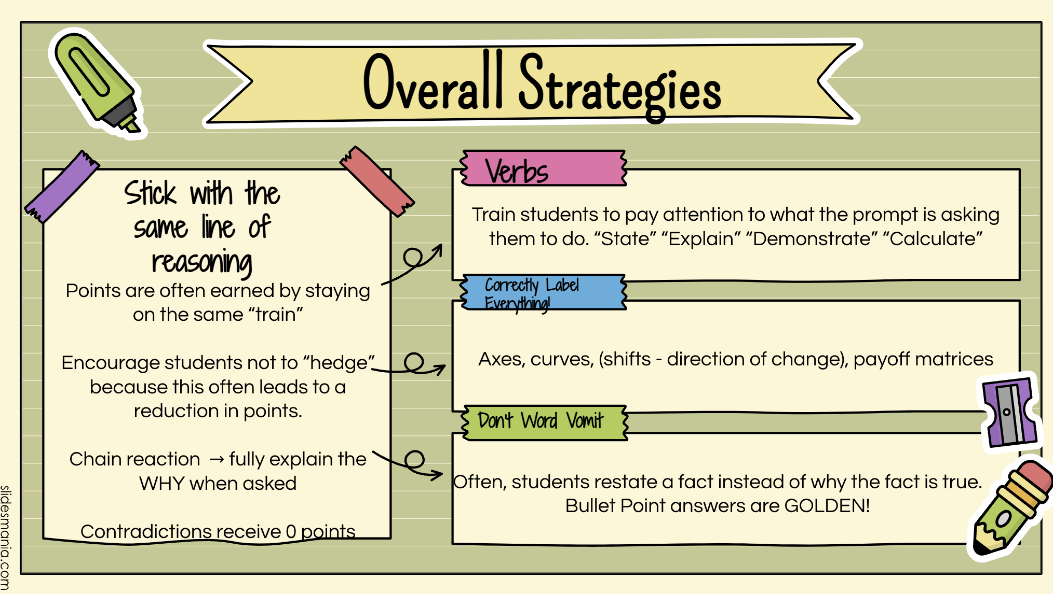

Slide 7
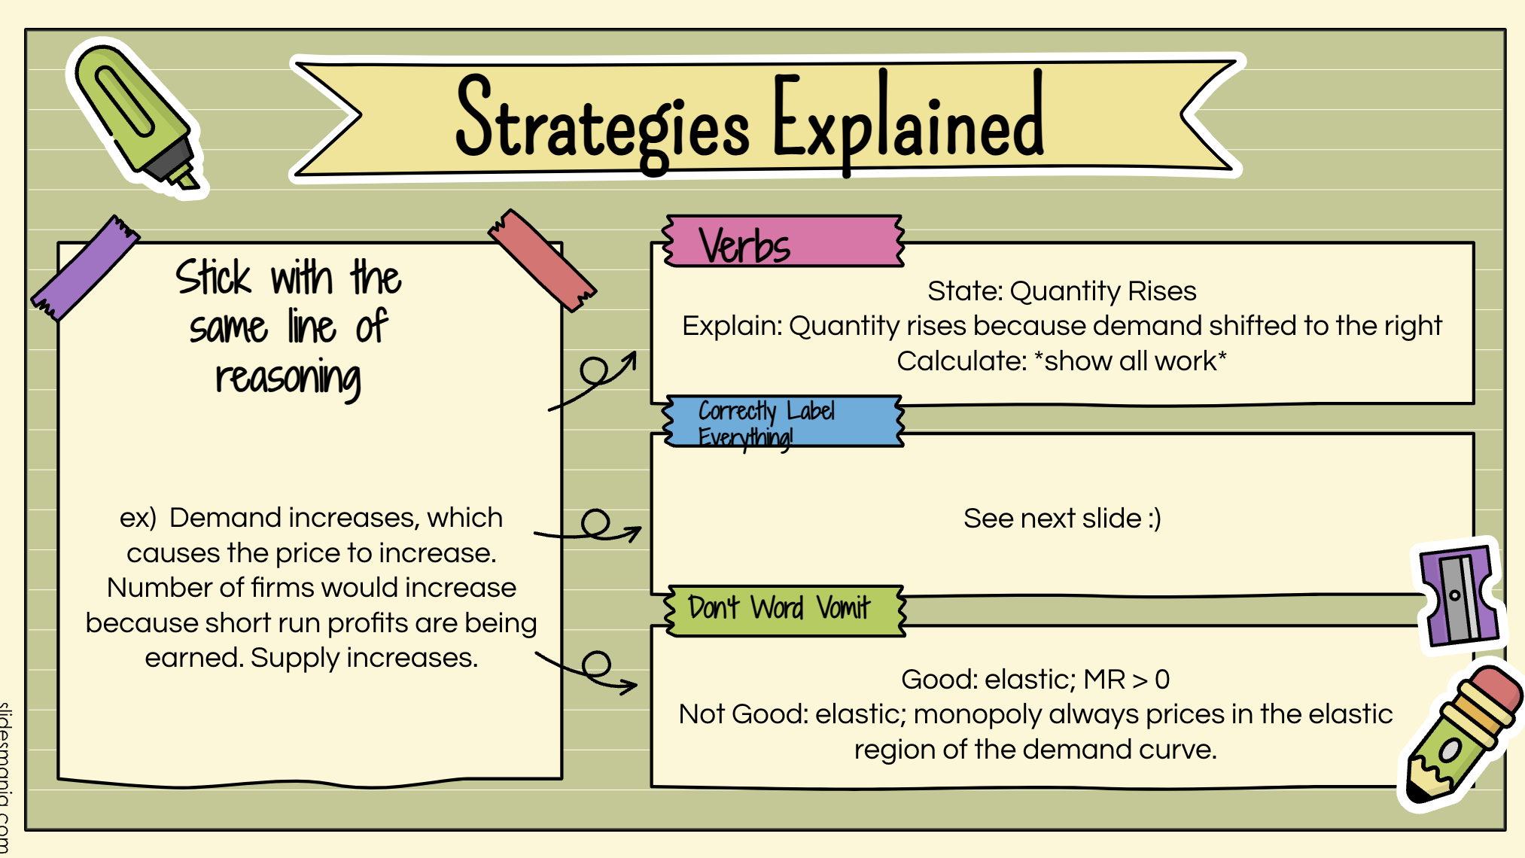

Slide 8

Study Strategies- How to Help Your Kiddos!
AP Classroom Practice Sets – Multiple Choice
AP Classroom FRQ Practice – Student Graded
FRQ Grading in Class
Take the time – give practice exams!
  Test Item Analysis – Topical/based on unit
Test Corrections? Retakes?
  Item analysis:
    Incorrect: Why did you get the question wrong? Why was your answer incorrect?
    Correct: What is the correct answer? Why is it correct?

Slide 9


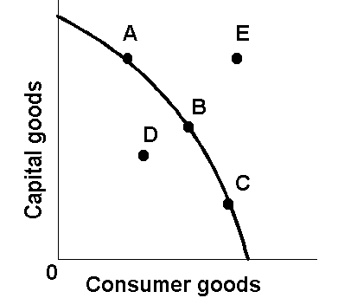
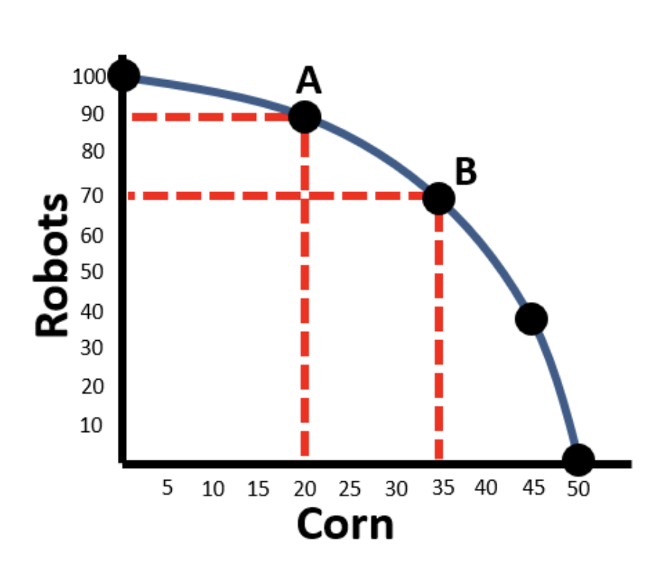
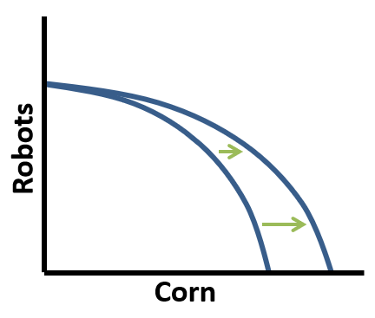
Unit 1, Topic 1.3: Production Possibilities Curve (Frontier)
PPC concave to origin:
-Points A, B, C –productively efficient
-Point E –unattainable given resources
-Point D – inefficient/some resources unemployed
PPC shift due to increase in improvements to factors of production for one product (corn)
PPC showing increasing opportunity costs

Slide 10
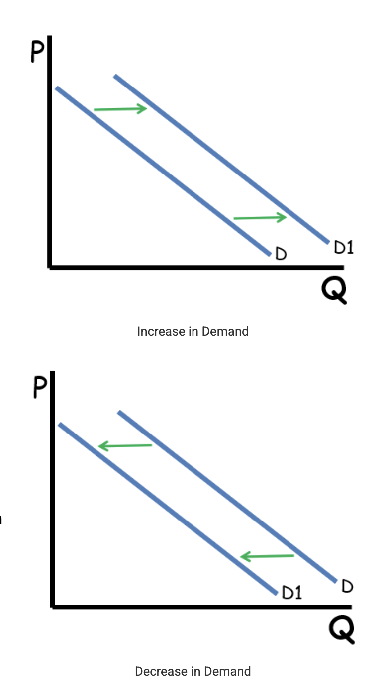

Changes in Demand
T - Tastes
I - Income
M – Market Size
E – Expectations of Future price
R – Related Goods

Slide 11
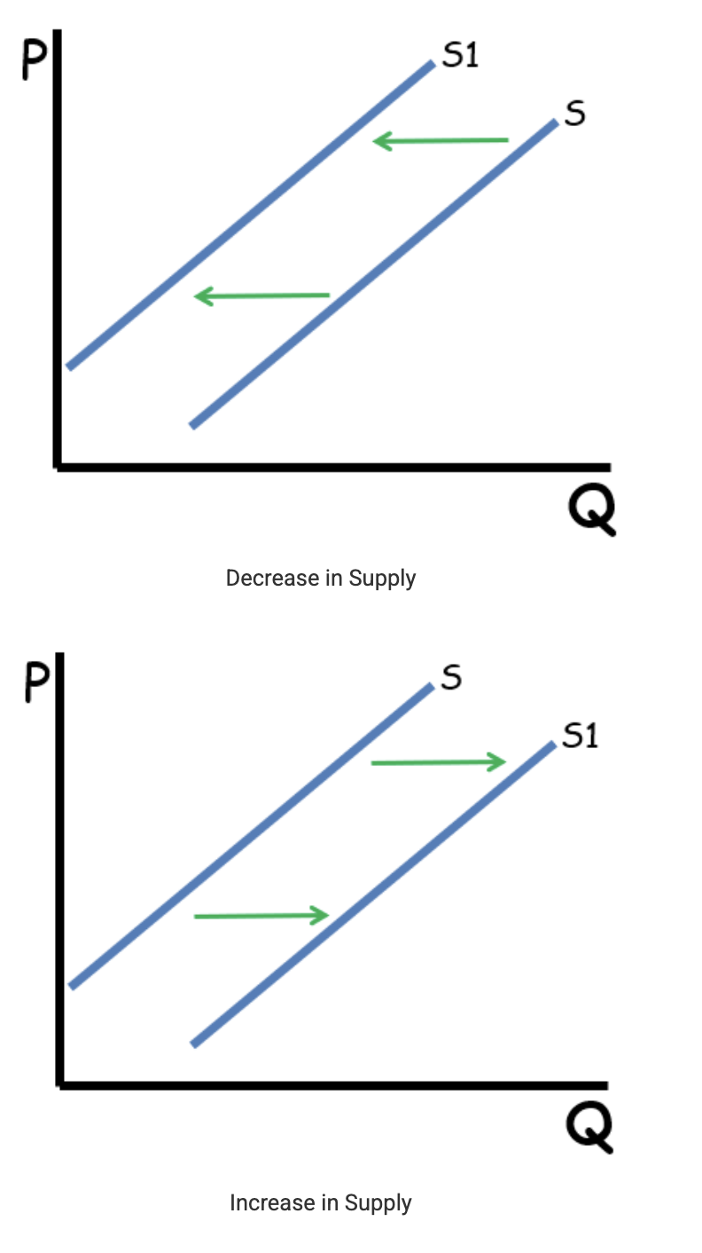
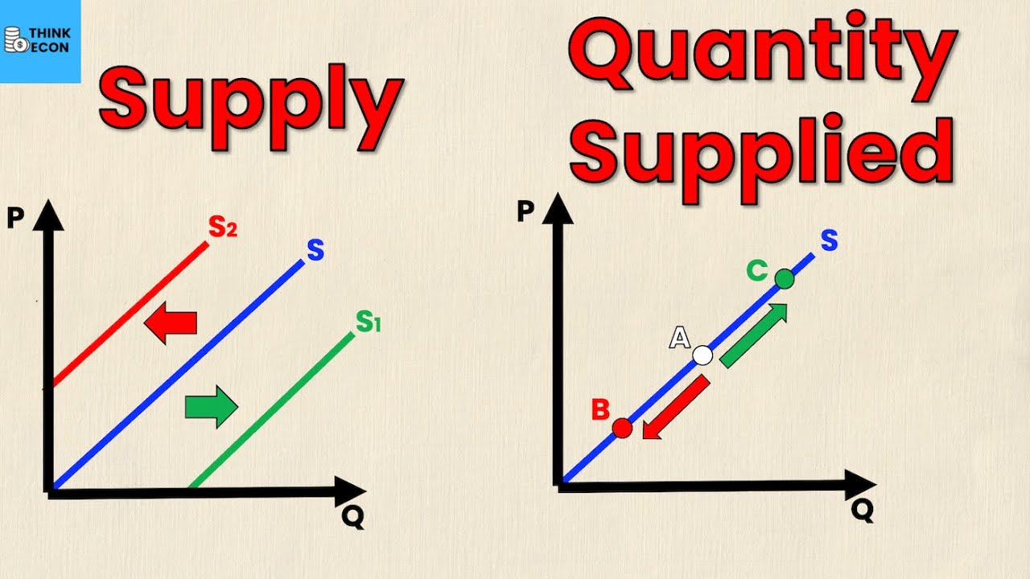
Changes in Supply
R – Resource Prices
O - Other Goods & Their Prices
T - Taxes
T - Technology
E – Expectations of Future Price
N – Number of Sellers

Slide 12
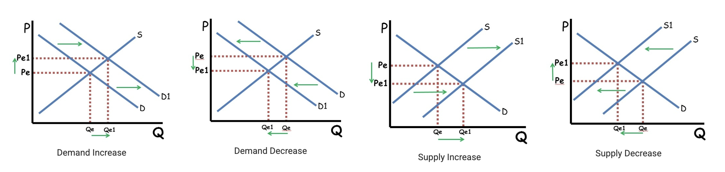
Changes in Demand & Supply

Slide 13
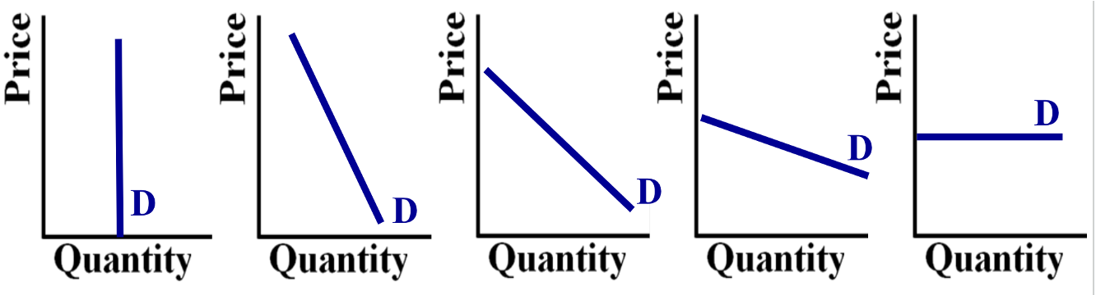
Unit 2, Topic 2.3: Price Elasticity of Demand
Left to right: perfectly inelastic, relatively inelastic, unit elastic, relatively elastic, perfectly elastic

Slide 14
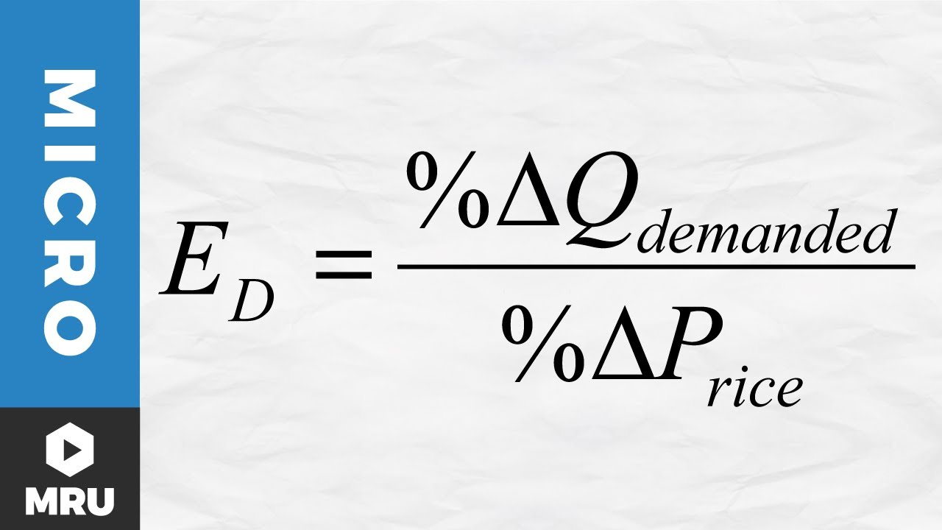

Slide 15
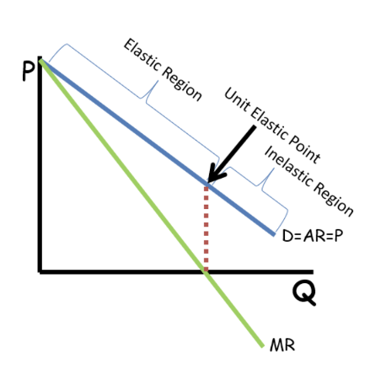
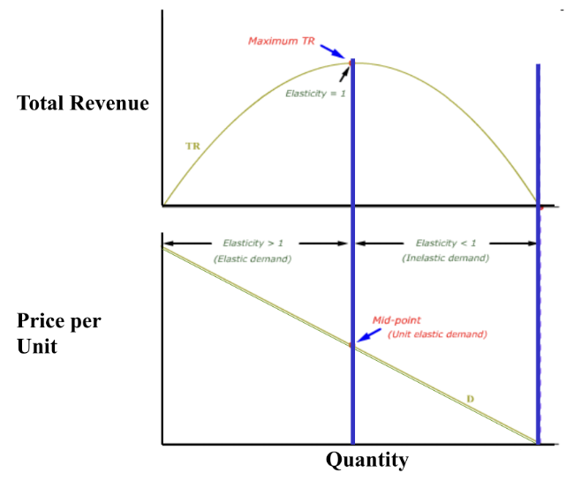
Unit 2, Topic 2.3: Price Elasticity of Demand

Slide 16
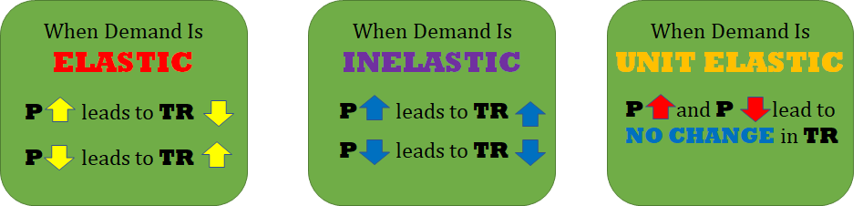
Using the TR Test for Elasticity
TR = P * Qd

Slide 17
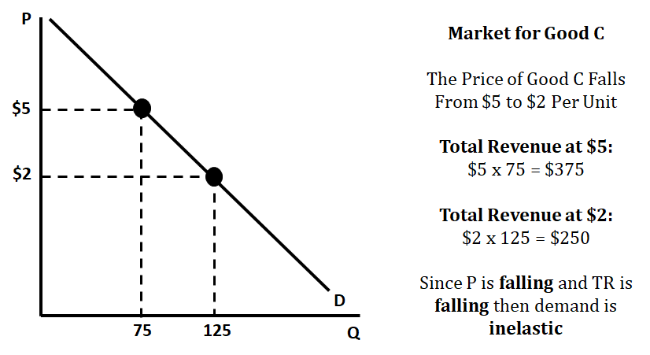
TR Test in Action

Slide 18
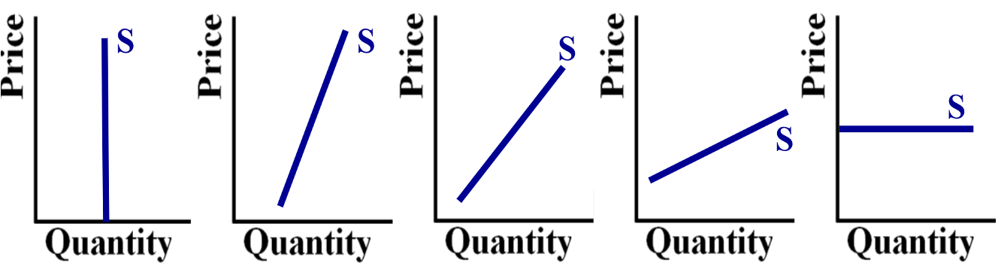
Unit 2, Topic 2.4: Price Elasticity of Supply
Left to right: perfectly inelastic, relatively inelastic, unit elastic, relatively elastic, perfectly elastic

Slide 19
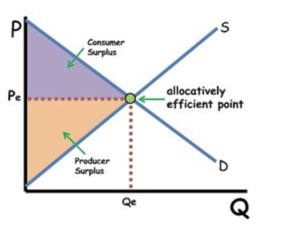
Unit 2, Topic 2.6: Market Equilibrium and Consumer and Producer Surplus

Slide 20
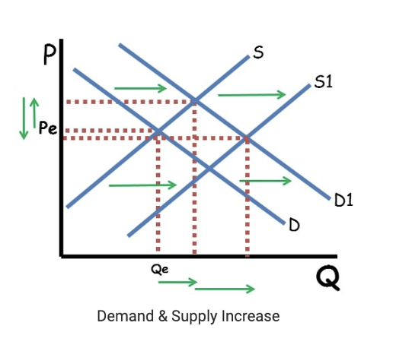
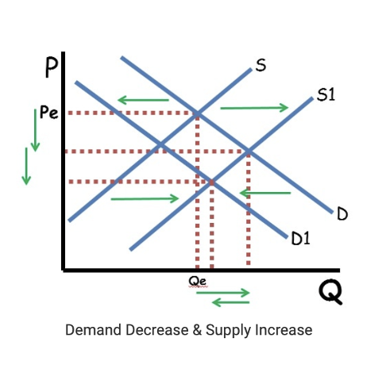
Unit 2, Topic 2.7: Market Disequilibrium and Changes in Equilibrium
Simultaneous Shifts in Supply & Demand

Slide 21
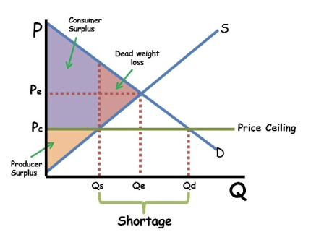
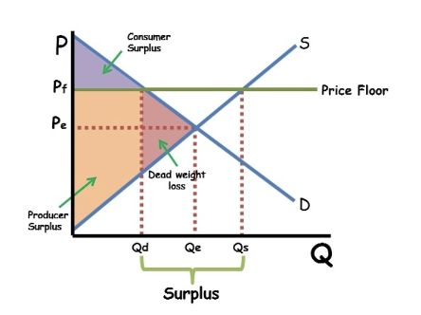
Unit 2, Topic 2.8: The Effects of Government Intervention in Markets
(Price Controls)

Slide 22
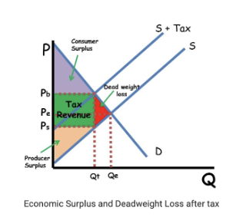
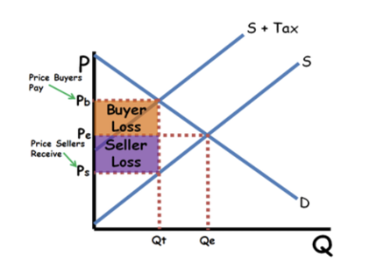
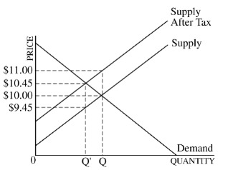
Tax Incidence
(2.8 Government Intervention in Markets)

Slide 23
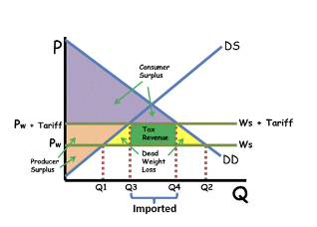
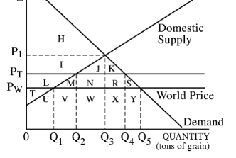
Topic 2.9 International Trade

Slide 24
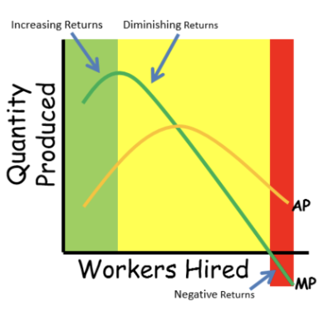
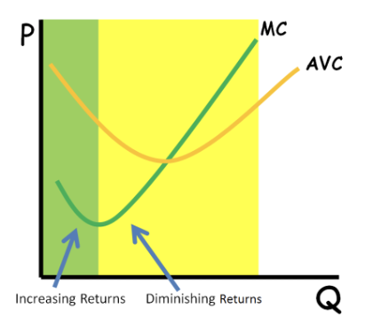
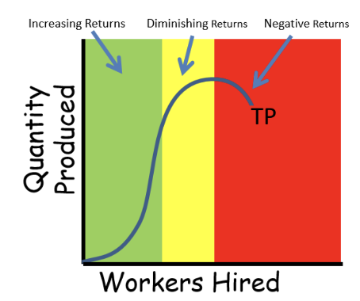
Production and Costs

Slide 25
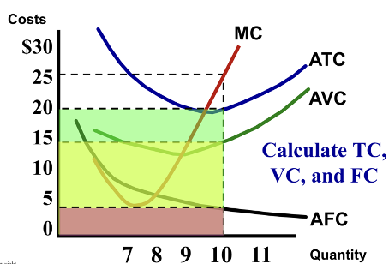
Topic 3.2 Short Run Production Costs

Slide 26
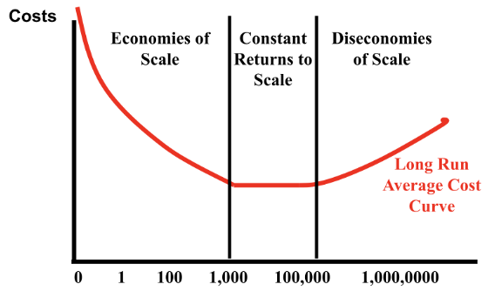
Topic 3.3 Long Run Production Costs

Slide 27
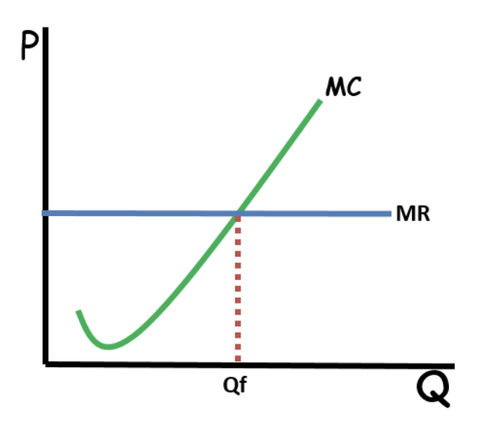
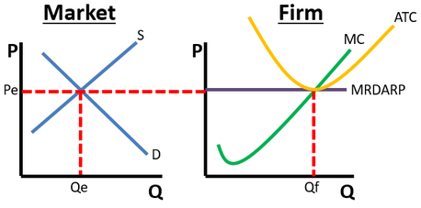
Topic 3.5 Profit Maximization

Slide 28
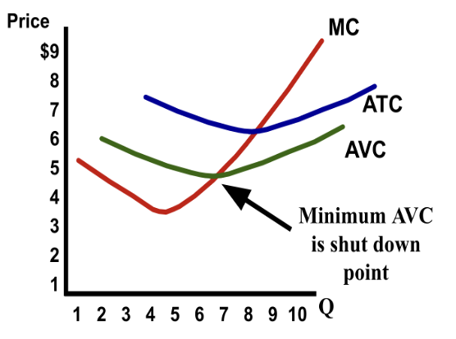
To remain open or shut down?

Slide 29
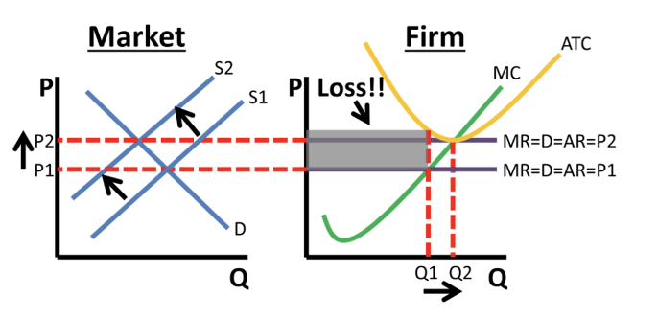
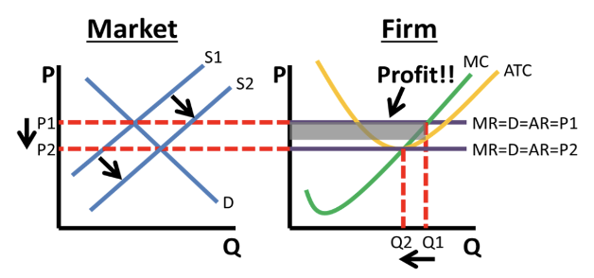
Topic 3.7 Perfect Competition

Slide 30
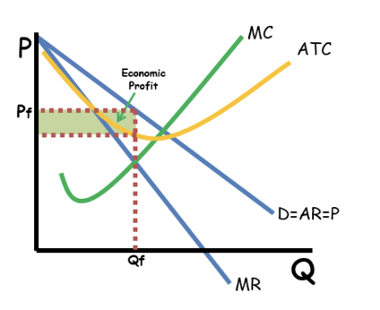
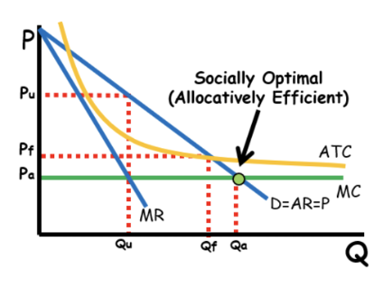
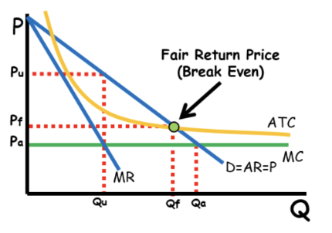
Monopoly

Slide 31
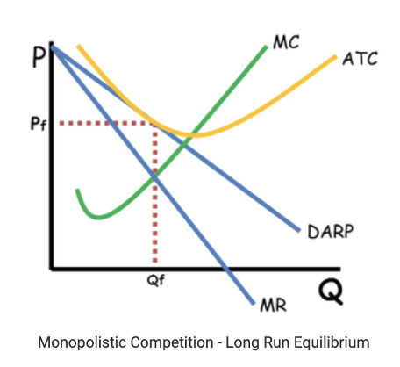
Monopolistic Competition

Slide 32
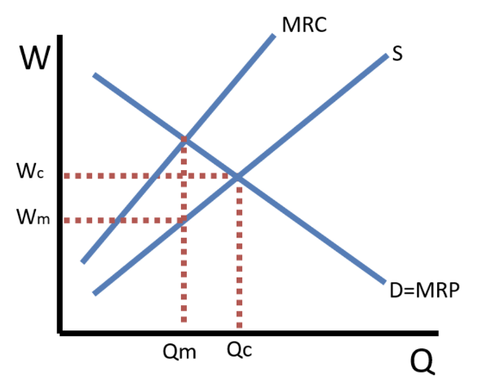
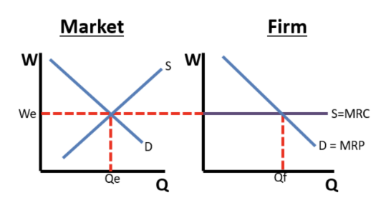
Factor Markets: PC and Monopsony

Slide 33
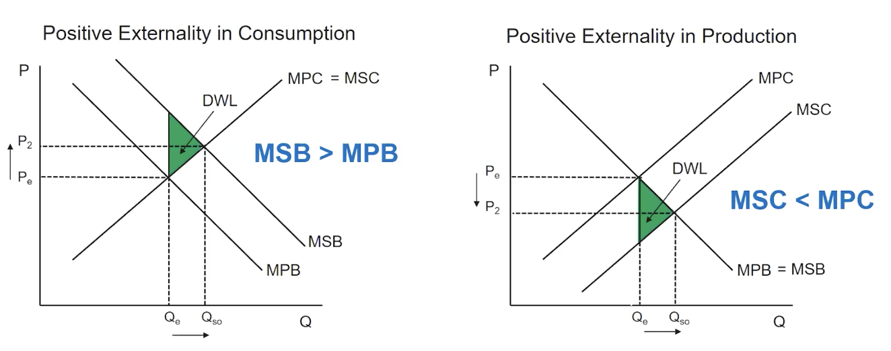
Positive Externalities

Slide 34
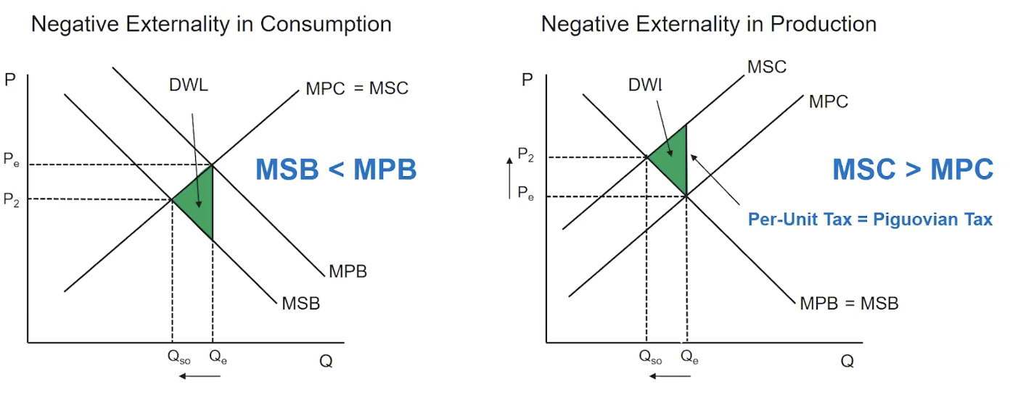
Negative Externalities

Slide 35

Thoughts/Questions - Ask a Reader!

Slide 36


Slide 37





Find your Local Competition and Register Today!
The National Personal Finance Challenge is a competition that provides
high school students with an exciting and motivating opportunity to build, apply, and demonstrate their knowledge of money management.
Through online exams and a personal finance simulation, teams showcase their expertise in earning income, spending, saving, managing credit, investing, and managing risk.
Teams of up to four students, with one teacher/coach, can qualify to represent their state at the National Personal Finance Challenge by
winning their state competition.
CASH PRIZES
for each member of the winning teams:
1st Place $2,000
2nd Place $1,000
3rd Place $500
4th Place $250
NATIONALS > Finals:
Critical thinking round & Quiz Bowl in Atlanta, Georgia on June 1-2.
Register today: bit.ly/cee-npfc

Slide 38





Teach Economics?
Your students may have what it takes to compete in the nation’s only high school economics competition!
Why Play?
• Fun team learning experience
• Great for college applications
• No other challenge like this
• Online participation makes access easy
• Chance for cash prizes
Two divisions based on
experience level
David Ricardo for first-time competitors who have taken no more than one economics course.
Adam Smith for returning competitors, AP, International Baccalaureate, and honors students.
How it Works
Teams register
Teachers enroll team(s) of 3- 4 high school students from the same school. Multiple
teams allowed.
Teams compete within their state
Compete to win your state competition for a
chance to advance to the National Semi-Finals.
National Semi-Finals: April 21-24, 2025
Teams answer multiple-choice questions on macroeconomics, microeconomics, and international & current events.
National Finals: Atlanta, Georgia
May 28-30, 2025
Teams analyze an economic issue and present their solution. Top teams engage in the Finals Quiz Bowl where they face-off answering questions to claim the National Title.
CASH PRIZES
for each member of the winning teams:
1st Place $1,000
2nd Place $500
3rd Place $250
4th Place $200
Register Today at NationalEconomicsChallenge.org

Slide 39








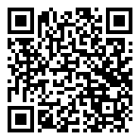



Free Personal Finance Program for High School Girls
Invest in Girls (a program of CEE) invites your high school students to learn about personal finance in a supportive all-girl environment! IIG instructors will teach students the basics of personal finance, how to invest, and help them build professional skills. These programs are online and free to attend.
Share this sign up link with your students
Or visit investingirls.org/for-students/

Slide 40

[INSERT FEATURED IMAGE OF WEBINAR SESSION]
Thank you

