Slide 1
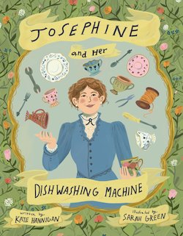

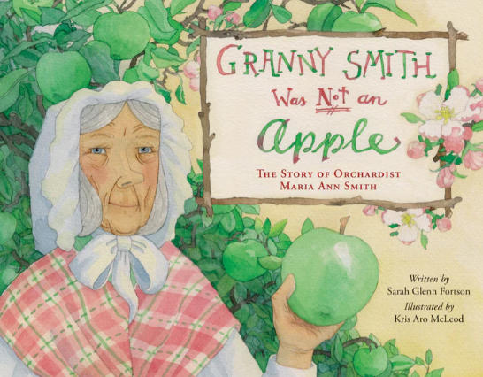
Resourceful Women:
Dishwashing Machines, Cookbooks, and Apples
March 19, 2025
Lauren Shifflett Associate Director
shiffllh@jmu.edu
JMU Center For Economic Education
Lynne Stover
Teacher Consultant
stoverlf@jmu.edu
JMU Center For Economic Education

Slide 2
EconEdLink Membership
You can now access CEE’s professional development webinars directly on EconEdLink.org! To receive these new professional development benefits, become an EconEdLink member. As a member, you will now be able to:
Automatically receive a professional development certificate via e-mail within 24 hours after viewing any webinar for a minimum of 45 minutes
Register for upcoming webinars with a simple one-click process
Easily download presentations, lesson plan materials and activities for each webinar
Search and view all webinars at your convenience
Save webinars to your EconEdLink dashboard for easy access to the event
Access our new Professional Development page here

Slide 3
Professional Development Opportunities
To earn professional development credit for CEE webinars found on EconEdLink, you must:
Watch a minimum of 45-minutes and you will automatically receive a professional development certificate via e-mail within 24 hours.
Attendees can learn how much credit they will earn per workshop.
Accessing resources:
You can now easily download presentations, lesson plan materials, and activities for each webinar from EconEdLink.org/professional-development/
Local resources:
Insert your local professional development opportunities (if applicable)

Slide 4
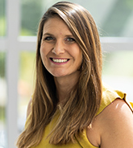
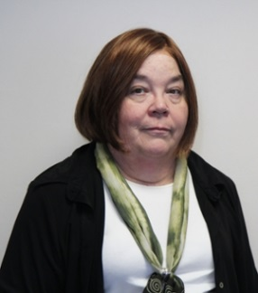
Presenters
Lauren Hensley Shifflett is the new Associate Director at the James Madison University Center for Economic Education. Prior to joining the Center, she spent twelve years in early elementary education where she enjoyed prospering young minds as a classroom teacher. Lauren became nationally known as an elementary economic educator when she received the John Morton Award of the national Council for Economic Education in 2021. Her love for economics guides her lessons to prepare students for life.
shiffllh@jmu.edu
Lynne Farrell Stover is currently a Teacher Consultant at the James Madison University Center for Economic Education. Prior to this, she spent thirty-three years in public education where she enjoyed various teaching assignments including classroom teacher, gifted education specialist, and librarian. She is the author of over fifty educational articles and eight teacher resource books. She is the recipient of the 2022 NAEE Platinum Curriculum Award for her lessons developed for Virginia’s Reading Makes Cents Program.
stoverlf@jmu.edu

Slide 5
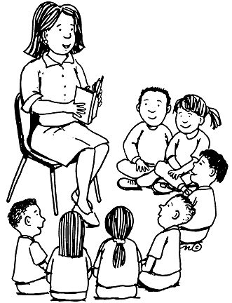
Session Agenda
Introduction
Standards and Concepts Review
Picture Books with Lessons and Activities
For Your Consideration
Session Evaluation

Slide 6
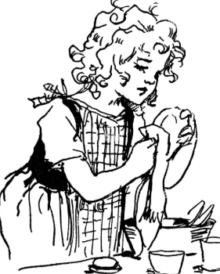
Objectives
In this webinar teachers will:
Understand the meaning of entrepreneurial traits.
Recognize the challenges faced by the featured historical women.
Describe factors influencing women’s choices concerning product development and innovation.
Use children’s literature to introduce economic concepts.

Slide 7
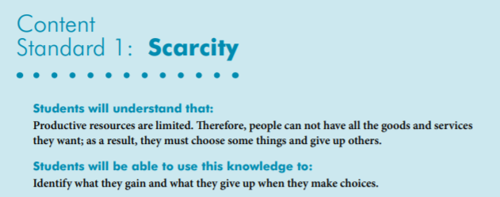
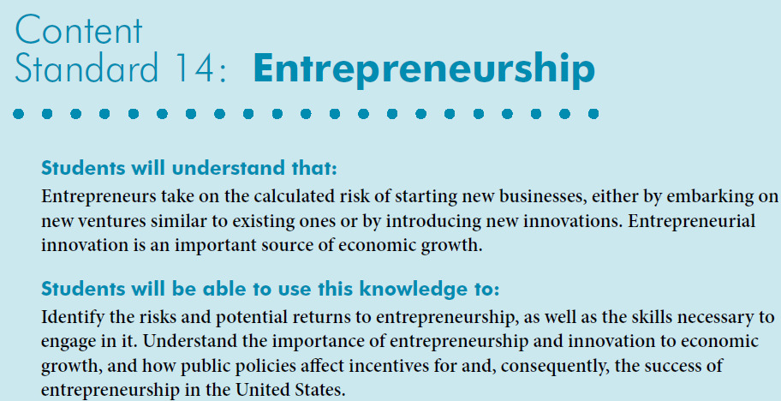
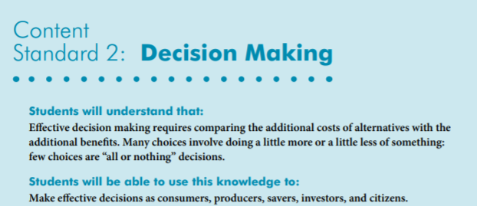

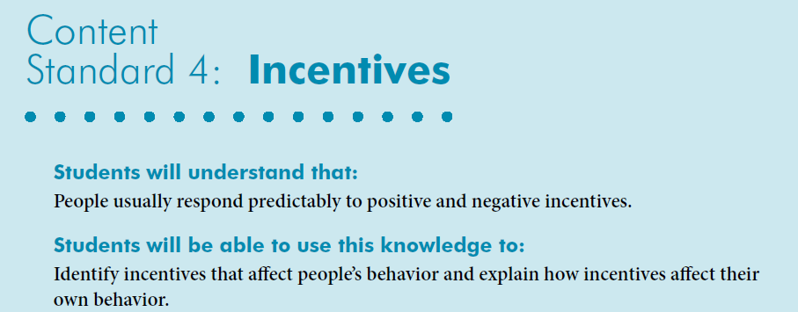
National Content Standards
https://www.councilforeconed.org/wp-content/uploads/2012/03/voluntary-national-content-standards-2010.pdf

Slide 8
Or…Let’s Learn Economic Concepts in Two Slides
ECONOMICS 101

Slide 9
ECONOMICS 101
Economics is the study of _________
(as they pertain to _________, _________, and the _________).
choices
consumers
producers
government
Every nation has productive resources
__________________
Resources from the earth, unaltered by man
__________________
People’s effort, skills, and knowledge
__________________
Man-made resources
used over and over
natural
human
capital
__________________
Goods used in production to become part of a product
intermediate
which are used to produce
goods
and
services
to be __________________ or __________________ with money (savings).
bartered
purchased

Slide 10
however
Productive resources, and therefore, goods and services, are limited
Human wants (needs)
are basically unlimited
resulting in
SCARCITY
Consequently, buyers (consumers) and sellers (producers) have to make
economic __________________ (resulting in
__________________ __________________)
choices
opportunity
cost
when answering
three basic economic questions
__________ ___________
Buyers and sellers answer ?’s
___________ goods and
services will be produced?
___________ will the goods and services be produced?
___ _______ will the goods and services be distributed?
___________ ___________
Government answers ?’s
market economy
What
How
To whom
command economy
Answering these questions most efficiently creates the need for
___________________ and ___________________ resulting in trade.
specialization
interdependence
decision
making
scarcity
Economics: ___________ - __________ under ___________.

Slide 11
Josephine and Her Dishwashing Machine
by Kate Hannigan
Book Synopsis: Josephine Garis Cochrane invents the first practical and successful hand-powered dishwasher despite societal hurdles, lack of professional training and financial hardships.
Publisher: Boyds Mills Press
Copyright Date: 2023
Reading Level; 2.3
Interest Level: 2-5
Josephine Cochrane- March 8, 1839-August 3, 1913

Slide 12
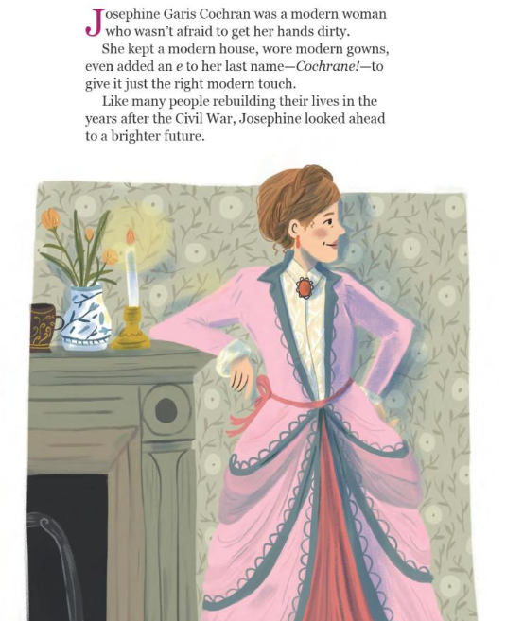
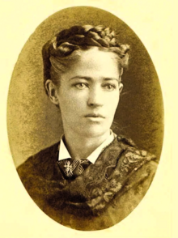
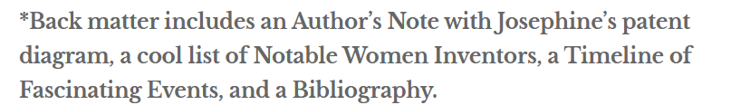

Slide 13
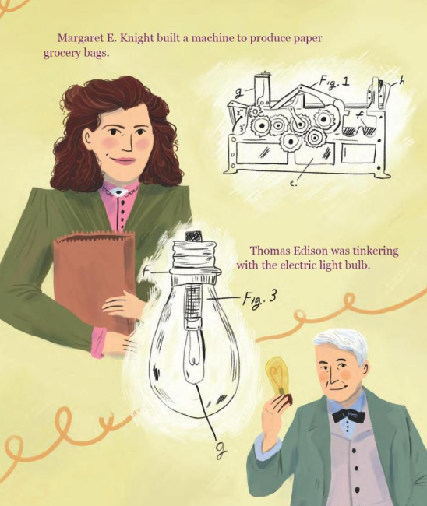
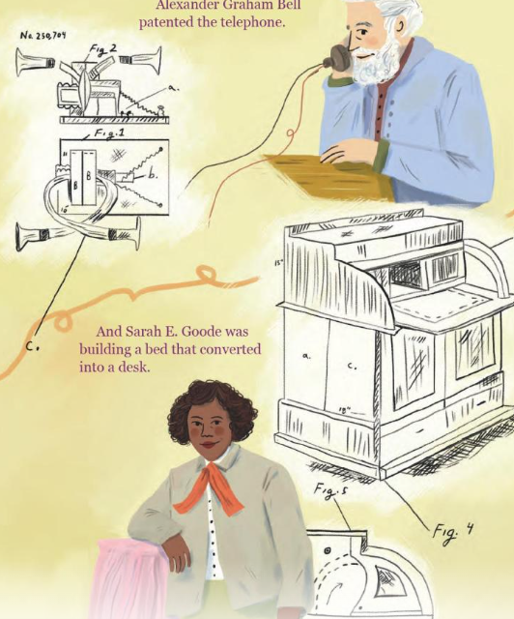
In the 1870’s and 1880’s, inventors were hard at work.
~BOOK FEATURES~
References to other inventors

Slide 14
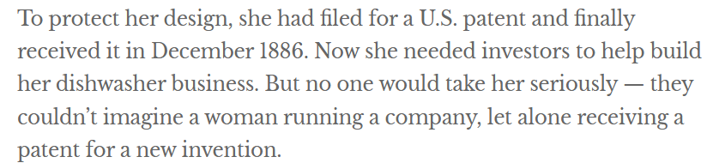
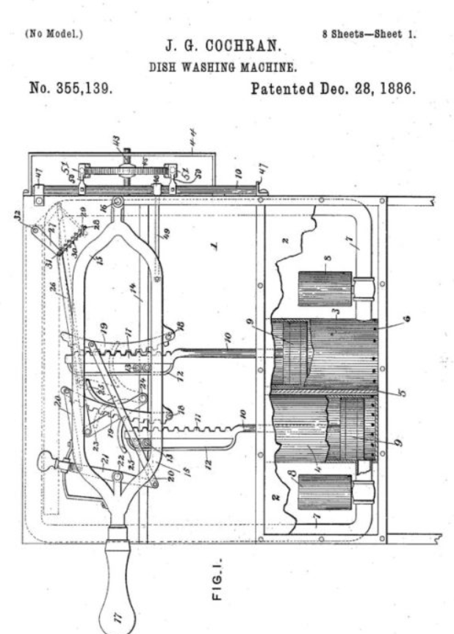
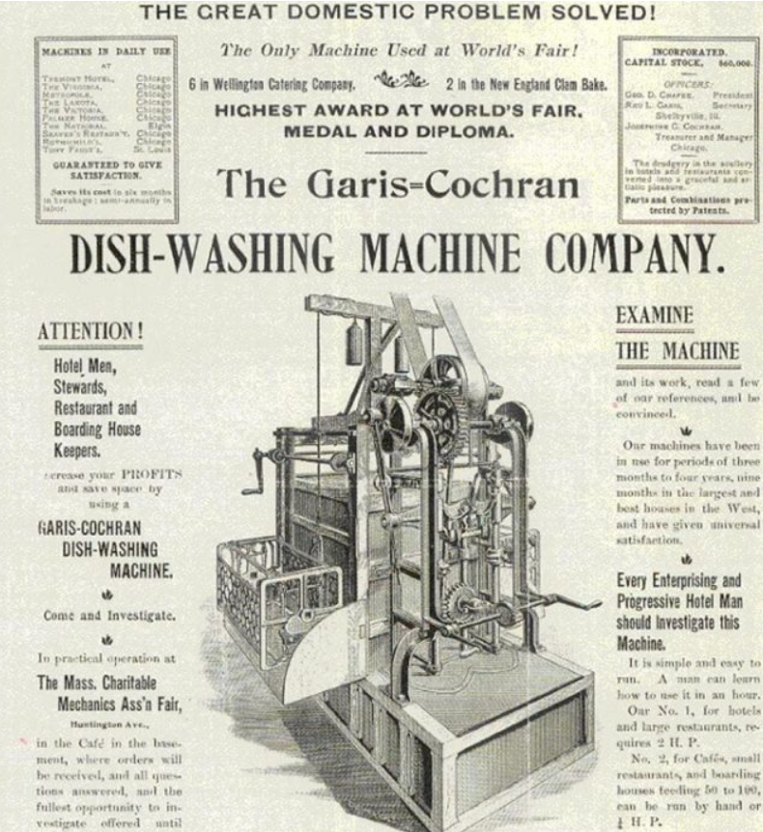
~BOOK FEATURES~
Primary Source Documents

Slide 15
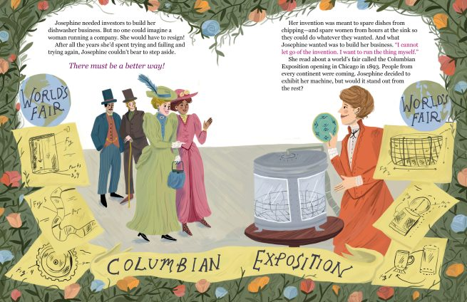
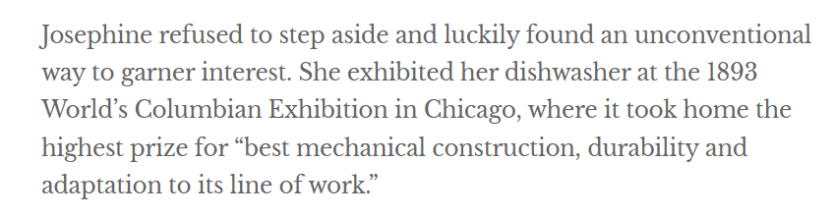
~BOOK FEATURES~
History References &
Connections
~BOOK FEATURES~

Slide 16
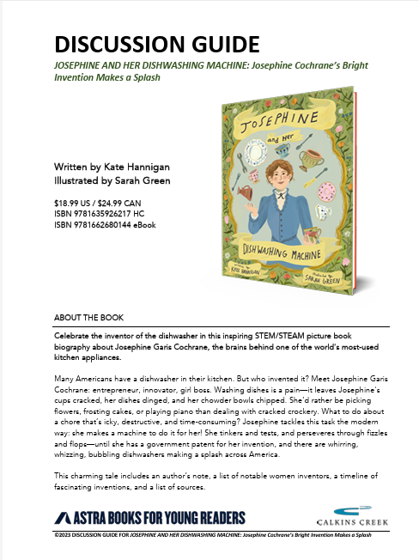
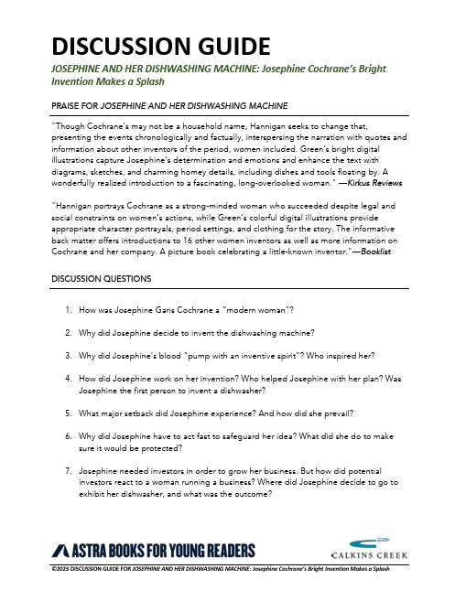
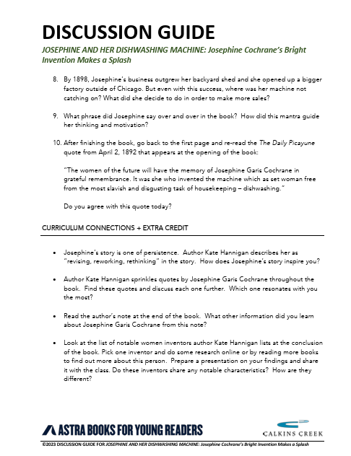
https://astrapublishinghouse.com/resources/josephine-and-her-dishwashing-machine-discussion-guide/

Slide 17
The Fabulous Fannie Farmer: Kitchen Scientist and America's Cook
by Emma Bland Smith
Book Synopsis: When Fannie Farmer learned to cook in the late 1800s, recipes could be silly. They might call for “a goodly amount of salt” or “a lump of butter.” Despite this problem, Fannie loved cooking, so when polio prevented her from going to college, she became a teacher at the Boston Cooking School. She’d noticed that precise measurements and specific instructions ensured that cakes rose instead of flopped, and doughnuts fried instead of burned. Students liked Fannie’s approach so much that she wrote a cookbook. Despite skepticism from publishers, Fannie’s book was a recipe for success.
Publisher: Boyds Mills Press
Copyright Date: 2024
Reading Level: 3.0
Interest Level: 2-5
Fannie Farmer- March 13, 1857-January 15, 1915

Slide 18
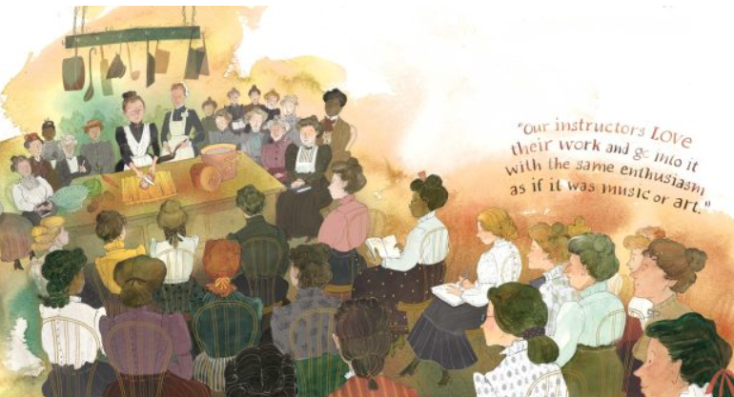
The first Julia Child or Martha Stewart?

Slide 19

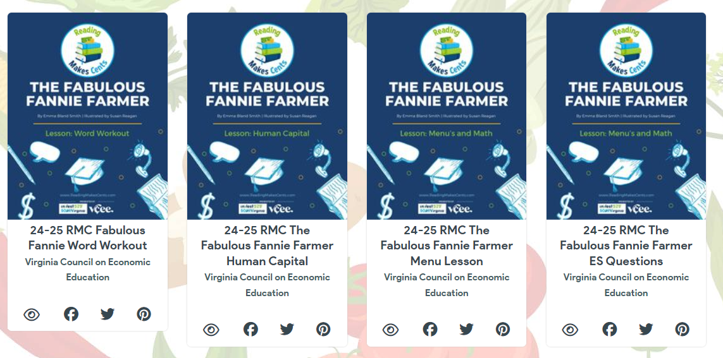
https://simplebooklet.com/rmcfanniefarmerlessons

Slide 20
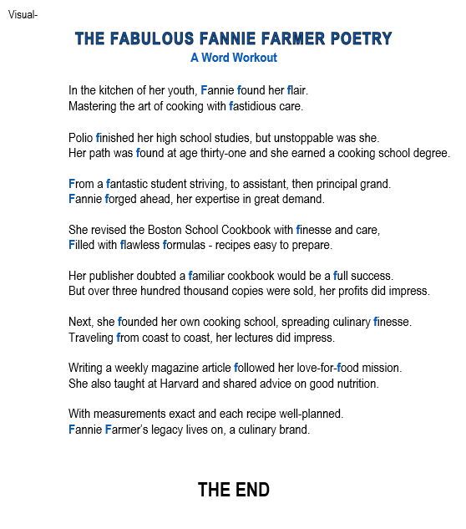
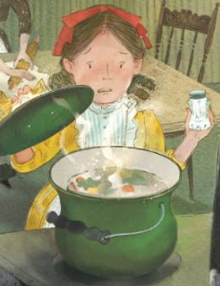
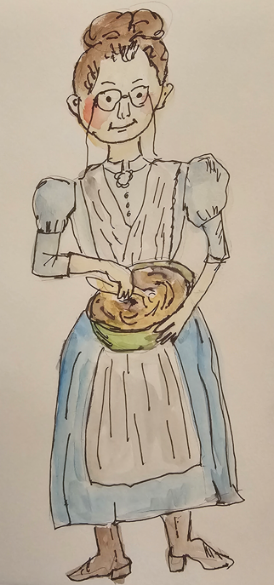
Lesson-Word Workout

Slide 21
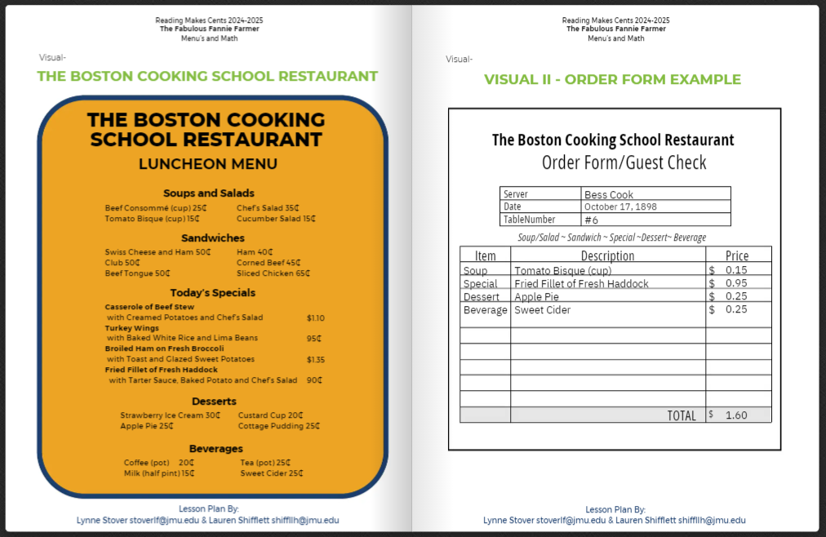
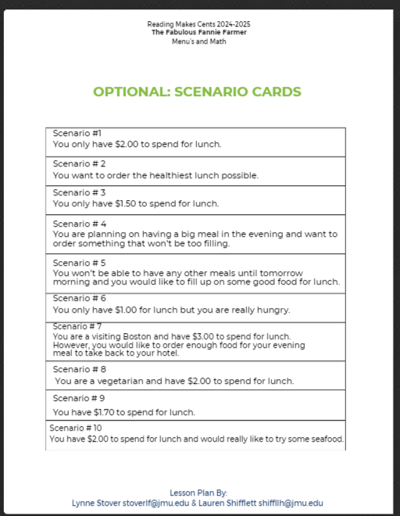
Middle School Lesson
The Boston Cooking School Restaurant

Slide 22
Granny Smith Was Not an Apple
by Sarah Glen Fortson
Book Synopsis: In the 1800s, a migrant farmer named Maria Ann Smith worked as an apple orchardist. Her discovery of a new type of apple that never turned red, but was always green, tart, sweet, and perfect for a pie, was due in part to a fluke of nature, and in part to Maria's insight and determination. The beloved Granny Smith apple that we know today was named in her honor.
Publisher: Pureplay Press
Copyright Date: 2023
Reading Level: 1.0
Interest Level: P-2
Maria Ann Smith – 1799- March 8, 1870

Slide 23
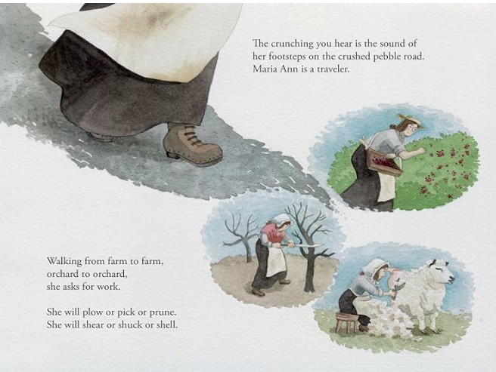
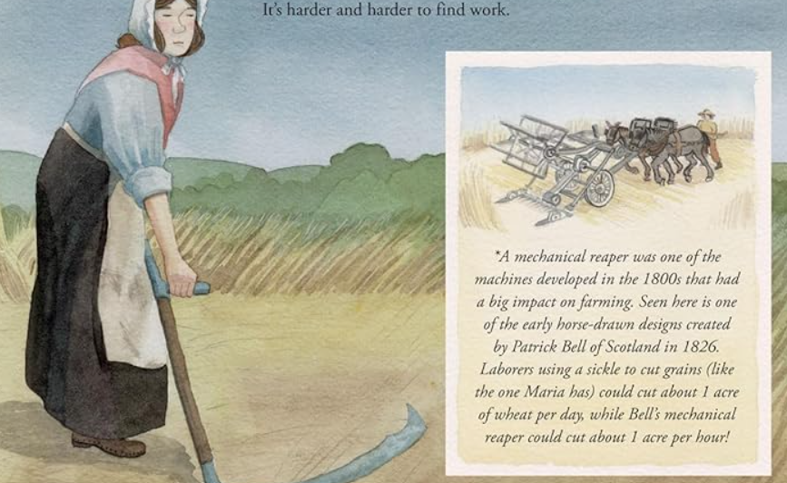
Themes and Concepts to Explore
Jobs
Human Capital
Capital Resources
Comparative Advantage
(Alliteration)

Slide 24
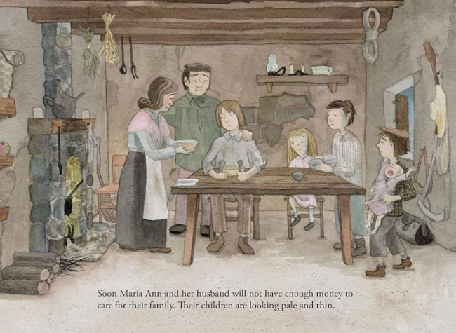
Themes and Concepts to Explore
Scarcity –Limited Resources
Poverty
Productive Resources

Slide 25
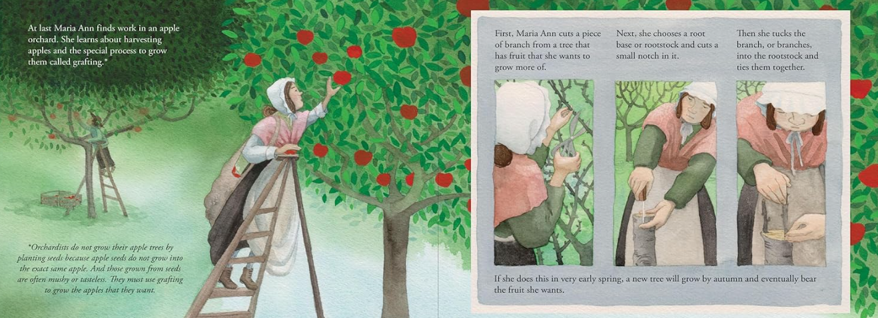
Themes and Concepts to Explore
Productive Resources
(Agriculture)
(STEM)

Slide 26
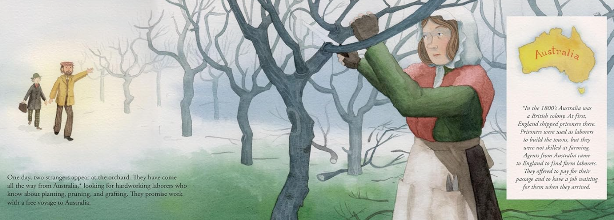
Themes and Concepts to Explore
Colonization
Human Resources
Productive Resource
Incentivies
(History)

Slide 27
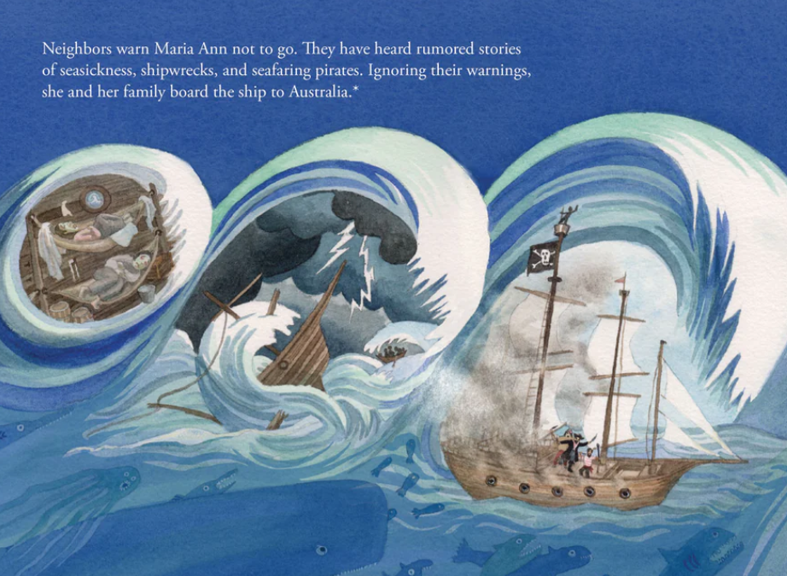
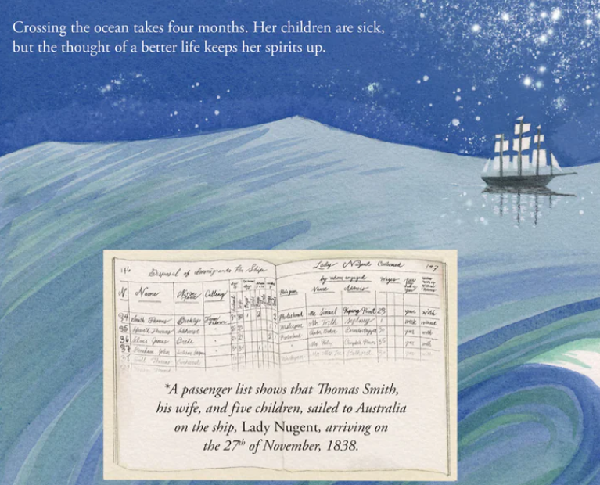
Themes and Concepts to Explore
Choices & Decision-Making
Risk Taking
(Primary Source Documentation)
(Geography)
(Transportation)

Slide 28
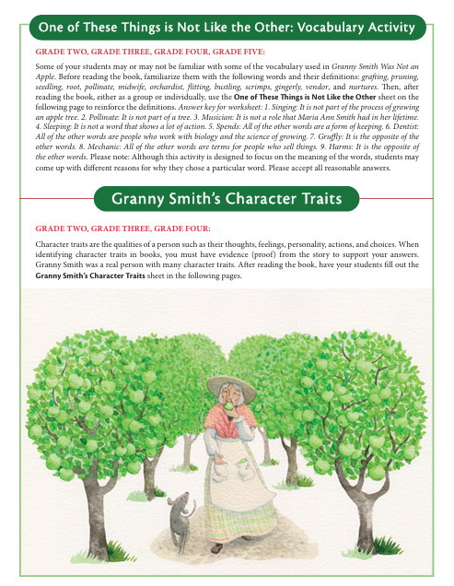
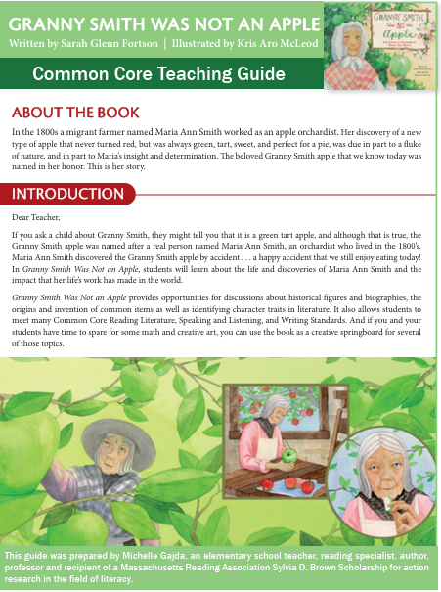
Teaching Guide
https://cdn.shopify.com/s/files/1/0579/5092/9056/files/Granny_Smith-Teaching_Guide.pdf?v=1711048670

Slide 29
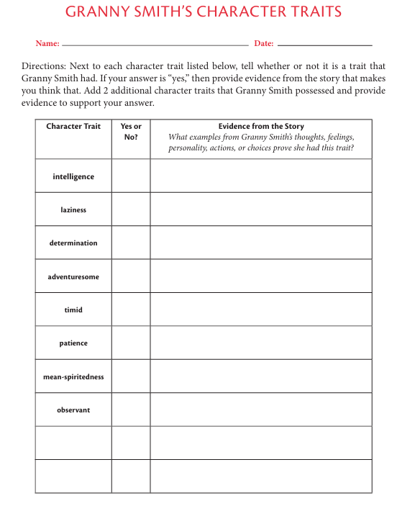
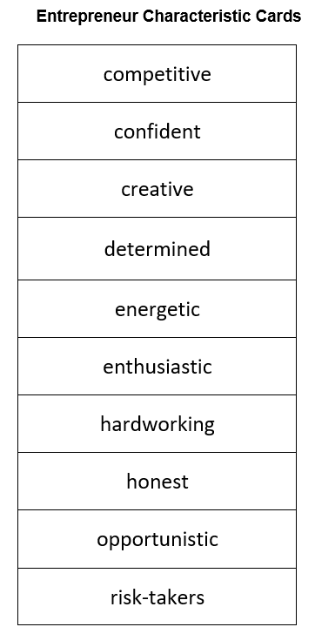

Slide 30
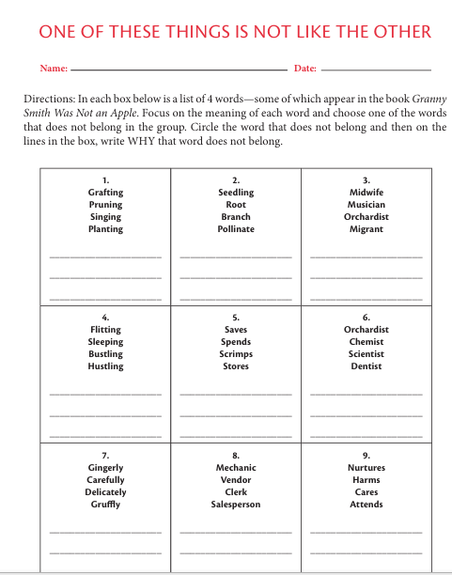
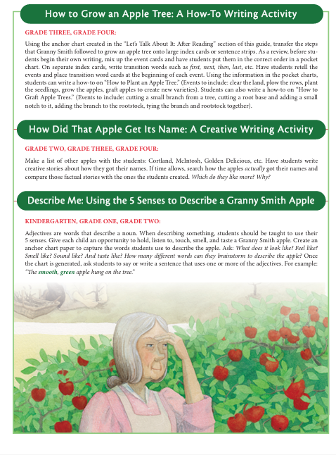

Slide 31

Maria Ann Smith – 1799
Josephine Cochrane – 1839
Fannie Farmer – 1857
Which of these enterprising women do you admire the most? Why?
If you could only use one of these books in your classroom, which one would it be? Why?
Can you think of any other picture books that could be used in a “Resourceful Women” unit?

Slide 32

If Time Allows….
Booklists, and
Literature Links

Slide 33
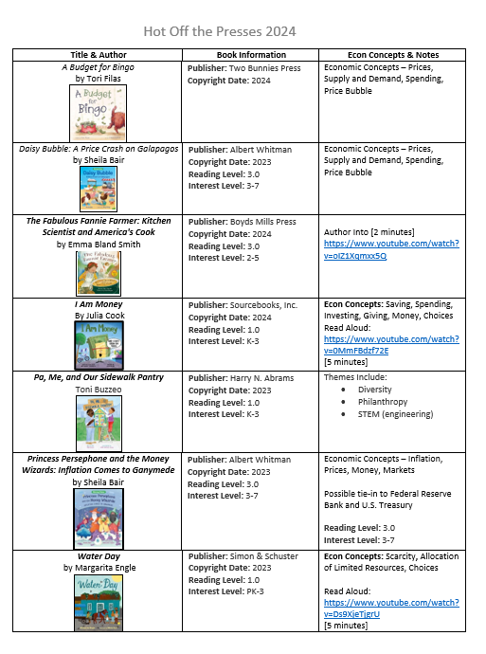
Hot Off the Presses!

Slide 34


Slide 35
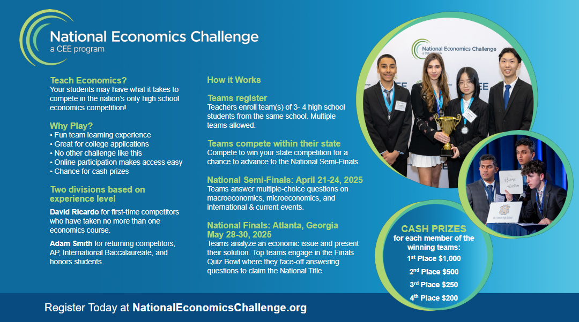

Slide 36


Slide 37
Contact information
Lauren H Shifflett shiffllh@jmu.edu
Lynne F Stover stoverlf@jmu.edu u.edu
Thank You!
Lauren H Shifflett shiffllh@jmu.edu
Lynne F Stover stoverlf@jmu.edu

