Slide 1



Exchange Rates During Periods of Conflict

Slide 2
Certificate Requirements
To earn professional development hours for webinars, you must:
Watch a minimum of 45-minutes and you will automatically receive a professional development certificate via e-mail within 24 to 48 hours.

Slide 3
Objectives
You will be able to:
Identify factors that contribute to fluctuations in money and exchange rates during war
Explain how the Quantity Theory of Money influences price level

Slide 4
Reflect...
How can I use this material in my classroom?
What questions will my students have?
Will my students be able to define the quantity theory of money using the example from the lesson?
Can my students give examples of what might happen to exchange rates during periods of conflict or war?

Slide 5




Presenter(s)
Cynthia Fitzthum
Cjfitzthum@stcloudstate.edu
Jeremy Miller (co- author)
Jmiller@c-ischools.org

Slide 6
Economics of War Lessons
Please join us for any of the following webinars......... or look for the webinars on demand and lessons on EconEdLink soon!
Date | Topic
2/6- Jeremy | The Copper Issue (A Supply and Demand Lesson)
2/20- Cindy | Why go to war? (A Lesson on Costs and Benefits)
3/6- Cindy | Exchange rates during periods of Conflict (Currency and exchange rates)
3/20- Cindy | What about trade during war? (Geography lesson with focus on re-allocation during periods of conflict)
4/3- Cindy | Oil and the Middle East (Lesson on Prices)
4/17- Jeremy | What would you do with $19,000 a month? (Human capital, risk/reward and personal finance lesson)
5/1- Jeremy | Specialization (Military vs. Contractor pay)
5/8- Jeremy | How big is the military pie? (A Lesson on Budgeting, Taxation and Opportunity Cost)
5/22- Cindy | The Draft Debate (Debate Model)
5/29- Jeremy | Reconstruction: Can it boost an economy? (Broken Window Fallacy)

Slide 7


Exchange Rates: Session Agenda
Standards/Concepts
Content (Procedure)
Assessment
Wrap-up/ Q & A

Slide 8
Standards and Concepts

Slide 9

National Standards
3. Changes in supply or demand cause relative prices to change; in turn, buyers and sellers adjust their purchase and sales decisions
https://www.councilforeconed.org/policy-advocacy/k-12-standards/

Slide 10

Economic Concepts
Quantity Theory of Money
According to the quantity theory of money, the general price level of goods and services is proportional to the money supply in an economy.
https://www.investopedia.com/insights/what-is-the-quantity-theory-of-money/
Inflation
A general increase in the price level.

Slide 11

[INSERT FEATURED IMAGE OF WEBINAR SESSION]
Content

Slide 12
Exchange Rates: Lesson Description
Students will examine the factors that influence money and exchange rates during periods of conflict through a group activity and discussion.

Slide 13
Reflect
Inflation is always and everywhere a monetary phenomenon in the sense that it is and can be produced only by a more rapid increase in the quantity of money than in output... A steady rate of monetary growth at a moderate level can provide a framework under which a country can have little inflation and much growth. It will not produce perfect stability; it will not produce heaven on earth; but it can make an important contribution to a stable economic society.
Milton Friedman

Slide 14
Lesson Materials
Visual 3.1 – Headline News and Quotes
Handout 3.1 – Group Headline Cards
Handout 3.2 – Headline Organizer
Handout 3.3 – Why do Foreign Exchange Rates Change?
Computer - one computer per student
Poster Paper- 4 large pieces

Slide 15
Warm Up
“What happens to money and exchange rates during periods of conflict?”

Slide 16
Group Activity
Display Visual 3.1- Headline News and Quotes.
Have a student read each headline out-loud to the class:
70% Rise in Price Level during War
Taxes to Cover Large Share of War Expense
Value of Currency Depends on Outcome of the War
Nations Suspend Convertibility of Gold in Midst of War

Slide 17
Group Activity
Explain to the students that the class is going to do an activity that focuses on money and exchange rates during periods of conflict.
Divide the class into 4 groups and assign one headline to each group. Pass out the correlating cards (Handout 3.1) to each group.
Tell the students they will be responsible for reading the information on their cards and locating the answers to the question (s) on their cards. Then, they will need to create a poster that has their headline on it, complete with all their information. They will use this to present to the class. (Note: You can have them create slides instead of posters if desired)

Slide 18
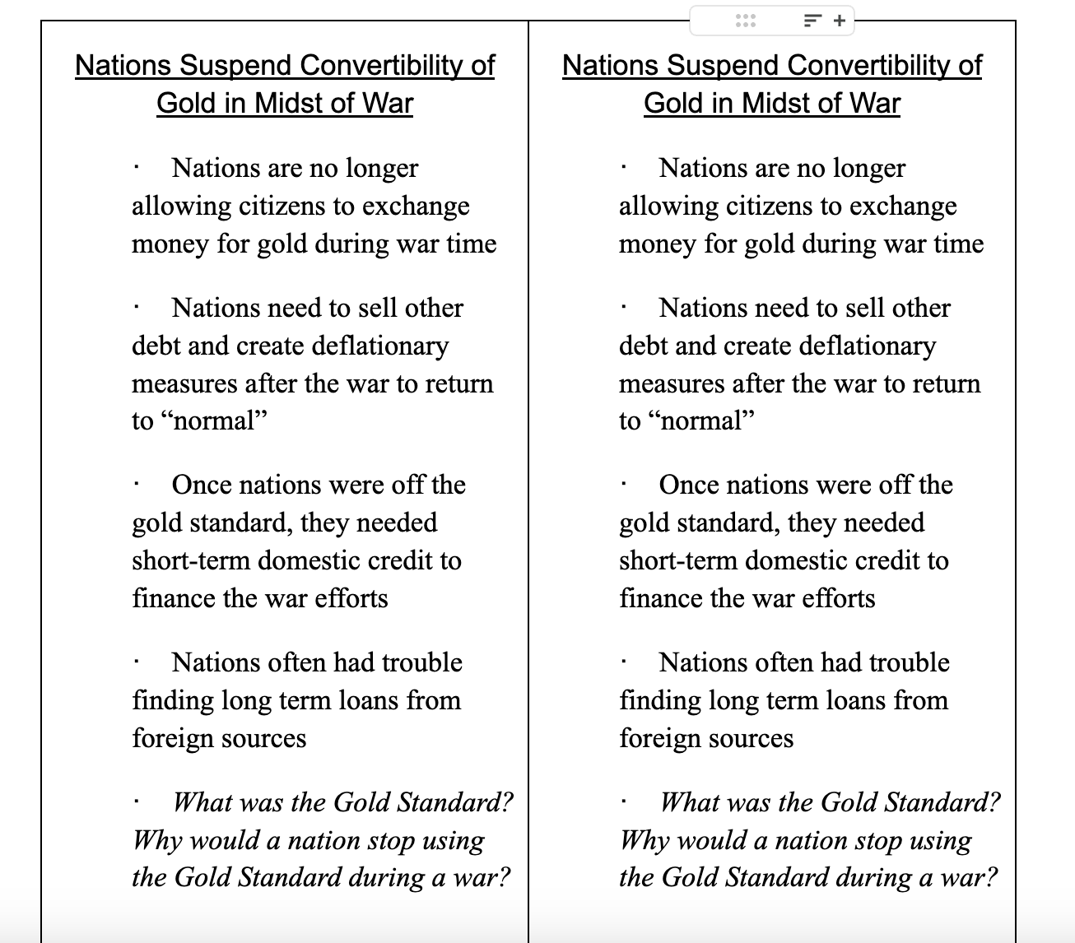

Slide 19
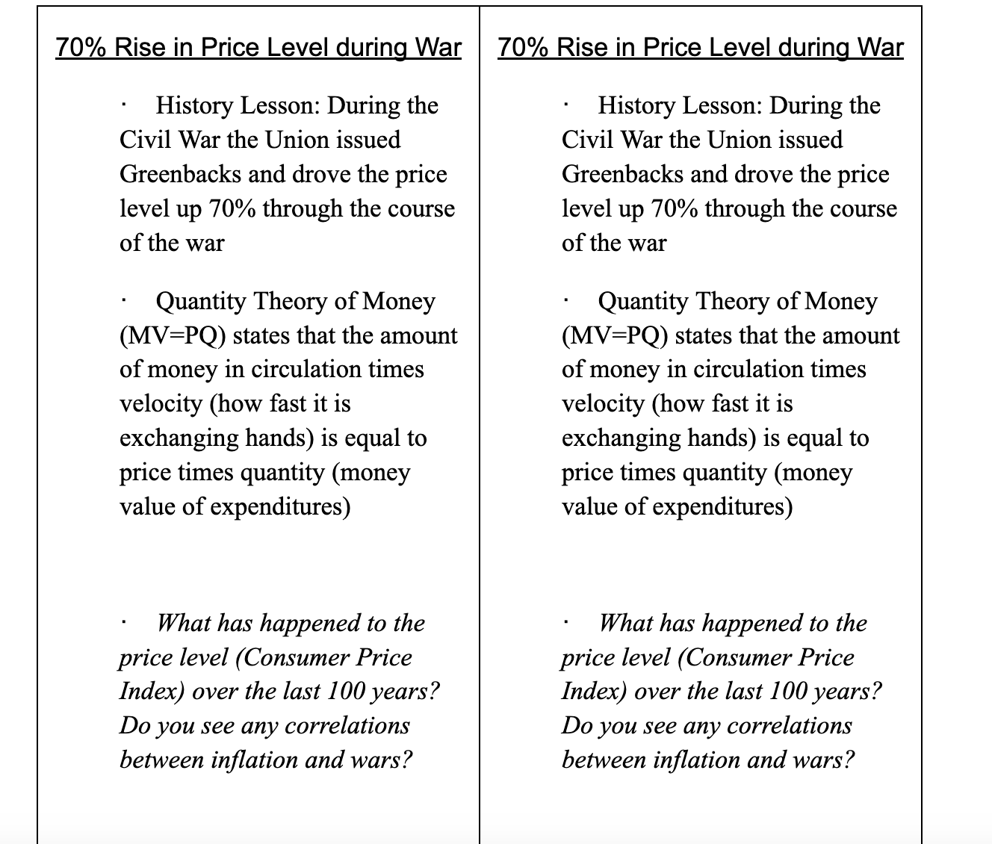

Slide 20
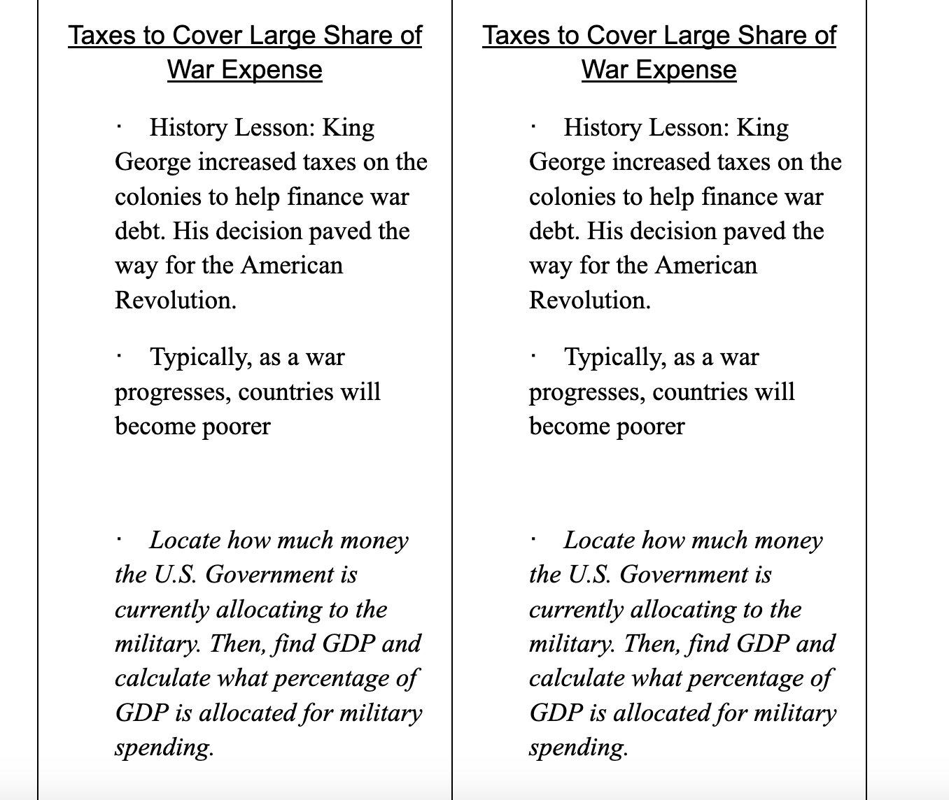

Slide 21
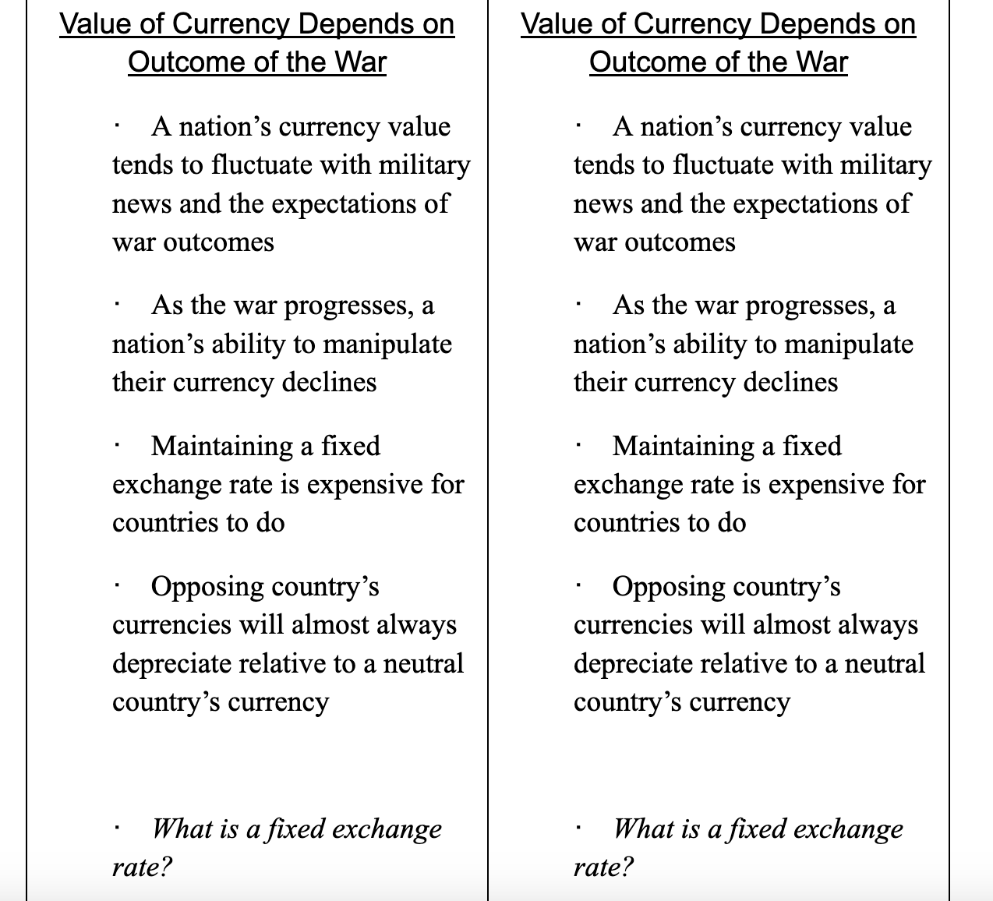

Slide 22
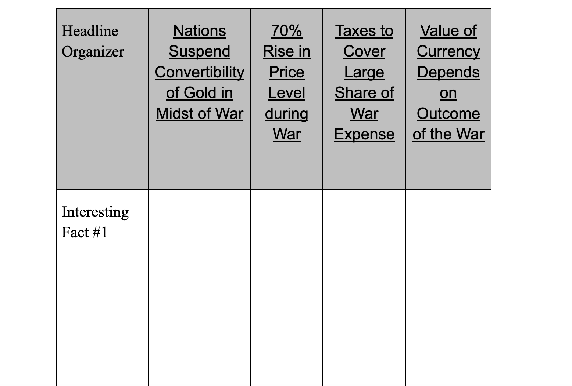
Group Activity
Have groups present their findings to the class. As each group presents, have each student fill out their organizers (Handout 3.2):

Slide 23

[INSERT FEATURED IMAGE OF WEBINAR SESSION]
Assessment

Slide 24
Assessment (Closure)
To demonstrate the Quantity Theory of Money, have five students come to the front of the room and give each of them a piece of blank paper. Then, have one student write “M”, one student write “V”, one student write “=”, one student right “P” and one student right “Q” on their sheets. Then, have them get in order of the equation (MV=PQ) and get on their knees in front of the class.
Ask the class the following:
· When P stands up (have P stand up), what will happen to V if M and Q stay the same? (V will also stand up.)
· When M stands up (have M stand up), what will happen to Q if V and P stay the same? (Q will also stand up.)
· Note: Repeat with any other combination. The main point is that both sides need to be equal.
Explain to the class that this equation demonstrates what happens to money when different factors change:
M= Money supply
V=Velocity of money
P= Price Level
Q= Output

Slide 25
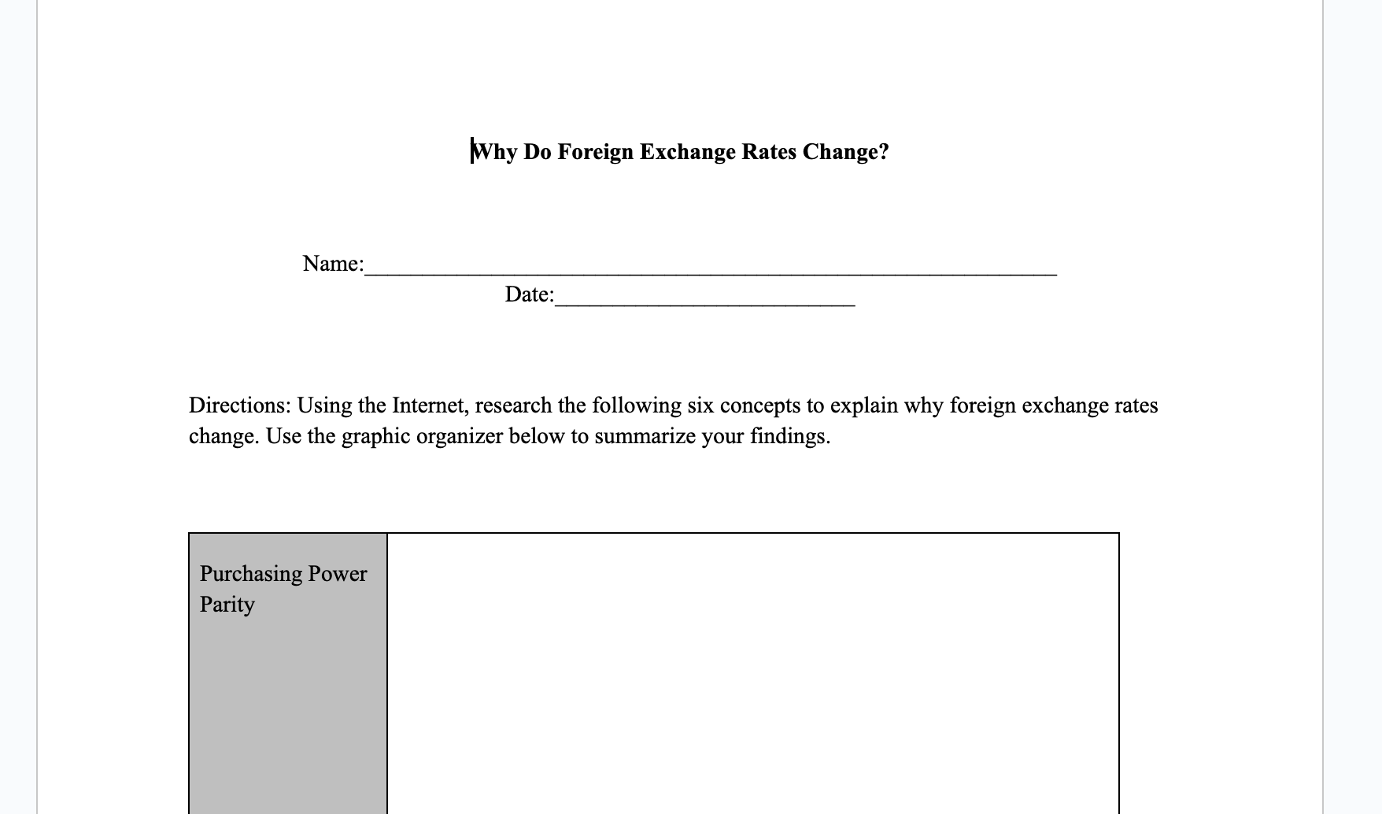
Assessment
Assign computer time or have students complete on their own Handout 3.3: Why do Foreign Exchange Rates Change? Students will look at 6 different reasons of why exchange rates will fluctuate and write down their findings on a graphic organizer.

Slide 26

Q & A

Slide 27
Reflect...
How can I use this material in my classroom?
What questions will my students have?
Will my students be able to define the quantity theory of money using the example from the lesson?
Can my students give examples of what might happen to exchange rates during periods of conflict or war?

Slide 28
Contact Us
Cynthia Fitzthum
Cjfitzthum@stcloudstate.edu
Jeremy Miller (co- author)
Jmiller@c-ischools.org

Slide 29





Find your Local Competition and Register Today!
The National Personal Finance Challenge is a competition that provides
high school students with an exciting and motivating opportunity to build, apply, and demonstrate their knowledge of money management.
Through online exams and a personal finance simulation, teams showcase their expertise in earning income, spending, saving, managing credit, investing, and managing risk.
Teams of up to four students, with one teacher/coach, can qualify to represent their state at the National Personal Finance Challenge by
winning their state competition.
CASH PRIZES
for each member of the winning teams:
1st Place $2,000
2nd Place $1,000
3rd Place $500
4th Place $250
NATIONALS > Finals:
Critical thinking round & Quiz Bowl in Atlanta, Georgia on June 1-2.
Register today: bit.ly/cee-npfc

Slide 30





Teach Economics?
Your students may have what it takes to compete in the nation’s only high school economics competition!
Why Play?
• Fun team learning experience
• Great for college applications
• No other challenge like this
• Online participation makes access easy
• Chance for cash prizes
Two divisions based on
experience level
David Ricardo for first-time competitors who have taken no more than one economics course.
Adam Smith for returning competitors, AP, International Baccalaureate, and honors students.
How it Works
Teams register
Teachers enroll team(s) of 3- 4 high school students from the same school. Multiple
teams allowed.
Teams compete within their state
Compete to win your state competition for a
chance to advance to the National Semi-Finals.
National Semi-Finals: April 21-24, 2025
Teams answer multiple-choice questions on macroeconomics, microeconomics, and international & current events.
National Finals: Atlanta, Georgia
May 28-30, 2025
Teams analyze an economic issue and present their solution. Top teams engage in the Finals Quiz Bowl where they face-off answering questions to claim the National Title.
CASH PRIZES
for each member of the winning teams:
1st Place $1,000
2nd Place $500
3rd Place $250
4th Place $200
Register Today at NationalEconomicsChallenge.org

Slide 31



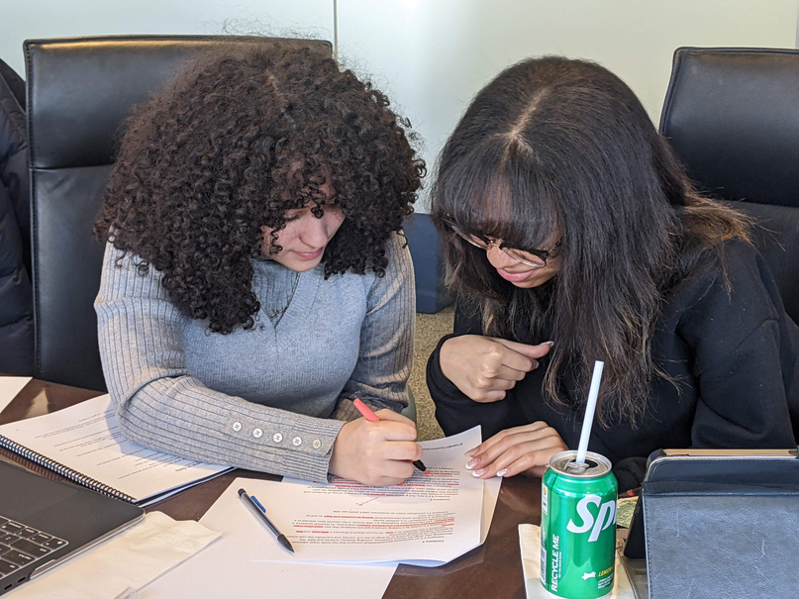




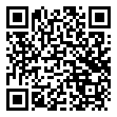



Free Personal Finance Program for High School Girls
Invest in Girls (a program of CEE) invites your high school students to learn about personal finance in a supportive all-girl environment! IIG instructors will teach students the basics of personal finance, how to invest, and help them build professional skills. These programs are online and free to attend.
Share this sign up link with your students
Or visit investingirls.org/for-students/

Slide 32

Thank you for attending today!

