Slide 1


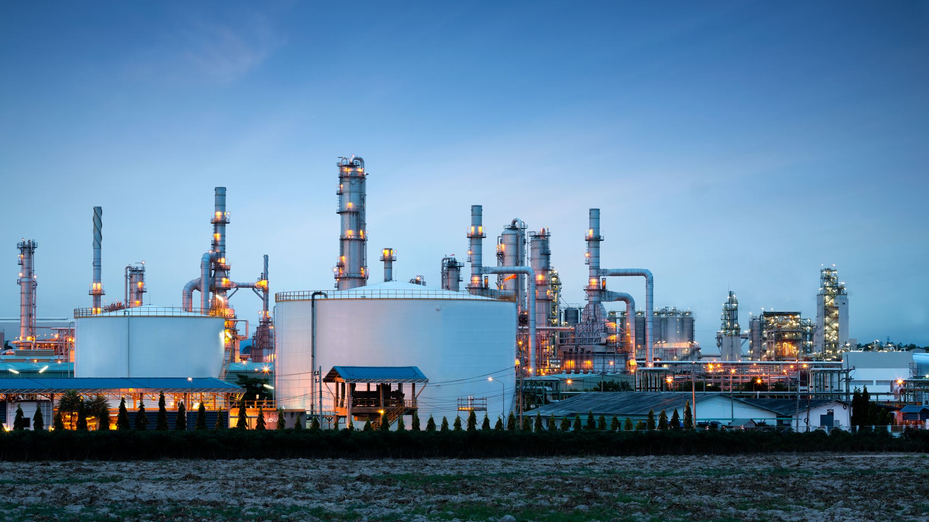
Oh my! Oil Prices & Conflict

Slide 2
Certificate Requirements
To earn professional development hours for webinars, you must:
Watch a minimum of 45-minutes and you will automatically receive a professional development certificate via e-mail within 24 to 48 hours.

Slide 3
Objectives
You will be able to:
Identify factors that influence oil and gas prices
Create a timeline of historical events
Analyze multiple perspectives to understand a complex issue

Slide 4




Presenter(s)
Cynthia Fitzthum
Cjfitzthum@stcloudstate.edu
Jeremy Miller (co- author)
Jmiller@c-ischools.org

Slide 5
Economics of War Lessons
Please join us for any of the following webinars......... or look for the webinars on demand and lessons on EconEdLink soon!
Date | Topic
2/6- Jeremy | The Copper Issue (A Supply and Demand Lesson)
2/20- Cindy | Why go to war? (A Lesson on Costs and Benefits)
3/6- Cindy | Exchange rates during periods of Conflict (Currency and exchange rates)
3/20- Cindy | What about trade during war? (Geography lesson with focus on re-allocation during periods of conflict)
4/3- Cindy | Oil and the Middle East (Lesson on Prices)
4/17- Jeremy | What would you do with $19,000 a month? (Human capital, risk/reward and personal finance lesson)
5/1- Jeremy | Specialization (Military vs. Contractor pay)
5/8- Jeremy | How big is the military pie? (A Lesson on Budgeting, Taxation and Opportunity Cost)
5/22- Cindy | The Draft Debate (Debate Model)
5/29- Jeremy | Reconstruction: Can it boost an economy? (Broken Window Fallacy)

Slide 6


Oil: Session Agenda
Standards/Concepts
Content (Procedure)
Assessment
Wrap-up/ Q & A

Slide 7
Standards and Concepts

Slide 8

National Standards
1. Market outcomes depend on the resources available to buyers and sellers, and on government policies.
https://www.councilforeconed.org/policy-advocacy/k-12-standards/

Slide 9

Economic Concepts
Opportunity Cost
The next-best alternative a person gives up in making a choice.
(Market) Demand
The quantity of a good or service that consumers are willing and able to buy at given prices during a period of time.

Slide 10
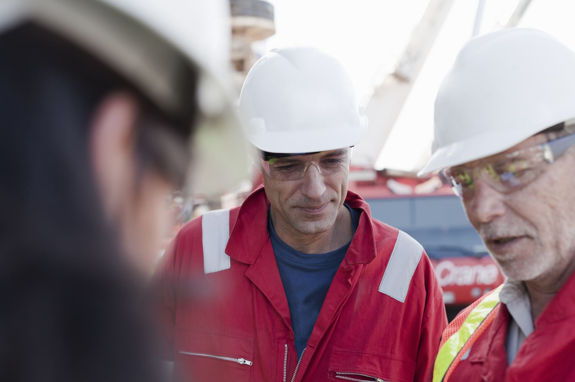
[INSERT FEATURED IMAGE OF WEBINAR SESSION]
Content

Slide 11
Oil: Lesson Description
How are gas prices affected by war?
What other factors influence gas prices?
Students will examine how gas prices are impacted by war and participate in a class activity that examines factors that push up oil and gas prices.

Slide 12
Reflect
Oil prices have certainly become a threat for the world economy.
Rodrigo Rato

Slide 13
Lesson Materials
Visual 9.1 – Breakdown of U.S. Gas Prices
Visual 9.2 – Average US Gas Prices 2000-2014, 2014-2024*
Visual 9.3 – Crude Oil Prices 1947-2011
Handout 9.1 – Timeline Slips
Handout 9.2 – Cartels, Speculators and SUV Lovers Readings
Handout 9.3 – Group Reading Questions
Video Clip – How Will the Crisis in Iraq Affect US Gas Prices?

Slide 14
Warm Up
1. Display Visual 9.1 (Breakdown of U.S. Gas Prices).
2. Ask students:
What is the current price for a gallon of gas? (Answer will vary on time and place- research www.gasbuddy.com prior to lesson.)
What do you think happens to oil and gas prices when there is a conflict or war? (Supply may stay the same while demand increases. This could cause prices to rise. Because more gas is being used for military equipment, there also is a trade-off being made for non-military equipment (opportunity costs). Think about all of the goods and services that rely on gas to be created and transported and the tradeoffs that need to be made due to scarcity. OPTIONAL: Show the demand curve shifting to the left, while supply stays the same on the whiteboard.)

Slide 15
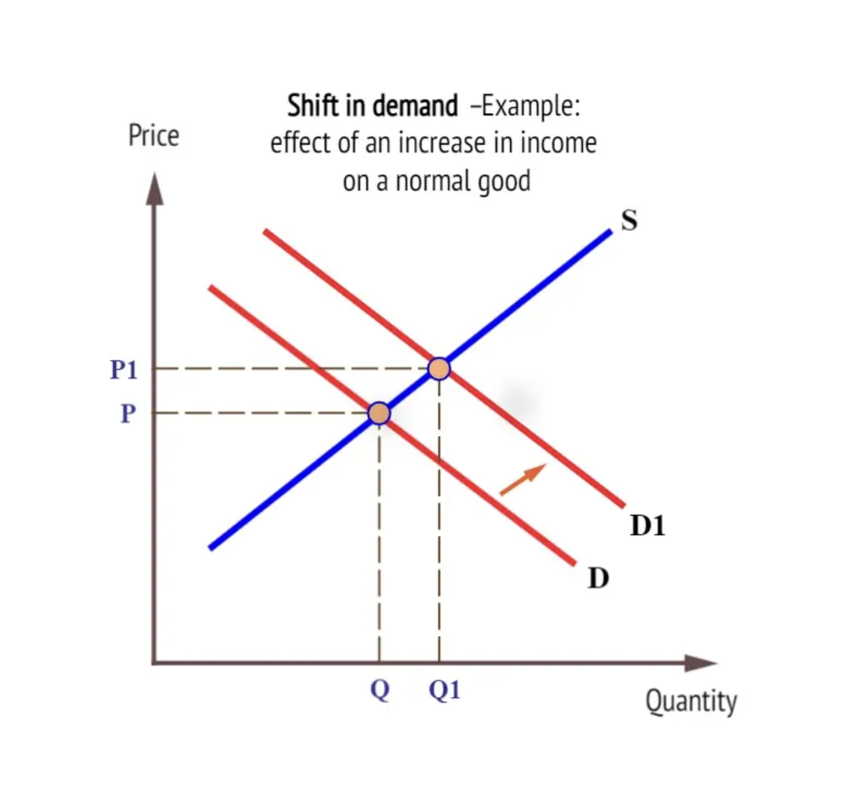

Slide 16
Lesson
3. Play the video clip “How Will the Crisis in Iraq Affect US Gas Prices?” on Youtube (Link in Sources section).
4. Ask the students:
5. What is the current average price for gas according to AAA? ($3.13/gallon- Jan '25)
6. Display Visual 9.2 (Historical Average US Gas Prices 2000-2014).
7. Ask the students:
What has happened, on average, to gas prices from 2000-2014 according to this graph? Why? (Gas prices have increased overall. Many reasons have contributed to this, including increased world market demand (Asia), war and military conflicts, increased costs of production, etc.) Now, have students investigate 2014-2024 prices.

Slide 17
Lesson
8. Display Visual 9.3 (Crude Oil Prices).
9. Ask the students:
What does this graph show? (How the price of crude oil has been affected by different world events.)
What are the correlations you can make with this graph and the previous graph of gas prices? (War, conflicts and financial events can cause large swings in the price of crude oil and gas prices.)

Slide 18
Lesson
10. Read the following to the students (write on the whiteboard the highlighted words and numbers):
The average American drives about 14,000 miles a year. Their demand for gas results in market demand for about 20 million barrels of oil products per day- of which half is used for motor vehicles! Prices usually increase when the world crude oil market tightens and lowers inventories. Also, growing market demand can sometimes outpace refinery capacity. When there is a war or conflict, crude oil market demand typically increases, and this leads to higher gas prices at the pump.

Slide 19
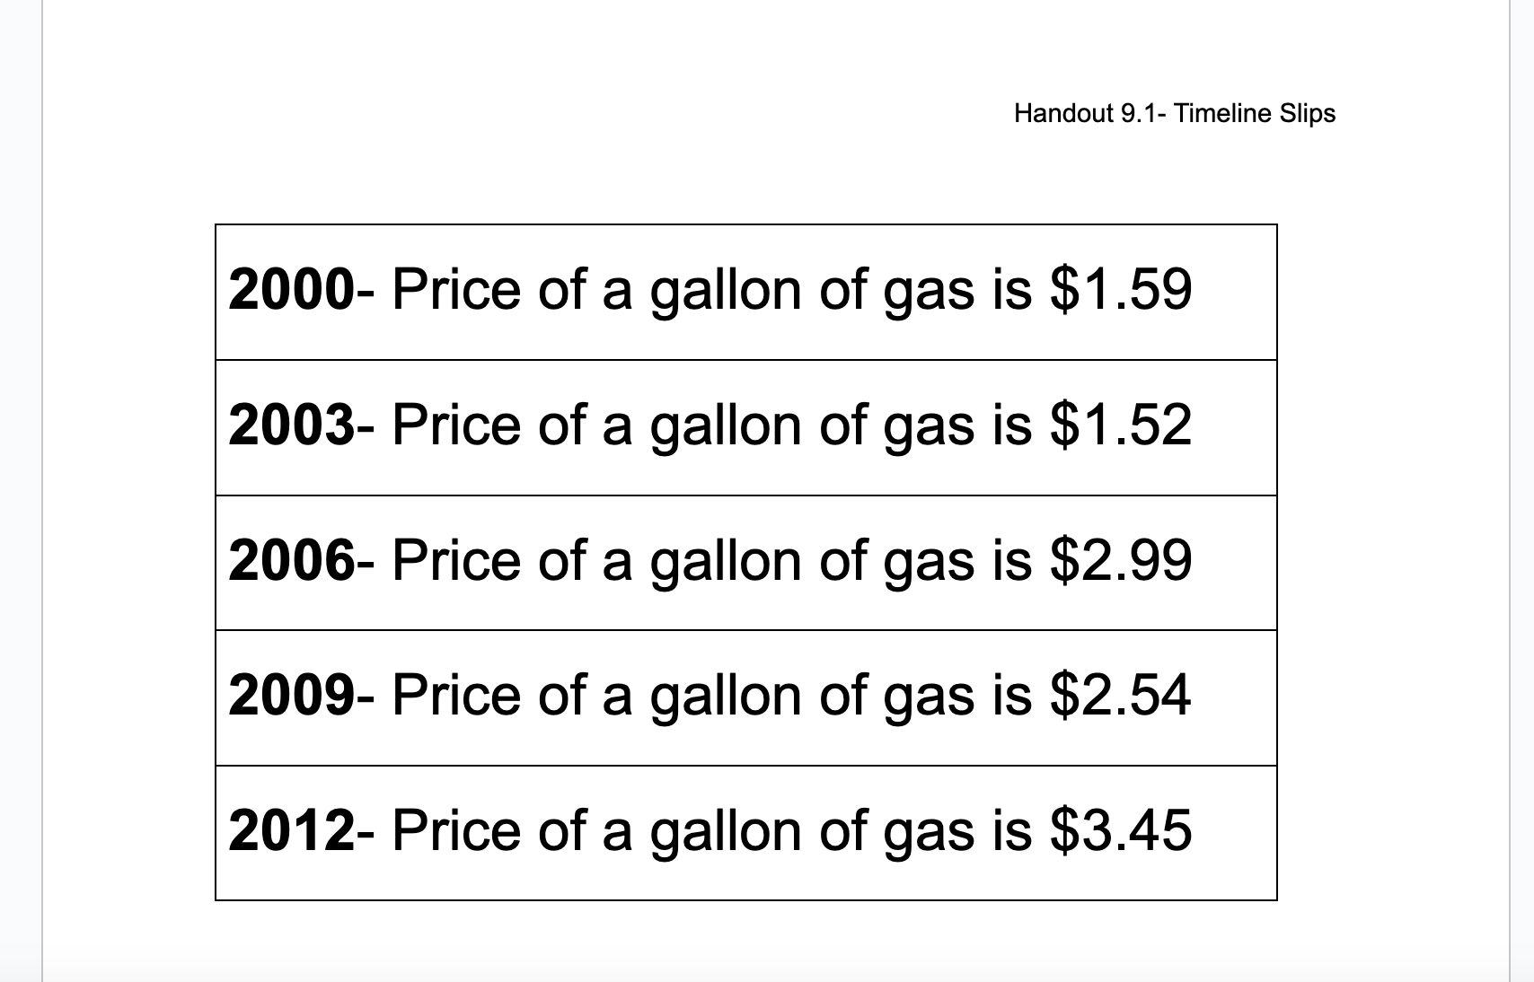
Handout 9.1

Slide 20
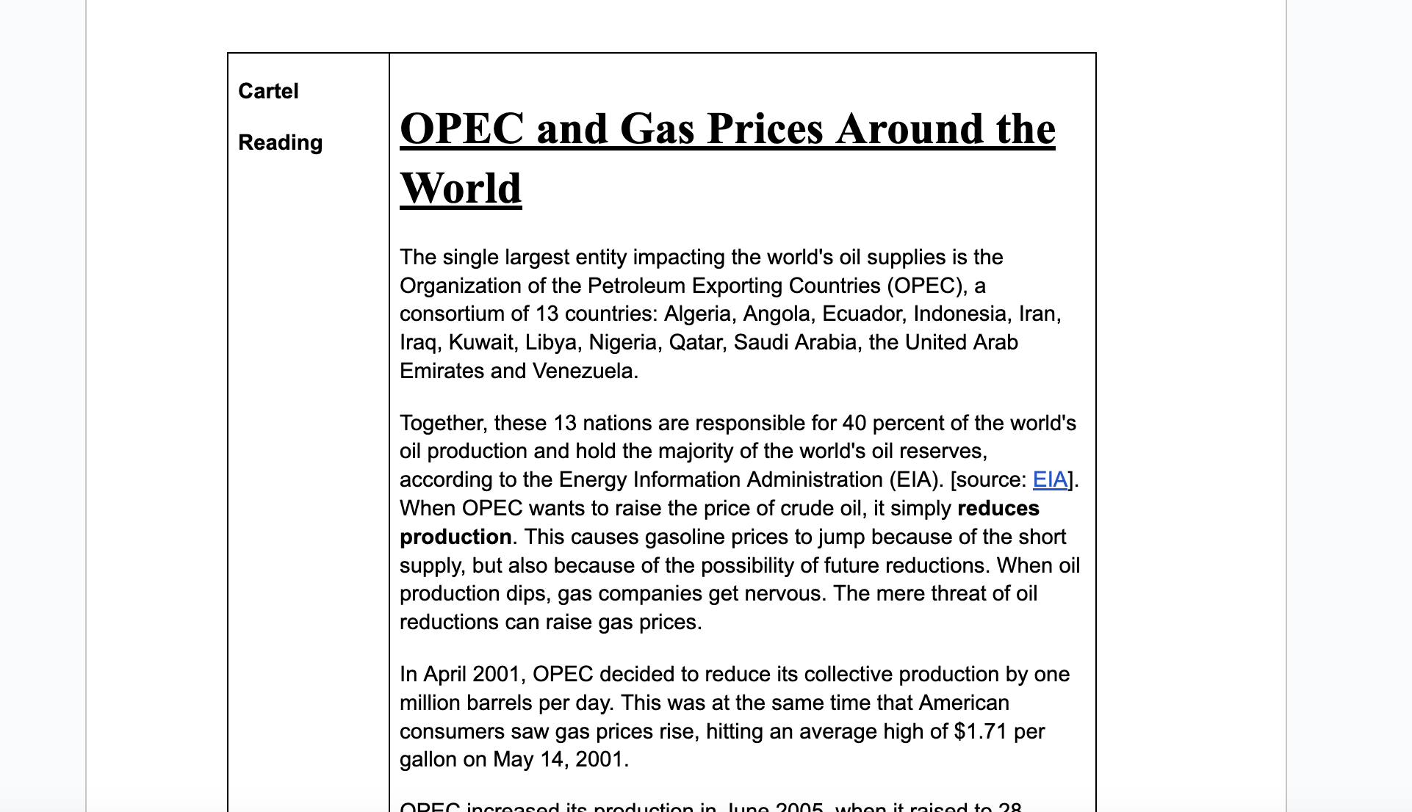
Handout 9.2

Slide 21
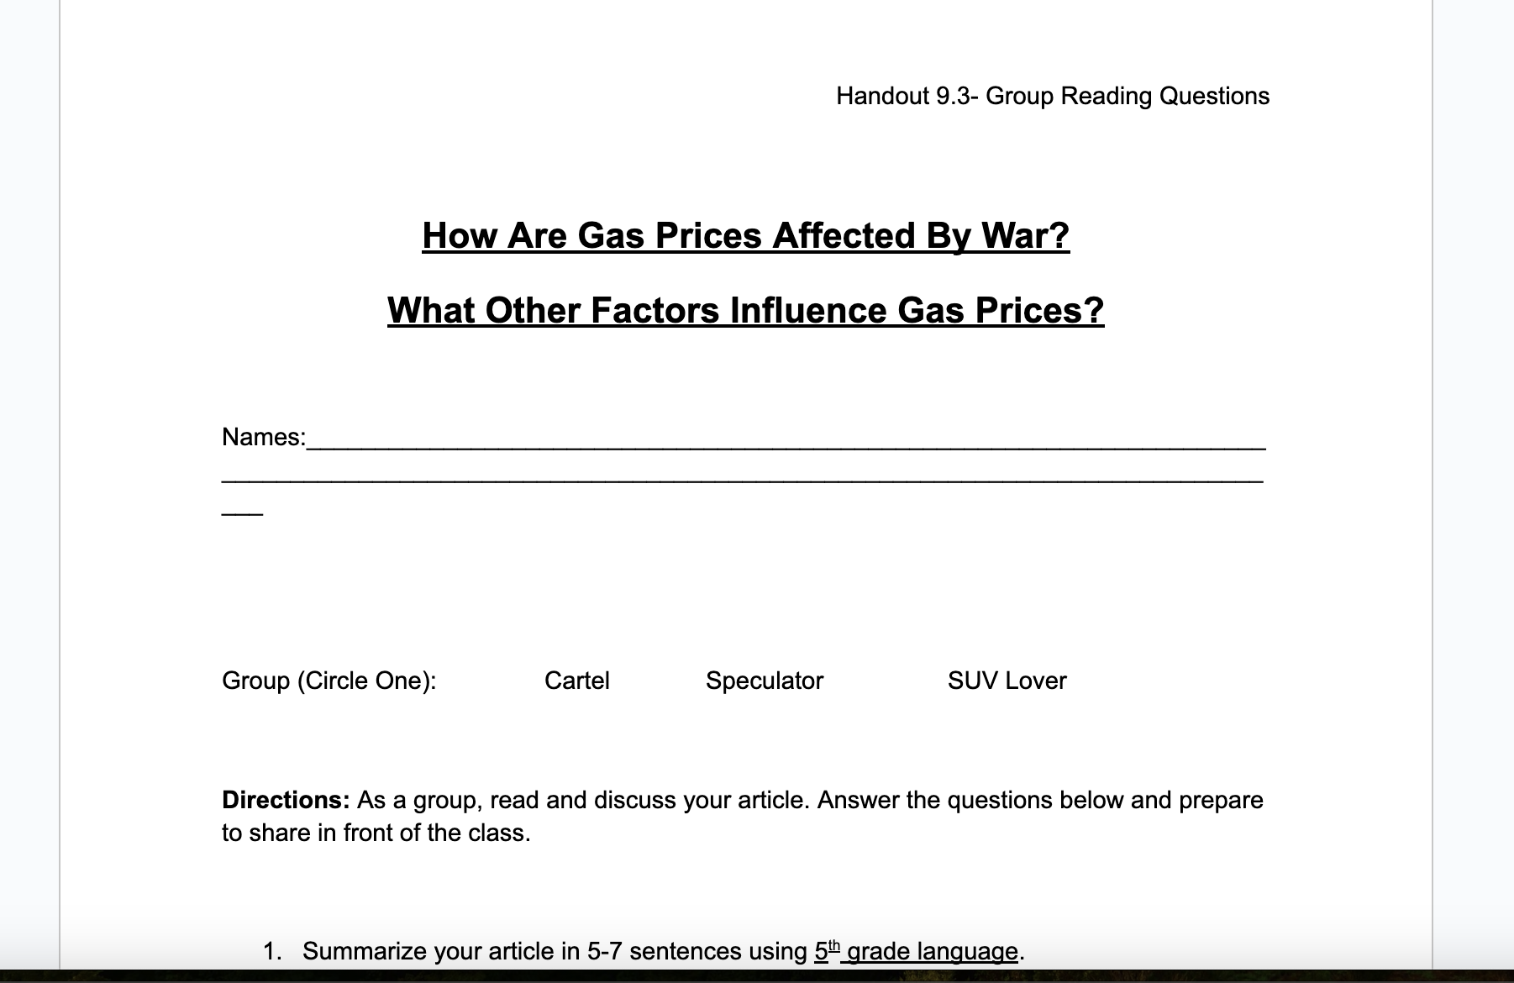
Handout 9.3

Slide 22
Lesson
11. Explain to the students know you are going to examine the history of oil and gas prices from 2000 to current day. Randomly pass out slips of Handout 9.1 to thirteen students. (Feel free to add current events as they happen to these slips)
12. Create a timeline on the whiteboard from 2000-current. Have students read their slips out-loud to the class and tape them/write them on the appropriate place on the timeline according to date. (Note: This is meant as an introduction to their next activity.)
13. As a class, review the timeline and discuss the events that have influenced prices of oil and gas by asking students:
What events have influenced world crude oil or US gas prices? (Wars, conflicts and military interventions.)
Why? (Increased market demand for oil and gas can lead to increased prices. Optional: demonstrate with supply and demand graph on board.)

Slide 23
Lesson
14. Divide the class into three groups. Give one group Handout 9.2 (Cartels), one group Handout 9.2 (Speculators) and one group Handout 9.2 (SUV Lovers).
15. Give each group time to read and discuss their articles.
16. Direct students to Handout 9.3 (Group Reading Questions) and allow time for each group to record their responses.
17. Once complete, have students present their findings to the class to help answer the closure questions.

Slide 24

[INSERT FEATURED IMAGE OF WEBINAR SESSION]
Closure &
Assessment

Slide 25
Assessment (Closure)
Ask the students the following:
What is a cartel? How do cartels influence world crude oil prices?
What is a speculator? How do speculators influence world crude oil prices?
How do SUV lovers contribute to higher gas prices?
How do wars or conflicts contribute to higher gas prices at the pump?

Slide 26
Assessment
Explain to students that they are going to take on the role as a journalist. Their headline will be “Higher Prices at the Pump” and they must write an article that addresses these three questions:
1. What are some factors that contribute to high gas prices?
2. How have gas prices changed from 2000-2014? 2014-2024?
3. How do cartels, speculators and SUV lovers contribute to higher gas prices?

Slide 27

Q & A

Slide 28
Reflect...
How can I use this material in my classroom?
What questions will my students have?
What other resources can I integrate into this lesson?
What questions do I still have or want to investigate further?

Slide 29
Contact Us
Cynthia Fitzthum
Cjfitzthum@stcloudstate.edu
Jeremy Miller (co- author)
Jmiller@c-ischools.org

Slide 30



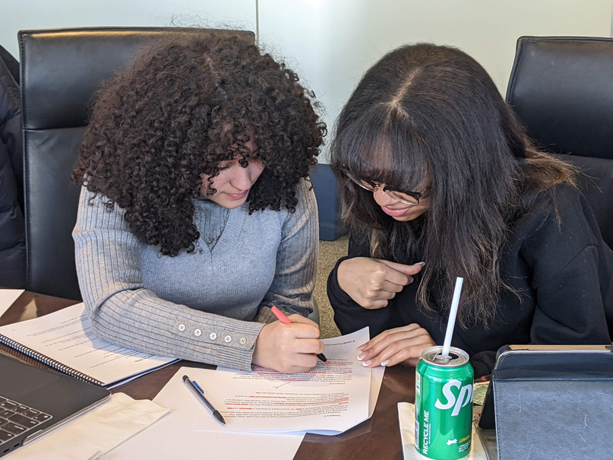








Free Personal Finance Program for High School Girls
Invest in Girls (a program of CEE) invites your high school students to learn about personal finance in a supportive all-girl environment! IIG instructors will teach students the basics of personal finance, how to invest, and help them build professional skills. These programs are online and free to attend.
Share this sign up link with your students
Or visit investingirls.org/for-students/

Slide 31

Thank you for attending today!

