Slide 1



Risk Management
&
Diversification

Slide 2
Certificate Requirements
To earn professional development hours for webinars, you must:
Watch a minimum of 45-minutes and you will automatically receive a professional development certificate via e-mail within 24 to 48 hours.

Slide 3
A Blueprint to Managing Risk
Join our dynamic webinar, "A Blueprint to Managing Risk" where we'll break down the basics of investing, explore key concepts, and show you how manages certain risks you will face throughout your life. We'll cover:
Types of insurances that can mitigate risks and financial burdens.
Diversification as a risk management strategies
Real-World Stories: Practical stories of managing risk.
Gamified Activities & assessments to solidify understanding and make the content fun for students. Don't miss this opportunity to improve your confidence in teaching investing.

Slide 4
Objectives
You will be able to:
Feel comfortable with a strong foundational understanding of risk management (insurances) and investment diversification
Break down concepts for students of all ages & socioeconomic status, making sure content relates to all demographics
Be able to implement effective and interactive pedagogical strategies for teaching financial literacy

Slide 5
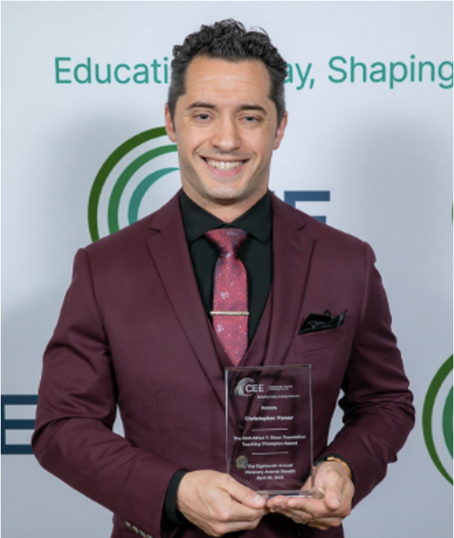
Presenter(s)
Christopher Power teaches economics, virtual enterprise, and technology to grades 9-12 at Francis Lewis High School in Fresh Meadows, NY. Christopher’s passion for finance and economics translates to unique and often loud (but entertaining!) lessons and discussion. Christopher focuses on brining real-world experiences into the classroom. Lessons include building pitch decks, analyzing economic data, calculating mortgage payments, managing money, and more. Christopher’s teaching approach is extremely popular with the students: he has grown the business program from 68 to 306 students per year. What matters to him most is creating career ready students who are capable of making calculated life and financial decisions. Christopher shared, “Financial literacy and economic education buys freedom. Evidence suggests 80% of people are financially illiterate. So, contrary to popular belief, money is not the root of all evil, the lack of financial literacy is.”
cpower29@gmail.com
www.linkedin.com/in/cpower

Slide 6
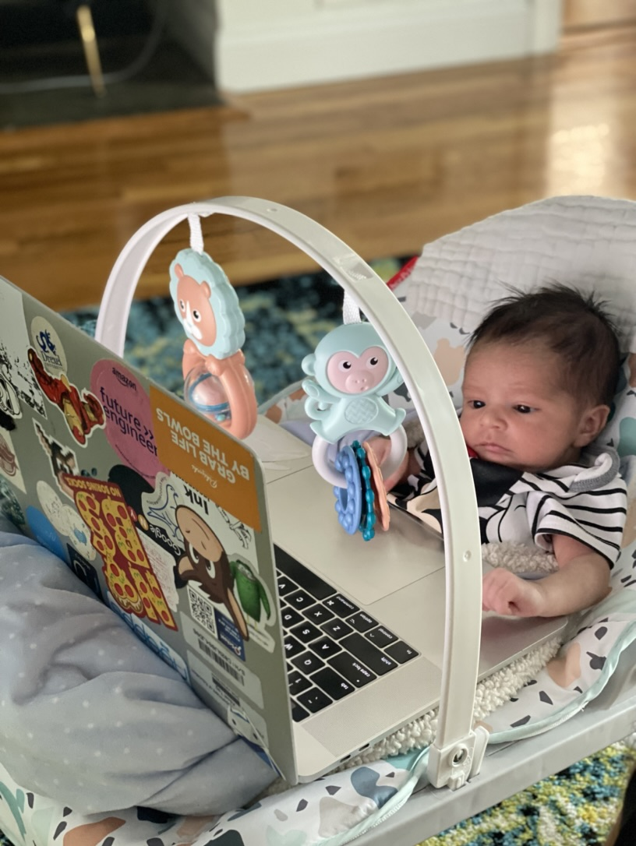
Session Agenda
Coffee Chat about issues with teaching financial literacy
Review lessons
  Lesson 1 - Insurances Video
  Lesson 2 - Insurances Case Study
  Lesson 3 - Diversification
Interactive Assessments
  Risk Management Quiz-Bowls
  Personal Finance Bracketology
Resources & Share out best practices

Slide 7

National Standards
Standard 2 Decision Making
Standard 7 Markets & Prices
Standard 10 Institutions
Standard 12 Interest Rates
https://www.councilforeconed.org/policy-advocacy/k-12-standards/

Slide 8

1 - Coffee Chat

Slide 9
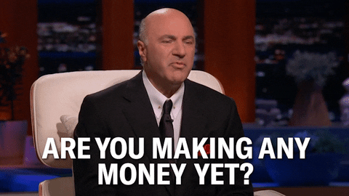
Coffee Chat
What is the best part about teaching
Financial Literacy/Econ?
Success stories anyone wants to share
about their students?
What are the students most interested in?
What are you most comfortable teaching?
What is the hardest part about teaching Financial Literacy/Economics?
What do the students dislike the most or find boring?
What do you not want to or avoid teaching?

Slide 10

Lesson 1
Insurances

Slide 11
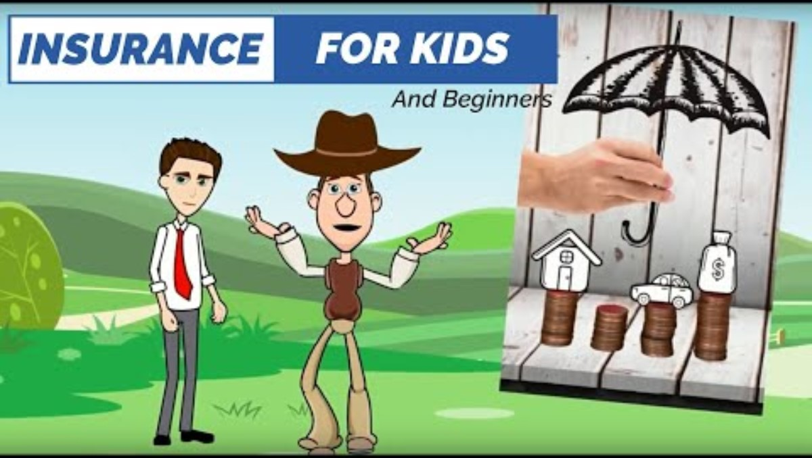
Insurance Basics
www.youtube.com/watch?v=z3NEM1HptqU

Slide 12
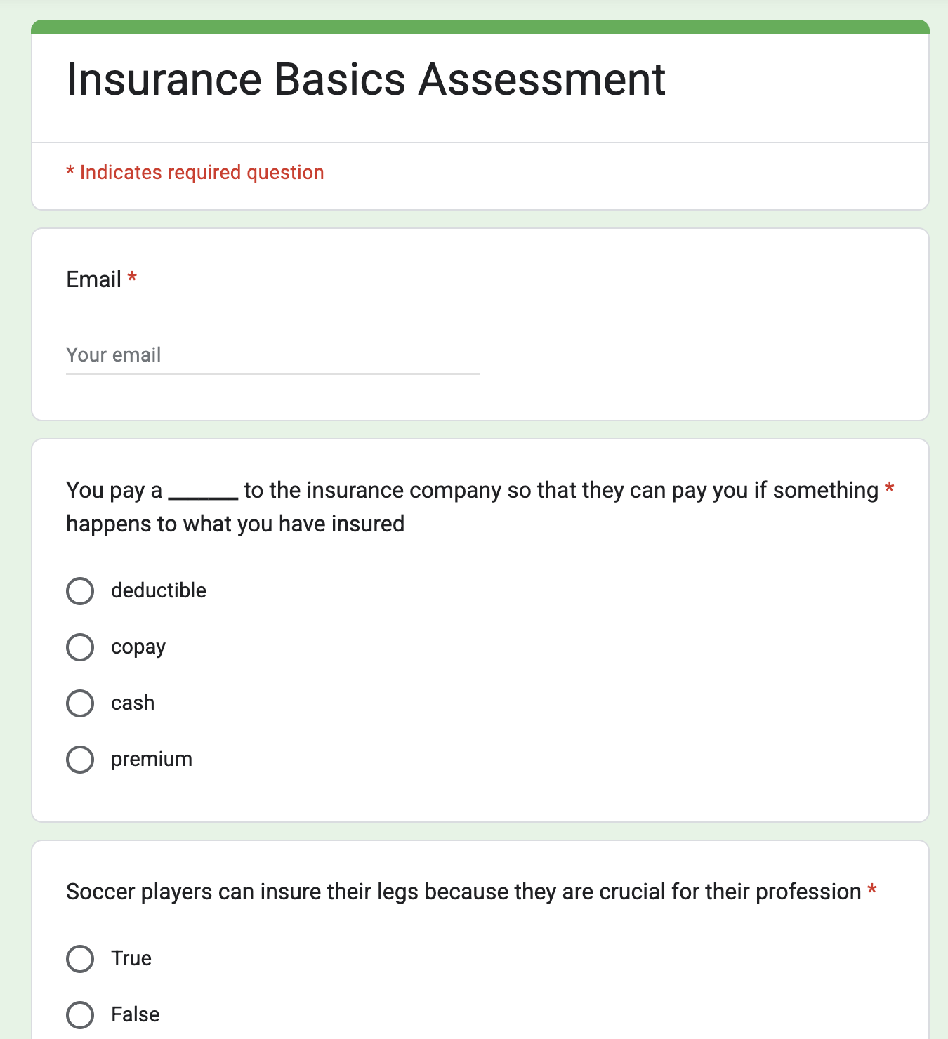
Insurance Basics Lesson
Lesson Plan: here
Video: here
AI Question Generators: Quizrise.com & Magic School
10 Question Google Form Assessment: here
Lesson Duration: 1-2 Days

Slide 13
Insurance Basics Review
PD Activity
In Main Room
  Watch video
  Take Assessment
  Review Assessment Data

Slide 14

Lesson 2
Insurances Case Study
ThePhoto by PhotoAuthor is licensed under CCYYSA.

Slide 15

Insurance Case Study
Lesson Plan: here
  Key Terms
  Case Study
  20 MC questions
  20 MC answers
Why Case Studies:
  Provide a way to apply theoretical knowledge to practical situations
  Promotes active participation and engagement, rather than passive absorption of information
Duration: 3 Days

Slide 16

Insurance Case Study
PD Activity
Breakout Rooms: (alternate rooms)
  Room 1 – Review Terms and add 10 terms to the list with definitions
  Room 2 – Read case study and answer questions

Slide 17

Lesson 3
Diversification: Managing Risk with Common Sense
ThePhoto by PhotoAuthor is licensed under CCYYSA.

Slide 18

Diversification with Comon Sense
An investor’s approach to investing for the future can be similar to the approach used for other life decisions: Use common sense, and, as the saying goes, “Don’t put all your eggs in one basket.” This sums up the concept of diversification.
CEE Link: here
VOYA Article: here
Lesson Content (article, worksheet, answers): here

Slide 19
Diversification with Common Sense
PD Activity
Breakout Rooms: (4rooms)
  Compete Part 1 & 2
  Compete Part 3
  Compete Part 4
  Compete Part 5

Slide 20

Class Activities
Quiz Bowl
ThePhoto by PhotoAuthor is licensed under CCYYSA.

Slide 21
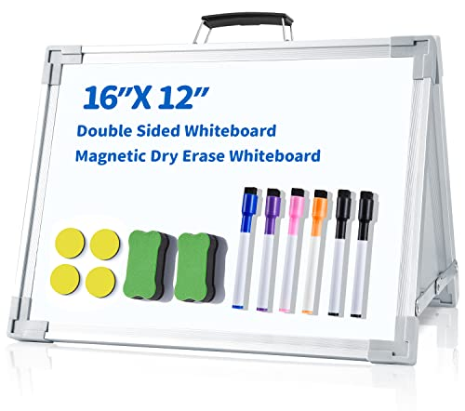
Personal Finance QuizBowl
Active Recall and Knowledge Reinforcement:
Fast-paced format encourages rapid retrieval of information, solidifying learned concepts.
Broad Content Coverage:
Variety of topics and phrasing can help personal finance relate to students differently.
Critical Thinking and Analytical Skills:
Apply their knowledge in novel situations.
Collaborative Learning and Teamwork:
Engagement and Motivation:
Make assessments more enjoyable.

Slide 22

Personal Finance QuizBowl
The Activity
Teams: Teams of 3+. Make sure team sizes are fair.
Gameplay: Moderator posts questions on board, or out loud. Teams have 10-20 questions to discuss and write answers on a board. Show your board to the judge. Example
Winners: Highest score at the end of the round wins.
  Poll Everywhere, PowerPoint Slides or verbally provide the questions
Duration: 1 Period for one QuizBowl.
Other Resources: npfc.councilforeconed.org

Slide 23
Personal Finance QuizBowl
PD Activity
Quizbowl Activity
  Main Room – Using Polleverywhere.com to show questions to teams.
    Strategy works because students can see the questions on iPads, computers or phones in their groups / individually
  Short 10 question Personal Finance Quizbowl

Slide 24
Class Activities
ThePhoto by PhotoAuthor is licensed under CCYYSA.

Slide 25
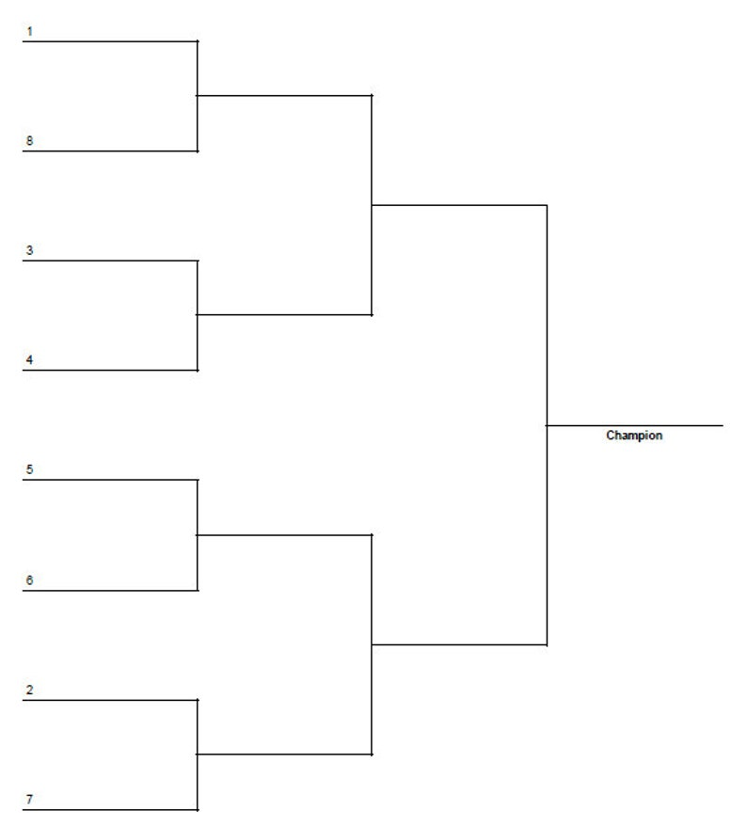
Personal Finance Bracket
Increase Engagement: Make financial concepts fun and competitive. Some students are often stand-offish when it comes to comfort around finance. Being interactive reduces inhibitions.
Reinforce Knowledge: Solidify understanding of key terms through application.
Promote Critical Thinking: Weigh the pros and cons of different decisions.
Decision-Making: Simulate real-world scenarios.
Foster Discussion: Spark conversations and debates about financial strategies

Slide 26
Personal Finance Bracket
Students review bracket decisions & discuss any needed clarifications
  Duration: 1 Period for students to review all 64 prompts
  Duration: 1 Period for teacher lecture with class on prompt questions
  64 Bracket Decisions – click here
Have students complete their bracket choices
  Duration: 1 Period or Homework
  Interactive bracket system click here (Demo this activity)
  Platform – Woobox
Class Debate: Class debates 5m/day. Class agrees on winners for each bracket
  Final 4 Brackets & Championship Winner Bracket get prizes.

Slide 27
Personal Finance Bracket
PD Activity
Personal Finance Madness
  Main Room Individually – complete the bracket Interactive bracket system click here
  Select a few of the bracket competitions & debate them, similar to in class.

Slide 28



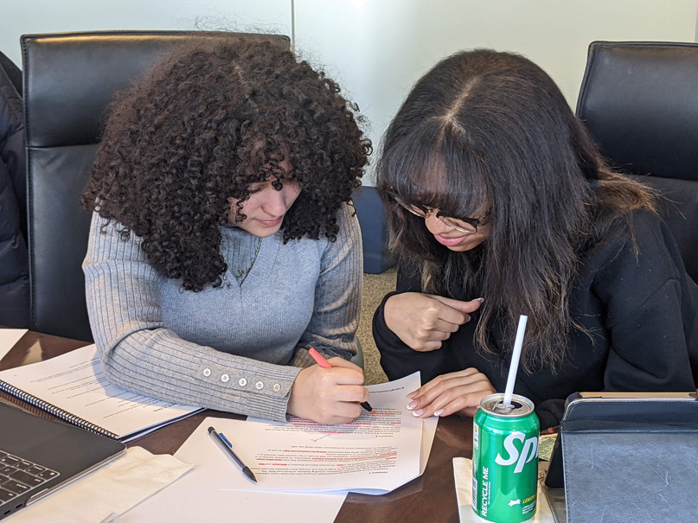








Free Personal Finance Program for High School Girls
Invest in Girls (a program of CEE) invites your high school students to learn about personal finance in a supportive all-girl environment! IIG instructors will teach students the basics of personal finance, how to invest, and help them build professional skills. These programs are online and free to attend.
Share this sign up link with your students
Or visit investingirls.org/for-students/

Slide 29

Thank you
ThePhoto by PhotoAuthor is licensed under CCYYSA.

