Slide 1


Personal Finance Bootcamp: Building Your Wealth

Slide 2
Certificate Requirements
To earn professional development hours for webinars, you must:
Watch a minimum of 45-minutes and you will automatically receive a professional development certificate via e-mail within 24 to 48 hours.

Slide 3
Objectives
You will be able to:
Understand basics of the stock market, bonds, mutual funds, and basics of taxes
Explain how taxes impact income, investments, and savings
Access and implement inclusive financial education resources

Slide 4
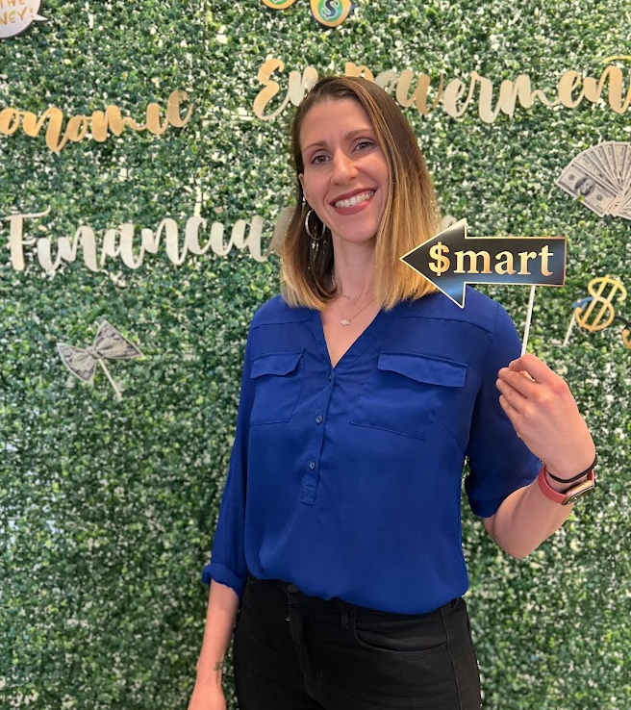
Presenter(s)
¡Hola! I'm Diana Isern:
  Assistant Principal - New York City Public Schools. I'm 19...or 20 years in, I lost track.
  Financial Educator & Advocate
  Curriculum Designer
  AFC® (Accredited Financial Counselor)
Email me! Disern@schools.nyc.gov
LinkedIn me! linkedin.com/in/dianaisern
Instagram me! @Dianadinero_edu

Slide 5

Session Agenda
Introduction: Yay you're here!
Investing 101: Why Invest?
Investment Vehicles (Stocks, Bonds, Funds)
Get Started Investing
Paying Tio Sam: Tax Basics and Investments
Breakouts!

Slide 6

National Standards
Standard 4: Saving and Spending
Benchmark 12.4: Compare strategies for investing as part of a comprehensive financial plan.
Benchmark 12.5: Explain how interest rates, inflation, and asset values affect saving and investing.
Standard 5: Financial Investing
Benchmark 12.1: Explain how investing may build wealth and help meet financial goals.
Benchmark 12.5: Explain how taxes affect the rate of return on investments.
Standard 6: Protecting and Insuring
Benchmark 12.4: Identify ways that tax codes may affect an individual's financial decisions.
https://www.councilforeconed.org/policy-advocacy/k-12-standards/

Slide 7

Yay You're Here!

Slide 8
Let's Break That Ice
What’s the best (or worst) financial advice you’ve ever received?
If you had to pick one investment to hold for the next 30 years—no selling allowed—what would it be and why?
What topic (investing or otherwise) do you absolutely LOVE to teach?
What financial topic do you and/or your students find most challenging?

Slide 9
About this whole teaching thing...
Teaching is personal. So is money. Our own financial journeys shape how we teach these topics.
Money scripts run deep. The stories we tell ourselves about investing, risk, and wealth affect our classroom approach.
Growth mindset matters for us too. Let's examine our own financial thinking so we can create inclusive spaces that truly motivate all students.
Diverse perspectives strengthen financial education. Today we'll explore how different communities approach investing and how to honor these perspectives in our teaching.

Slide 10
A Note on Inclusion
Inclusivity isn't a check done ✅ kind of situation. It is a continual awareness to teach in support of kids of a diverse nation. There are lots of subtle ways to make students feel seen, but two overt ways I am conscious of cultural inclusivity are through:
Abundant thinking and language use
  "Good morning future investors"
  "What kinds of wealth does your family already have?"
Centering diverse role models and perspectives
  Books, podcasts, videos, etc. From a variety of experiences
  Not assuming I know what students will connect to

Slide 11
Another Note on Inclusion
Differentiation is something that I am continually growing and approaching differently every year to support various learning styles and personalities. Some ways that I differentiate in my financial literacy class are through:
  Vocabulary support (Diffit is a friend of mine)
  Multimodal options (Ex: Using videos to explain concepts or providing visuals like Napkin Finance)
  Providing lots of choice with various levels, including advanced concepts
  Utilizing student leaders as supports

Slide 12

Topic 1
Investing 101:
Why Invest?

Slide 13
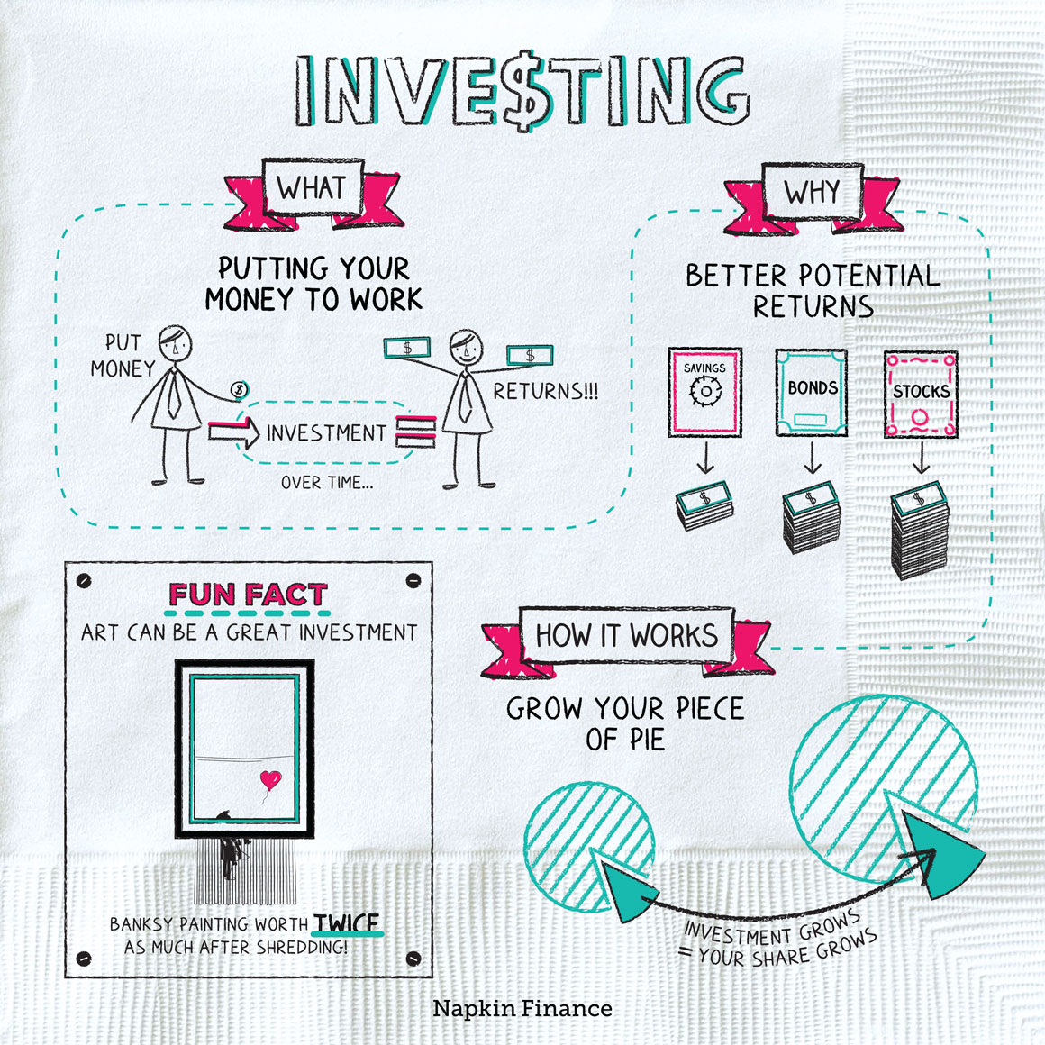

Investing 101: Overview

Slide 14
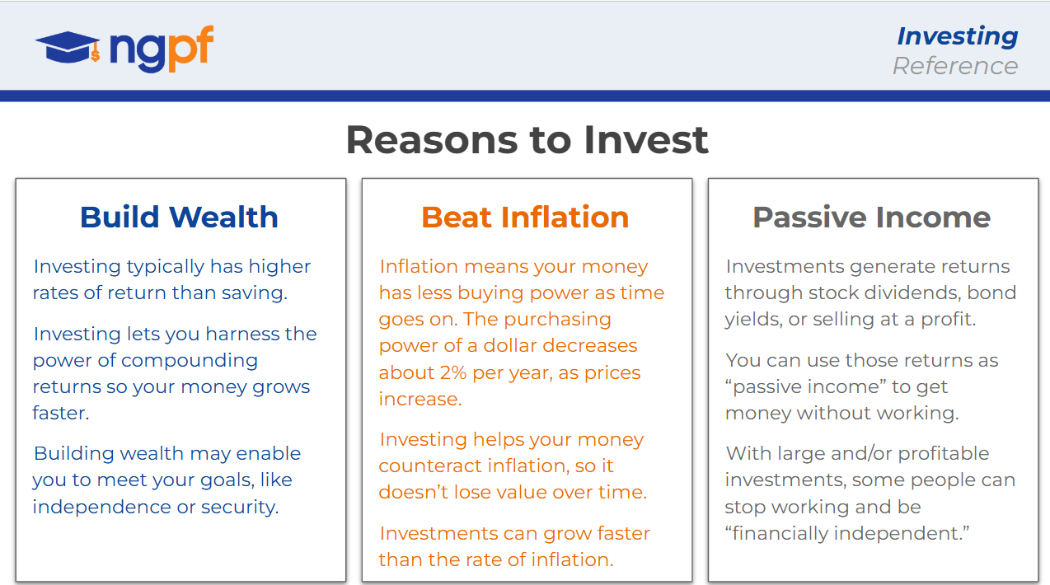
Investing 101: Benefits of Investing

Slide 15
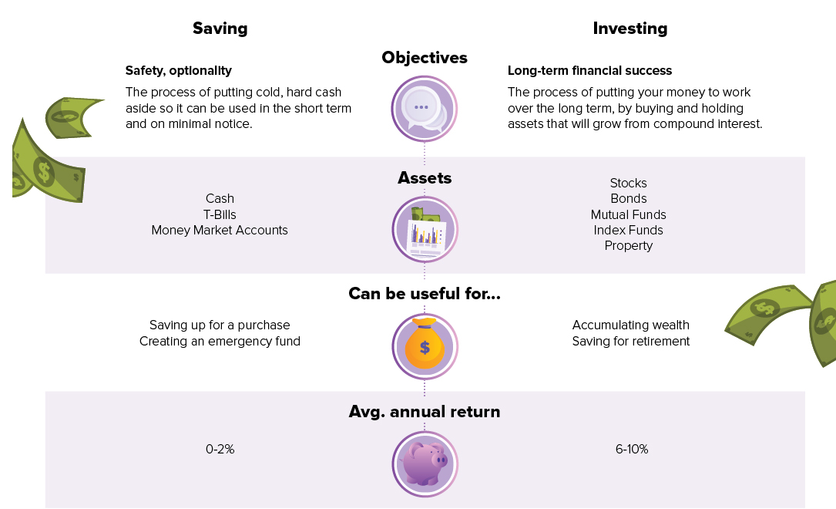
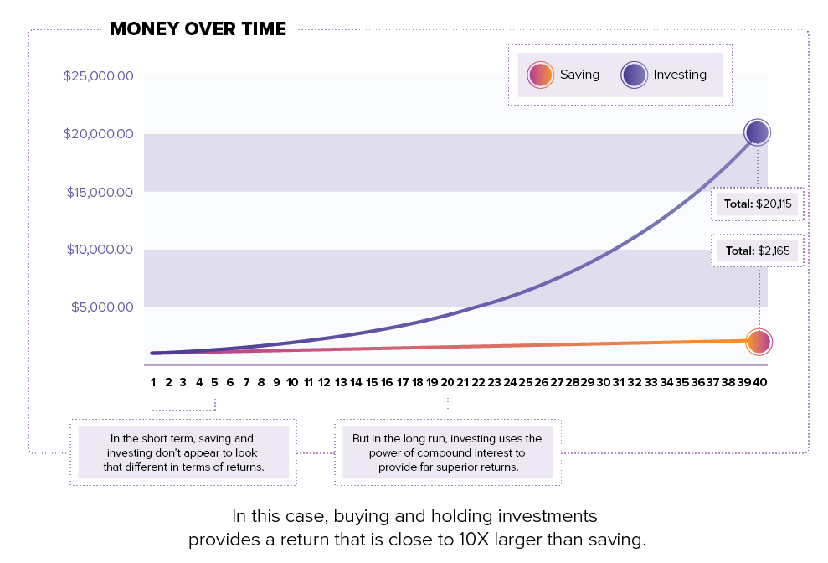
Investing 101: Saving vs. Investing​
Source: Visual Capitalist Wealth 101

Slide 16

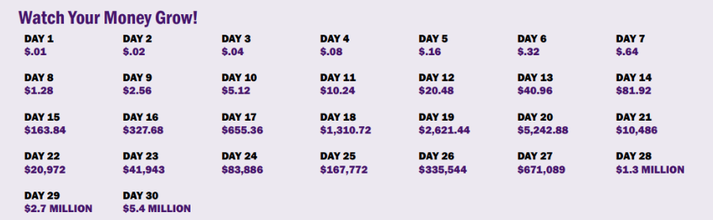
Investing 101: Compound Interest
Have $20 today or one penny today that is doubled in value every day for 30 days?

Slide 17
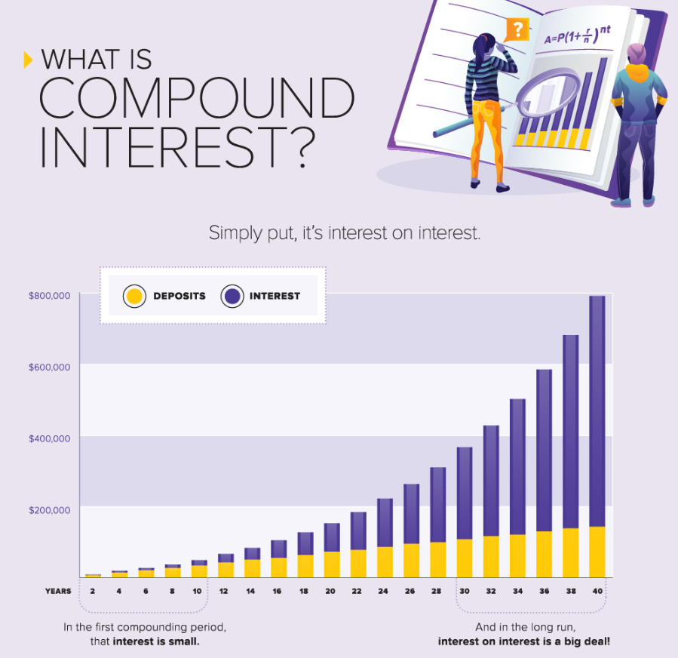
Investing 101: Compound Interest Explained
Source: Visual Capitalist

Slide 18
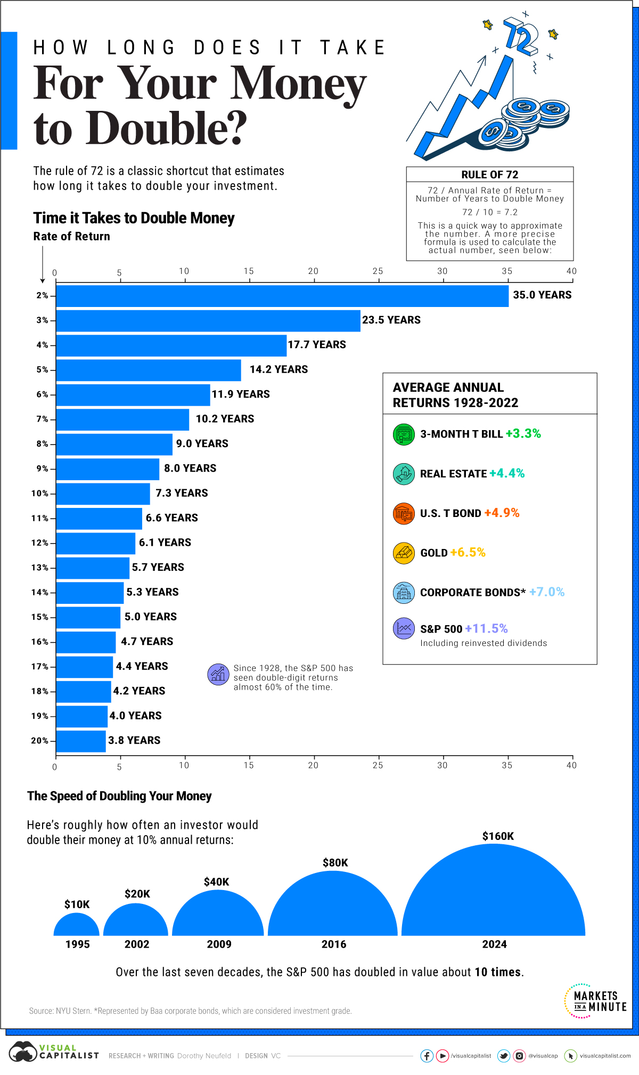
Investing 101: Rule of 72
Using the rule of 72, an investor can estimate how long it takes to double their moolah using a certain rate of return.
For example: With your money growing at a 10% interest rate, it would take ~7.2 years to double your money.
Source: Visual Capitalist

Slide 19
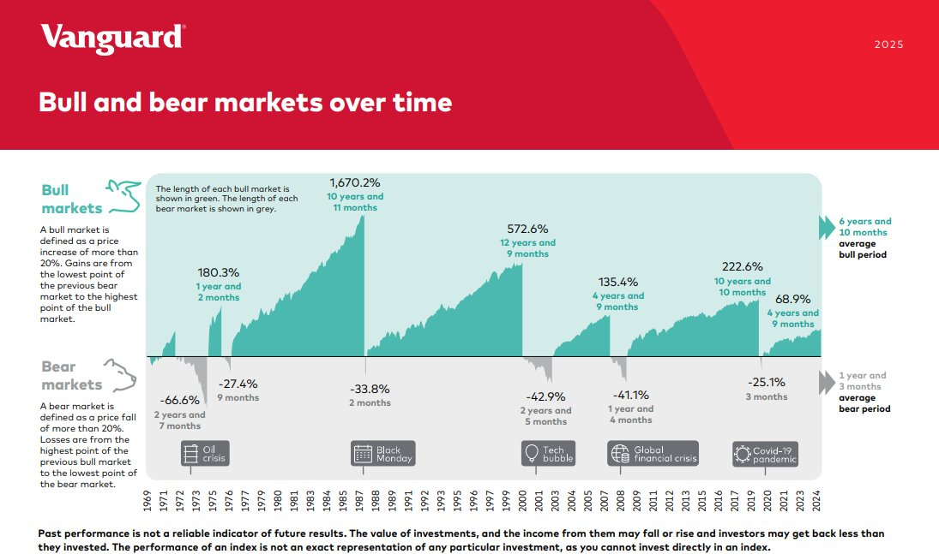
Investing 101: Bulls & Bears
Source: Vanguard

Slide 20
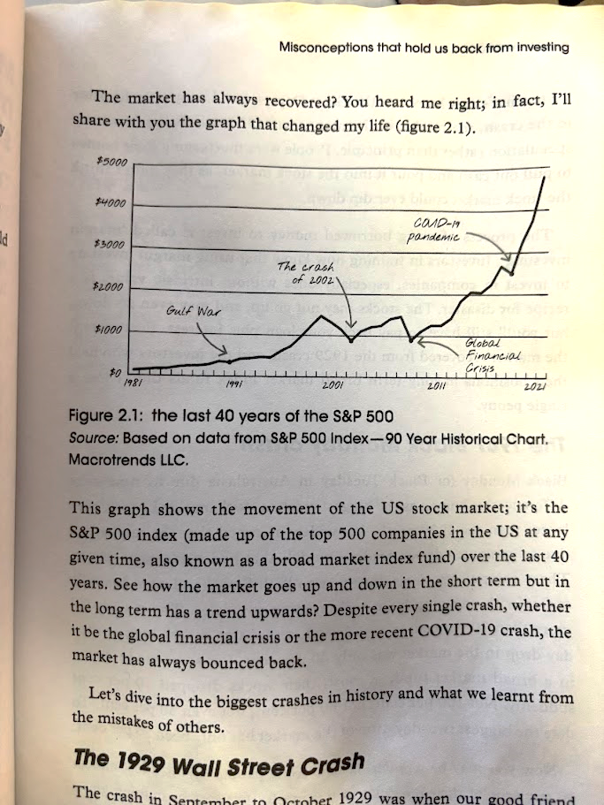

Investing 101: Historical Returns S&P 500
Check out this graph and explanation from the book, Girls that Invest
Excerpt of Chapter 2: Misconceptions that hold us back from investing

Slide 21
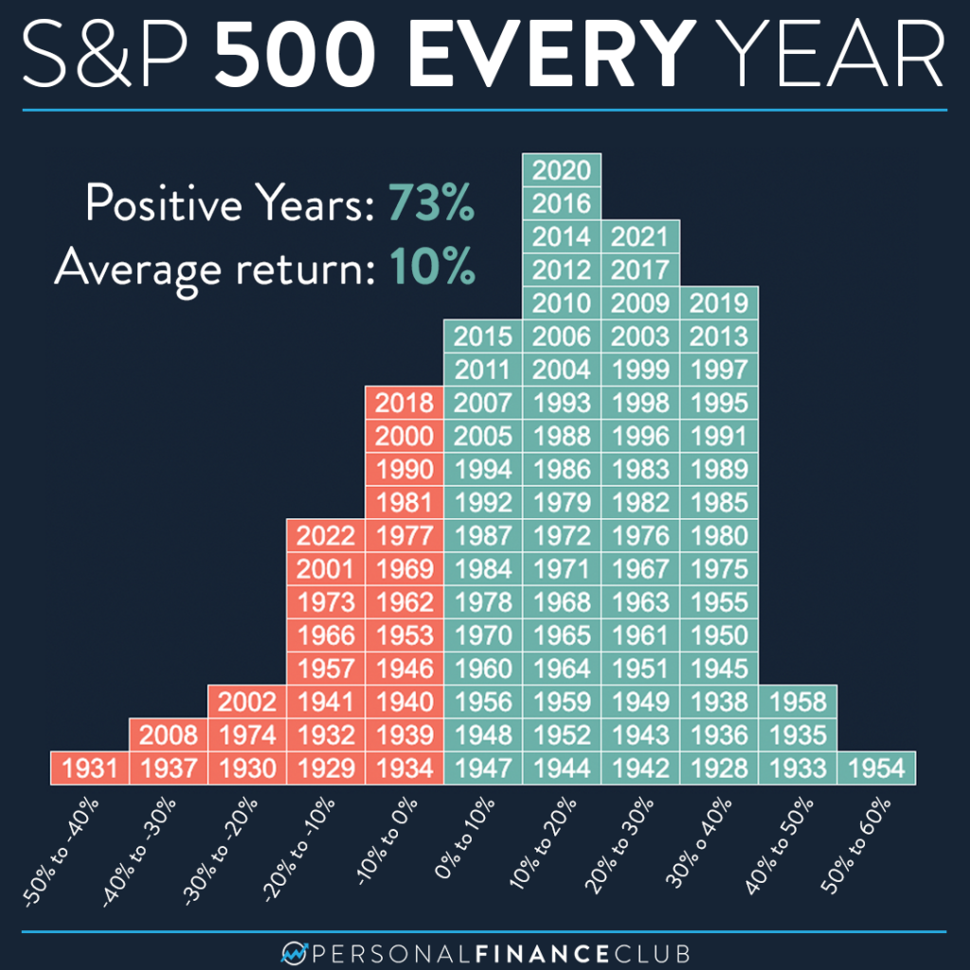
Investing 101: Historical Returns S&P 500
Source: Personal Finance Club

Slide 22
Investing 101: Long-Term Investing Benefits
Over a recent 20-year period, if you had been out of stocks during the market's 10 best days over 50% of the gains are missed. Missing the 20 best days leaves us with a negative return. So, stay invested, it's impossible to know when the big up days are going to happen. The only way to be sure to benefit from big up days in the market is to stay in the whole time.
Source: Personal Finance by Garmin & Fox

Slide 23
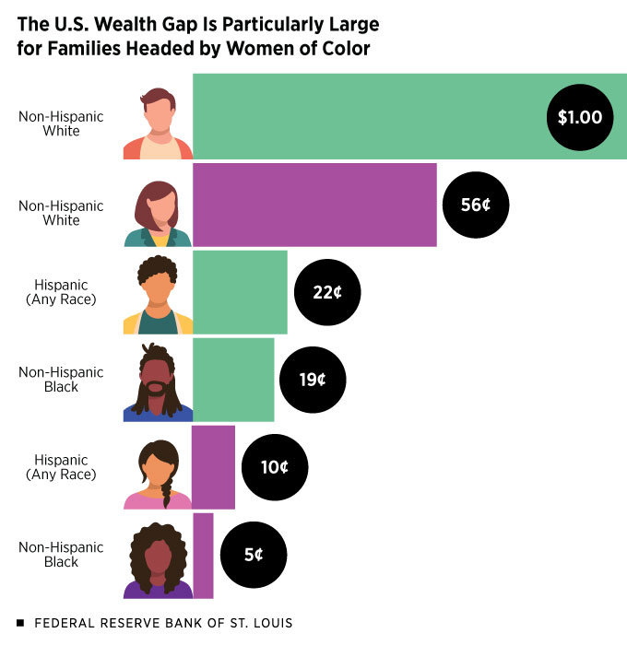
Investing 101: Wealth Gaps
Who has been left out of this compounding equation?
  The gaps in 2019 in terms of median wealth per every dollar held by families headed by white men.
Source: Federal Reserve Bank of St. Louis

Slide 24
Investing 101: Differences in Stock Market Investing
Black families had about 7% of their money in stocks compared to 18% for white families. Black families have historically put most of their wealth (about two-thirds) into homes and physical assets. (NBER)
22% of women have invested money in the stock market compared to 40% of men. (Credit Karma). There's a gender investing gap and for women who earn $100,000, this gap could cost as much as $1 million over a 30-year period. (Ellevest)
These investment disparities matter because stocks have historically outperformed housing by about 5x, widening wealth gaps and limiting financial opportunity for underrepresented groups.

Slide 25
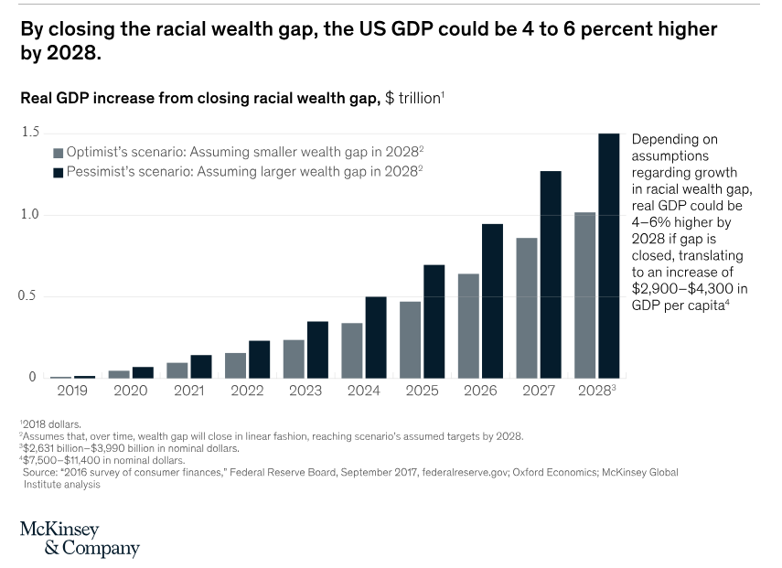
Investing 101: Impact of Closing Wealth Gaps

Slide 26
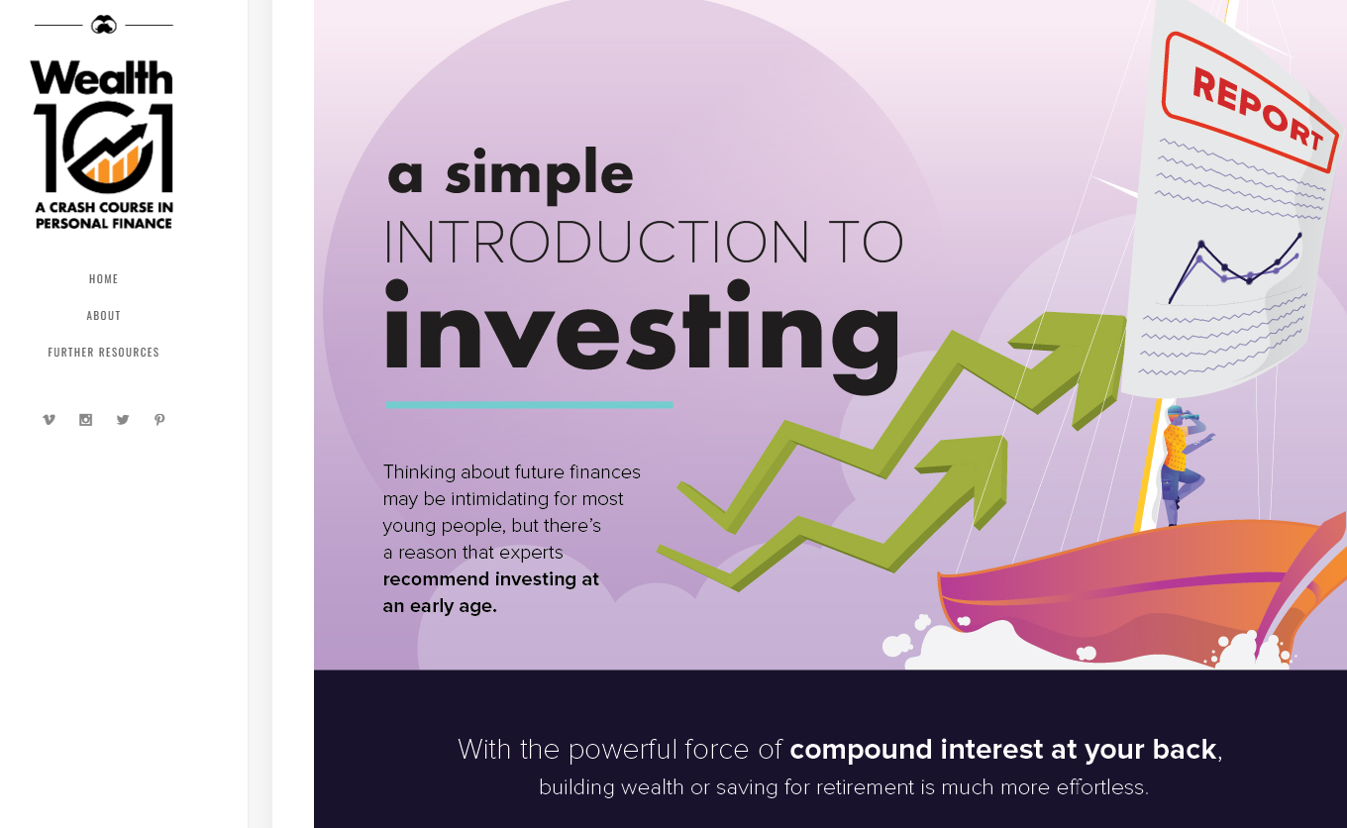
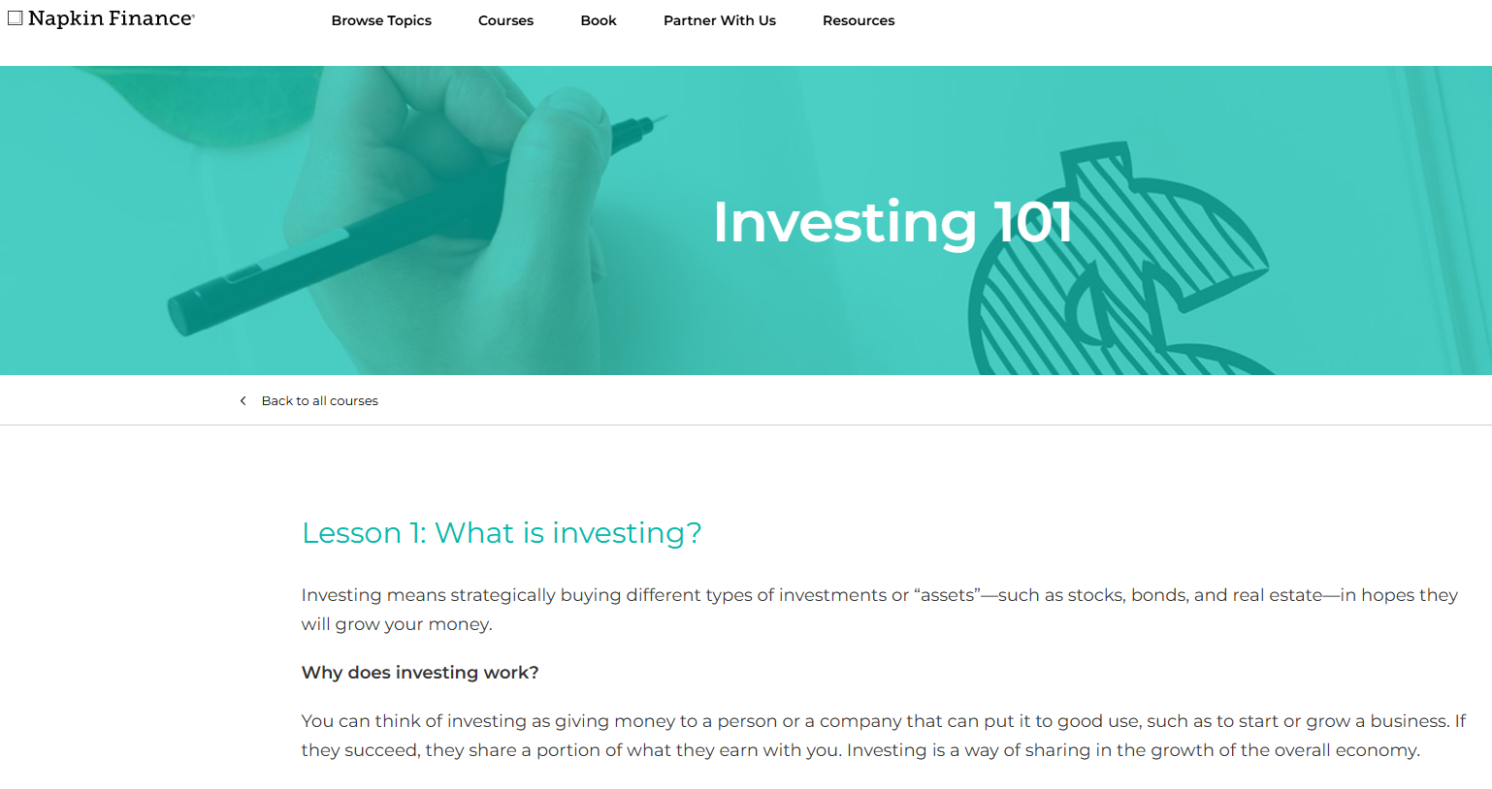
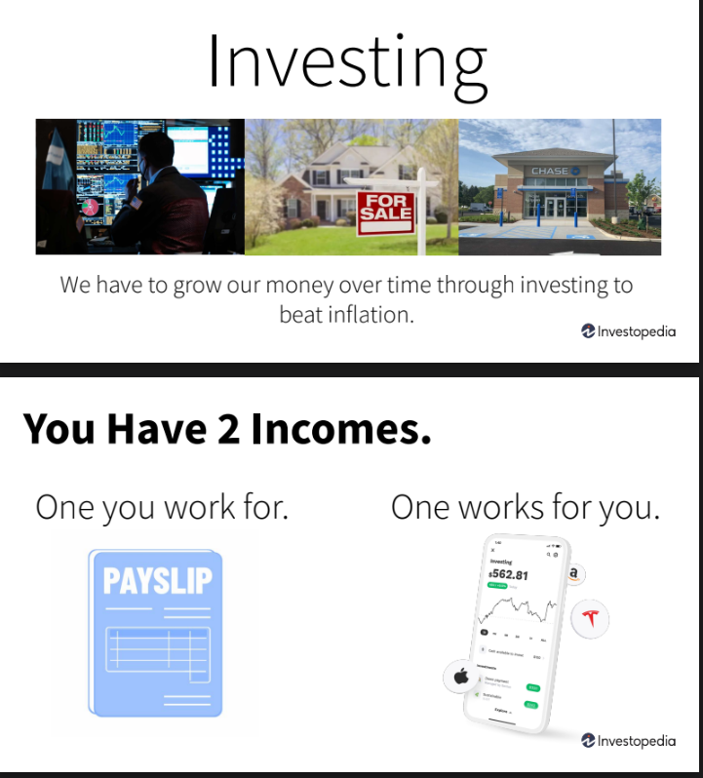
Investing 101: Resources
Visual Capitalist: Wealth 101
Napkin Finance: Investing 101 Course
Investopedia - Investing 101
What resources do you use to introduce investing?

Slide 27

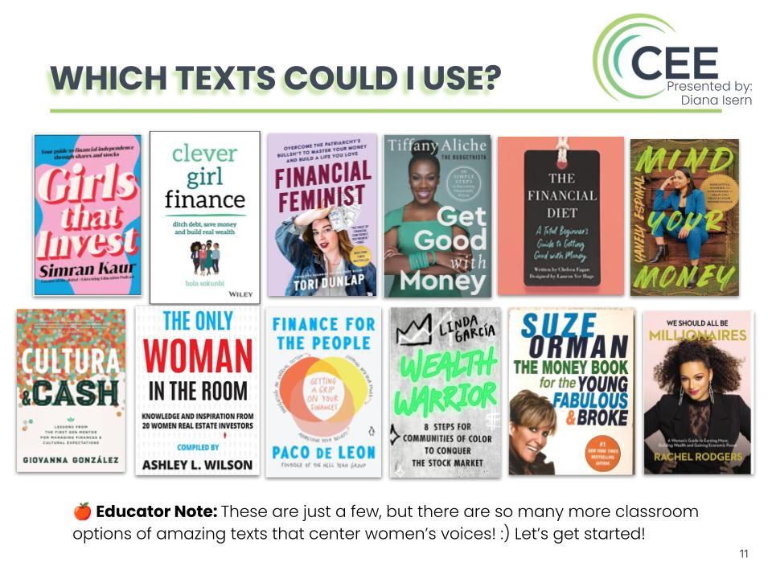
Investing 101: Classroom Connection
Financial Literature Circles
Most of these texts have investing chapter. Depending on the unit, I guide them towards the chapter that is relevant to what we are learning
But honestly, as long as they are reading, I'm good with whatever they decide!

Slide 28
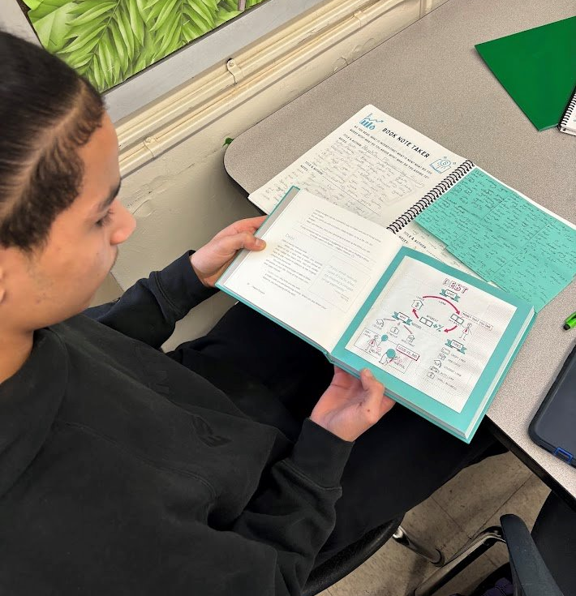


Investing 101: Classroom Connection​
Financial Literature Circles...in action!

Slide 29
Investing 101: Educator Reflection
For Self-Reflection:
What were your earliest memories or lessons about investing? How have they shaped your approach today
What emotions come up for you when thinking about the stock market?
How comfortable do you feel discussing investing concepts with others?
For Classroom Application:
What do you think students know, or don’t know, about investing? How will you find out if these assumptions are true?

Slide 30

Topic 2
Investment Vehicles

Slide 31
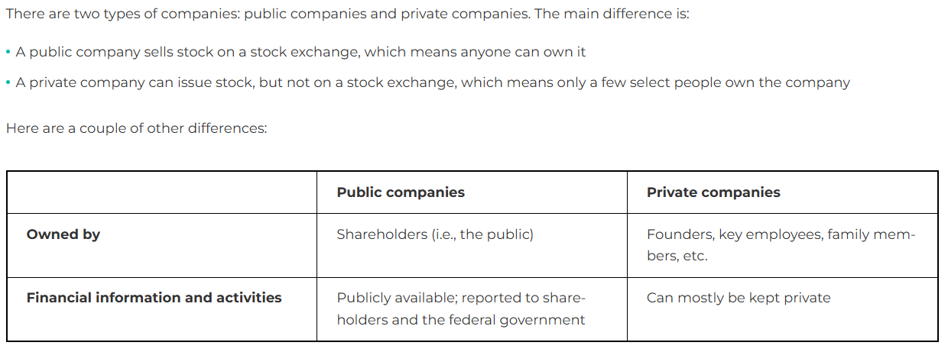
Investment Vehicles: Public and Private Companies
Resource: Napkin Finance

Slide 32
Investment Vehicles: Stocks & IPOs
When you hear about "stocks" or "the stock market" in the news, they're talking about publicly traded companies that anyone can buy a part of. Rather than taking on debt through loans, companies can decide to "go public" through an Initial Public Offering (IPO).
Why Companies Issue Stock
Companies sell pieces of ownership (stocks) to you (the investor) get money for things like:
Creating new products
Making current products better
Expanding to new markets
Building facilities
Paying off debts
Hiring people
Opening locations in new areas
Why investors buy stocks
Investors buy stocks hoping to make money in two main ways:
Selling stocks later when they're worth more
Receiving dividend payments (a share of the company's profits)

Slide 33
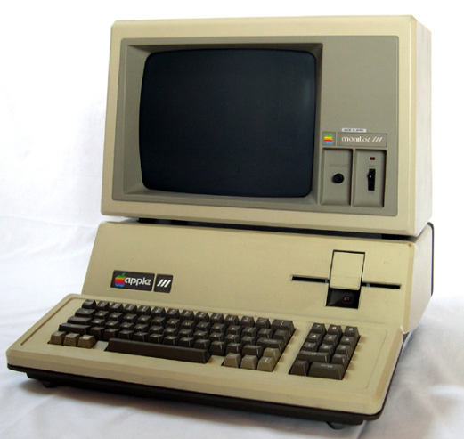
Investment Vehicles: Stocks & IPOs
Example: Apple (AAPL)
Apple's Stock Issuance: Apple went public on December 12, 1980, with an Initial Public Offering (IPO) at $22 per share. The company raised about $100 million from the public offering. At the time, Apple needed capital to:
Expand production of their Apple II computer
Develop new products like the Macintosh and iPhone
Compete with larger companies like IBM
Hire additional engineering and marketing talent
Build manufacturing facilities
Why Investors Bought Apple Stock:
Growth investors: A $2,200 investment (100 shares) at the IPO would be worth millions today after stock splits
Dividend investors: Since 2012, Apple pays regular dividends, providing income alongside growth

Slide 34

Investment Vehicles: Companies & Brands
Parent Company
A parent company is like the head of a family. It owns or controls other companies and makes big decisions about money and strategy.
Example: LVMH is a parent company that owns many luxury brands.
Company
A company is a business organization that sells products or services. Companies can be independent or owned by a parent company.
Example: Louis Vuitton is a company (owned by the LVMH parent company).
Brand
A brand is the name, design, and identity that people recognize. It's what customers know and connect with emotionally.
Example: Fenty Beauty is a brand that was created through a partnership between Rihanna and LVMH.

Slide 35
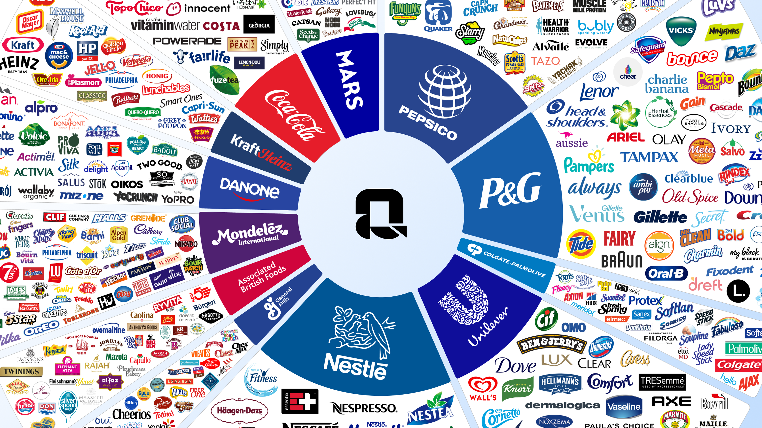
Investment Vehicles: Companies & Brands

Slide 36
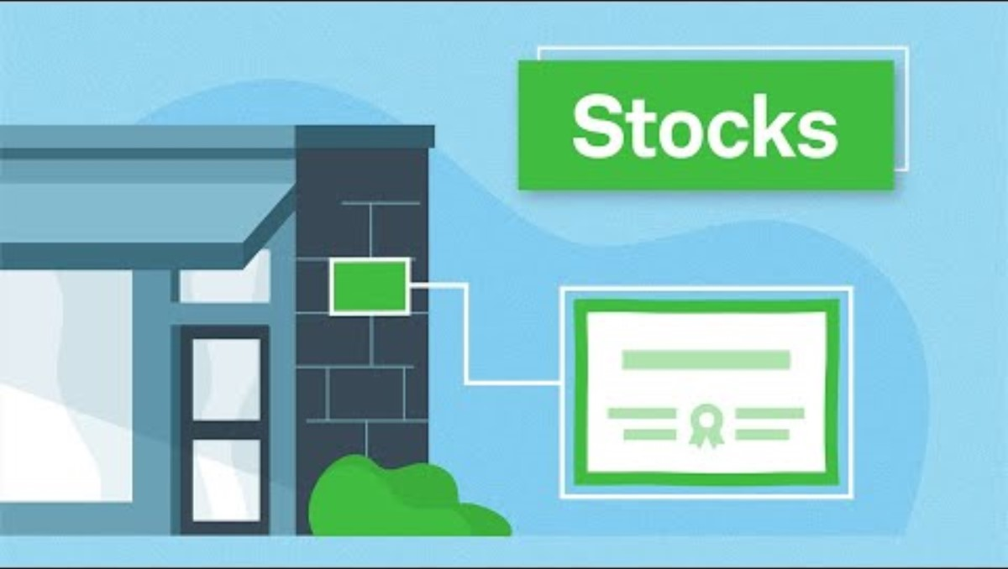
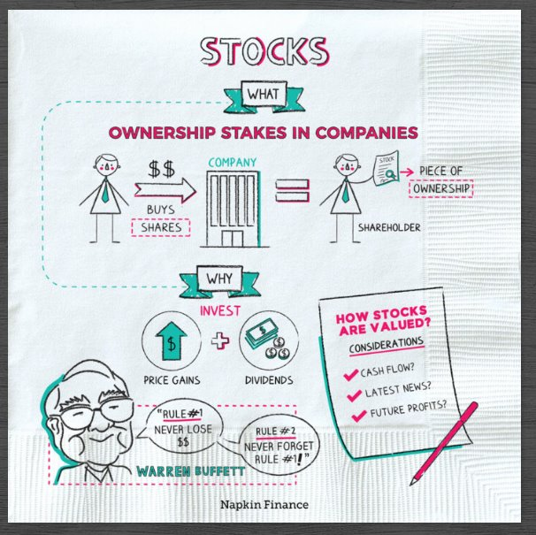
Investment Vehicles: Owning Stocks
Charles Schwab
Investing Basics: Stocks

Slide 37

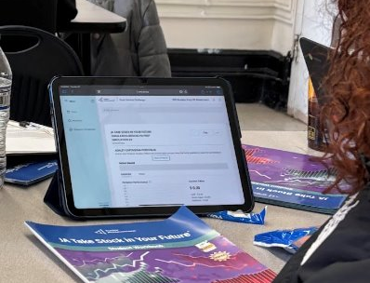
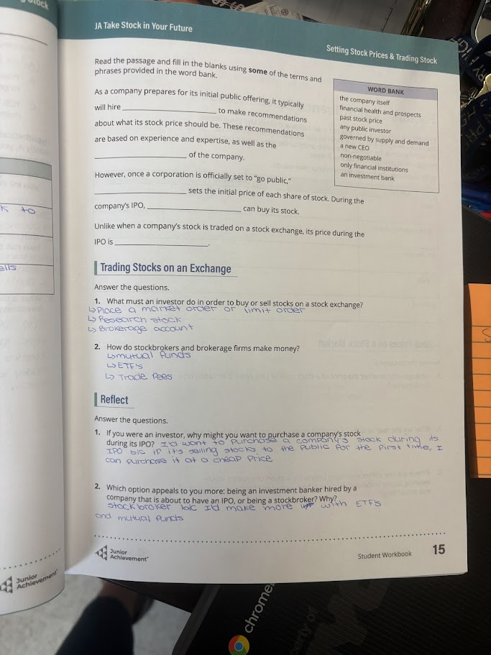
Investment Vehicles: Classroom Connection
Partnership
Junior Achievement Take Stock in Your Future competition

Slide 38
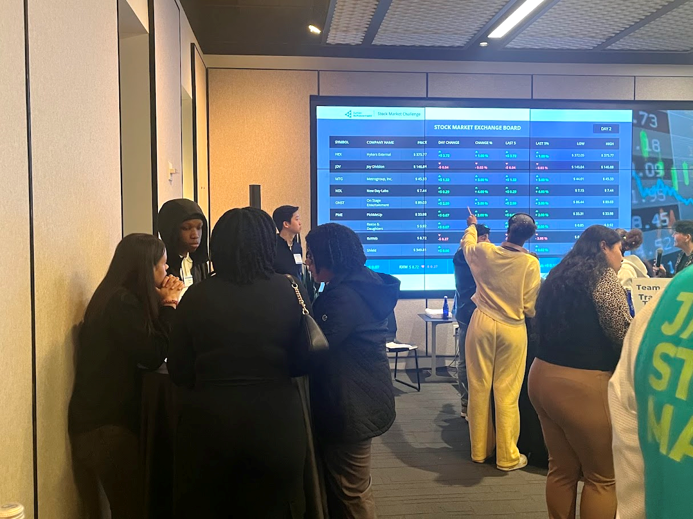

Investment Vehicles: Classroom Connection
Partnership
Junior Achievement Take Stock in Your Future competition

Slide 39
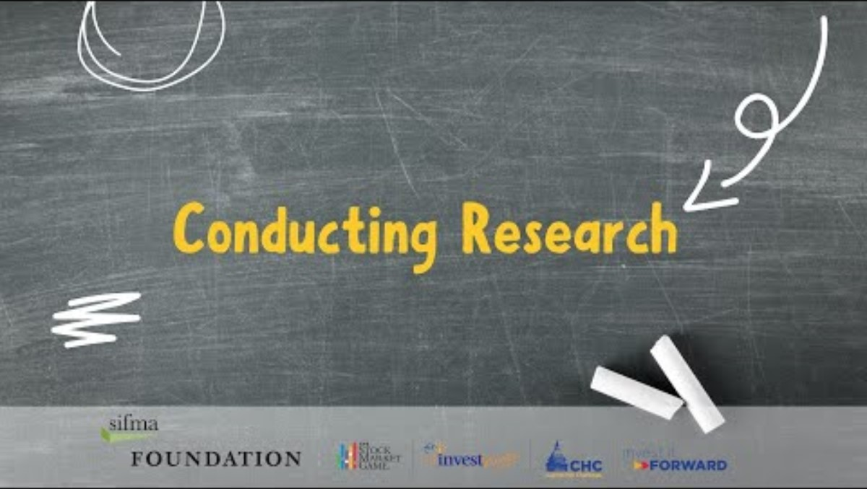
Investment Vehicles: Classroom Connection
Project: Researching Stocks
Students have seen stock tickers their whole life. They engage with this activity because they make a connection between understanding stocks and their own financial goals.
Steps
Students decide on a stock of a company they used this weekend.
Watch SIFMA video: Conducting Research
Go to Yahoo Finance and fill out stock quote analysis worksheet (next slide)
Conducting Research | SIFMA (0:20-1:00)

Slide 40
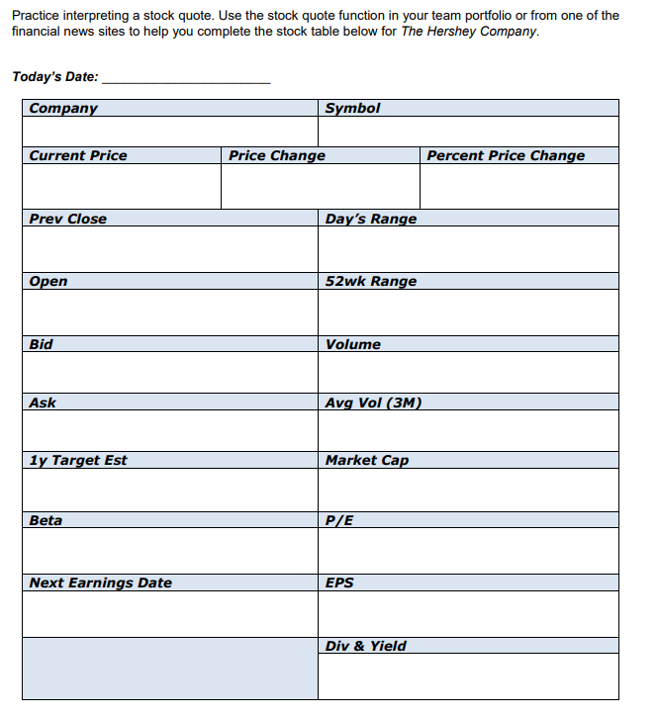
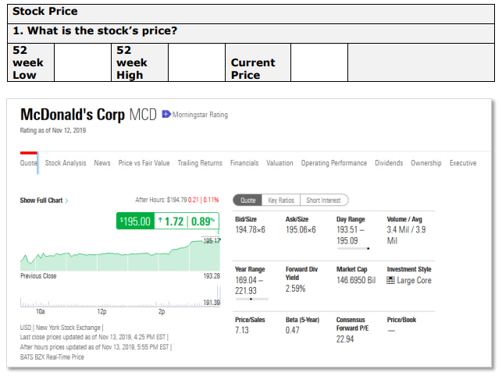
Investment Vehicles: Classroom Connection
Project: Researching Stocks (SIFMA)
Simplified Option​
Advanced Option

Slide 41
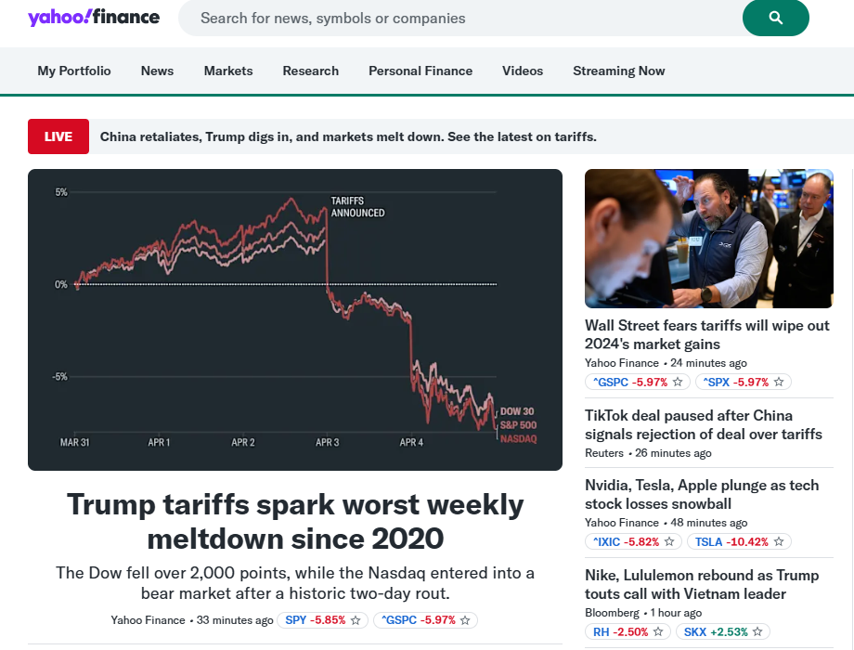
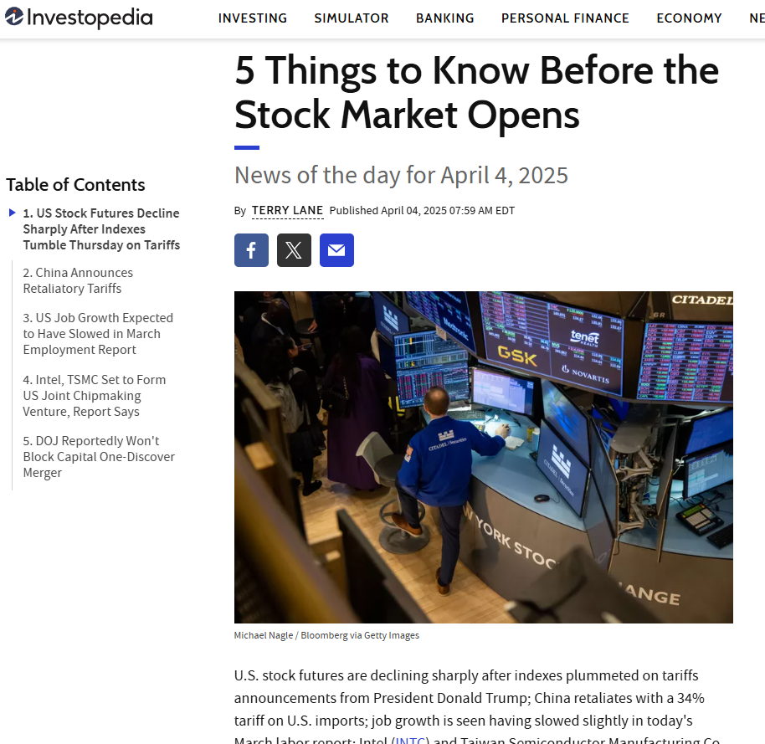
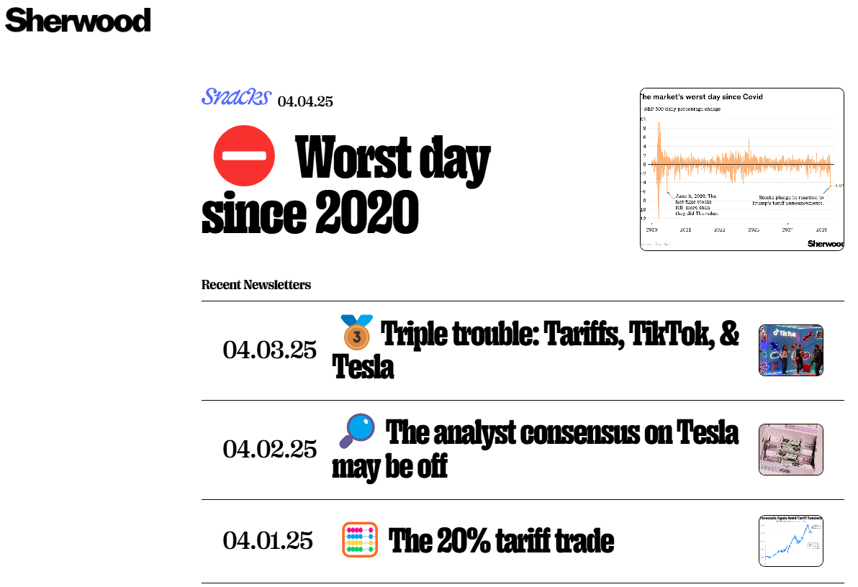
Investment Vehicles: Classroom Connection
Entry Task / Discussion Idea
Someone asks you, "What is happening in the stock market today?" Answer in your own words. Use one of the following to help you explain.
Yahoo Finance
https://finance.yahoo.com/
Investopedia
5 Things to Know Before the Stock Market Opens Newsletter
Sherwood Snacks
https://sherwood.news/snacks/newsletters/

Slide 42
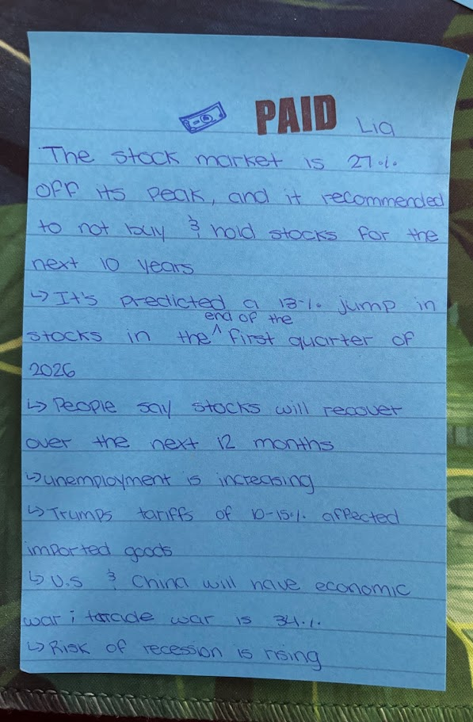
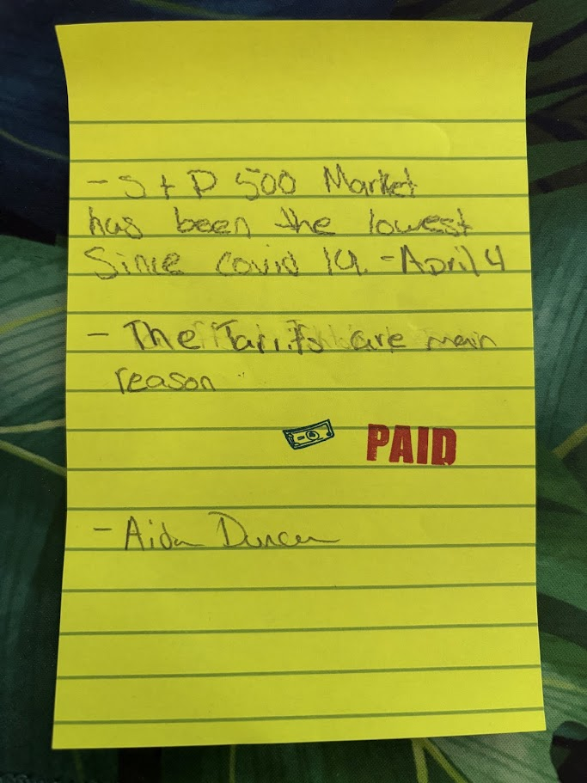
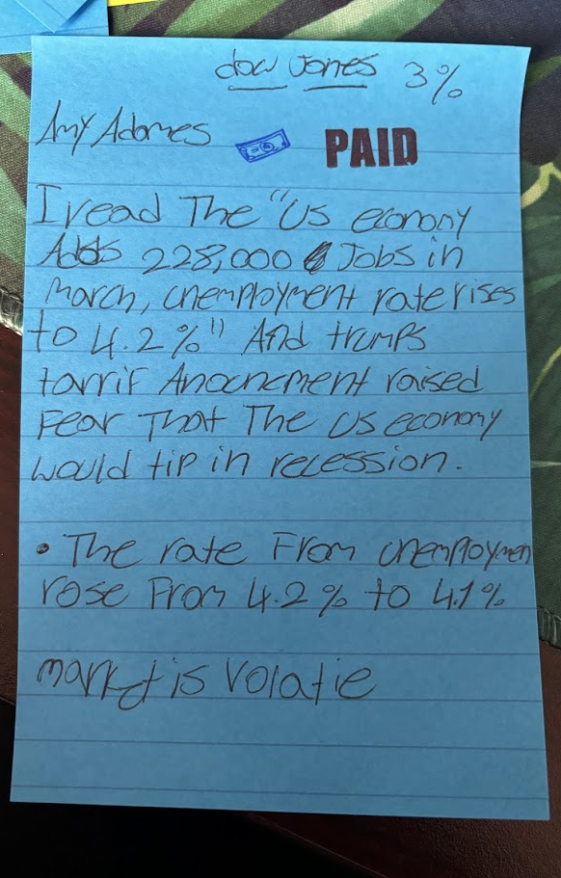
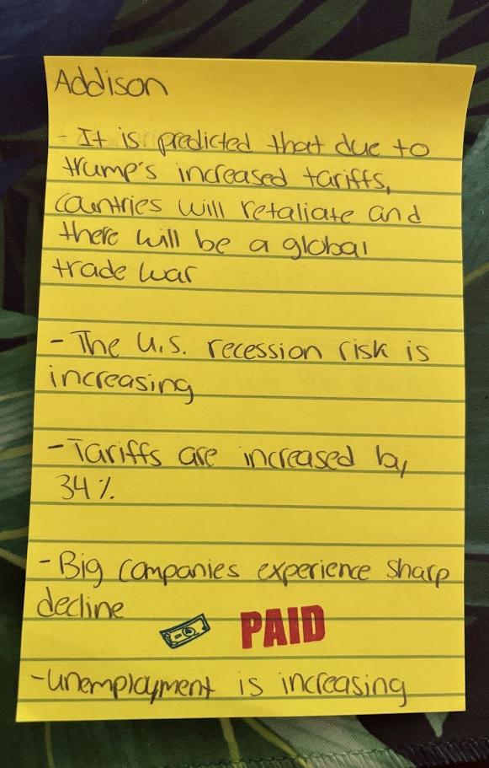
Investment Vehicles: Classroom Connection
Entry Task / Discussion Idea
Someone asks you, "What is happening in the stock market today?" Answer in your own words. Use one of the following to help you explain.

Slide 43

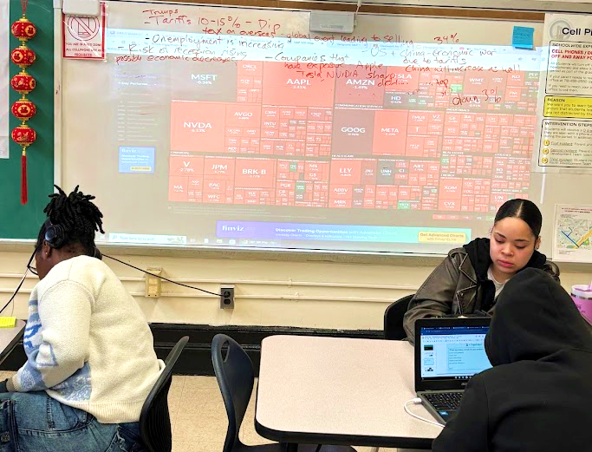

Investment Vehicles: Classroom Connection
Activity
Using finviz to analyze the stock market and make connections to news

Slide 44
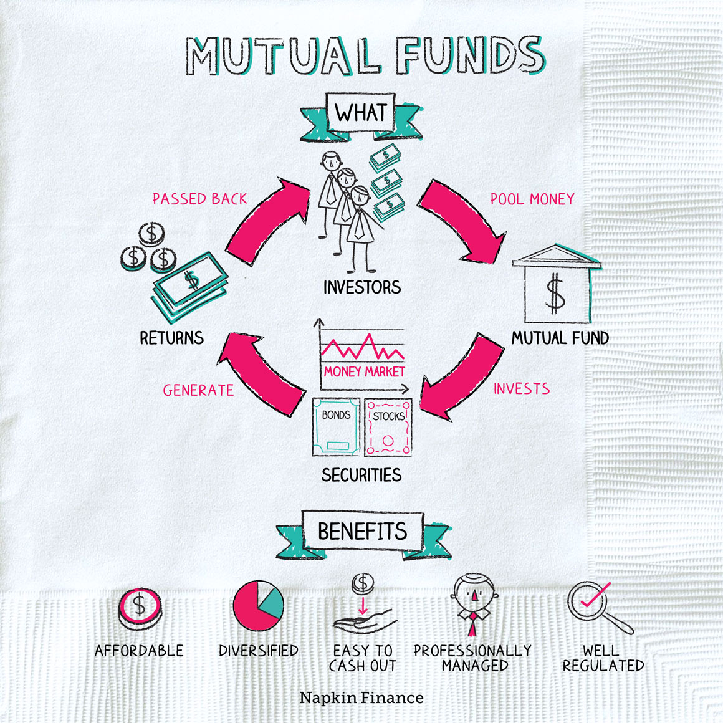
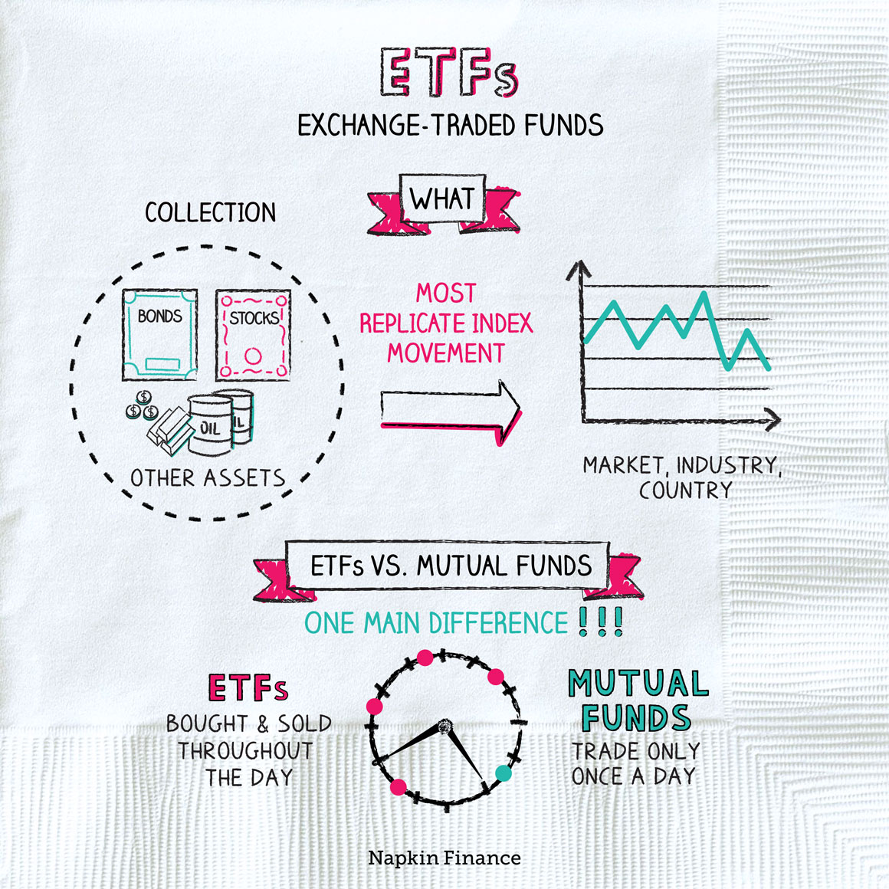
Investment Vehicles: Mutual Funds & ETFs
Similarities: Both are professionally managed "baskets" of stocks or bonds that provide diversification across asset classes, sectors, and geographies.
Key difference: ETFs trade like stocks throughout the day, while mutual funds are priced once daily after market close and purchased in dollar amounts.
Example: VTI and VTSAX track the same index (the US Total Market Index), but VTI is an ETF (Exchange Traded Fund) that trades throughout the day, while VTSAX is a mutual fund that trades once per day after the market closes. ​
Notes:
Index funds, ETFs, and mutual funds are all investment vehicles, but they differ in how they are managed, traded, and priced.
Mutual Funds: Active investment strategy to outpace market, priced once a day, less liquid.
ETFs: Passive or active investment strategy, traded throughout the day, more liquid, lower expense ratios (annual fees)
Index Funds (Mutual Funds or ETFs): Passive investment strategy to match market, priced once a day, less liquid, lower expense ratios (annual fees)

Slide 45


Investment Vehicles: Mutual Funds & ETFs
Index Funds vs Mutual Funds & ETFs | Alice Cee, CPA
Mutual Funds vs. ETFs –Which is Right For You? | Wall Street Journal

Slide 46
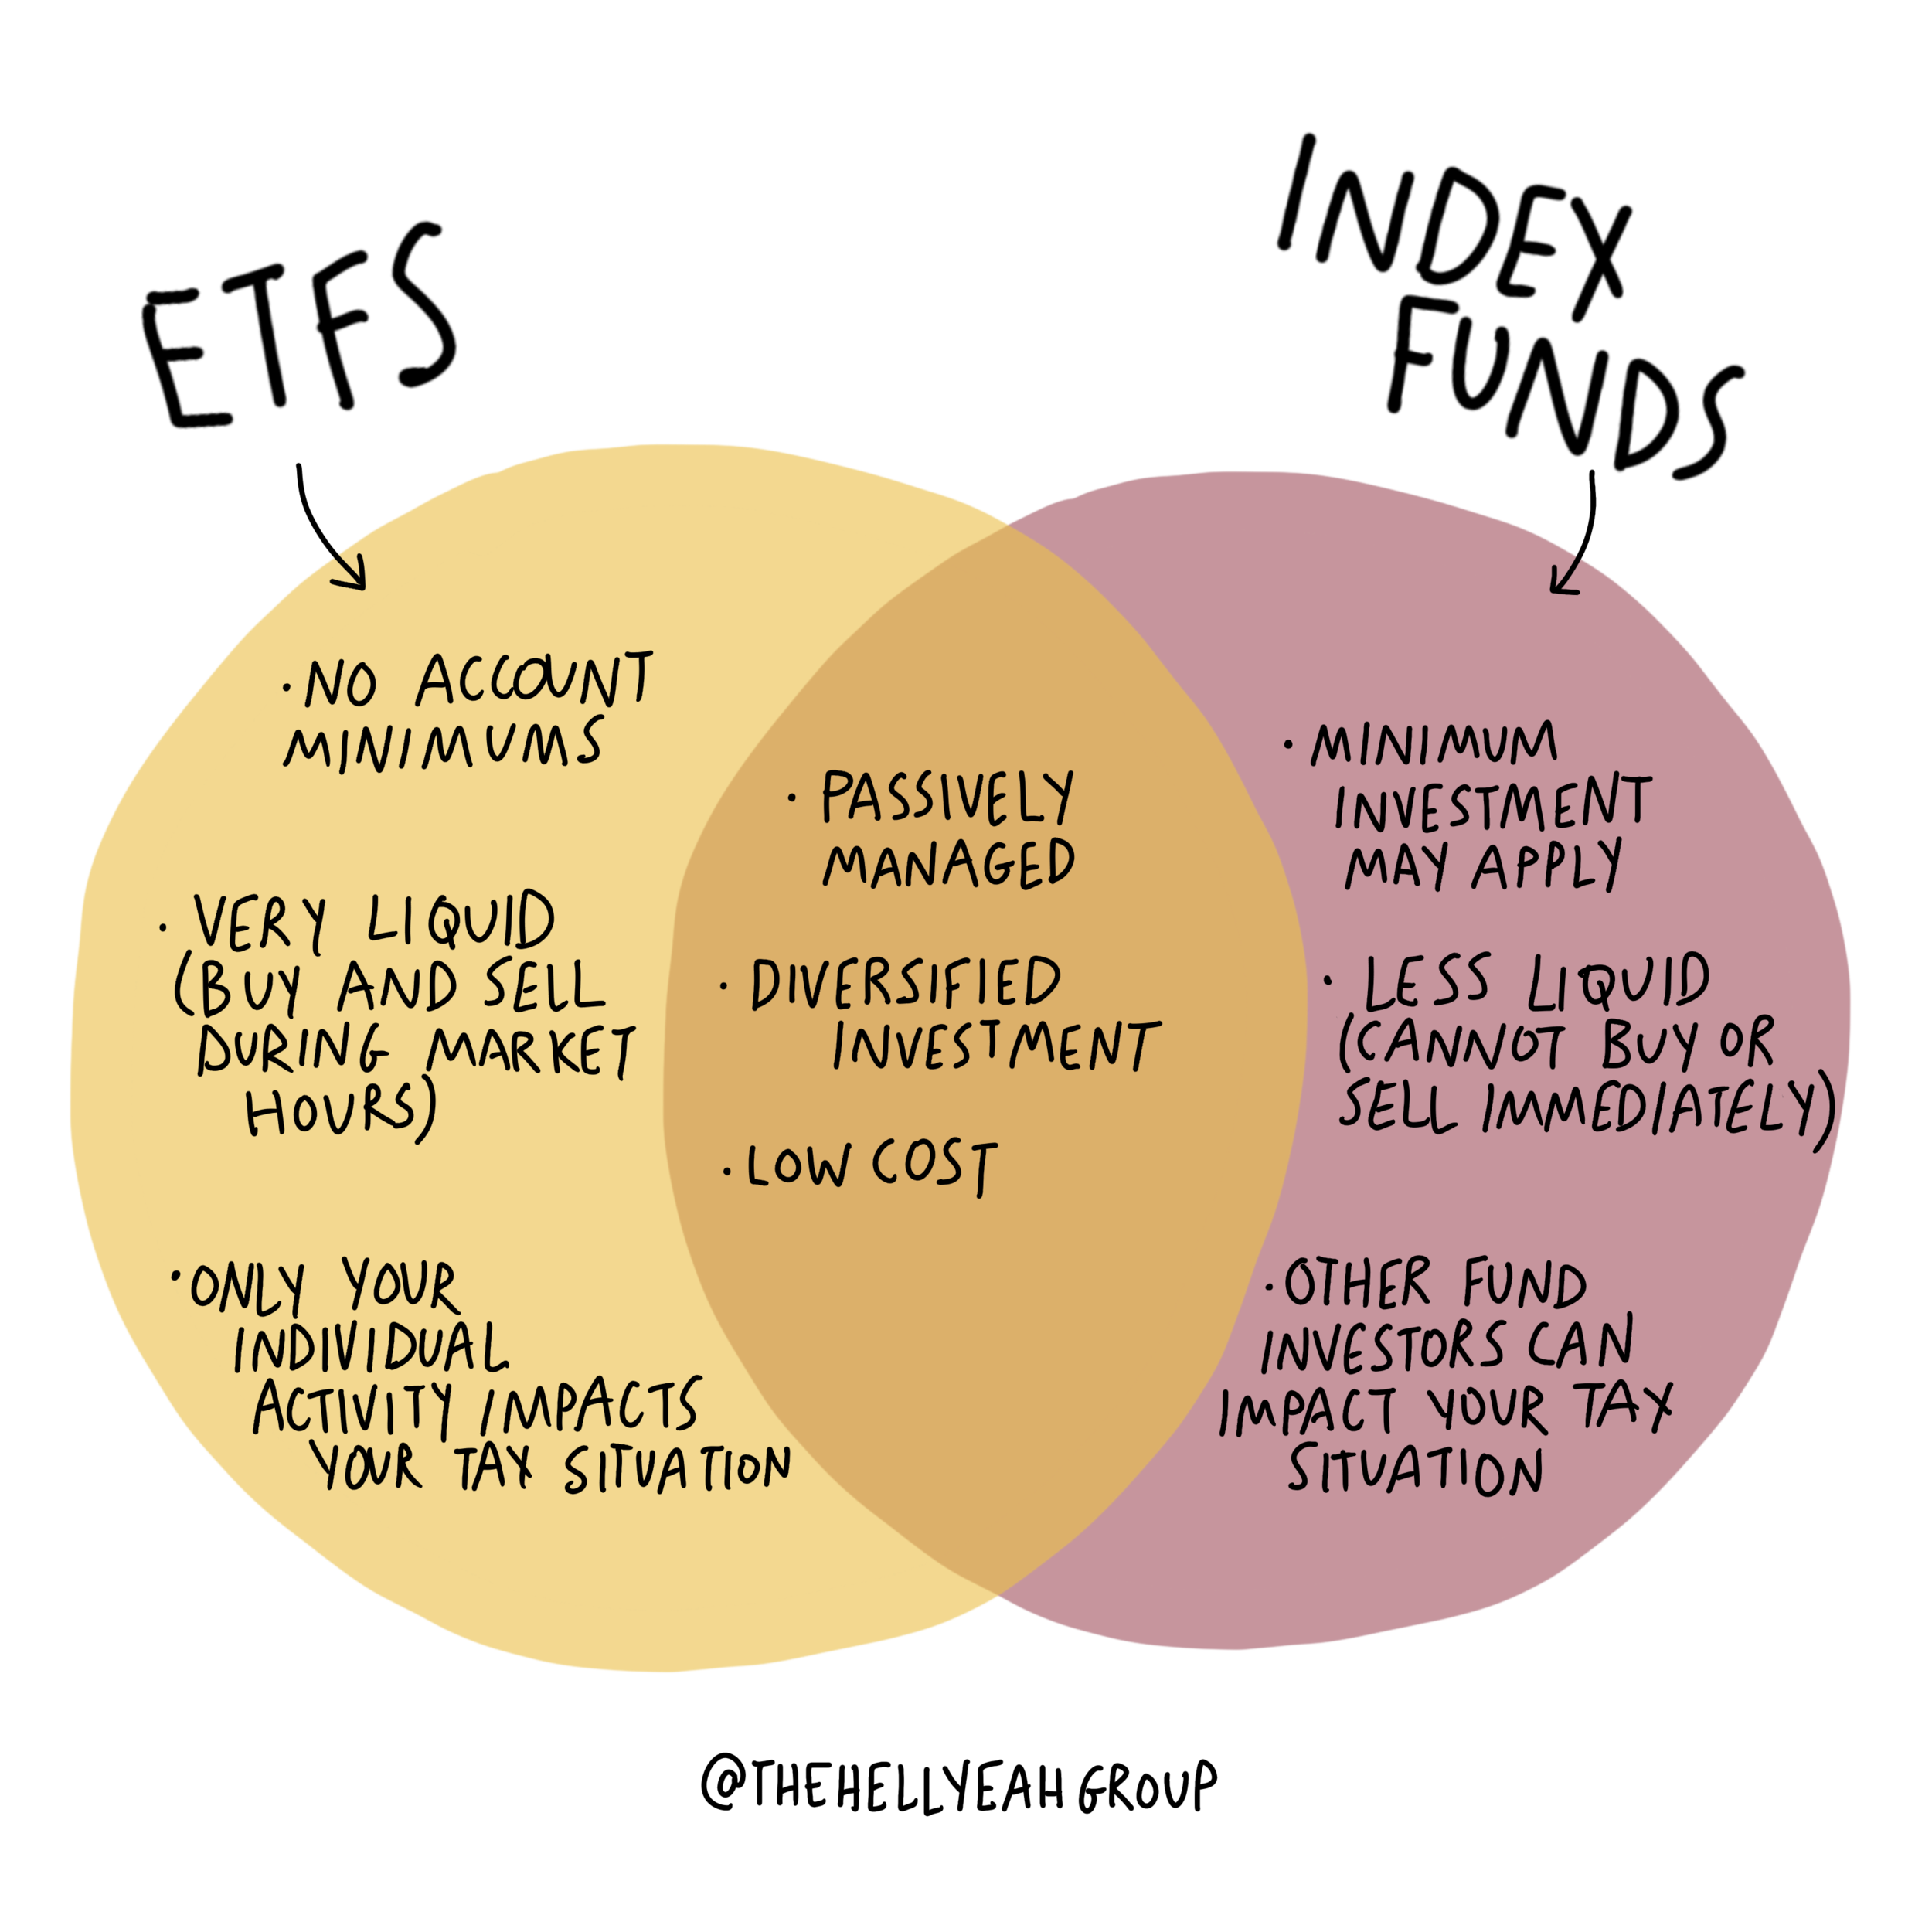

Investment Vehicles: Understanding Index Funds
An index fund is a type of investment fund (either a mutual fund or an ETF) that aims to replicate the performance of a specific market index, like the S&P 500.
Visual from Finance for the People by Paco de Leon

Slide 47

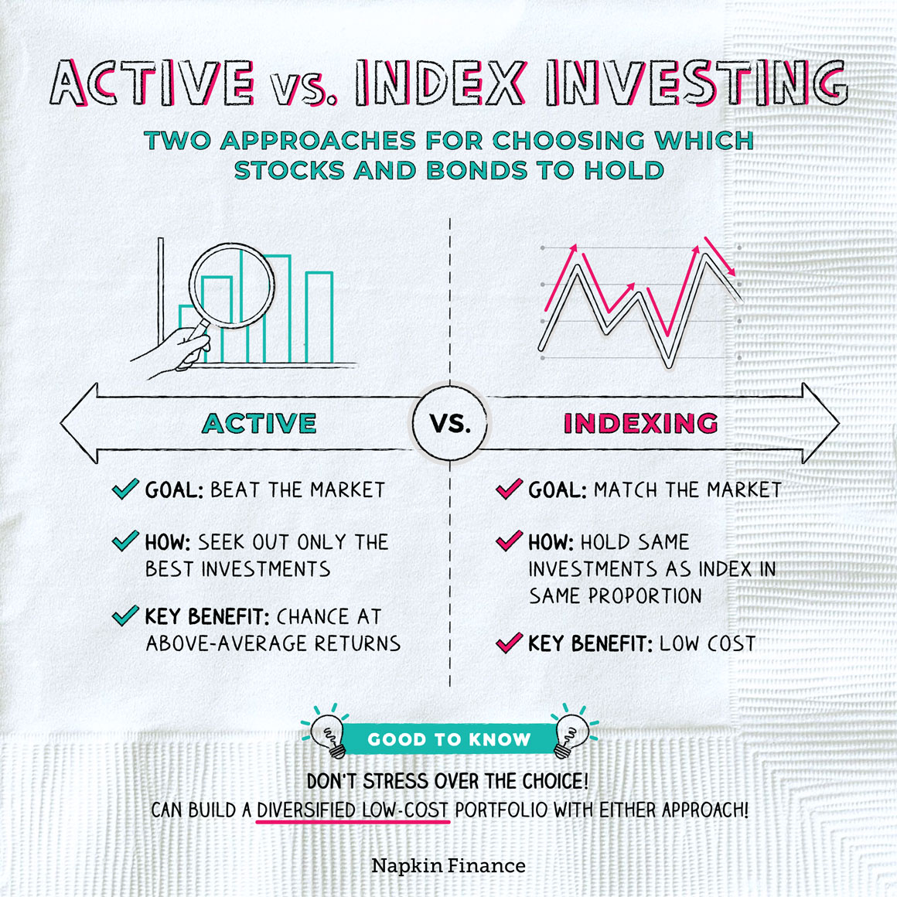
Investment Vehicles: Active vs. Passive Management
What the Heck is a Mutual Fund | Two Cents
(2:20-3:15)

Slide 48
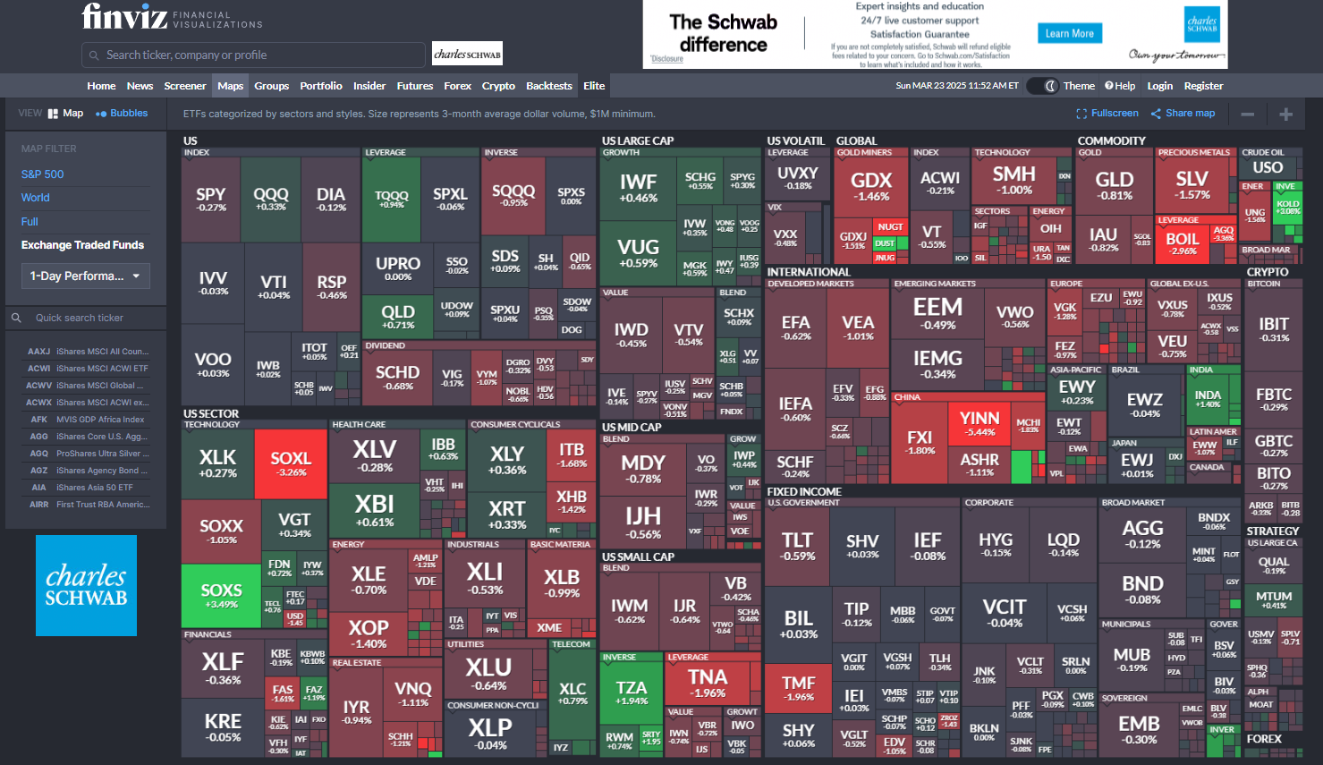
Investment Vehicles: Classroom Connection
Project: Researching Funds
Choose 3 ETFs to analyze on Yahoo Finance or Finviz.com:
What are the fund's top 10 holdings?
Describe the fund. What companies and industries is it invested?
What is its performance for 1 year, 3 years, 5 years, All time?
Is this fund a good investment? Explain.

Slide 49
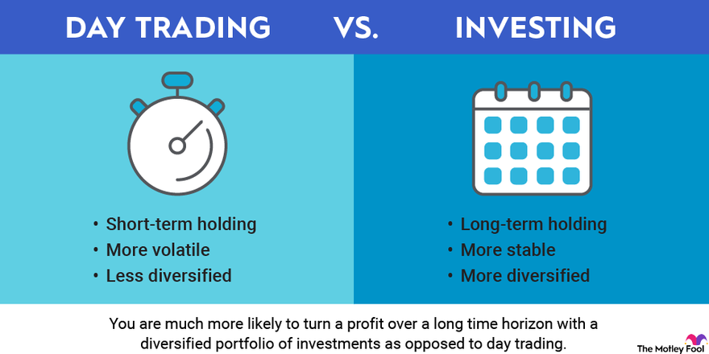
Investment Vehicles: Classroom Connection
Discussion: Day Trading
Many of my students are interested in day trading. This interest can create an engaging moment to have a discussion around the risks and rewards.
Resources
CNBC Article: Attention Robinhood power users: Most day traders lose money
Charles Schwab Article: Investing vs. Trading: What's the Difference?
Popcorn Finance Podcast: Trading vs. Investing
CNBC Video: Investing 101: Lessons from Self-Made Millionaire Tiffany James

Slide 50
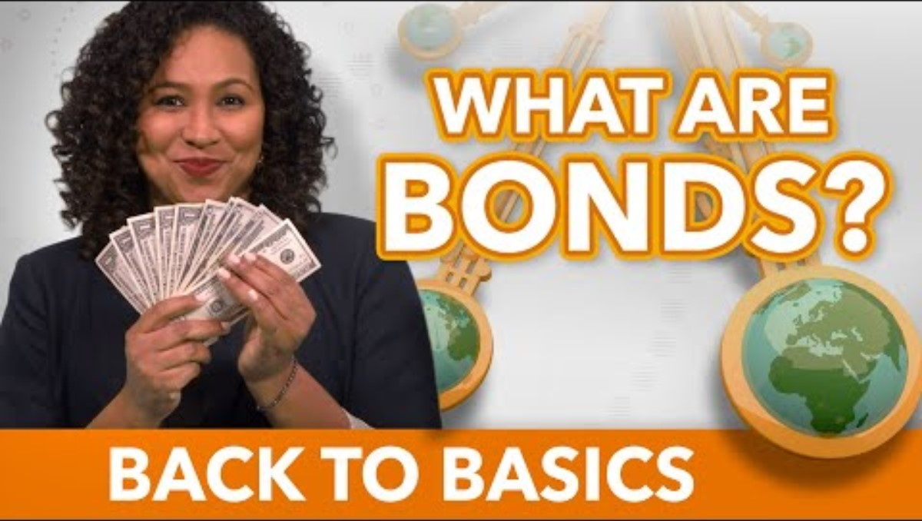
Investment Vehicles: Bonding with Bonds
What are bonds?
Why are they seen as less risky?
Bonds are essentially loans that investors make to a company or government, in return for a promise of repayment of the principal amount (face value) plus interest payments (coupon) over a set period.
What are Bonds? | IMF
(0:30-3:10)

Slide 51
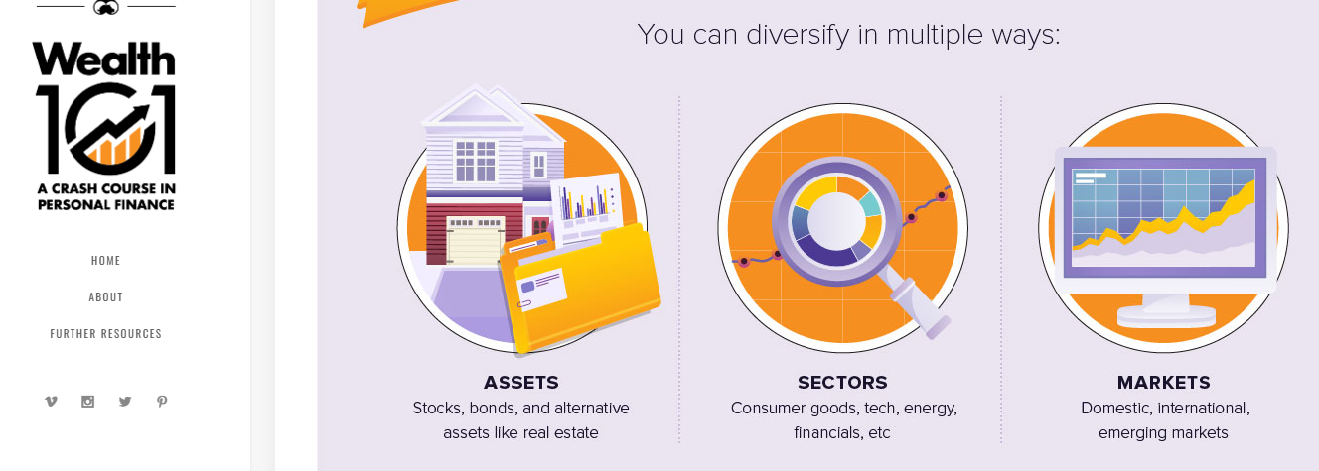
Investment Vehicles: Diversification
Types of Diversification:
Asset Classes
Sectors
Markets

Slide 52

Investment Vehicles: Diversification
Assessing Risk and Diversification | SIFMA

Slide 53
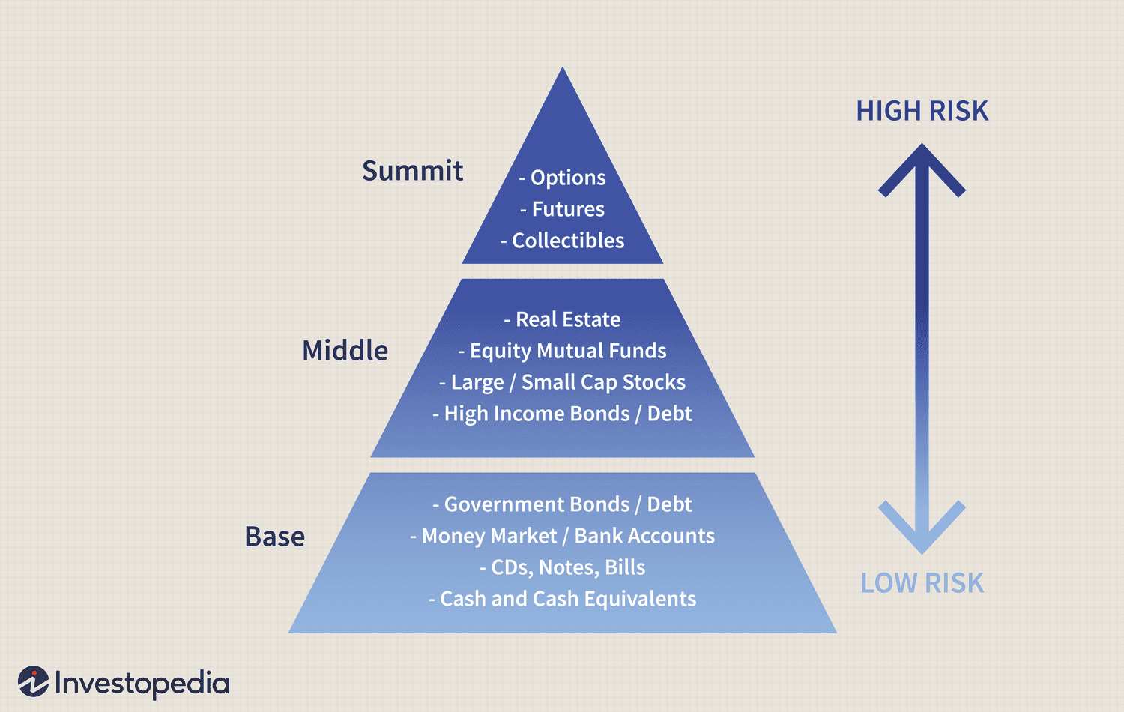
Investment Vehicles: Risk Levels & 120-age Rule
Bonds are a way to diversify your risk.
The 120-age investment rule: A rule of thumb to diversify your risk. Subtract your age from 120 and using the result as the percentage of your investment dollars in stocks and other equity investments. Any remainder should become investments in low-risk assets, including certificates of deposit (CDs), bonds, Treasury bills and fixed annuities.
For example, if you’re 30 years old, subtracting your age from 120 gives you 90. Therefore, you would invest 90% of your retirement money in stocks and 10% into more consistent financial instruments. This rule creates a portfolio that gradually carries less risk.
Source: Smart Asset

Slide 54
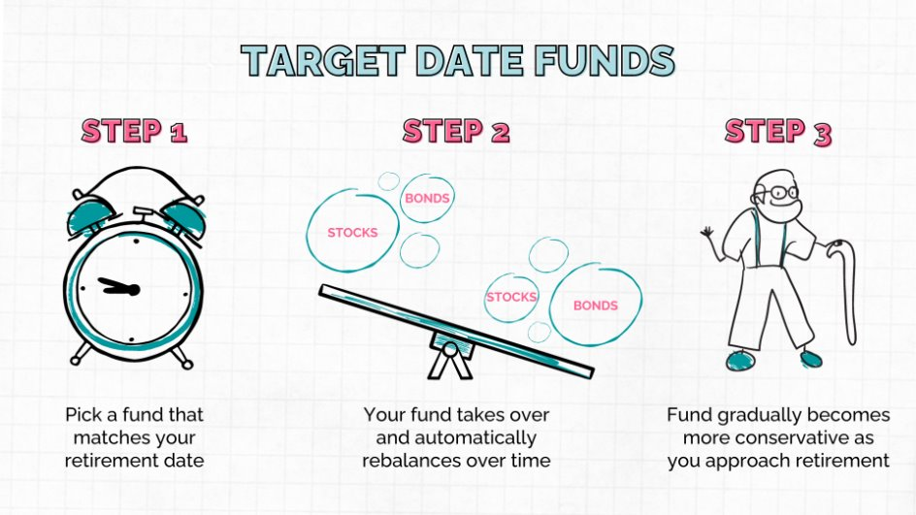
Investment Vehicles: Target Date Funds
Target-date funds are designed to grow your investments optimally for a specific future date, making it easier to adjust your asset allocation over time.
Young investors should focus on stocks, while those nearing retirement should shift to safer options.

Slide 55
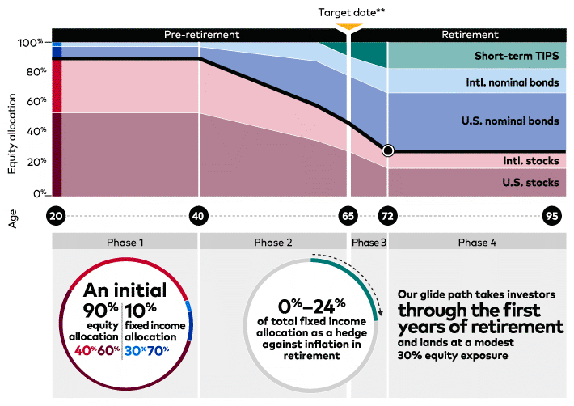
Investment Vehicles: Target Date Funds
This image from Vanguard shows you the movement of target date funds as they approach the target date.

Slide 56
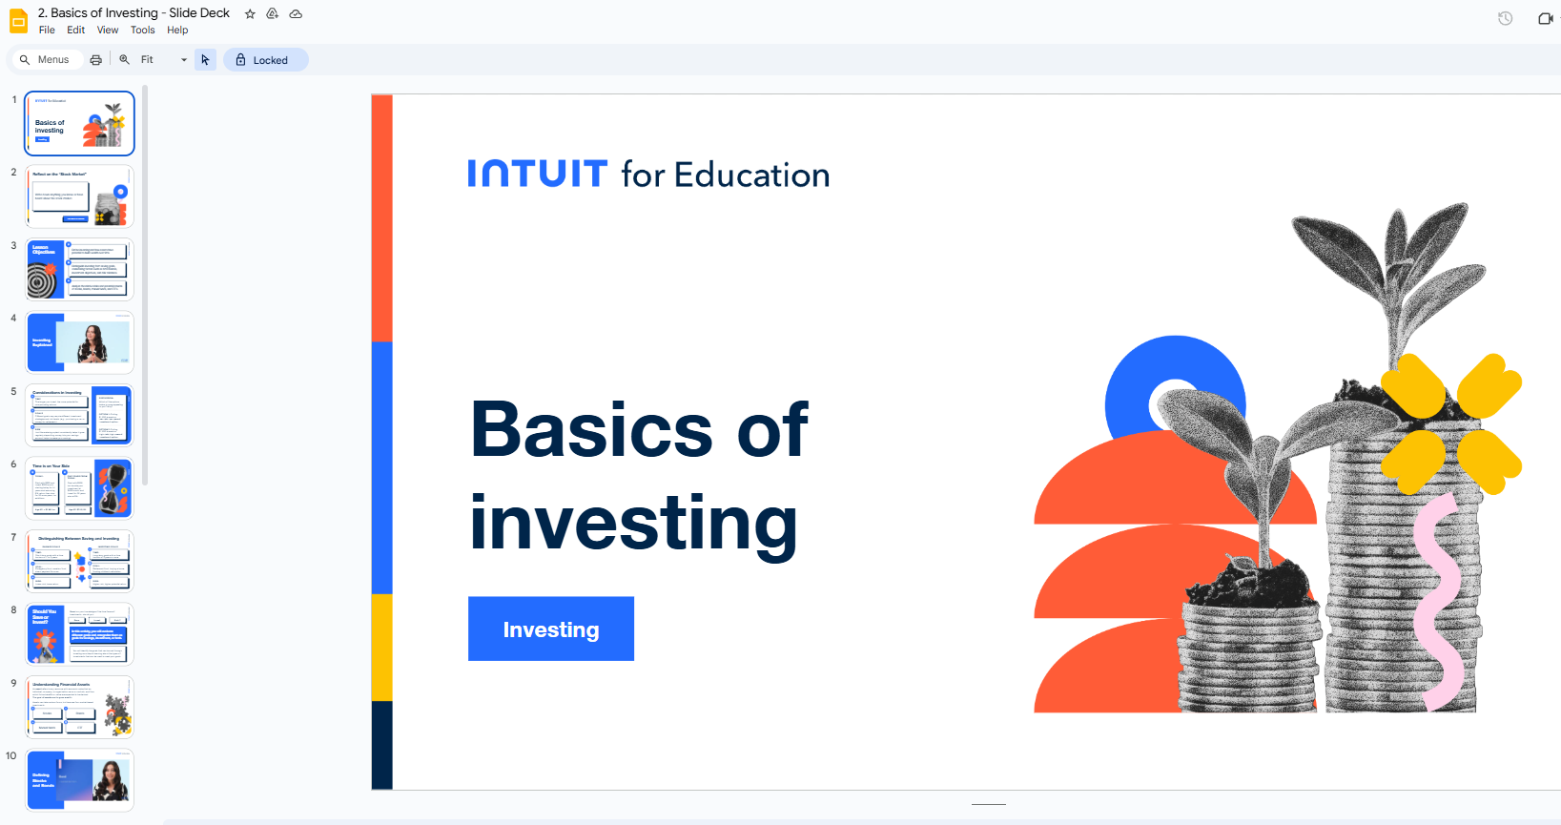
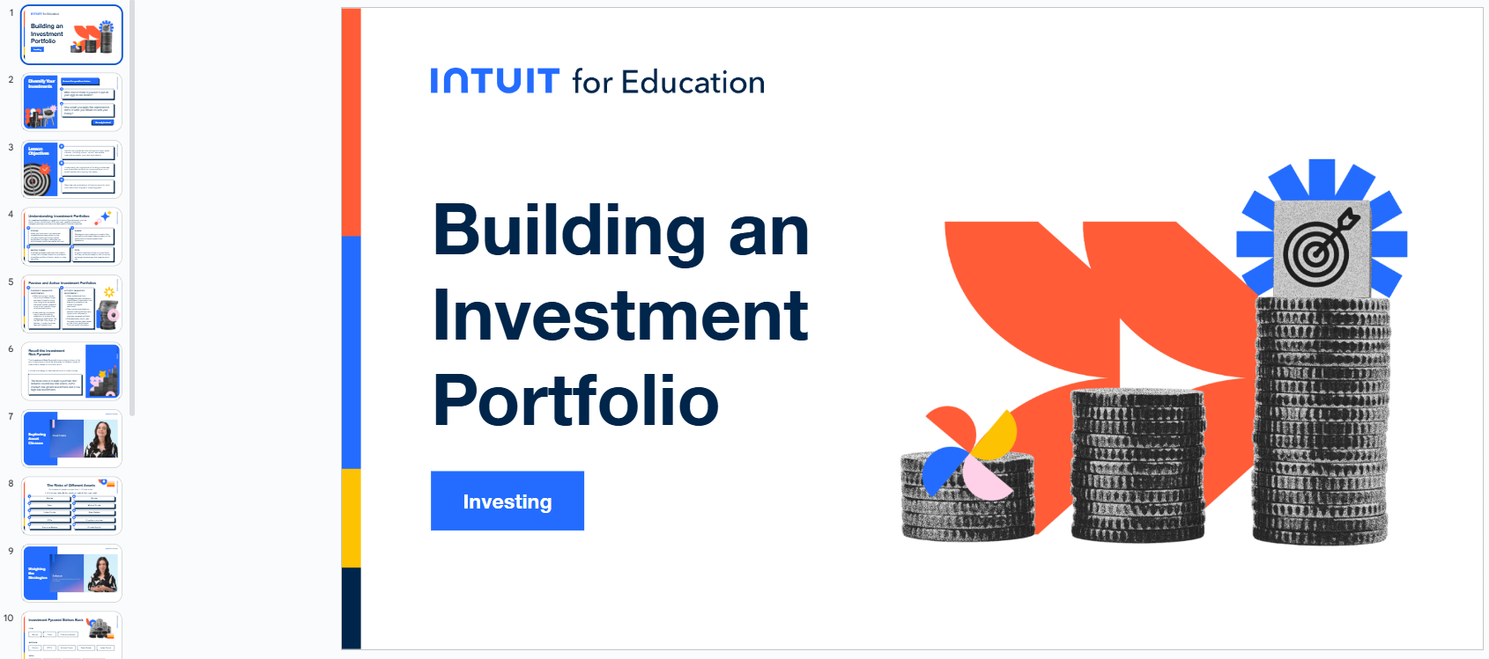
Investment Vehicles: Classroom Resources
Intuit for Education: Lessons & Slide Decks

Slide 57



Investment Vehicles: Classroom Resources
Additional Lesson Resources:
NGPF Investing Unit: Lessons & activities
Additional Video Resources:
Explained | The Stock Market | Netflix (Can be an option for advanced learners)
How does the stock market work? | TedEd

Slide 58
Investment Vehicles:
Last Word
"I don't want you wearing anything...if you don't own it."
When you are only a consumer, you are making everyone richer except yourself.
The good news is, funds are an easy way to become an investor and ensure that you own a piece of everything you consume.
Source: Me, but I'm sure I got it from somewhere at some point

Slide 59
Investment Vehicles: Educator Reflection
For Self-Reflection:
Which investment vehicles are you most familiar with, and which feel most unfamiliar?
What misconceptions about investing did you have before this session?
For Classroom Application:
What misconceptions do your students typically have about stocks and markets?
How do you make abstract market concepts concrete for diverse learners?
What investing fundamentals do you believe are most essential for your students?

Slide 60

Topic 3
So how do I Invest?: Practical Steps to Get Started

Slide 61


Get Started: Accounts & Brokerages
Book:
Rich AF by Vivian Tu
Excerpt of Chapter 5: I wasn't born rich, but my kids will be – The Investing Section
Video:
How to Invest for Beginners | Ex-Wall Street Trader Explains Investing | Your Rich BFF (2:40-2:40)

Slide 62

Get Started: Power of Investing Early
One gift of teaching investing to young people who have a long runway of time is for them to understand the power of compounding in growing their assets. Early knowledge can lead to earlier investing, potentially providing more opportunities for wealth building over time.

Slide 63
Get Started: Fighting FOMO
Feeling like you are missing out? A Chinese proverb fits this situation...
  “The best time to plant a tree was 20 years ago. The second best time is now."
  There is never a "perfect" moment to start something, as the present is always the best opportunity.
  AKA The best time to invest was yesterday. The second best time is now.

Slide 64

Get Started: Is ETF or Mutual Fund right for you?
How To Determine Whether A ETF or Mutual Fund Is Best For You | Investopedia

Slide 65


Get Started:
Perspectives
Money With Katie Show
The Easiest Way to Build Wealth with JL Collins, the Godfather of Financial Independence
21:50-26:00

Slide 66


Get Started:
Dollar Cost Averaging
Stock Market for Beginners: How to Start Investing Today with ‪@ChrisSain1‬ | Earn Your Leisure Podcast
(34:00-37:00)
U.S. Bank

Slide 67



Get Started: Resources
Books
Learning Websites
Simple Path to Wealth by JL Collins
Moomoo Library
Sherwood News

Slide 68


Get Started: Resources
Videos
Toolkit
https://www.youtube.com/@WealthTwins/shorts
https://thebudgetnista.com/ggwm-toolkit/
What resources do you recommend when starting to invest?

Slide 69
Get Started: Educator Reflection
For Self-Reflection:
What emotions come up for you when thinking about starting to invest?
What barriers have prevented you from starting your own investment journey? Have these barriers shifted at all?
As an existing investor, what was the most valuable lesson you learned when you first started investing?
For Classroom Application:
How might you create a safe environment for students to practice investment decision-making?
How could you make "getting started" with investing feel accessible to all students regardless of financial background?

Slide 70

Topic 4
Paying Tio Sam:
Tax Basics

Slide 71

Tax Basics: Paycheck
Key Terms:
Gross Income
YTD
Rate
Pay Period
Federal Tax
FICA
State Tax
Deductions
Net Income

Slide 72

Tax Basics: W-4 Form & Withholding
IRS Form W-4 tells your employer how much federal income tax to withhold from your paycheck. You’ll be asked to fill one out when you start a new job.
**In 2025, the IRS uses the redesigned Form W-4, which doesn't include allowances anymore. Instead, employees provide specific information to determine accurate withholding amounts.**

Slide 73

Tax Basics: 1099 vs. W-2 Forms & Employment
Key Terms: ​
W-2 Form
1099 Form​
Contractor
Gig Economy / Side Hustle

Slide 74


Tax Basics: Filing Taxes
Key Terms:
April 15
1040
Deductions (Standard vs. Itemized)
Tax Brackets
Refund vs. owe

Slide 75


Tax Basics: Marginal Tax Code (Federal Taxes)
How Do Taxes Actually Work | Humprey Yang
How marginal tax rates actually work, explained with a cartoon | Vox

Slide 76



Tax Basics: Resource – Federal Tax Brackets
Source: ​
How Tax Brackets Work | Fidelity Learning

Slide 77

Tax Basics: State Income Taxes
Source: ​Taxfoundation.org

Slide 78

Tax Basics: Composite Taxes by state
Including: ​
Property tax, state income tax, sales and excise taxes
NY wins, woohoo!
Source: ​
Wallet Hub

Slide 79


Tax Basics: Tax Advantaged Options - Retirement
Key Terms: ​
Traditional IRA
Roth IRA
401K
403b, TDA
Pre-tax
After-tax
**Contributing to a Roth IRA does not lower your taxes as they are made with after-tax $. Traditional IRA contributions do reduce your adjusted gross income (AGI) for that year.

Slide 80

Tax Basics: Resource – Retirement
Money Explained | Netflix
  E1: Get Rich Quick, E2: Credit Cards, E3: Student Loans, E4: Gambling, E5: Retirement

Slide 81

Tax Basics: Tax Advantaged Options – For Kids
529 & UTMA Accounts
Purpose: 529 plans are intended to help pay for educational expenses, while UTMA accounts can be used for anything that benefits the minor.
Tax Impact: 529 plans have more tax advantages, with tax-free growth and distributions for educational purposes. UTMA accounts do not have special tax benefits for education spending, but are considered more flexible.
Resource:
UGMA vs. UTMA vs. 529 Plans: Which Is Best for You?
Forbes Advisor
Notes:
UTMA has greater negative impact on Financial aid than 529.

Slide 82

Tax Basics: Deductions
A tax deduction is an amount that you can subtract from your taxable income to lower the amount of taxes that you owe. You can choose the standard deduction—a single deduction of a fixed amount—or itemized deductions on your income tax return.
In 2025, the standard deduction for single filers is $15,000.00.
Filing a joint return, the standard deduction is $30,000.00.
For head of household, the standard deduction is $22,500.00.

Slide 83


Tax Basics: Tax Credits
A tax credit is a dollar-for-dollar amount that taxpayers claim on their tax return to reduce the income tax they owe. Tax credits are more favorable than tax deductions because they reduce the tax due dollar for dollar, not just the amount of taxable income.
Common Tax Credits include:
1. Child tax credit
2. Child and dependent care credit
3. American opportunity tax credit
4. Lifetime learning credit
Example:
Resource:
22 Popular Tax Deductions and Tax Breaks NerdWallet

Slide 84

Tax Basics: Taxes & Investments
Short-term capital gains result from selling assets held for a year or less and are taxed at ordinary income tax rates.
Long-term capital gains apply to assets held longer than a year and are taxed at the same rates as qualified dividend income.
Dividend taxation is the tax of dividends received by shareholders when you invest in stocks or ETFs for example.

Slide 85



Tax Basics: Where Do Taxes Go?

Slide 86

Tax Basics: Resources
VITA
https://irs.treasury.gov/freetaxprep/
The IRS's Volunteer Income Tax Assistance (VITA) and Tax Counseling for the Elderly (TCE) programs offer free basic tax return preparation to qualified individuals.
VITA sites offer free tax help to people who need assistance in preparing their own tax returns, including:
People who generally make $67,000 or less
Persons with disabilities; and
Limited English-speaking taxpayers

Slide 87


Tax Basics:
Classroom Resources
Intuit for Education: Lessons & Slide Decks

Slide 88


Tax Basics: Classroom Connection
Simulation
Has lesson, slides and worksheet
*You can try this during breakouts
Scholarship Opportunity
Students do one of the tax simulations and a short essay

Slide 89

Tax Basics: Classroom Connection
Activity: Paystub Breakdown
From the CEE Invest in Girls Program. Students LOVE to analyze pay stubs.
There is a sense of empowerment knowing what all these deductions mean and where your money is ending up...

Slide 90

Tax Basics: Classroom Connection
Discussion: Tax Dollars
Many of my students are interested in where taxes go. When they look at this Federal Income Tax Receipt they are surprised and have a lot of thoughts and questions. This interest can create an engaging moment to have a discussion around taxes. *You can try this during breakouts.
Resource
Your Federal Income Tax Receipt | National Priorities Project

Slide 91


Tax Basics: Classroom Resources
Additional Lesson Resources:
NGPF Taxes Unit: Lessons & activities
Additional Video Resources:
MissBeHelpful: What's a W-2 Anyway?
Calculator
https://www.talent.com/tax-calculator

Slide 92
Tax Basics: Educator Reflection
For Self-Reflection:
What tax concepts related to investing do you find most confusing?
What resources do you currently use to stay informed about tax laws?
What was your biggest "aha moment" when learning about investment taxation?
For Classroom Application:
How can we make taxes engaging rather than intimidating?
What tax concepts are most relevant to high school students?
How do perceptions of taxes vary across different communities?

Slide 93

Interactive Session
Break out!

Slide 94
Time to get interactive.
There will be 4 breakout options.
Please choose a facilitator in your group. (The person with birthday closest to February 8th!) ♒
Choose one topic to explore for 15 minutes. Then discuss for 5. After the time is up, you will come back to the main session and then be able to choose a second room.
Then repeat with a second choice.
At the end of both sessions, we will come back together and share your thoughts and next steps!

Slide 95
Time to... Break Out Round 1!
Breakout 1: Investment Simulation
Experience.
Use Investopedia Simulator to create and manage a mock portfolio of $100k
Explore learning videos in “Learn” section
Discuss.
  What criteria did you use to select stocks or funds for your portfolio?
  What was most surprising to you about the investment selection process?
  How comfortable did you feel making investment decisions with $100k (even though it wasn't real money)?
  How might you adapt this simulation experience for your students?
Breakout 2: Taxes and Tio Sam
Experience.
Use TurboTax Simulator to do Antonio's taxes.
Explore lesson, worksheet and slideshow that accompany the simulation
If time, go to Your Federal Income Tax Receipt and put in your salary from last year.
Discuss.
  What tax deductions or credits were you previously unaware of?
  What misconceptions about taxes do you think most people have?
  Based on the Federal Income Tax Receipt, which gov't spending areas surprised you?
  What tax concepts do you think are most important for your students to understand?
Notes:
Links for the activities:
Breakout 1:
https://www.investopedia.com/simulator/
Breakout 2:
https://education.intuit.com/home/simulation/turbotax/practice_filing_taxes
https://www.nationalpriorities.org/interactive-data/taxday/

Slide 96
Time to... Break Out Round 2!
Breakout 3: Social Media and Money
Experience.
Use Padlet: Finfluencers to get to know Finfluencers that you can introduce to your class around personal finance and investing
Explore their posts and videos.
Post your comments about the finfluencer for other educators on the Padlet!
Discuss.
  Which financial influencer's content resonated with you the most and why?
  How might you incorporate social media financial content into your existing curriculum?
  What potential benefits and risks do you see in using social media as a financial education tool?
Breakout 4: Risky Business
Experience.
Take the Nerdwallet Investment Risk Quiz to explore how your risk tolerance affects investment choices.
Option to take another quiz: Forbes Investment Tolerance Quiz
Discuss.
  Did your risk tolerance assessment results surprise you? Why or why not?
  What factors beyond the quiz questions do you think influence your approach to risk?
  How might your life stage impact your risk tolerance compared to your students
  How can we teach students that risk tolerance is personal and there's no single "right" approach?
Notes:
Breakout 3:
https://padlet.com/disern2/cee-personal-finance-bootcamp-finfluencers-o3hox8vlu6arp4du
Breakout 4:
https://www.nerdwallet.com/article/investing/what-is-risk-tolerance-and-why-its-important?msockid=363809ddc6a26f8535d61d9ac7766e57
https://www.forbes.com/advisor/investing/investment-risk-tolerance-quiz/

Slide 97
Discuss
What was the most valuable gold nugget you learned during the breakout sessions?
How do you plan to implement the knowledge and skills gained from today's session in your classroom?
What other resources came up for you? What can you share with the group?

Slide 98

Contact Me

Slide 99


Slide 100
Thank you

