Slide 1

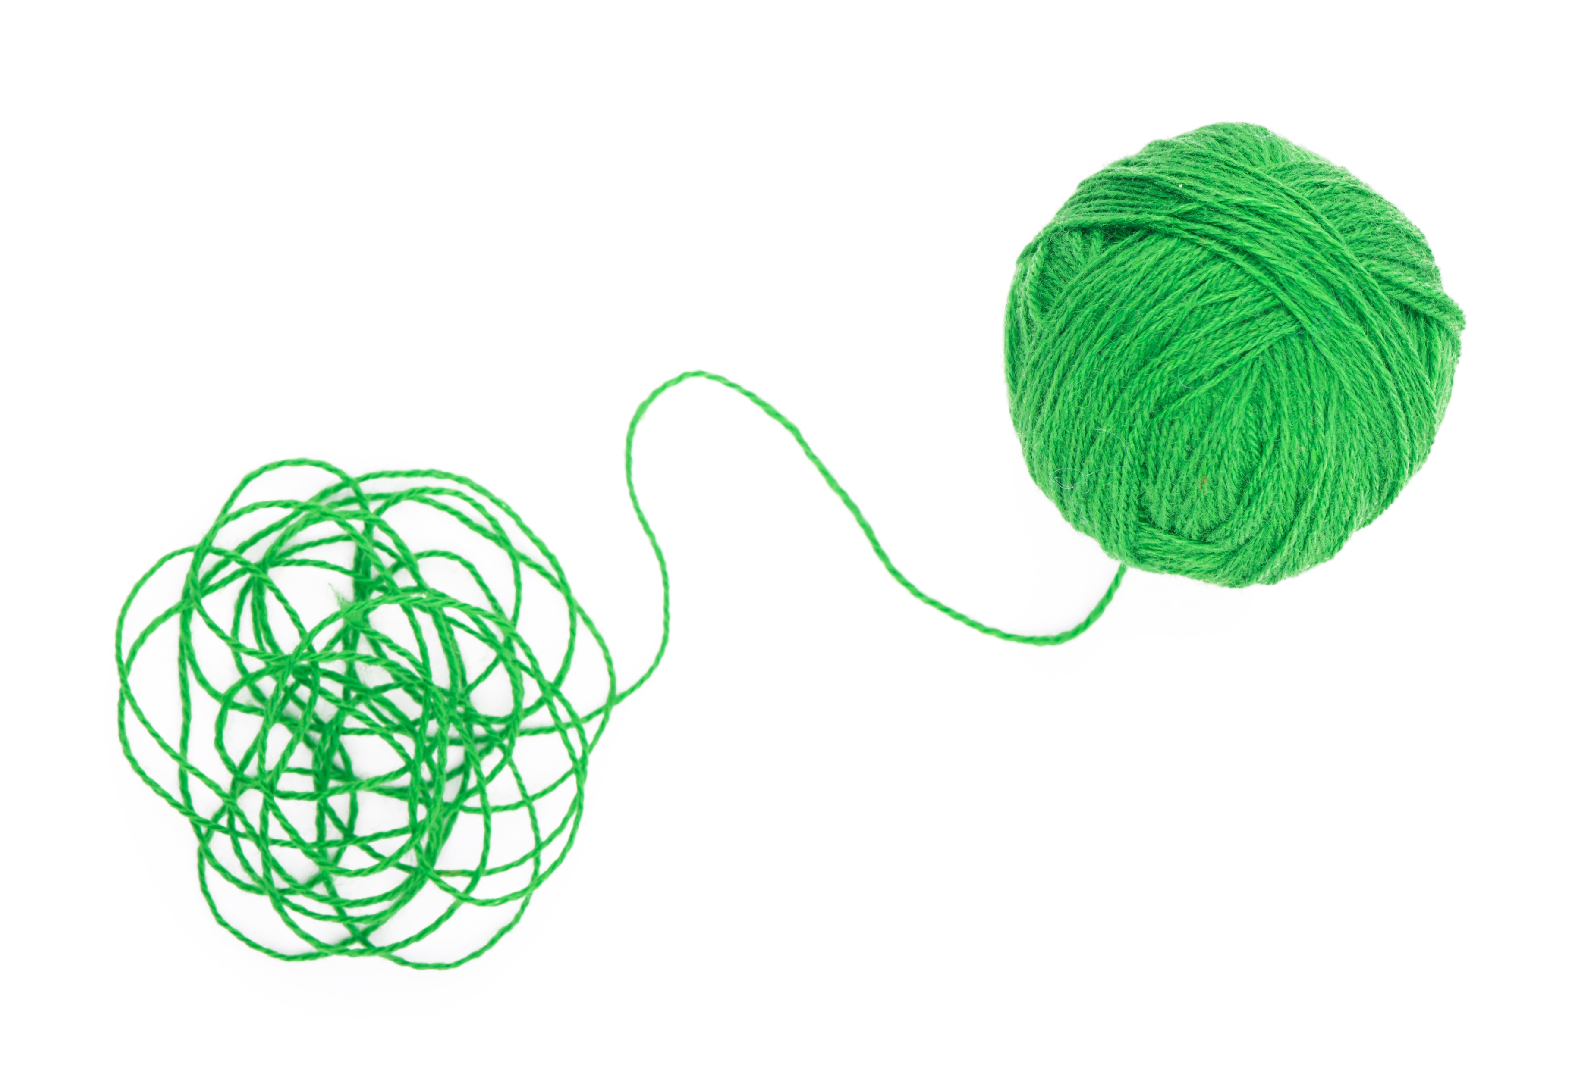
Stringing Together Supply and Demand:
A Tactile Approach to Graphing

Slide 2
Supply and Demand Scenarios
Let’s Practice!
A hurricane disrupts offshore oil production in the Gulf of Mexico, reducing the supply of oil.
Does this impact supply or demand in the market for oil?
Does it decrease or increase?
Where would the new line be located? Show this with your yarn on the graph.
Is the new price higher or lower?
Is the new quantity higher or lower?

Slide 3
Supply and Demand Scenarios
1. A popular smartphone brand releases a new model with cutting-edge features.
  Demand increase
2. A major drought impacts the wheat production in a key agricultural region.
  Supply decrease
3. A new technology makes solar panel production more efficient and less expensive.
  Supply increase
4. The demand for air conditioners peaks during a hot summer season.
  Demand increase

Slide 4
Supply and Demand Scenarios
5. A new synthetic meat product gains popularity as a viable alternative to traditional meat. What happens to the market for traditional meat?
  Demand decreases
6. A new technology makes traditional DVDs obsolete. What happens to the DVD market?
  Demand decreases
7. A city experiences rapid population growth. What happens to the housing market?
  Demand increases
8. A breakthrough in medical technology makes certain treatments more effective and cheaper.
  Demand and Supply increase

Slide 5
Exit Slip:
Which graph correctly depicts the scenario?

Slide 6
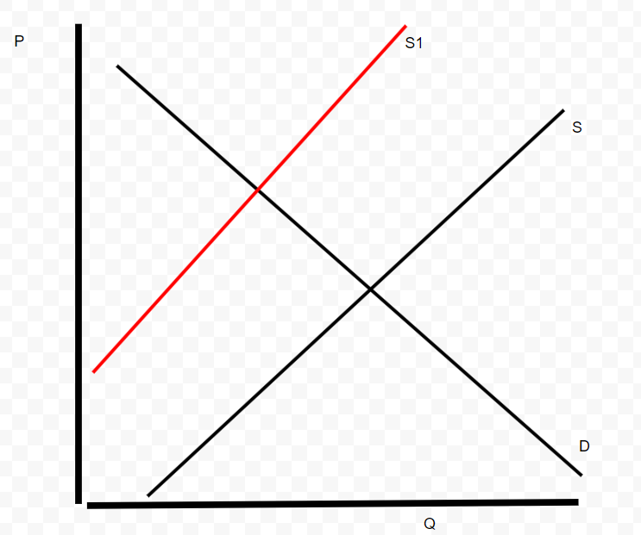
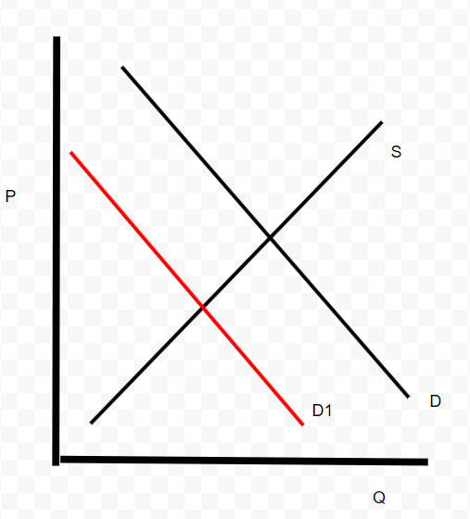
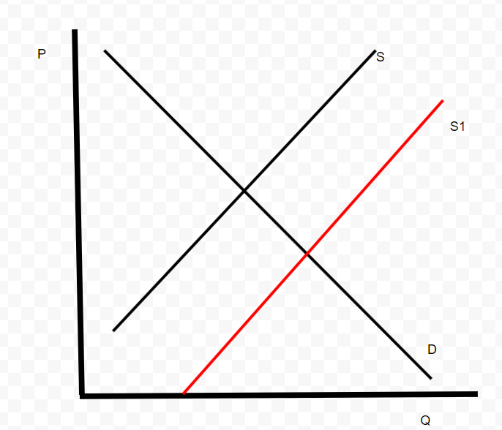
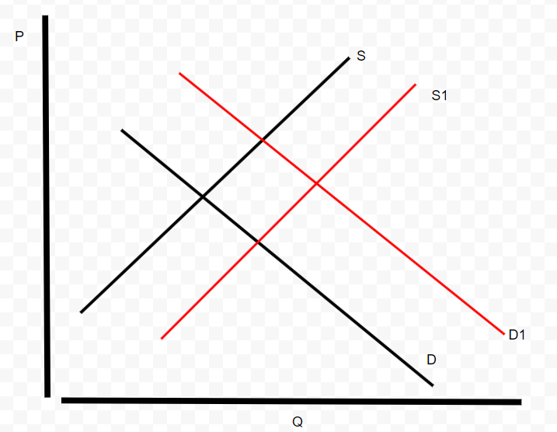
Your Turn
Prompt:
What would happen to the market for desktop computers if the price of laptop computers dropped dramatically?
B
A
D
C
Notes:
Answer: D decrease - B

Slide 7
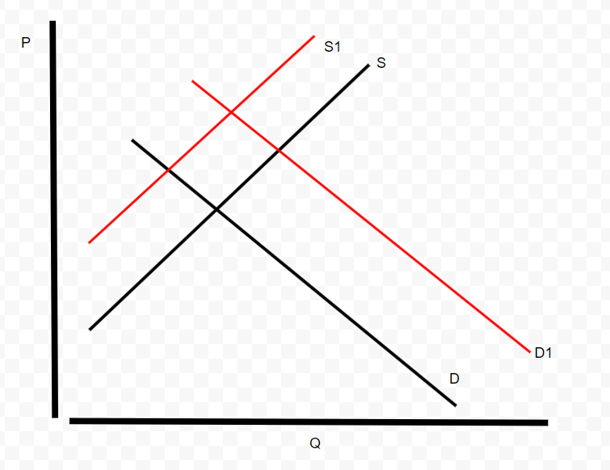
Your Turn
Prompt:
What would happen to the market for energy drinks if the cost of sugar doubled? (NOTE: Sugar is a necessary ingredient in energy drinks.)
A
B
C
D
Notes:
Answer: S decrease - A

Slide 8
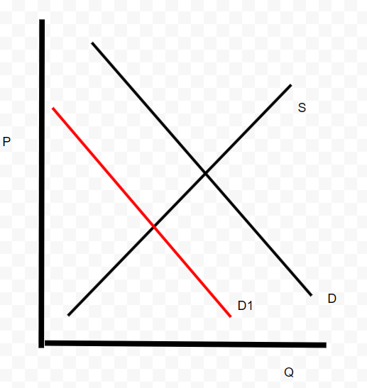
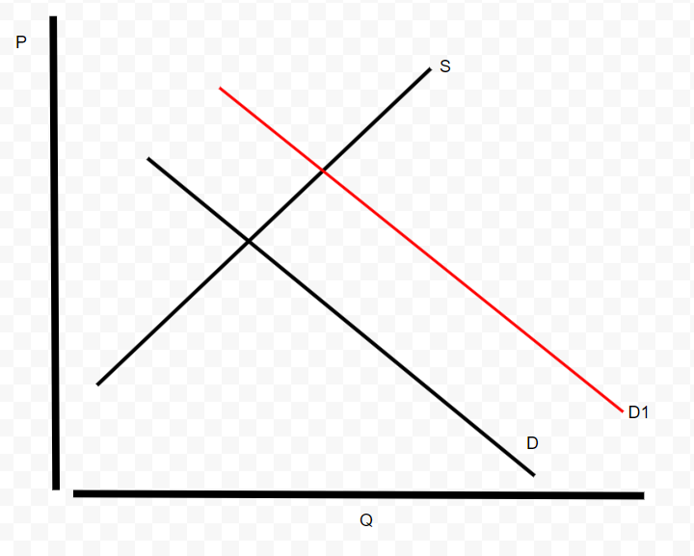
Your Turn
Prompt: Marshmallows are on sale, and people now want to make rice crispy treats. Show the effects on the market for Rice Krispie cereal.
A
B
D
C
Notes:
Answer: D increase -D

Slide 9
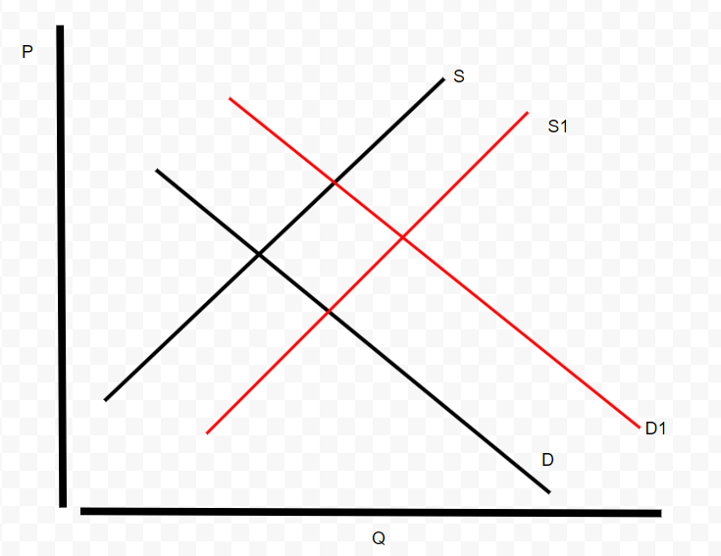
Your Turn
Prompt:
Assume books and magazines are substitutes. Paper is used to make books. What will happen in the book market if the price of magazines increases and at the same time the price of paper goes down?
A
B
D
C
Notes:
Answer: The demand for books will increase, the supply of books will increase. Q* will increase, P* is unknown. - Graph D

Slide 10
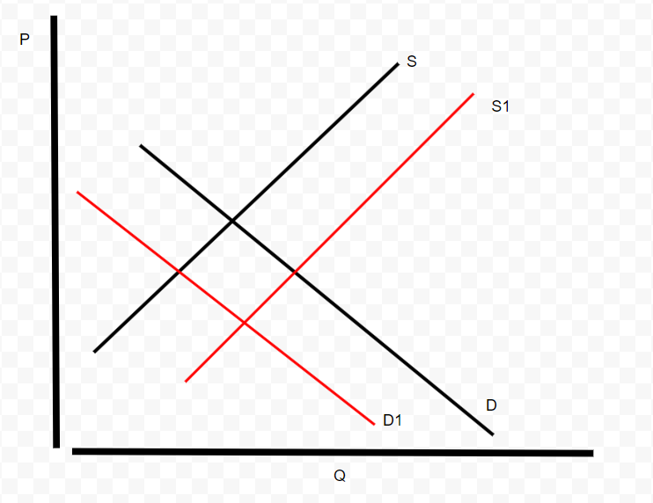
Your Turn
A
B
Prompt: What will happen in the lemonade market if a new technology is introduced in the production of lemonade and at the same time the price of fruit punch decreases (assume fruit punch and lemonade are substitutes)?
D
C
Notes:
Answer:The supply of lemonade will increase, the demand for lemonade will decrease. P* will decrease, Q* in unknown. – Graph C

Slide 11
Extension
Write your own prompt and draw the corresponding graph.

