Slide 1

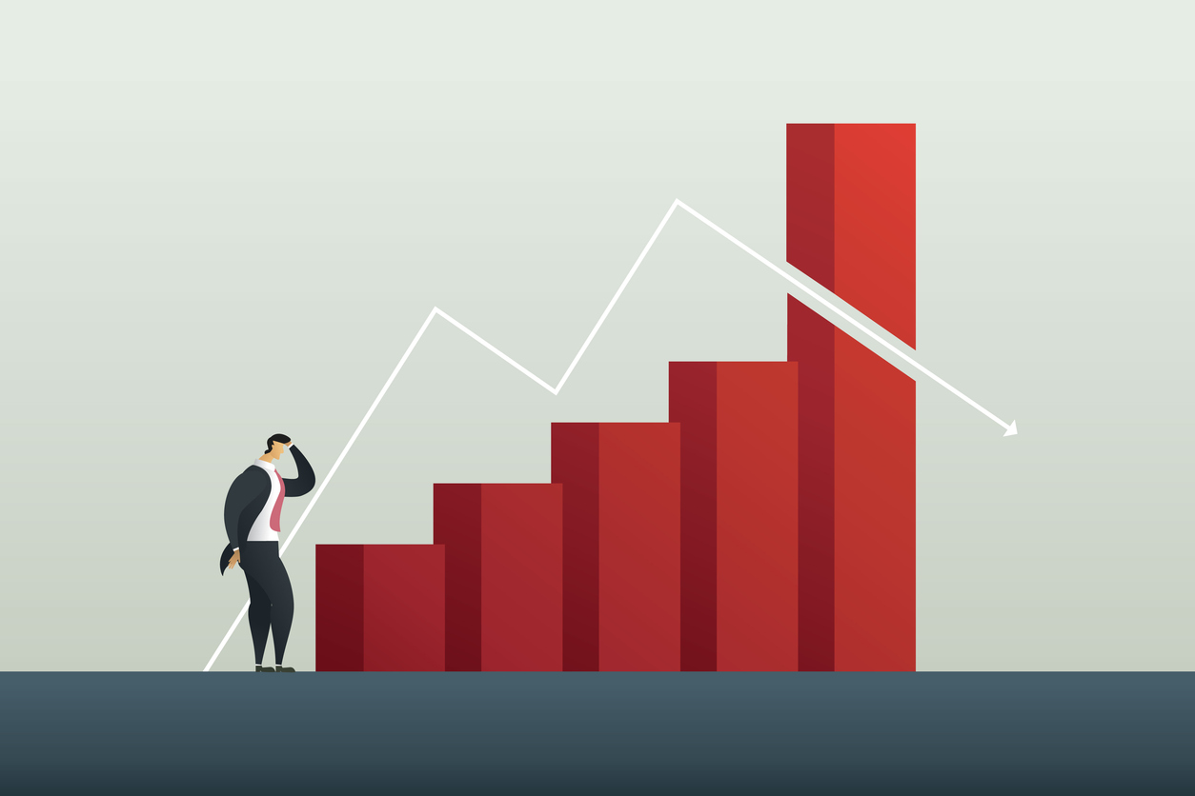
Understanding Market Failure: Key Concepts

Slide 2
Certificate Requirements
To earn professional development hours for webinars, you must:
Watch a minimum of 45-minutes and you will automatically receive a professional development certificate via e-mail within 24 to 48 hours.

Slide 3
Objectives
You will be able to:
Explain Market Failure and Externalities
Implement interactive activities in the classroom
Connect Lessons to Real-Life Issues

Slide 4
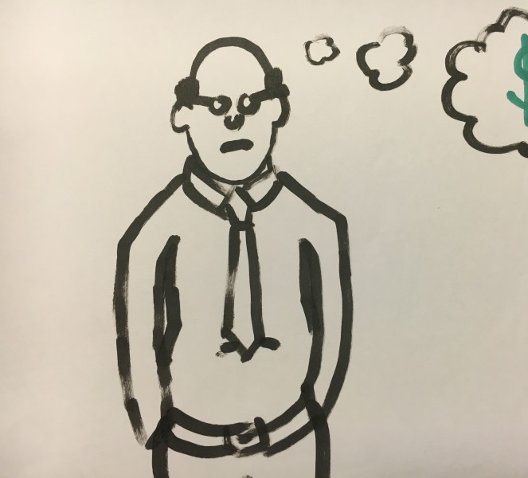
Presenter(s)
Brian Lynch
fezcgdad@gmail.com

Slide 5

National Standards
Business
Decision Making
Economics
Externalities
https://www.councilforeconed.org/policy-advocacy/k-12-standards/

Slide 6
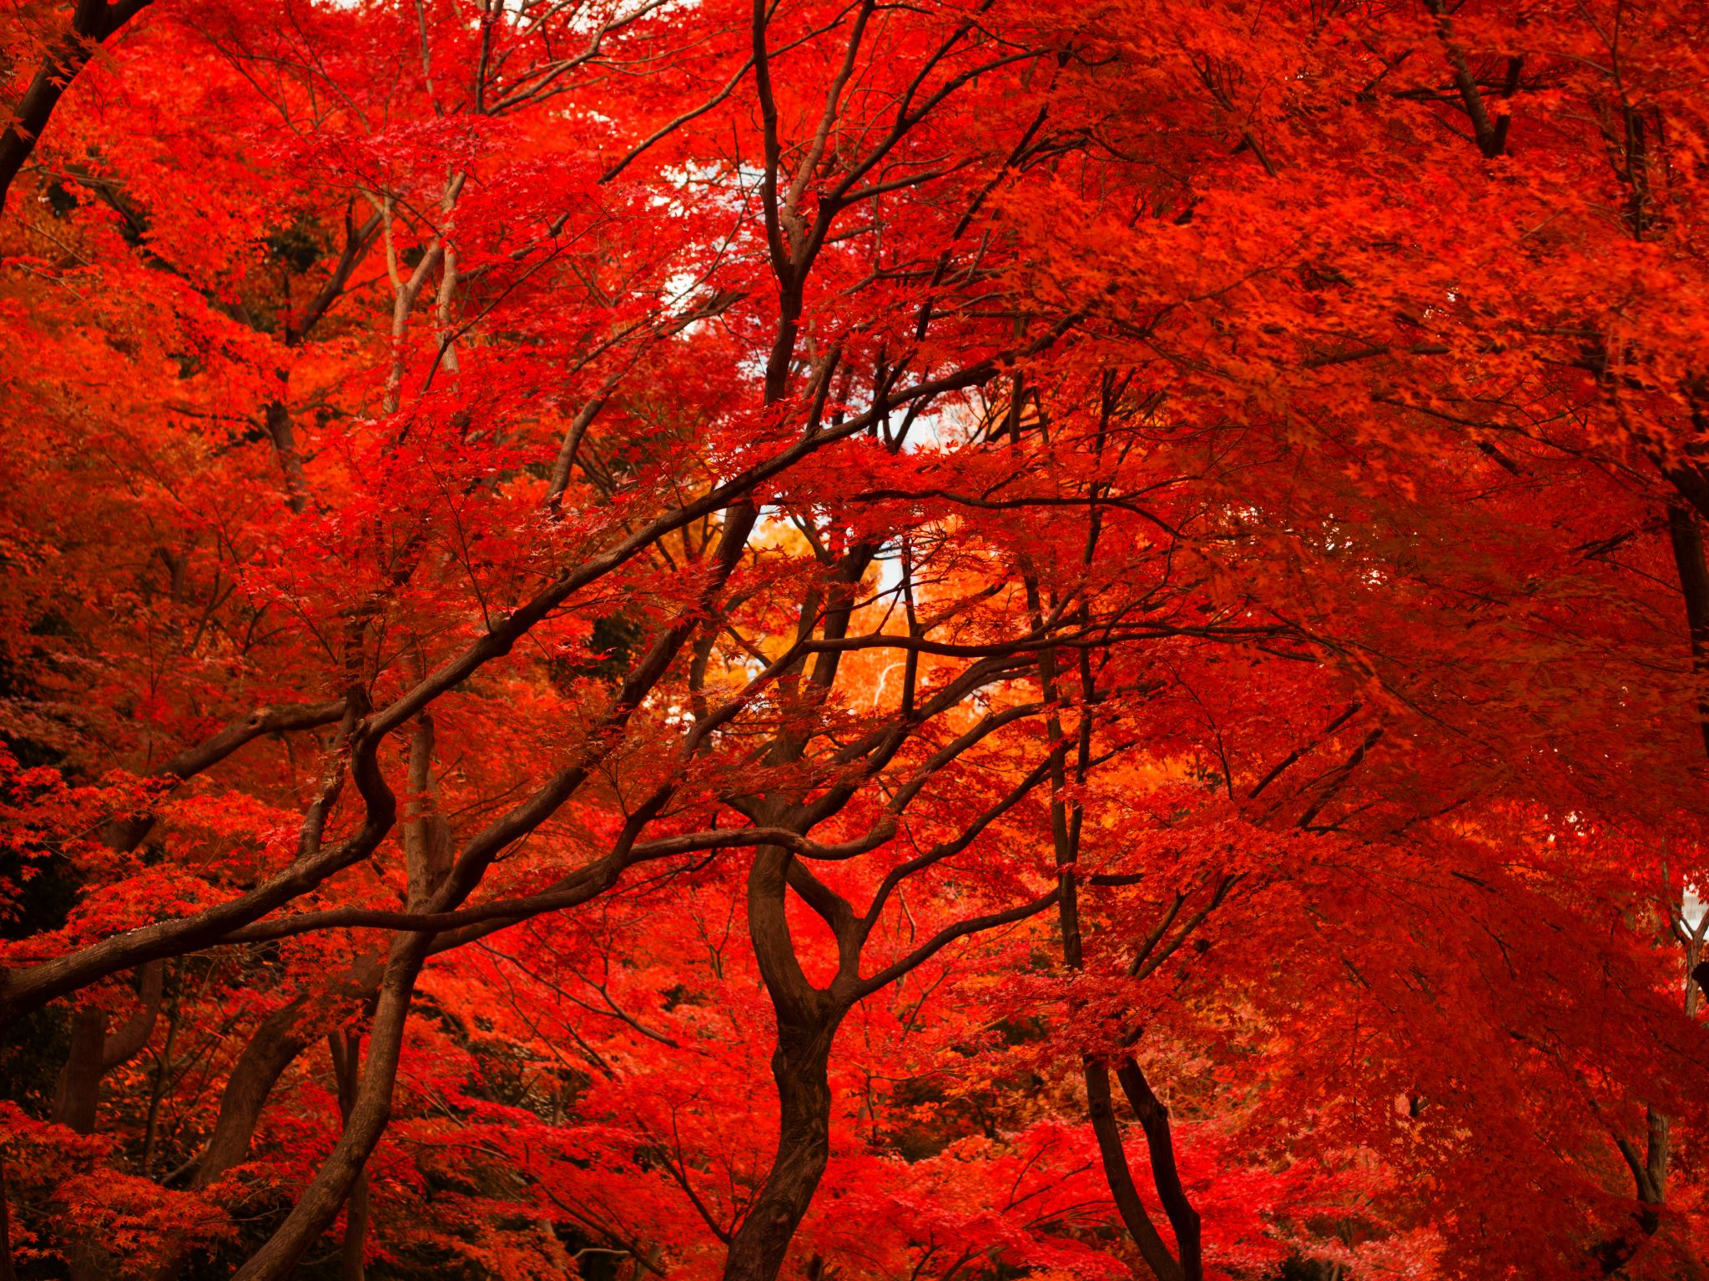
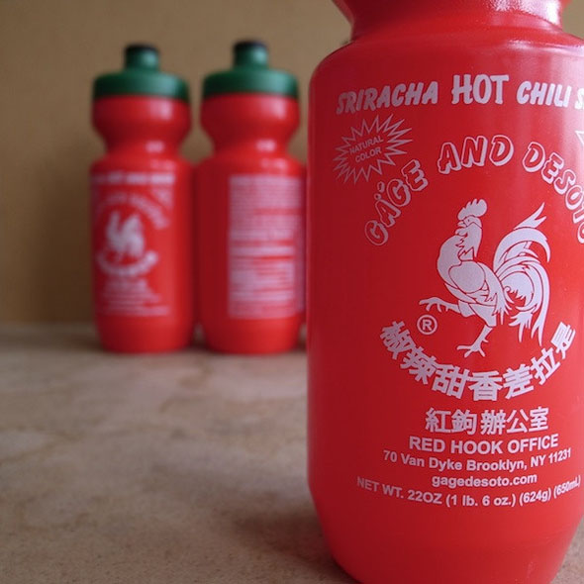
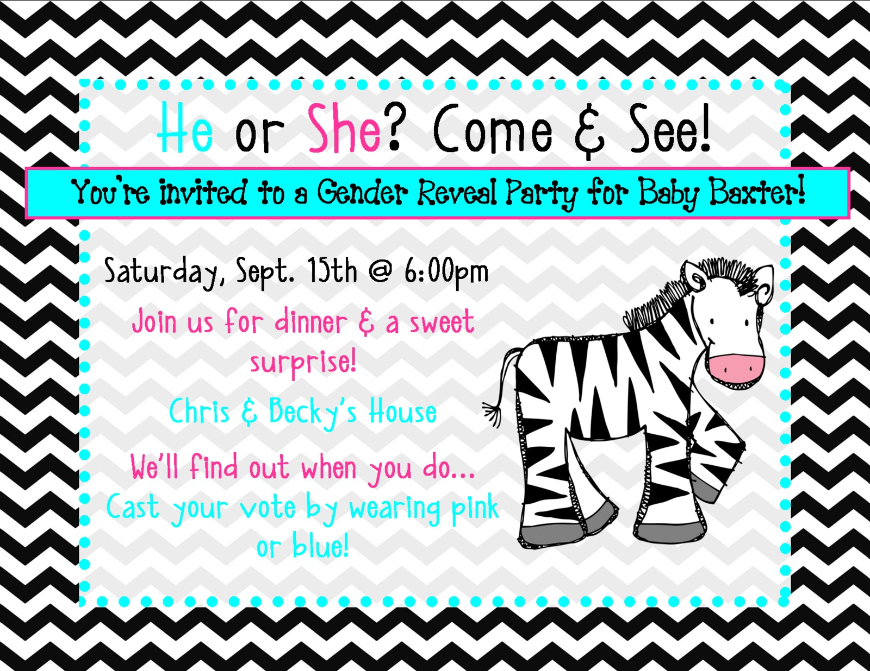
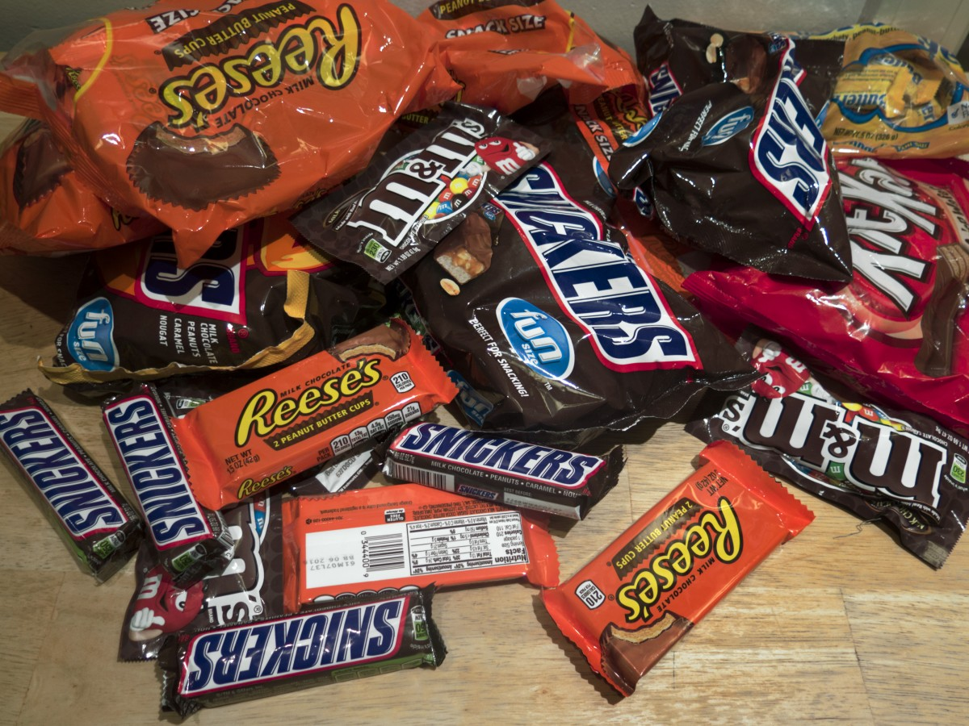
SO WHAT DO ALL OF THESE HAVE IN COMMON
ThePhoto by PhotoAuthor is licensed under CCYYSA.
ThePhoto by PhotoAuthor is licensed under CCYYSA.
ThePhoto by PhotoAuthor is licensed under CCYYSA.

Slide 7
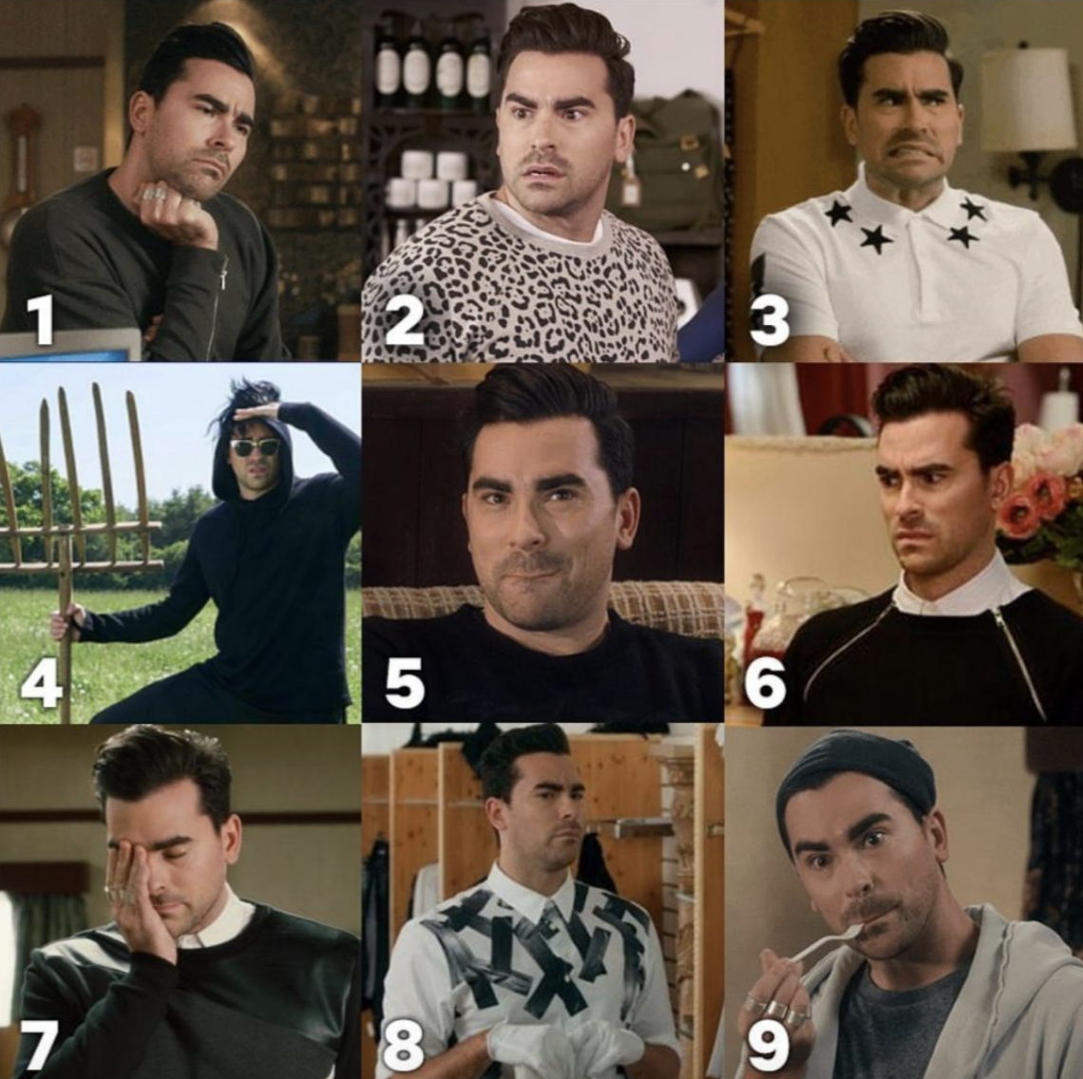
Quick Question
In the chat, please put the number that best describes your comfort level as a teacher with market failures and externalities
7
8
9

Slide 8
Session Agenda
Explore Market Failure
Exploring and Fixing Negative Externalities
Exploring and Fixing Positive Externalities
Exploring Public goods
Exploring Common pool resources

Slide 9
1 - Market Failure

Slide 10
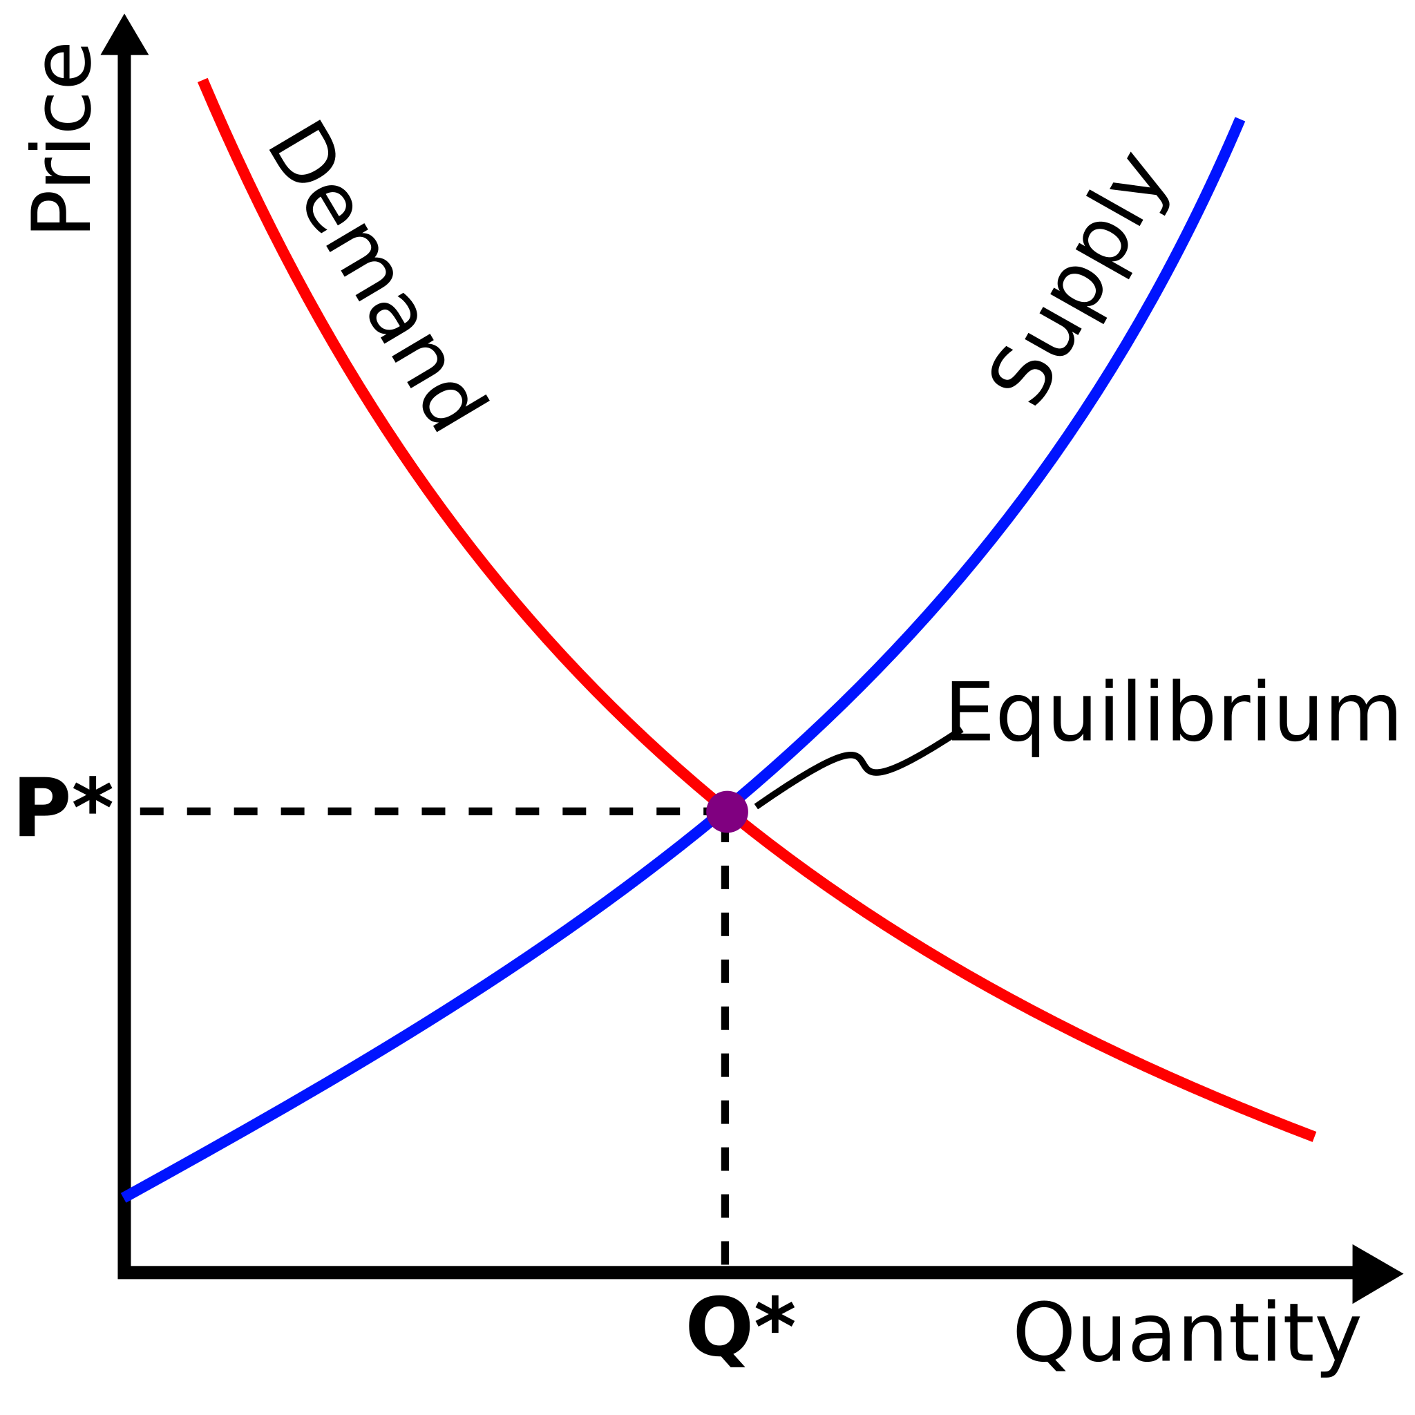
What is good about this graph?
Ask students to graph equilibrium
Ask them what is neat about this graph
Yes- even scalping Taylor Swift tickets is efficient

Slide 11
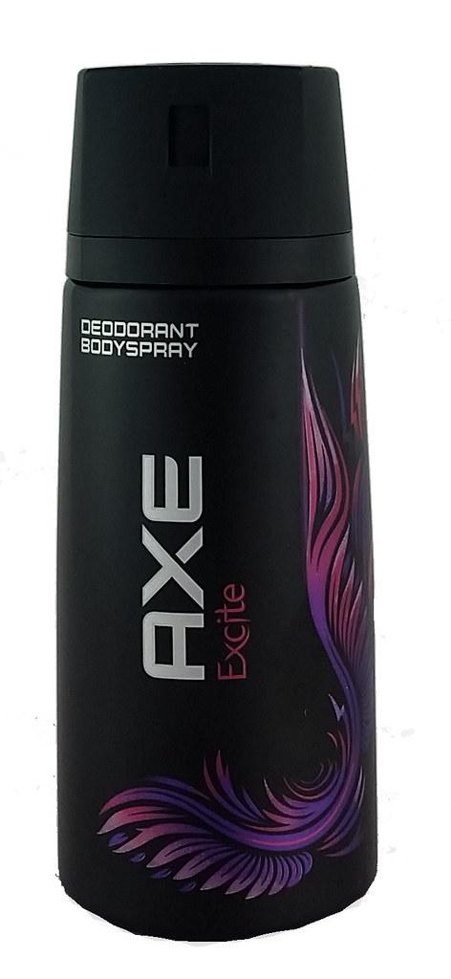
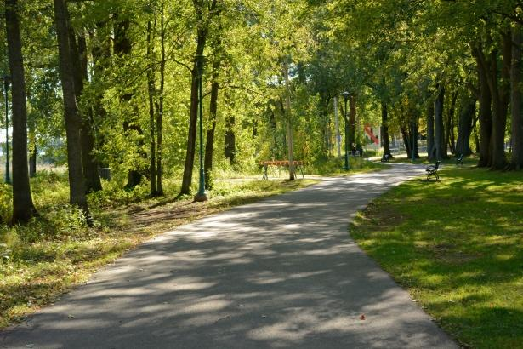
We have a problem
There is something that we left out
What if we are not coming up with outcomes that would benefit the whole of society?

Slide 12
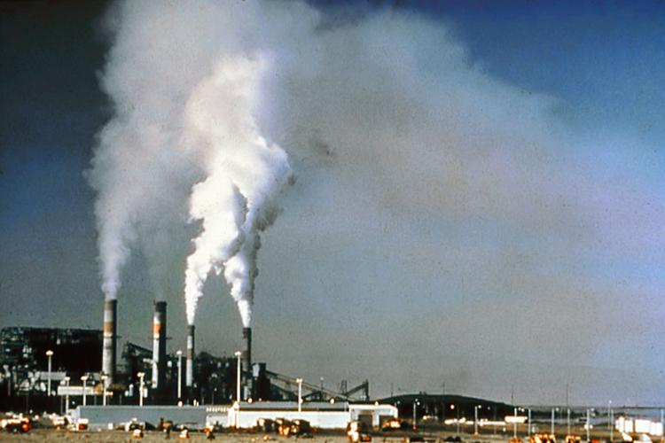
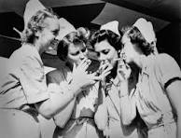
Bell Ringer
Who is responsible for the damage in these pictures?

Slide 13
Market Failure
We are not producing at socially optimal level(Too much, not enough)
What the world needs now,is love, sweet love,it's the only thing that there's just too little of (well not really)

Slide 14
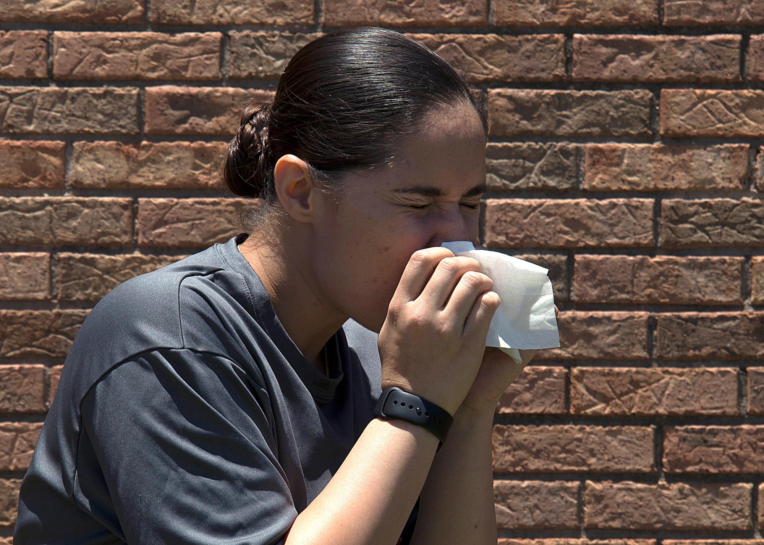
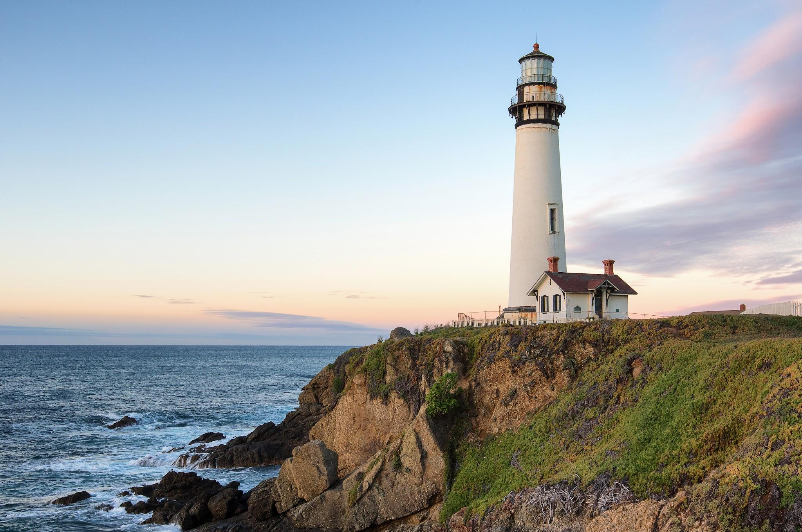

Market Failure exists when
There are Externalities involved
When the good or service is defined as a Public Good
Notes:
Characteristics of a public good will be covered in a later side

Slide 15
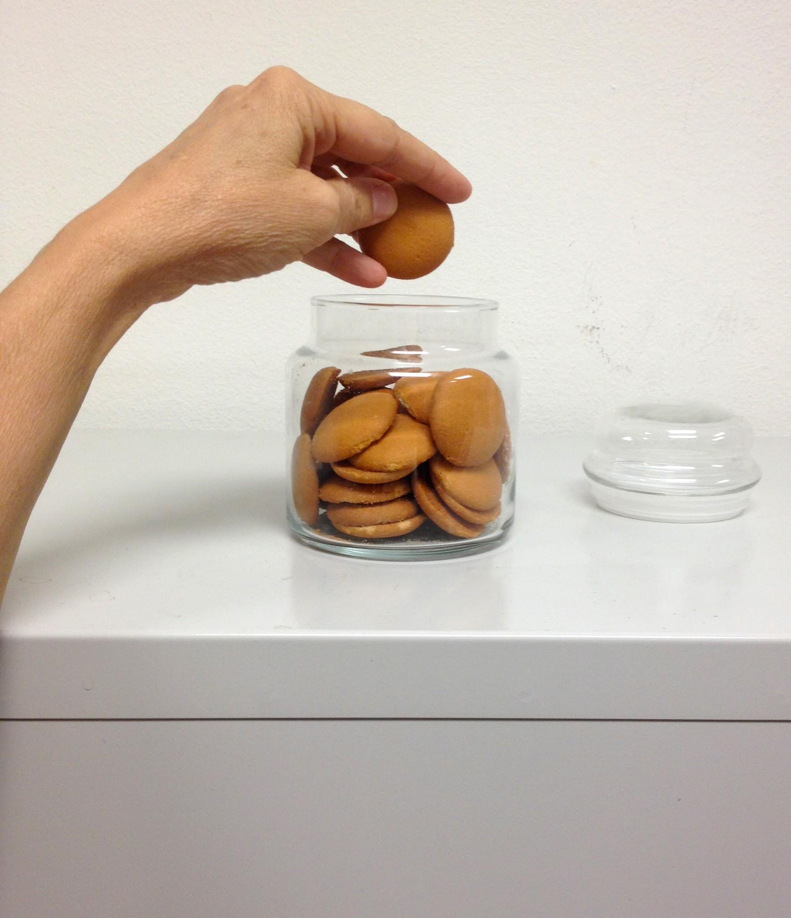

Market Failure exists when
When we have a common pool good/resource
When monopolies can be bad for society
ThePhoto by PhotoAuthor is licensed under CCYYSA.
Notes:
Characteristics of a public good will be covered in a later side

Slide 16
3 - Exploring and Fixing Negative Externalities

Slide 17
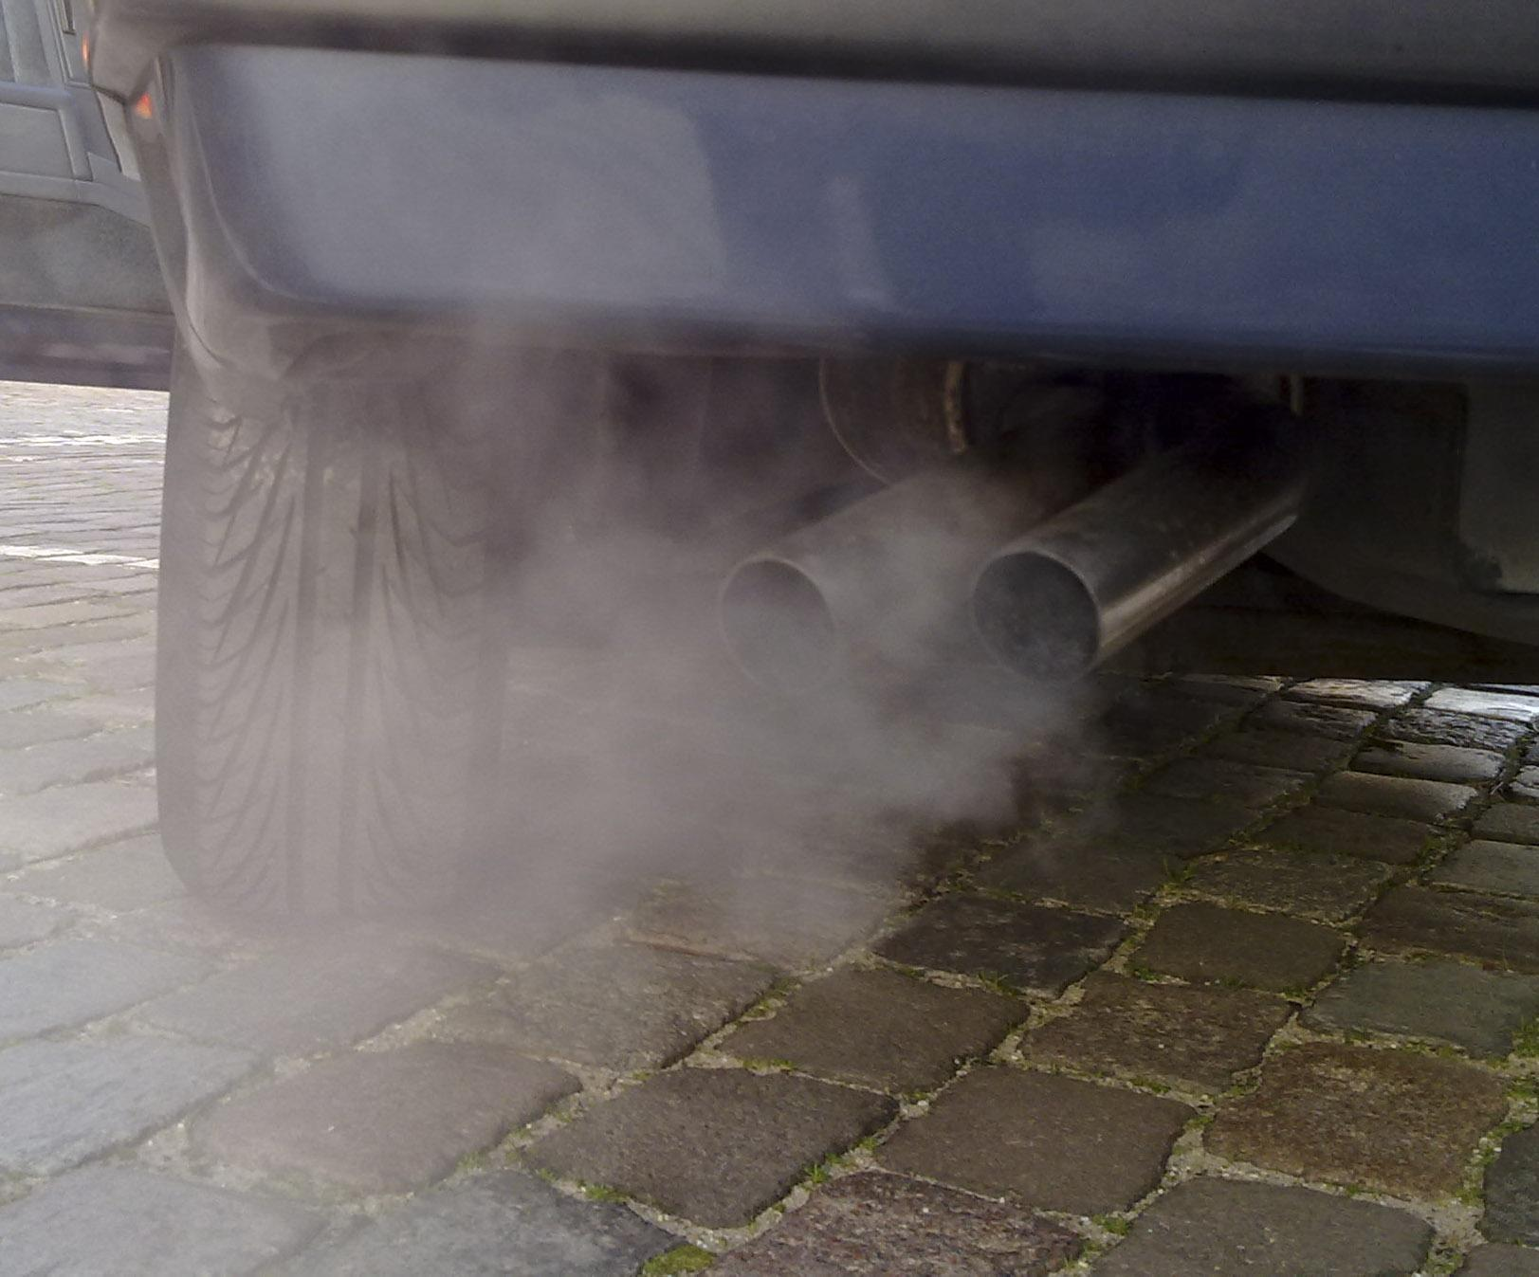
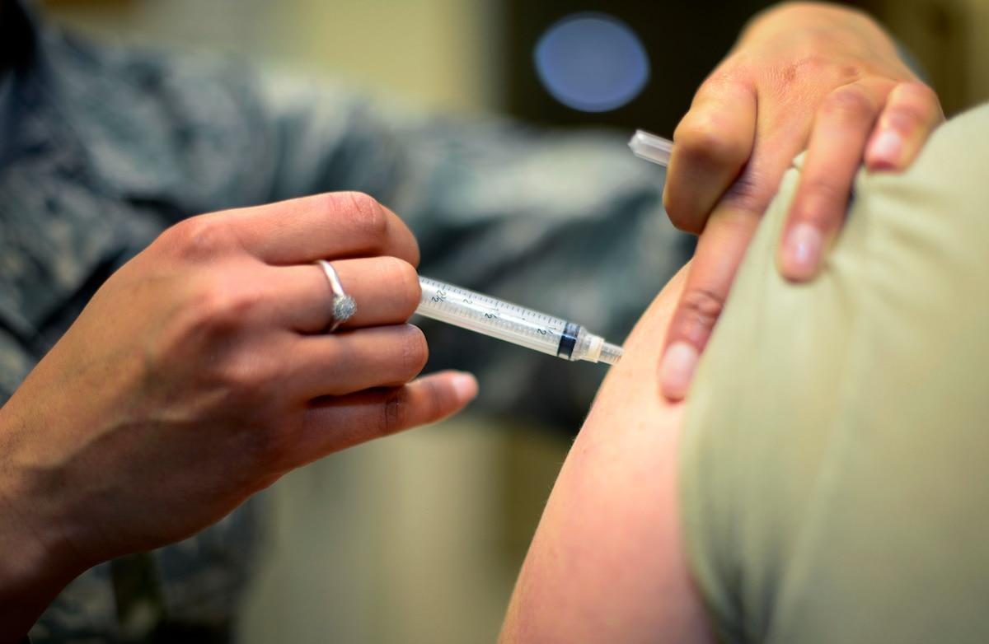
Externalities
Externality: A cost or a benefit borne by someone other than the consumer or producer of a good (i.e., a bystander)
Negative Externality:
Positive Externality:

Slide 18
Teacher Tip
Use deodorant spray as an activity in class to show this
Positive: Have a student volunteer and have them spray a smidge-smells nice to other people
Negative: Have them spray 4 more times on their clothes- what happens?

Slide 19
Why should we care
Pollutants in rivers-great interactive website
Private Planes and carbon emissions
Young people worried about climate change

Slide 20
Negative Externality
Fireworks
Pickleball
Leaf blowers
Now it’s your turn in the chat

Slide 21
Negative Externality
Is zero pollution realistic- should that be our goal?
Great interactive from MRU that looks at trade-offs for pollution control

Slide 22
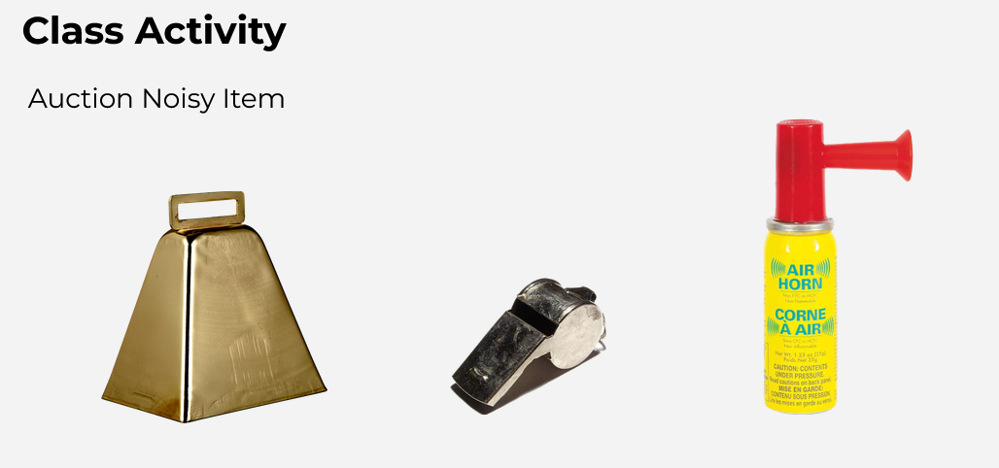

Slide 23

Make sure the noise maker is being used in class
Ask students as many examples as you can think of in 3 minutes.
Think of times that you have been bothered by someone else’s behavior.
Notes:
If students are struggling to come up with examples, encourage them to consider times they have been annoyed by someone else in a public space. You can also directly ask them about the cowbell someone should be ringing in class by now.
Some additional examples: Your neighbor playing loud music late at night, someone wearing terrible smelling cologne or perfume (too much axe anyone?), one student’s disruptive behavior during class negatively impacts other students’ learning (e.g. cowbell clanging), someone watching videos on a plane with no headphones

Slide 24
Auction Reflection
What externality was created by the auction?
Calculate the external cost:
  How much would you pay to not listen to this item?
  Add together the class total _______________. This is the external cost!
Is the external cost greater than the winning bid for the cowbell?

Slide 25
If yes, your auction was inefficient!
The market produced too much because it didn’t consider bystanders.

Slide 26
How to fix the externality
Ask students how we can decrease the production and consumption of goods that create negative externalities?
Set things up in a way that we change the behavior of those directly involved in the externality

Slide 27

How to decrease
How might the government attempt to remedy the externality?

Slide 28
How to decrease
1.Command and control- Make rules limiting the “harmful behavior”
Ban Tiktok
Ban gas powered leaf blowers

Slide 29
How to fix the externality
1.Command and control- Make rules limiting the “harmful behavior”
NO RUNNING IN THE HALLWAYS!!!!
Ban or restrict pickleball activities, Enforce the use of quieter paddles and balls

Slide 30
How to decrease
2.Taxes- Charges a fee/fine for anyone creating the externality.
Tax soda/sweets
Fine companies who pollute
Pickleball-have the players pay for sound barriers

Slide 31
How to fix the externality
3.Trading Permits- Essentially you get an allowance on how much you can pollute! (Meh!)...in the chat
Great lesson plan from Stephen Day to explain how permits can work in the classroom.The lesson contains a video explanation of the activity

Slide 32
How to fix the externality
SOCIAL PRESSURE
Don’t let your relatives smoke in the house
Passing gas in an elevator- dirty looks and an uncomfortable ride.

Slide 33
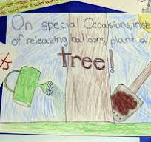
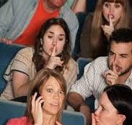
How to fix the externality

Slide 34

Teacher tip
Ask students why they have to get boosters/ vaccinations before they go back to school every Fall

Slide 35
4 - Exploring and Fixing Positive Externalities

Slide 36
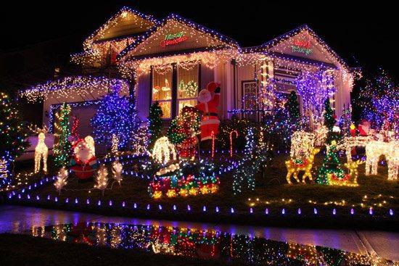
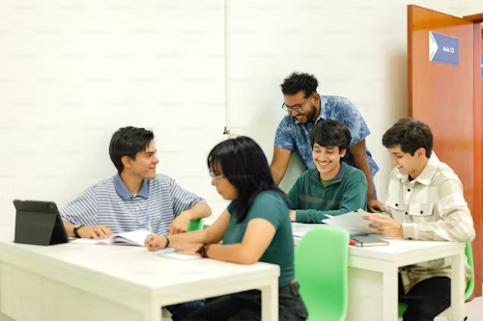
Positive Externalities
When an action provides benefits to others beyond those directly involved

Slide 37
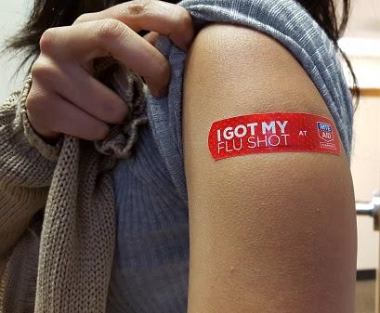
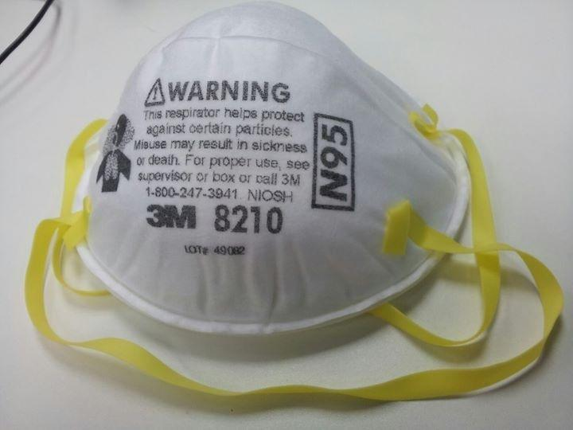
The Flu Vaccine/Masks
The Flu Vaccine reduces the likelihood of bystanders getting the flu!

Slide 38
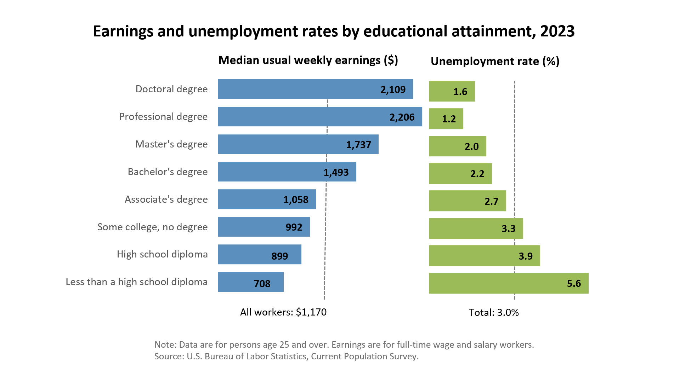
Teacher tip
There is a private benefit to student- there are external benefits to society from getting a college education
List them on the board

Slide 39
How to increase
Governments subsidize public education, museums, vaccine clinics, art, literature, music, research, innovation.

Slide 40
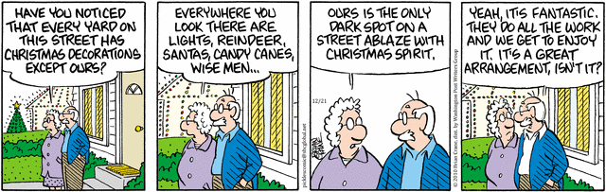
Christmas
How do we remedy this- any suggestions :)

Slide 41
How to fix the externality
Governments subsidize public education, museums, vaccine clinics, art, literature, music, research, innovation.

Slide 42
4 - Exploring Public Goods

Slide 43
Public good- Warm up Activity
Auction a class-wide HW pass for homework. Y’all be excused from HW
Highest bidder Minimum price is $1.
No $1 bid - there is still HW today.
SILENT - No talking or coordinating.
Everyone write down your bid.

Slide 44
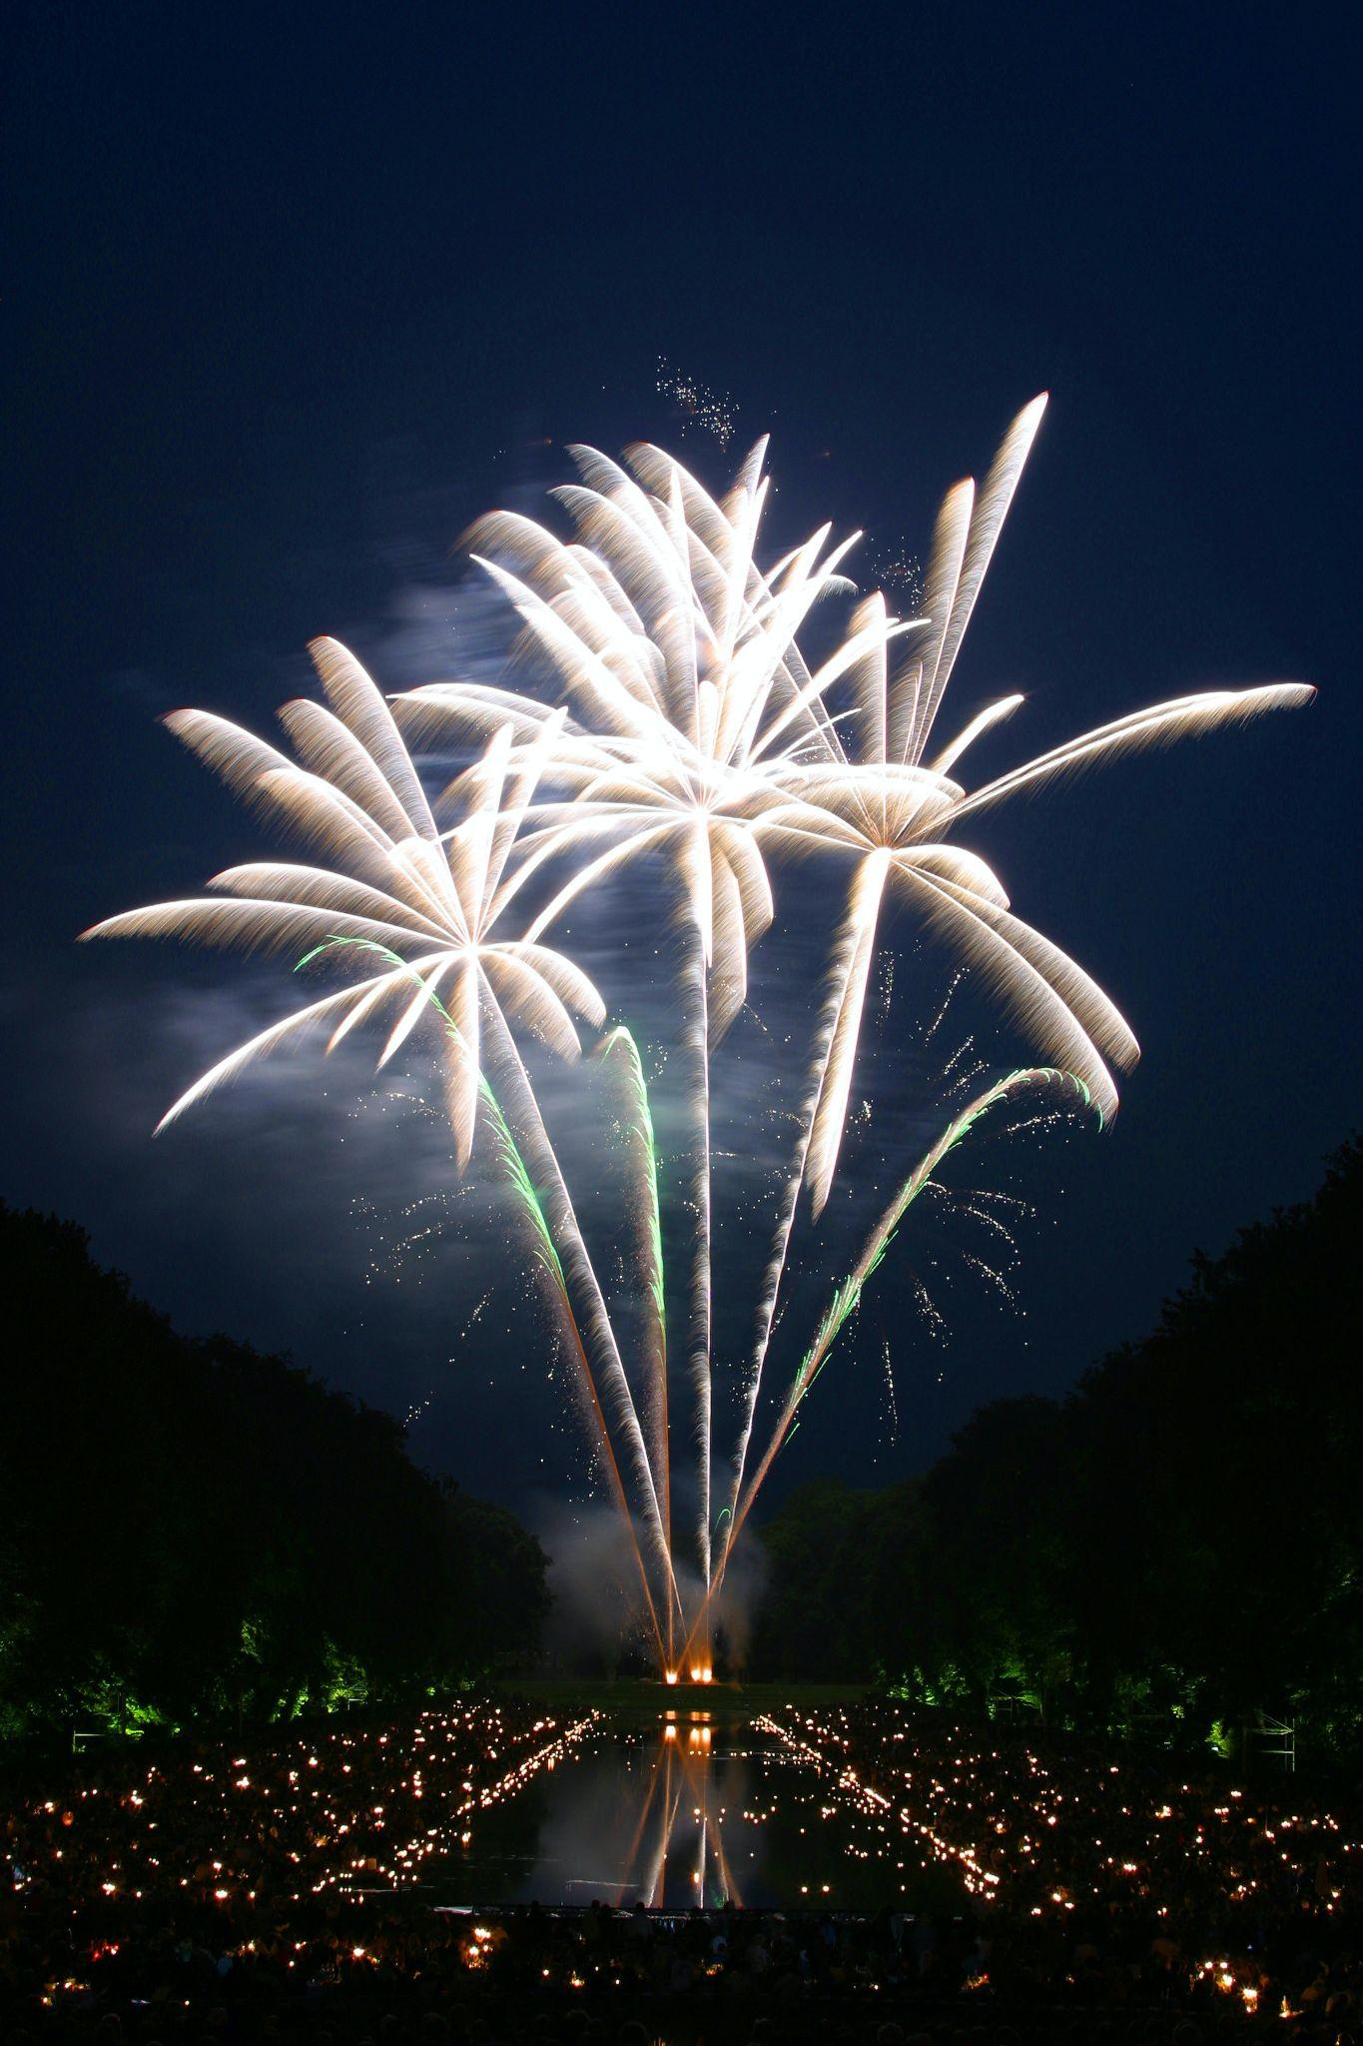
Public goods
A free rider -who enjoys the benefits of a good without paying.
It will more than likely happen occur when a good is nonexcludable
(anyone can get enjoy it for free, like the HW pass).

Slide 45
Public goods
ASK STUDENTS
Have they ever paid to go watch fireworks?
No one has to pay and everyone gets to enjoy the good or service
How sad would you be if we didn’t have fireworks

Slide 46
Public goods
ASK STUDENTS
Does it make sense for a business to provide fireworks?
Why not?- Remember Market Failure

Slide 47
Public goods
Public good: a product that is nonexcludable and nonrival
It is extremely difficult to prevent others from enjoying it(NE)
Me enjoying something doesn’t stop your enjoyment of it (NR)

Slide 48
What does non-excludable mean?
Non-excludable means it's impractical or impossible to prevent people from using or benefiting from a good or service, even if they haven't paid for it.

Slide 49
What does non-rival mean, in your own words?
Non-rival means that one person's use or consumption of a good or service does not reduce its availability to others.
.

Slide 50

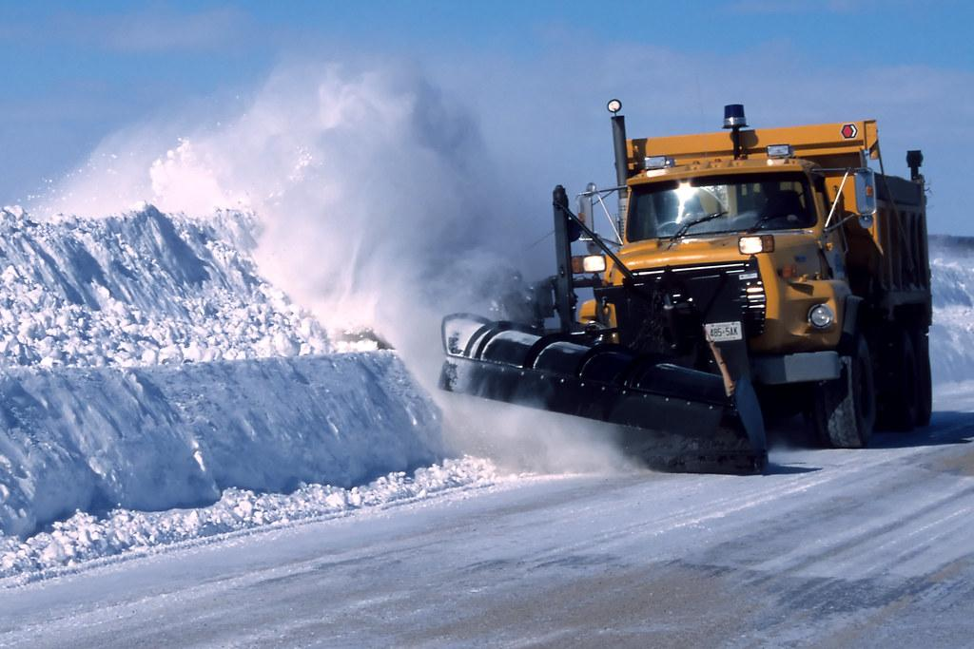
Public goods
The government comes to the rescue(state, local, federal)

Slide 51
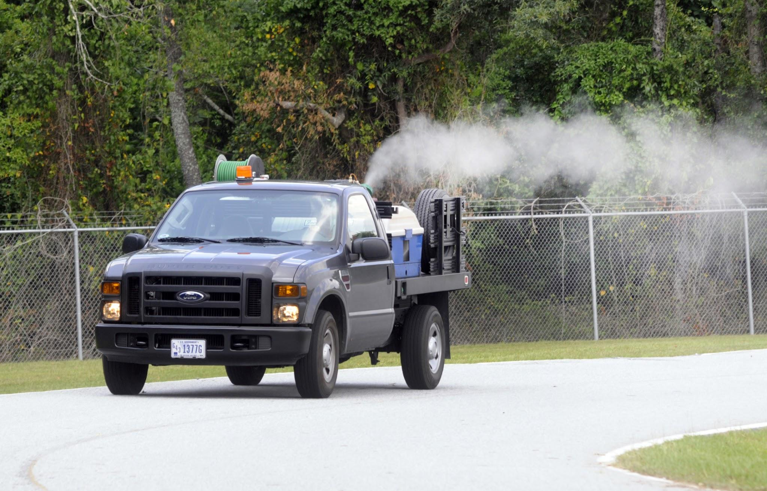
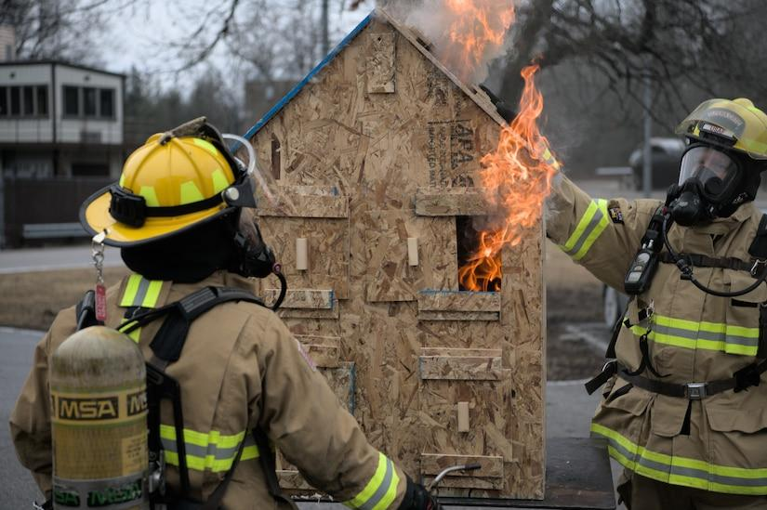
Public goods
Pay for them via taxes (solves the free-rider problem)

Slide 52
5- Exploring Common Pool Resources

Slide 53
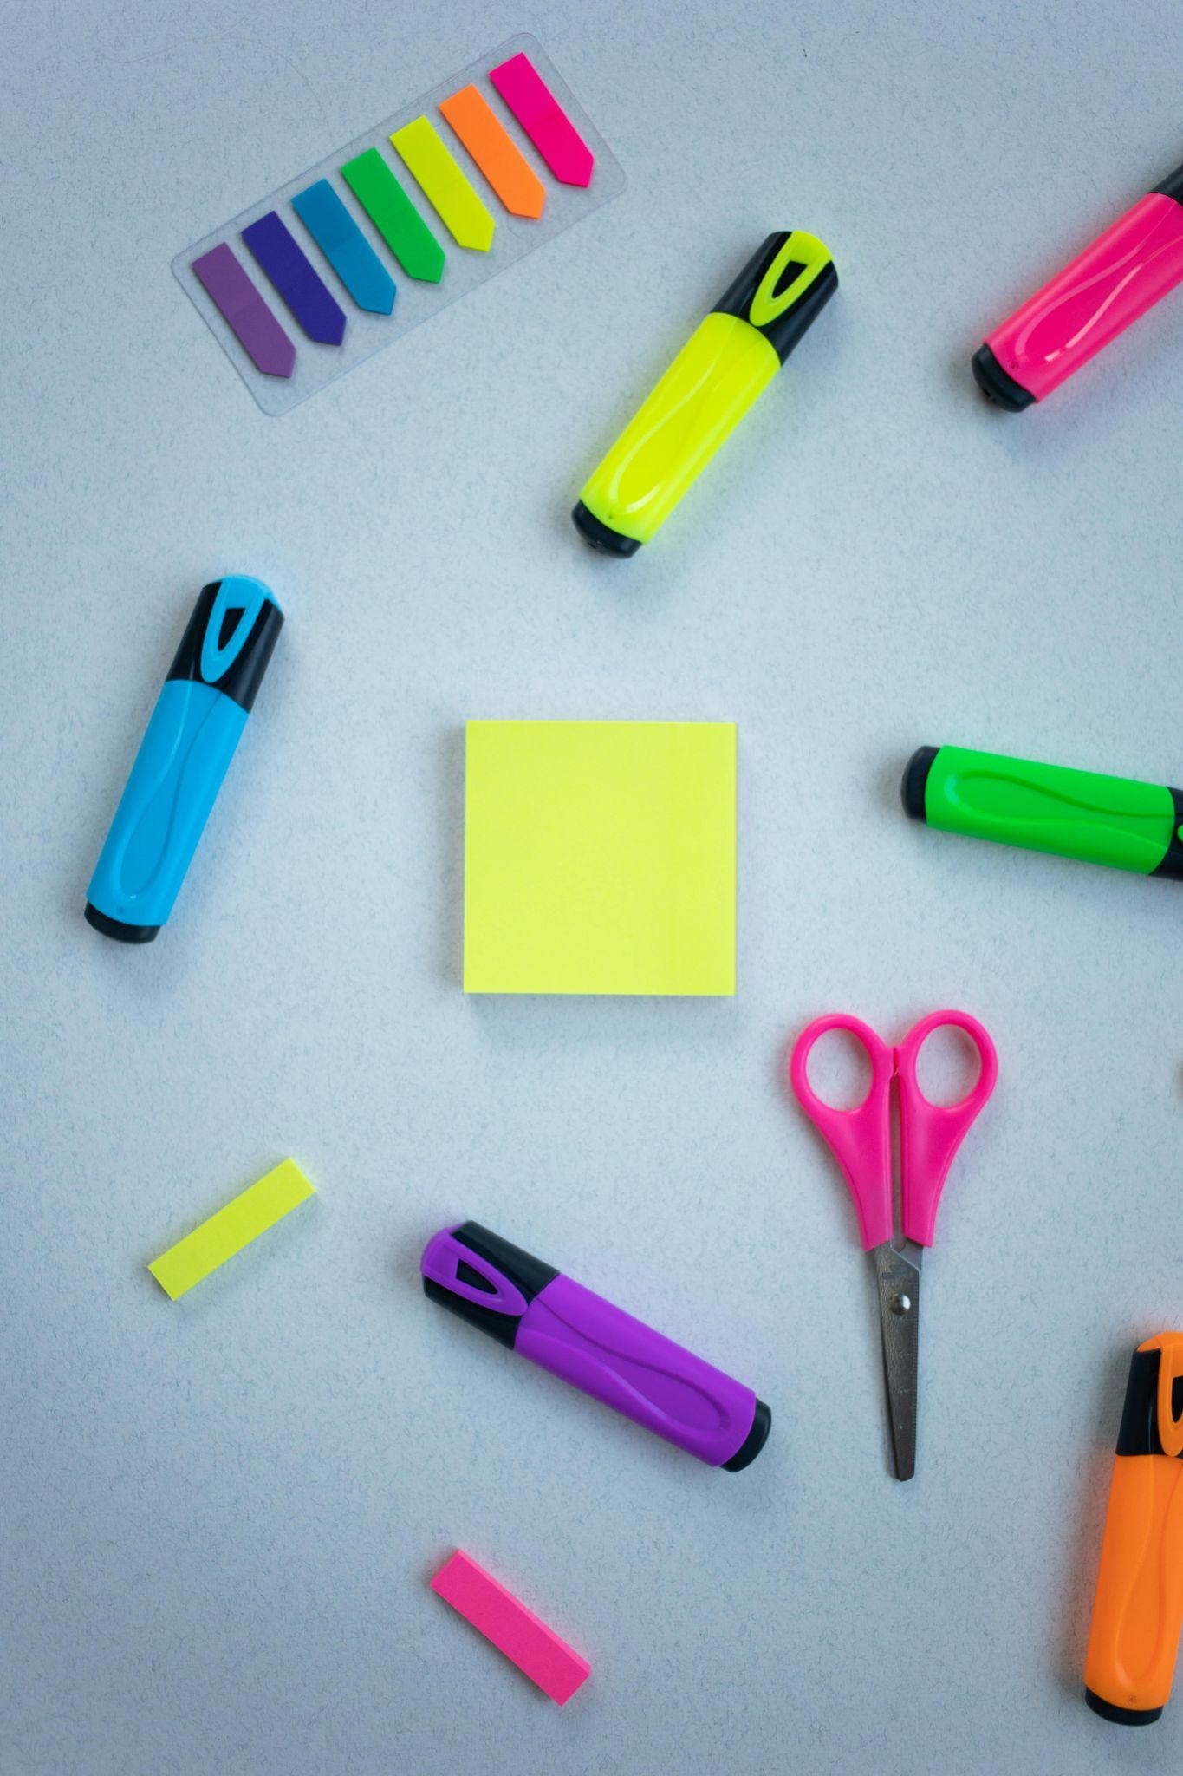

Common pool resource

Slide 54
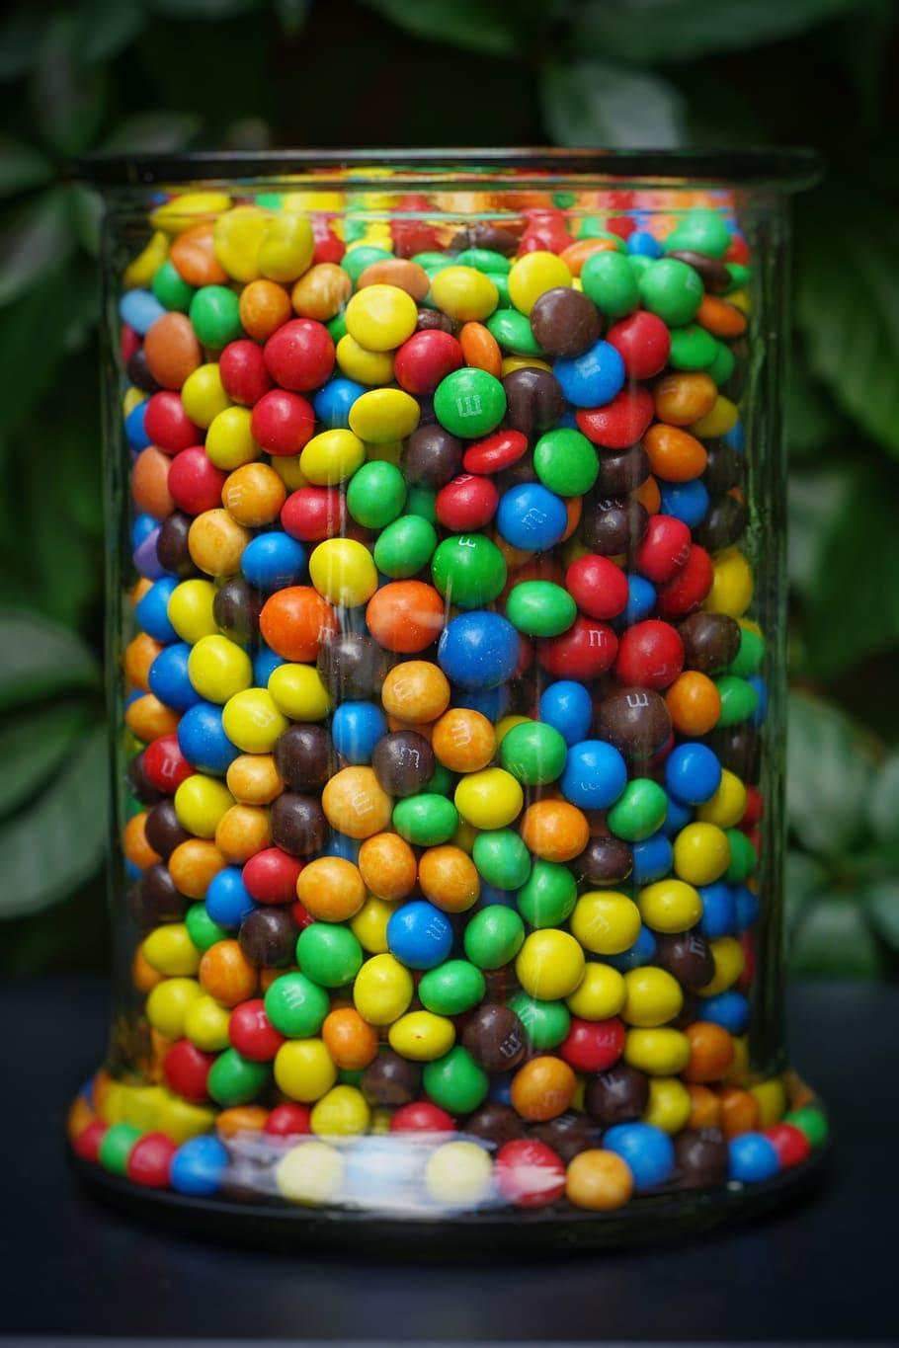
Warm up activity
Write down how many M&Ms you would like from the jar.
If the sum of everyone’s guesses is less than or equal to the amount of M&Ms in the container, you will receive your requested number of candies.
If it goes over the total amount- NO ONE gets any candies.

Slide 55
Warm up activity
Also, if the claims do NOT exceed the # in the bag, the following prizes will be awarded:E.g.
$20 for the largest claim
$15 for the 2nd largest claim
$10 for the 3rd largest claim

Slide 56
Warm up activity
Debriefing
  What was your thinking in making your “claim”?
  Why did the total claim exceed the actual total
  How did the rules of the game encourage this outcome?
  Who owned the bag of M&Ms?
  How could you establish ownership of M&Ms?

Slide 57
Common pool resource
M&Ms in the bag are fish in an ocean fishery- consequences are more severe
Nonexcludable- you didnt pay for it, but you still get to take one
Rival - once you take a piece, I cannot get any of it (so what is there to stop me getting there before you, and taking all of it!)

Slide 58
Common pool resource
Examples:
Shared office or school supplies
Tennis Courts- pickleball games.
Public beach
Open wi-fi network

Slide 59
Tragedy of the Commons
A tragedy of the commons refers to a situation in which a common resource is overused.
Overuse occurs because: Resource is non-excludable
Resource is rival, my consumption lowers your consumption. Individuals do NOT have an incentive to conserve resources for future use.
.

Slide 60
A tragedy of the commons refers to a situation in which a common resource is overused.
Overuse occurs because: Resource is non-excludable
Resource is rival, my consumption lowers your consumption. Individuals do NOT have an incentive to conserve resources for future use.

Slide 61
Fixing the tragedy of the commons
We cannot change the rivalrous nature of a resource- but can we change?
HINT: Consider how the nonexcludable aspect could be changed to excludable.

Slide 62
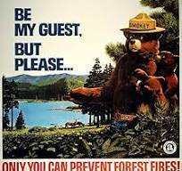
Fixing the tragedy of the commons
Hunters support limiting the number of animals they kill, and placing restrictions on killing females of some animals

Slide 63
Fixing the tragedy of the commons
If you own the right to have something, you will invest in it, instead of trying to get as much as possible as quickly as possible
The FISH game is a great activity to illustrate the tragedy of the commons and the importance of property rights

Slide 64
Things to use in your sandbox!
Unit Plan from MRU -externalities and public goods
When the good or service is defined as a public good (2 characteristics that will be covered in a later side)
Econiful: Lesson Plans On Material we covered today
Great article about leaf peepers and common resources

Slide 65
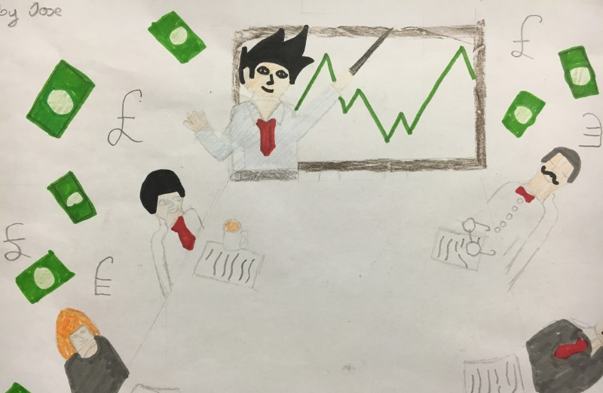
Contact Us
Brian Lynch
fezcgdad@gmail.com

Slide 66


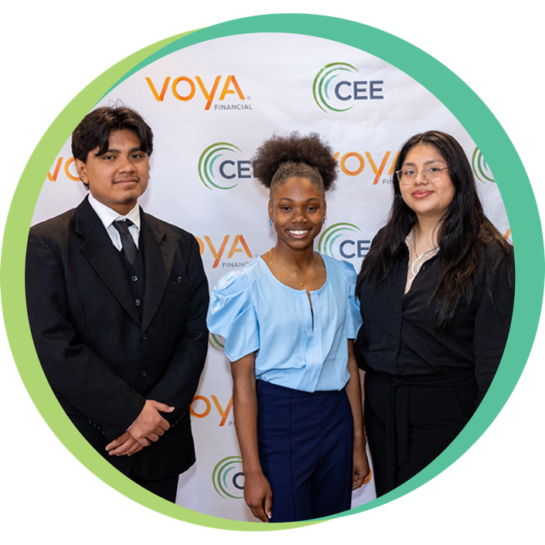


Find your Local Competition and Register Today!
The National Personal Finance Challenge is a competition that provides
high school students with an exciting and motivating opportunity to build, apply, and demonstrate their knowledge of money management.
Through online exams and a personal finance simulation, teams showcase their expertise in earning income, spending, saving, managing credit, investing, and managing risk.
Teams of up to four students, with one teacher/coach, can qualify to represent their state at the National Personal Finance Challenge by
winning their state competition.
CASH PRIZES
for each member of the winning teams:
1st Place $2,000
2nd Place $1,000
3rd Place $500
4th Place $250
NATIONALS > Finals:
Critical thinking round & Quiz Bowl in Atlanta, Georgia on June 1-2.
Register today: bit.ly/cee-npfc

Slide 67


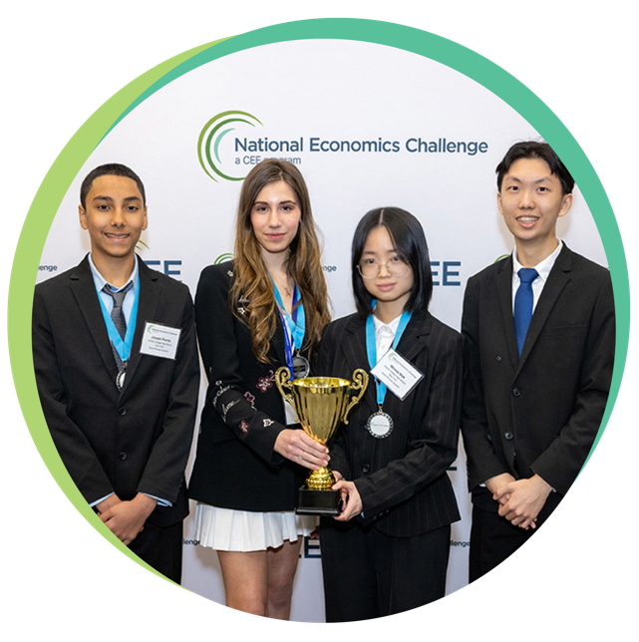
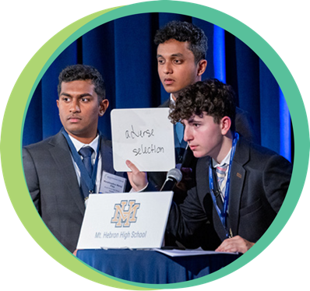

Teach Economics?
Your students may have what it takes to compete in the nation’s only high school economics competition!
Why Play?
• Fun team learning experience
• Great for college applications
• No other challenge like this
• Online participation makes access easy
• Chance for cash prizes
Two divisions based on
experience level
David Ricardo for first-time competitors who have taken no more than one economics course.
Adam Smith for returning competitors, AP, International Baccalaureate, and honors students.
How it Works
Teams register
Teachers enroll team(s) of 3- 4 high school students from the same school. Multiple
teams allowed.
Teams compete within their state
Compete to win your state competition for a
chance to advance to the National Semi-Finals.
National Semi-Finals: April 21-24, 2025
Teams answer multiple-choice questions on macroeconomics, microeconomics, and international & current events.
National Finals: Atlanta, Georgia
May 28-30, 2025
Teams analyze an economic issue and present their solution. Top teams engage in the Finals Quiz Bowl where they face-off answering questions to claim the National Title.
CASH PRIZES
for each member of the winning teams:
1st Place $1,000
2nd Place $500
3rd Place $250
4th Place $200
Register Today at NationalEconomicsChallenge.org

Slide 68


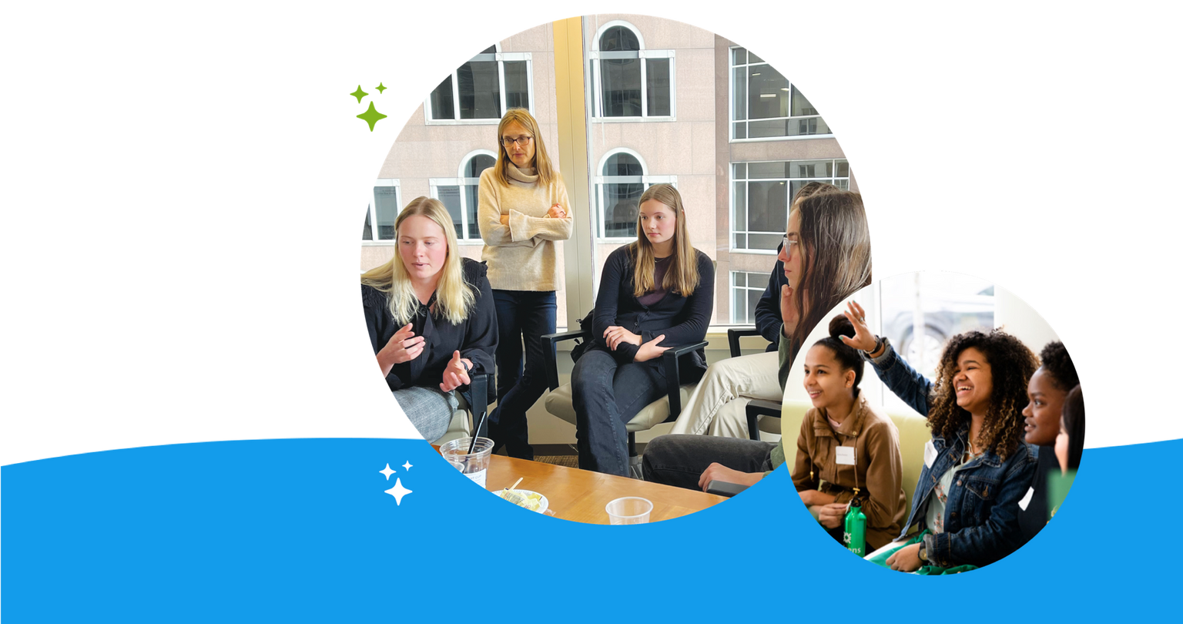
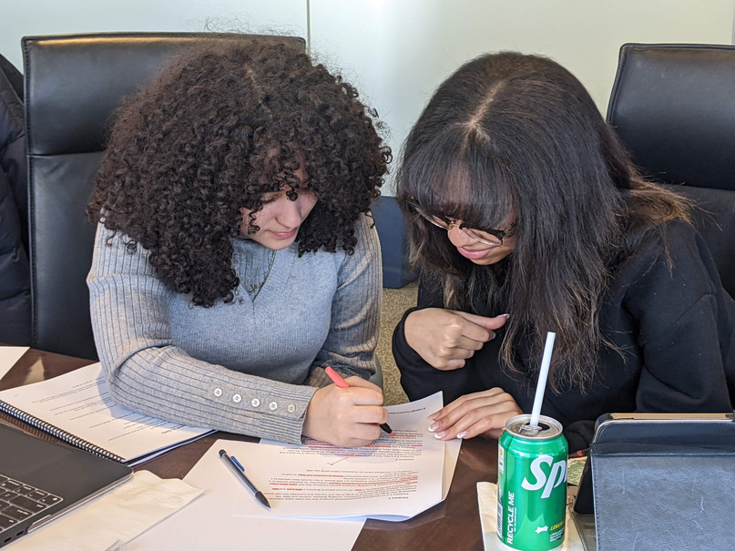

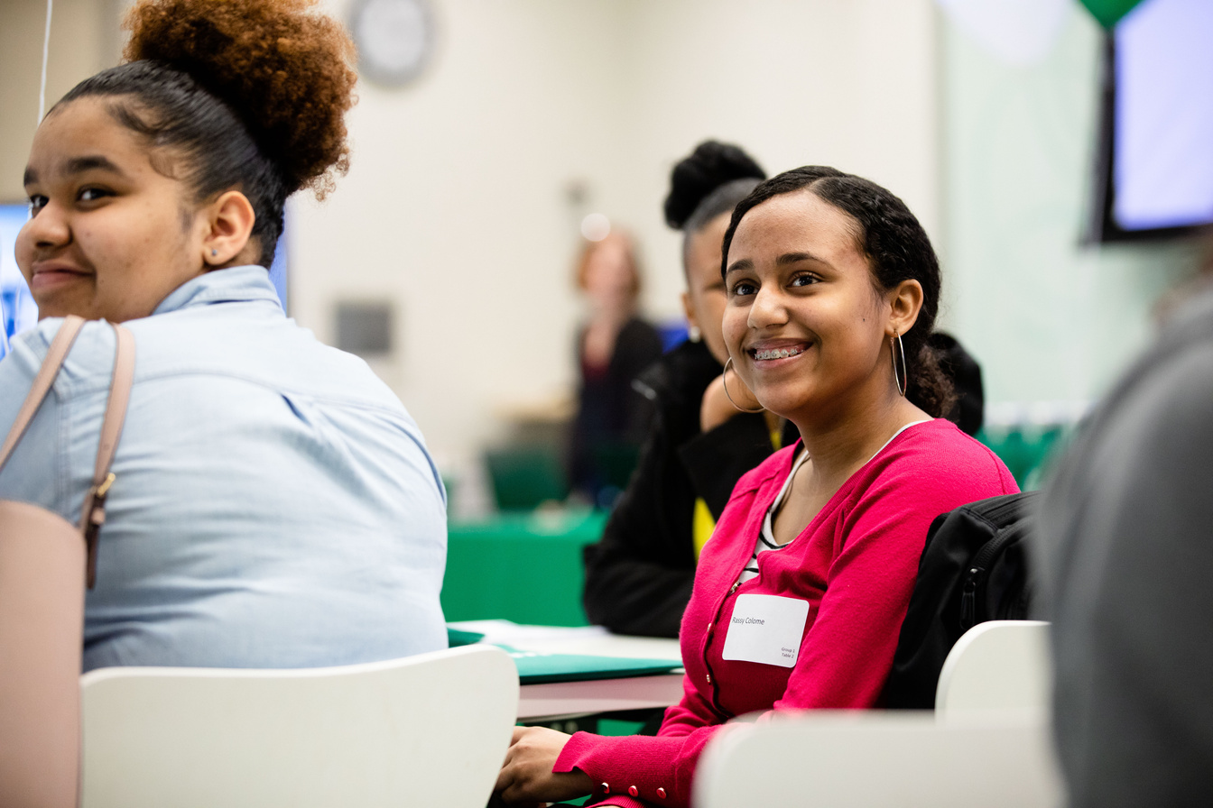
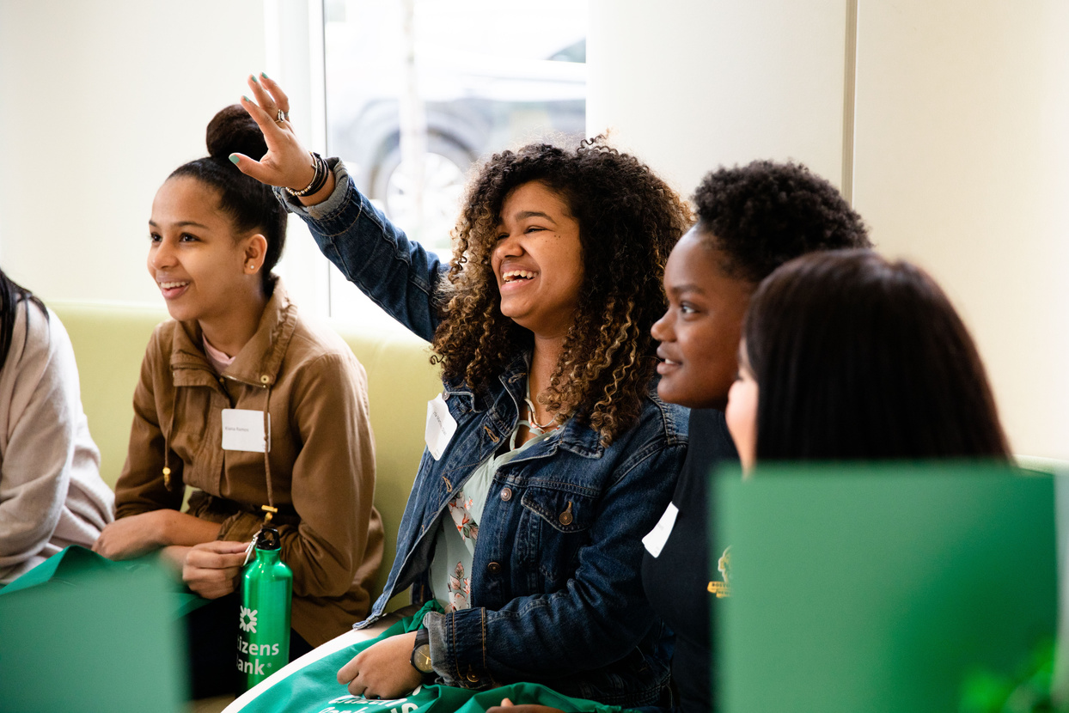

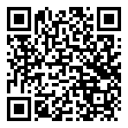



Free Personal Finance Program for High School Girls
Invest in Girls (a program of CEE) invites your high school students to learn about personal finance in a supportive all-girl environment! IIG instructors will teach students the basics of personal finance, how to invest, and help them build professional skills. These programs are online and free to attend.
Share this sign up link with your students
Or visit investingirls.org/for-students/

Slide 69
Thank you

