Slide 1

[INSERT FEATURED IMAGE OF WEBINAR SESSION]
AP MACROECONOMICS
POST-EXAM ANALYSIS
©2025 College Board
DISCLAIMER: This presentation is not sponsored by the College Board and only reflects the presenter’s analysis of the 2025 AP Micro free response questions.

Slide 2
Certificate Requirements
To earn professional development hours for webinars, you must:
Watch a minimum of 45-minutes and you will automatically receive a professional development certificate via e-mail within 24 to 48 hours.

Slide 3
Objectives
Review the 2025 AP Macroeconomics Free- Response Questions (FRQ’s).
Learn effective strategies for teaching content that is tested on the FRQ portion of the AP exam.

Slide 4

Session Agenda
FRQ’s- Set 1 Analysis
2. FRQ’s- Set 2 Analysis
© 2025 College Board

Slide 5
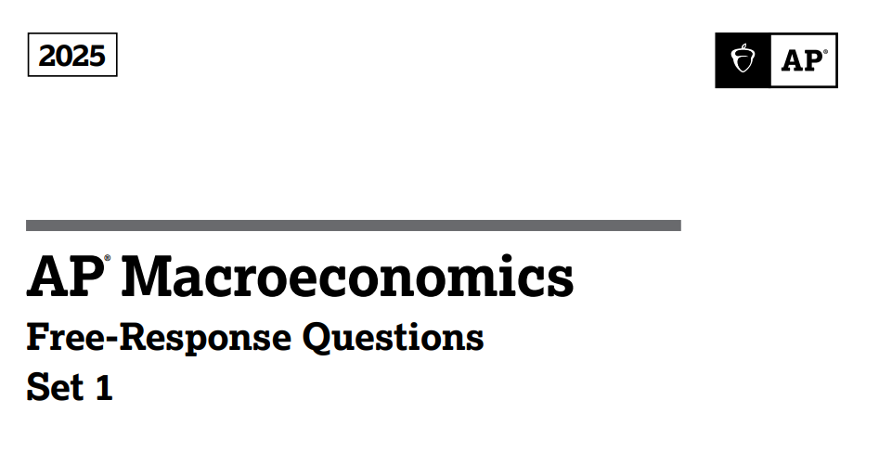

Slide 6
Set 1: Question 1
LRPC
Assume the economy of Vortania is in long-run equilibrium.
A. Draw a correctly labeled graph of the short-run and long-run Phillips curves for the economy of Vortania, and label the long-run equilibrium point as P.
Inflation %
P
Inf e
SRPC
NRU/Yf
UE%
6

Slide 7
Set 1: Question 1
LRPC
B. Assume that new residential construction projects are being implemented in Vortania.
Ii. Change in residential construction increases Investment, a component of RGDP, shifting AD to right. A shift to the right of AD is a movement to the left along the SRPC curve.
Inflation %
S
Will the real output in Vortania increase, decrease, or remain the same in the short-run?
P
Inf e
Increase.
ii. Assuming no change in inflationary expectations, on your graph in part A, show the short-run effect of the new residential construction projects on Vortania's economy, labeling the new short-run equilibrium point as S.
SRPC
NRU/Yf
UE%
7

Slide 8
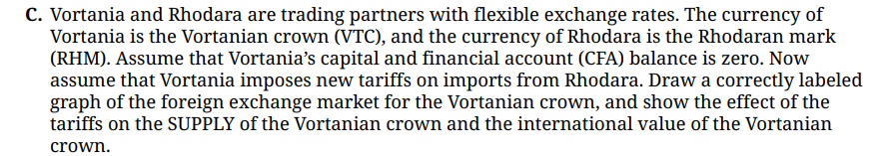


Set 1: Question 1

Slide 9
Set 1: Question 1
RHM/VTC
Vortanian Crown
Market
C. Tariffs on imports from Rhodara reduce the demand for Rhodara's goods. Consequently, fewer VTCs will be exchanged. The supply of VTC to purchase Rhodara's goods decreases.
S₁
D. Based solely on the change in the international value of the Vortanian crown shown in part c, will Vortania's net exports increase, decrease, or remain the same in the short run?
er₁
S
er_{e}
D
Decrease—exports go down and imports go up based solely on the appreciation of the VTC. Therefore (X-M) decreases.
Q₁ Q_{e}
Quantity of VTC
VTC APPRECIATES

Slide 10
Set 1: Question 1
Increase or move to a surplus.
In part D, net exports declined. This means that the Current Account will decrease due to the decrease in exports.
CA + CFA = 0 Since CA decreases, CFA must increase.
Decrease. Since NX decrease, Aggregate Demand will shift left resulting in lower employment.

Slide 11
Set 1: Question 1
RHM/VTC
Vortanian Crown
Market
F. Assume the central bank of Vortania wants to return the Vortanian crown to its international value before the imposition of the tariffs. Would the central bank buy or sell Vortanian crowns in the foreign exchange market? Explain.
S₁
er₁
S
The central bank would sell the VTC on the foreign exchange market, shifting the supply to the right until the VTC returns to its previous value.
er_{e}
D
Q₁ Q_{e}
Quantity of VTC

Slide 12
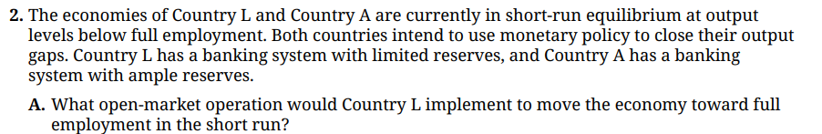
Set 1: Question 2
Buy bonds since Country L has limited reserves.
With ample reserves, Country A can decrease the interest they pay on bank reserves or decrease administered rates.

Slide 13
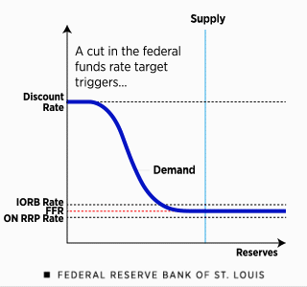
Set 1: Question 2
Policy Rate
C. Draw a correctly labeled graph of the reserve market in Country A, and show the effect of the monetary policy action in Part B on the policy rate.
The monetary policy in Part B is expansionary, decreasing administered rates:
- Interest on Reserve Balances
- Overnight Reverse Repurchase Rate
- Discount Rate
Source: How the Federal Reserve Implements Monetary Policy

Slide 14
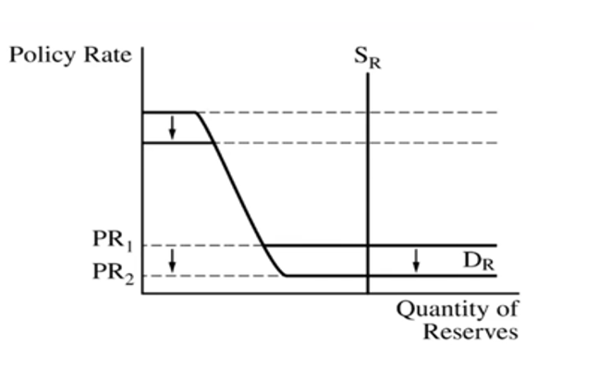
Set 1: Question 2
C.
If answer in Part A is "decrease interest on reserves", only the lower portion of the demand curve would shift.
If answer in Part A is "decrease administered rates," both the upper and lower portion of the demand curve should shift down.

Slide 15

Set 1: Question 2
The short-run aggregate supply curve will increase (shift to the right) as wages and input costs decrease since the economy is beneath full employment.

Slide 16
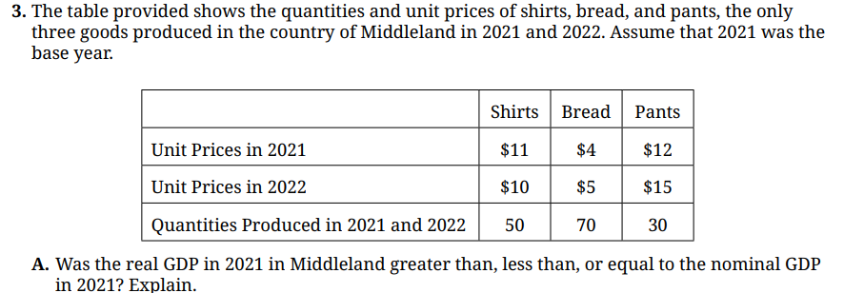
Set 1: Question 3
The same since nominal and real are always the same in the base year. Base year prices and current prices are the same in the base year.
Real GDP = $11 (50) + $4 (70) + $12 (30)
= $550 + $280 + $360
= $1190

Slide 17
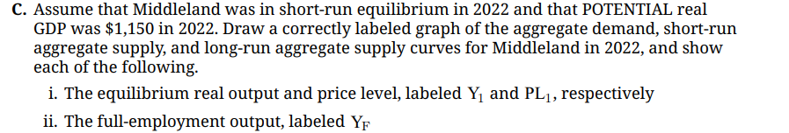
Set 1: Question 3
Actual RGDP in 2022 was $1190 (from Part B), which is above the potential RGDP of $1150. There is an inflationary gap.

Slide 18
Set 1: Question 3
LRAS
Price Level
Inflationary Gap of $40
Y₁ = $1190
Y_{F} = $ 1150
SRAS
PL₁
AD
Y_{F}
Y₁
RGDP
18

Slide 19

Set 1: Question 3
Output gap = $1190 - $1150 = $40 (inflationary gap which means there needs to be a reduction in government spending or increase in taxes.)
Spending Multiplier = 1/(1- MPC) = 1/0.2 = 5
-$40 = 5 (change in government spending)
-$40/5 = -$8
Government spending needs to be reduced by $8 to close the inflationary gap.

Slide 20
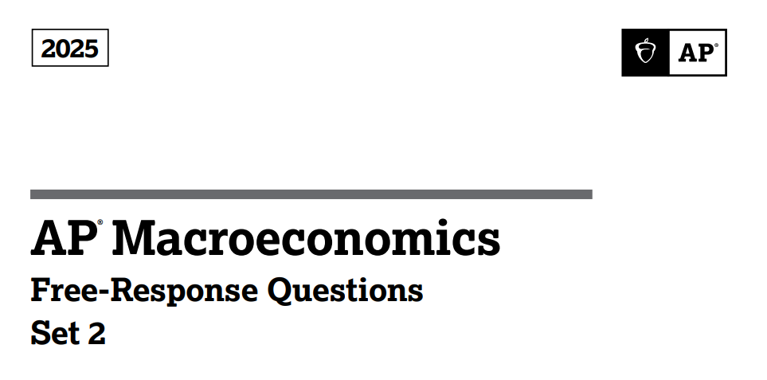

Slide 21
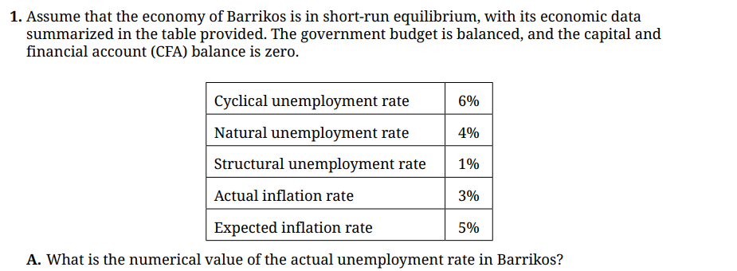
Set 2: Question 1
10% (Cyclical UE% + Natural UE%)
Remember that Natural Unemployment Rate includes Structural.

Slide 22
Set 2: Question 1
B. Using the relevant numerical values, draw a correctly labeled graph of the short-run and long-run Phillips curve for Barrikos. Indicate the current short-run equilibrium with a point labeled X. Plot the relevant numerical values on the graph.
LRPC
Inflation %
5%
X
3%
SRPC
4%
10%
UE%
22

Slide 23
Set 2: Question 1
C. Based on your graph in part B, identify one specific fiscal policy action that the government of Barrikos would take to move the economy toward long-run equilibrium.
Increase government spending
Decrease taxes
D. Assume that the fiscal policy action identified in part C is implemented.
i. Will the government budget in Barrikos move into surplus, move into deficit, or remain balanced? Explain.
Prior to the fiscal policy action, the government budget was balanced, with revenue equal to spending. The fiscal policy action will move the budget into a deficit.
Increasing government spending without increasing taxes or revenue to offset the spending will result in a deficit.
Decreasing taxes without a commensurate decrease in spending will also lead to a deficit.

Slide 24
Set 2: Question 1
D. ii. Assume there is no change in inflationary expectations. On your graph in part B, show a possible new short-run equilibrium point, labeled Z, that would result from the fiscal policy action identified in part C.
LRPC
Inflation %
Z
5%
Fiscal policy action will lead to a shift to the right of Aggregate Demand which results in a leftward movement along the SRPC curve. Any point to the left of X is correct.
X
3%
SRPC
4%
10%
UE%
24

Slide 25
Set 2: Question 1
Real Interest Rate
D. iii. Draw a correctly labeled graph of the loanable funds market and show the effect of the fiscal policy action identified in part C on the real interest rate.
S_{Lenders}
r₂
r₁
Explanation: Government increases deficit spending to address recession. Supply of loanable funds shifts left; real interest rate increases.
D₁
D _{Borrowers}
Q₁ Q₂
Q _{Loanable Funds}
Loanable Funds Market

Slide 26
Set 2: Question 1
Loanable Funds Market
Real interest rate
S₁
S_{Lenders}
A leftward shift in the Supply of Loanable Funds is also acceptable.
r₂
r₁
D_{Borrowers}
Q₂
Q₁
Q_{LF}
26

Slide 27

Set 2: Question 1
Surplus. The increase in the real interest rate will result in a capital inflow as investors seek the higher interest rate that's available in the Barrikos Loanable Funds Market.
The international value of the Barrikos currency will appreciate. The increase in the real interest rate will increase the demand for the Barrikos currency as investors exchange their currency for the Barrikos currency to obtain the higher rate of return. OR, the supply of Barrikos currency will decrease as domestic investors will supply fewer loanable funds to foreign markets.

Slide 28
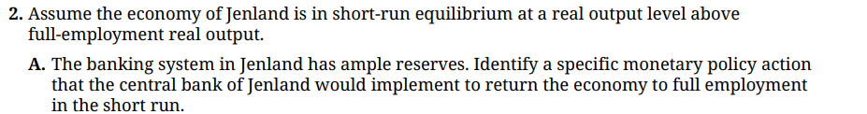
Set 2: Question 2
Increase interest on bank reserves
Increase administered (policy) rates

Slide 29
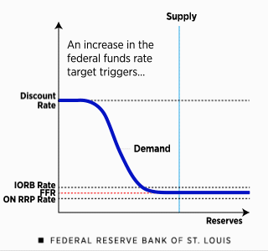
Set 2: Question 2
B. Draw a correctly labeled graph of the reserve market for Jenland, and show the effect of the central bank's action identified in part A on the policy rate.
Jenland Central bank will implement contractionary monetary policy, increasing administered rates:
- Interest on Reserve Balances
- Overnight Reverse Repurchase Rate
- Discount Rate
Source: How the Federal Reserve Implements Monetary Policy

Slide 30
Set 1: Question 2
C.
If answer in Part A is "increase interest on reserves", only the lower portion of the demand curve would shift up.
If answer in Part A is "increase administered rates," both the upper and lower portion of the demand curve should shift up.

Slide 31
Set 2: Question 2
Decrease. (The price of bonds and the interest rate are inversely related.)
Decrease. The increase in the interest rate will result in a decrease in Investment and interest sensitive consumption, resulting in a decrease (leftward shift) of the Aggregate Demand curve which leads to a lower price level and output.

Slide 32
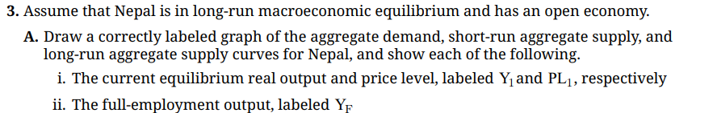
Set 2: Question 3

Slide 33
Set 1: Question 3
LRAS
Price Level
SRAS
PL₁
AD
Y_{F}/Y1₁
RGDP
33

Slide 34
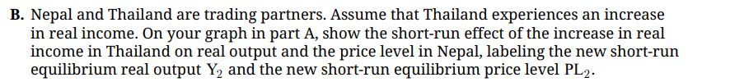
Set 2: Question 3
Price Level
LRAS
SRAS
PL₂
Increase in real income in Thailand means that Thai consumers will buy more of everything (including imports from Nepal). Nepalese exports to Thailand will increase, shifting their Aggregate Demand curve to the right, resulting in a higher real output and price level.
PL₁
AD₁
AD
Y₁/Y_{F}
Y₂
RGDP
34

Slide 35
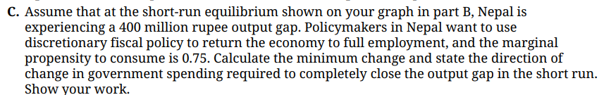
Set 2: Question 3
Inflationary gap of 400 million rupee
Government Spending Multiplier = 1/(1-MPC) = 1/0.25 = 4
-400 million rupee = 4 x ( change in government spending)
-400 million rupee/4 = -100 million rupee
Government spending should be reduced by 100 million rupee

Slide 36
Automatic stabilizers will lessen the shift of the aggregate demand illustrated in Part B. As national income increases due to the increase in exports, income taxes also increase. At the same time there will be a decrease in transfer payments (unemployment, social welfare programs) as fewer people will access them due to the higher levels of national income. Both of these automatic stabilizers (income taxes, transfer payments) will dampen the rightward shift of Aggregate Demand.

Slide 37












Free Personal Finance Program for High School Girls
Invest in Girls (a program of CEE) invites your high school students to learn about personal finance in a supportive all-girl environment! IIG instructors will teach students the basics of personal finance, how to invest, and help them build professional skills. These programs are online and free to attend.
Share this sign up link with your students
Or visit investingirls.org/for-students/

