Slide 1

[INSERT FEATURED IMAGE OF WEBINAR SESSION]
AP MICROECONOMICS
POST-EXAM ANALYSIS
©2025 College Board
DISCLAIMER: This presentation is not sponsored by the College Board and only reflects the presenter’s analysis of the 2025 AP Micro free response questions.

Slide 2
Certificate Requirements
To earn professional development hours for webinars, you must:
Watch a minimum of 45-minutes and you will automatically receive a professional development certificate via e-mail within 24 to 48 hours.

Slide 3

Presenter
Name: Kathleen Brennan
Email Address: kmbrennan108@gmail.com
Social Handles X : @econkate
Instagram: @kmbrennan108

Slide 4
Objectives
Review the 2024 AP Microeconomics Free- Response Questions (FRQ’s).
Learn effective strategies for teaching content that is tested on the FRQ portion of the AP exam.

Slide 5

Session Agenda
FRQ’s- Set 1 Analysis
2. FRQ’s- Set 2 Analysis
© 2025 College Board

Slide 6
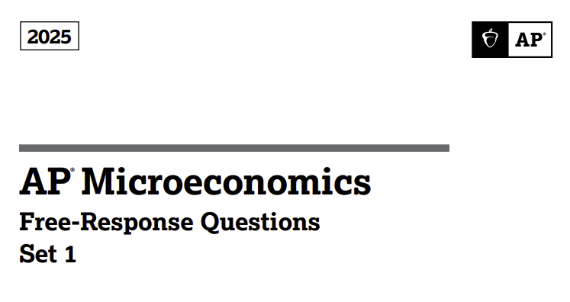

Slide 7
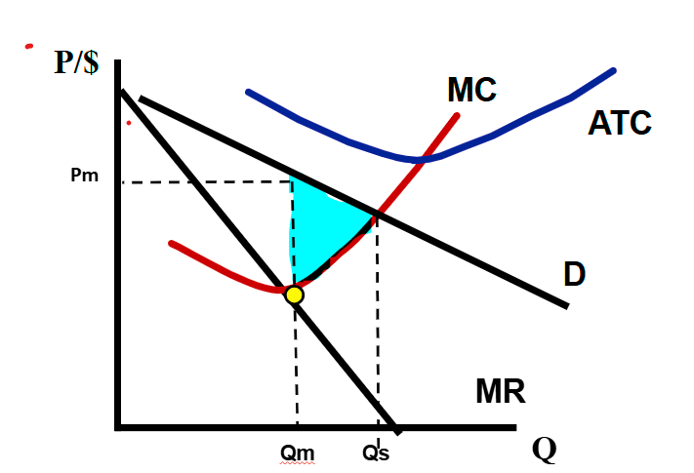
Set 1: Question 1
Voda Reservoir is a profit-maximizing firm and the only producer of bottled water in a country. Currently, Voda Reservoir is earning negative economic profit.
Draw a correctly labeled graph for Voda Reservoir and show each of the following:
i. The profit-maximizing quantity, labeled Qm
ii. The profit-maximizing price, labeled Pm
Iii. The average total cost curve consistent with Voda Reservoir earning negative economic profit, labeled ATC
iv. The area of deadweight loss, shaded completely
B. Suppose the government requires Voda Reservoir to produce the socially optimal quantity of bottled water. On your graph in part A, show the socially optimal quantity of bottled water, labeled Qs.

Slide 8
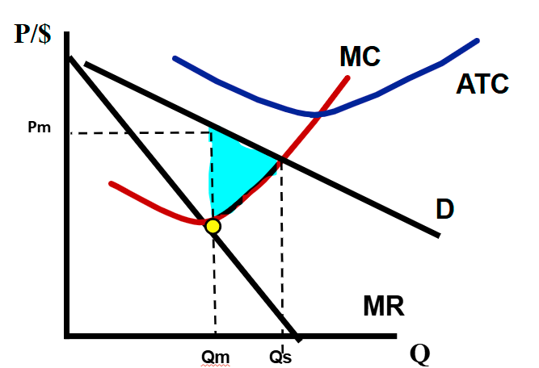
Set 1: Question 1
C. Suppose instead the government grants a per-unit subsidy to Voda Reservoir. What will happen to Voda Reservoir's profit-maximizing quantity of bottled water? Explain.
Profit maximizing quantity increases since the subsidy shifts Voda's marginal cost curve down (to the right). MR=MC now occurs at a higher quantity.

Slide 9
Set 1: Question 1
D. Suppose new producers have entered the bottled water market and Voda Reservoir continues to operate in the bottled water market. Will the demand for Voda Reservoir's bottled water become more elastic, become less elastic, or stay the same as new producers enter the market?
More elastic

Slide 10
Set 1: Question 1
E. Voda Reservoir hires workers in a perfectly competitive labor market.
If the demand for bottled water increases, what will happen to Voda's demand for labor? Explain.
The government implements a new regulation that increases the minimum age required for a worker to be employed in a bottle-water factory. What will happen to the market wage in the short run? Explain.
The demand for labor will increase since it is a derived demand equal to its marginal revenue product (MRP) where MRP = Marginal Revenue (MR) x Marginal Product (MP). As demand for bottled water increases, the price of water increases, thus increasing MR and consequently MRP.
ii. The increase in the minimum age reduces the supply of labor, shifting the supply curve of labor to the left. The new equilibrium market wage will be higher.

Slide 11
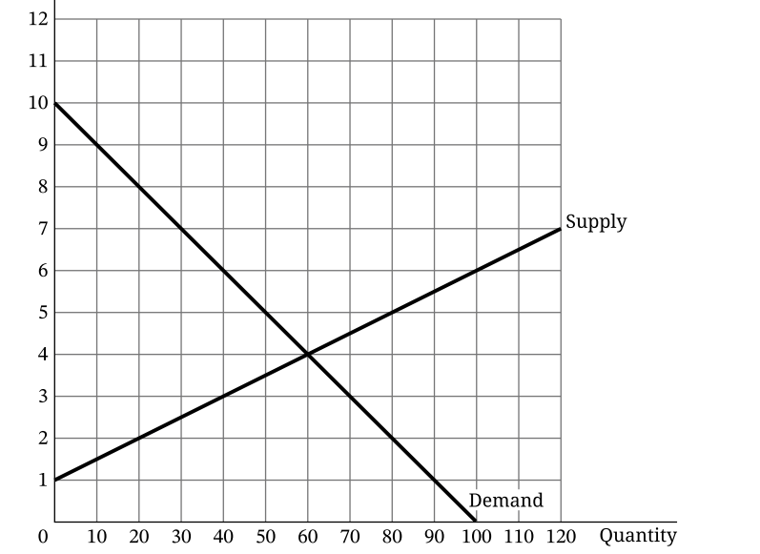
Set 1: Question 2
Calculate the total economic surplus at market equilibrium. show your work.
Total Surplus: [(10-1)(60)/2 = 270
B. If the government sets a price floor at $3 per bushel, will there be a surplus, shortage, or neither? Explain.
Neither, since the price floor is beneath the equilibrium price of $4 per bushel.

Slide 12
Set 1: Question 2
C. Suppose that instead of the price floor, Rushland engages in international trade and the world price of rice is $5 per bushel.
Will Rushland export or import rice. Explain using numbers from the graph.
  Export; at $5, farmers will be willing to supply 80 bushels, 50 will be demanded domestically, while 30 will be exported.
ii. Calculate the domestic consumer surplus when Rushland engages in international trade. Show your work.
  CS = [(10-5)(50)]/2 = 125
iii. Calculate the total revenue that Rushland's farmers will earn at the world price. Show your work.
  Revenue = $5 x 80 = $400

Slide 13
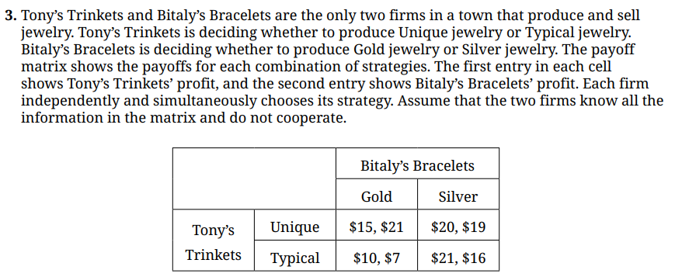
Set 1: Question 3

Slide 14
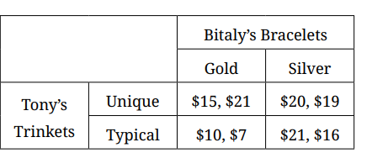
Set 1: Question 3​
Suppose Bitaly chooses to produce Silver jewelry. Is choosing to produce Unique jewelry the best choice for Tony? Explain using numbers from the payoff matrix.
  If Bitaly produces Silver, Tony should produce Typical since $21> $20.
B. Is Bitaly's dominant strategy to produce Gold jewelry, Silver Jewelry, or does not have a dominant strategy. Explain using numbers form the payoff matrix.
C. Identify all Nash Equilibria for this game.
Tony- Unique, Bitaly- Gold
Tony – Typical, Bitaly- Silver
Bitaly doesn't have a dominant strategy. If Tony produces Unique, Bitaly should produce Gold since $21> $19. If Tony produces Typical, Bitaly should produce Silver, since $16>$7. Bitaly's decision on what to produce depends on what Tony does and is therefore not a dominant strategy.
 | Gold | Silver
Unique | $15 $21 | $20 $19
Typical | $10 $7 | $21 $16

Slide 15
Set 1: Question 3
D. Suppose Tony's profit from producing Typical jewelry increase regardless of what Bitaly does. What is the minimum amount by which Tony's profit must increase in order for Typical jewelry to become a dominant strategy?
$2- no, since $15 >$12
$4- no, since $15>$14
$6- yes, since $15 <$16
E. Suppose instead that these two firms now cooperate and merge into one firm to maximize their combined profits. The new firm will have two locations and continue to face the same actions and payoffs. Calculate the new firm's maximum combined profit. Show your work.
 | Gold | Silver
Unique | 15 +21= 36 | 20 + 19 = 39
Typical | 10 + 7 = 17 | 21 + 16 = 37

Slide 16
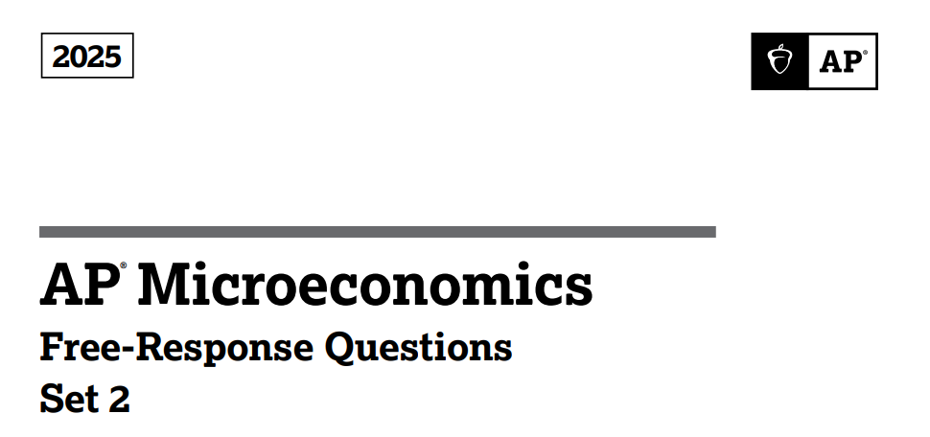

Slide 17
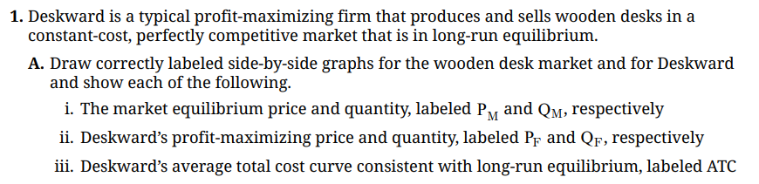






P
S
P/$
MC
ATC
Pm
Pf
D, MR, AR
D
Qm
Q
Q
Qf
Desk Industry
Deskward Firm

Slide 18
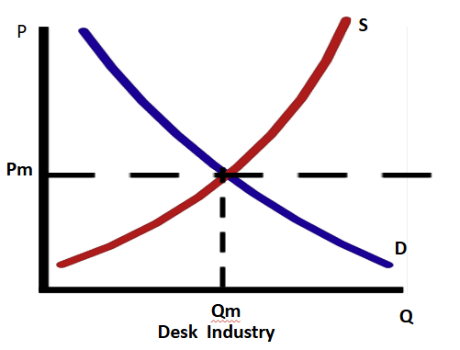

Set 2: Question 1
B. If the monthly rent, a fixed cost, on Deskward's factory building increases, what will happen to the firm's profit maximizing quantity in the short-run? Explain.
The profit-maximizing quantity will not change, since rent is a fixed cost that does not affect the MC of production.
S + per-unit subsidy
C. Suppose the government is considering granting a per-unit subsidy to producers of wooden desks. On your market graph in part A, show the short-run effect of a per-unit subsidy on each of the following:
The new market equilibrium price and quantity of wooden desks, labeled P* and Q*.
The are representing the total cost of the subsidy to the government, shaded completely.
P*
Q*

Slide 19
Set 2: Question 1
D. Instead of the per-unit subsidy, suppose the government imposes a binding price floor in the market for wood desks. Will the price floor result in a shortage of wooden desks, a surplus of wooden desks, or neither? Explain.
Surplus. A binding price floor will increase the quantity supplied, while at the same time decreasing the quantity demanded.
Qs > Qd (surplus)
Price floor
Qd
Qs

Slide 20
Set 2: Question 1
E. Deskward also produces chairs. Deskward increases its production from 500 chairs to 600 chairs, and its long-run total cost increase from $80,000 to $108,000.
Calculate Deskward's long-run average total cost of producing 500 chairs. Show your work.
$80,000/500 = $160
ii. As Deskward increases production from 500 to 600 chairs, is Deskward experiencing economies of scale, diseconomies of scale, or the efficient scale? Explain using numbers.
500 chairs: LRATC = $160
600 chairs: LRATC = $108,000/600 = $180
Since LRATC increases as output increases, Deskward is experiencing diseconomies of scale.

Slide 21
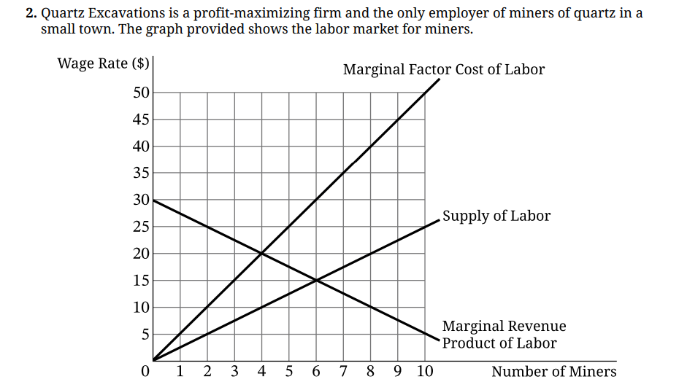
Set 2: Question 2
Identify the profit-maximizing number of miners to hire.
4 miners, where MFC = MRP
B. Will Quartz pay its profit-maximizing number of workers a wage equal to $15, greater than $15, or less than $15? Explain using numbers.
Less than $15. At the profit maximizing quantity 4 miners will be willing to work for a wage of $10.

Slide 22
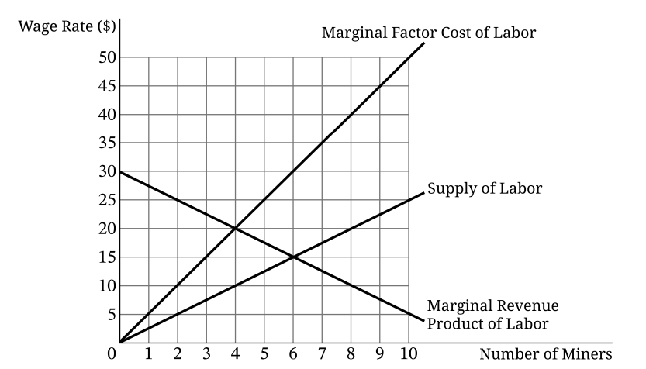
Set 2: Question 2
C. Suppose the government sets a minimum wage (a price floor on wages) at $25. Calculate the total wage bill for Quartz at the resulting profit-maximizing number of miners. Show your work.
Quartz will hire workers up to the point where the MFC = MRP. With a minimum wage of $25, 2 workers will be hired.
2 workers x $25 = $50

Slide 23
Set 2: Question 2
D. Suppose that instead of a minimum wage, there is now an increase in the demand for quartz.
Will the marginal revenue product of miners increase, decrease, or remain the same? Explain.
The marginal revenue product (MRP) of miners will increase.
MRP = Marginal Revenue X Marginal Product.
When the demand for quartz increases, its price increase which results in an increase in the marginal revenue that the labor produces.
ii. After the demand for quartz increases, Quartz hires the new profit-maximizing number of miners. Will the marginal factor cost of the last miner hired be greater than, less than, or equal to the marginal factor cost of the last miner hired before the demand for quartz increased?
Greater than

Slide 24
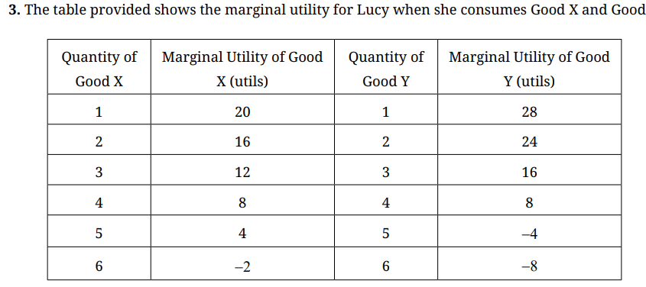
Set 2: Question 3
If Good X and Y are free, how many units of each good will maximize Lucy's total utility.
Total Utility X | Total Utility Y
20 | 28
36 | 52
48 | 68
56 | 76
60 | 72
58 | 64
B. Calculate Lucy's total utility if she consumes 2 units of Good X and 2 units of Good Y. Show your work.
X= 20 + 16 = 36 Y= 28 + 24 = 52 Total Utility = 36 + 52 = 88
5 units of Good X, 4 units of Good Y

Slide 25
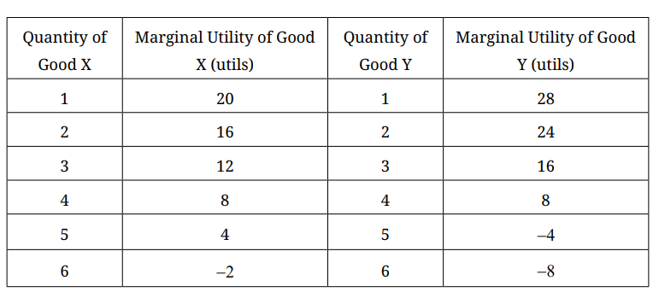
ii. What is the optimal combination? Explain using marginal analysis.
MUx/Px | MUy/Py
10 | 7
8 | 6
6 | 4
4 | 2
2 | -1
-1 | -2
C. Suppose that the price of each unit of Good X is $2 and the price of each unit of Good Y is $4, Lucy has a budget of $20 to spend on the two goods.
If Lucy purchases 2 units of Good X, what is the maximum quantity of Good Y she can purchase?
Optimal combination is 4 units of Good X and 3 units of Good Y. At that combination, the MU/P for each good are equal to 4, and Lucy has used up all her income.
$2(4) + $4(3) = $20
$20 = $2(2) + $4(Y)
$16= $4(Y)
4 = Y

Slide 26
D. Suppose the price elasticity of demand for Good X is –2.0, the price elasticity of demand for Good Y is –0.8, and the cross-price elasticity of demand between Good X and Good Y is +1.6. Are Goods X and Y complementary goods, substitute goods, or normal goods, or inferior goods? Explain.
Substitute goods. The cross-price elasticity of the two goods is positive, meaning that as the price of one good goes up, the demand for the other goes up. The consumer will substitute X for Y as the price of Y increases.
There is no information on whether the goods are normal or inferior since the income elasticity of demand is not stated in the problem.

Slide 27












Free Personal Finance Program for High School Girls
Invest in Girls (a program of CEE) invites your high school students to learn about personal finance in a supportive all-girl environment! IIG instructors will teach students the basics of personal finance, how to invest, and help them build professional skills. These programs are online and free to attend.
Share this sign up link with your students
Or visit investingirls.org/for-students/

