Slide 1


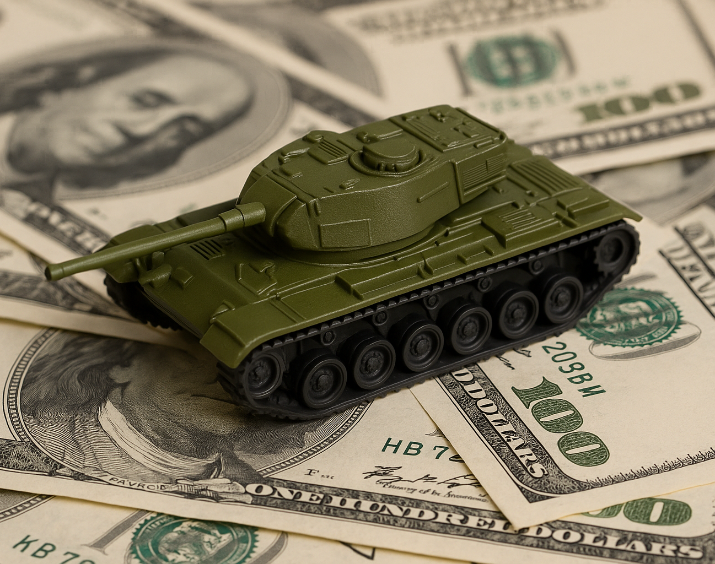
[INSERT FEATURED IMAGE OF WEBINAR SESSION]
How Big is the Military Pie?

Slide 2
Certificate Requirements
To earn professional development hours for webinars, you must:
Watch a minimum of 45-minutes and you will automatically receive a professional development certificate via e-mail within 24 to 48 hours.

Slide 3


Presenter(s)
Jeremy Miller (co- author, presenter)​
jmiller@c-ischools.org
Cynthia Fitzthum (co-author)
Cjfizthum@stcloudstate.edu

Slide 4


Session Agenda
Economics of War Series description
Lesson objectives/Standards/Concepts
Activity description
Q & A

Slide 5
Economics of War Lessons
Please join us for any of the following webinars......... or look for the webinars on demand and lessons on EconEdLink soon!
Date | Topic
2/6- Jeremy | The Copper Issue (A Supply and Demand Lesson)
2/20- Cindy | Why go to war? (A Lesson on Costs and Benefits)
3/6- Cindy | Exchange rates during periods of Conflict (Currency and exchange rates)
3/20- Cindy | What about trade during war? (Geography lesson with focus on re-allocation during periods of conflict)
4/3- Cindy | Oil and the Middle East (Lesson on Prices)
4/17- Jeremy | What would you do with $19,000 a month? (Human capital, risk/reward and personal finance lesson)
5/1- Jeremy | Specialization (Military vs. Contractor pay)
5/8- Jeremy | How big is the military pie? (A Lesson on Budgeting, Taxation and Opportunity Cost)
5/22- Cindy | The Draft Debate (Debate Model)
5/29- Jeremy | Reconstruction: Can it boost an economy? (Broken Window Fallacy)

Slide 6
Objectives
You will be able to:
Evaluate the level of military spending in the United States
Describe the arguments for both increasing and/or decreasing the size of the U.S. military
Explain the trade-offs and opportunity costs that the U.S. faces when determining the size of the military’s budget

Slide 7

National Standards
Scarcity 12-1: Choices made by individuals, firms, or government officials are constrained by the resources to which they have access.
Decision Making 12-2: To determine the optimal level of a public policy program, voters and government officials must compare the marginal benefits and marginal costs of providing a little more or a little less of the program’s services.
https://www.councilforeconed.org/policy-advocacy/k-12-standards/

Slide 8
[INSERT FEATURED IMAGE OF WEBINAR SESSION]
Lesson Activity

Slide 9
Introduction
In 2024, the U.S. spent $850 billion on national defense — more than the next 10 countries combined.
This amount represents:
  1/8 of total national spending
  About 50% of discretionary spending
Key Questions:
  Is this spending too much or too little?
  What are the trade-offs compared to other public priorities (e.g., education, infrastructure, healthcare)?
Trade-Offs:
  More military funding = less funding for domestic programs (schools, roads, Social Security, NASA, debt reduction).
  Balancing security with other national needs requires complex cost-benefit analysis.

Slide 10
Introduction
Wilsonian Idealism:
  Founded on collective international peacekeeping.
  Advocates for cooperation over dominance.
  Argues the U.S. doesn’t need outsized military spending if working with allies.
Realpolitik (Henry Kissinger):
  Focuses on power, practicality, and national self-interest.
  Justifies strong military spending to maintain U.S. dominance and global influence.

Slide 11
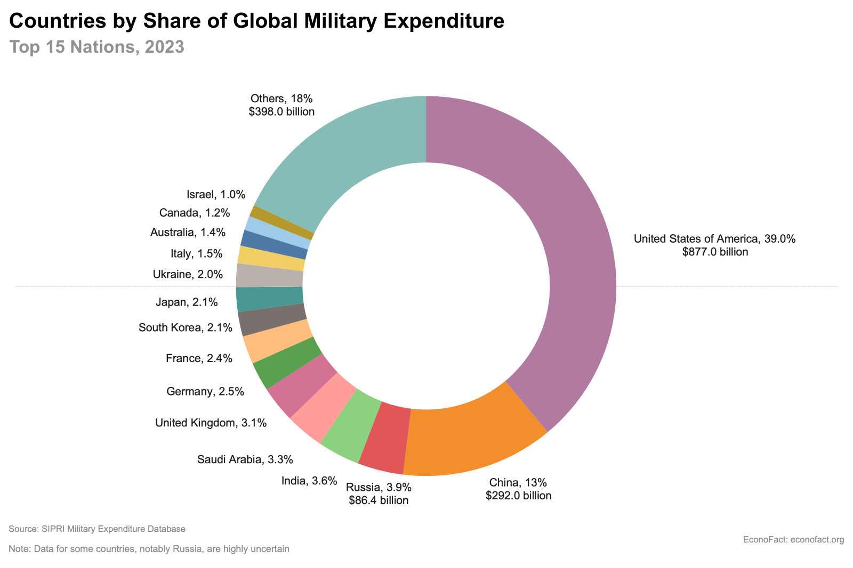
Military Spending

Slide 12
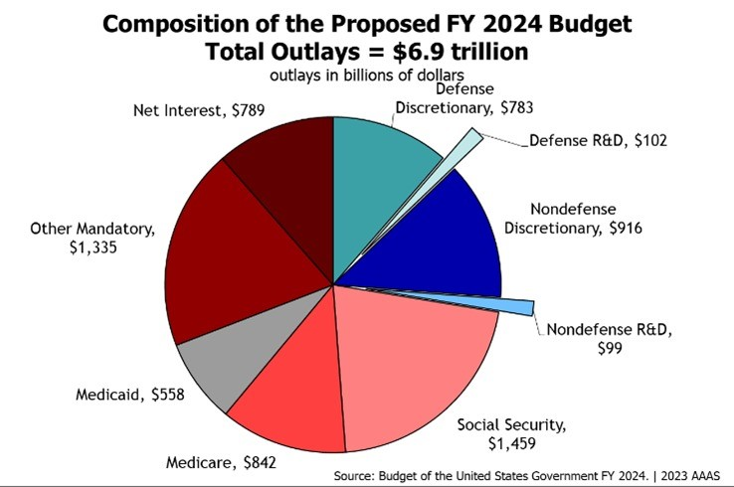
Military Spending

Slide 13
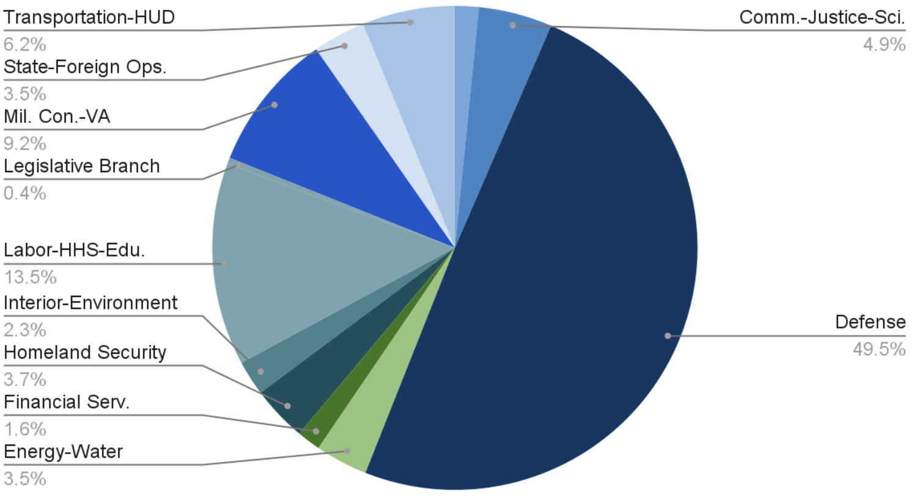
Military Spending

Slide 14
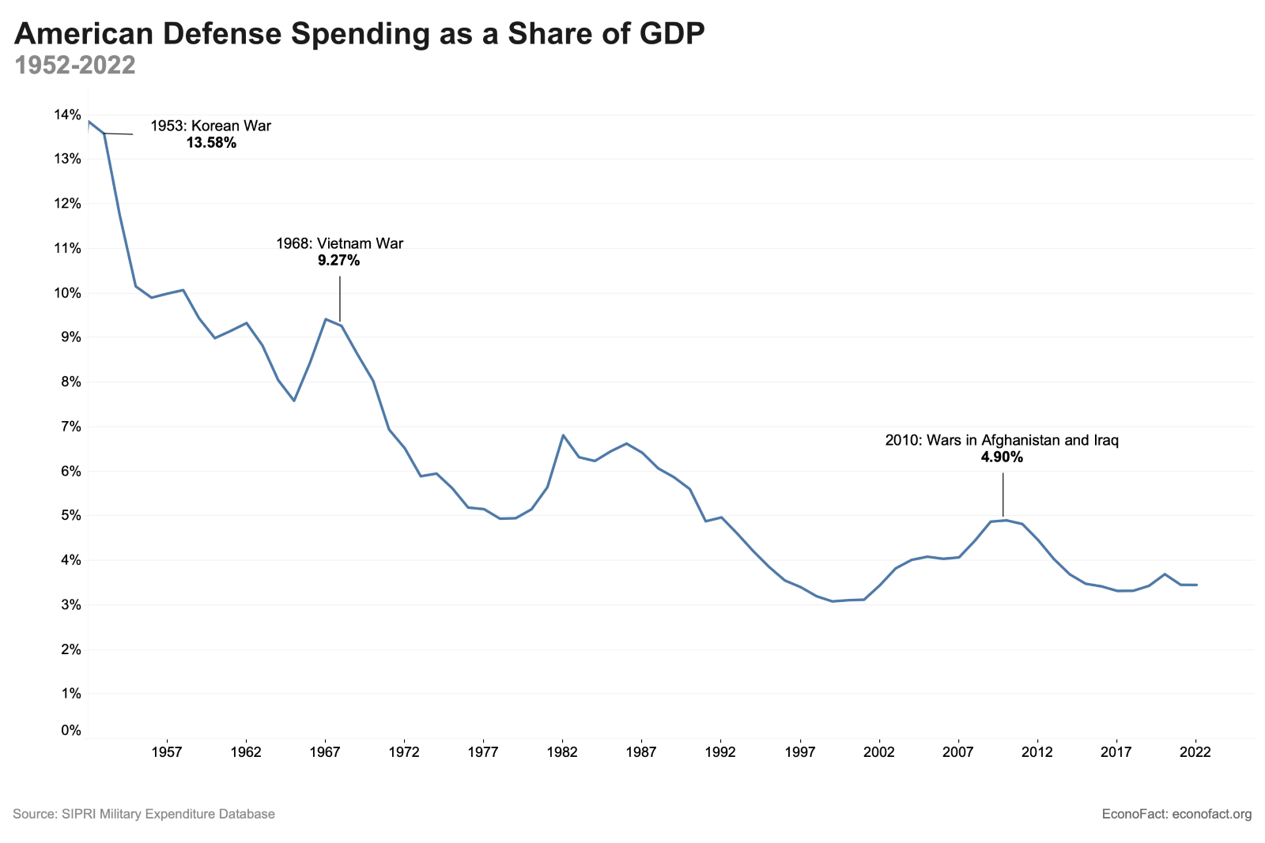
Military Spending

Slide 15
Debate
  The class will be randomly divided into two teams; one team will argue for a larger military, while the other side will argue for a smaller military.
  Each team will be broken up into three-four groups. Each group will be given a resource to help you develop your argument. Discuss the article within your group and create and outline of arguments that you can share with the team.
  The teams will come back together and each team will share their findings. Your team will then create a unified strategy and initial defense of your position.
  Debate Option 1: Each team will select one student to present the initial argument. Once both sides have presented, anyone can comment. You must raise your hand and wait to be called on by the teacher.
  Debate Option 2: Lincoln –Douglas Style team Debate

Slide 16
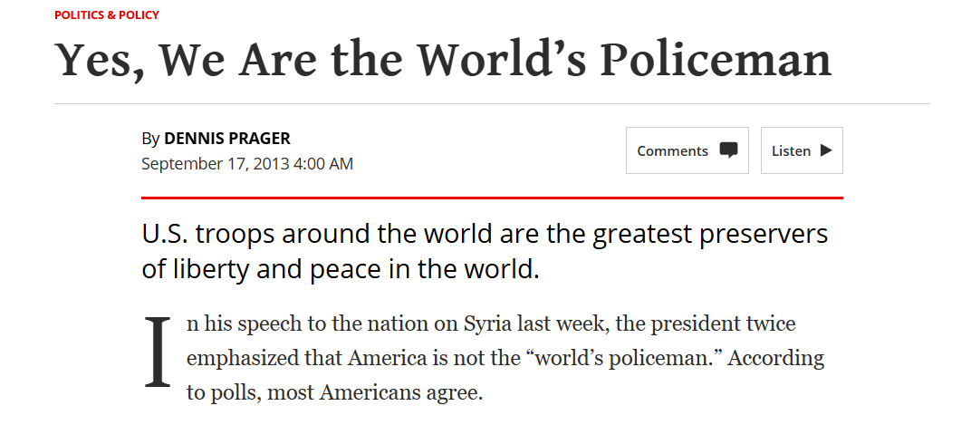
Supporting Argument – Larger Presence

Slide 17
Supporting Argument – Larger Presence
Argues that global stability depends on U.S. leadership—without it, chaos and tyranny fill the void.
Just as cities need police, the world needs a stabilizing force to prevent violent power struggles.
If not the U.S., alternatives like Russia, China, or Iran would dominate regions, and the UN is too weak to lead.
Historical lesson: U.S. presence in post-war nations like Japan and Germany brought peace; premature exits (e.g., Vietnam) led to disaster.
Withdrawing invites global disorder—the U.S. will likely be forced to return, but at a greater cost.

Slide 18
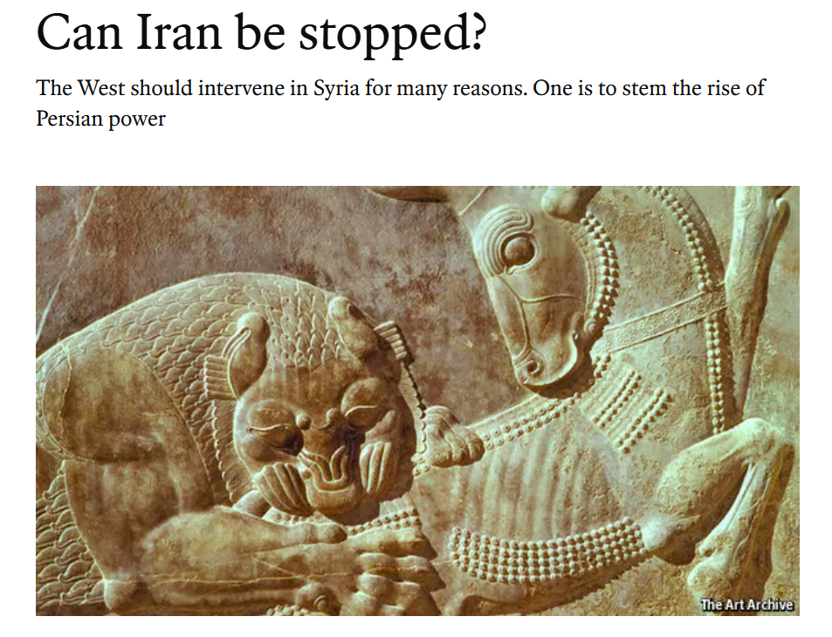
Supporting Argument – Larger Presence

Slide 19
Supporting Argument – Larger Presence
Despite internal economic hardship (30% inflation, shrinking exports, growing poverty), Iran is expanding its nuclear capability and regional influence.
Iran has installed over 9,000 new centrifuges, allowing it to potentially produce a nuclear weapon within months, if it chooses.
A friendly Iranian president may mislead the West into easing pressure too soon while Iran accelerates its nuclear program.
Iran’s influence is growing in the region:
  Strong ties to Iraq
  Control in Lebanon through Hezbollah
  Military involvement in Syria, supporting Bashar al-Assad

Slide 20
Supporting Argument – Larger Presence
The West's current negotiation strategy risks failure, as slow diplomacy may allow Iran to build a bomb before effective action is taken.
Urges the West to:
  Engage diplomatically but cautiously
  Demand strict inspections and tight nuclear controls
  Intervene in Syria with a no-fly zone to weaken Iran’s influence and support moderate rebels.
Hope for a better future with Iran, but prepare for worsening threats—this is no time to retreat from the Middle East.

Slide 21
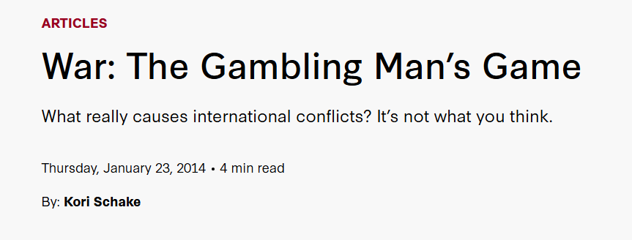
Supporting Argument – Larger Presence

Slide 22
Supporting Argument – Larger Presence
Core Argument:
Wars occur when nations misjudge their relative power; war is a result of conflicting perceptions, not necessarily deliberate aggression.
Diplomatic Failure:
War usually follows a diplomatic crisis where both sides overestimate their bargaining strength.
War as a Power Test:
War acts as the "ultimate test" of power, often followed by a more stable peace once the power hierarchy is clarified.

Slide 23
Supporting Argument – Larger Presence
Optimism Drives War:
Nations are more likely to go to war when confident about their strength or economic recovery. Overconfidence is a common trait among war initiators.
Realism Without the Label:
Blainey shares Realist tendencies but focuses on perceptions of power, not the pursuit of power as motivation.
Factors That Influence War Likelihood:
  Military strength and capability
  Expectations of third-party involvement
  Historical memory of war suffering
  Economic strength to sustain conflict

Slide 24
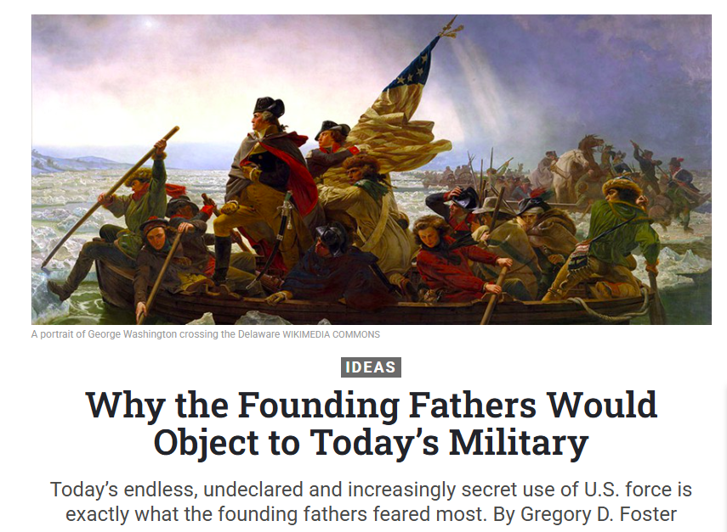
Supporting Argument – Smaller Presence

Slide 25
Supporting Argument – Smaller Presence
National security was one priority among many, not the dominant focus — the Preamble emphasizes a balanced pursuit of justice, liberty, and welfare alongside defense.
War was clearly defined, formally declared by Congress, and undertaken as a last resort, not hidden behind euphemisms or executive discretion.
Standing armies were feared for their potential to enable tyranny, drain resources, and provoke conflict — the militia and citizen-soldier model was preferred.
Today’s professional military is:
  Overpowered, globally deployed, and expensive
  Culturally distant from civilian society
  Enabled by secrecy, undeclared wars, and expanded executive power

Slide 26
Supporting Argument – Smaller Presence
Civilian oversight has weakened, with Congress marginalized and elected leaders often lacking military experience or strategic literacy.
Founders’ expectations — such as checks and balances, rule of law, and congressional war powers — are increasingly unmet in today’s security apparatus.
Modern concerns like drones, surveillance, and defense contracting raise ethical and constitutional questions the Founders might challenge.
Conclusion: The Founders’ commitment to reason, restraint, and representative oversight remains vital — and increasingly absent in national security matters today.

Slide 27
Supporting Argument – Smaller Presence
The Problem of Excessive Military Spending in the United States
William Nordhaus
Yale University
Prepared for American Economic Association
Session on “The Costs of War”

Slide 28
Supporting Argument – Smaller Presence
Massive Spending Scale
U.S. defense spending in 2005: $590 billion, or 4.8% of GDP.
Equals nearly $5,000 per family — more than all non-defense government consumption combined.
The U.S. accounts for about half of global military spending.
Are Threats Justifying This Spending?
The U.S. faces fewer immediate threats than other nations.
Some argue the U.S. supplies global security as a public good, but many allies see our military actions as harmful, not protective.

Slide 29
Supporting Argument – Smaller Presence
Strategic & Budget Inertia
Obsolete Cold War programs (e.g., missile submarines, nuclear stockpiles) persist despite irrelevance.
Real defense cuts are rare due to weak political pressure and entrenched military-industrial interests.
Lack of Oversight & Accountability
Loose budget constraints lead to poor tracking and secretive spending.
Example: a $24 billion line item passed without detail or scrutiny.
Congress and the public are often unaware of real costs, actions, and consequences (e.g., covert operations, NSA activities).

Slide 30
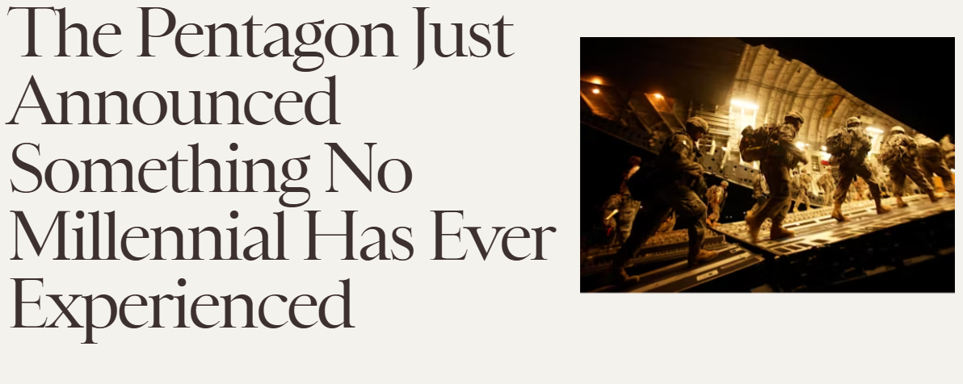
Supporting Argument – Smaller Presence

Slide 31
Supporting Argument – Smaller Presence
Proposed major cuts to troop levels, benefits, and legacy systems
Historically, the U.S. downsized after wars — until WWII and the Cold War created a permanent military state.
Millennials see no major threat like past generations; terrorism requires intelligence, not large armies.
Endless war has been justified by fear, not strategy — critics are often silenced politically.
Eisenhower warned the military-industrial complex would drain resources from education, health, and infrastructure.
His “Cross of Iron” speech: every weapon built is a cost to human needs.

Slide 32
Assessment
After examining the graphs showing U.S. military spending and considering the recent military and diplomatic conflicts, explain why you feel that the United States government should decrease, increase, or maintain its current levels of military spending.
After listening to both sides of the debate, have your views changed? How so? Why or why not?
What do you think is the proper role for the United States military?
Should the U.S. military budget but reduced, increase, or stay the same? Why?

Slide 33
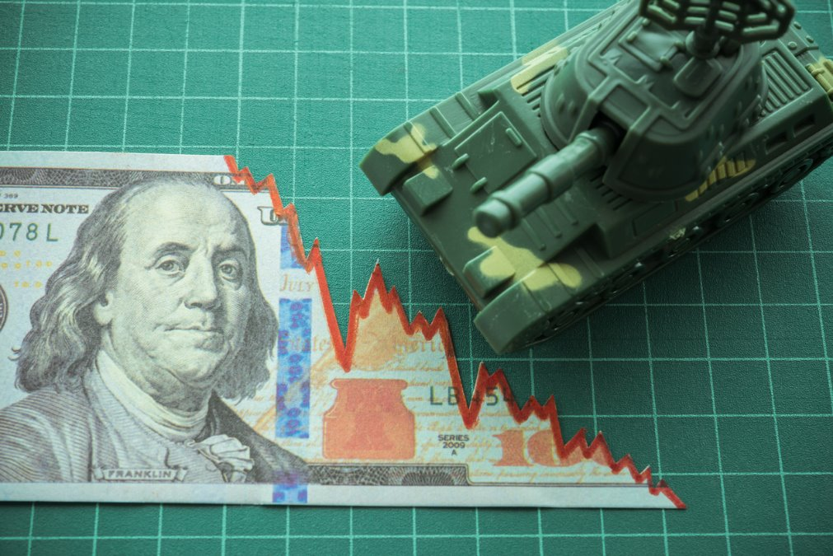
[INSERT FEATURED IMAGE OF WEBINAR SESSION]
Q&A

Slide 34
Contact Us
Jeremy Miller (co- author, presenter)​
jmiller@c-ischools.org
Cynthia Fitzthum (co-author)
Cjfizthum@stcloudstate.edu

Slide 35


Slide 36
[INSERT FEATURED IMAGE OF WEBINAR SESSION]
Thank you

