Slide 1
Pokenomics: Gotta TRADE ‘Em All
Pokemon Trainer: Alex Lamon
Lead Teacher of Business Education
NJCEE: Executive Director
Favorite Pokemon: Gengar
njeconomics.com
Notes:
Pokemon
About me - ash costume
Why pokemon? History of pokemon and current hype/culture & Origin of the idea/credit
Main trading activity - demo, student log examples
Supplemental add-ons/connections

Slide 2
What’s your name?
Introductions

Slide 3
Who am I?
Philosophy of this session.
Notes:
Some ppl say I look like Ash

Slide 4
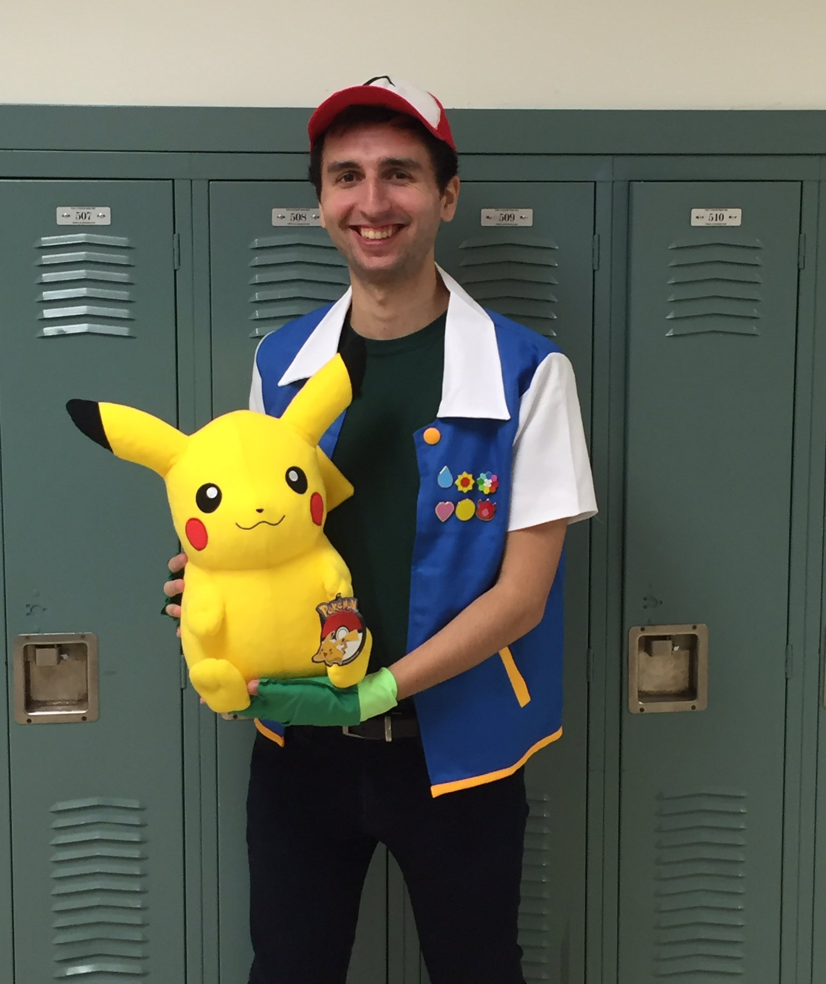
Who am I?

Slide 5
Who am I?

Slide 6
Philosophy of this session
Build your item box!
Notes:
This is a toolbox based session
To engage and connect to real world concepts through pokemon

Slide 7
BIOME MAP
Intros

Slide 8
BIOME MAP
Item Box

Slide 9
BIOME MAP
Pokemon History

Slide 10
BIOME MAP
Cultural hype

Slide 11
BIOME MAP
Trading Activity

Slide 12
BIOME MAP
More Resources!
Notes:
Ask questions at any time

Slide 13
Pokemon History 101

Slide 14
Pokemon History
1. Creation and Early Beginnings (1996)
Pokémon was created by Satoshi Tajiri and developed by Game Freak in 1996 in Japan.
2. Expansion into Other Media (Late 1990s)
The Pokémon anime premiered in 1997 in Japan, followed by a worldwide release in 1998. It introduced Pikachu as the mascot,solidifying the franchise’s identity.
Trading Card Game allowed players to collect and trade.
3. Cultural Phenomenon (2000s)
Pokémon was a household name across the globe, with over 100 million games sold, several seasons of the TV show, and trading cards dominating playgrounds.
4. Evolution of the Franchise (2010s)
The release of Pokémon GO re-ignited the global Pokémon craze. Augmented reality allowed players to catch Pokémon in real-life locations, connecting digital and physical worlds.

Slide 15
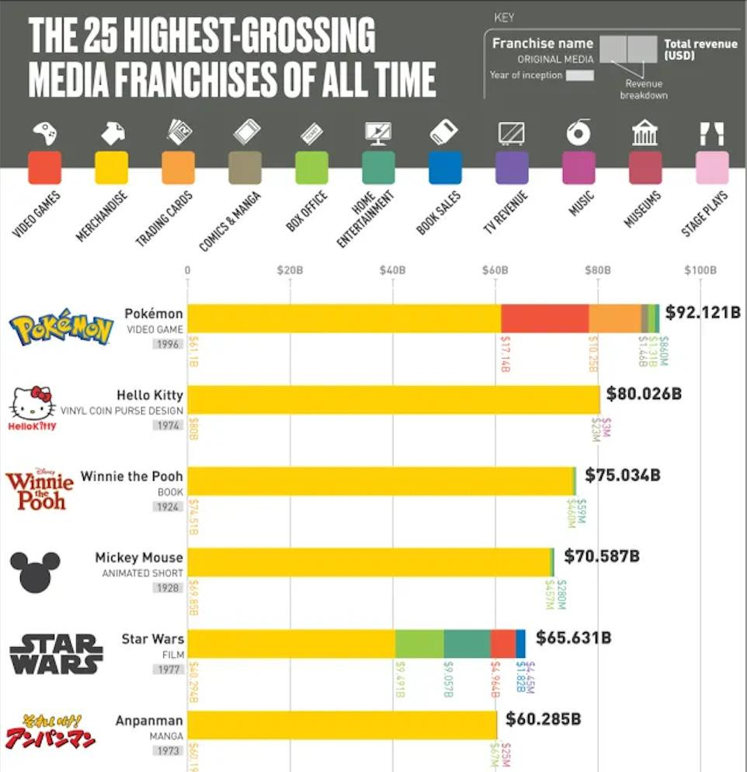
Current Day
5. Global Market Impact (Present Day)
Economic Powerhouse: Pokémon has become the highest-grossing media franchise in history, generating more than $100 billion in revenue from video games, merchandise, trading cards, movies, and more.

Slide 16
Why Pokemon?
It has staying power & economic connections!

Slide 17
Why Pokemon?
Notes:
Source

Slide 18
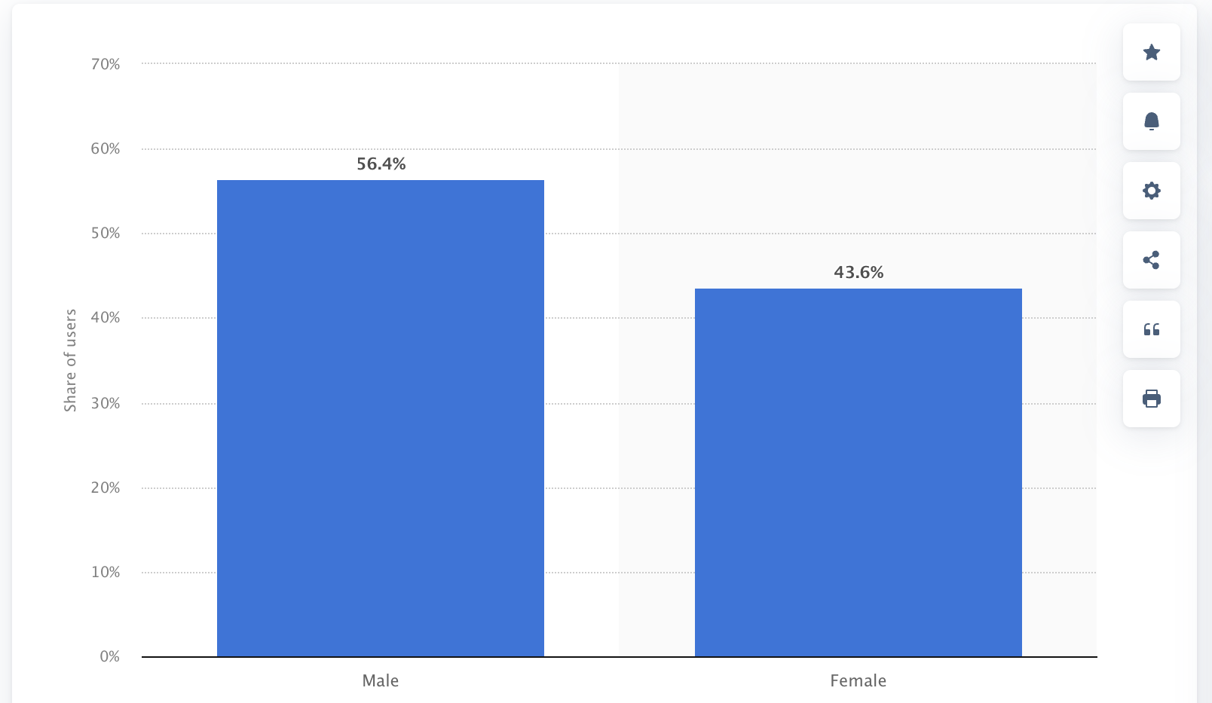
Why Pokemon?
Distribution of Pokémon GO users in the United States, by gender
Notes:
Source
Distribution of Pokémon GO users in the United States as of February 2019, by gender

Slide 19
Pokemon Trading Simulation

Slide 20
-International Trade-
Pokémon Card Activity
Notes:
The core idea behind the activity is to give students a fun and engaging way to practice trade with each other and make decisions. They are trading within a classroom market. Pokemon cards are a natural fit as they are already traded. Connection to elementary to high school concepts is easy with this activity.

Slide 21
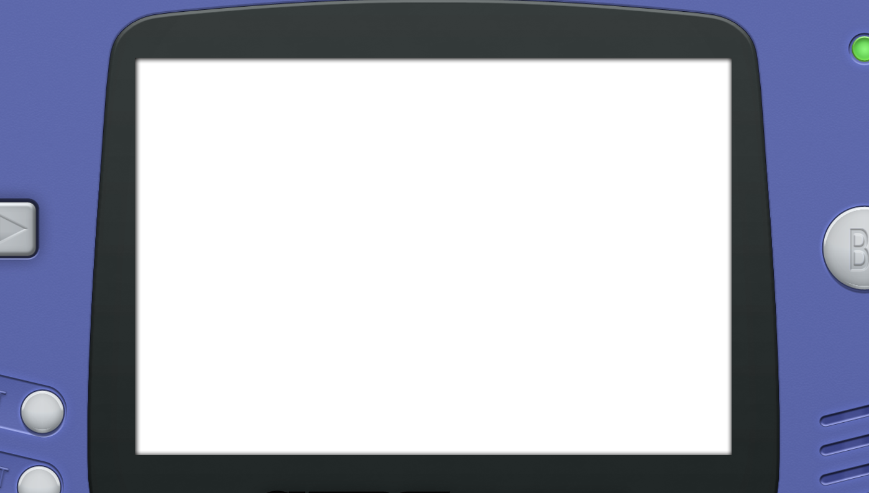
Welcome to the world of Pokémon! I’m professor Oak.

Slide 22
I would take more time on introductions, but it seems these marvelous creatures have been turning into cards lately...

Slide 23
Oh my! There goes Marill too! Don’t worry, I may have a way to turn them back, but I need your help!

Slide 24
I have a mission for all of you. Collect as many cards as you can, the stronger the card, the better!

Slide 25
With the cards you collect, I should have enough data to turn them back.
Whoever ends up with the most HP will be the true Pokémon master!

Slide 26
This is a Pokemon card.

Slide 27
The number at the top is the Pokemon’s HP. It is the only number you need to worry about.
Notes:
Students will learn that the person with the most combined HP of all their pokemon cards at the end of the simulation is the winner.

Slide 28
Next to the HP is the Pokemon’s type (color). This might come in handy!

Slide 29
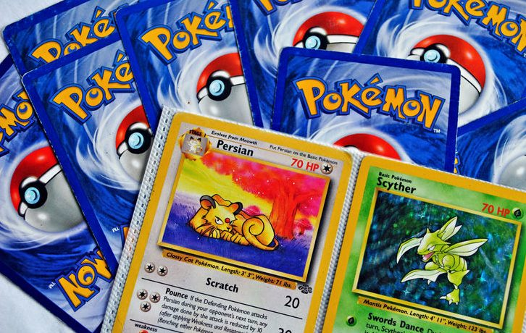
I have 4 cards to get you started, but to get more you will have to either trade with others or complete jobs throughout the Kanto region.

Slide 30
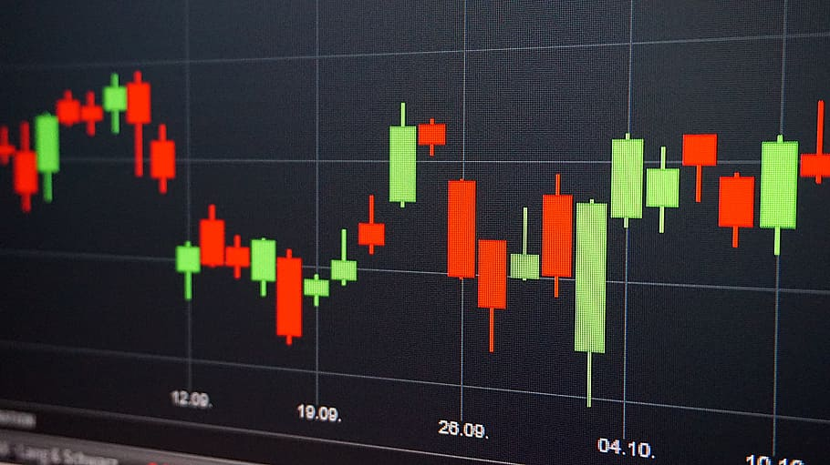
Be careful while trading. Everyday a Pokemon’s value may go up or down, as I discover what cards will be the most valuable to my research.

Slide 31
But don’t worry, everyday I will give you clues and prediction on what I think could happen to a card’s value.

Slide 32
I have sent my best assistant to guide you. I think you know them as your teacher. They will let you know how the rules will go with trading and doing jobs.
Best of luck!

Slide 33
Grass/Green:
Draw a picture of an animal.
Fire/Red:
Give me a snack I like
Electric/Yellow:
Guess the number I’m thinking of (1-5)
Water/Blue:
Beat me in Rock Paper scissors
Ghost/Purple:
Write someone a compliment
Ground/Brown:
Do 10 push-ups.
Normal/White:
Tell me something IDK about you
Only 1 job attempt per day
You cannot do the same color twice.

Slide 34
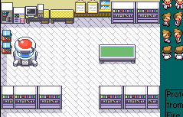
Day
Professor’s Journal:
All cards are valued by their HP, but I have a feeling things will change.
1
Professor’s Predictions:
Red and blue card’s value will change… but I’m not sure if they will go up or down.

Slide 35
Day
Professor’s Journal:
Red cards are worth double.
Blue cards are worth half.
2
Professor’s Predictions:
You might have to give some cards up tomorrow...but how many I’m not sure.
Do you have a bird Pokemon? If so, I have a great reward for you.

Slide 36
Day
Professor’s Journal:
I’m running low on cards. I’ll take one at random.
Birds seemed to be great for my research. If you have one, you get a random card from my deck.
Today only! High risk, high reward task!
3
Professor’s Predictions:
Blue or Red cards could return to their normal value…
Something bad could happen if you don’t have a blue card.
Notes:
The high risk high reward task is a challenging general econ/business question
Reward is: student gets to pick any color of their choice

Slide 37
Day
Professor’s Journal:
Blue cards are now back up to their normal amount.
If you don’t own a blue card, I will take 2 cards from you at random
4
Professor’s Predictions:
New research shows something interesting with 30HP & 40HP Pokemon.
A potion auction is happening today. They might be valuable to my research.

Slide 38
Day
Professor’s Journal:
Potions were successful in my research. To me, they are worth 150HP.
30HP & 40HP Pokemon are now worth triple. Wonderful!
5
Professor’s Predictions:
Research is nearly complete, but I found the most incredible discovery!If the Pokemon’s color matches their trainers eye color, that Pokemon shows a greater bond!
Notes:
5 Pokemon are much too strong, I can’t control them.These Pokemon all have 100 or more HP but will be worth nothing to me.
New research shows something interesting with 30HP Pokemon.

Slide 39
Day
Professor’s Journal:
For ALL cards you have that match the color of your eyes, that card is worth double!
6
Professor’s Predictions:
Thanks to all of you and the cards you have earned, I have completed my research! My assistant will be double checking your cards to see who earned the most HP.
For one last chance at a bonus point on this FRQ, write down Mr. Lamon’s favorite Pokemon of all time.

Slide 40
Thanks to all of you and the cards you have earned, I have completed my research! My assistant will be double checking your cards to see who earned the most HP.
Regardless of the result, it was the combined motivation of all of you that helped me turn these Pokemon back! Just wonderful!

Slide 41
What you’ll need
Cards
Example
Log
Time
FRQ

Slide 42
Related Concepts: What trade/international business terms do you teach?
Notes:
And how do you see your ability to use this activity to relate to those ideas?

Slide 43
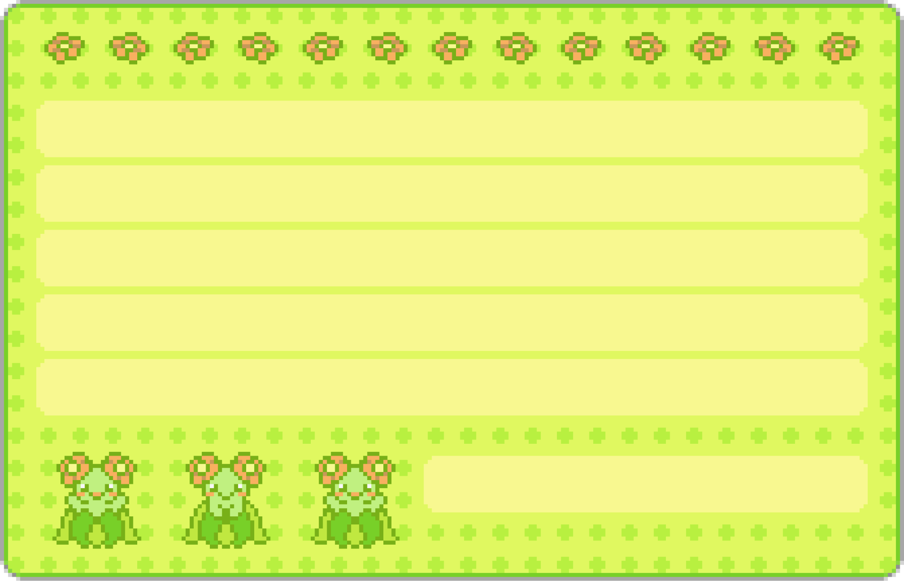
Types of Resources
Risk
Mantis
What types of resources are needed to produce Pokemon cards?
Classify: Land, Labor, Capital, Entrepreneurship
Lion
Elephant
Trade
Rhino
Bison

Slide 44
PPC & Trade
How would the production of Pokemon Cards and Pokemon plushies change if…
A new factory opened in Japan?
Printing machines broke down across Europe
AI art gained popularity for Pkmn cards
Plushie demand increased
Workers across Japan go on strike
Racoon
Cougar
Worm
Owl
Acorn
Bear
Ladybird
Grey wolf
Squirrel

Slide 45
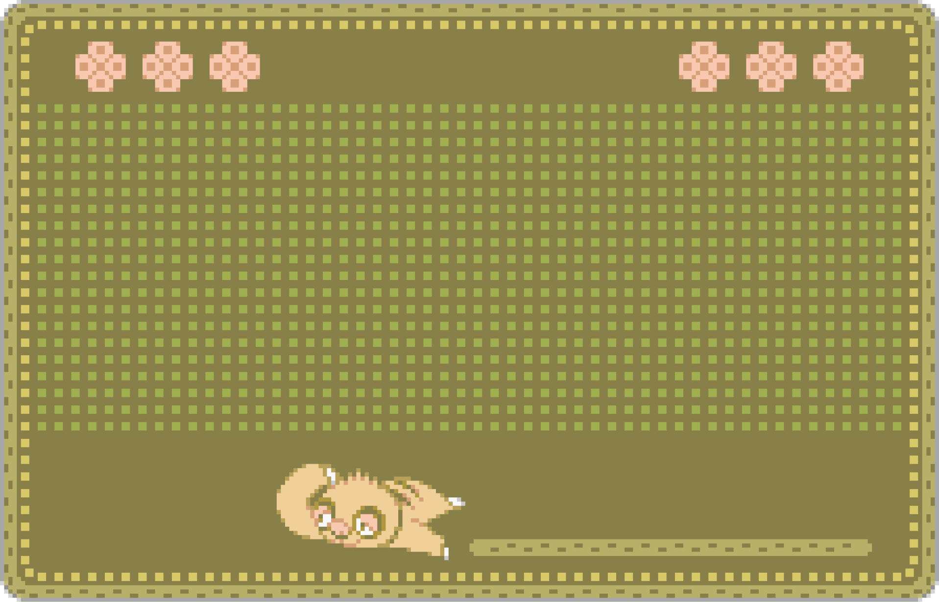
Comparative Advt.
Beetle
Where are Pokemon cards produced?
Specialization: Which jobs are you best at?
Notes:
1. Quality Control
Pokémon cards are highly collectible, and maintaining consistent, high-quality production is critical for both collectors and players. Producing the cards in regions with stringent quality control standards, like the United States, EU, and Japan, helps ensure consistent print quality, durability, and authenticity. While China could offer lower costs, there may be concerns about maintaining the same level of quality control.
2. Intellectual Property Protection
Pokémon cards represent a highly valuable intellectual property (IP). Manufacturing in countries with stricter IP laws, like the U.S., EU, or Japan, offers better protection against counterfeiting and IP theft. While China is improving in IP protection, concerns about counterfeits and leaks may make it riskier for companies with highly sensitive IP like Pokémon.
3. Brand Reputation and Trust
The Pokémon brand is synonymous with quality and consistency. Producing in regions with a strong reputation for reliable manufacturing may reinforce consumer trust. Any issues with production, especially related to quality, could harm the brand's image and consumer confidence.
4. Regulatory Compliance
The Pokémon Company has to adhere to various safety and environmental regulations, especially for products marketed to children. The regulatory environment in the U.S., EU, and Japan may be seen as more predictable and better aligned with the company’s standards for product safety and environmental compliance.
5. Proximity to Key Markets
By producing cards in the U.S., EU, and Japan, The Pokémon Company ensures that products are closer to their key consumer markets, reducing shipping times and logistical complexities. Manufacturing in these regions also helps meet the demand for local language products (English, French, German, etc.) and allows faster response to market fluctuations.
6. Localized Production for Specific Markets
Portuguese cards are produced in Brazil to cater specifically to the Brazilian market, where local production can offer advantages like reduced tariffs, faster distribution, and alignment with local demand. This strategy may also apply to other regions with localized production considerations.
7. Reputation of China in Collectible Market
The collectible market is particularly sensitive to the "Made in China" label, often due to concerns about fakes or lower quality. Since Pokémon cards are part of a premium collectible market, consumers may prefer cards produced in countries with a higher perceived standard of production.
Source

Slide 46
BOP
BOP (Balance of Payments)
Use Pokemon transactions to practice balancing and identifying current vs. financial accounts!
Tadple
Alligator
Catfish
Duck
Frog

Slide 47
BOP
In the fiscal year ending March 2024, The Pokémon Company generated nearly $1 billion in revenue from mobile games like Pokémon Go and sold over 11.9 billion trading cards worldwide. These transactions involve foreign countries purchasing goods and services from Japan.
Question: How would these international sales impact Japan’s balance of payments? Explain whether these transactions would be considered a credit or a debit and why.
Tadple
Alligator
Catfish
Duck
Frog

Slide 48
BOP
These international sales would result in a credit to Japan's current account.
The revenue from mobile games like Pokémon Go and the sales of trading cards represent exports of goods and services from Japan to other countries.
Since foreign buyers are paying Japan for these exports, the transactions create an inflow of foreign currency into Japan.
Sales are recorded as positive entries (credits) in Japan’s current account because they increase the country's foreign reserves.
Tadple
Alligator
Catfish
Duck
Frog

Slide 49
More BOP Examples
1. Trading Cards:
Current Account (Trade in Goods):
Export of Goods: Japan exports Pokémon cards to the U.S. worth $10 million.
Answer: This is a debit (-) to the current account because the U.S. is losing (paying) money for the import.
2. Video Games:
Current Account (Trade in Services):
Export of Services: A U.S.-based game developer sells Pokémon video game software to consumers in Europe, generating $15 million in revenue.
Answer: This is a credit (+) to the current account.
3. Royalty Payments:
Current Account (Income):
Income Receipts: The Pokémon Company (based in Japan) receives $7 million in royalties from U.S. companies that use the Pokémon brand on merchandise.
Answer: This is a debit (-) to the U.S. current account.
4. Pokémon Movie:
Financial Account:
Direct Investment (U.S. to Japan): A U.S. entertainment company invests $20 million in the production of a Pokémon movie in Japan.
Answer: This is a debit (-) in the U.S. financial account because it represents an outflow of investment.
Portfolio Investment (Japan to U.S.): A Japanese company buys $10 million worth of shares in a U.S. media company that holds Pokémon distribution rights. This is a credit (+) to the U.S. financial account because it represents a foreign investment in U.S. assets.
Surplus and Deficit Impacts
If the U.S. exports more Pokémon cards and games than it imports (more credits than debits in the current account), the U.S. would have a current account surplus.
If the U.S. invests heavily in Pokémon-related projects abroad (financial outflows > inflows), it would result in a financial account deficit.

Slide 50
Exchange Rate
This pack of cards goes for ¥180 Yen. How much in USD?
Would you feel poor or rich when buying cards in Japan, as a U.S. consumer?
What would a Japanese tourist feel here?
Shark
Octopus
Anglerfish

Slide 51
More Ex. Rate Examples
If the value of the U.S. dollar strengthens compared to the Japanese yen, how would this affect the price of importing Pokémon cards from Japan to the U.S. for American consumers?
Answer: If the dollar strengthens, it would cost fewer dollars to import Pokémon cards from Japan, making the cards cheaper for U.S. buyers. This increases demand for imported Pokémon merchandise in the U.S.
Suppose a U.S. game developer sells a Pokémon video game in Europe. If the euro weakens against the dollar, how might this impact the developer’s sales in Europe?
Answer: If the euro weakens, European consumers would find it more expensive to buy U.S. products like Pokémon games because they would need more euros to purchase goods priced in dollars. This decreases demand for the game in Europe.
A Pokémon tournament in Japan offers a prize of 1 million yen. If the yen weakens against the dollar, how would this affect the value of the prize for a U.S. participant?
Answer: If the yen weakens, the prize would be worth fewer U.S. dollars when exchanged. For example, if the exchange rate goes from 100 yen per dollar to 150 yen per dollar, the prize would drop in value when converted to dollars.
How would fluctuations in the exchange rate between the Japanese yen and the British pound affect a Japanese company exporting Pokémon merchandise to the U.K.?
Answer: If the yen weakens relative to the pound, the Japanese company would receive more yen for the same amount of pounds earned from U.K. sales, potentially increasing profit margins. However, if the yen strengthens, the company would receive fewer yen, reducing profits.
If a U.S. tourist visits a Pokémon Center in Japan and the Japanese yen depreciates against the U.S. dollar, how would this affect their purchasing power in Japan?
Answer: The U.S. tourist would have greater purchasing power in Japan because they would need fewer dollars to buy the same amount of yen. This means they can buy more Pokémon merchandise for less money than before.

Slide 52
Trade resources
Atlas of Economic Complexity
Art of the Swap
Ship Map
Making Happy Meals
Penguin
Sealion
Seal
Walrus

Slide 53
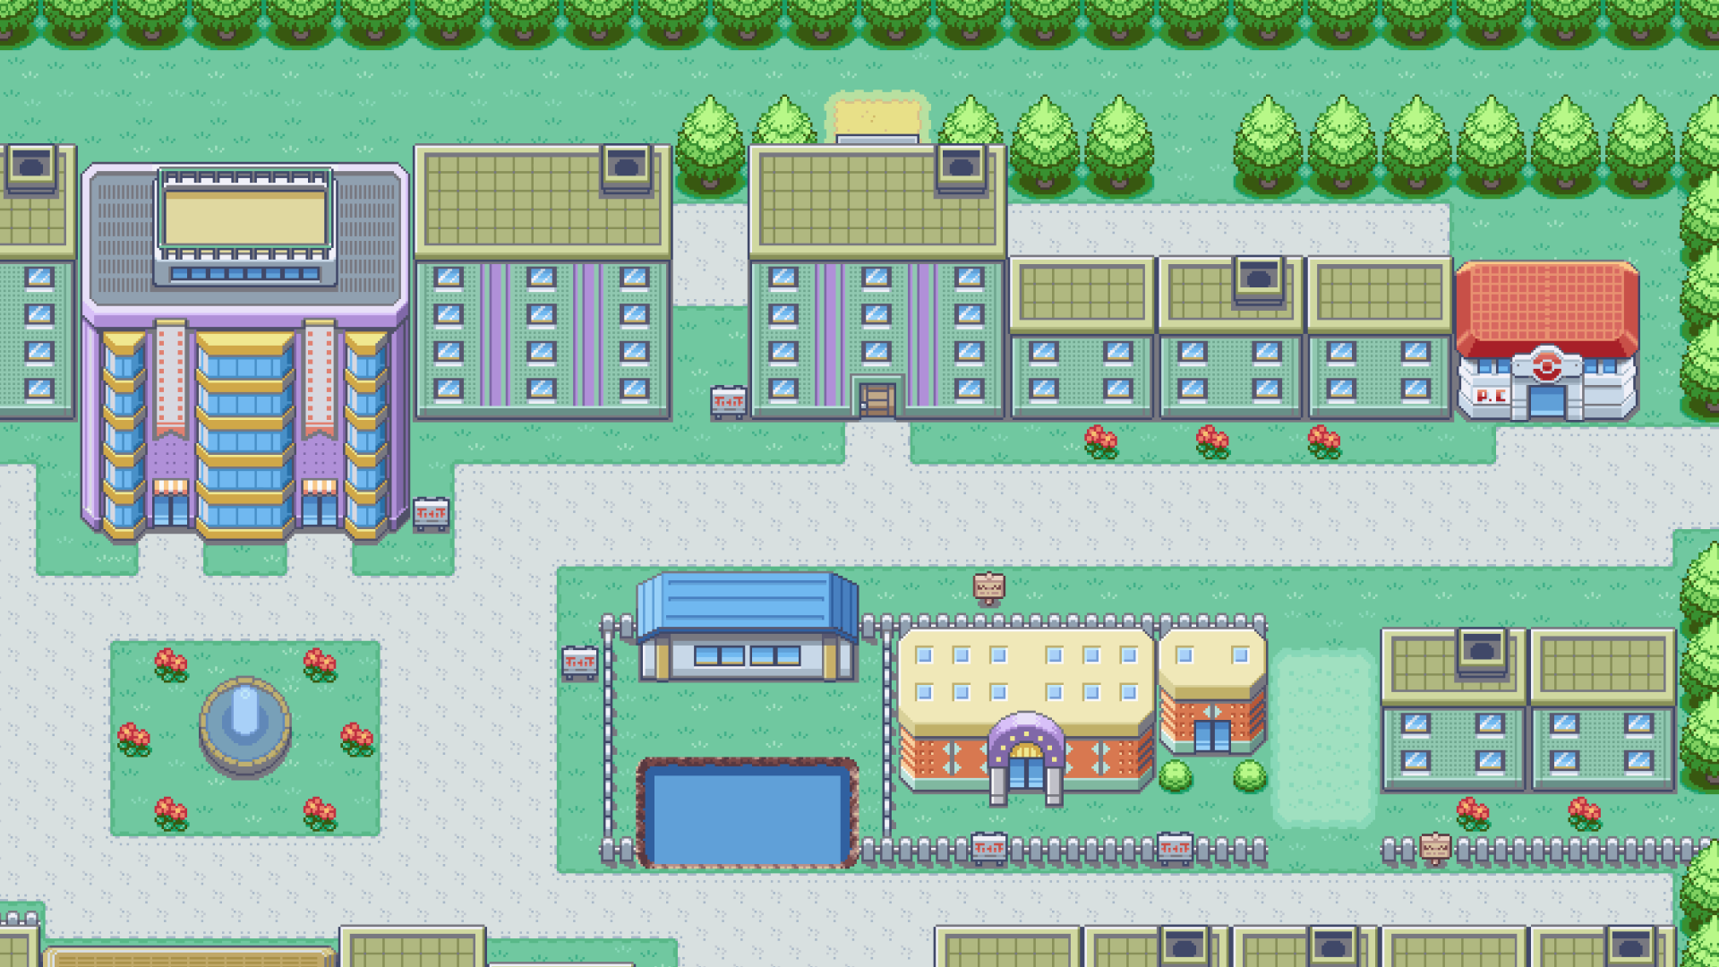
Economics is ALL AROUND US!

Slide 54
It’s super effective!
Student
3
Teacher
6
50/50
LinkedIn
NJ CEE
alex@njeconomics.com

