Slide 1



[INSERT FEATURED IMAGE OF WEBINAR SESSION]
Is War Good for the Economy?

Slide 2
Certificate Requirements
To earn professional development hours for webinars, you must:
Watch a minimum of 45-minutes and you will automatically receive a professional development certificate via e-mail within 24 to 48 hours.

Slide 3


Session Agenda
Economics of War Series description
Lesson objectives/Standards/Concepts
Activity description
Q & A

Slide 4
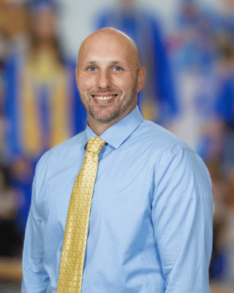

Presenter(s)
Jeremy Miller (co- author, presenter)​
jmiller@c-ischools.org
Cynthia Fitzthum (co-author)
Cjfizthum@stcloudstate.edu

Slide 5
Economics of War Lessons
Please join us for any of the following webinars......... or look for the webinars on demand and lessons on EconEdLink soon!
Date | Topic
2/6- Jeremy | The Copper Issue (A Supply and Demand Lesson)
2/20- Cindy | Why go to war? (A Lesson on Costs and Benefits)
3/6- Cindy | Exchange rates during periods of Conflict (Currency and exchange rates)
3/20- Cindy | What about trade during war? (Geography lesson with focus on re-allocation during periods of conflict)
4/3- Cindy | Oil and the Middle East (Lesson on Prices)
4/17- Jeremy | What would you do with $19,000 a month? (Human capital, risk/reward and personal finance lesson)
5/1- Jeremy | Specialization (Military vs. Contractor pay)
5/8- Jeremy | How big is the military pie? (A Lesson on Budgeting, Taxation and Opportunity Cost)
5/22- Cindy | The Draft Debate (Debate Model)
5/29- Jeremy | Reconstruction: Can it boost an economy? (Broken Window Fallacy)

Slide 6
Objectives
You will be able to:
Describe how military spending affects a nations’ GDP
Identify the opportunity costs associated with military spending

Slide 7

National Standards
Economic Fluctuations 8-1:1. GDP is a basic measure of a nation’s economic output and income. It is the total market value, measured in dollars, of all final goods and services produced in the economy in one year.
Allocation 3-12: 1. Comparing the benefits and costs of different allocation methods in order to choose the method that is most appropriate for some specific problem can result in more effective allocations and a more effective overall allocation system.
https://www.councilforeconed.org/policy-advocacy/k-12-standards/

Slide 8
[INSERT FEATURED IMAGE OF WEBINAR SESSION]
Lesson Activity

Slide 9
Gross Domestic Product
GDP - The total value of all final goods produced and services provided in a country during one year.
GDP = C + I + G + Nx
  Consumer spending
  Investment spending
  Government Spending
  Net Exports

Slide 10
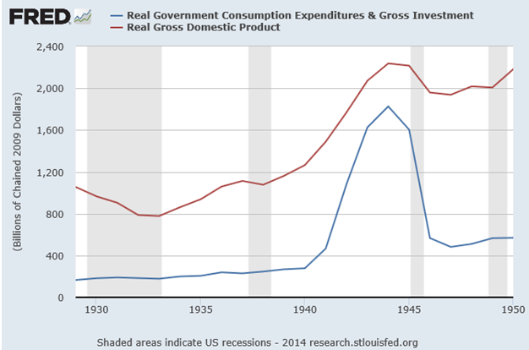
WWII GDP

Slide 11
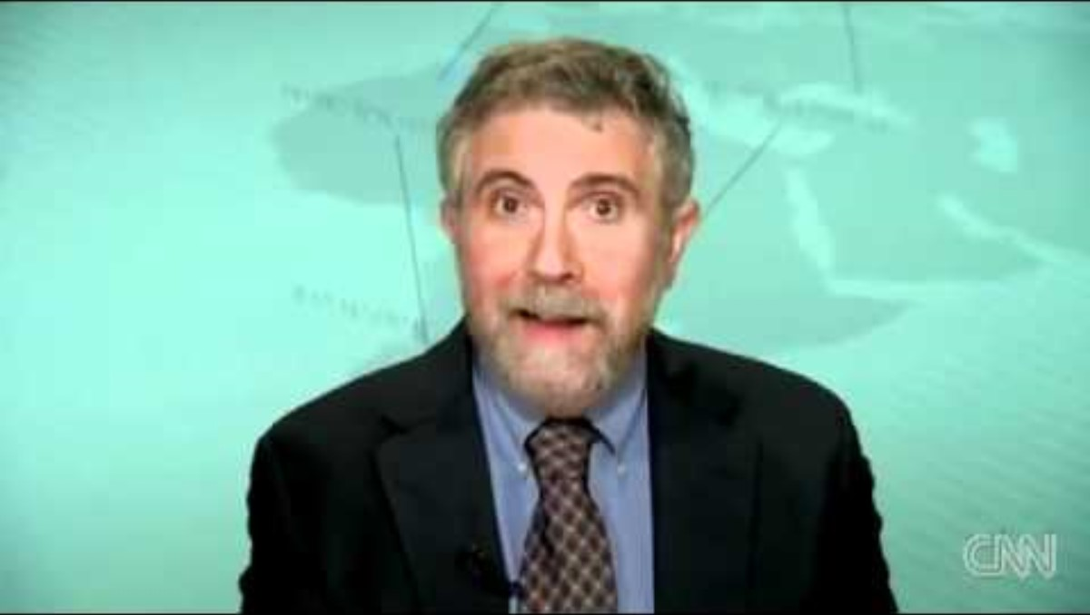
Space Aliens
https://www.youtube.com/watch?v=jaED2ErdIv8&t=85s​

Slide 12

Hard Times

Slide 13
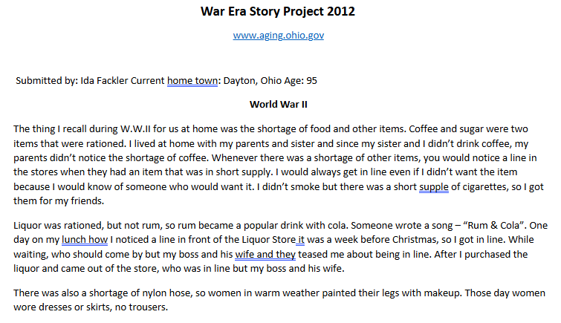
Personal Accounts

Slide 14
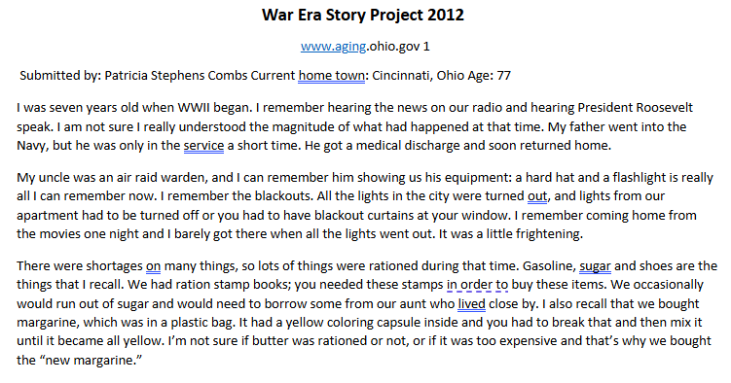
Personal Accounts

Slide 15


Rationing

Slide 16


Rationing

Slide 17
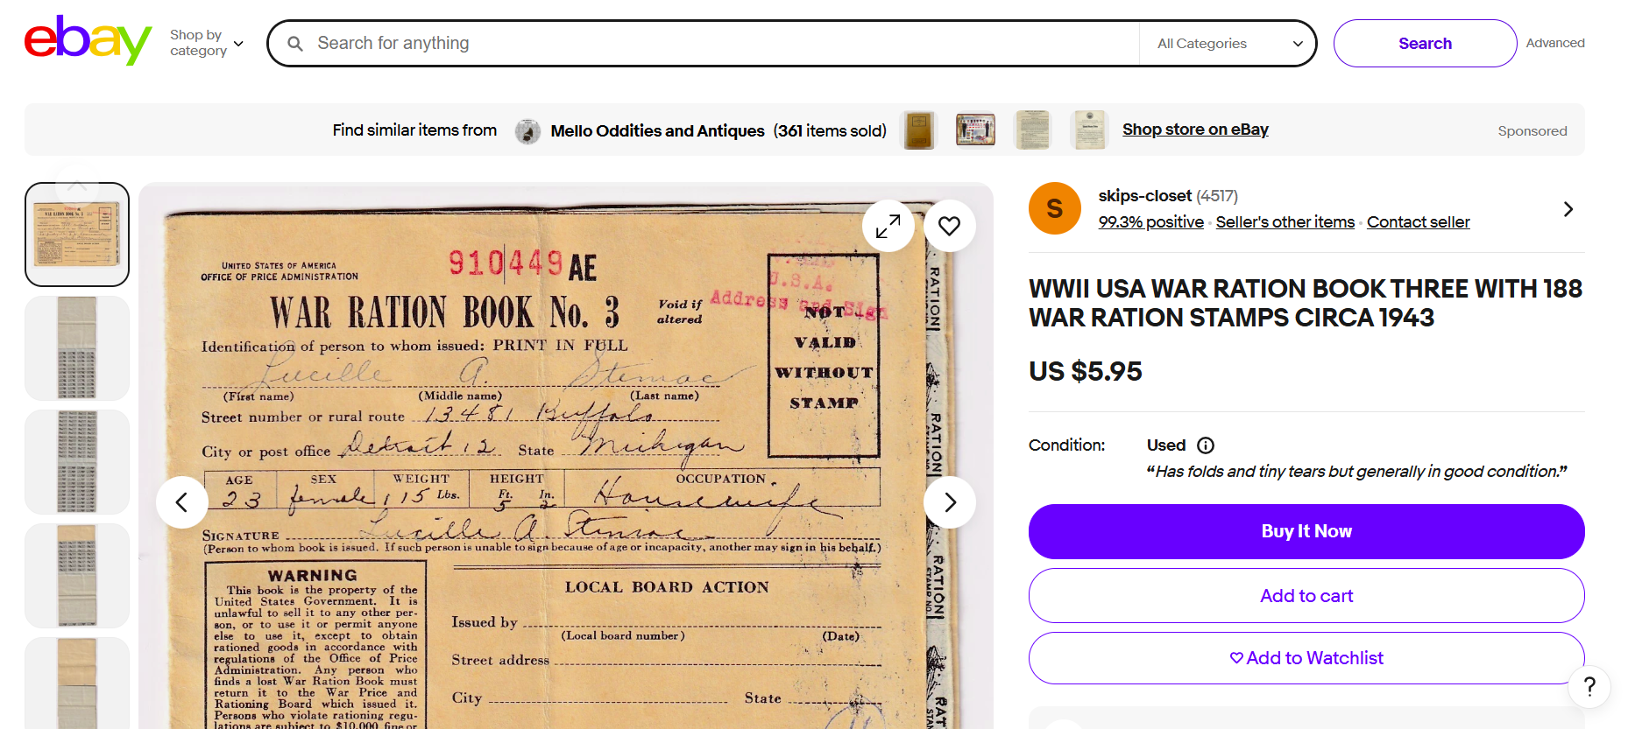
Rationing

Slide 18
Frederic Bastiat
"There is only one difference between a bad economist and a good one: the bad economist confines himself to the visible effect; the good economist takes into account both the effect that can be seen and those effects that must be foreseen."
Broken Windows Fallacy - What is Seen and What is Not Seen

Slide 19

Activity
Divide class into groups of 4
  Students in each group are assigned a job
    Lumberjack
    Construction Worker
    Building Owner
    "War"
  Materials
    Construction paper
    Popsicle Sticks
    Foam
    Marshmallows
    Play money

Slide 20
Activity
Create a forest (natural resources)
Building Owner pays the construction worked to build a structure
  Construction worker pays the lumberjack to provide lumber
  "War" breaks out and destroys the building
    It must be rebuilt
Who was made better off? Why?
Who was made worse off? Why?
Is the economy better off due to the war? Why or why not?

Slide 21
Assessment
What does Bastiat mean by “What is Seen and What is not Seen?”
What is “seen” and “unseen” in The Broken Window?
Was it good that the window was broken? Why or why not?
How can this lesson be applied to warfare? What is the “seen” and the “unseen” in war?

Slide 22
Contact Us
Jeremy Miller (co- author, presenter)​
jmiller@c-ischools.org
Cynthia Fitzthum (co-author)
Cjfizthum@stcloudstate.edu

Slide 23


Slide 24
[INSERT FEATURED IMAGE OF WEBINAR SESSION]
Thank you

