Slide 1



From Soldier to Contractor: Pay Gaps Explained
[INSERT FEATURED IMAGE OF WEBINAR SESSION]

Slide 2
Certificate Requirements
To earn professional development hours for webinars, you must:
Watch a minimum of 45-minutes and you will automatically receive a professional development certificate via e-mail within 24 to 48 hours.

Slide 3
Objectives
You will be able to:
Describe the trade-offs of investing in human capital
Explain why some jobs bring higher wages than others

Slide 4
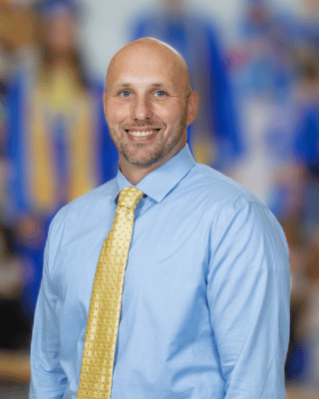

Presenter(s)
Jeremy Miller (co- author, presenter)​
jmiller@c-ischools.org
Cynthia Fitzthum (co-author)
Cjfizthum@stcloudstate.edu

Slide 5


Session Agenda
Economics of War Series description
Lesson objectives/Standards/Concepts
Activity description
Q & A

Slide 6
Economics of War Lessons
Please join us for any of the following webinars......... or look for the webinars on demand and lessons on EconEdLink soon!
Date | Topic
2/6- Jeremy | The Copper Issue (A Supply and Demand Lesson)
2/20- Cindy | Why go to war? (A Lesson on Costs and Benefits)
3/6- Cindy | Exchange rates during periods of Conflict (Currency and exchange rates)
3/20- Cindy | What about trade during war? (Geography lesson with focus on re-allocation during periods of conflict)
4/3- Cindy | Oil and the Middle East (Lesson on Prices)
4/17- Jeremy | What would you do with $19,000 a month? (Human capital, risk/reward and personal finance lesson)
5/1- Jeremy | Specialization (Military vs. Contractor pay)
5/8- Jeremy | How big is the military pie? (A Lesson on Budgeting, Taxation and Opportunity Cost)
5/22- Cindy | The Draft Debate (Debate Model)
5/29- Jeremy | Reconstruction: Can it boost an economy? (Broken Window Fallacy)

Slide 7

Objectives & Standards

Slide 8

National Standards
Standard 13: Income for most people is determined by the market value of the productive resources they sell. What workers earn depends, primarily, on the market value of what they produce and how productive they are.
Standard 2: Effective decision making requires comparing the additional costs of alternatives with the additional benefits. Most choices involve doing a little more or a little less of something; few choices are all-or-nothing decisions.
https://www.councilforeconed.org/policy-advocacy/k-12-standards/

Slide 9
Concepts
Wages are a price, determined similarly to any other good or service
  Supply and demand
Skills (human capital) allows workers to earn higher pay
  More training typically requires a greater opportunity cost
  The greater the opportunity cost, the higher the wages
    Typically reduces the quantity supplied of labor
      If it was easy, everyone would do it
    As long as demand is sufficient, wages increase
Opportunity costs
  Time
  Money
  Comfort

Slide 10
Lesson Activity
[INSERT FEATURED IMAGE OF WEBINAR SESSION]

Slide 11


Contractors in Iraq & Afghanistan
US Government used private contracting companies to provide support and logistics for the war efforts
Trucking
Police/security trainers
Food & laundry services
Security Services
  Static security (base, gate guards)
  Personal protection (State Department, DOD, CIA)

Slide 12
Discussion
Who would like to have a high paying career?
What kinds of jobs have high pay?
Why are these high paying occupations?
What opportunity costs do you think you would face when working towards a high paying job?
How important is the training prior to entering these fields? Why?

Slide 13

Salaries
Security Contractors
$350-1000/day in-country
Typically, a 90/30 rotation – 90 days in-country, 30 days of leave
  ~$95,000 – 270,000/year
Enlisted Military (E-5) - $24,000/year (in 2005)

Slide 14

"Hell Week"

Slide 15
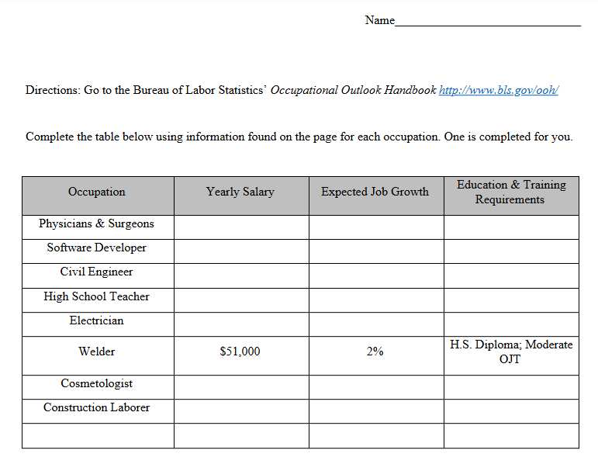
Career Exploration
Students will use the Bureau of Labor Statistics website to research median salaries and job outlooks for selected careers
  They will also research a field of their choosing
They will then look at the academic requirements for jobs that require post-secondary education

Slide 16


Career Exploration

Slide 17

Education Exploration

Slide 18
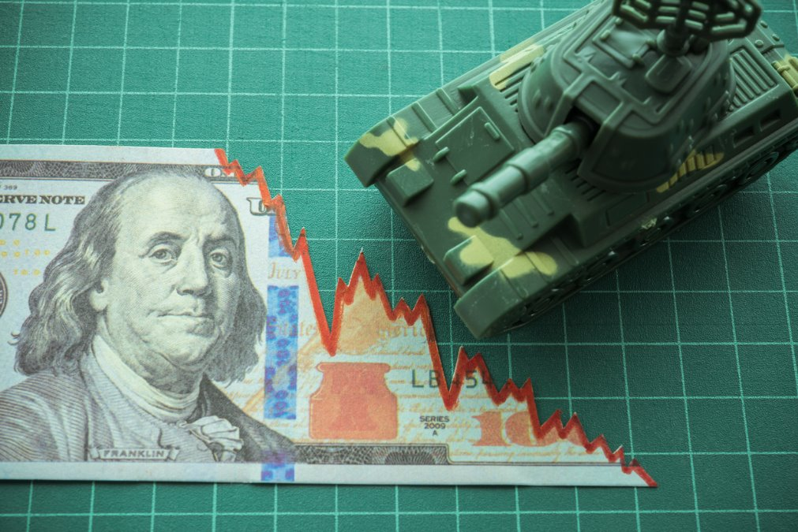
[INSERT FEATURED IMAGE OF WEBINAR SESSION]
Q&A

Slide 19
Contact Us
Jeremy Miller (co- author, presenter)​
jmiller@c-ischools.org
Cynthia Fitzthum (co-author)
Cjfizthum@stcloudstate.edu

Slide 20


Slide 21
Thank You
[INSERT FEATURED IMAGE OF WEBINAR SESSION]

