Slide 1



The Draft Debate

Slide 2
Certificate Requirements
To earn professional development hours for webinars, you must:
Watch a minimum of 45-minutes and you will automatically receive a professional development certificate via e-mail within 24 to 48 hours.

Slide 3
Objectives
You will be able to:
Analyze the effects of fiscal policy on a nation’s productivity
Examine the costs and benefits of a military draft

Slide 4




Presenter(s)
Cynthia Fitzthum
Cjfitzthum@stcloudstate.edu
Jeremy Miller (co- author)
Jmiller@c-ischools.org

Slide 5
Economics of War Lessons
Please join us for any of the following webinars......... or look for the webinars on demand and lessons on EconEdLink soon!
Date | Topic
2/6- Jeremy | The Copper Issue (A Supply and Demand Lesson)
2/20- Cindy | Why go to war? (A Lesson on Costs and Benefits)
3/6- Cindy | Exchange rates during periods of Conflict (Currency and exchange rates)
3/20- Cindy | What about trade during war? (Geography lesson with focus on re-allocation during periods of conflict)
4/3- Cindy | Oil and the Middle East (Lesson on Prices)
4/17- Jeremy | What would you do with $19,000 a month? (Human capital, risk/reward and personal finance lesson)
5/1- Jeremy | Specialization (Military vs. Contractor pay)
5/8- Jeremy | How big is the military pie? (A Lesson on Budgeting, Taxation and Opportunity Cost)
5/22- Cindy | The Draft Debate (Debate Model)
5/29- Jeremy | Reconstruction: Can it boost an economy? (Broken Window Fallacy)

Slide 6


Draft Debate: Session Agenda
Standards/Concepts
Content (Procedure)
Assessment
Wrap-up/ Q & A

Slide 7
Standards and Concepts

Slide 8

National Standards
2. To determine the optimal level of a public policy program, voters and government officials must compare the marginal benefits and marginal costs of providing a little more or a little less of the program’s services.
3. To compare marginal benefits with marginal costs that are realized at different times, benefits and costs must be adjusted to reflect their values at the time a decision is made about them. The adjustment reflects expected returns to investment compounded over time.
https://www.councilforeconed.org/policy-advocacy/k-12-standards/

Slide 9

Economic Concepts
Costs and Benefits
A process of examining the advantages (benefits) and disadvantages (costs) of each available alternative in arriving at a decision
Productivity
A measure of output per unit of input.

Slide 10

[INSERT FEATURED IMAGE OF WEBINAR SESSION]
Content

Slide 11
Draft: Lesson Description
Should there be a military draft in the 21st Century?
This lesson explores the military draft in regards to the price system, productivity and costs.

Slide 12
Reflect
A military draft forces people to serve in the military—something they would not necessarily choose to do. With a draft in place, the military can pay lower wages than it would take to attract a force of willing volunteers of the same size, skills, and quality. This reduction in pay is properly viewed as a tax on military personnel. The amount of the tax is simply the difference between actual pay and the pay necessary to induce individuals to serve voluntarily. If, for example, pay would have to be twenty thousand dollars per year to attract sufficient volunteers, but these volunteers are instead drafted at twelve thousand dollars per year, the draftees each pay a tax of eight thousand dollars per year. (econlib.org)

Slide 13
Lesson Materials
Visual 10.1 – Costs and Benefits of Military Draft T-Chart
Visual 10.2- Assessment Statements and Questions
Handout 10.1 – Against the Draft
Handout 10.2- For Military Service
Handout 10.3- Group Response Questions

Slide 14
Warm Up
1. Ask students:
What is a military draft? (compulsory enrollment into military service)
When was the last time the United States used the draft to fulfill military service positions? (Vietnam War)
Can the draft still be used today? (Yes. The U.S. Government requires all men living in the U.S. between the ages of 18-25 to register with the Selective Service System so that the government can be ready in case a need for the draft comes up again.)

Slide 15

Lesson
https://www.izzit.org/tools/resources/teachers_guides/volunteer_military_teachers_guide.pdf

Slide 16
Lesson
2. Watch “Critical Choices: A Volunteer Military or a Draft?” from izzit.org. (Note: This is a free video you can request from their website, or you can view it on their Youtube channel.)
3. Display Visual 10.1: Costs and Benefits of a Military Draft T-Chart. Ask students to brainstorm and state the benefits and costs of a military draft and record them on the visual.
4. Divide the class into 4 equal groups. Give two groups Handout 10.1 and two groups Handout 10.2
5. Give the students time to read silently or out-loud their respective handouts.

Slide 17
Lesson
6. Have each of the 4 groups select one spokesperson and one recorder. Distribute one copy of Handout 10.3 to each group and have them complete together.
7. Select one spokesperson from each side to share Handout 10.3 and their findings with the class.
8. Explain to the students that these proposals were both introduced after September 11th, 2001. One clearly opposes the military draft and the other calls for mandatory military training/service and national service for objectors.

Slide 18
Lesson
9. Ask the students:
Some economists have proposed to let the military services compete in the labor market for volunteers- to let the price system work as a voluntary service. What would be the benefits and costs of doing this?

Slide 19

[INSERT FEATURED IMAGE OF WEBINAR SESSION]
Assessment

Slide 20
Assessment (Closure)
Ask the students the following:
How does the military draft impact productivity in society? (It depends on whom is drafted and their motivations. It could increase or decrease overall productivity in society.)
Would it be to the military’s advantage to continue to enlist a strictly volunteer force or reinstate the draft? Would it depend at all on other factors? (Answers may vary.)
OPTIONAL READING: “The Wrong Man In Uniform” by Bruce Kerry Chapman or “On the Principles of Political Economy and Taxation” by David Ricardo

Slide 21
Assessment
How do you get best output for society?
Have students select one statement on Visual 10.2 to respond to by either creating a T-Chart of costs and benefits in response to their chosen statement or writing a one-page response in support or rebuttal to their statement.
Schedule time for students to present their findings and conclusions to the class.

Slide 22
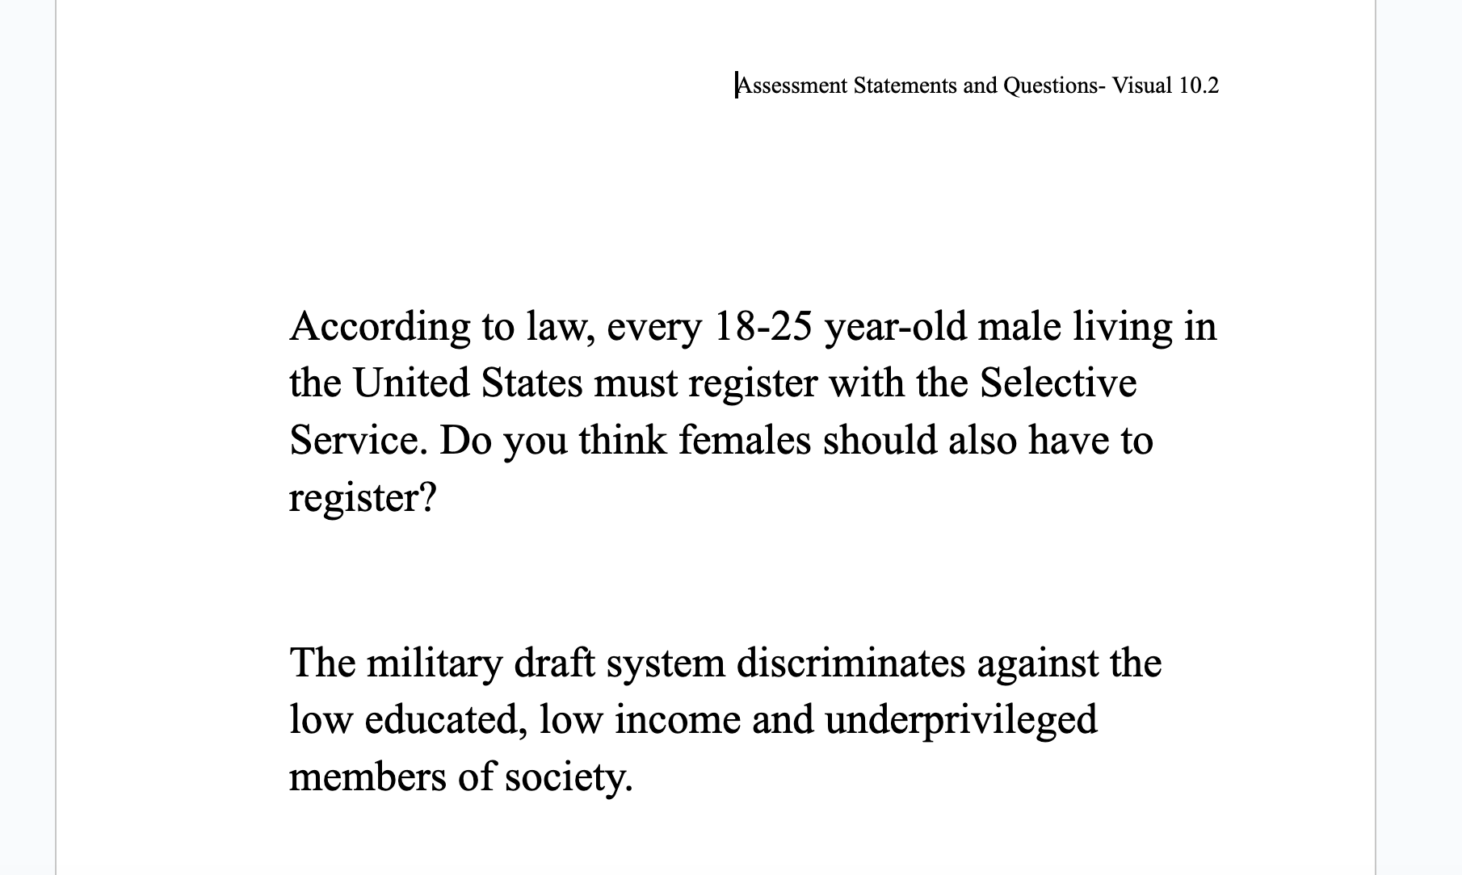
Assessment : Visual 10.2

Slide 23

Q & A

Slide 24
Reflect...
How can I use this material in my classroom?
What questions will my students have?
How can I encourage deliberative dialogue in my classroom setting?

Slide 25
Contact Us
Cynthia Fitzthum
Cjfitzthum@stcloudstate.edu
Jeremy Miller (co- author)
Jmiller@c-ischools.org

Slide 26


Slide 27

Thank you for attending today!

