Slide 1



What Would You Do With $19,000 a Month?
[INSERT FEATURED IMAGE OF WEBINAR SESSION]

Slide 2
Certificate Requirements
To earn professional development hours for webinars, you must:
Watch a minimum of 45-minutes and you will automatically receive a professional development certificate via e-mail within 24 to 48 hours.

Slide 3
Objectives
Students will be able to:
Describe how to reduce personal financial risk through savings
Create a personal budget
Analyze personal expenditures and income sources

Slide 4

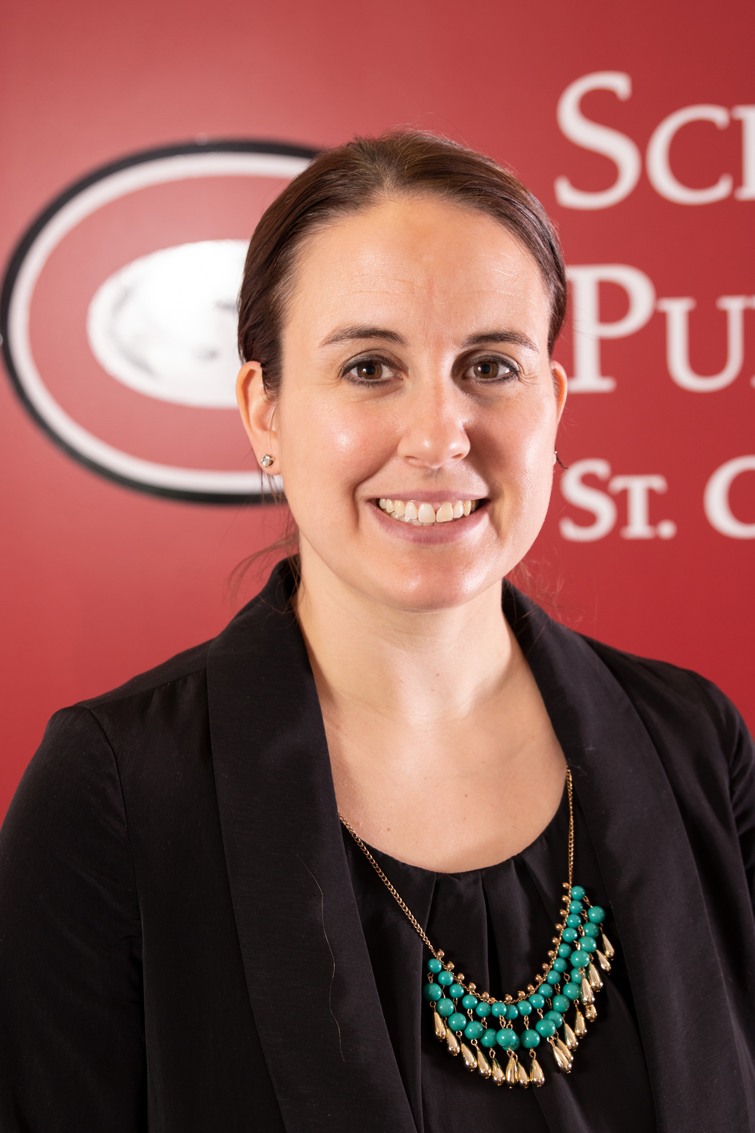
Presenter(s)
Jeremy Miller (co- author, presenter)​
jmiller@c-ischools.org
Cynthia Fitzthum (co-author)
Cjfizthum@stcloudstate.edu

Slide 5


Session Agenda
Economics of War Series description
Lesson objectives/Standards/Concepts
Activity description
Q & A

Slide 6
Economics of War Lessons
Please join us for any of the following webinars......... or look for the webinars on demand and lessons on EconEdLink soon!
Date | Topic
2/6- Jeremy | The Copper Issue (A Supply and Demand Lesson)
2/20- Cindy | Why go to war? (A Lesson on Costs and Benefits)
3/6- Cindy | Exchange rates during periods of Conflict (Currency and exchange rates)
3/20- Cindy | What about trade during war? (Geography lesson with focus on re-allocation during periods of conflict)
4/3- Cindy | Oil and the Middle East (Lesson on Prices)
4/17- Jeremy | What would you do with $19,000 a month? (Human capital, risk/reward and personal finance lesson)
5/1- Jeremy | Specialization (Military vs. Contractor pay)
5/8- Jeremy | How big is the military pie? (A Lesson on Budgeting, Taxation and Opportunity Cost)
5/22- Cindy | The Draft Debate (Debate Model)
5/29- Jeremy | Reconstruction: Can it boost an economy? (Broken Window Fallacy)

Slide 7

Objectives & Standards

Slide 8
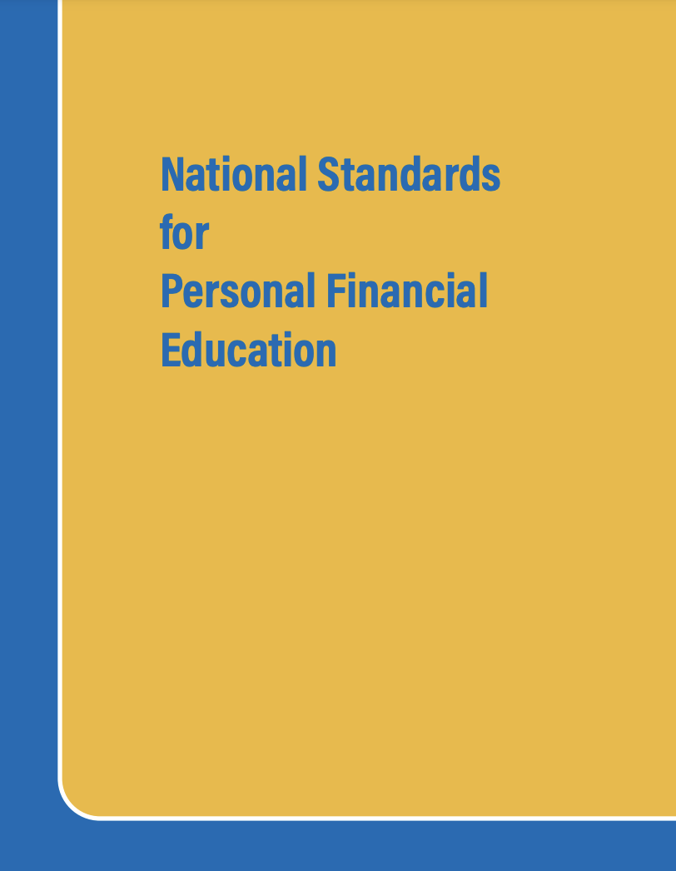
National Standards
Spending 12-1: A budget helps people achieve their financial goals by allocating income to necessary and desired spending, saving, and philanthropy
https://www.councilforeconed.org/policy-advocacy/k-12-standards/

Slide 9

National Standards
Scarcity 12-1: Choices made by individuals, firms, or government officials are constrained by the resources to which they have access.
https://www.councilforeconed.org/policy-advocacy/k-12-standards/

Slide 10
[INSERT FEATURED IMAGE OF WEBINAR SESSION]
Lesson Activity

Slide 11
Lesson Description
This lesson explores the economic concept of having unlimited wants through a budget-creation activity.
A comparison between private security contractor earnings and those of an enlisted military member will serve as an example of how personal spending tends to closely match income, without a similar increase in savings.
Students will also see how unexpected expenses can quickly eliminate any savings and require consumers to use debt to cover those expenses.

Slide 12


Contractors in Iraq & Afghanistan
US Government used private contracting companies to provide support and logistics for the war efforts
Trucking
Police/security trainers
Food & laundry services
Security Services
  Static security (base, gate guards)
  Personal protection (State Department, DOD, CIA)

Slide 13
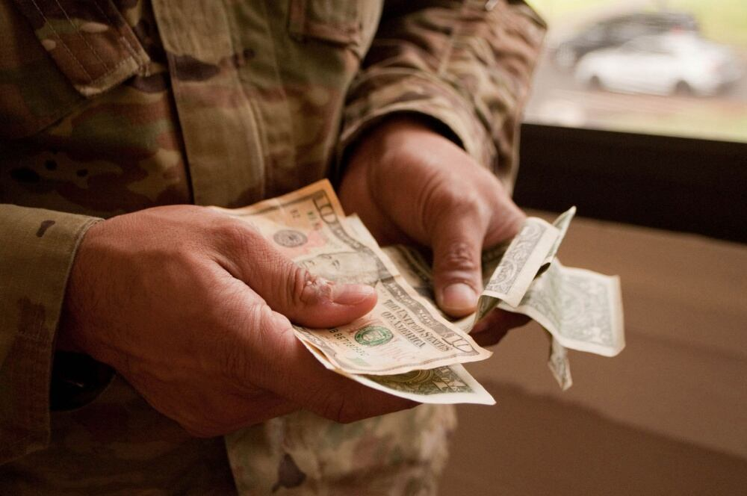
Salaries
Security Contractors
$350-1000/day in-country
Typically, a 90/30 rotation – 90 days in-country, 30 days of leave
  ~$95,000 – 270,000/year
Enlisted Military (E-5) - $24,000/year (in 2005)

Slide 14
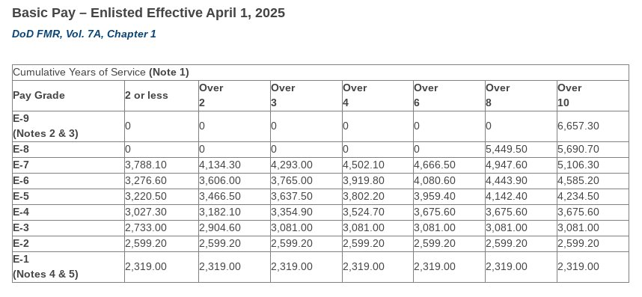
Salaries

Slide 15
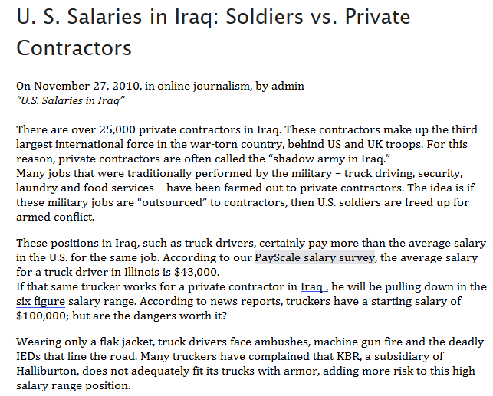
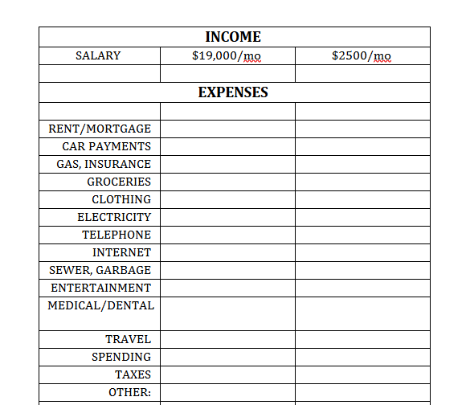
Budgeting
Lesson Plan
Introduce the differences between private security contractors and military members, in terms of their roles and salaries
Have the students create monthly budgets for both income levels
  Give them a chance to look up the how much each expense typically costs
  They will likely need help coming up with accurate numbers

Slide 16
Budgeting
Lesson Plan
Introduce the differences between private security contractors and military members, in terms of their roles and salaries
Have the students create monthly budgets for both income levels
  Give them a chance to look up the how much each expense typically costs
  They will likely need help coming up with accurate numbers

Slide 17
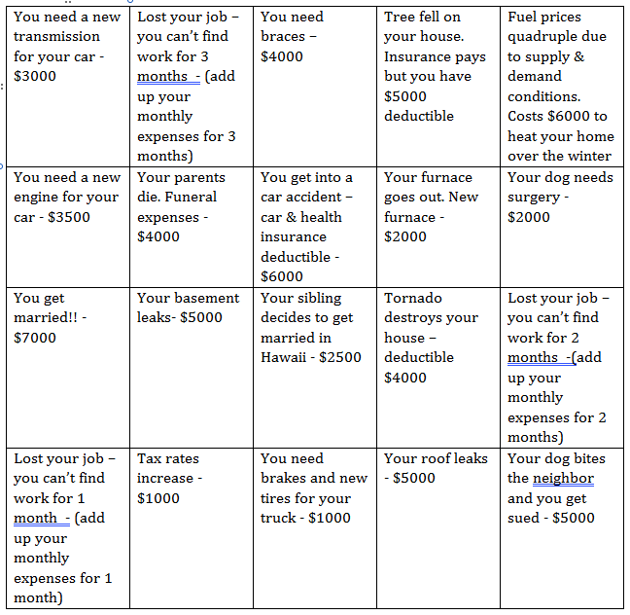
Budgeting
Lesson Plan
After the students have created budgets for each income level, have students draw "uh oh" slips.
Have them calculate how the unexpected expense will impact their savings and their ability to pay their bills.

Slide 18
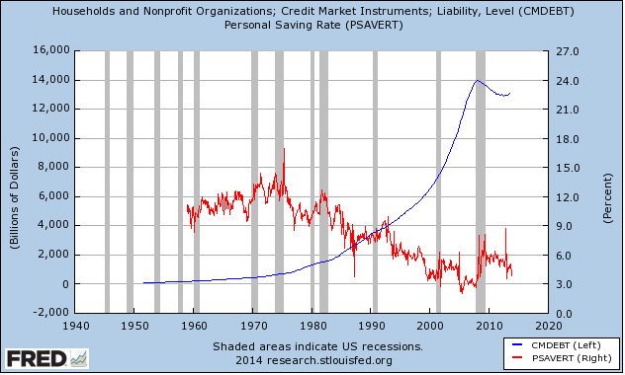
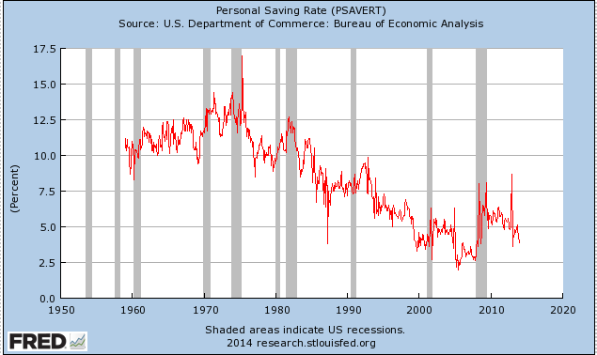
Saving Rates vs. Debt
[Insert Answer]

Slide 19
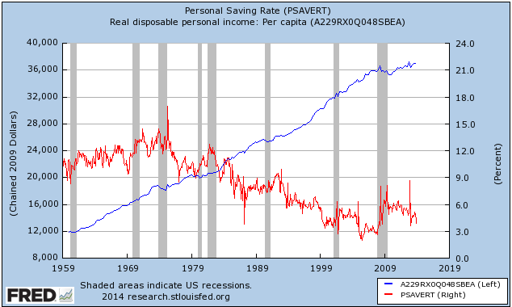
Saving Rates vs. Disposable Income
[Insert Answer]

Slide 20
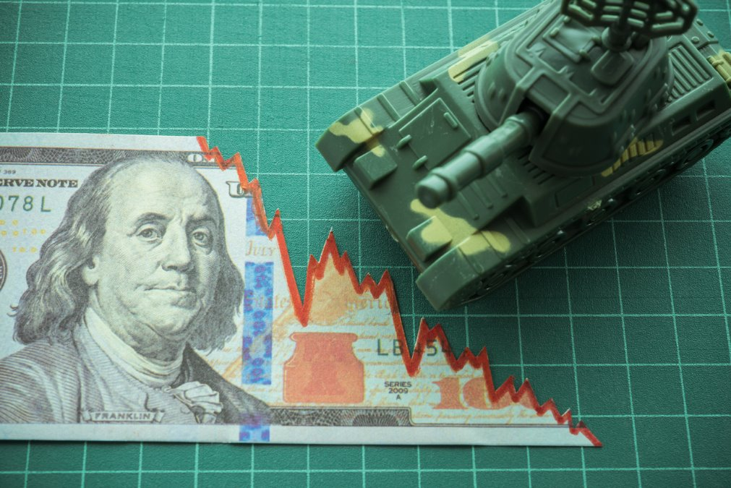
[INSERT FEATURED IMAGE OF WEBINAR SESSION]
Q&A

Slide 21
Presenter(s)
Jeremy Miller (co- author, presenter)​
jmiller@c-ischools.org
Cynthia Fitzthum (co-author)
Cjfizthum@stcloudstate.edu

Slide 22








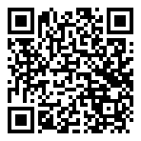



Free Personal Finance Program for High School Girls
Invest in Girls (a program of CEE) invites your high school students to learn about personal finance in a supportive all-girl environment! IIG instructors will teach students the basics of personal finance, how to invest, and help them build professional skills. These programs are online and free to attend.
Share this sign up link with your students
Or visit investingirls.org/for-students/

Slide 23
[INSERT FEATURED IMAGE OF WEBINAR SESSION]
Thank you

