Slide 1

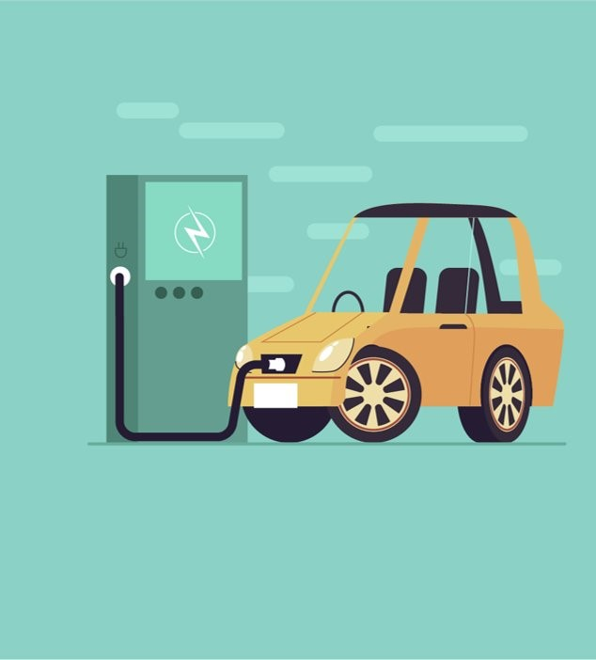
Eco-Economics:
To Ban or Not to Ban

Slide 2
Objectives
You will be able to:
Recognize that government policies have costs and benefits.
Evaluate the benefits and costs of energy policies from varying perspectives.
Formulate an argument, using the economic way of thinking.
Identify ways a policy might be changed to eliminate or reduce consequences for various groups.

Slide 3
Session Agenda
Introduction - Polling
Economic Background
Jigsaw
Debrief

Slide 4

National Standards
Standard 2: Decision Making
Standard 16: Role of Government & Market Failure
https://www.councilforeconed.org/policy-advocacy/k-12-standards/

Slide 5

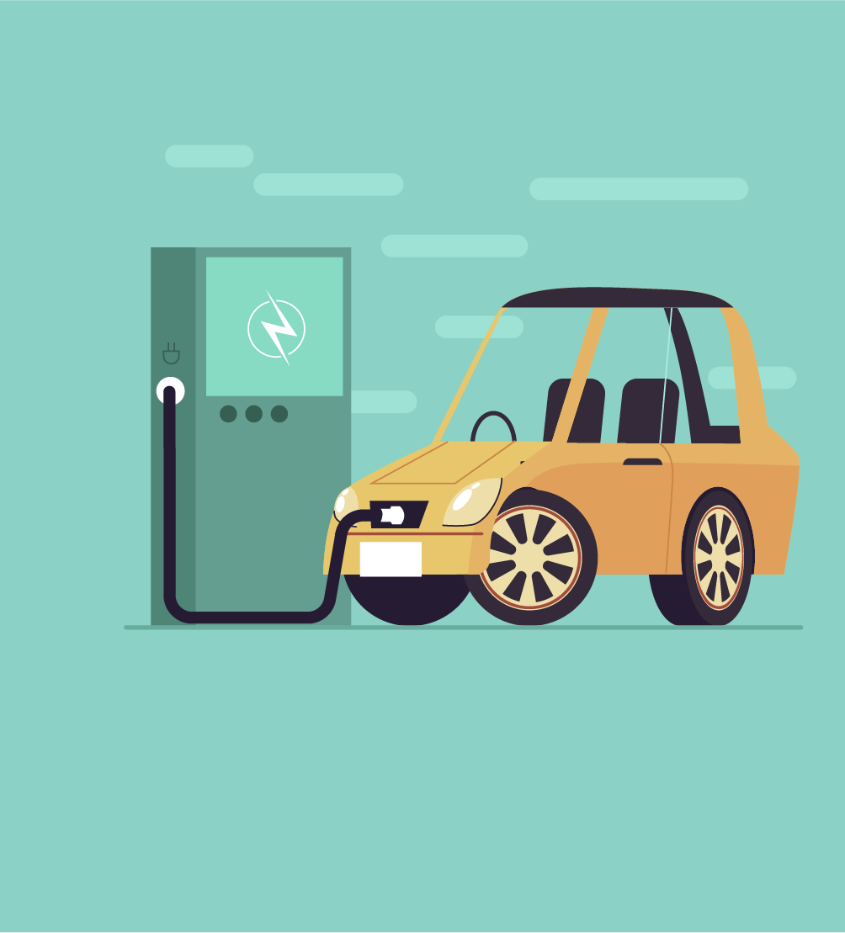

How Does One Energy Policy - a Ban on Gas-powered Cars - Affect So Many People Differently?

Slide 6



Is this a good policy or a bad policy?
California and several other states are banning the sale of new gas-powered vehicles by 2035. This means that consumers will look to electric vehicles, or EVs, as their main vehicle option.
What does it mean to be a good policy
or bad policy?
padlet.com/econstig/EVpolicy
Notes:
Is this a good policy or bad policy? Why? (Answers will vary widely, especially given your geographical location, but many students will say yes, this is a good policy because gas powered vehicles are part of the climate change problem. Others might say that this is not a good policy because there are still other things causing climate change or that oil is not going to go away. Accept all answers and listen to what the students are saying regardless of their supporting evidence, or lack thereof.)
What do we mean when we say good policy or bad policy? (Answers will vary again but students will likely talk about how many people the policy can help or hurt, the cost of the policy being worth it, etc.)

Slide 7

What is economics?
Economics is the study of choices.
A policy can be thought of as a choice by a lawmaker.
Economists regularly examine policies such as the one in California by weighing the costs against the benefits.
Costs are things unfavorable to a decision maker
Benefits are things favorable to a decision maker

Slide 8

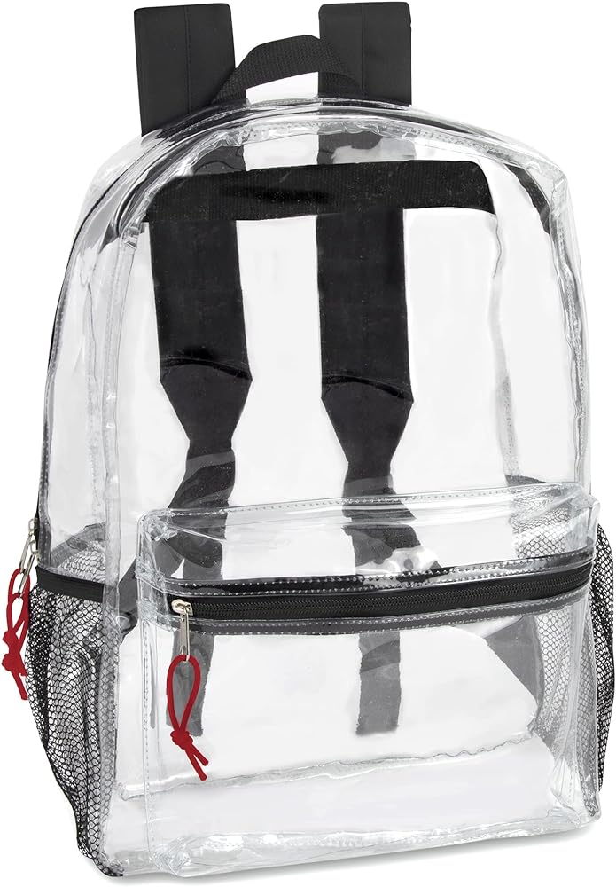
New policy: All students must
carry see-through backpacks!
The school board is considering a new policy requiring all students to carry a see-through backpack.
              What are the costs for students, teachers, or
              parents associated with this policy?
What are the benefits for students, teachers,
or parents associated with this policy?
Notes:
What are the costs for students, teachers, or parents associated with this policy? (Answers will vary but may include: students not liking the style or lack of privacy for items in their backpacks. Parents or students will have to spend money to buy the new item. Teachers might have to check that students are following the new policy including potential discipline.)
What are the benefits for students, teachers, or parents associated with this policy? (Answers will vary but may include: increased level of safety as you cannot hide things in your backpack, students will all have similar backpacks so there is less competition for fashionable or desirable items, etc.)

Slide 9
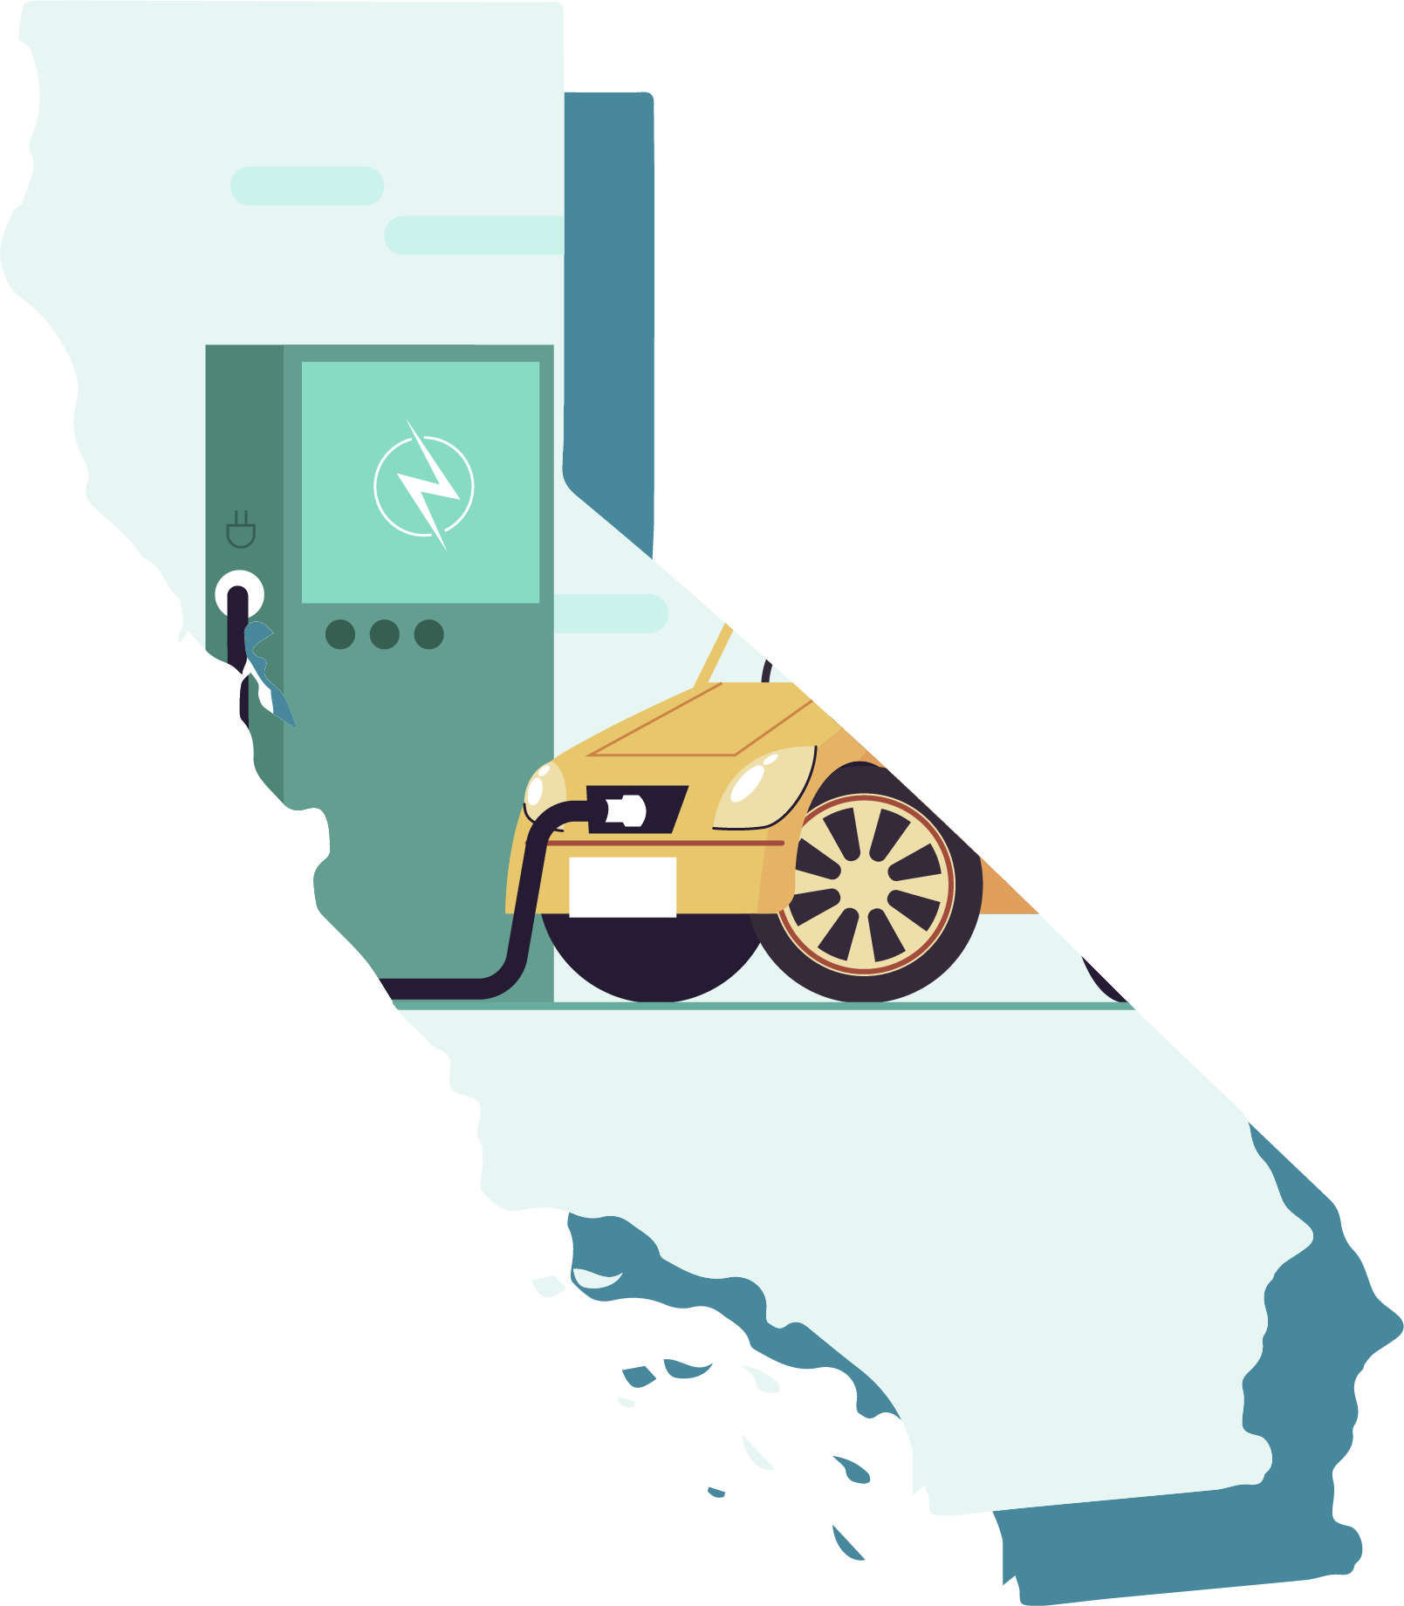
Activity 2.1: Thinking about policies like an economist
List 2-3 benefits of implementing a policy such as California’s ban on the sale of new gas-powered vehicles by 2035.
List 2-3 costs of implementing a policy such as California’s ban on the sale of new gas-powered vehicles by 2035.
https://padlet.com/econstig/caliEV

Slide 10
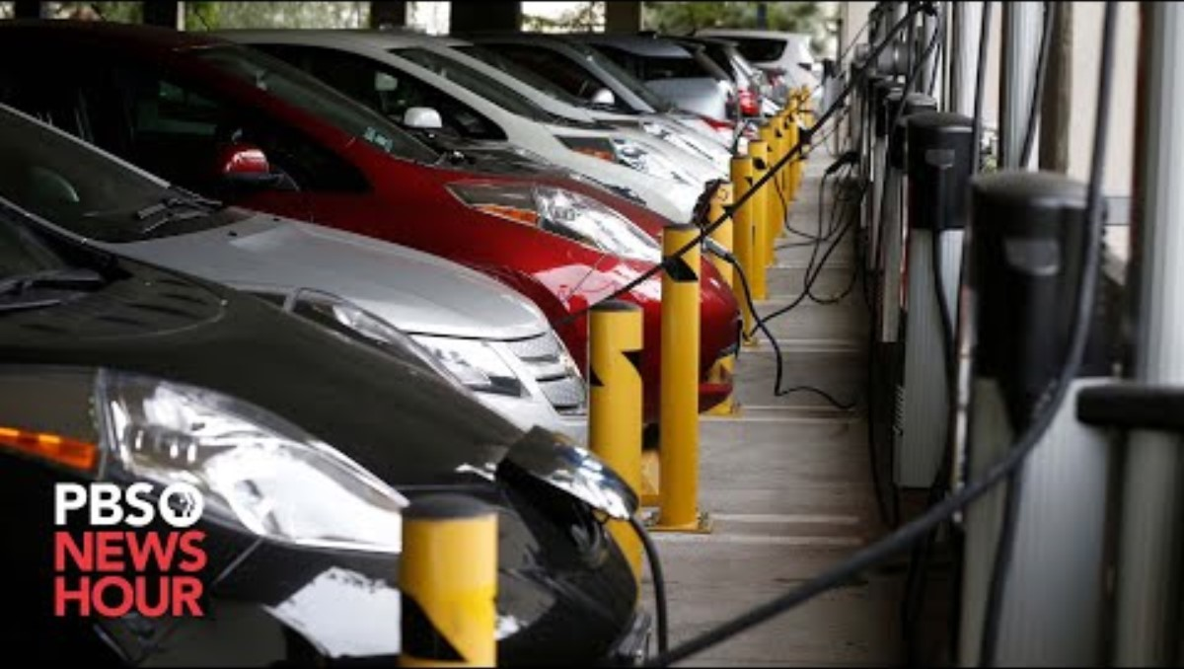
Notes:
PBS News Hour Video: https://www.pbs.org/newshour/show/californias-move-to-ban-sales-of-new-gasoline-fueled-cars-could-spread-to-other-states (7:56)
Youtube link: https://www.youtube.com/watch?v=q1QdkPmWcHM

Slide 11
Activity 2.1: Thinking about policies like an economist (cont.)
In the chat - List 2-3 people or groups of people that might be affected by a policy such as California’s ban on the sale of new gas-powered vehicles by 2035.

Slide 12

Opportunity Costs
In addition to looking at the benefits and costs of a
policy, economists must also take into account opportunity costs.
Opportunity cost is the value of the next-best
alternative when a decision is made; it's what is given up.
  If a state requires a certain amount of their land to be dedicated to a solar farm there are costs beyond the dollar amount of this project. What must be given up to make the solar farm?

Slide 13
Activity 2.2: Policy Stakeholder Roles - Individual
You have been given a role as 1 of 5 policy stakeholders
  Consumer
  City planners in California
  Car companies (i.e General Motors, Ford, Honda, Fiat Chrysler)
  California Utility Companies
  Lithium battery producers
In a moment you will get together in a group composed of other students with your role.**
In your groups, read through the information on your card. Answer the questions at the bottom of the sheet of paper. You have 10 minutes.
Stakeholders within the group do not all have to agree on
question 3.
Notes:
https://docs.google.com/document/d/1g8Lo1jjFwhFrKfkZm_SRE6Ot61wlDgJkWuokVqlJaUQ/edit?usp=sharing

Slide 14
Activity 2.2: Policy Stakeholder Roles (cont.)
In your groups, read through the information on your card.
Answer the following questions as a group on the back of your sheets. You have 10 minutes. (Stakeholders within the group do not have to all agree on question 3.)
What benefits would the policy have for someone in this role?
What costs would the policy have for someone in this role?
In general, how would someone with this role feel about banning gas-powered vehicles? Explain. Be sure to identify the most important benefits and/or costs in your decision.
Notes:
https://docs.google.com/document/d/1g8Lo1jjFwhFrKfkZm_SRE6Ot61wlDgJkWuokVqlJaUQ/edit?usp=sharing

Slide 15
Activity 2.4: Break Out Rooms
Policy discussion and decisions
Next, get into groups of 5 with 1 role in each group.
Your group should have at least 1 person from each of the following policy stakeholders
  Consumer
  City planners in California
  Car companies (i.e General Motors, Ford, Honda, Fiat Chrysler)
  California Utility Companies
  Lithium battery producers
In your groups use Activity 2.4: Policy Discussion and Decisions to take notes about each stakeholder as they explain their role and the costs and benefits the ban on new-gas powered vehicles as it pertains to them.
Next answer the questions as a group.

Slide 16
How does one energy policy affect so
many people differently?
With every policy there are costs and benefits. As you’ve discussed in your groups many times, different groups of people have different costs and benefits.
How did your groups vote overall?
Which role had the most influence or was the most important in your decision? Explain why.
What opportunity costs does a bill like this have?

Slide 17
How does one energy policy affect so
many people differently? (cont.)
There are no perfect policies out there.
There are policies which are better and worse and even those assessments are highly subjective depending on the groups being affected.
Every policy can be improved because often there are unseen consequences or groups of people who might be drastically hurt by a policy.
Therefore, it is important for us to think about ways to improve a policy.

Slide 18
How does one energy policy affect so
many people differently? (cont.)
Regardless of how you voted, what improvements could be made to the policy to either
make it feasible to pass (if your group was not in favor)
or
make it so more roles within the group were in favor of the bill (if you were in favor but some roles were against).
Think about the costs from the different roles.
Are there ways to reduce the costs to those groups?

Slide 19
Wrap Up
Suppose a state adopts a new policy requiring all farms to have windmills to generate electricity. An opportunity cost of that policy might include:
  the dollar amount of the windmill for each farm.
  the land the windmills are taking up could be used for crops for livestock.
  the state could use hydroelectric power if they did not pass this policy.
  the farmers would be able to use the electricity from the windmill.

Slide 20
Wrap Up
Why are there such differences in opinions on energy policies when it is a commodity that everyone needs?
  Groups of people are unable to cooperate with other groups.
  People do not understand that everyone needs energy.
  People’s costs and benefits for any policy vary.
  Energy policies are not effective.

Slide 21


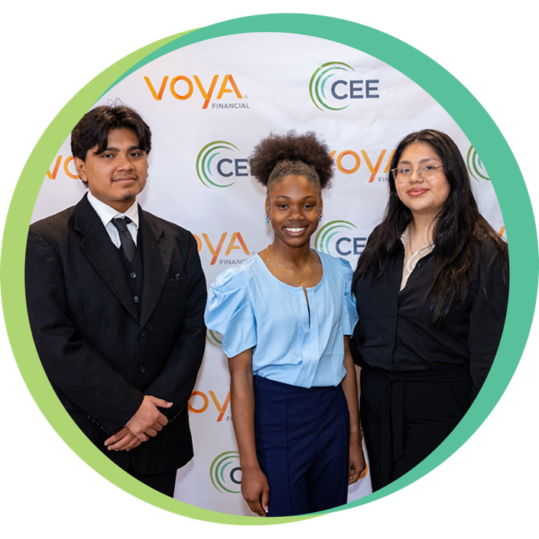


Find your Local Competition and Register Today!
The National Personal Finance Challenge is a competition that provides
high school students with an exciting and motivating opportunity to build, apply, and demonstrate their knowledge of money management.
Through online exams and a personal finance simulation, teams showcase their expertise in earning income, spending, saving, managing credit, investing, and managing risk.
Teams of up to four students, with one teacher/coach, can qualify to represent their state at the National Personal Finance Challenge by
winning their state competition.
CASH PRIZES
for each member of the winning teams:
1st Place $2,000
2nd Place $1,000
3rd Place $500
4th Place $250
NATIONALS > Finals:
Critical thinking round & Quiz Bowl in Atlanta, Georgia on June 1-2.
Register today: bit.ly/cee-npfc

Slide 22


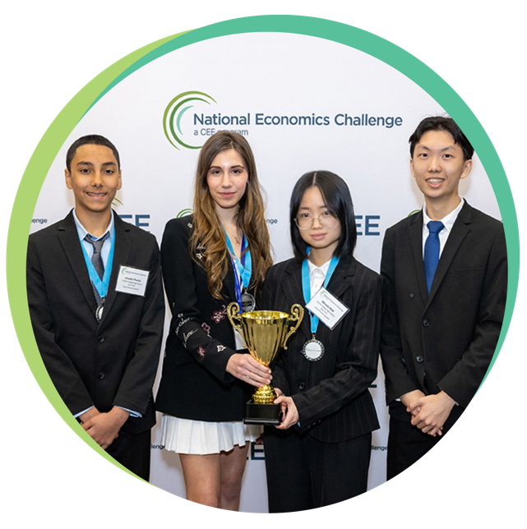


Teach Economics?
Your students may have what it takes to compete in the nation’s only high school economics competition!
Why Play?
• Fun team learning experience
• Great for college applications
• No other challenge like this
• Online participation makes access easy
• Chance for cash prizes
Two divisions based on
experience level
David Ricardo for first-time competitors who have taken no more than one economics course.
Adam Smith for returning competitors, AP, International Baccalaureate, and honors students.
How it Works
Teams register
Teachers enroll team(s) of 3- 4 high school students from the same school. Multiple
teams allowed.
Teams compete within their state
Compete to win your state competition for a
chance to advance to the National Semi-Finals.
National Semi-Finals: April 21-24, 2025
Teams answer multiple-choice questions on macroeconomics, microeconomics, and international & current events.
National Finals: Atlanta, Georgia
May 28-30, 2025
Teams analyze an economic issue and present their solution. Top teams engage in the Finals Quiz Bowl where they face-off answering questions to claim the National Title.
CASH PRIZES
for each member of the winning teams:
1st Place $1,000
2nd Place $500
3rd Place $250
4th Place $200
Register Today at NationalEconomicsChallenge.org

Slide 23



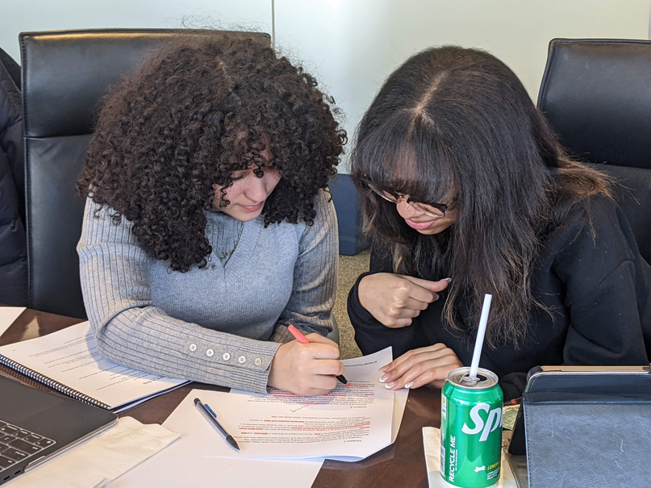




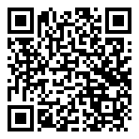



Free Personal Finance Program for High School Girls
Invest in Girls (a program of CEE) invites your high school students to learn about personal finance in a supportive all-girl environment! IIG instructors will teach students the basics of personal finance, how to invest, and help them build professional skills. These programs are online and free to attend.
Share this sign up link with your students
Or visit investingirls.org/for-students/

Slide 24
Eco-Economics:
To Ban or Not to Ban
Thank you!

