Slide 1

Summer Institute on Inflation
Welcome! I’m Alex.
Lead Teacher of Business Education
NJ Council for Economic Education Executive Director
Rider University Professor of Business Ed.
Curriculum Development and PD for:
CEE, College Board, and Intuit for Education
Notes:
How do we help students make sense of rising prices, shrinking paychecks, and tough financial choices? In this session, we’ll dive into practical strategies for teaching inflation, purchasing power, and the cost of living in ways that connect directly to students’ real-world experiences. Explore how economic crises shape personal decisions and societal outcomes, and gain tools to guide students in analyzing current events, evaluating trade-offs, and understanding the long-term impact of financial realities. Bring relevance and empathy into your econ or social studies classroom by anchoring instruction in the economic challenges students see and feel every day.
reddit
My plan:
Intros - who are we and where are we teaching inflation? To whom?
What is inflation and the misconceptions? How do we measure it and how do we teach that?
Some sort of - what do you like to use to teach it, what are the struggles?
Inflation today - what is it? How do students find it out and interpret? Shrinkflation
Inflation last 5 years (the student experience)
Show graphs, Fred
PF implications: real vs. nominal incomes, savings account, investing & compound interest to combat inflation,
***around this point, go through inflation content/activities as I would in my classroom***
Activities
Phillips curve decades poster
Get some fun historical pics of inflation (and deflation?)

Slide 2



Thanks to our supporters who invest in CEE’s teacher professional development and classroom resources.

Slide 3
EconEdLink Membership Perks
As an EconEdLink member, you have access to a wealth of valuable resources! Here’s a quick overview of the perks that come with your membership:
New Webinars, Lesson Plans, and Activities are added every month, keeping your teaching toolkit fresh and up-to-date.
Learn from experts in personal finance and economics tailored to K-12 education.
Free high-quality resources like presentations, lessons, and activities, all available for download.
Instant access to your professional development certificates as soon as the requirements are met.
Additionally, we’re offering a 20% discount at the CEE Store. You can purchase our bestsellers like Financial Fitness for Life and AP Economics using the code: EEL20.

Slide 4
Certificate Requirements
To earn professional development hours for webinars, you must:
Watch a minimum of 75% for our longer sessions and the full 45 minutes for our 45 minute sessions.
You will automatically receive a professional development certificate via e-mail within 24 to 48 hours.

Slide 5
Introduce yourself in the chat!
Who do you teach and what do you teach them?
How long have you been teaching?
Optional: Why did you sign up for this session?
(What do you hope to gain)

Slide 6
Session Goals
01
02
03
Discuss Inflation & Misconceptions
Analyze Inflation Today & Student’s Experience
Explore Activities for Teaching Inflation

Slide 7
What financial decision have you made recently that was impacted by inflation?
Notes:
We’re going through this, and our students are, as well.

Slide 8
01
Inflation & Misconceptions

Slide 9

What’s Inflation?
Share: What are student misconceptions about inflation?
We can print money!
Inflation is always bad
Deflation must be…good?
How can we dispel these?
Notes:
Teachers share in the chat student challenges or misunderstandings about inflation

Slide 10
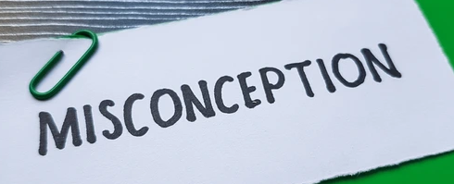
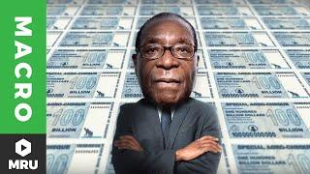
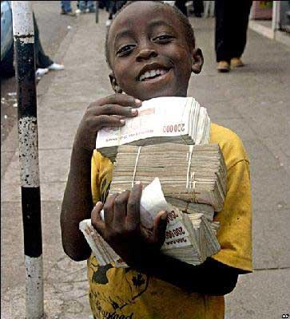
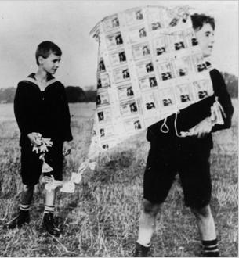
We can always print money?

Slide 11
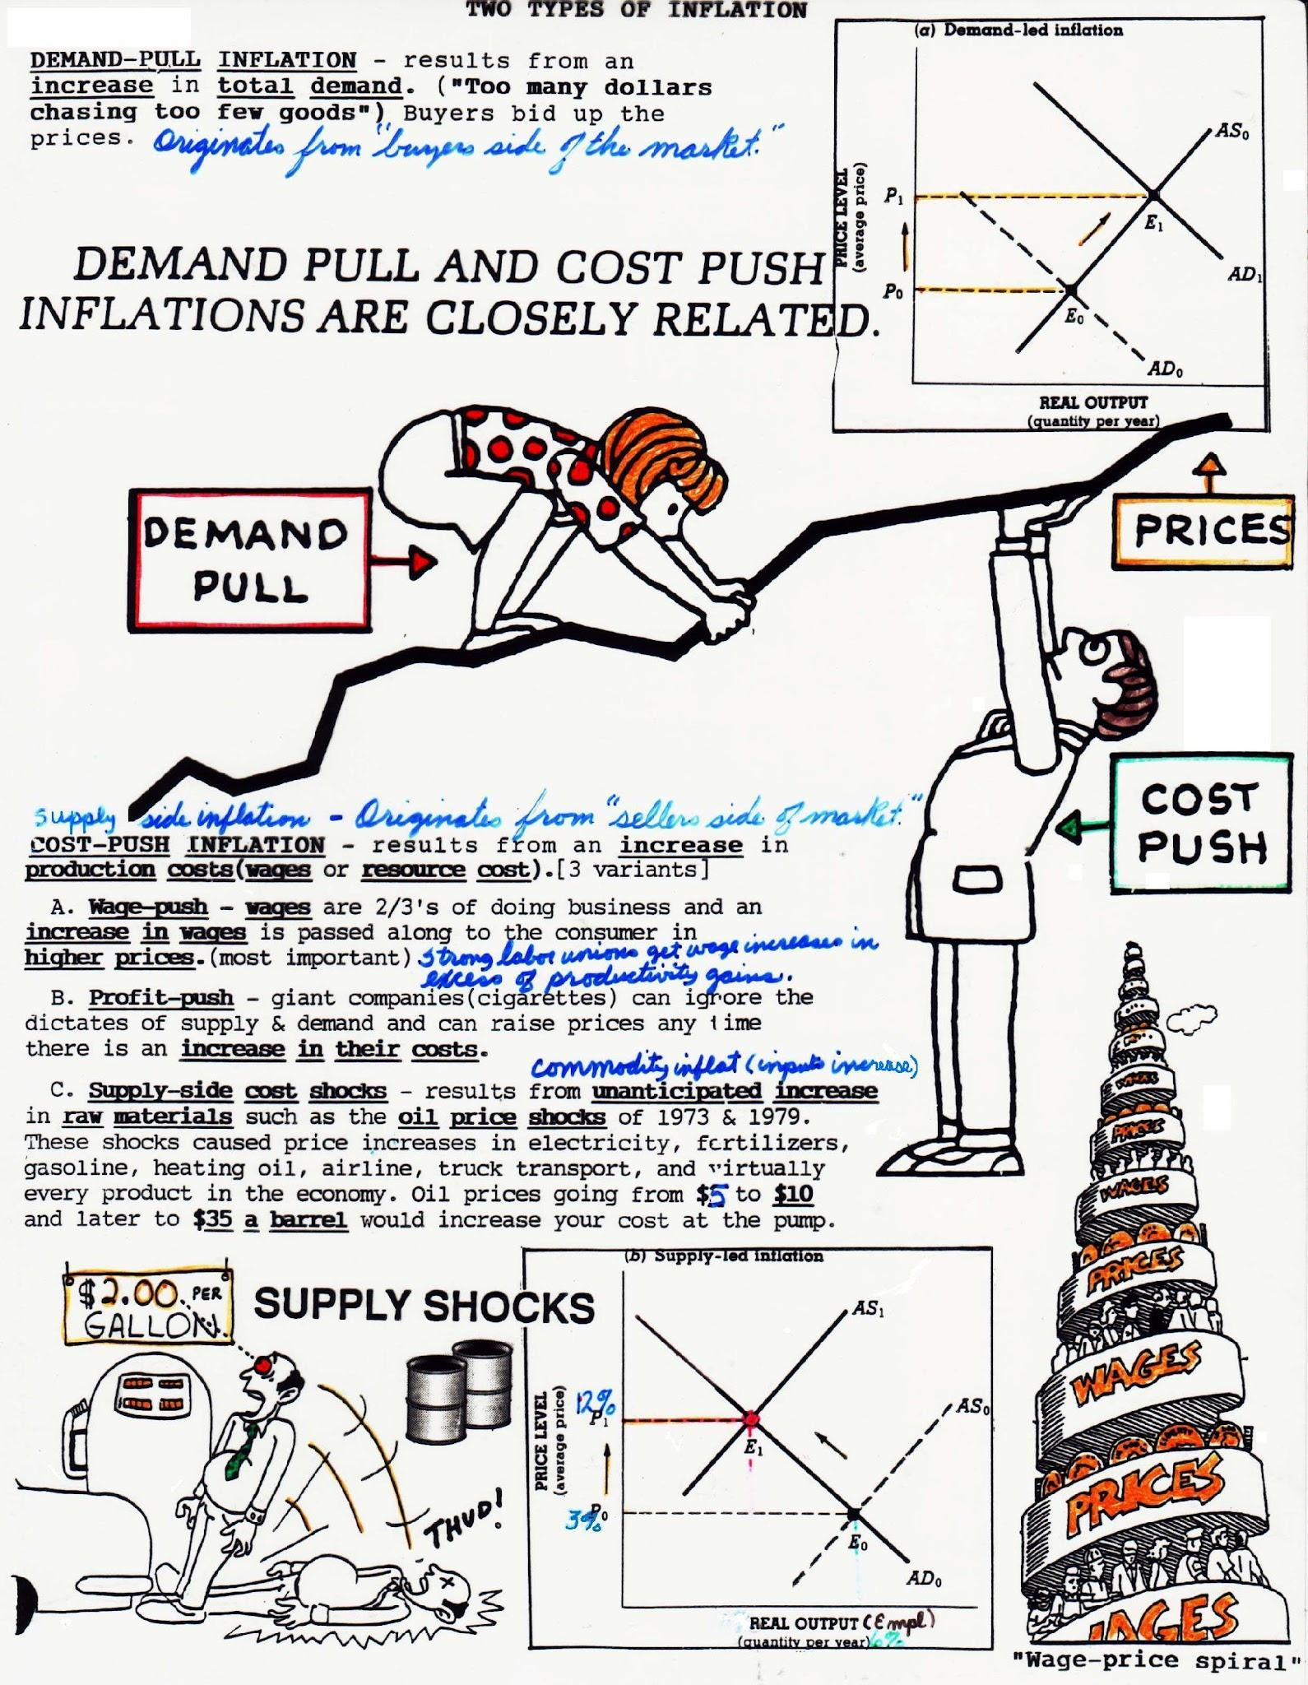
Inflation is always bad?
Student prompt: Would you rather live in a world where prices never change or where they rise slowly every year?
The Wage-Price spiral can showcase prices increasing is alright, as long as wages keep up with (or outpace) inflation.

Slide 12
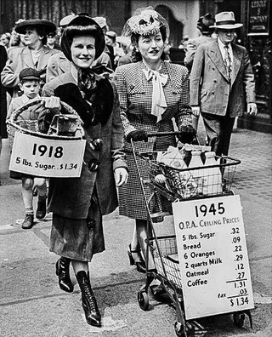
Deflation is good?
Student prompt: Why could you buy so much more in 1945 compared to 1918?
Deflation vs. Disinflation?

Slide 13
How’s inflation right now?
Anyone know the current inflation rate in the United States? (June 2025)
2.7%
What’s the Federal Reserve’s inflation target?
2.0%

Slide 14
02
Inflation Today & Students’ Experience

Slide 15
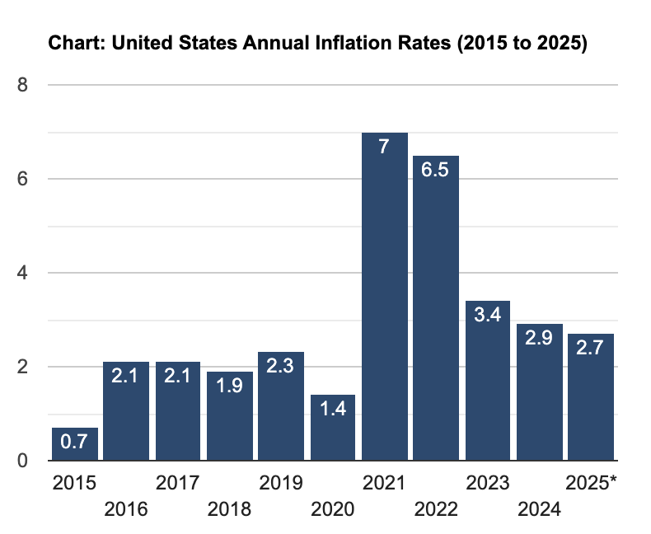
Notes:
The student perspective - the last several years our students have been more aware about money, so the annual inflation data from the last several years is part of their mindset about prices.
Source

Slide 16
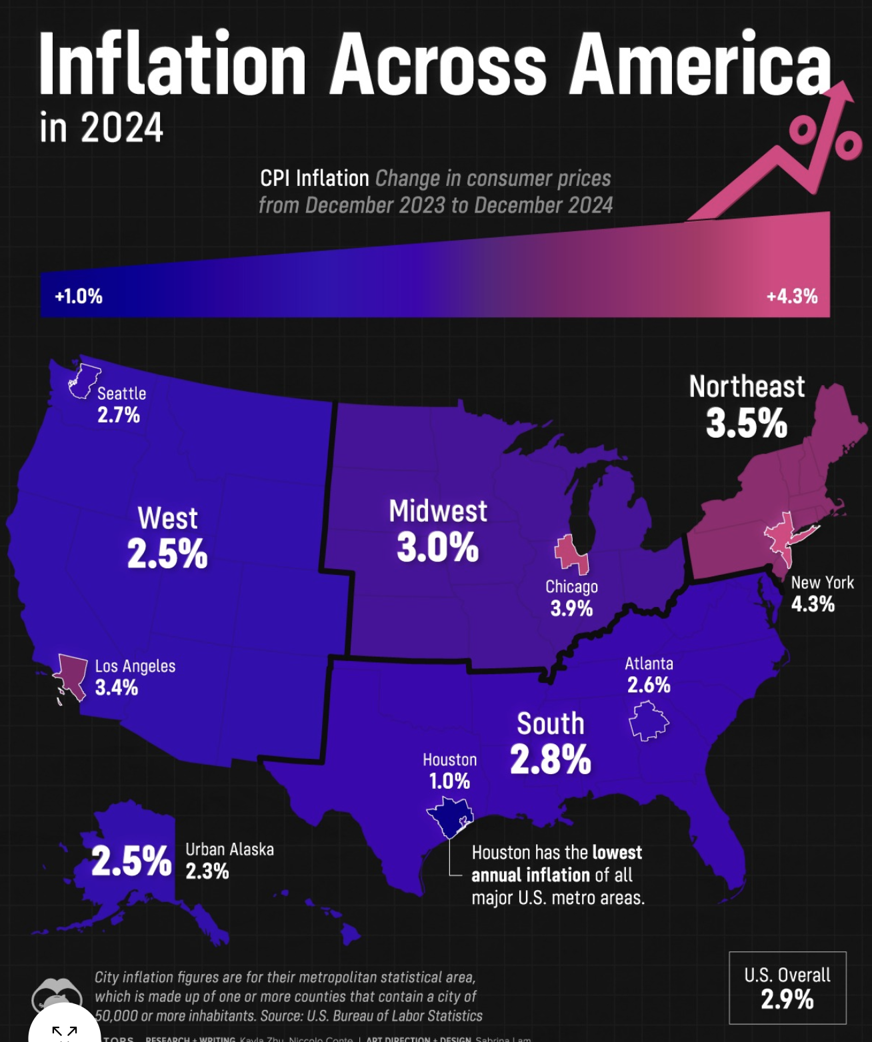
Notes:
Accounting for differences: regional

Slide 17

Another inflation distinction? Sector.
Which sector (example: cars) do you think has gone up the most since 2000?
Share your prediction in the chat.

Slide 18
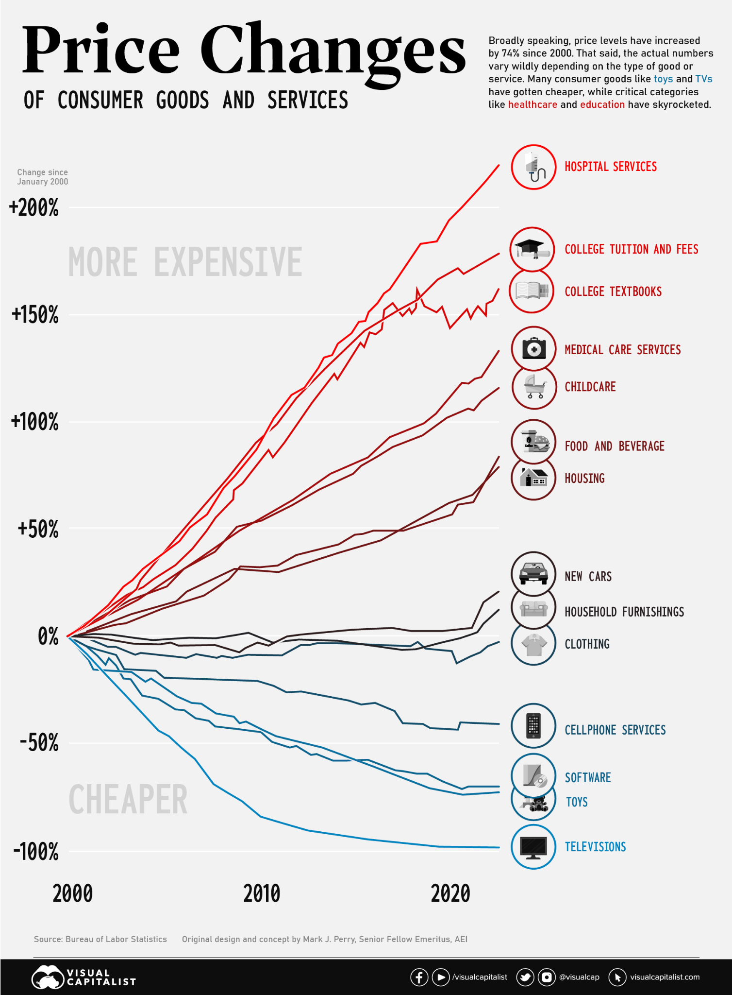
Notes:
Accounting for differences: sector
Image source

Slide 19
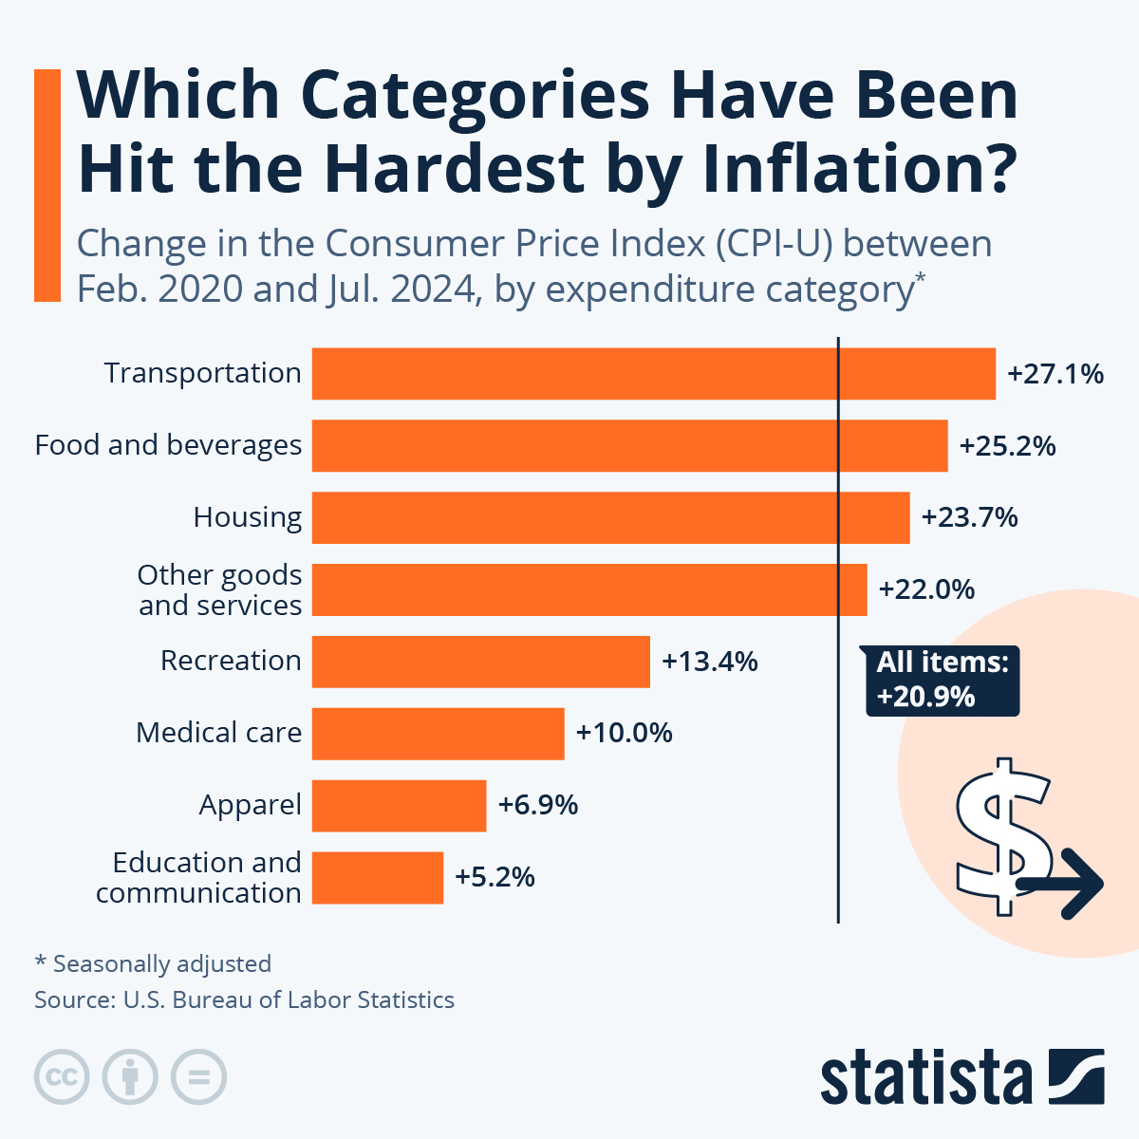
We can get even more specific and have students use the inflation calculator.
Calculator usage:
How much would $100 be worth today?
Pick a product & find its price - has it risen more or less than inflation? Like a $0.15 Big Mac!
Notes:
More recent increases

Slide 20
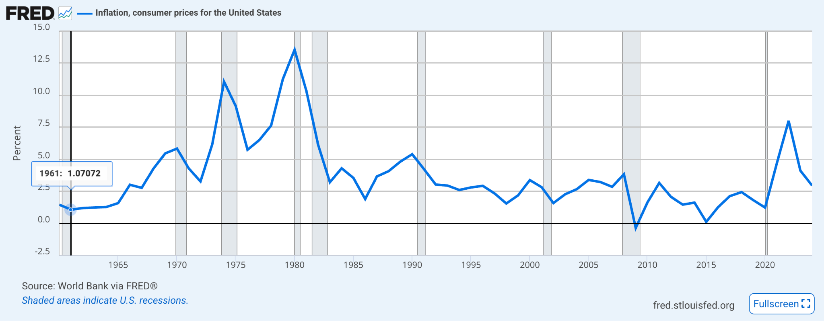
FRED Database

Slide 21
How else do students experience inflation?
Ideas for the classroom - how do we help students interact and apply financial decision making in light of inflation?
College Costs
Daily Spending
School Activity Costs
Sticker shock at tuition, meal plans and housing costs
Application fees for school and standardized tests
Food: especially on apps, delivery fees have been increasing
Combo meals Chipotle or McDonald’s costing $12–15
Shrinkflation!
Prom, sports, activities
Athletic fees, travel costs

Slide 22
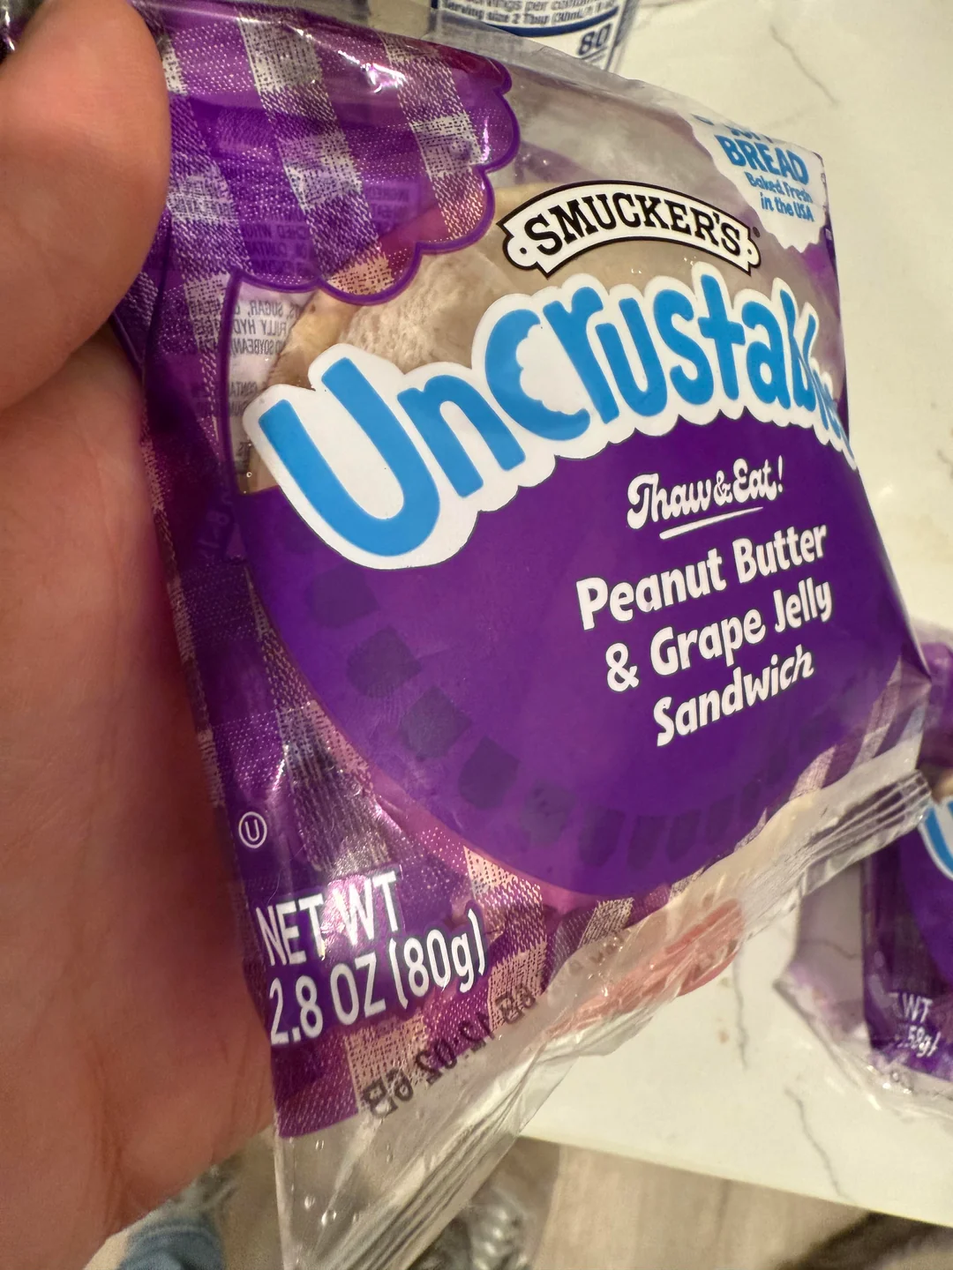
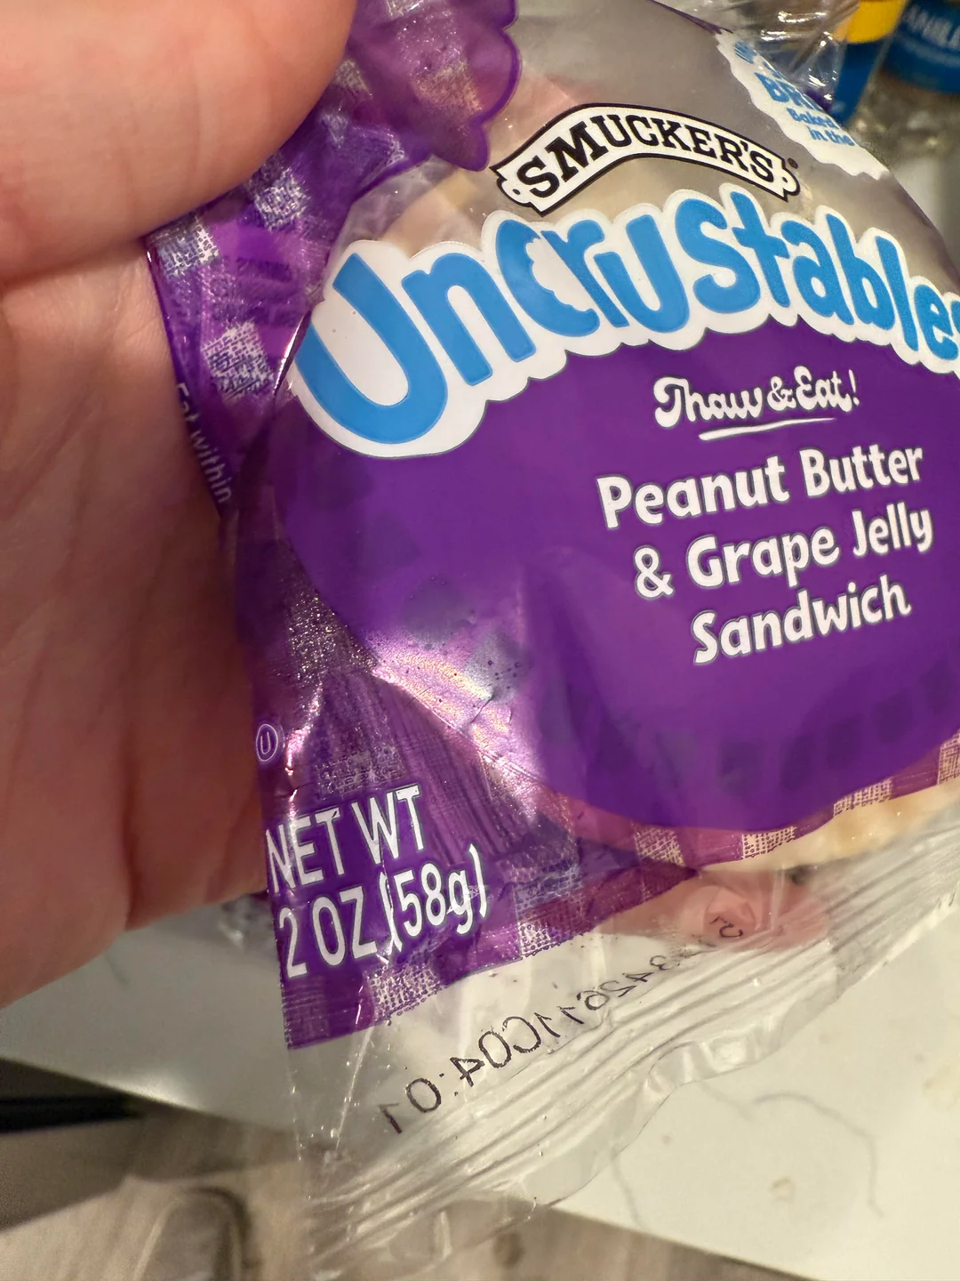

Slide 23

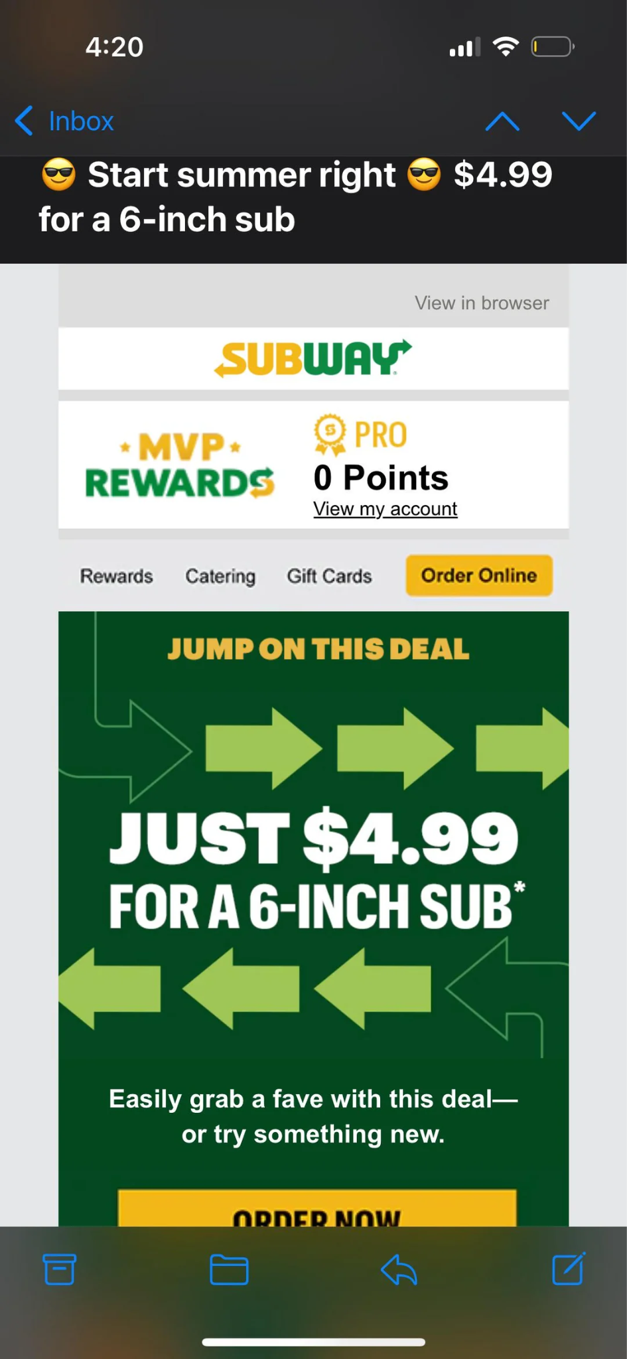

Slide 24
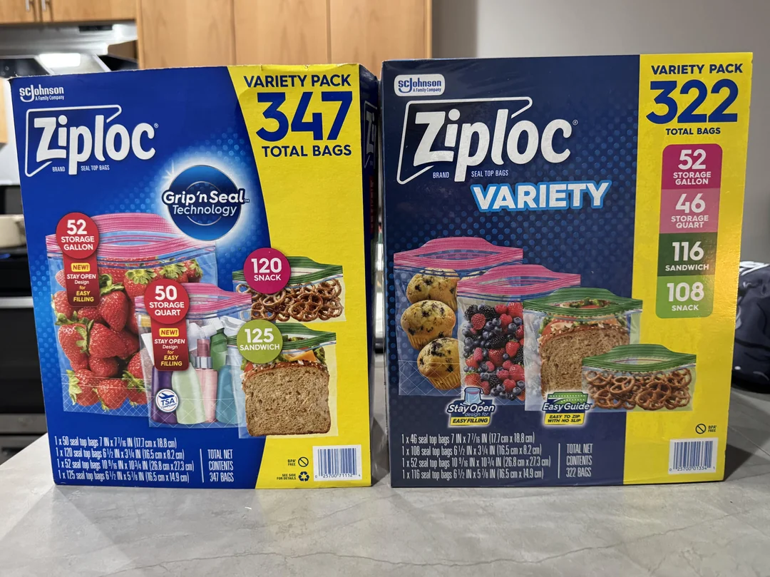

Slide 25

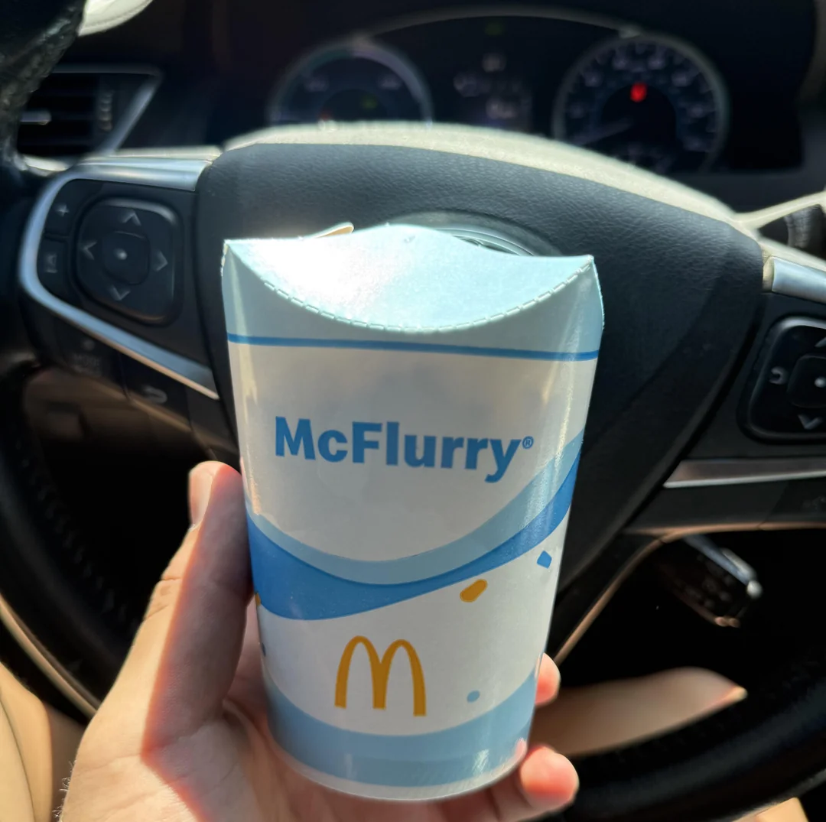

Slide 26
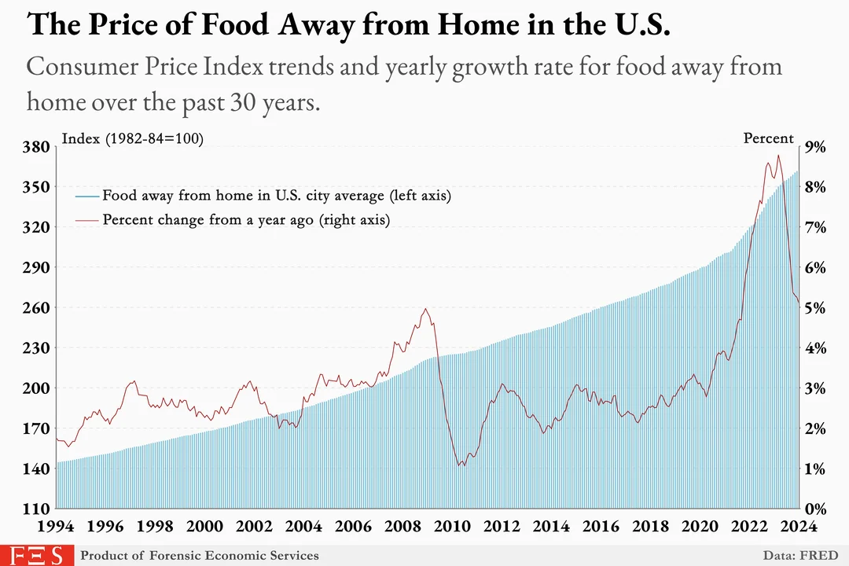
Notes:
Cost of eating out struggle

Slide 27
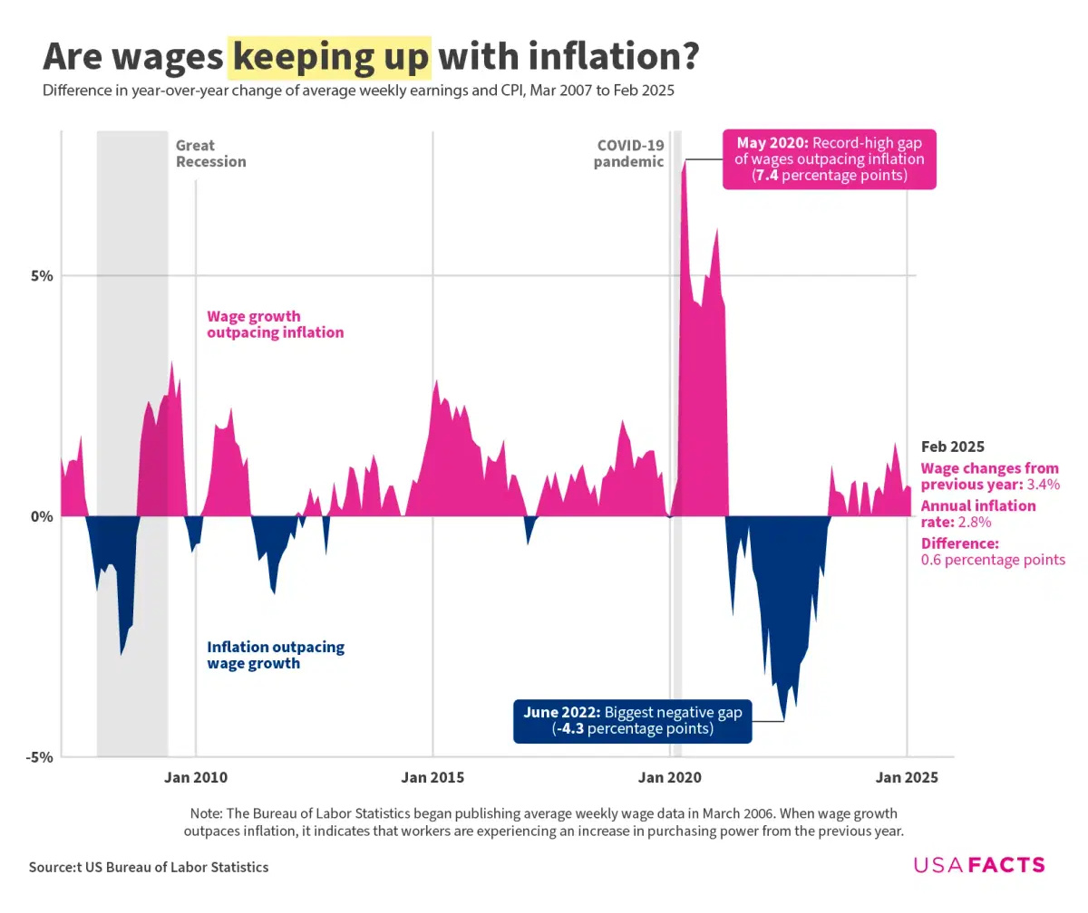
Notes:
Another frustration when it happens - inflation outpacing inflation

Slide 28

BREAK

Slide 29
03
Activities for Teaching Inflation

Slide 30

Inflation Auction
Auction off virtual or real prizes
Today’s auction:
A compliment
A LinkedIn connection
An inflation Kahoot sent to your DMs
Notes:
Year 2 debrief:
• Ask students what happened to the price in year 2. The price of the item went up.
• Was the population better off in year 2 than in year 1? Answers will vary but students
should note that there were still only 3 goods to buy. When income rises but production
stays the same, the price rises due to a shortage of goods. As a result, they weren’t any
better off even with the raise. Students may point out that output usually doesn’t stay the
same and that is fine.
Year 3 debrief:
Prize: https://create.kahoot.it/details/58ab1a28-3728-4000-bcc7-411032ae8ea8

Slide 31
Inflation Auction
Year 1: Distribute money ($5) and bid
Year 2: Getting a raise! $10 total income, pass out, keep remaining funds
Year 3: Another raise! $20 total.
Plus, a new item hits the market!
Auction off virtual or real prizes
Today’s auction:
A compliment
A LinkedIn connection
An inflation Kahoot sent to your DMs
Year 1 | Year 2 | Year 3
Compliment: | Compliment: | Compliment:
LinkedIn: | LinkedIn: | LinkedIn:
N/A | N/A | *new* Kahoot:
Notes:
Year 2 debrief:
• Ask students what happened to the price in year 2. The price of the item went up.
• Was the population better off in year 2 than in year 1? Answers will vary but students
should note that there were still only 3 goods to buy. When income rises but production
stays the same, the price rises due to a shortage of goods. As a result, they weren’t any
better off even with the raise. Students may point out that output usually doesn’t stay the
same and that is fine.
Year 3 debrief:
Ask students what happened to the price in year 3 now that output has doubled. The
price of the items still went up.
• Was the population better off in year 3 than in year 2? Answers will vary but students
should note that there were still not enough goods for everyone to buy and as a result the
price went up and they weren’t any better off even with the raise.
• Let them know that inflation impacts everyone and today they will explore how it is
measured.
Prize: https://create.kahoot.it/details/58ab1a28-3728-4000-bcc7-411032ae8ea8

Slide 32
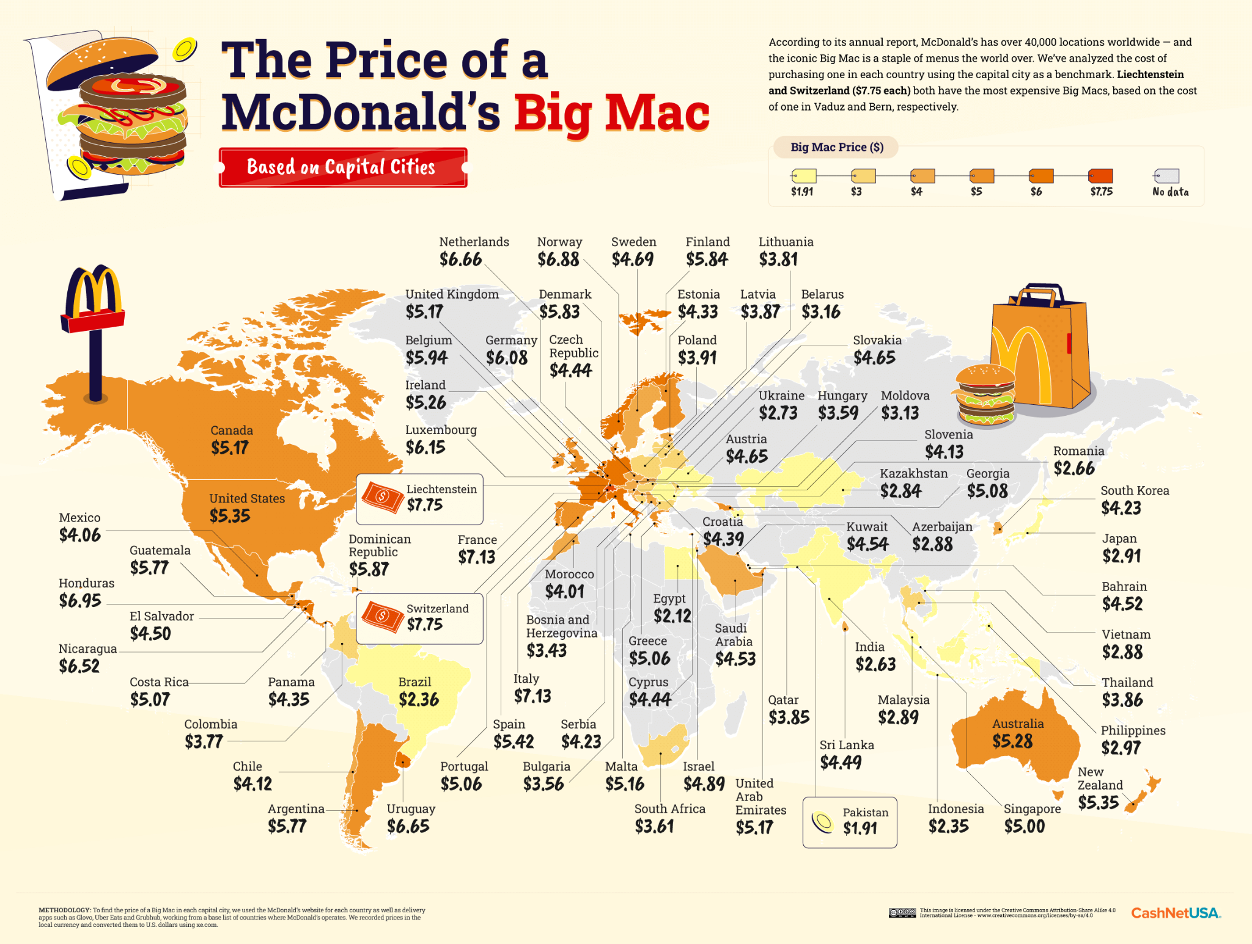
The Big Mac Index
Big Mac Index
Help students understand why prices differ in various places.
Labor is often a key factor, and this activity helps students realize why some inflation is useful.
Student examples and directions

Slide 33
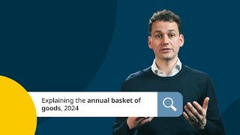
Market Basket Calculations
[infographic for reference] -- [CPI Background]
Create your U.S. Market Basket
Have student groups select and justify 5 items that should be in the market basket for America that are not likely a part of it.
Or
Ask students to come up with a list of 15 items that are evergreen - staples that will likely not be going anywhere. Check the average prices of these items today, and compare to a base year [teacher choice] to see rate of inflation.

Slide 34

Decade Posters
Decade Posters
Use FRED to look up the unemployment rate and inflation rate for each year in your particular decade.
Plot the unemployment and inflation data on a graph. Use inflation for the Y axis and unemployment for the X axis. Label each point with the year, but do not connect the points.
Research FIVE economic related events that impacted the United States economy during your decade
Analyze the economic data and events and be prepared to present the following:
  What trends do you notice between the unemployment rate and inflation rate?
  Do you notice a relationship between the inflation rate and unemployment rate for any years in your decade? (Was Phillip right or wrong? In between?)
  How did the economic events impact the inflation rate and unemployment in subsequent years?

Slide 35
More Inflation Activities
Worldwide Inflation
Winners & Losers of Inflation
Who is helped and who is hurt when inflation rolls around?
Hint: Lenders hurt, borrowers helped
Infographic
Video (warning: accurate, but meme)
Calculating Inflation
Inflation Diaries
Adjusting for inflation, predict which is cheaper!
Students interview a parent or guardian: How have rising prices changed the way they shop or save?
What was the price of bread, milk, gas, when they were growing up?

Slide 36


Slide 37
Thank you!
May your wages always outpace inflation.
Stay connected: lamonteach@gmail.com and linkedin.com/in/alexlamon

