Slide 1


Buy Now, Regret Later?
Smart Digital Spending

Slide 2



Thanks to our supporters who invest in CEE’s teacher professional development and classroom resources.

Slide 3
EconEdLink Membership Perks
As an EconEdLink member, you have access to a wealth of valuable resources! Here's a quick overview of the perks that come with your membership:
New Webinars, Lesson Plans, and Activities are added every month, keeping your teaching toolkit fresh and up-to-date.
Learn from experts in personal finance and economics tailored to K-12 education.
Free high-quality resources like presentations, lessons, and activities, all available for download.
Instant access to your professional development certificates as soon as the requirements are met.
Additionally, we’re offering a 20% discount at the CEE Store. You can purchase our bestsellers like Financial Fitness for Life and AP Economics using the code: EEL20.

Slide 4
Certificate Requirements & Materials
To earn professional development hours for webinars, you must:
Watch a minimum of 75% for our longer sessions and the full 45 minutes for our 45 minute sessions.
You will automatically receive a professional development certificate via e-mail within 24 to 48 hours.
Want to revisit today’s content? All session materials and recordings will be available on EconEdLink.org within the following day (10am EST)

Slide 5
Virtual Engagement & Etiquette
We encourage you to engage actively throughout the session!
Feel free to use the chat to ask questions
Share ideas
Or let us know if you need support
We’d love for you to turn on your camera and join the conversation to help create a more connected and collaborative environment.
To minimize distractions, please make sure your microphone is muted unless you're speaking.
At the end of the session, an evaluation form will appear. Your feedback is incredibly valuable and helps us improve future programming.

Slide 6
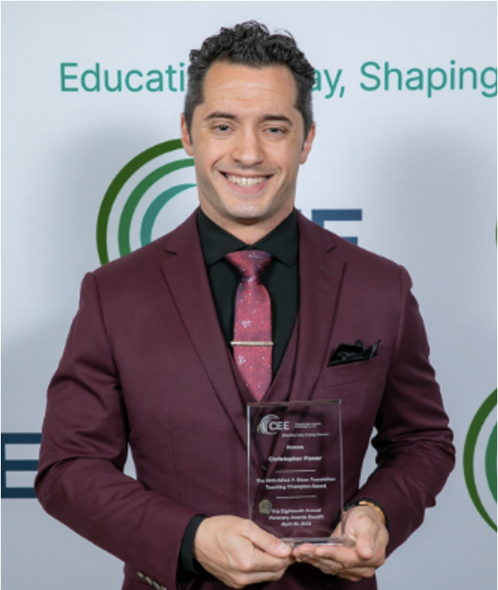
Presenter(s)
Christopher Power teaches economics, virtual enterprise, and technology to grades 9-12 at Francis Lewis High School in Fresh Meadows, NY. Christopher’s passion for finance and economics translates to unique and often loud (but entertaining!) lessons and discussion. Christopher focuses on brining real-world experiences into the classroom. Lessons include building pitch decks, analyzing economic data, calculating mortgage payments, managing money, and more. Christopher’s teaching approach is extremely popular with the students: he has grown the business program from 68 to 306 students per year. What matters to him most is creating career ready students who are capable of making calculated life and financial decisions. Christopher shared, “Financial literacy and economic education buys freedom. Evidence suggests 80% of people are financially illiterate. So, contrary to popular belief, money is not the root of all evil, the lack of financial literacy is.”
cpower29@gmail.com
www.linkedin.com/in/cpower

Slide 7
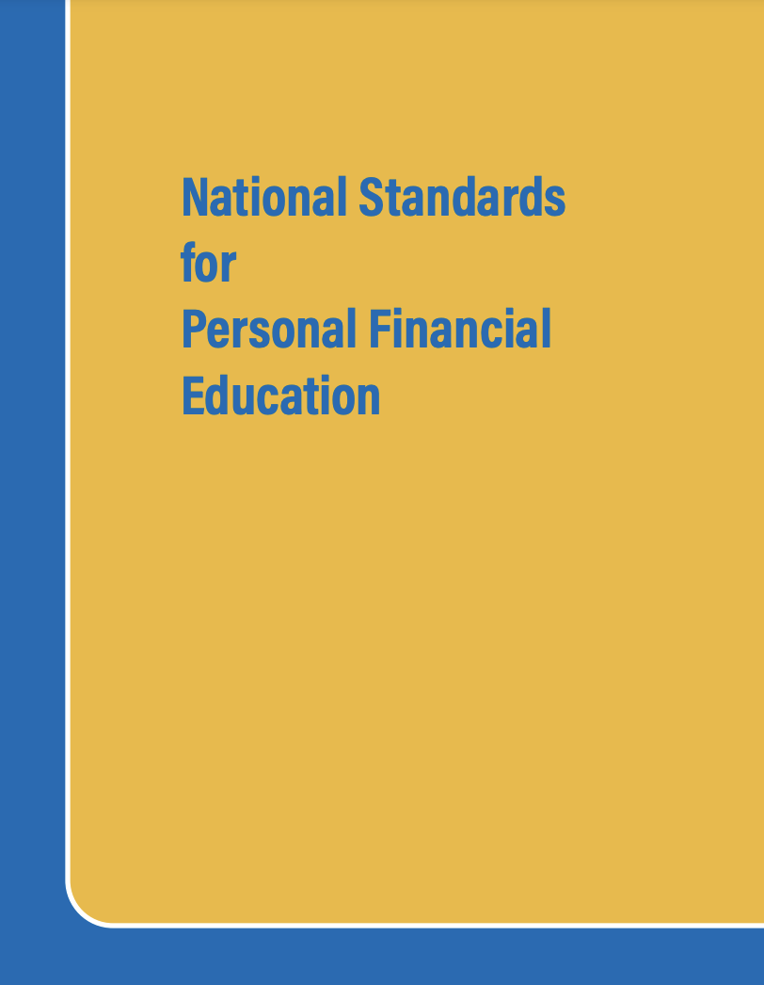
National Standards
Earning Income
Spending:
Saving
Investing
Managing Credit
Managing Risk
https://www.councilforeconed.org/policy-advocacy/k-12-standards/

Slide 8
Unlocking Consumer Financial Literacy
We live in a world of one-click purchases, influencer promos, and Buy Now Pay Later apps, students face an increasingly complex digital marketplace.
This session explores how to help students become thoughtful, informed consumers by understanding the psychology behind brand loyalty, digital marketing, and spending incentives.
We’ll break down how influencer culture, targeted ads, and payment tech shape decision-making—and offer frameworks to guide students in evaluating financial choices critically.
Learn how to foster digital financial literacy through engaging, real-world lessons that empower students to resist impulse, understand long-term consequences, and make smarter spending decisions online.

Slide 9
Objectives
You will be able to:
Feel comfortable unpacking data and concepts around consumer behavior
Break down concepts around spending & spending habits
Understand more about decision-making framework
Be able to implement effective and interactive pedagogical strategies for teaching financial literacy in real-world scenarios

Slide 10

Session Agenda
Item 1 - Ice Breaker - Coffee Chat about issues with teaching financial literacy. [10m]
  Lesson 1 – Video "Do Now's" with AI Q&A [25m]
  Lesson 2 – Myth Busting Consumer Behavior with Steven Stern (CPA, Partner & CFO @ Shepherd Wealth Group) [25m]
  Lesson 3 - Let's Play Financial Advisors in 2025 [25m]
  Lesson 4 – 2 CEE Consumer Lessons [20m]
  Resources & Share out best practices [15m]

Slide 11

1 - Coffee Chat

Slide 12

Coffee Chat
What is the best part about teaching
Financial Literacy?
Struggles: Students? Parents? Admin?
Success stories?
Habits we see in our students (or their parents)?
List key terms/concepts on consumer behavior?
Controversial Strategy I am trying this year. Removing GDP as an "economic indicator" & replacing it with a "20s 30s Survey"

Slide 13
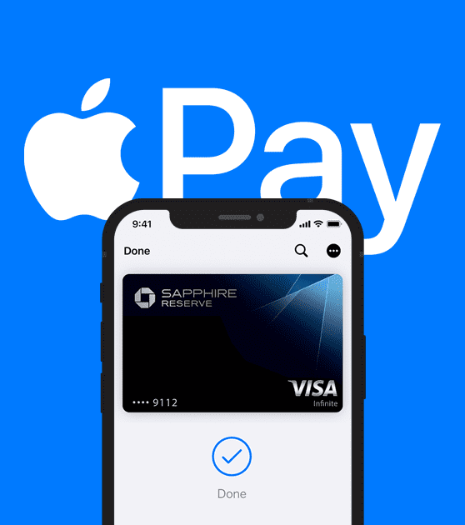
Lesson 1 – Video Do Now's
Consumer Behavior & BNPL
ThePhoto by PhotoAuthor is licensed under CCYYSA.
ThePhoto by PhotoAuthor is licensed under CCYYSA.

Slide 14
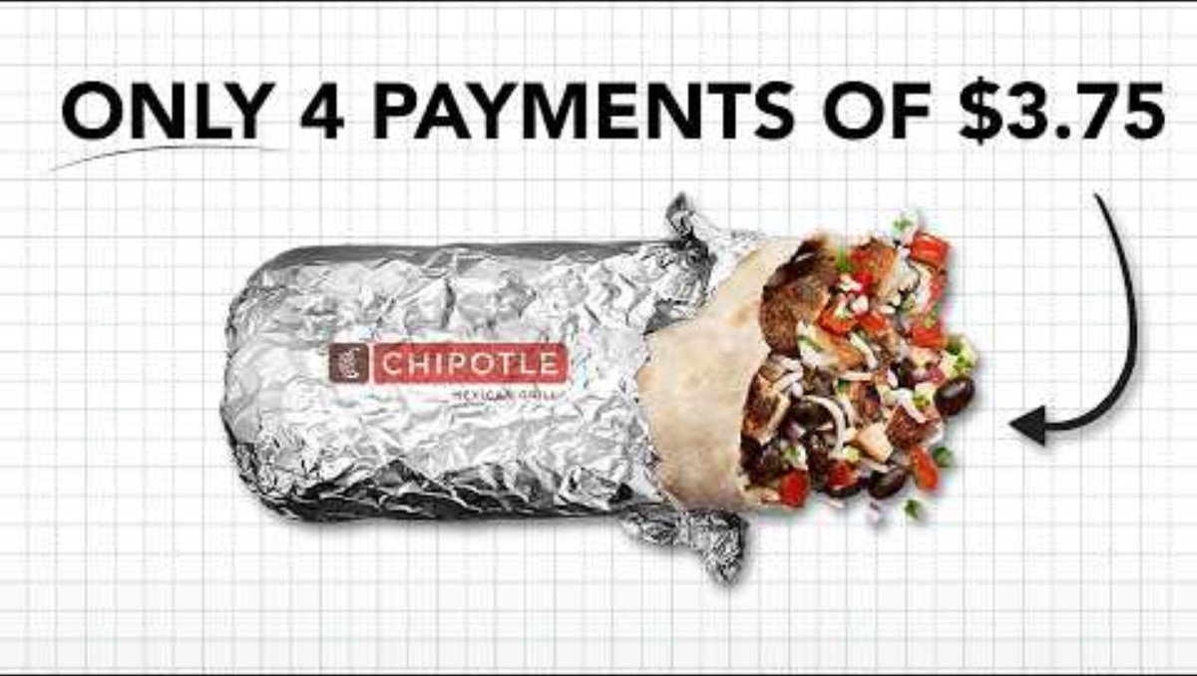
Consumer Behavior & BNPL
Introduction to BNPL / Pay in 4 (12m)
https://www.youtube.com/watch?v=KkN6I3gZfGI

Slide 15
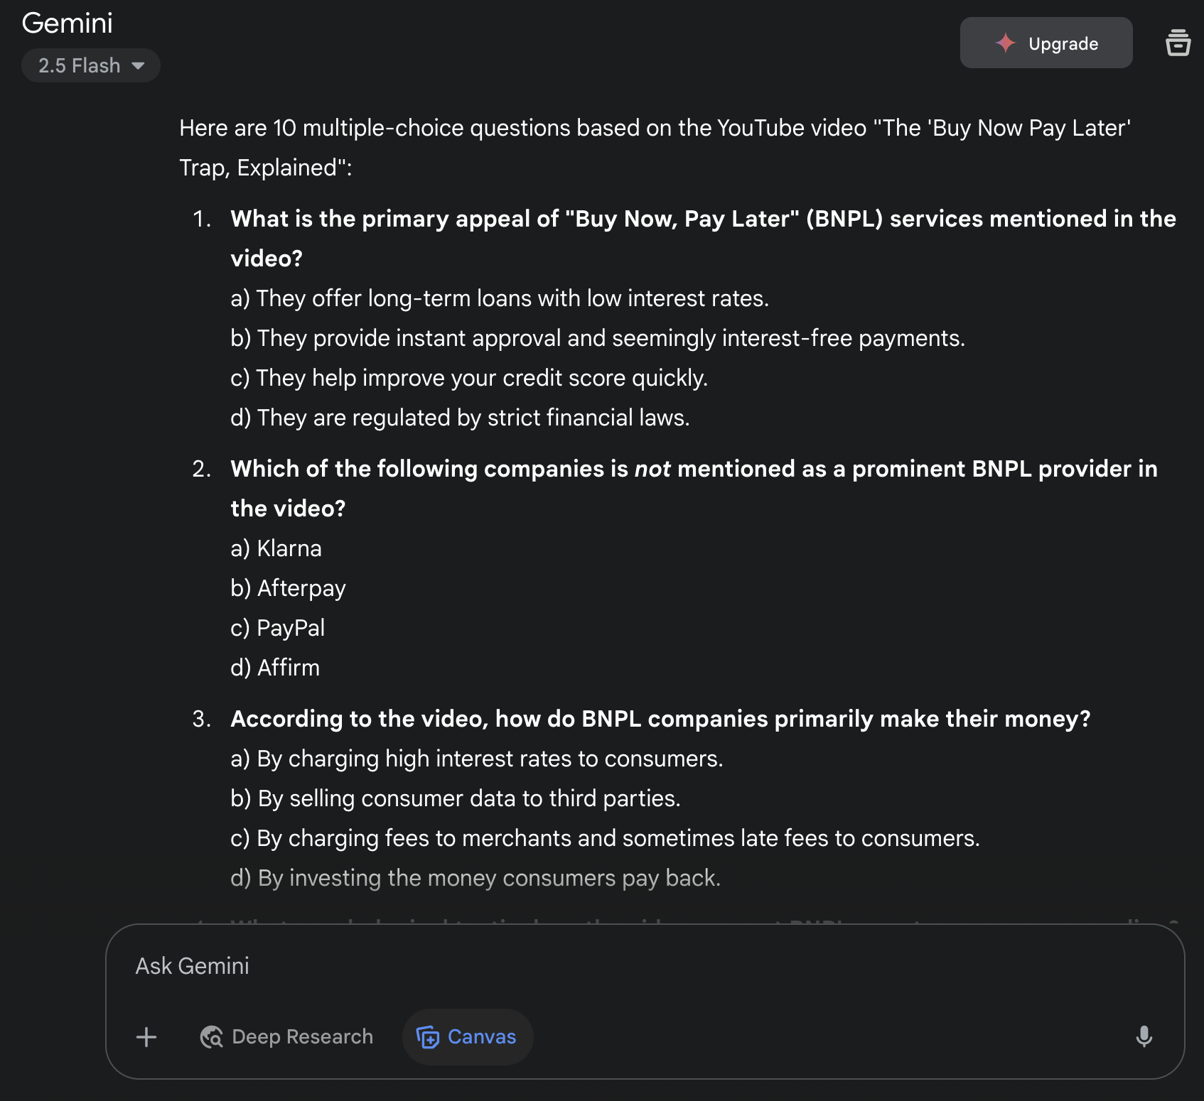
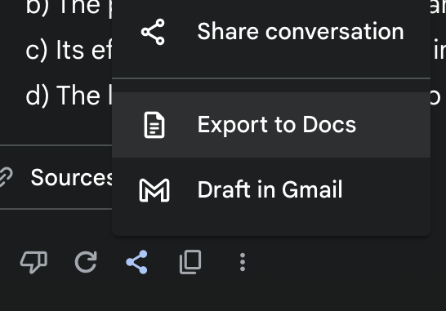
Consumer Behavior & BNPL
Link:
  https://www.youtube.com/watch?v=KkN6I3gZfGI%E2%80%8B
AI Question Generator:
  Gemini.google.com
Use the Prompt below:
  " Make me 10 multiple choice questions from this youtube video - https://www.youtube.com/watch?v=KkN6I3gZfGI "
  Export to Google Docs or Copy
  Create a Google Form Quiz

Slide 16
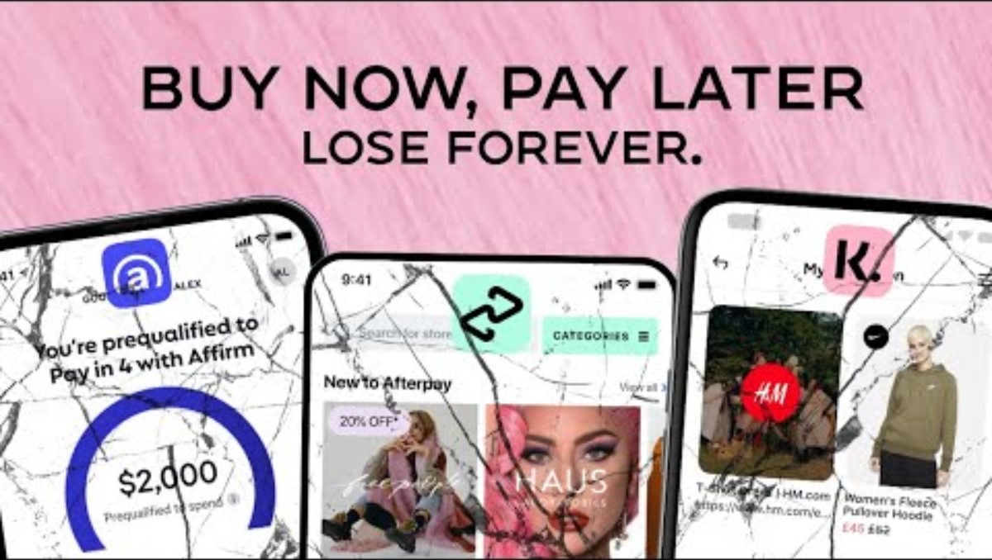

Consumer Behavior & BNPL
Conspiracy Theory BNPL vs 2008 Recession (39m)
After Students Understand Credit Scores (2m)
https://www.youtube.com/watch?v=R1JaMRpcDrQ
https://www.youtube.com/watch?v=iVjQMuR7eaw

Slide 17
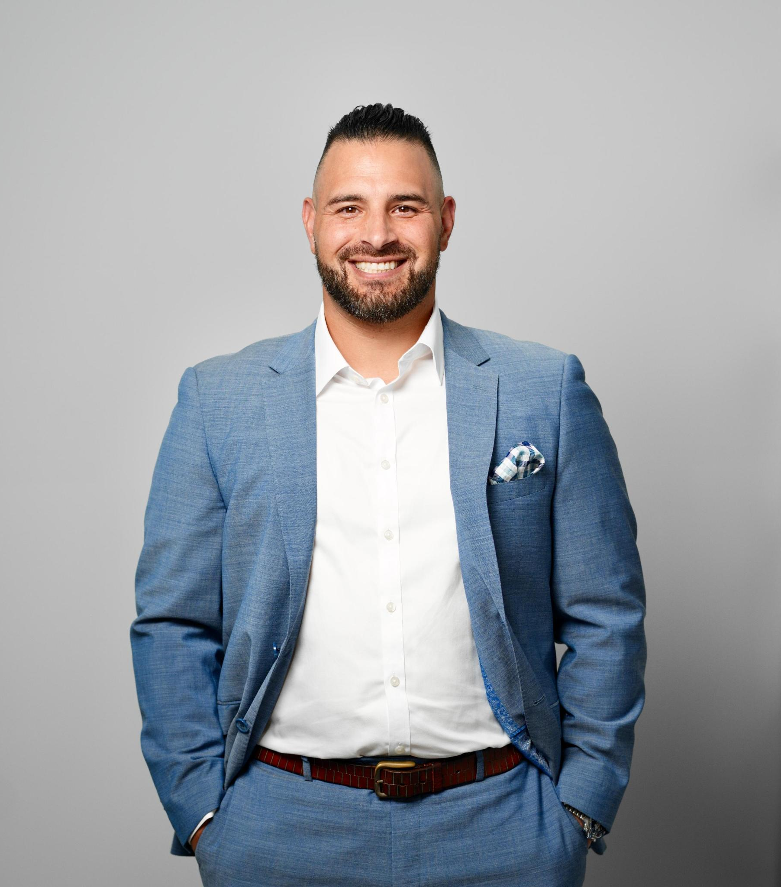
Lesson 2
Myth Busting Consumer Behavior with Steven Stern
CPA, Partner & CFO Shepherd Wealth Group
www.shepherdwealthgroup.com info@shepherdwealthgroup.com

Slide 18
Myth Busting Consumer Behavior
Objective:
  To provide students with direct access to professional financial expertise, fostering a deeper understanding of real-world financial concepts and empowering them to ask informed questions that directly impact their lives and future decisions.
Key Takeaways:
  Financial Literacy is Lifelong: Recognize that managing money is a learning process.
  Real-World Relevance: Connect classroom concepts to practical, everyday situations
  Value of Professional Advice: Understand the role of a financial advisor and how they can help navigate complex financial decisions.
  Empowered Questioning: Develop the confidence and ability to ask pertinent questions about personal finance, addressing individual concerns and misconceptions.
PollEverywhere.com for anonymous surveys - For This PD use - PollEv.com /cpower

Slide 19
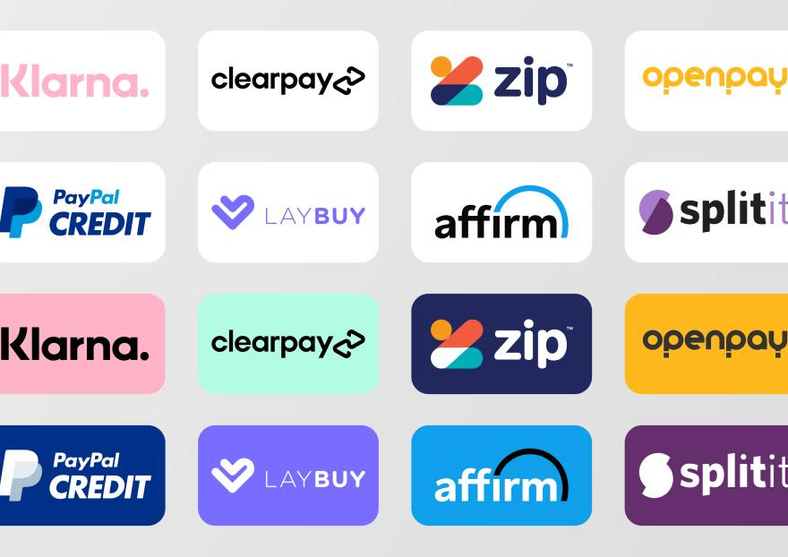
Myth Busting Consumer Behavior
30% of Consumers use BNPL.

Slide 20
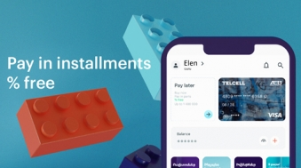
Myth Busting Consumer Behavior
BNPL doesn't affect your credit score.

Slide 21
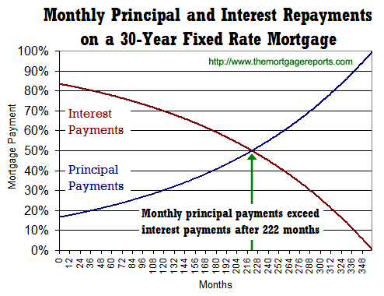
Myth Busting Consumer Behavior
Make additional mortgage payments to pay off your mortgage early.

Slide 22
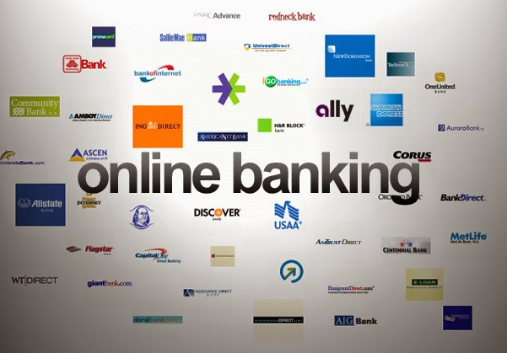
Myth Busting Consumer Behavior
Keeping track of BNPL & Credit Cards are relatively easy in 2025.

Slide 23

Myth Busting Consumer Behavior
You need to hire an advisor for financial decisions.

Slide 24

Myth Busting Consumer Behavior
High Income leads to wealth.

Slide 25
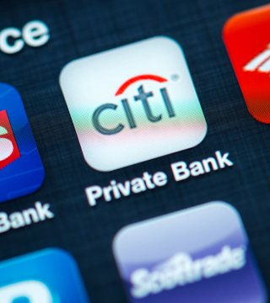
Lesson 3
Let's Play: Financial Advisors in 2025

Slide 26

Let's Play: Financial
Advisors in 2025
Six case studies focusing on "buy now pay later" and consumer behavior. Each case study prompts for a “financial advisor” to advise them. - Lesson Link: here
PD Activity
Breakout Rooms
6 Rooms for 6 Case Studies
10 Minutes to read and discussion the questions. Select a point person to speak for your room.
Share out

Slide 27
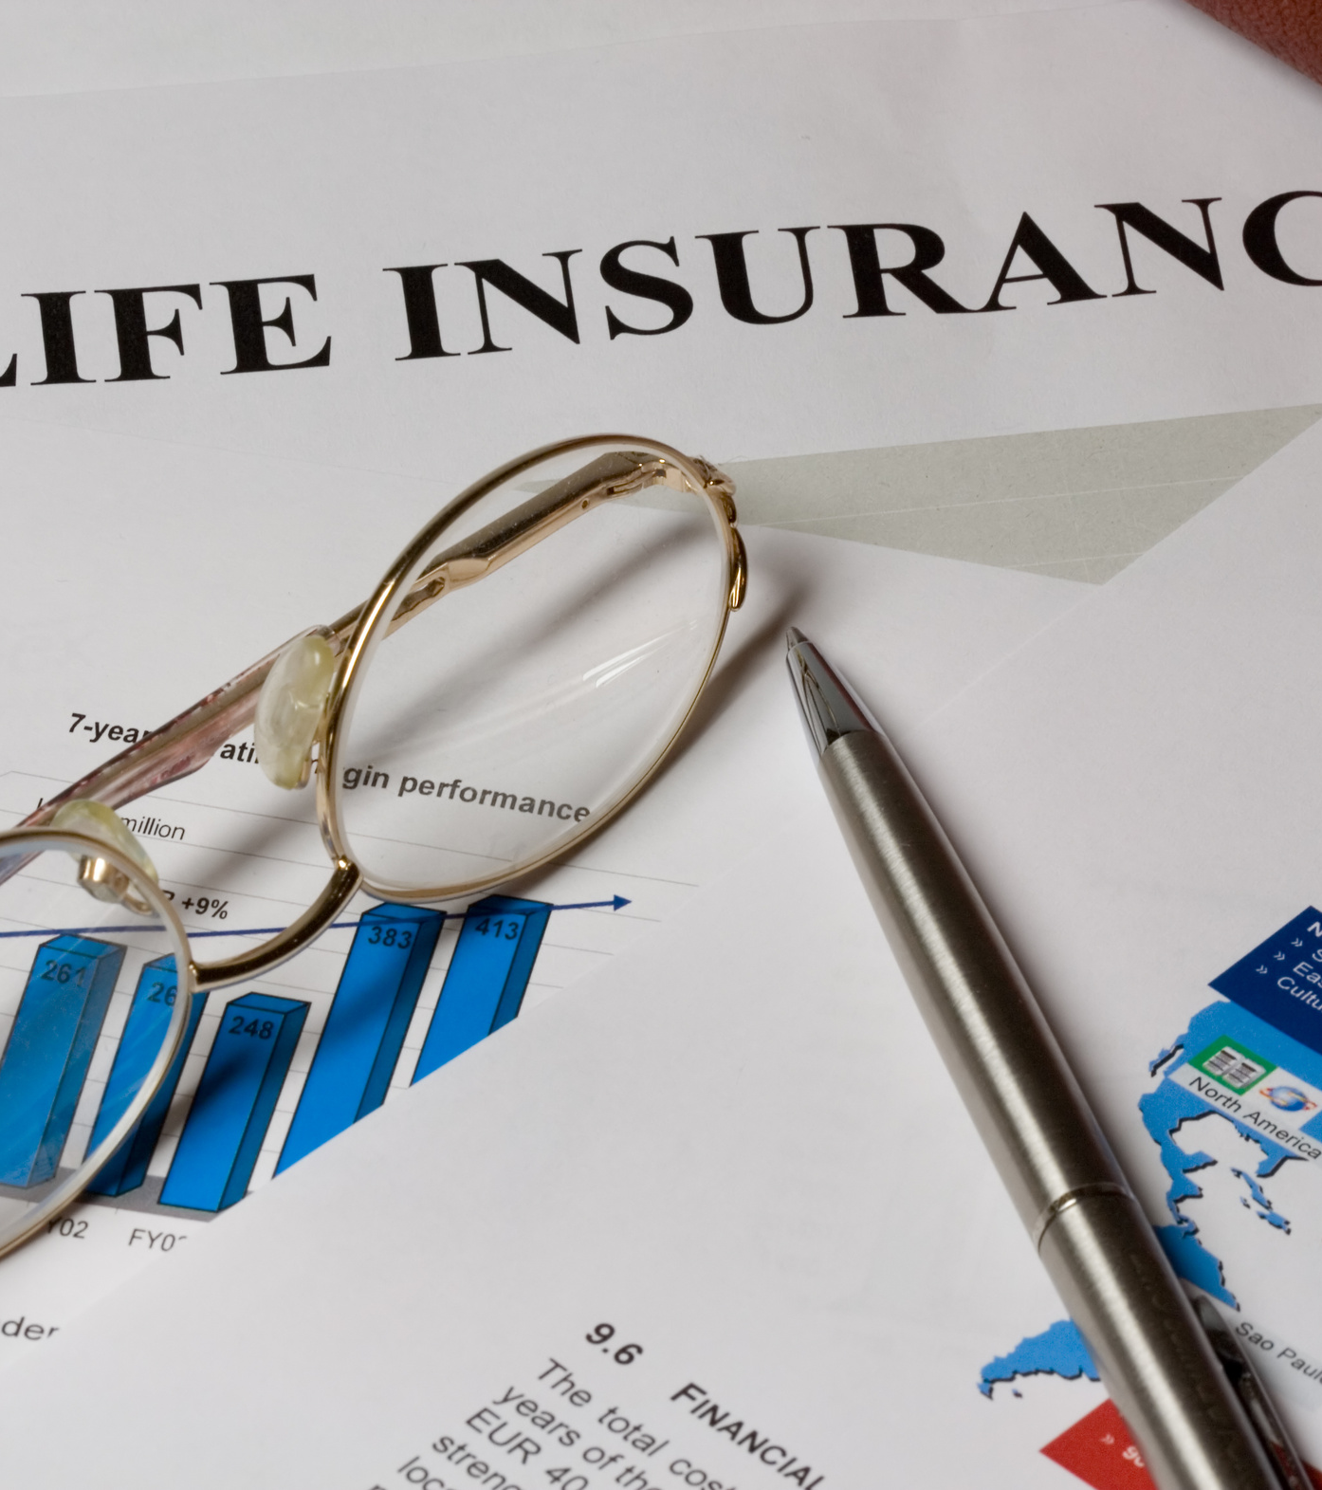
Lesson 4
Two CEE BNPL Lessons
ThePhoto by PhotoAuthor is licensed under CCYYSA.

Slide 28
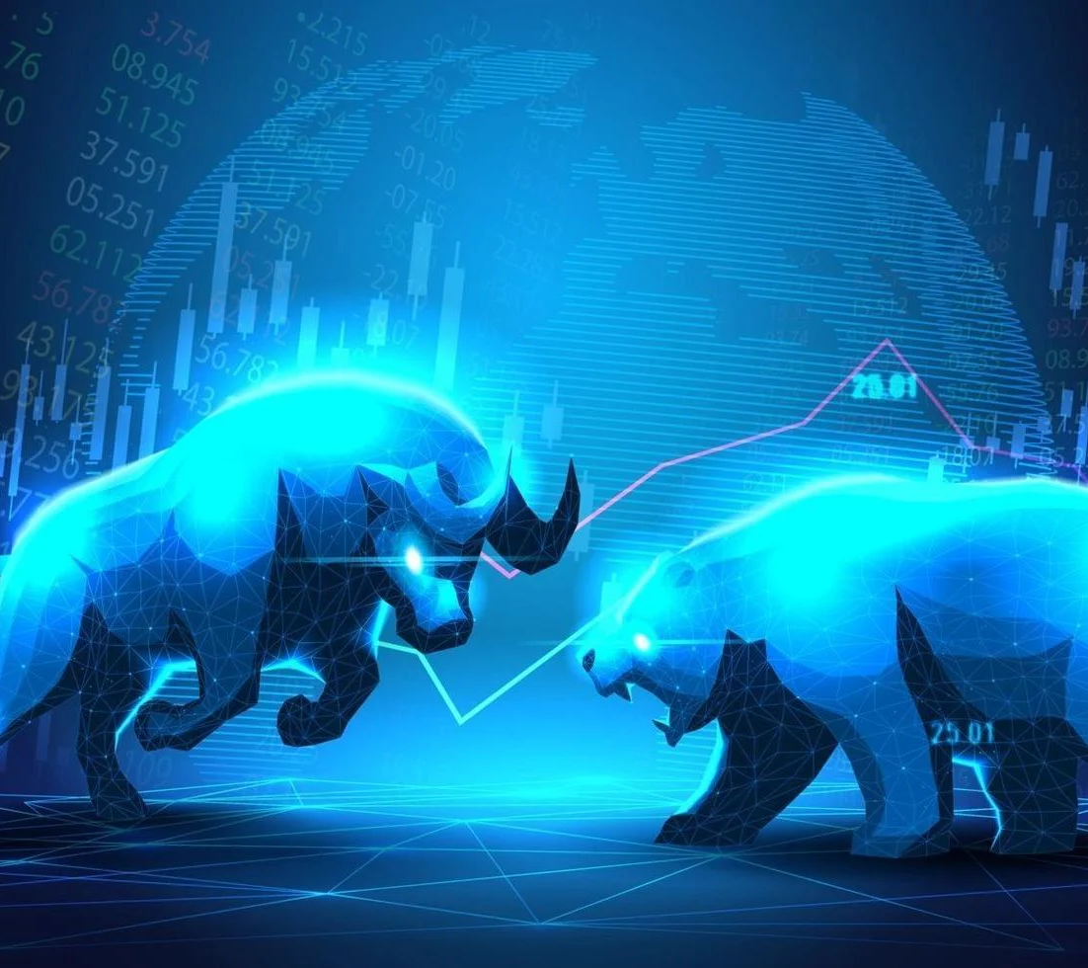
CEE Lessons - CREDIT
Credit Webinar, Lesson Plan & PPT:
https://econedlink.org/webinar/personal-finance-series-buy-now-pay-later/
Takeaways:
  The difference between traditional vs. non-traditional credit
  Understand credit boosters
  Analyze the pros and cons of “Buy Now, Pay Later” options Review the features of credit builder loans

Slide 29
CEE Lessons – CONSUMER CHOICE
Consumer Choice Lesson Plan:
https://econedlink.org/resources/how-e-commerce-influences-consumer-choice/
Takeaways:
  Allow price to influence you.
  Realize how consumer choice reflects decisions based on personal values, financial constraints and wants
  Appreciate substitutes

Slide 30


Slide 31

Thank you
Stock Ticker Contact
Eric Bala | E: EricB@EmpireUSA.com | T: 1.631.544.9111 | EMPIRE ELECTRONICS USA | 103 Fort Salonga Road Northport NY, 11768 USA Serving the industry for over 40+ years| www.empireusa.com

