Slide 1


CEE's 2025 Summer Institute
Bad Bunny to Swifty Hooking Students on Econ & History Through Music & Culture
FIRESIDE CHAT

Slide 2

Opening Remarks and Introductions

Slide 3



Thanks to our supporters who invest in CEE’s teacher professional development and classroom resources.

Slide 4
EconEdLink Membership Perks
As an EconEdLink member, you have access to a wealth of valuable resources! Here's a quick overview of the perks that come with your membership:
New Webinars, Lesson Plans, and Activities are added every month, keeping your teaching toolkit fresh and up-to-date.
Learn from experts in personal finance and economics tailored to K-12 education.
Free high-quality resources like presentations, lessons, and activities, all available for download.
Instant access to your professional development certificates as soon as the requirements are met.
Additionally, we’re offering a 20% discount at the CEE Store. You can purchase our bestsellers like Financial Fitness for Life and AP Economics using the code: EEL20.

Slide 5
Certificate Requirements
To earn professional development hours for webinars, you must:
Watch a minimum of 75% for our longer sessions and the full 45 minutes for our 45 minute sessions.
You will automatically receive a professional development certificate via e-mail within 24 to 48 hours.

Slide 6
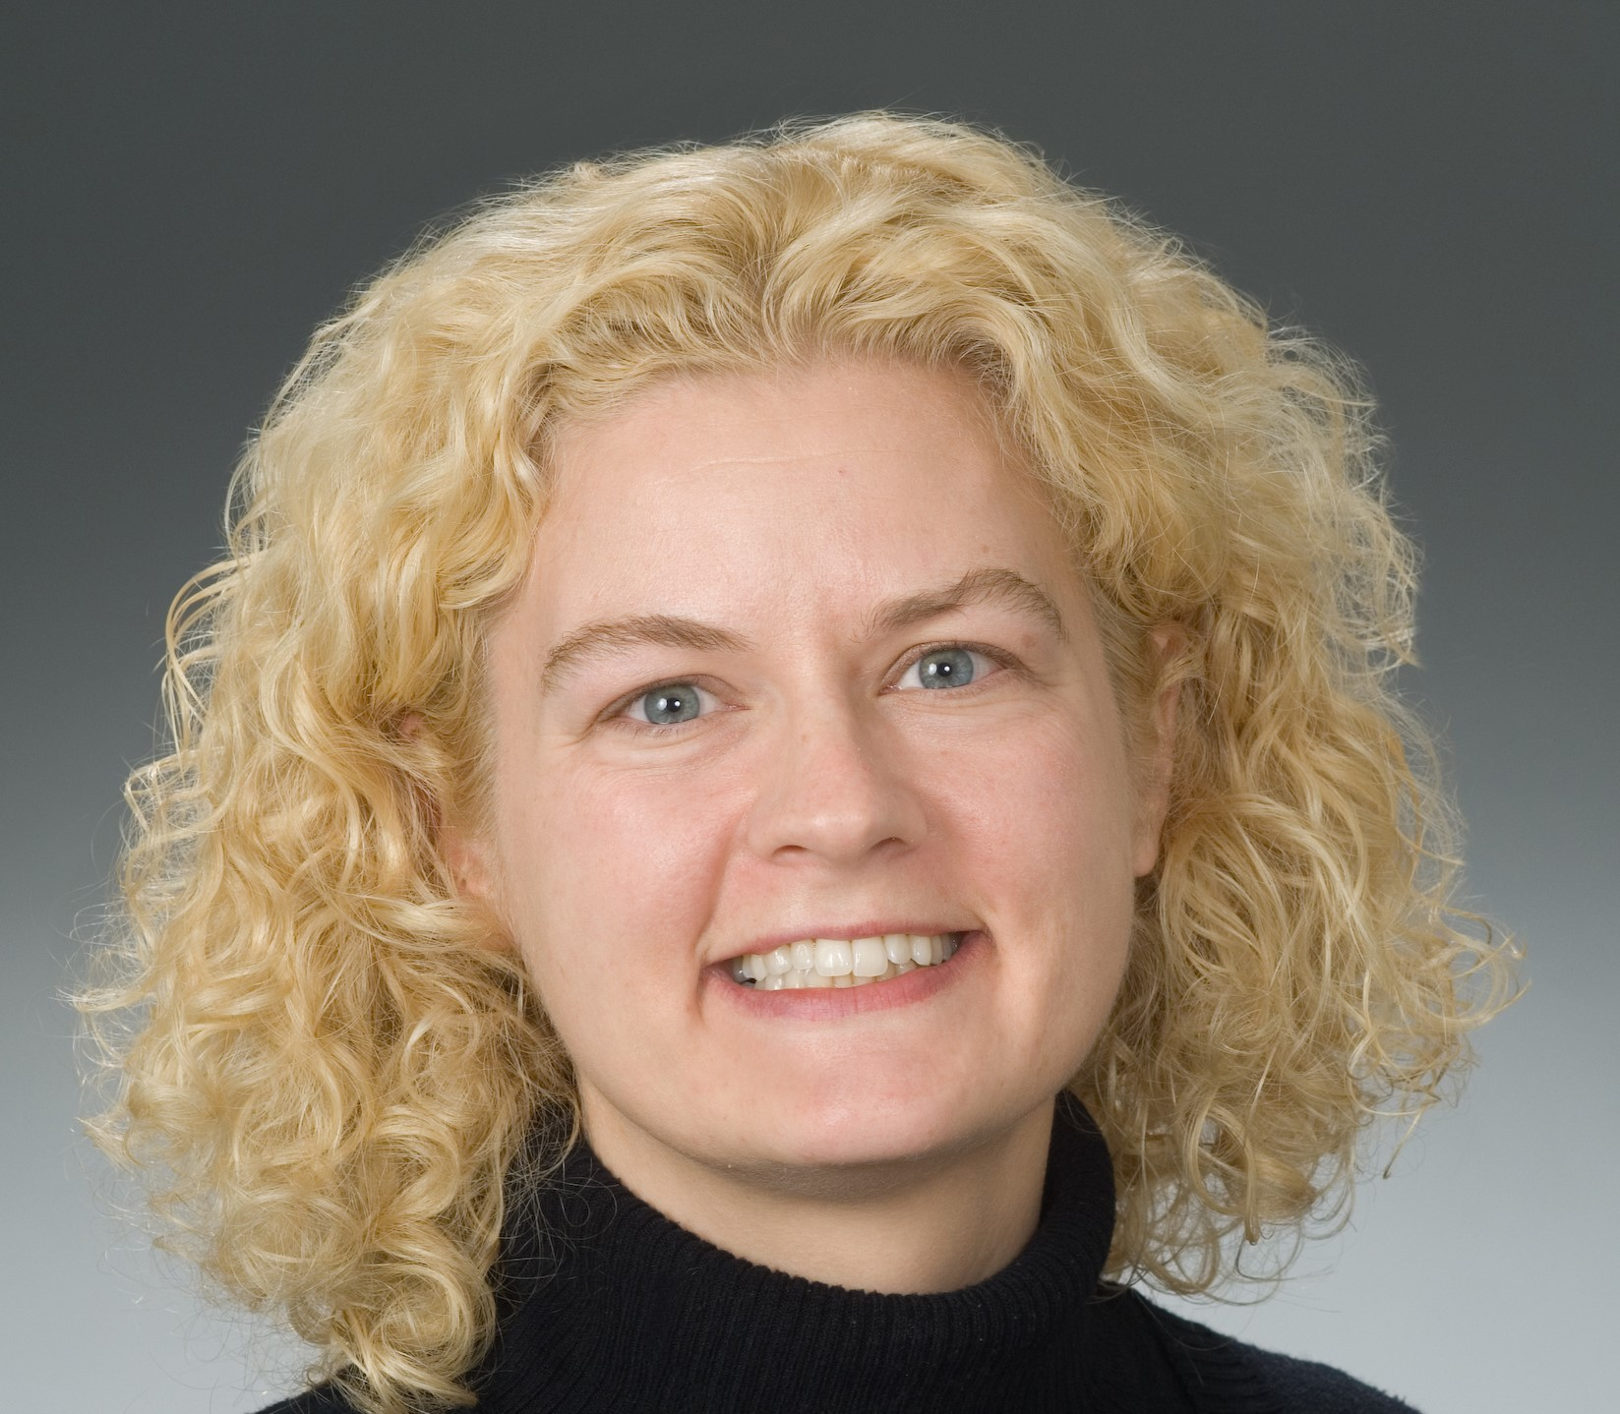
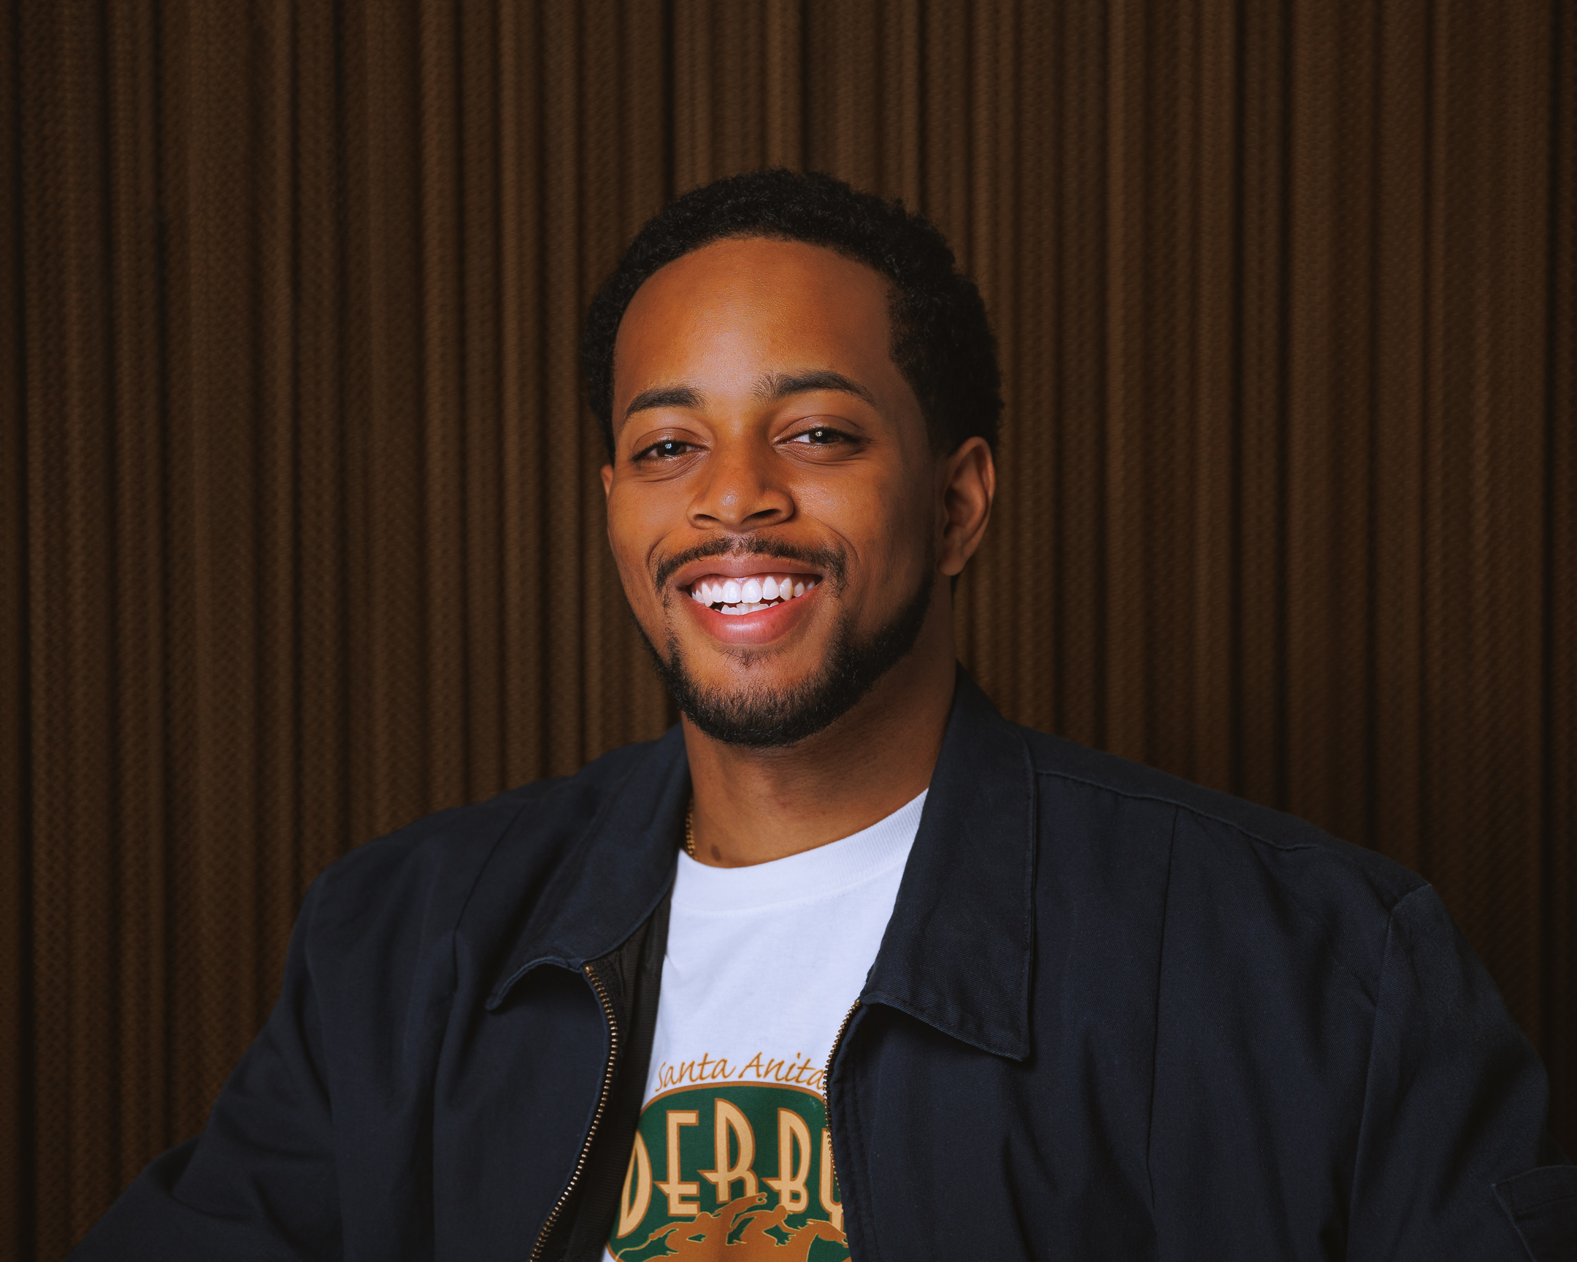
Keynote Speakers
Kara Reynolds
Professor of Economics
American University
Justin Polk
Awaken your students’ passion for creativity
SoundTrap for Education

Slide 7
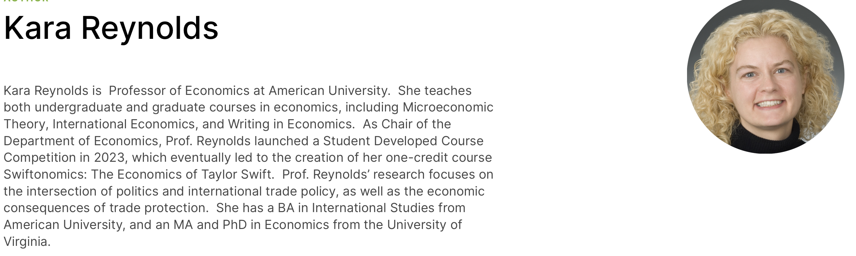

Slide 8


Slide 9

Fireside Chat + Q&A

Slide 10

Closing Remarks

Slide 11
Citations
Milovanska-Farrington, Stefani, Wayne Geerling, and G. Dirk Mateer. "Female influencers: The economics behind the millions." Available at SSRN 4627440(2023).
Dahlberg, Kelsey Halfen, et al. "Behind the billions: how Taylor Swift and MrBeast can be used to teach economics." International Journal of Pluralism and Economics Education 15.1 (2024): 69-89.
Halfen Dahlberg, Kelsey, et al. "Swiftonomics: Using Taylor Swift to Teach Supply and Demand and Foreign Exchange Rates." Available at SSRN 4721864 (2024).
Krueger, Alan B. Rockonomics: A backstage tour of what the music industry can teach us about economics and life. Crown Currency, 2019.
Freakonomics, “Why is the Live-Event Ticket Market So Screwed Up?” December 6, 2017, https://freakonomics.com/podcast/why-is-the-live-event-ticket-market-so-screwed-up/.
“Community Corner: Data Enchanted,” Stata News 40(1) January 2025, https://www.stata.com/stata-news/news40-1/community-corner-data-enchanted/

Slide 12


