Slide 1


2025 Summer Institute:
Students First – Fresh Strategies for Managing a Purpose Driven Classroom

Slide 2



Thanks to our supporters who invest in CEE’s teacher professional development and classroom resources.

Slide 3
EconEdLink Membership Perks
As an EconEdLink member, you have access to a wealth of valuable resources! Here's a quick overview of the perks that come with your membership:
New Webinars, Lesson Plans, and Activities are added every month, keeping your teaching toolkit fresh and up-to-date.
Learn from experts in personal finance and economics tailored to K-12 education.
Free high-quality resources like presentations, lessons, and activities, all available for download.
Instant access to your professional development certificates as soon as the requirements are met.
Additionally, we’re offering a 20% discount at the CEE Store. You can purchase our bestsellers like Financial Fitness for Life and AP Economics using the code: EEL20.

Slide 4
Certificate Requirements & Materials
To earn professional development hours for webinars, you must:
Watch a minimum of 75% for our longer sessions and the full 45 minutes for our 45 minute sessions.
You will automatically receive a professional development certificate via e-mail within 24 to 48 hours.
Want to revisit today’s content? All session materials and recordings will be available on EconEdLink.org within the following day (10am EST)

Slide 5
Virtual Engagement & Etiquette
We encourage you to engage actively throughout the session!
Feel free to use the chat to ask questions
Share ideas
Or let us know if you need support
We’d love for you to turn on your camera and join the conversation to help create a more connected and collaborative environment.
To minimize distractions, please make sure your microphone is muted unless you're speaking.
At the end of the session, an evaluation form will appear. Your feedback is incredibly valuable and helps us improve future programming.

Slide 6
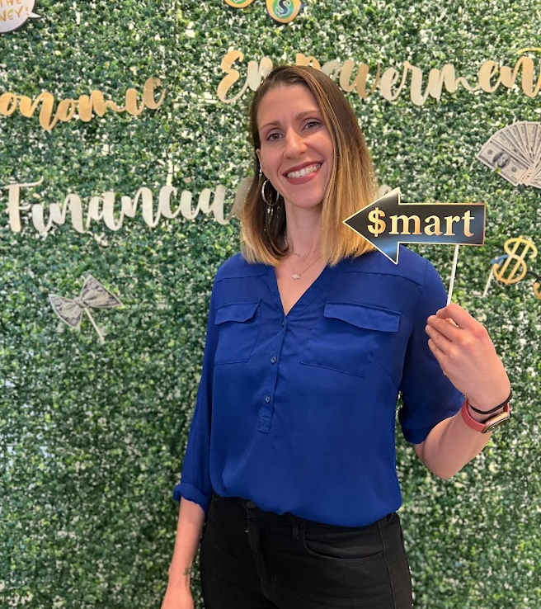
Presenter(s)
¡Hola! I'm Diana Isern:
  Assistant Principal - New York City Public Schools. 20 years in!
  Financial Educator & Advocate
  Curriculum Designer
  AFC® (Accredited Financial Counselor)
Email me! Disern@schools.nyc.gov
LinkedIn me! linkedin.com/in/dianaisern
Instagram me! @Dianadinero_edu

Slide 7
Objectives
You will be able to:
Prioritize student voice and ownership
Build purposeful classroom routines
Use Econ and Personal Finance as leadership platforms

Slide 8
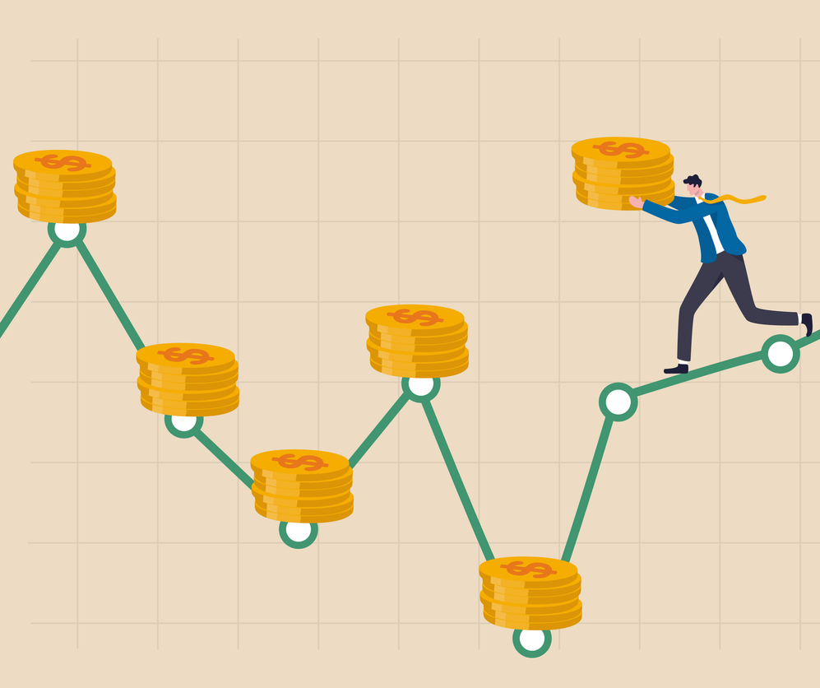
Session Agenda
Introduction: Yay you're here!
Opening: Community Wealth
Part 1: Student Voice Through Routines
Part 2: Leadership Strategies That Empower
Part 3: Student-Centered Activities
Closing & Resources

Slide 9

Grounding:
Community Wealth

Slide 10

Opening Connection
What's one financial message you remember from music, social media, or your family growing up?

Slide 11

Community Share...
A money message you have heard students share
Forms of wealth you have observed in your students' communities
Your own non-financial wealth (skills, cultural knowledge, languages)
What wealth patterns are showing up in our group?​

Slide 12
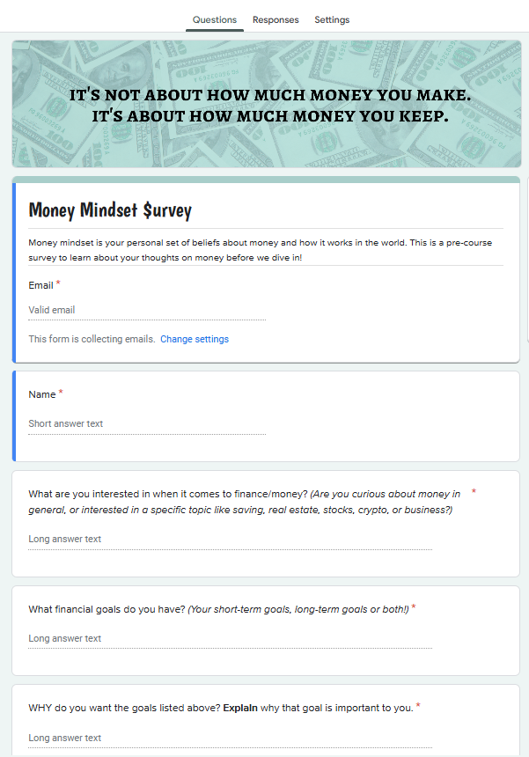
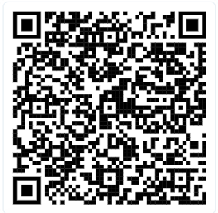
Takeaway
Money Mindset Survey
Read the answers thoroughly to build connection and trust
Give the survey in first week to know the forms of wealth students are bringing into the classroom.
It also reveals gaps, and what will engage students!

Slide 13

Bridge to Session
To truly center student voice and leadership, we first need to examine our own perceptions—what we assume students can or can't do—and how those assumptions shape the opportunities we create.
That’s why it’s essential to approach this work with an abundant mindset: one that sees potential over limitation.
Today we'll explore three ways to build on student strengths—through daily routines, discussion strategies, and student-centered activities.

Slide 14

Part 1:
Building Student Voice Through Routines

Slide 15
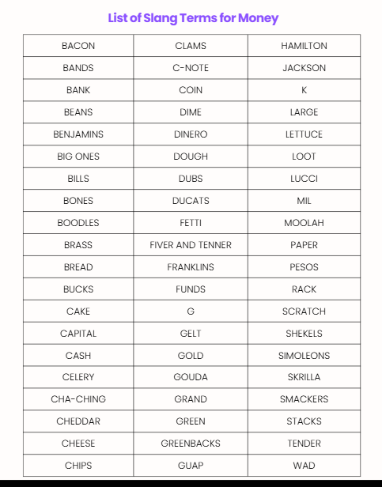
Routine #1
Diana Dinero Introductions
Purpose: Break the ice with humor and envision your future money-making self!
Give students a list of slang money terms:
  Link: 11 Gen Z Money Phrases
  Link: Break the Bank with Slang Terms For Money
Students create a money $ name combining a money slang term with their name. The cornier the better.
Have students make a nametag or placard and introduce themselves to the class.
Extra Fun: Teacher and students refer to each other by their $ names during class.

Slide 16
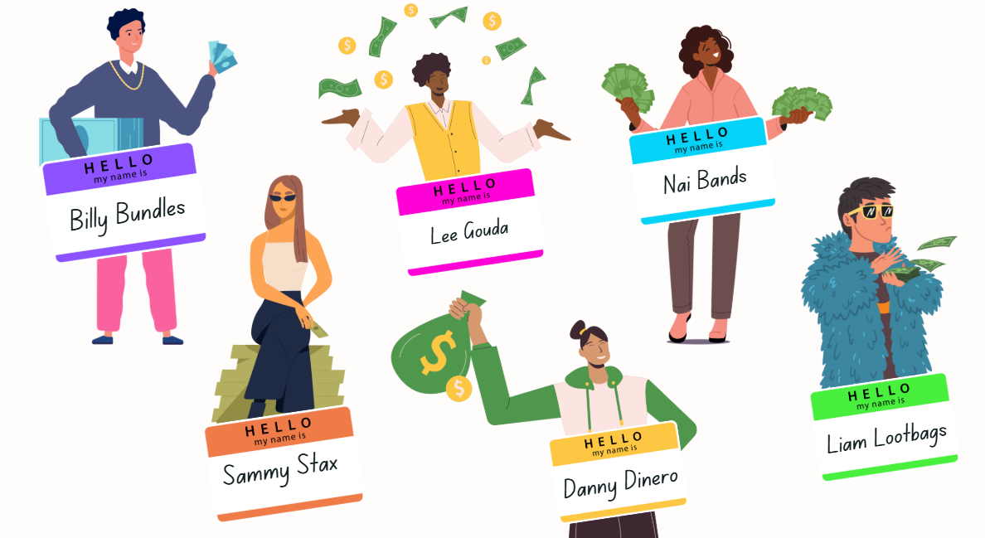
Classroom Examples

Slide 17

Share Out
Drop it in the chat, what's your $ name?

Slide 18

Routine #2
Get Paid Do Now: DEMO
Read your Chime money horoscope. Is it true for you? Why or why not?
Put link in chat: https://www.chime.com/blog/your-money-horoscope-what-your-astrological-sign-says-about-your-money-habits/

Slide 19
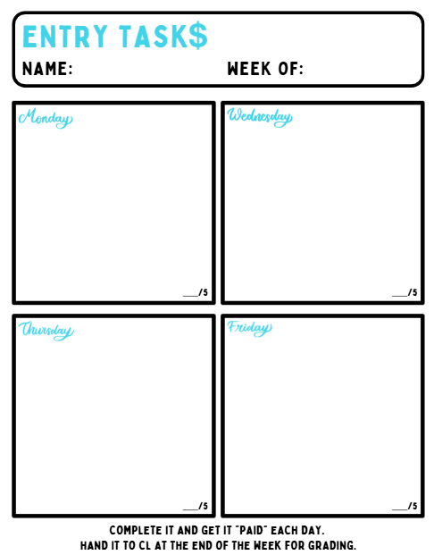
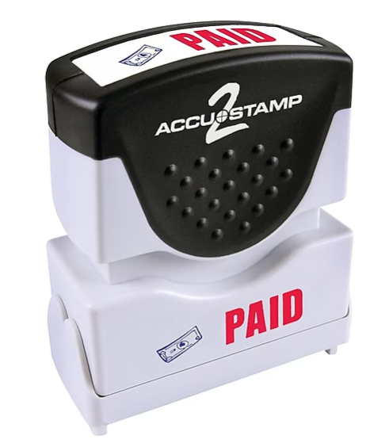
Routine #2
Get Paid Do Now
Purpose: Prompts invite students to reflect on their financial beliefs and experiences in imaginative ways, students feel safe to explore topics often seen as intimidating.
Use engaging prompts such as: ​
  Create your money motto in 6 words
  Money wisdom from your family in 10 words or less
  Complete: Money is like ___ because ___​
You can stamp them, or choose a different student (maybe who’s birthday is coming up) to read them, stamp them, and choose 2 to share out​
Students can lead collection/distribution

Slide 20
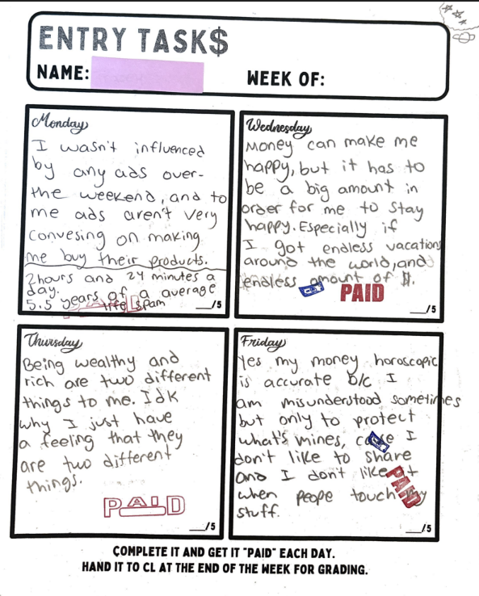
Classroom Examples
Monday-What advertising tactics did the Superbowl ads use? Did any of them work on you?
Wednesday-What amount of money do you think would make you "happy"?
Thursday-Is being wealthy and being rich the same to you? Why or why not?
Friday-Is your Chime money horoscope true for you? Why or why not?

Slide 21
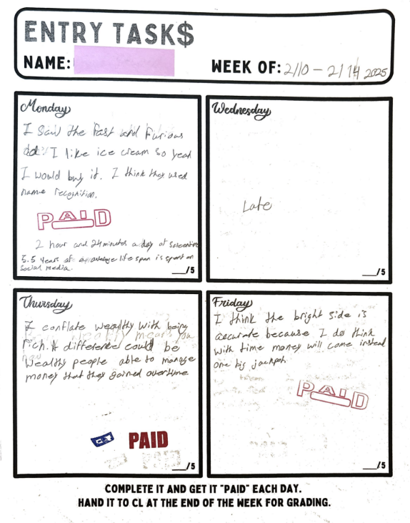
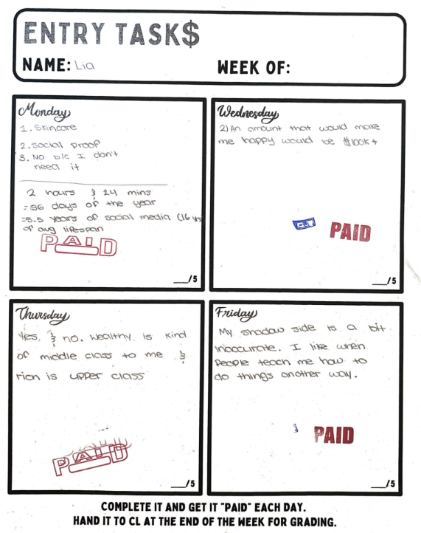

Slide 22
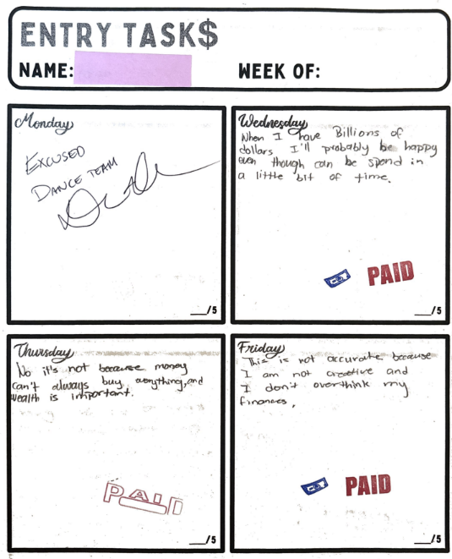
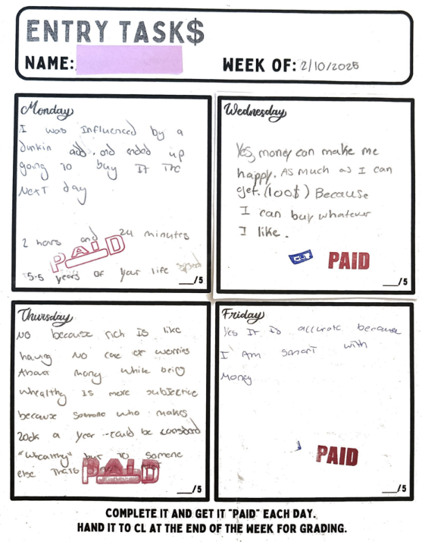

Slide 23
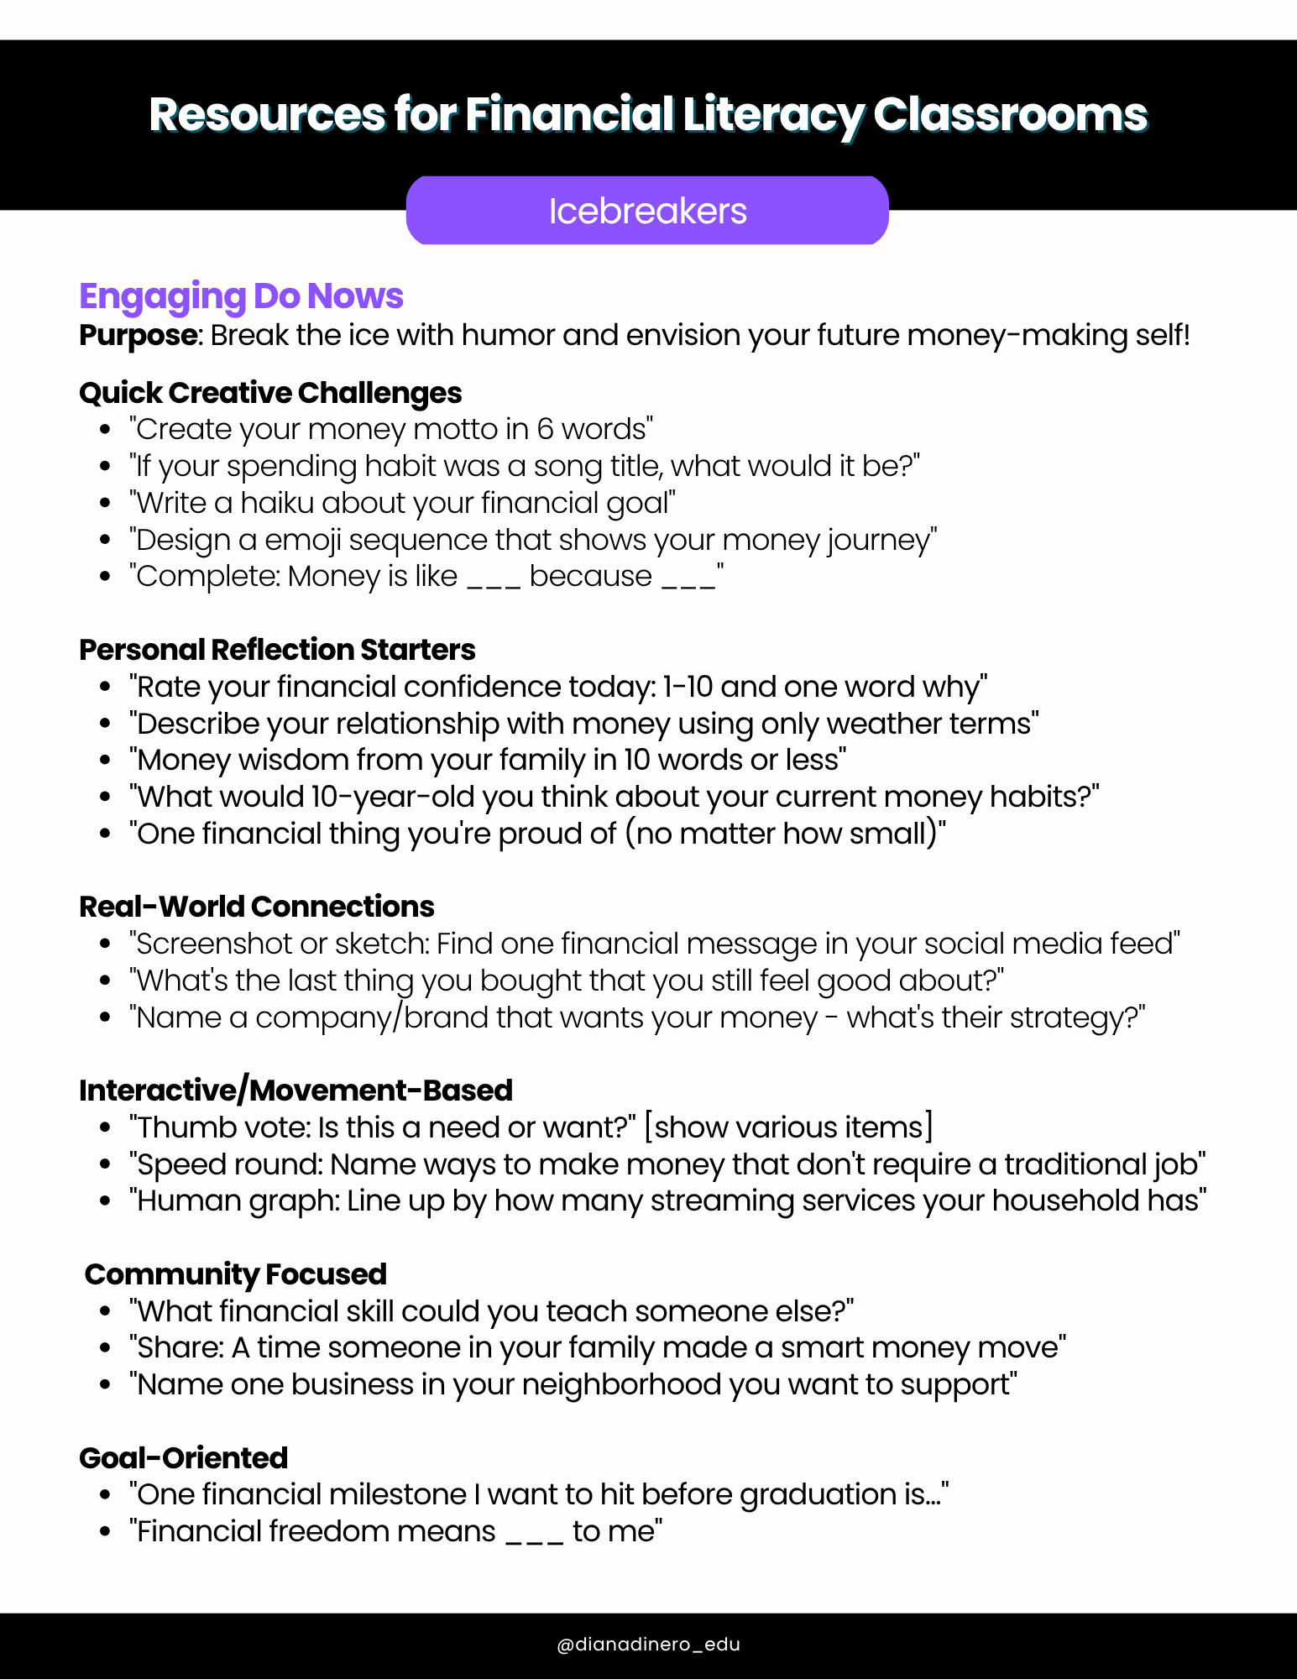
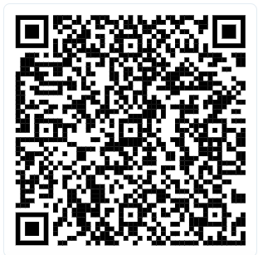
Takeaway
Engaging Do Now Questions

Slide 24
Breakout #1
Design Your Purpose-Driven Routine
Task: Design one daily/weekly routine that:
Centers student voice and ownership
Connects to real-world finance/economics
Can become student-led after modeling
Guiding Questions:
What would this look like in Week 1 vs 10?
Which students would thrive leading this?
How does it build community?

Slide 25
Share Out
What purpose-driven routine did you create?

Slide 26
Part 2:
Leadership Strategies for Student Ownership and Voice

Slide 27
Activity #1
Money Mindset Four Corners: DEMO
Success means financial independence.
Some people just have the knack for being good with money, and others don't.
My financial habits are mostly inherited from my upbringing.
Media and culture shape how I view money, whether I like it or not.

Slide 28
Activity #1
Money Mindset Four Corners
Purpose: Debatable prompts allow students to reflect on their financial beliefs, make connections to peers, understand money mindsets are similar or different based on lived experiences
Set up the room with four corners: Strongly Agree, Agree, Disagree, Strongly Disagree
Give students statements such as:
  "Debt is always bad"
  "Money conversations should stay private"
After they choose, have a student from each side share out.
Then push participants who chose "agree" or "disagree" to take a strong stance.
How does taking a stance change engagement?

Slide 29
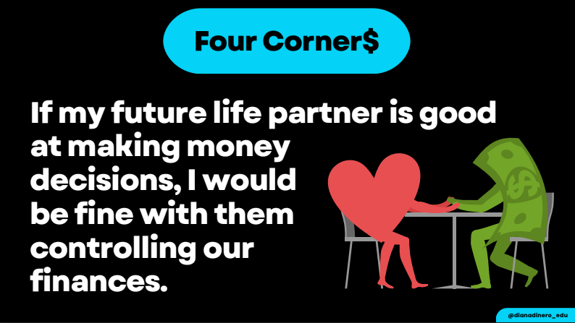
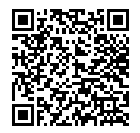

Takeaway
Money Mindset Four Corners

Slide 30
Activity #2
Peer Teaching & Student Facilitation
Purpose: Students develop confidence through low-risk opportunities to lead early in the lesson.
Students lead mini-lessons to teach their peers a new topic. This can be in whole group or small groups.
Give students extra credit or other incentives to participate.
Write them a line they can put on their LinkedIn or Resume such as:
  Led peer-to-peer financial literacy workshops on budgeting, credit, and career planning, using interactive activities to boost engagement and understanding.
  Developed and facilitated student-centered lessons that made financial topics relatable through games, discussions, and real-life scenarios.
They can lead assessments such as Pear Deck or Kahoot or Blooket. Option to make it a routine every other Friday, etc. Choose a different student every other week.
Have them create slides to go with it. Students are great with Canva presentations.
Keep the mini-lessons to 5-10 minutes. Give students a video or reading to learn prior to having to teach it.

Slide 31
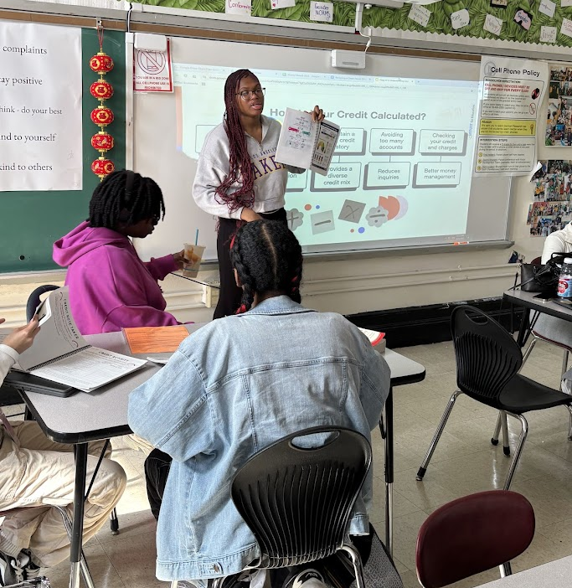
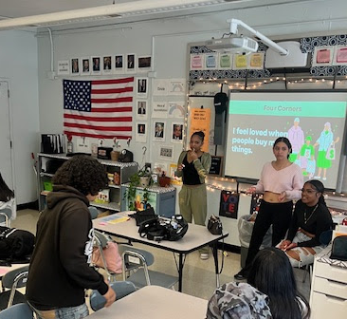
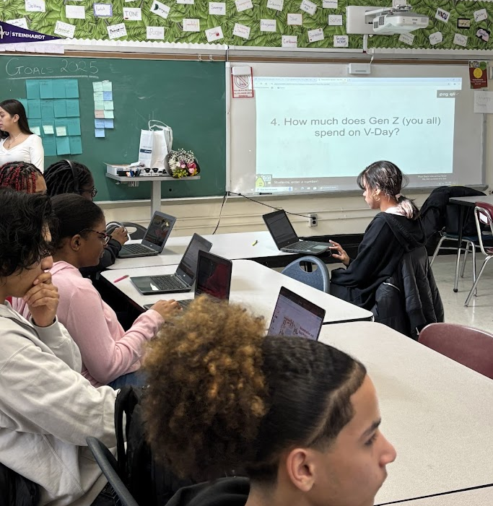
Leading Mini Lessons in Whole Group and Small Group
Featured:
The basics of credit scores
Leading money mindset four corners
Love and money Valentine's Pear Deck

Slide 32
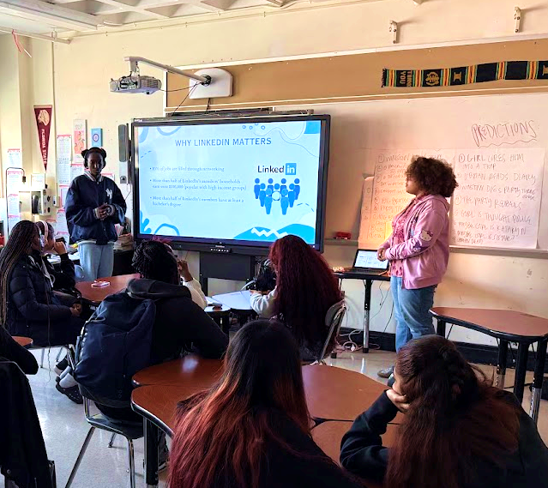
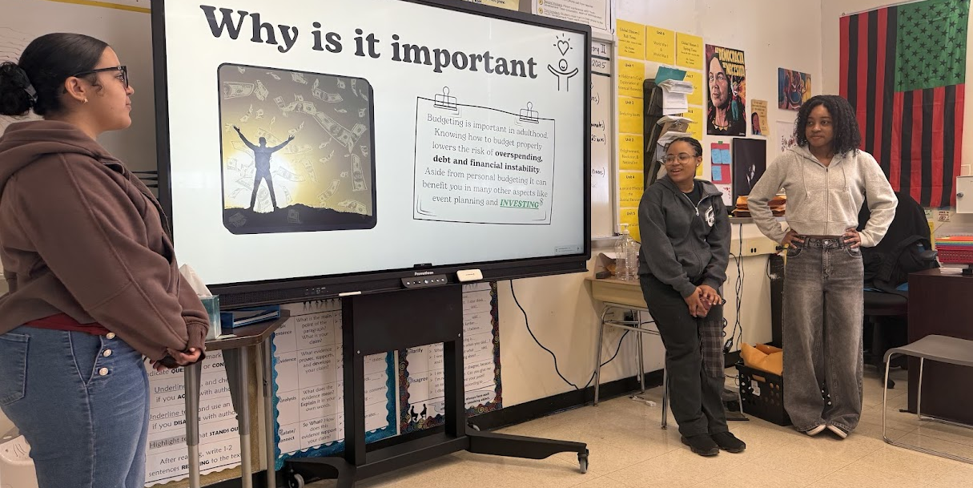
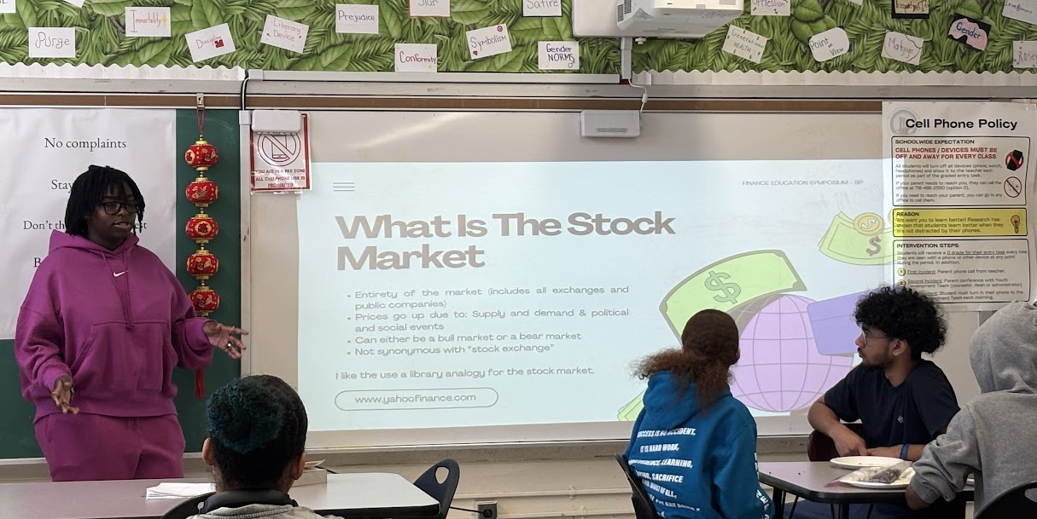
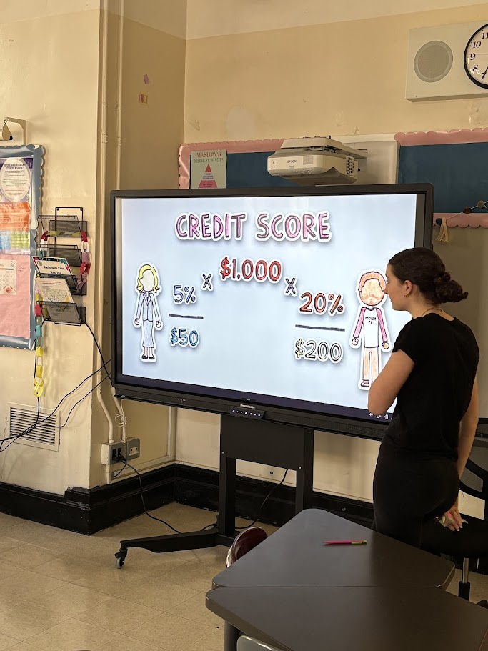
Presenting Topics for Fin Lit Month
Featured:
How to Budget Towards Your Values
Why Linked In Matters
What is the Stock Market Anyway?
Why Credit Scores Matter

Slide 33
Breakout #2
Planning for Student Facilitation
Task: Create a light implementation plan
Choose one activity to pilot (Four Corners, Peer Teaching, Socratic seminars)
Identify 3-ish student leaders to start with
Plan your rollout. For example:
  Week 1: Teacher models
  Week 2: Co-facilitation
  Week 3: Student-led with support
  Week 4: Full student ownership
Consider Needs:
How are topics selected? How are students taught content?
Facilitation scaffolds and routines
Discuss: What's your comfort level with students leading discussions or teaching content? What support would you need?

Slide 34
Share Out
Share one "aha moment" about student facilitation in whole group or chat!

Slide 35

Part 3:
Engaging with
Student-Centered Activities

Slide 36
Activity #3
Student-Centered Personal Budget Tracker
Purpose: Interest-based budget trackers allow students to visualize saving and spending in a way that matches their identities and values.
Each student receives a Google Sheet pre-populated Tracker with tabs for: 1) Income, 2) Retirement, 3) Savings, 4) Student Loans, 5) Housing, 6) Transportation, 7) Expenses, 8) Balance Sheet. We focus on one budget category per day.
Each day they add their own interests and goals to the learning and have dedicated work time for students to apply what they’ve learned directly in their budget tracker.
Bonus Student Leadership: Students can lead the mini-lessons each day

Slide 37
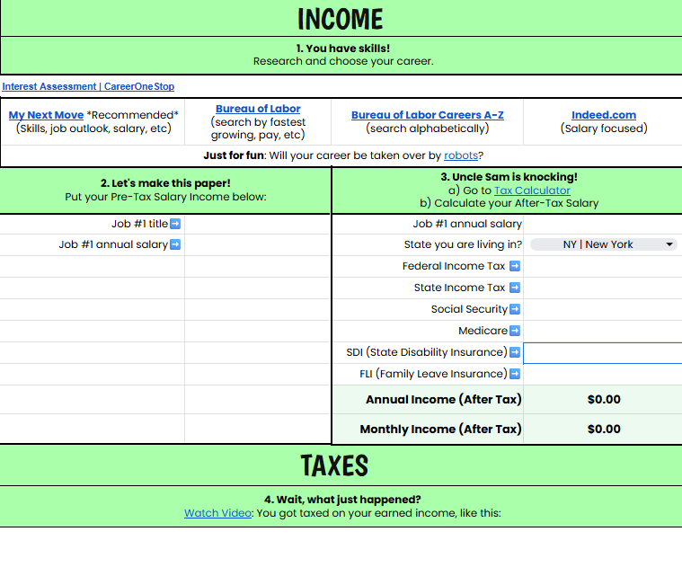
Income Tab:
Students choose careers to research and calculate monthly take home pay.

Slide 38
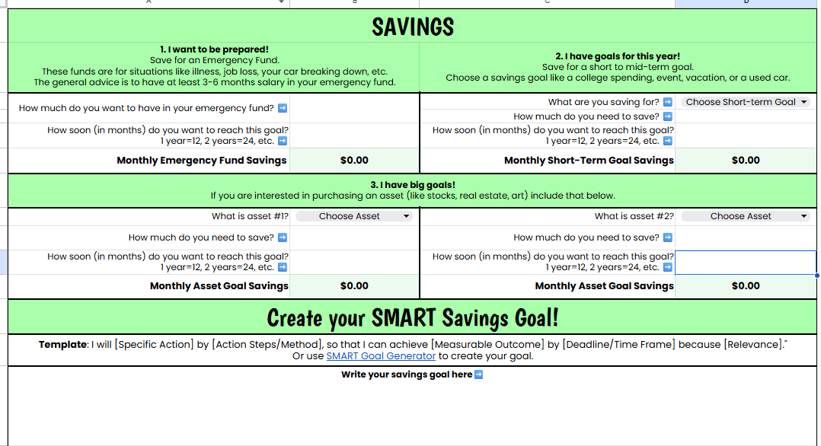
Savings Tab:
Students choose savings goals aligned to their value and calculate how much they need to
"Pay Yourself First".

Slide 39
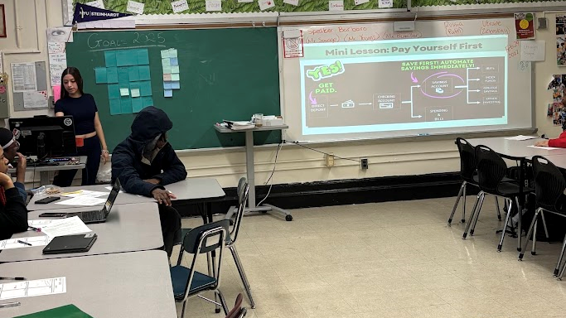
Savings Tab (Student Leader)
Leading mini-lessons and supporting students that day with savings tab in their budget tracker

Slide 40
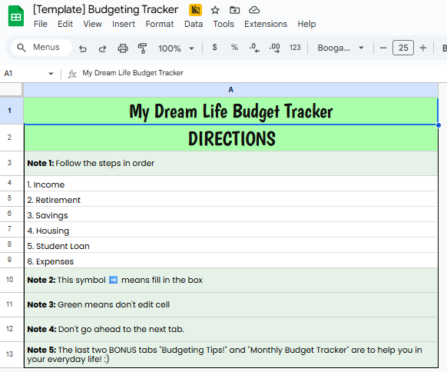
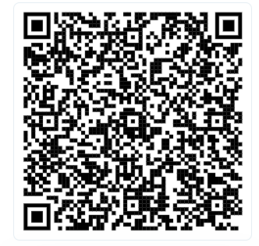
Takeaway
Student-Centered Budget Tracker

Slide 41

Income Tab (Student Leader)
Student leading small group and explaining what they need to know about taxes and paycheck withholding.

Slide 42

Breakout #3
Planning for Student-Centered Activities
Task: Choose one activity that you already teach to make more purposeful or interest-based.
Discuss:
Which activity could you implement?
What would you need to adapt to make it more purposeful?

Slide 43
Share Out
Which strategy are you most excited to try?
What purposeful
classroom action will you commit to?

Slide 44
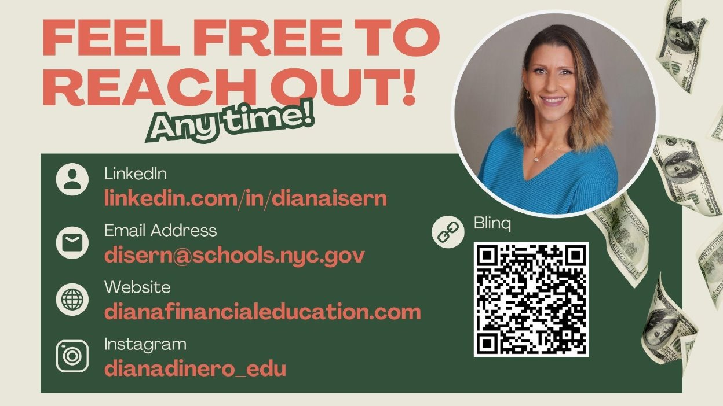
Contact Me

Slide 45


Slide 46


Slide 47
Thank you!

