Slide 1


Find Your Rhythm with Finance

Slide 2
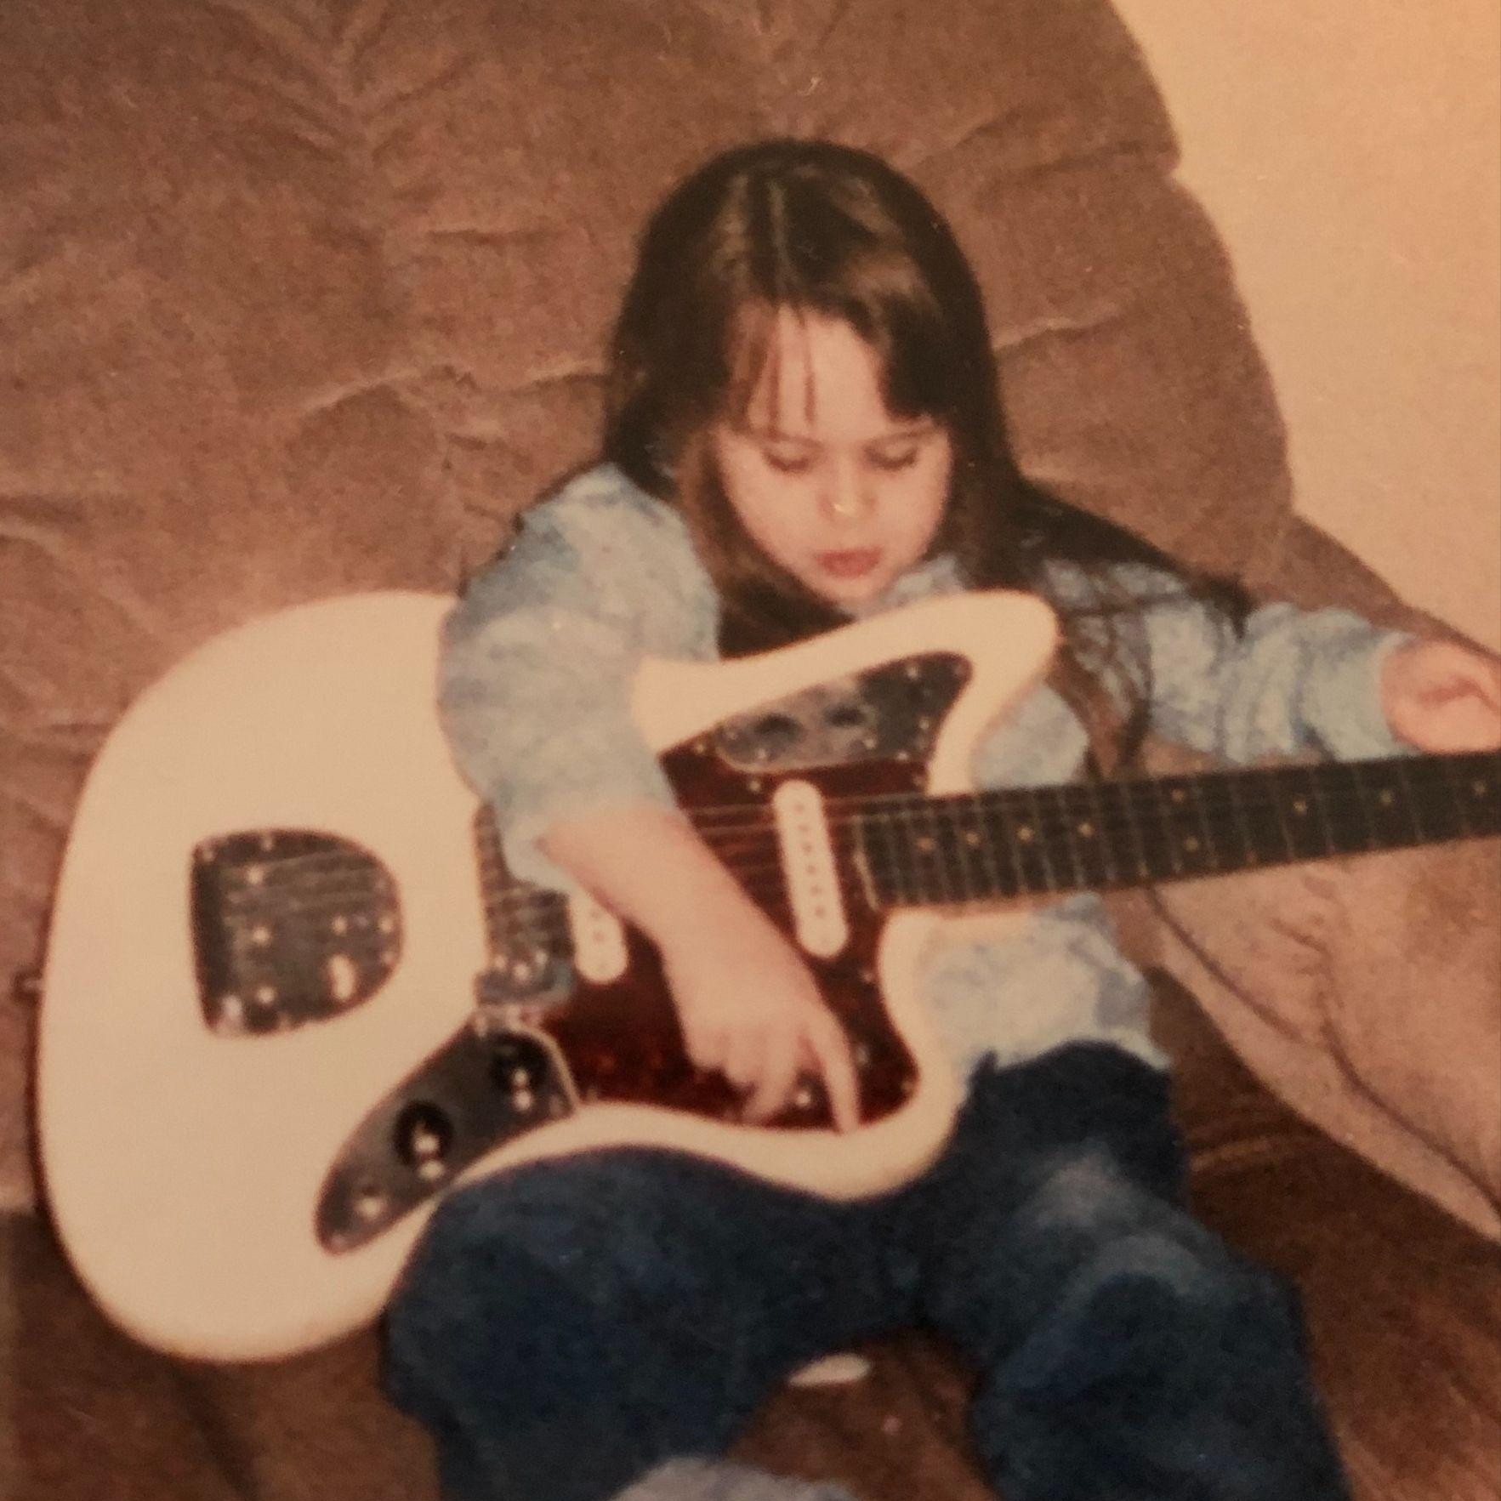
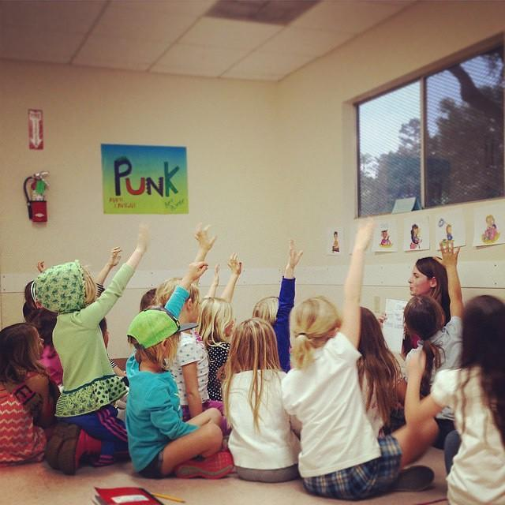
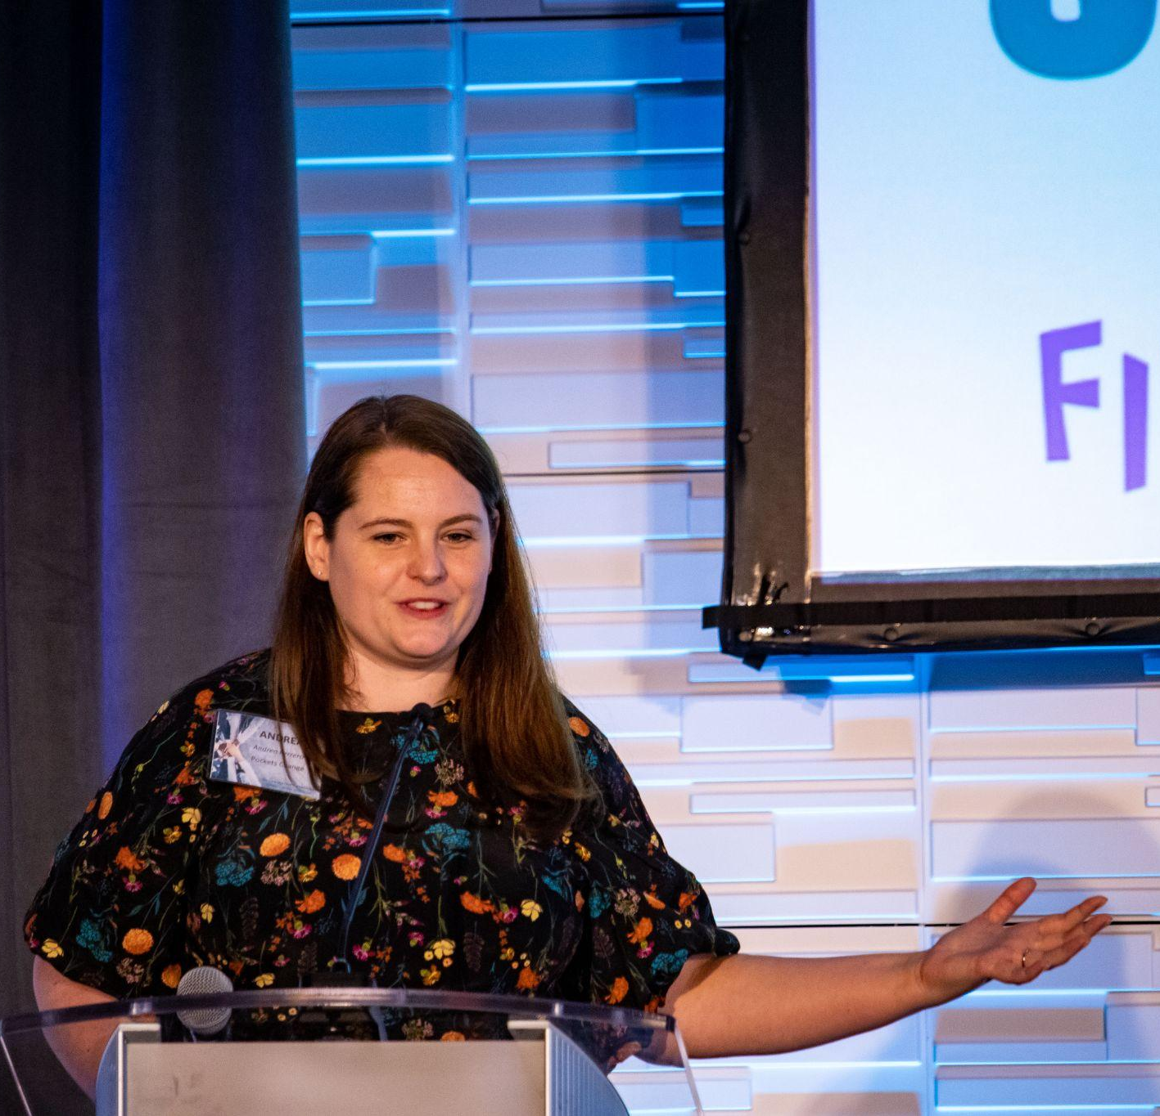
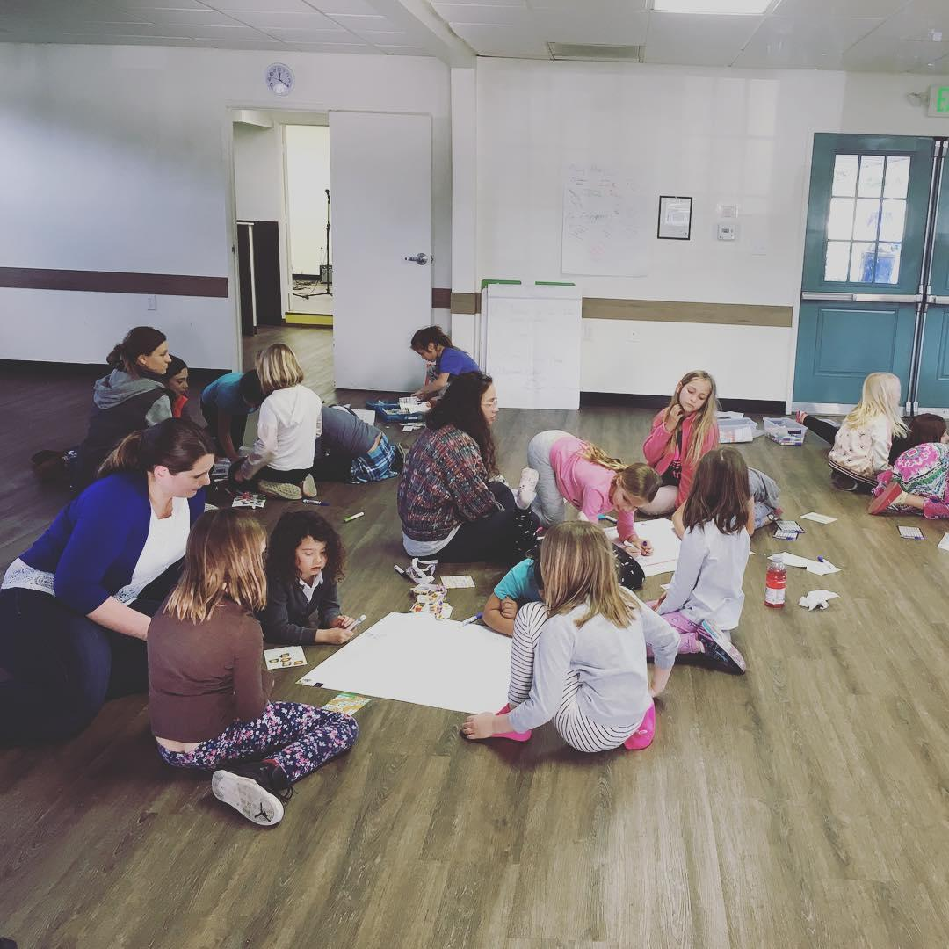
HISTORY OF ME

Slide 3
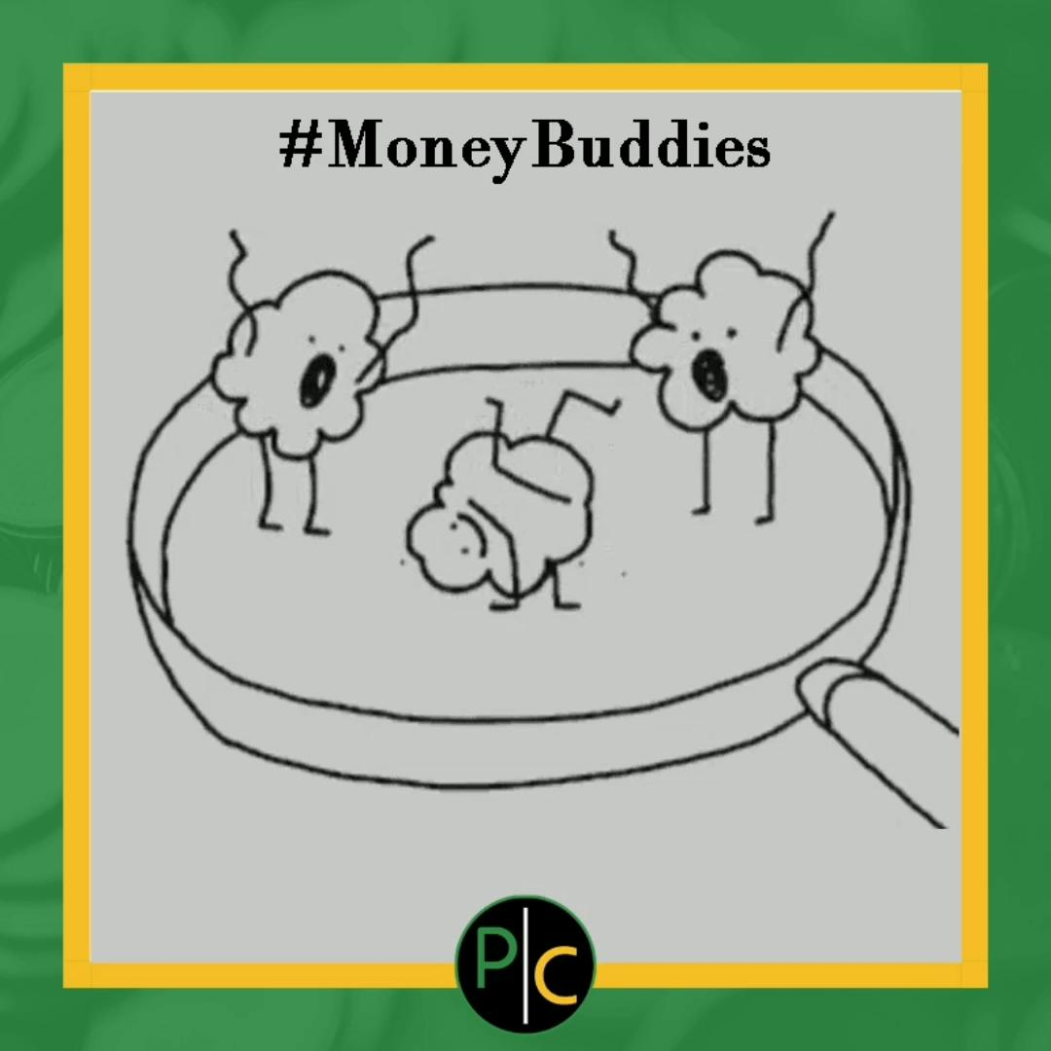
Who’s in the room
Name
Grade levels you teach
What you’re most interested in learning?
What you’re most excited to share?

Slide 4
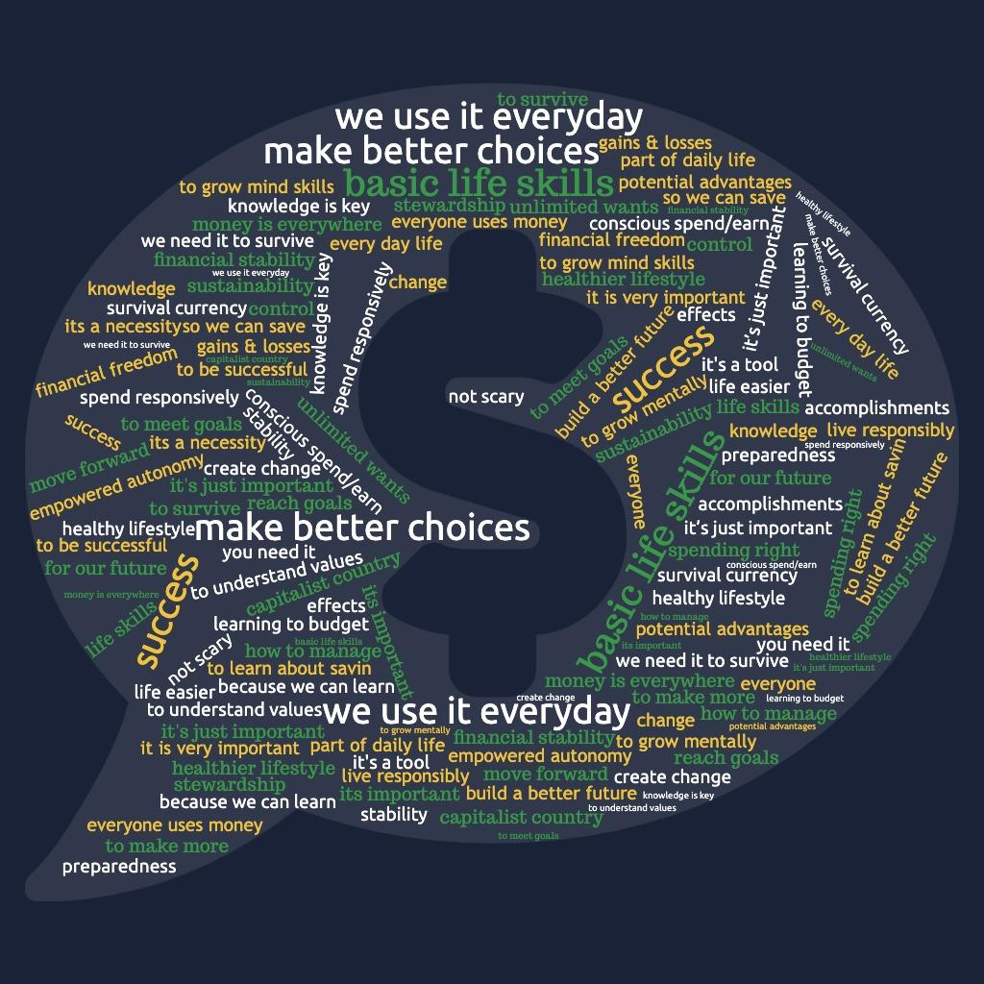

Why Should We Talk About Money?
Notes:
Write Why We Should Talk about Money on sticky note
Share outs
Gather stickies for poster

Slide 5
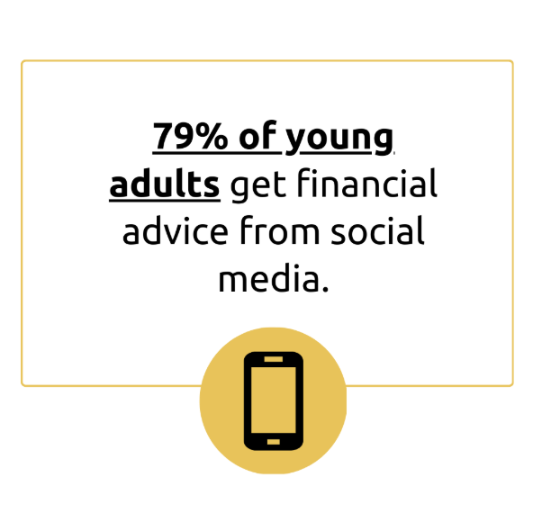
Stats for Financial Education:
Where We Get Our Information
Notes:
References:
https://www.forbes.com/advisor/investing/financial-advisor/adults-financial-advice-social-media/
https://www.nasdaq.com/articles/nearly-80-of-young-adults-get-financial-advice-from-this-surprising-place
https://www.scholarsandstorytellers.com/american-dream

Slide 6
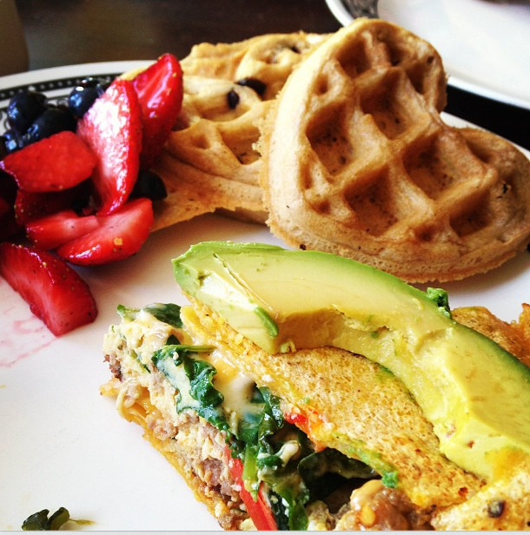



You’re part of a system that’s designed to take you out
Bad credit score? Your landlord, employer, utility company, cell phone company, insurance company can penalize you
Didn’t file taxes every year? Can’t buy a house, get a business loan, might owe back taxes
No estate plan? All the work it took to accumulate wealth goes to lawyers and court fees
getshameless.com

Slide 7
You’re not wrong,
you’re not a fool,
you’re not alone

Slide 8







Money Talks
Find a Money Buddy
Share, Which meme fits your money feels?
Money Buddy
Notes:
We form our relationship with money between ages of 3-7 years old.
We need to make plans and take action in ways that work for us as individuals.
Finance is personal & emotional.

Slide 9
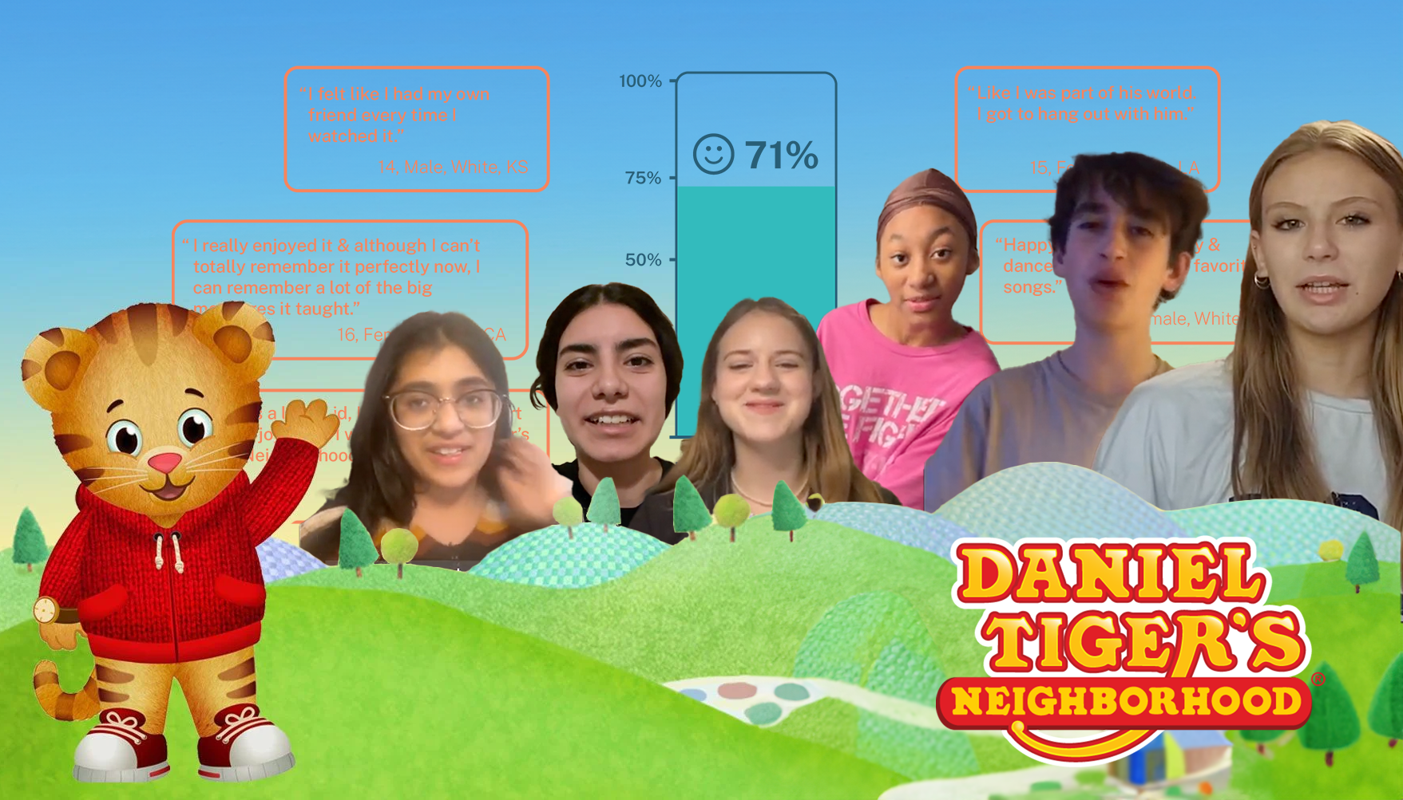
Developmental Progression:
Application of Information
In this groundbreaking study of teens ages 13-16 who watched Daniel Tiger as toddlers, we found that nearly 12 years later after the show's debut, adolescents still remember and actively use the social-emotional skills they learned from Daniel and friends. An impressive 57% of teens recall specific strategies for managing emotions, with 21% reporting they still use Daniel Tiger's calming techniques today.
~UCLA Scholars & Storytellers in partnership with Fred Rogers Productions
Notes:
Our latest research, done in collaboration with Fred Rogers Productions, uncovered something remarkable: the lessons from Daniel Tiger's Neighborhood haven't just entertained children — they've shaped teenagers' emotional lives for years to come.
In this groundbreaking study of teens ages 13-16 who watched Daniel Tiger as toddlers, we found that nearly 12 years later after the show's debut, adolescents still remember and actively use the social-emotional skills they learned from Daniel and friends. An impressive 57% of teens recall specific strategies for managing emotions, with 21% reporting they still use Daniel Tiger's calming techniques today.
Perhaps most striking is what's missing in today's teen media landscape. While 77% of teens express interest in content addressing social-emotional topics, only 35% report finding shows that teach these vital skills — with many turning to content made for younger audiences to fill this gap.
This research reveals not just the enduring power of quality children's programming, but also identifies a significant opportunity for creators to develop content that addresses the social-emotional needs of today's teenagers. Read more to discover how Daniel Tiger's lessons continue to make a difference in teenagers' lives and what this means for the future of youth programming.

Slide 10
Share in Chat
Share the last 5 things you spent money on.

Slide 11
Where you spend your money is a representation of what you value
You ALWAYS put
your money where
your mouth is

Slide 12
Spending Values
The Spending Values Matrix
The Basics
The YES
The Details
The Nothing
Notes:
Make a Copy & Build a Budget based on your values: Spending Values Plan spreadsheet

Slide 13
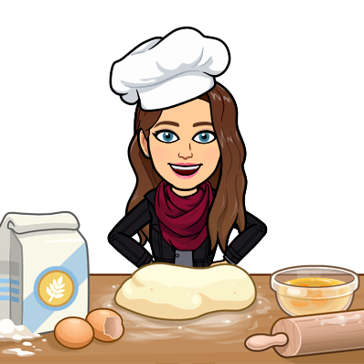
Spending Values
The Spending Values Matrix
The Basics
A.K.A. fixed expenses
The things you need to live and work.
Know the number, but don’t get stuck here.
Bills
Clothes
Groceries
Phone

Slide 14

Spending Values
The Spending Values Matrix
The stuff that makes you feel like you. It’s the one you might feel guilty about. You were told this was a waste. Irresponsible. If you don’t responsibly budget for the things you enjoy in your details...
The Details
Eating with friends
Candy
Nails
Books
Sneakers
Notes:
Our wants are needs! What feeds you emotionally….What are your details?
I talked about webcomics, Penny toys, succulents, and sneakers for myself

Slide 15

Spending Values
The Spending Values Matrix
Video Games
Candy
Sneakers
Nails
...you’ll end up spending even more money here. When you don’t do things you enjoy, you can run out of willpower and that’s when advertising and convenience trick you into buying things you don’t even want
The Nothing
Notes:
What might the nothing be for you? How do you tell the difference between the details and the nothing?
Do you remember it?
Andrea - streaming services, how did I sign up for $80 worth of channels (prime/hulu/hbo/disney/netflix)
What’s one thing you could spend less on?
Talked about how one of our groups of 5th graders had disagreement on whether pets were the details/nothing
Kindergartners discussing Stanley the pet guinea pig (details/nothing)
Shared story of me returning plant three times to store that had return/exchange policy (overwatered, too much sun, some how both)
How that process made me realize that in my 20s hanging flower pots were not my details they were my nothing, but now they are in my details
Our details shift with us over time

Slide 16
WANTS
ARE
NEEDS
TOO
Notes:
Create a spending plan that makes space for your details
I intro’d webcomics as one of my details and also talked about how when I don’t spend on art that matters to me I find myself feeling more tired at the end of the week and more likely to order that forgettable chicken from 3 blocks over. I talk through the numbers of how taking care of my wants actually helps me spend more on what I care about, feel more like me, and save more too.

Slide 17
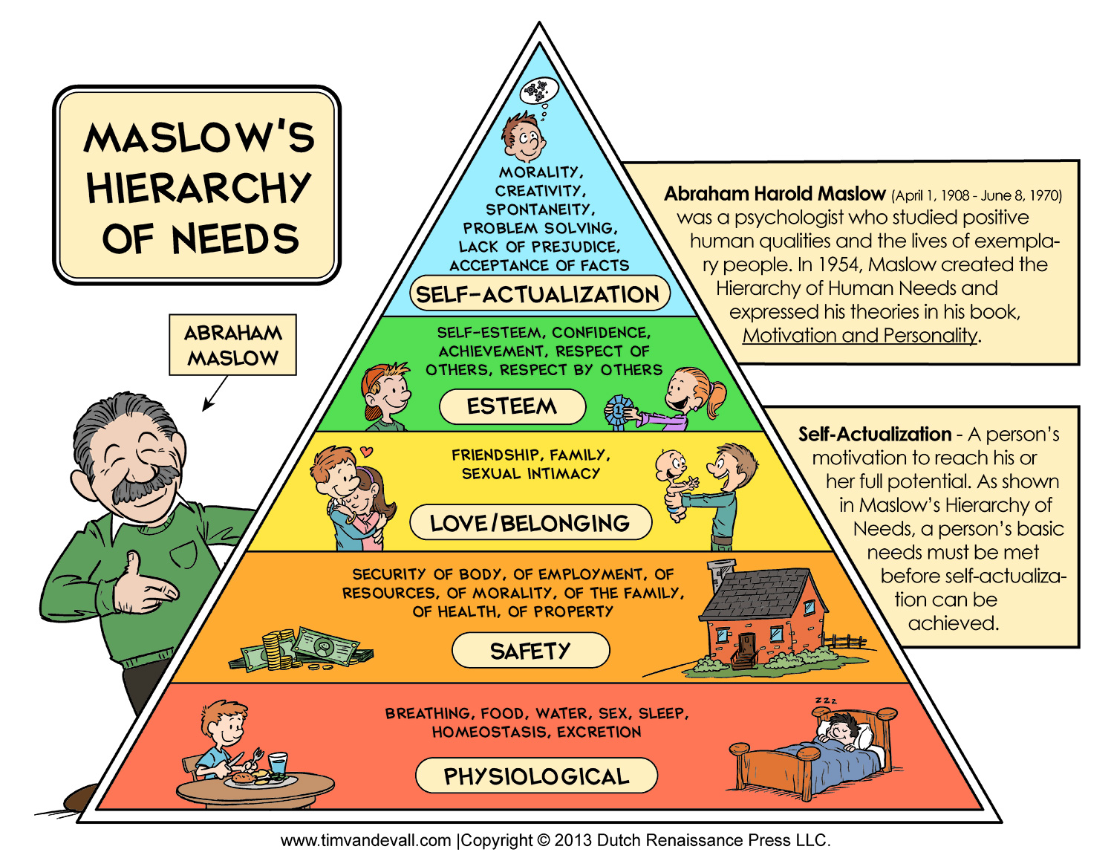
The Spectrum of Wants and Needs
Notes:
Our students get prioritization, choice, and the sense of urgency of trying to meet many needs.
We can create meaningful spaces for deeper financial skill building.
Less dichotomy of Needs vs. Wants, and deeper conversations about personal priorities, values, and goals. The learning standards around opportunity cost, decision-making happen in those creative explorations.

Slide 18

Notes:
32 seconds then stop

Slide 19
Write or Draw, or open a voice note
Share one of your details and the judgement that goes through your head (or ears) when you want to buy it.

Slide 20
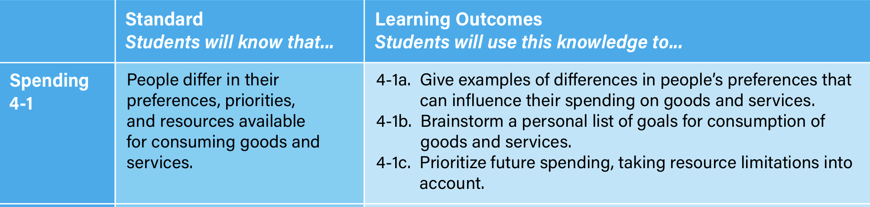
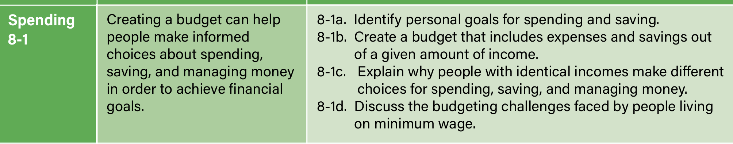
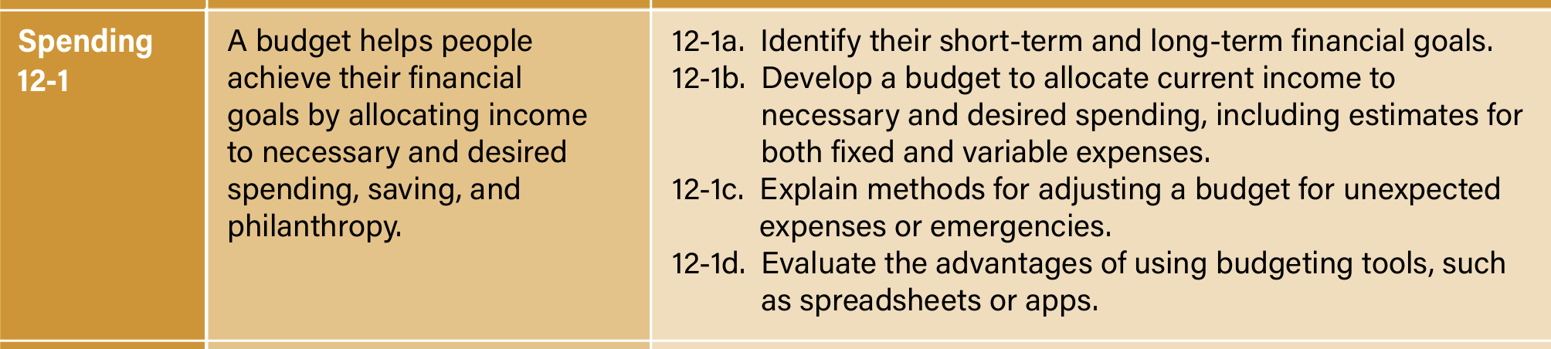
Learning Standards are the map for money talks
CEE/Jump$tart National Standards for Public Financial Education (2021)
Notes:
Let’s move from frameworks to practical classroom activities

Slide 21
Spending and Saving Activities for K-12
https://www.pocketschange.com/freetoolkit
Notes:
Bring spending conversations into classroom through -
Picture books - What If story
Play center activities - turtle game with play money for family nights
After school clubs/Micro economies - like feather stories
Spending Values research & create spending plans
Future Me app for photo of me as older person and then writing postcard to myself, then identifying saving goals
Yes, and spending plan - student who wanted one billion dollars
Students craft and share money stories as an learning tool - example Enrique Ipad story & mall for instructional peer teach in
Cell phone bill adjustment peer advocacy

Slide 22
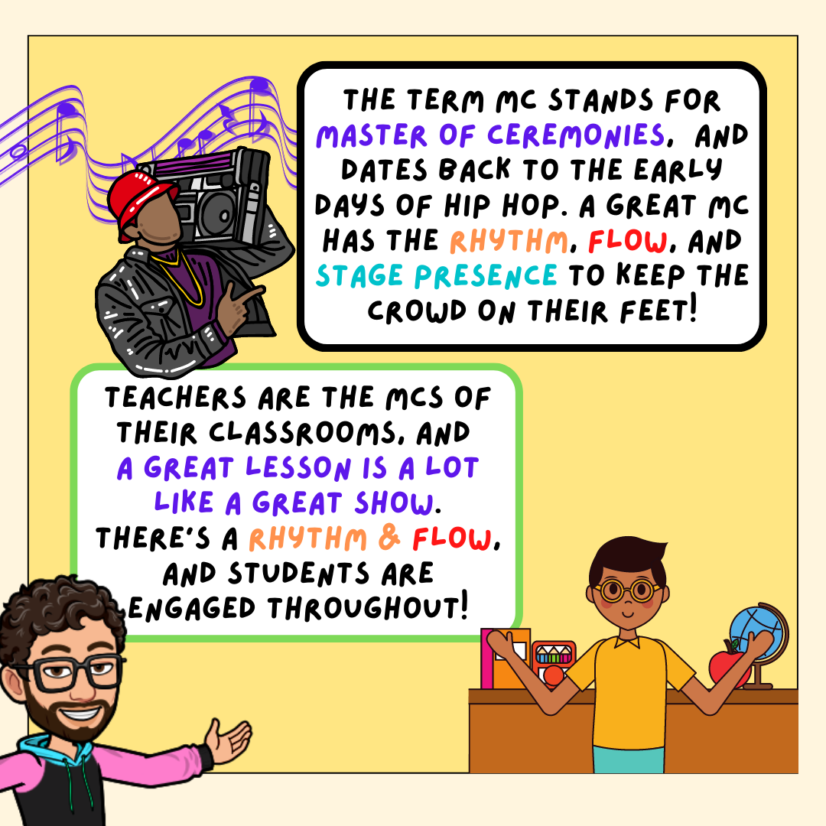
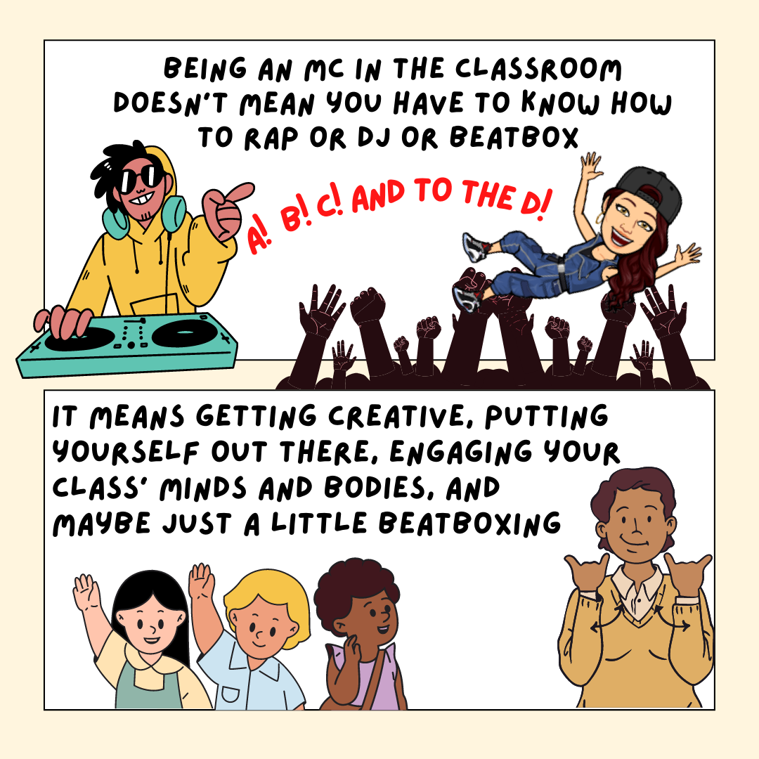
Art to Express and Decompress
Notes:
Teachers are artists, we’re creators and innovators.

Slide 23
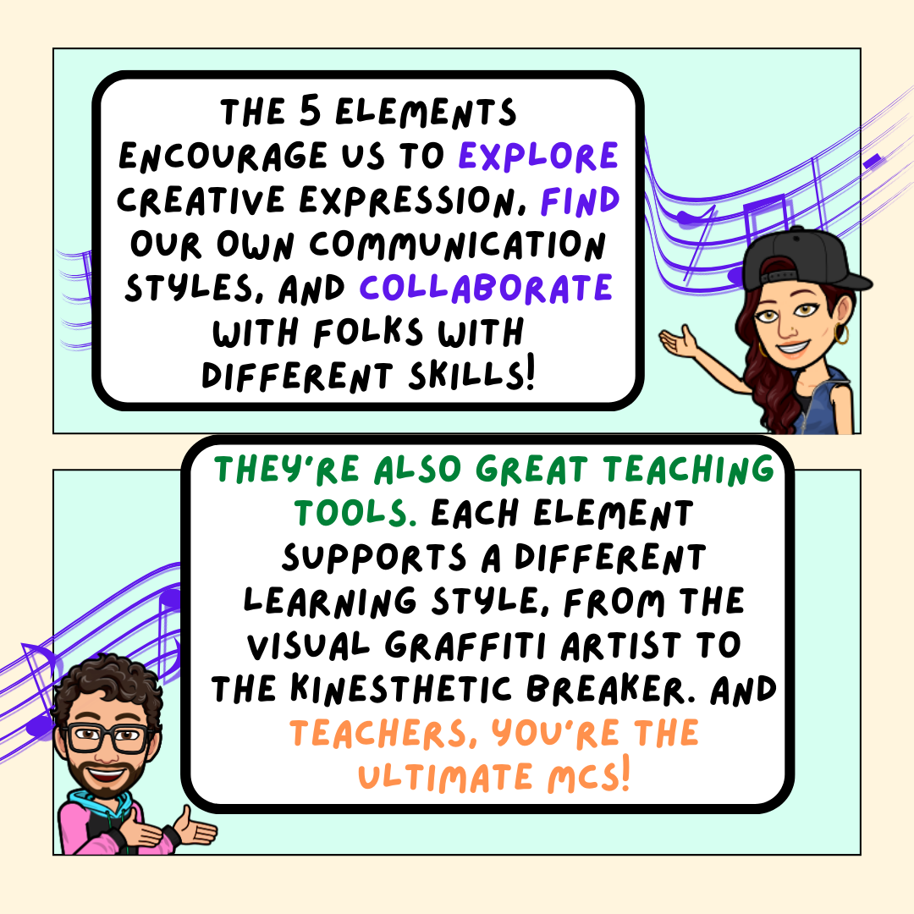

Slide 24
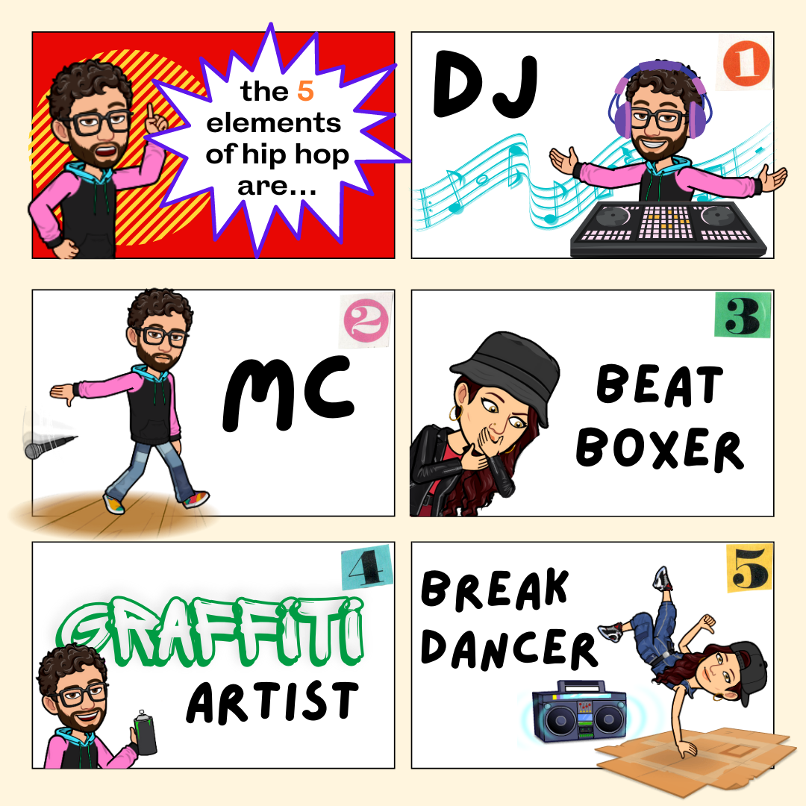

Slide 25

Lean into Strengths, Develop Weaknesses
Hip Hop Pedagogy
MC - linguistic/interpersonal, leader/clown, stories
Beatboxer - musical, rhythm, pace, organization
DJ - Logical/spatial remix, recontextualize
B-Boy - kinesthetic Body language,
Graf Writer - natural/intrapersonal imagery, introvertedness

Slide 26
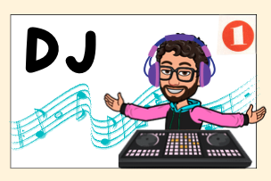
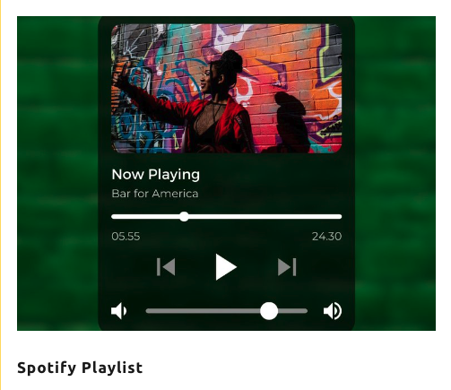
Art to Express and Decompress
Art to Express and Decompress
Create a playlist of 3-5 songs that feel like you
Get together with a group and create a money personality playlist
Tools to Use:
Canva for playlist handout
Spotify

Slide 27
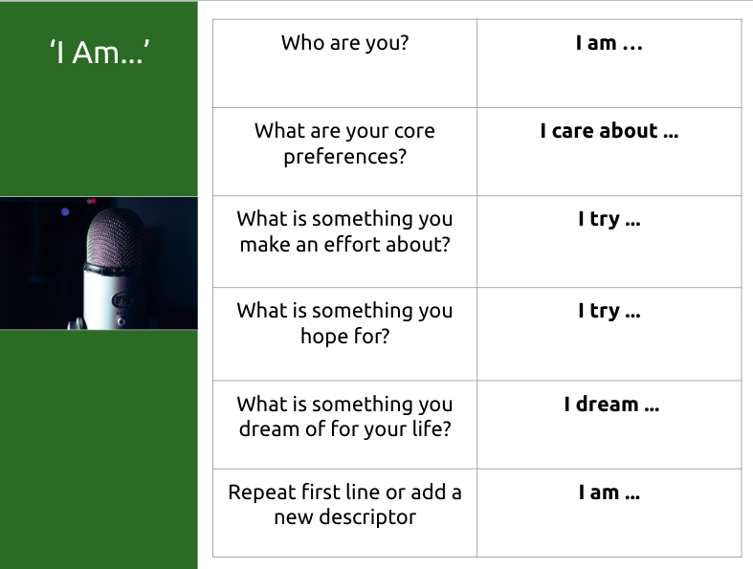
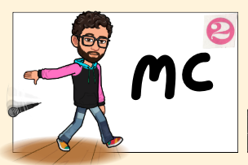
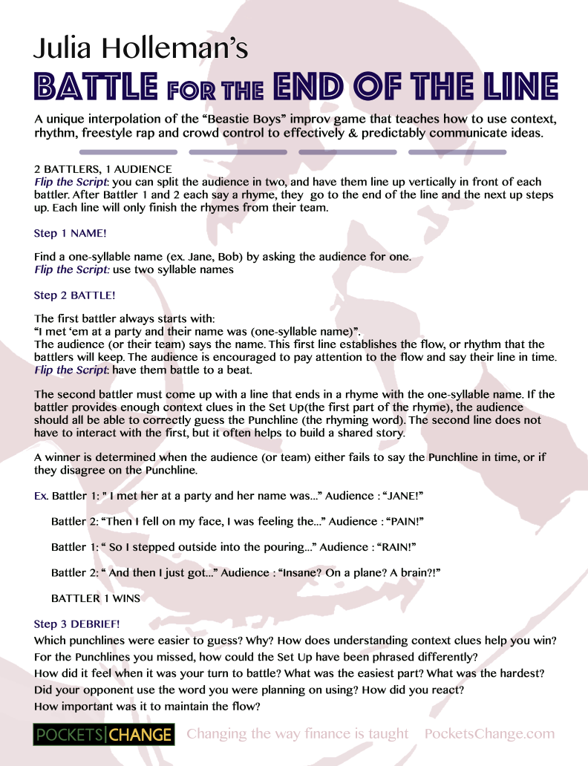
Art to Express and Decompress
Art to Express and Decompress
With a group, play Battle for the End of the Line and discuss context & improvisation
Write an I Am Poem and share with a money buddy

Slide 28

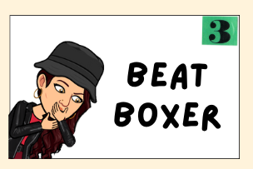
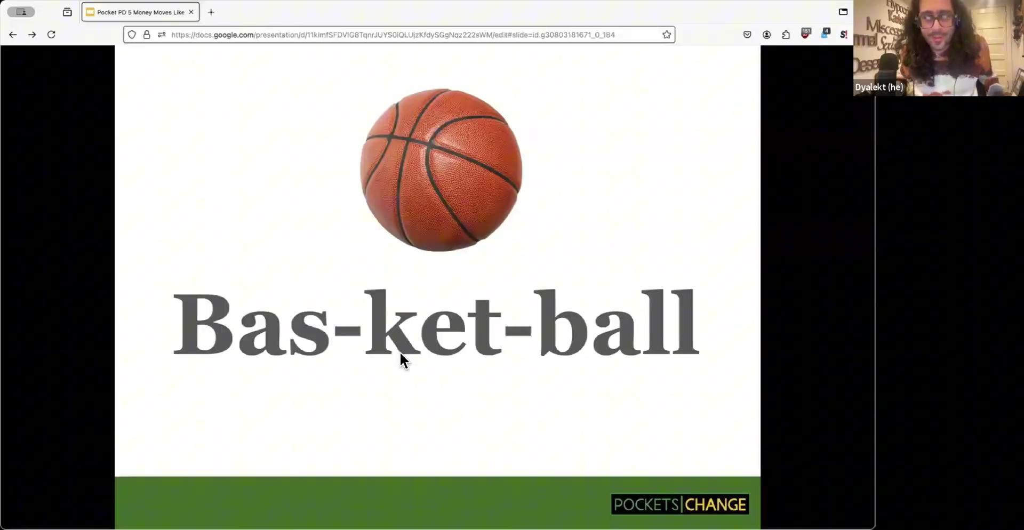
Art to Express and Decompress
Art to Express and Decompress
Try out Box Breathing for Grounding
Try out Beatbox Breath with a group
For more professional beatboxers:
https://youtube.com/@americanbeatbox?si=y5MvlcP7pUR9hM_H

Slide 29
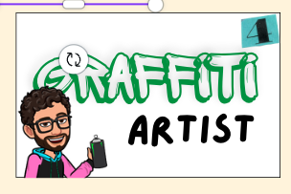
Art to Express and Decompress
Art to Express and Decompress
Create a mood board with artists/works of art that can answer the following prompts:
What does money mean to you?
What do you want to preserve?
What do you want to change?
Tools to use: Canva, physically cut from magazines, or drawn on poster board or notebooks.

Slide 30

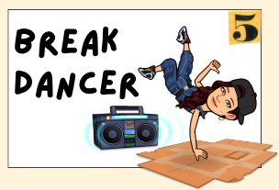
Art to Express and Decompress
Art to Express and Decompress
Create a 2-minute movement about the feelings of spending
Try out Learning Studio
Hip Hop Public Health
Take a Hype Break with A collection of fifty 2-minute fun hip-hop dance physical activity break instructional videos designed to energize, invigorate, and motivate!
Hip Hop Public Health

Slide 31
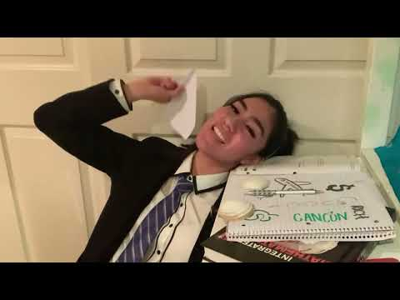
“Money Means” Cleo de Jay
Create in Class

Slide 32
Financial Education
Project Ideas
What kind of projects can students create & share?
📓Poems
👾 Games
🎤 Songs
📱 Videos
🎨 Visual Art
💡Creative Projects that Share Financial Knowledge (posters, podcasts, pitches,presentations, paintings, photos and more)

Slide 33


Slide 34
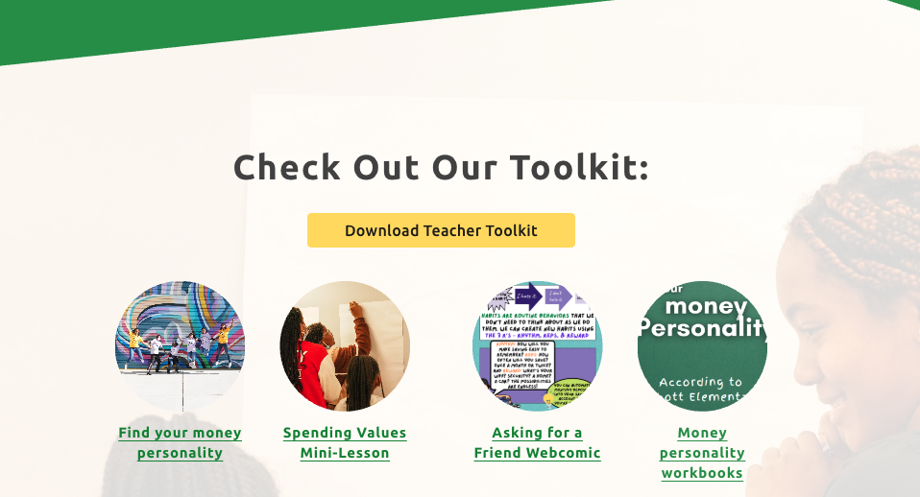
https://www.pocketschange.com/freetoolkit

Slide 35
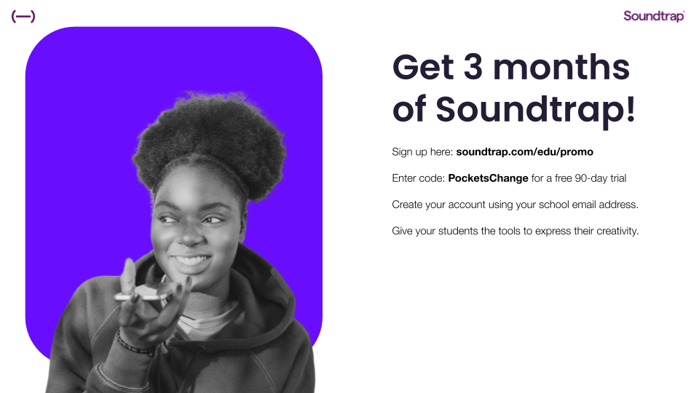
Soundtrap for Education
bit.ly/PCSoundtrap
Notes:
Speaker on panel yesterday - Justin Polk, former Los Angeles Unified educator and currently serves as Customer Success Manager for Soundtrap for Education, bringing a creative and practical lens to student engagement. Learn how audio storytelling, music production, and podcasting can deepen understanding of complex topics, encourage student voice, and foster cross-disciplinary learning.
Teacher Resources:
Getting Started with Soundtrap for Education: [Link]
Teacher Onboarding Guide: [Link]
Lesson Plans Library: [Link]
Soundtrap Certified Educator Course (produced by Young Producers Group): [Link]
Student Resources:
Soundtrap Student Resource Hub: [Link]
"Inside the Studio" Youtube Beginner Tutorials: [Link]
Community and Help:
Soundtrap for Education Community: [Link]
Support and FAQs: [Link]

Slide 36
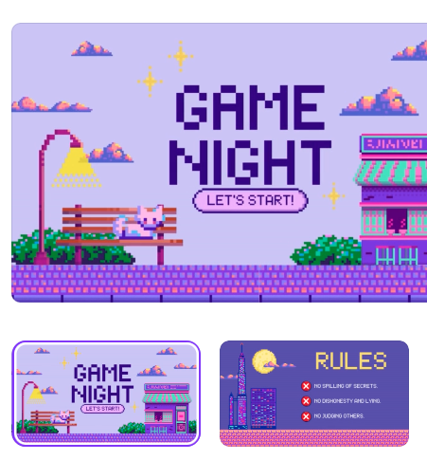
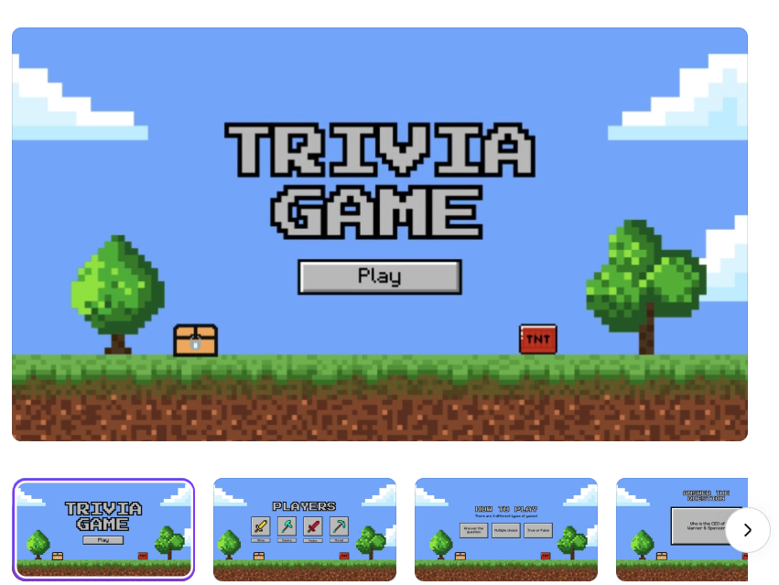
Design a Game
Game Templates
https://www.canva.com/presentations/templates/game/

Slide 37
Which Phrase Do You Relate To More?
I think more about the money I have now, it’s not real until it’s in my hands.
I’m usually spending money in my head before I even get it.
pocketschange.com/quiz
Notes:
Poll #1: Single Choice

Slide 38
Which Phrase Do You Relate To More?
I tend to plan ahead.
I tend to deal with things as they come.
pocketschange.com/quiz
Notes:
Poll #2: Single Choice

Slide 39
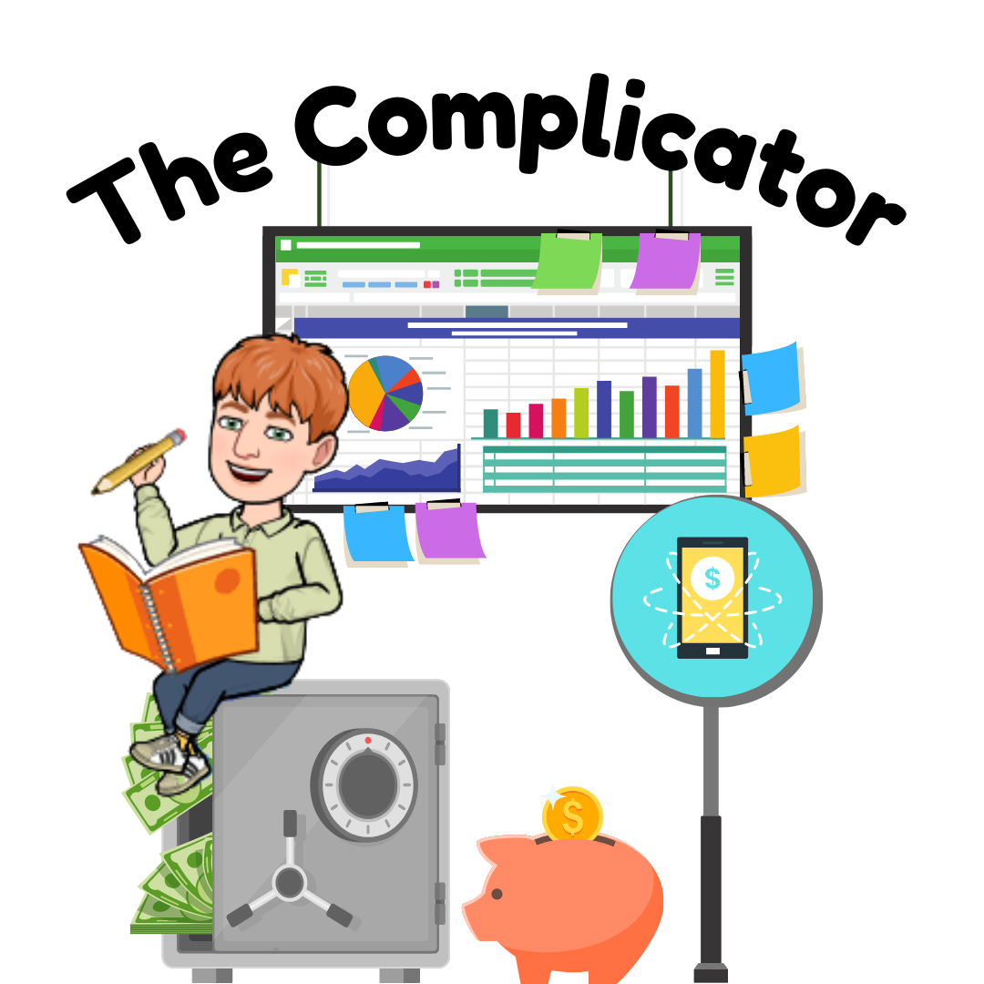
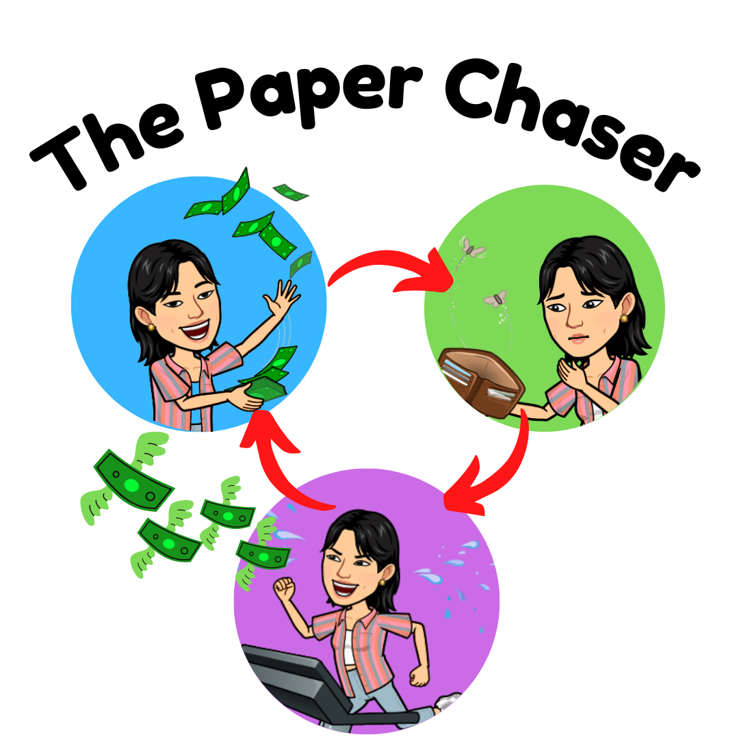

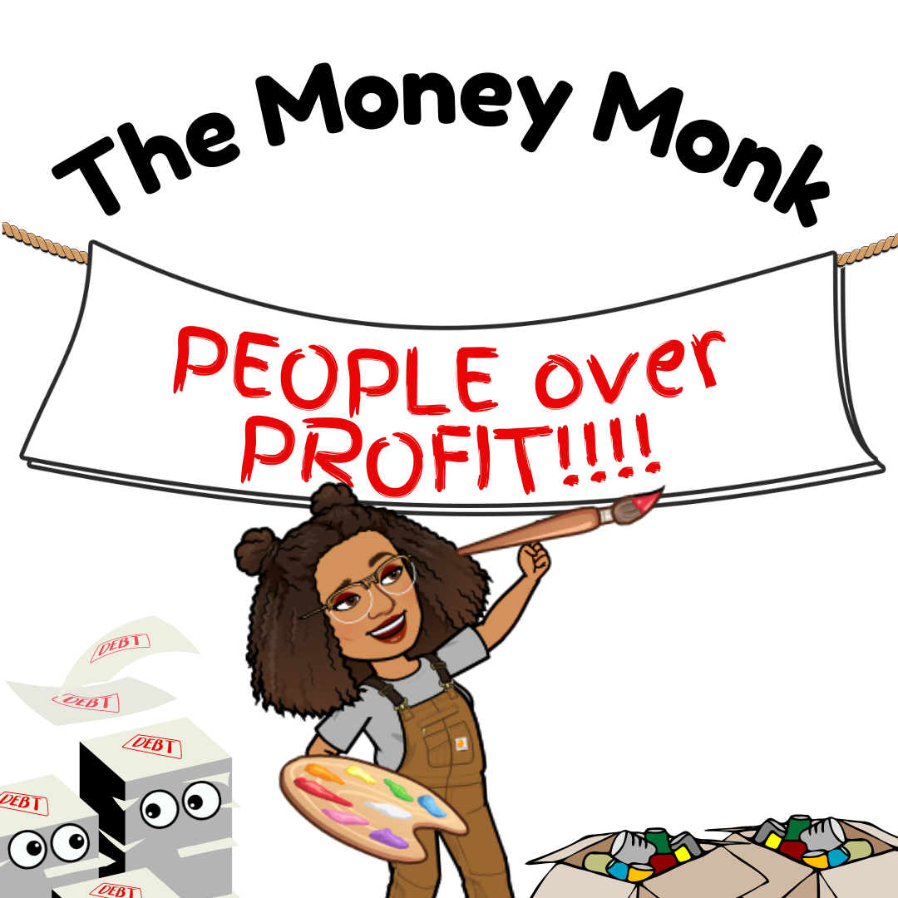
What’s Your Money Personality?
AA
BA
Proactive
Net Worth
More money, more problems!
More money, NO problems!
Cash Flow
Reactive
AB
BB
I’ll take care of it tomorrow...
Money changes people, man...

Slide 40
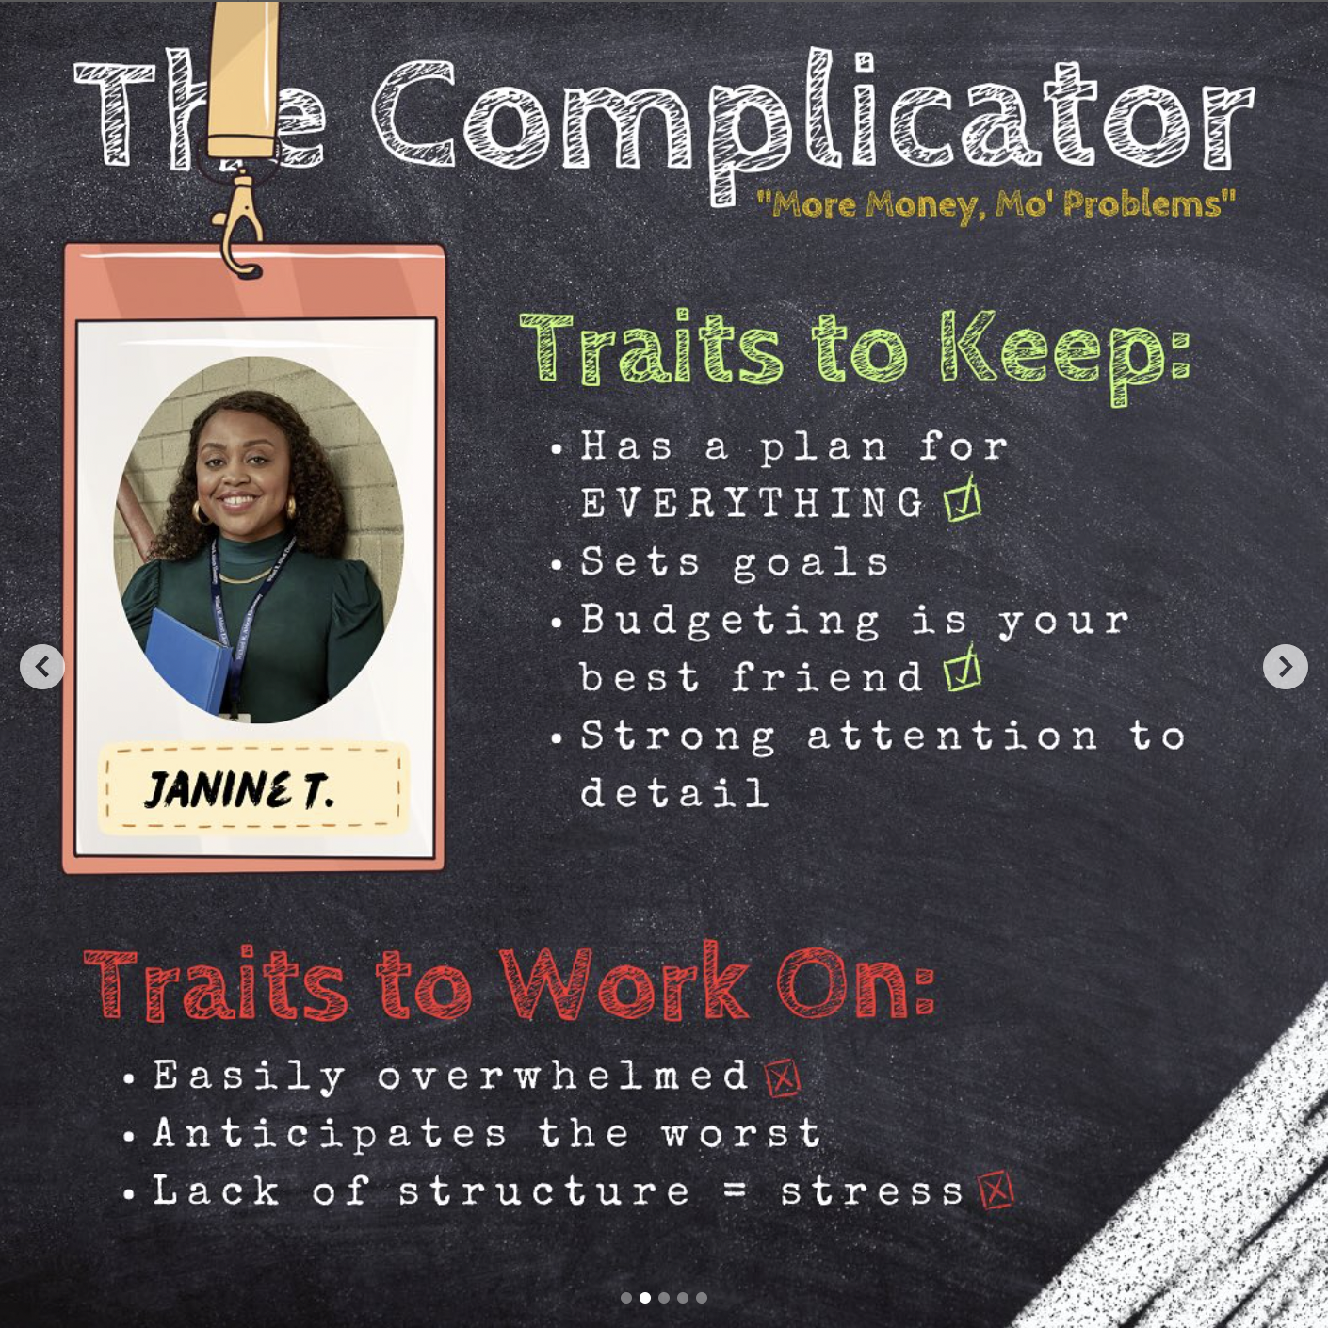
brunchandbudget.com/seechange
@brunchandbudget

Slide 41
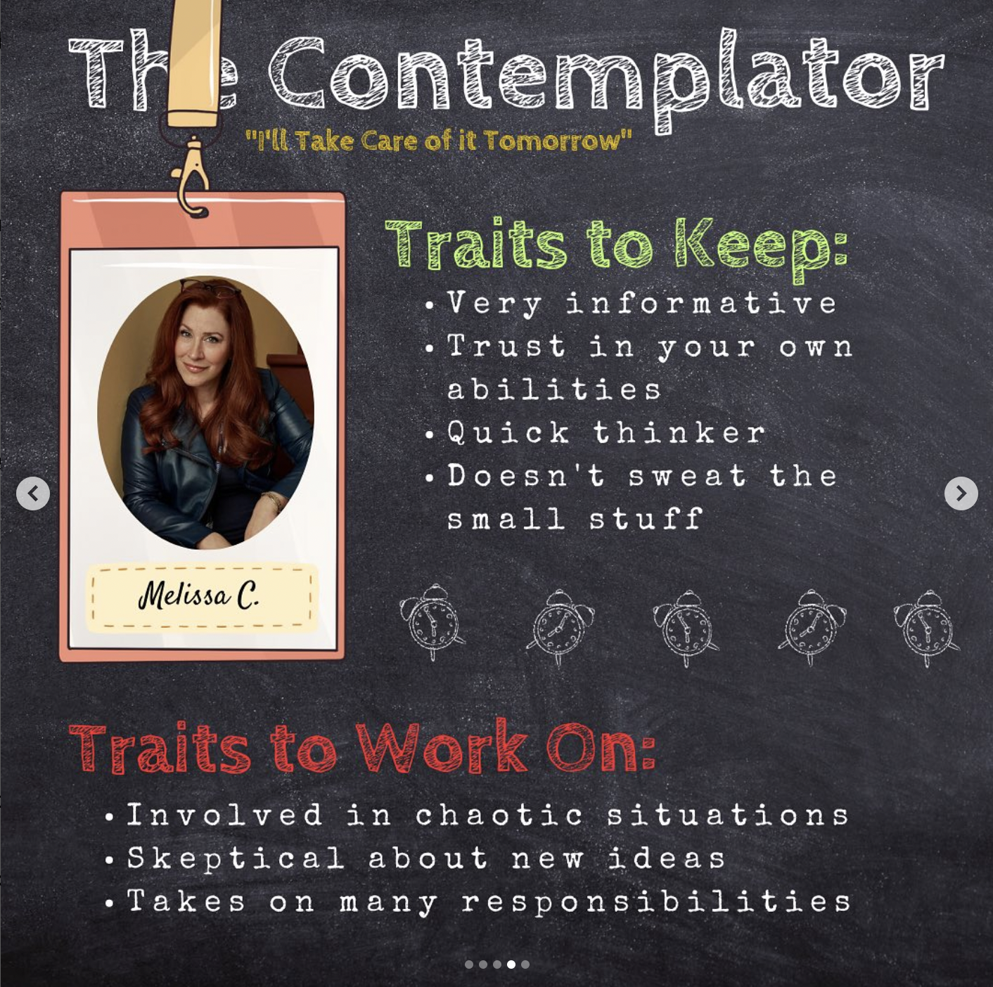
brunchandbudget.com/seechange
@brunchandbudget

Slide 42
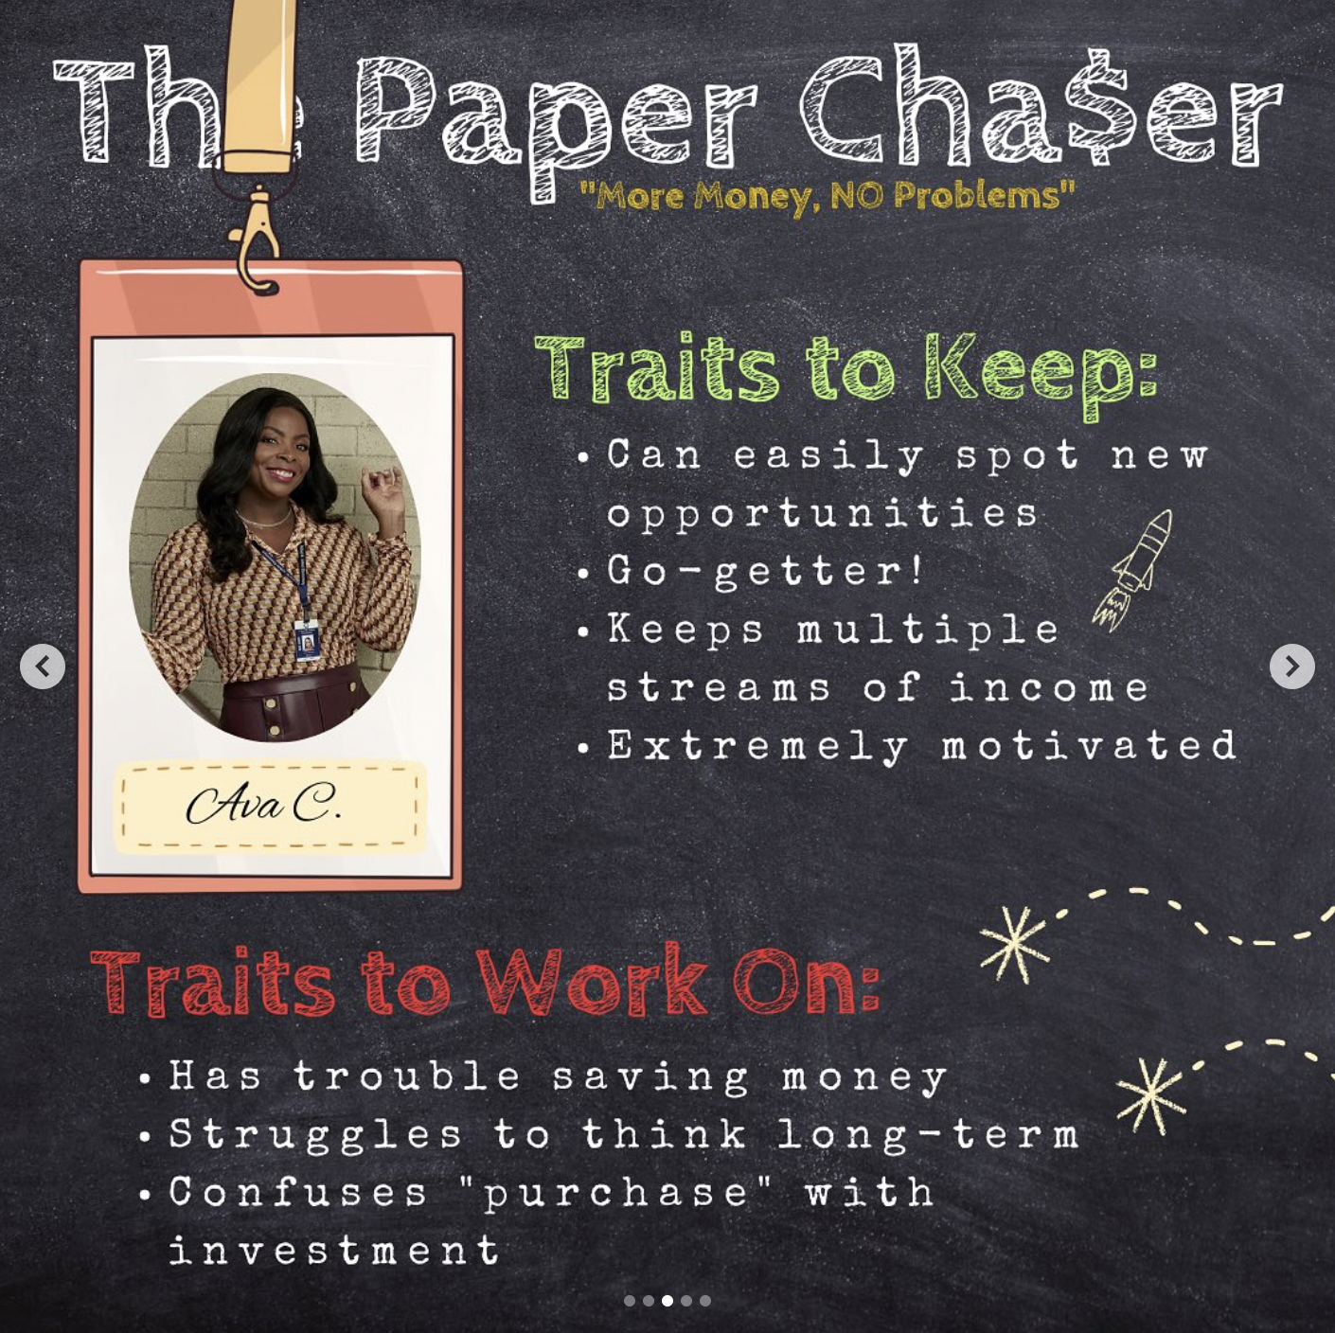
brunchandbudget.com/seechange
@brunchandbudget

Slide 43
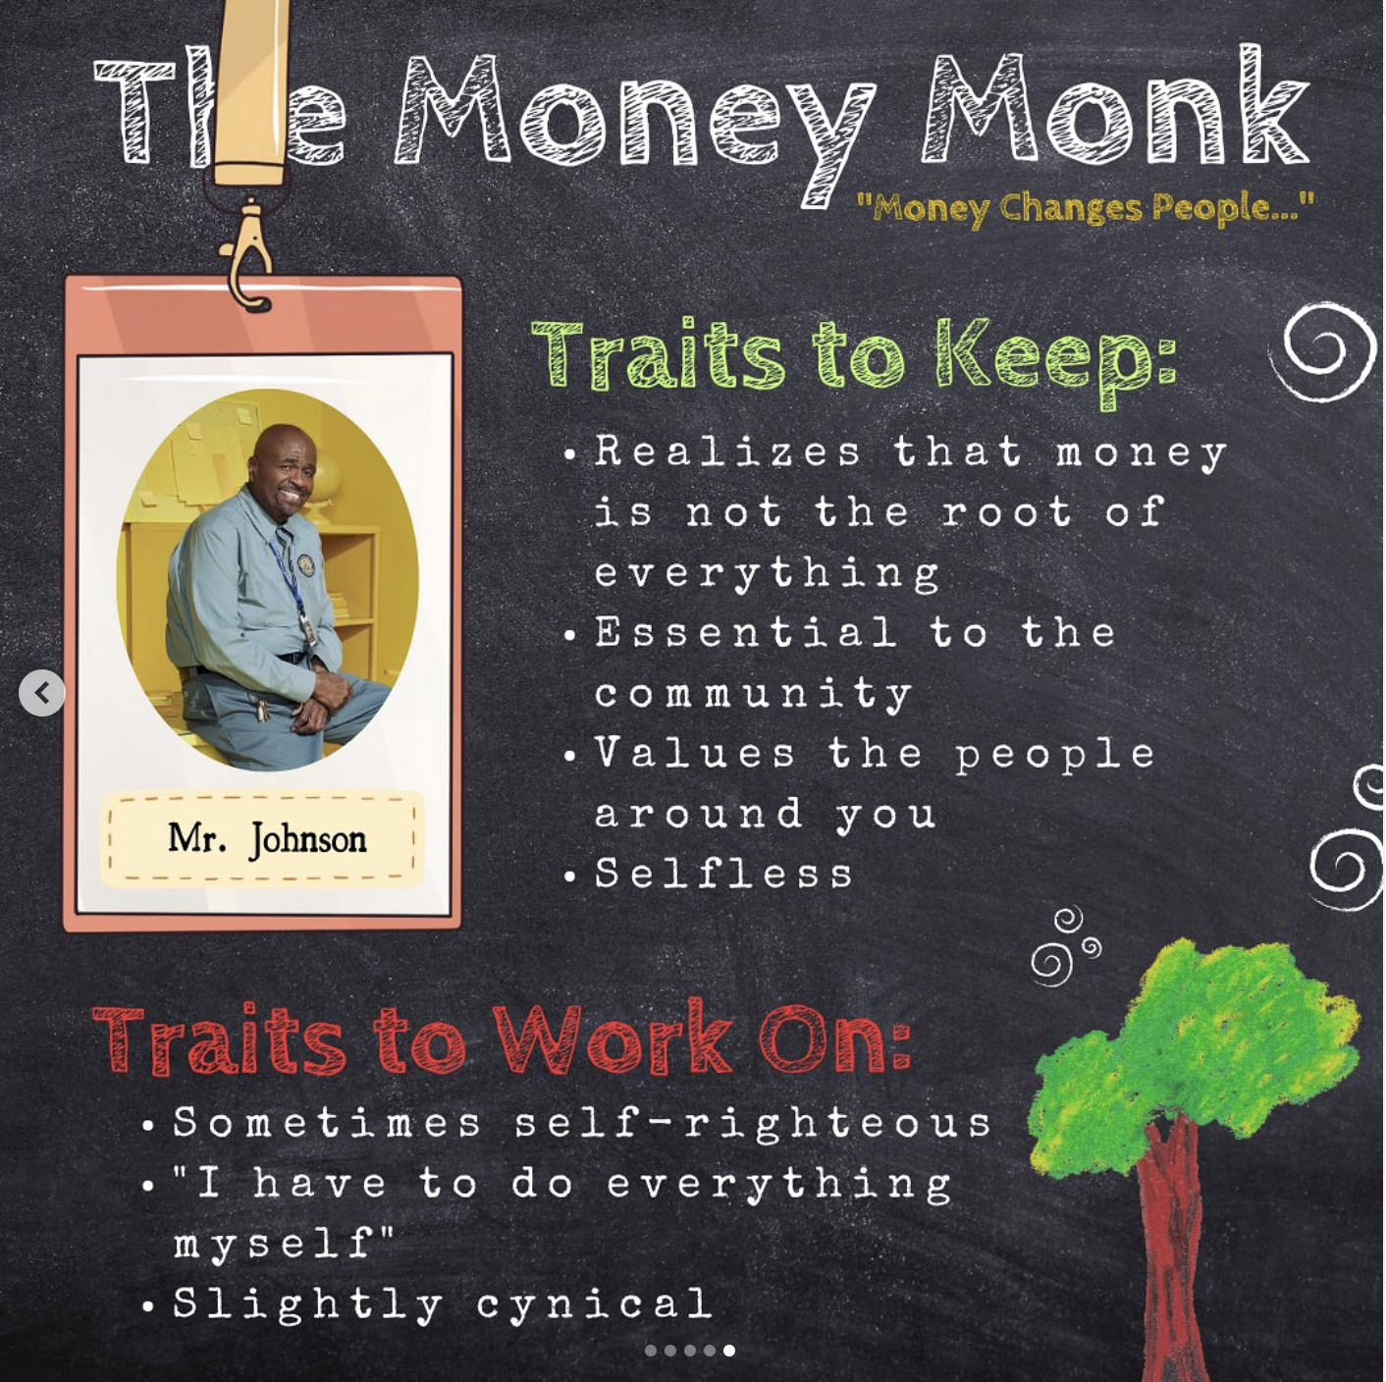
brunchandbudget.com/seechange
@brunchandbudget

Slide 44
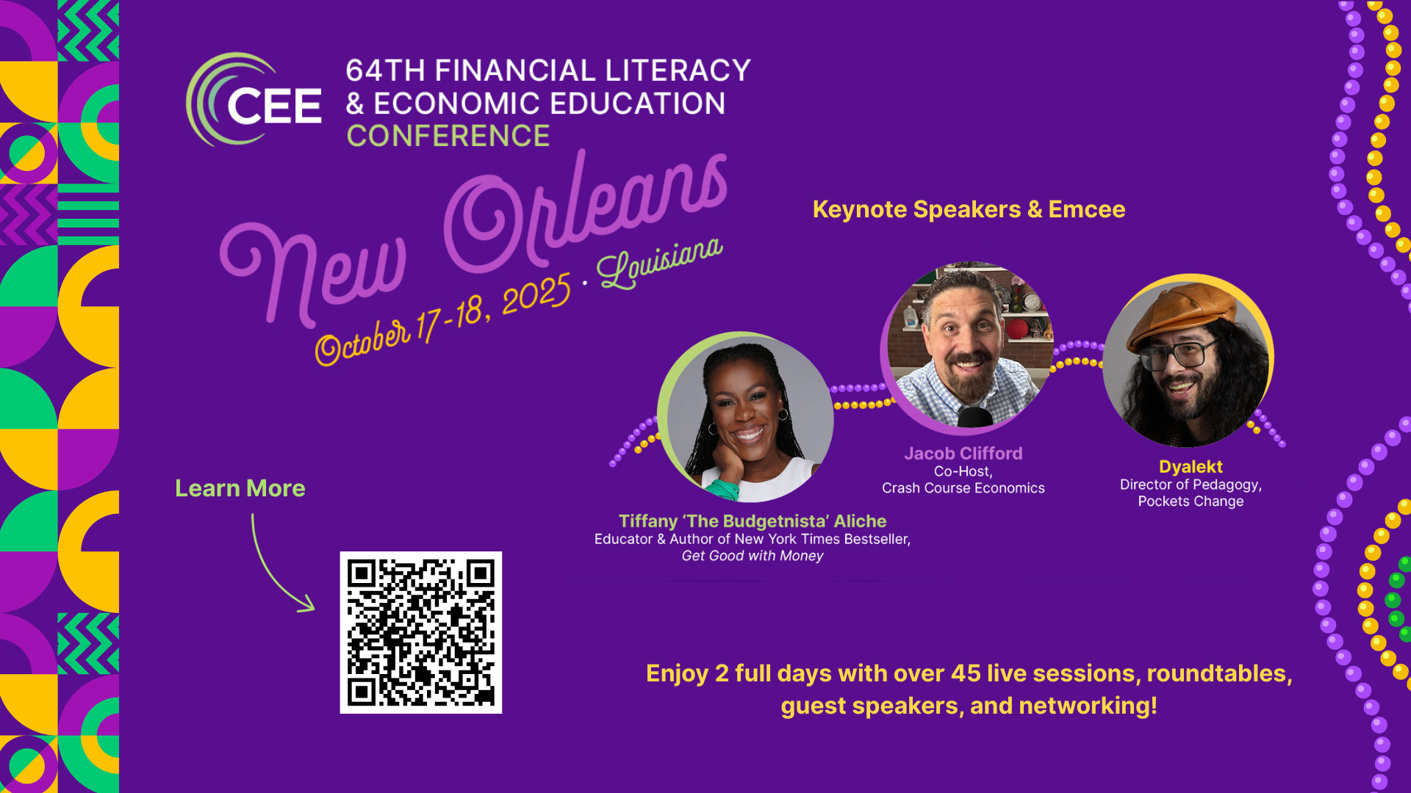

Slide 45
