Slide 1


2025 Summer Institute: Classroom Kickoff! Put Students in the Lead from Day One

Slide 2



Thanks to our supporters who invest in CEE’s teacher professional development and classroom resources.

Slide 3
EconEdLink Membership Perks
As an EconEdLink member, you have access to a wealth of valuable resources! Here's a quick overview of the perks that come with your membership:
New Webinars, Lesson Plans, and Activities are added every month, keeping your teaching toolkit fresh and up-to-date.
Learn from experts in personal finance and economics tailored to K-12 education.
Free high-quality resources like presentations, lessons, and activities, all available for download.
Instant access to your professional development certificates as soon as the requirements are met.
Additionally, we’re offering a 20% discount at the CEE Store. You can purchase our bestsellers like Financial Fitness for Life and AP Economics using the code: EEL20.

Slide 4
Certificate Requirements & Materials
To earn professional development hours for webinars, you must:
Watch a minimum of 75% for our longer sessions and the full 45 minutes for our 45 minute sessions.
You will automatically receive a professional development certificate via e-mail within 24 to 48 hours.
Want to revisit today’s content? All session materials and recordings will be available on EconEdLink.org within the following day (10am EST)

Slide 5
Virtual Engagement & Etiquette
We encourage you to engage actively throughout the session!
Feel free to use the chat to ask questions
Share ideas
Or let us know if you need support
We’d love for you to turn on your camera and join the conversation to help create a more connected and collaborative environment.
To minimize distractions, please make sure your microphone is muted unless you're speaking.
At the end of the session, an evaluation form will appear. Your feedback is incredibly valuable and helps us improve future programming.

Slide 6
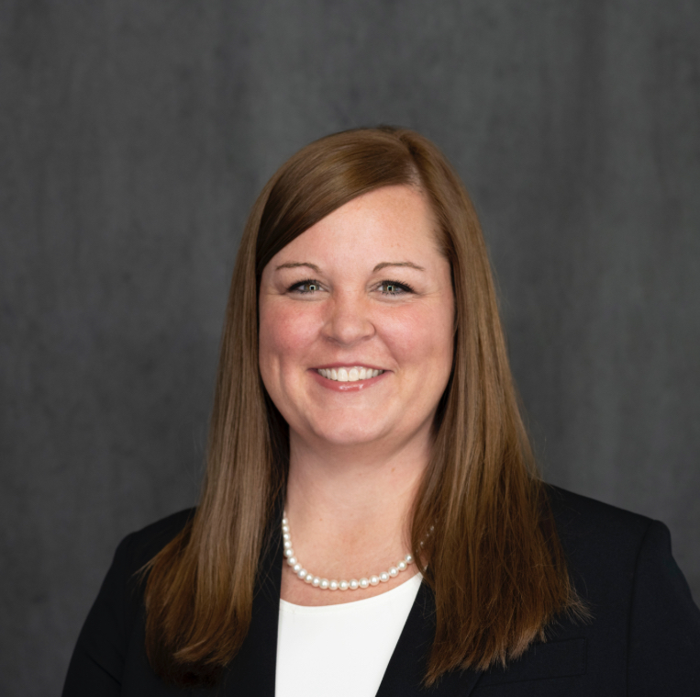
Presenter
Dr. Amanda Price
priceaj@calvertnet.k12.md.us
https://www.linkedin.com/in/amanda-price-ph-d-72b887ab/

Slide 7
Objectives
You will be able to:
Prioritize student voice and ownership
Build purposeful classroom routines
Use Econ and Personal Finance as leadership platforms

Slide 8

Session Agenda
Co-Setting Norms and Establishing Routines
Manage Collaborative Work
Student Led Activities
Bonus Material: How PBL can shift Your classroom

Slide 9


National Standards
https://www.councilforeconed.org/policy-advocacy/k-12-standards/
Notes:
This is for before you get to your standards…But here they are incase you need a reminder of what they are

Slide 10
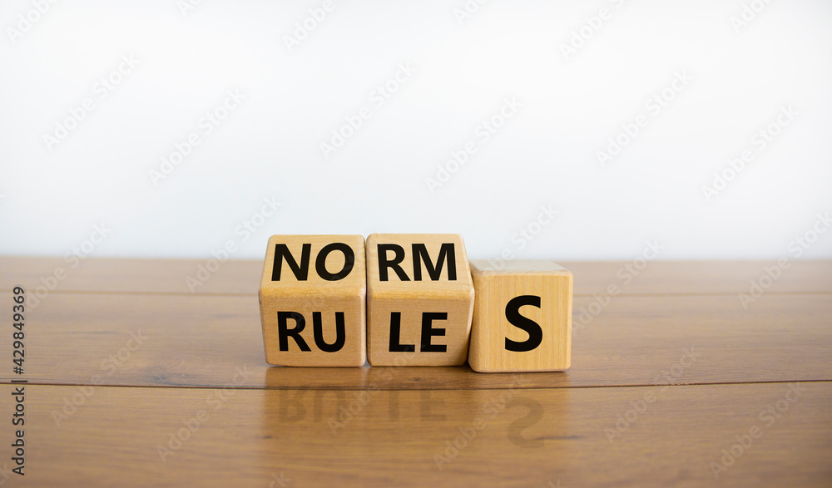
Co-Setting Norms
And Establishing Routines

Slide 11
Co-Create Class Norms
Use insights from the personal experience to co-create classroom norms.
- What helped your class be successful?
- What behaviors got in the way?
- What kind of classroom do we want to build together?

Slide 12

Just because I want to go to St. Croix, the whole ship does not shift off its path to St. Thomas just for me!
Norms don’t shift for 1 person

Slide 13



Culture Building:
Reflecting on Your Experience
What is your favorite movie? Why is it your favorite?
Round 1: Journal or Recall | 1 minute (silent)
Round 2: Share with Group | 1 minute (4 min total)
Look for common threads
Round 3: Share with the whole group | 3-5 minutes
Each group shares common threads
Notes:
Break Out Group

Slide 14

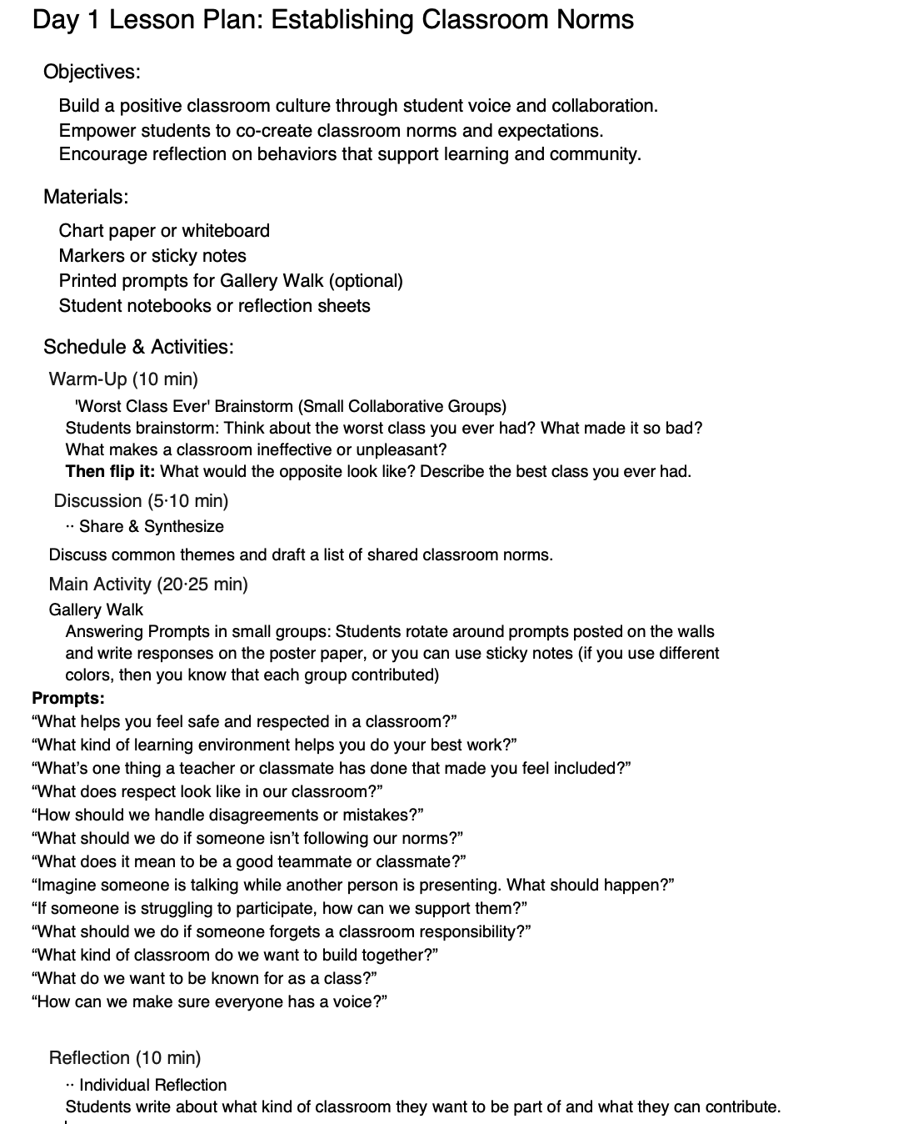

Creating Norms
Address Unspoken Rules

Slide 15

What is your favorite movie?

Slide 16

How would you feel if you were late to the movies?
How would you feel if your friends/family started to watch a movie without you?

Slide 17

Do you leave the movie to get snacks? Why/Why not?

Slide 18

How do you feel when someone is talking throughout the movie?
Notes:
For example: I hate it when my husband pauses a movie to talk about what just happened!

Slide 19

How would you feel if the movie stops just so a family member could take a phone call?

Slide 20

Do you enjoy discussing movies with your friends during or after watching it?

Slide 21

Do you leave the movies before the credits?
How would you feel if the power went out before the movie ended?

Slide 22
Non-Negotiables

Slide 23
Just like the movies, class will start without you! Make sure you are in the classroom and in your seat before the bell rings

Slide 24
Just like you get your snacks before the movie begins, Be prepared with all materials everyday

Slide 25
It is rude, like the movies, to talk when it is not appropriate!
Be respectful and polite to others (and yourself), this includes school property
Notes:
For example: I hate it when my husband pauses a movie to talk about what just happened!

Slide 26
Your mom can call the office...
Keep cell phones on silent and in backpack during class.

Slide 27
We will be discussing... So actively participate and engage with your peers when appropriate.

Slide 28
You don't want to miss anything important, so...
Follow the 10/10 rule and Wait to be dismissed by the teacher.

Slide 29
Non-Negotiables Re-cap
Be in the classroom and in your seat before the bell rings
Be prepared with all materials such as CHARGED laptop and science notebook everyday
Be respectful and polite to others (and yourself), this includes school property
Keep cell phones on silent and in backpack during class.
Actively participate and engage with your peers when appropriate.
Wait to be dismissed by the teacher.

Slide 30
Collaboration Time
Reflection: What was the worst class you ever had? What made it so bad?

Slide 31
Collaboration Time
Reflection: What was the BEST class you ever had? What made it so AWESOME?

Slide 32
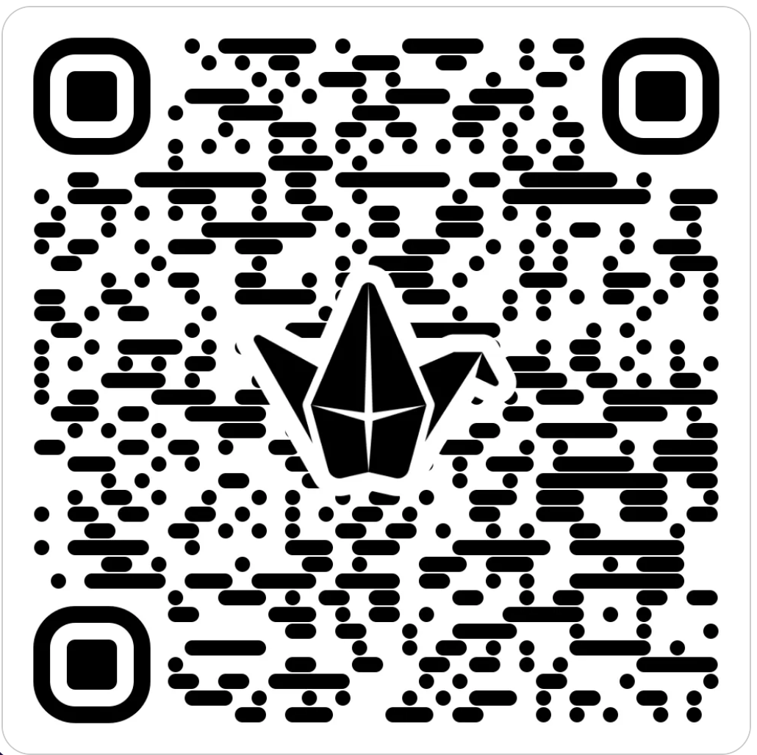
Share Out
What specific elements make a class engaging and memorable for you as a student?
Notes:
https://padlet.com/priceaj2/what-specific-elements-make-a-class-engaging-and-memorable-f-l8k66g5isq0vj34v

Slide 33

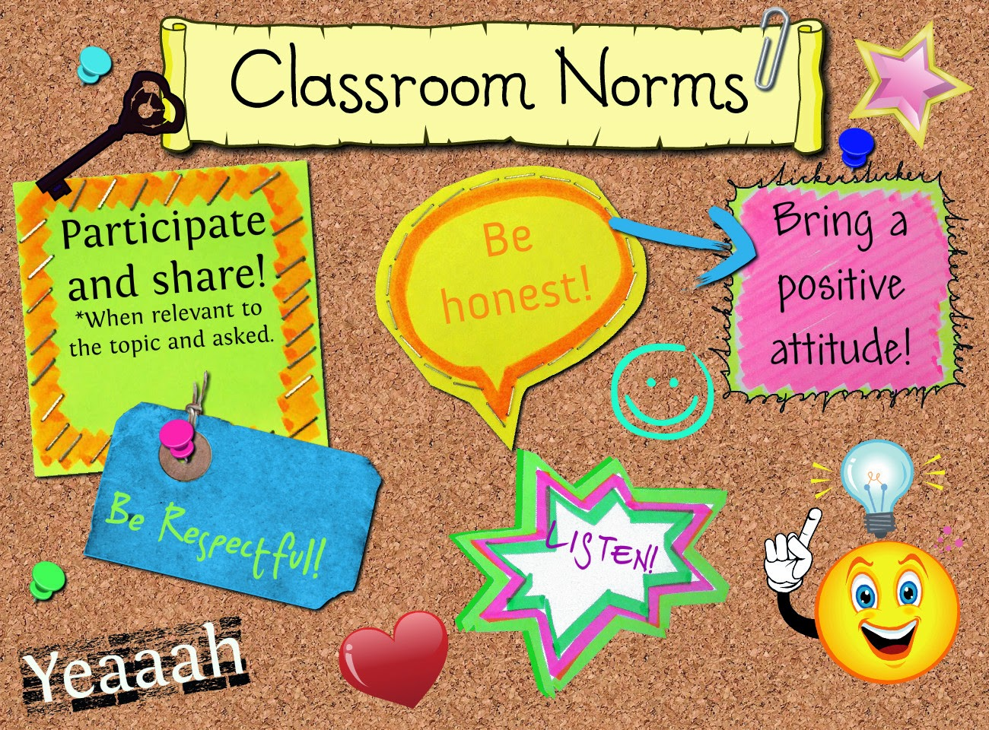

Developing Norms
What norms have I learned?
The goal is to develop a class culture that promotes academic achievement.
To address potential impatience, our class is like a supertanker. "It won’t turn quickly based on one person's needs, but we will arrive at the intended academic destination."
In addition, as a class we will revisit norms often and make course corrections.

Slide 34
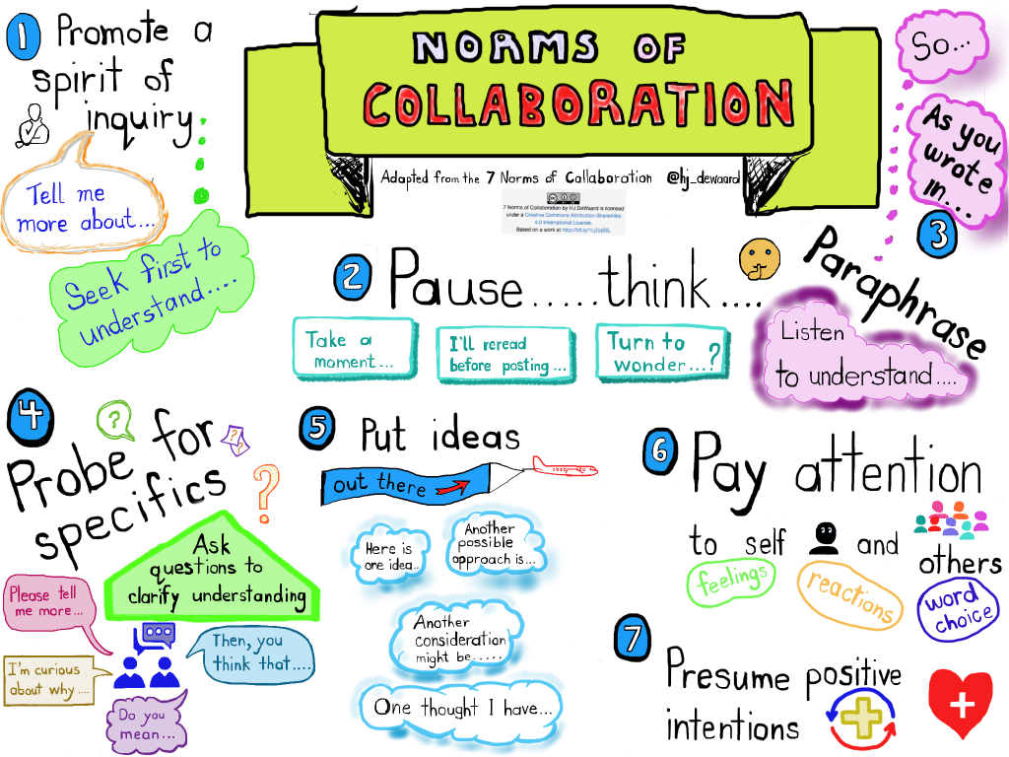

Slide 35

Group Agreements
Pick the top 3 that are the most important to you
Engage in the work
Adopt a beginner’s mindset
Give and expect dignity and respect
Appreciate non-closure
Welcome curiosity
6. Expect and learn from failure
7. Listen to learn
8. Lean into discomfort
9. Encourage constructive silence
10. Discourage Distractions
Facilitator Agreements:
Offer clear expectations and examples
Provide and protect time for you to work, reflect, and take care of your needs

Slide 36
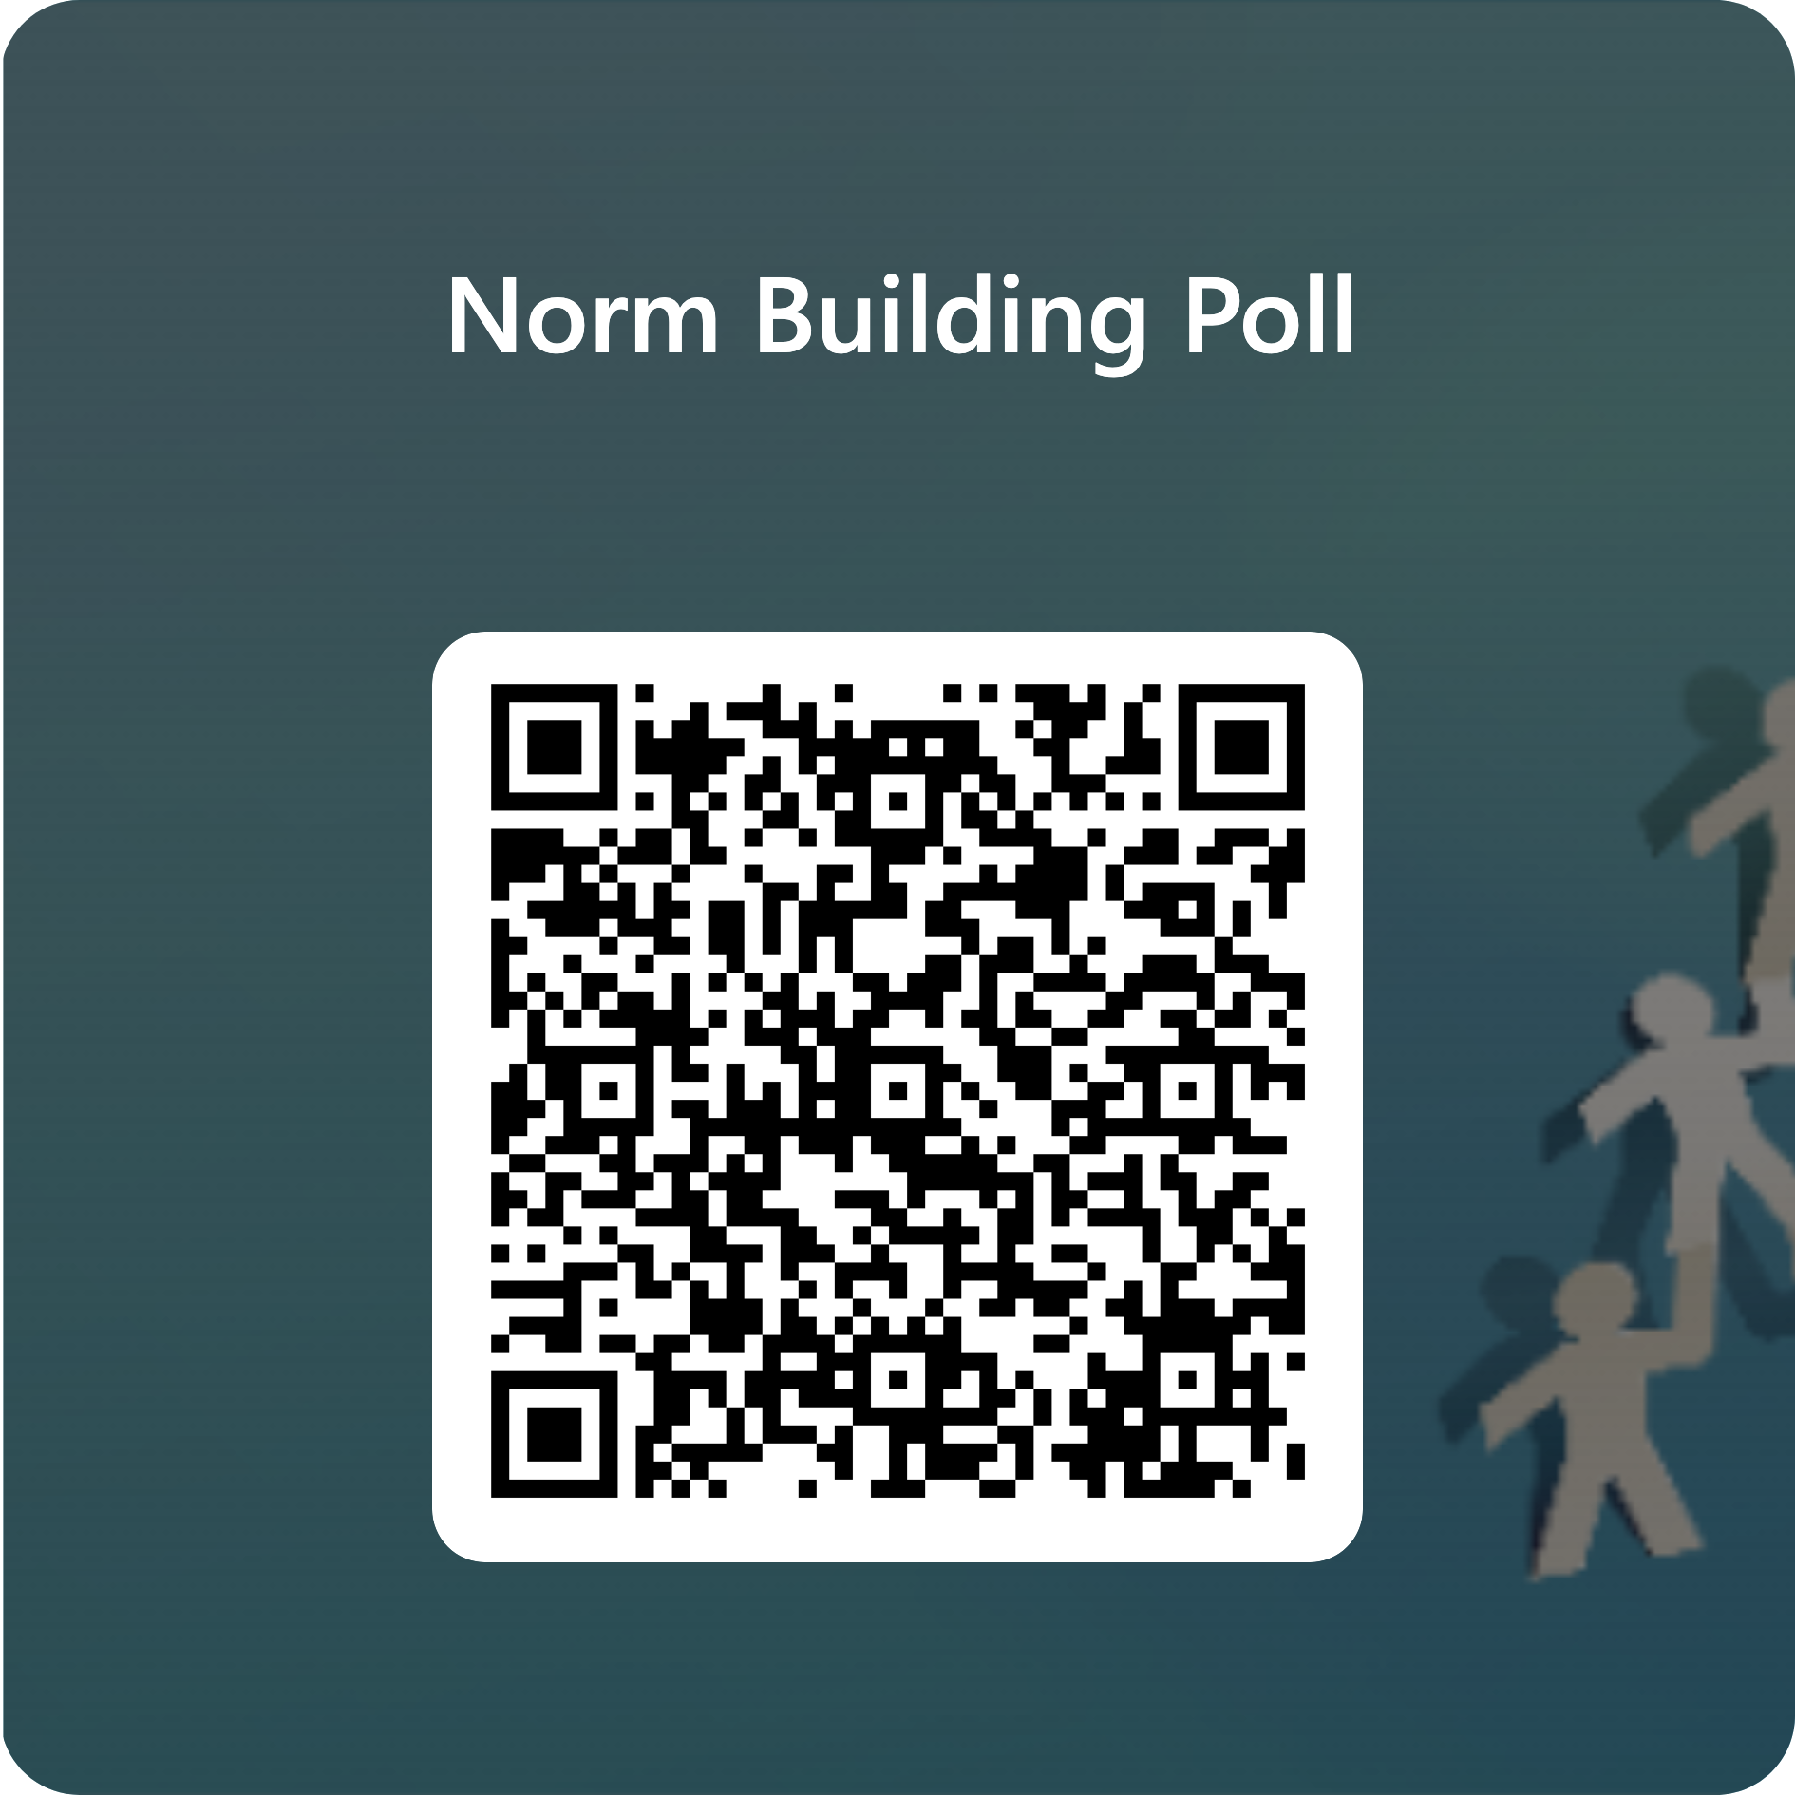
Norms Poll
Our top 5 Norms:
Notes:
https://www.poll-maker.com/#qp=5535144x97F6C1f8-164

Slide 37
Norm Building
POTENTIAL PROBLEM AREAS
What (if any) norms are needed to address these areas?
Student-to-student interactions
The physical space and/or personal property
Sensitive topics
Transitions
When the instructor leaves/is absent from the room
Communication
Using the pencil sharpener, drinking fountain, and/or restroom
When tasks are finished early
Smart phones
Confusion or frustration
Intolerance
When needed materials are missing
In Previous classes what has interfered with your learning?

Slide 38
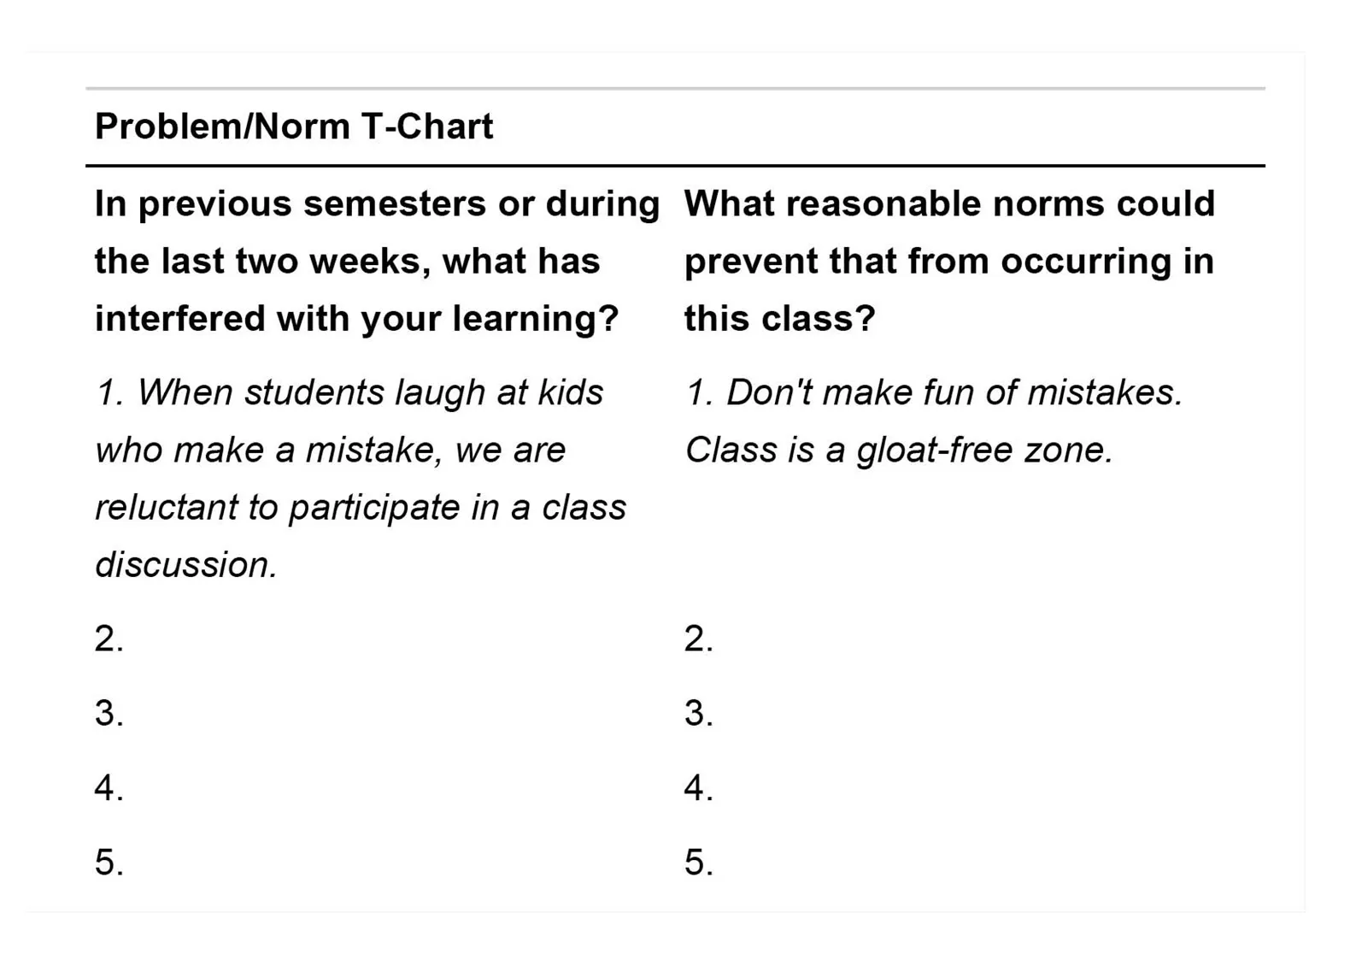

Slide 39
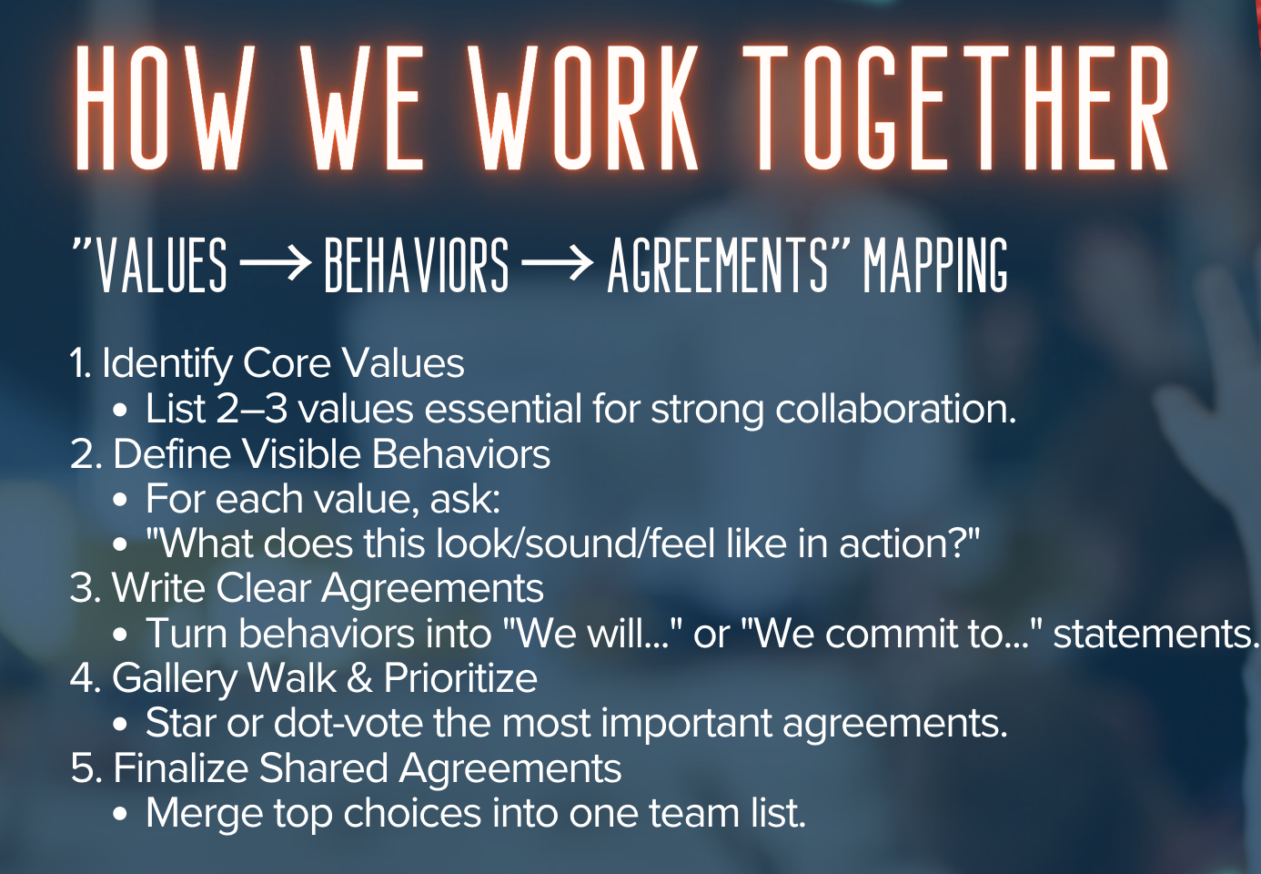
Notes:
Its always important to go back and revisit norms throughout the year.

Slide 40
Empowering Classroom Routines
Examples of Empowering Classroom Routines
Here are some routines you can introduce early in the year:
Routine | Description
Morning Meetings or Daily Check-ins | Students share goals, questions, or news to build community.
Student-Led Warm-Ups | Each day, a different student leads a short activity or question.
Classroom Jobs or Roles | Students rotate roles like facilitator, timekeeper, or tech manager.
Reflection Journals | Daily or weekly reflections on learning, challenges, and goals.
Exit Tickets | Students answer a prompt or question before leaving class.
Goal-Setting Mondays / Feedback Fridays | Students set intentions and reflect on progress weekly.

Slide 41
Routines and Responsibilities
Classroom Leadership Roles
Discussion Facilitator: Leads class conversations and ensures all voices are heard.
Project Manager: Oversees group progress and deadlines.
Resource Curator: Finds and shares relevant articles, videos, or tools.

Slide 42

The Importance of Routines
https://www.youtube.com/watch?v=VA39LsP4_ao&t=148s

Slide 43
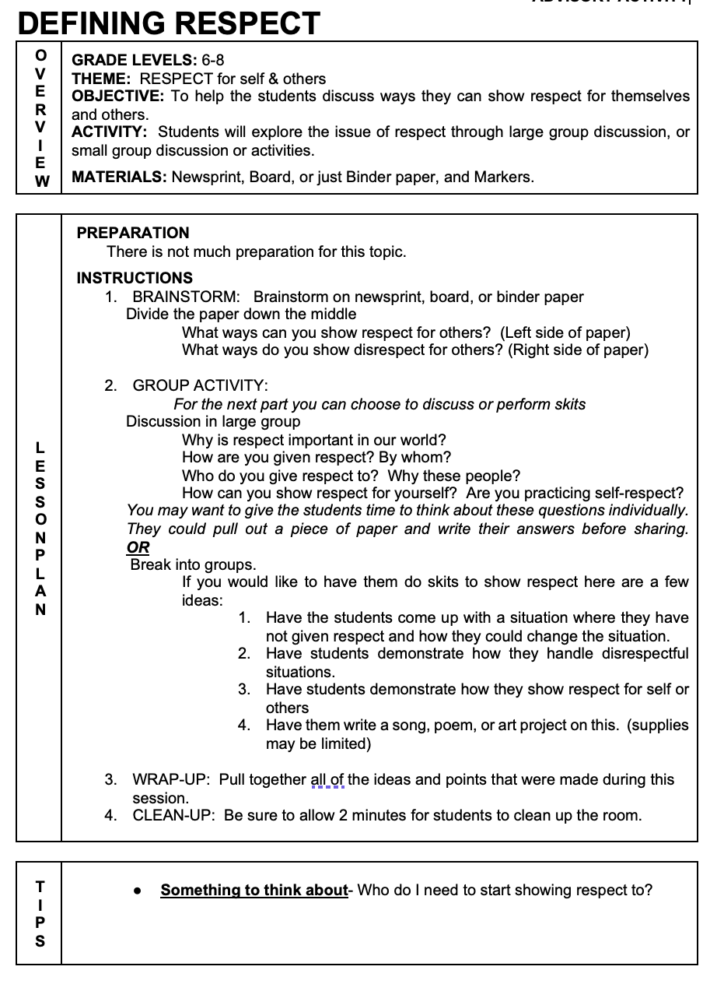
What Respect Means to You
Lesson Plan
Students come from different backgrounds and what is respectful may look different: Use this lesson to develop a common definition of RESPECT

Slide 44
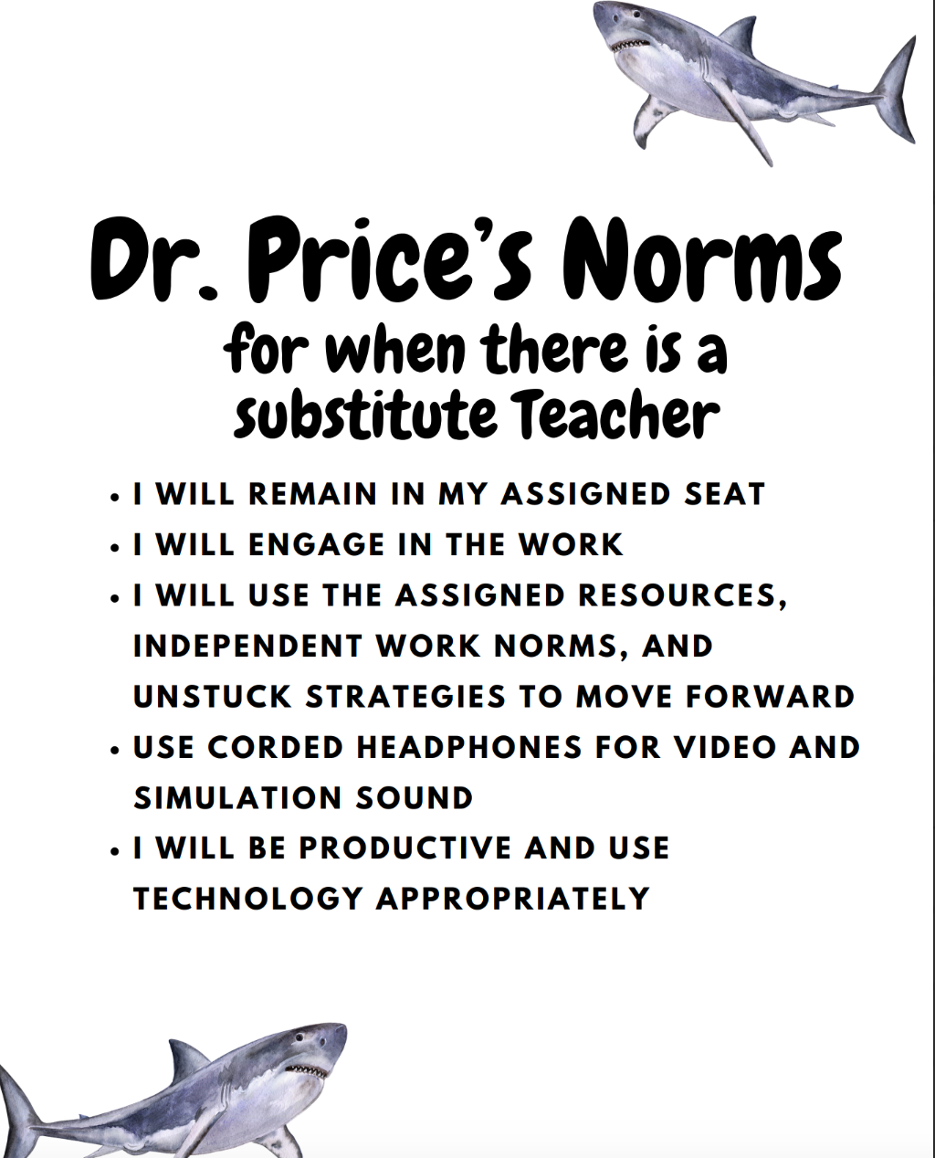
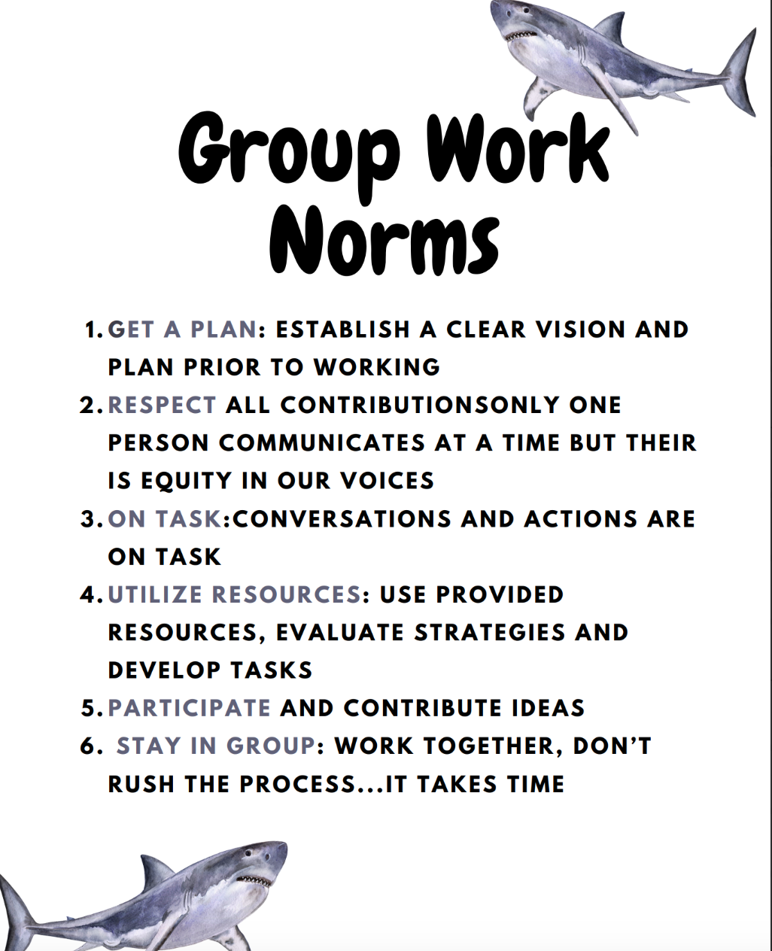
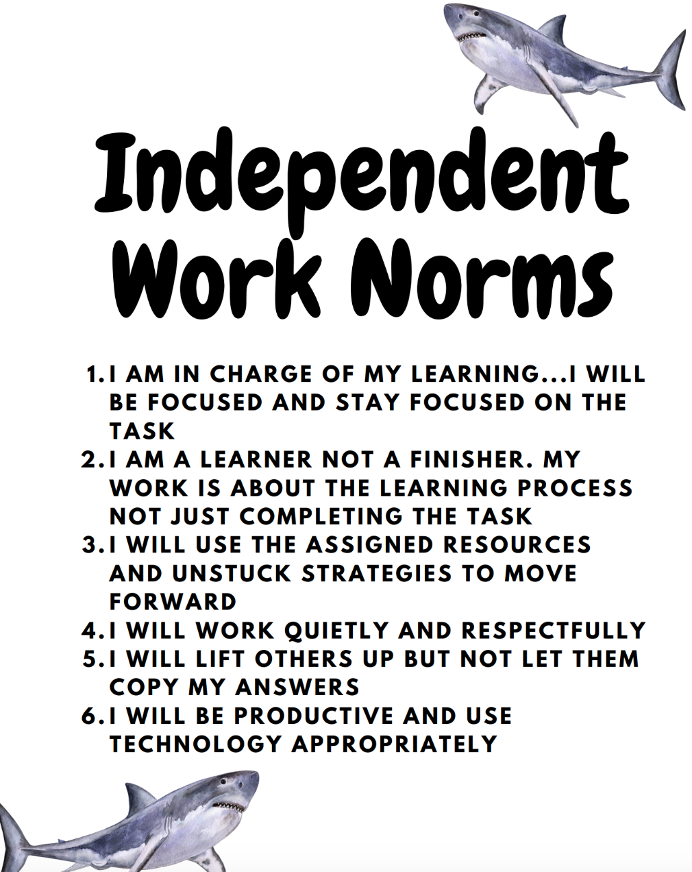
Examples of Norms and Routines

Slide 45

Small Group Norms and Expectations
Work together to accomplish a task.
  Divide up the work
  Pull your weight
Everyone has a voice and should be heard.
  Each person should present ideas/answers to the group.
Take turns speaking.
  Allow others to talk and share ideas. There’s no “I” in Team.
Actively listen.
  Listen without interrupting. Be focused on the speaker.
Politely disagree
  You don’t have to agree with everything but be respectful of other’s views and opinions

Slide 46
Collaboration Norms
Pausing
Paraphrasing
Posing Questions
Putting Ideas on the Table
Paying Attention
Pursuing a Balance
Presuming Positive Intentions
Providing Supporting Data
Seven Norms of Collaboration
Norms for Collaboration from Center for Adaptive Schools

Slide 47
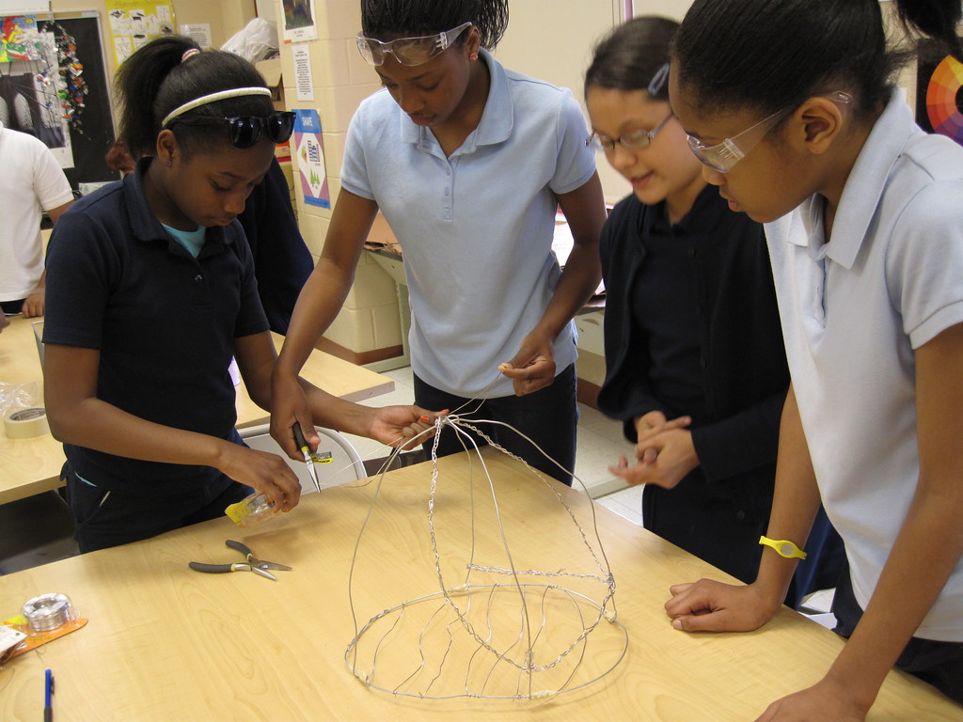
Manage Collaborative Structures

Slide 48

How to make student worktime productive

Slide 49
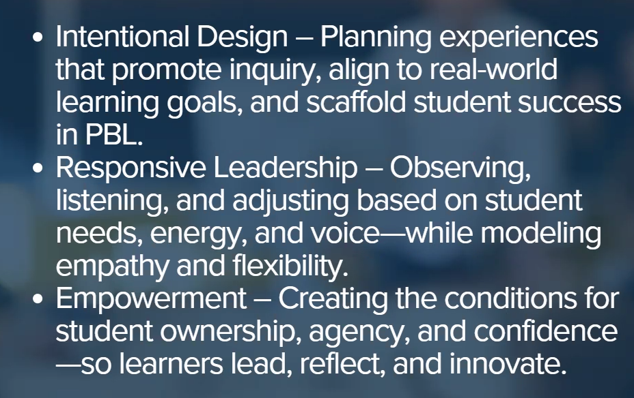
Role of the Teacher

Slide 50
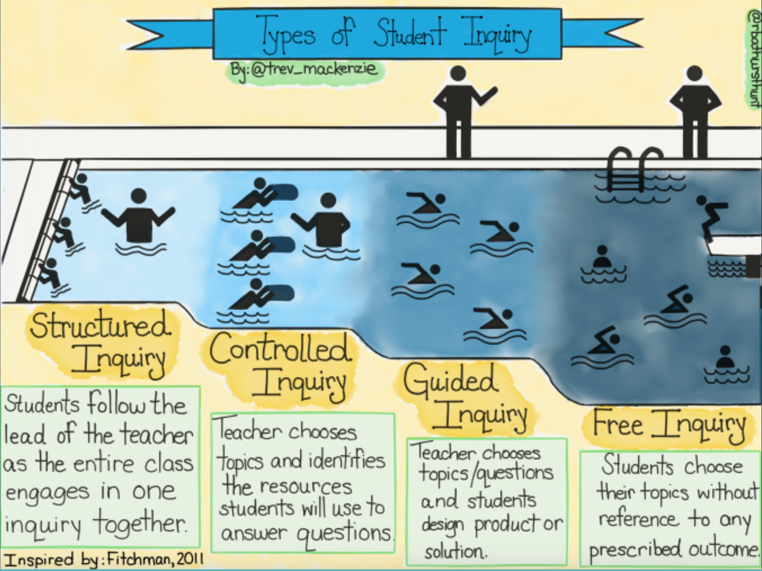
Intentional Planning: Levels of Inquiry
Notes:
In my planning I am intentional about the levels of inquiry
Using the levels of inquiry—structured, controlled, guided, and free—can significantly enhance group collaboration by gradually building students’ independence, confidence, and teamwork skills. Here’s how each level contributes to managing collaborative time effectively:

Slide 51
Structured Inquiry
Definition: Teacher provides the question, method, and materials. Students follow directions to reach a conclusion.
Example Activity: Budgeting Simulation
Students are given a fixed income and a list of expenses (housing, food, transportation, etc.).
They follow a step-by-step worksheet to create a monthly budget.
The goal is to understand how to balance needs vs. wants.
Notes:
How it helps: Provides a clear, shared starting point for all students.
Collaborative benefit: Reduces confusion and ensures everyone understands the process. Great for early stages of group work or for students new to collaboration.
Example: All groups complete the same budgeting worksheet with assigned roles (e.g., calculator, recorder, presenter).

Slide 52
Controlled Inquiry
Definition: Teacher provides the question and materials, but students determine how to analyze or interpret the data.
Example Activity: Credit Card Comparison
Students are given 3–4 credit card offers with different interest rates, fees, and rewards.
The teacher asks: “Which credit card is the best option for a college student?”
Students analyze the data and justify their choice using a decision matrix.
Notes:
How it helps: Encourages decision-making within a defined framework.
Collaborative benefit: Promotes discussion and consensus-building as students interpret data or compare options.
Example: Groups analyze different credit card offers and decide which is best for a college student, justifying their choice together.

Slide 53
Guided Inquiry
Definition: Teacher provides the question, but students choose their own methods and resources to investigate.
Example Activity: “How can I afford my first car?”
Students research car prices, insurance, maintenance, and financing options.
They create a financial plan and present their findings.
They choose their own sources (e.g., Kelley Blue Book, insurance sites) and tools (e.g., spreadsheets, infographics).
Notes:
How it helps: Offers more autonomy while still supporting structure.
Collaborative benefit: Teams must divide tasks, delegate research, and synthesize findings—enhancing communication and interdependence.
Example: Groups research how to afford a car, assign roles (e.g., insurance researcher, loan calculator), and present a shared financial plan.

Slide 54
Free Inquiry
Definition: Students generate their own questions and design their own investigations.
Example Activity: Personal Finance Passion Project
Students choose a topic of interest (e.g., investing in crypto, starting a small business, saving for college).
They develop a driving question (e.g., “Is it smarter to invest in a Roth IRA or a 529 plan for college?”).
They research, analyze, and present their findings in a format of their choice (video, blog, presentation, etc.).
Notes:
How it helps: Maximizes student ownership and creativity.
Collaborative benefit: Teams must self-manage time, roles, and goals—developing leadership, accountability, and problem-solving.
Example: Students choose a personal finance topic (e.g., investing, entrepreneurship), form interest-based groups, and design their own inquiry and product.

Slide 55
Levels of Inquiry
Notes:
How Inquiry Levels Improve Collaboration
Scaffolded independence: Students build collaboration skills progressively.
Role clarity: Each level encourages purposeful role distribution.
Time efficiency: Clear expectations and autonomy reduce off-task behavior.
Deeper engagement: Students are more invested when they have voice and choice.

Slide 56
Group with Intention
3. Low Support (Independent Practice)
Who it's for: Students who are ready to apply knowledge on their own.
Examples:
  Independent projects
  Choice boards or menus
  Self-assessment tools
  Teacher as a coach or observer
4. Strategic Support (Responsive Intervention)
Who it's for: Students who need targeted help based on formative assessment.
Examples:
  One-on-one conferencing
  Reteaching or enrichment groups
  Use of accommodations or modifications
  Personalized learning plans
1. High Support (Teacher-Directed)
Who it's for: Students who are new to a concept or need significant help.
Examples:
  Step-by-step modeling
  Think-alouds
  Sentence starters or graphic organizers
  Frequent check-ins or proximity support
2. Moderate Support (Guided Practice)
Who it's for: Students who have some understanding but still need scaffolding.
Examples:
  Small group instruction
  Guided questions or prompts
  Peer collaboration with teacher monitoring
  Checklists or partially completed tasks
Notes:
Think about who is in your room and group based on the levels of support. Remember these levels can be fluid—students may move between them depending on the task, content, or their confidence.
Planning with intention--> students in Low support need roles to help other students or need extension activites

Slide 57
Productive Collaborative Time
1. Set Clear Goals and Milestones
Break the project into benchmarks (e.g., interview prep, design drafts, final product).
Use a visual project calendar (like the one in your unit) to help students see what’s due and when.
2. Assign Roles and Responsibilities
Use your group contract to define roles (Project Manager, Research Lead, etc.).
Rotate roles weekly to build diverse skills and accountability.

Slide 58
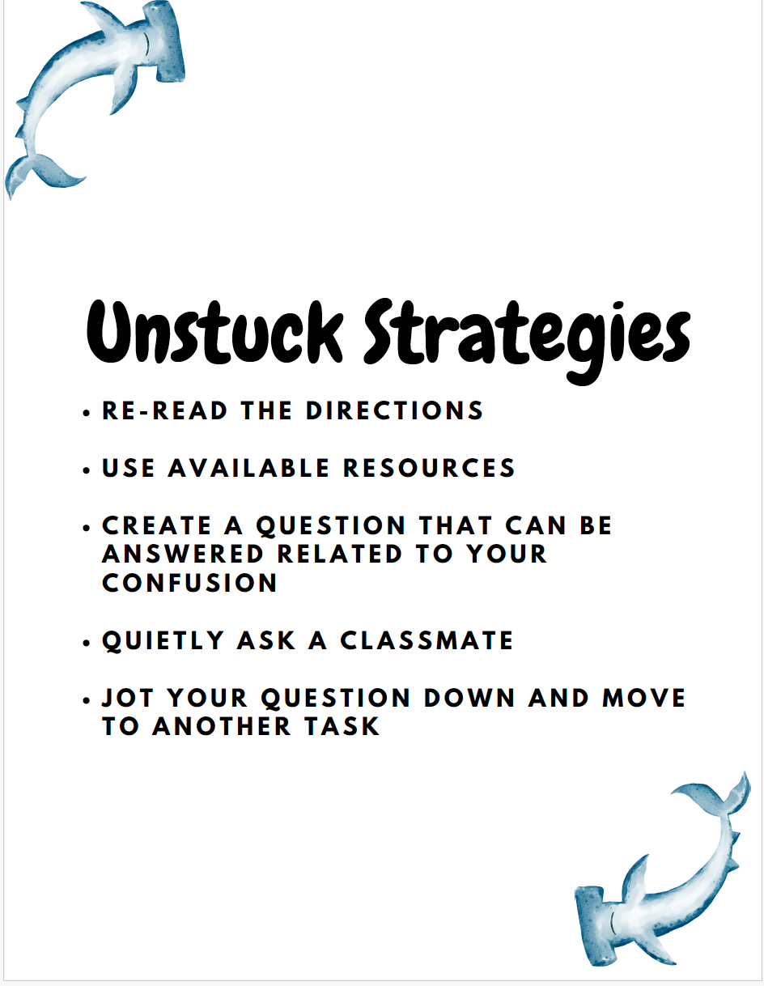

Slide 59
Assign Roles and Responsibilities
🗣️ Communication Lead
Manages how the group communicates its message to the public and stakeholders. This includes writing slogans, preparing presentations, and ensuring the message is clear, persuasive, and audience-appropriate.
📋 Project Manager
Keeps the team organized and on track. Sets deadlines, monitors progress, facilitates meetings, and ensures that all team members are contributing and collaborating effectively.
🧠 Research Lead
Responsible for gathering accurate, credible information. Ensures that all information used in the project is fact-checked and clearly understood by the team.
🎨 Design Lead
Oversees the visual and creative aspects of the project design. Works closely with the team to develop engaging, informative, and visually appealing designs that effectively communicate the overall message.

Slide 60
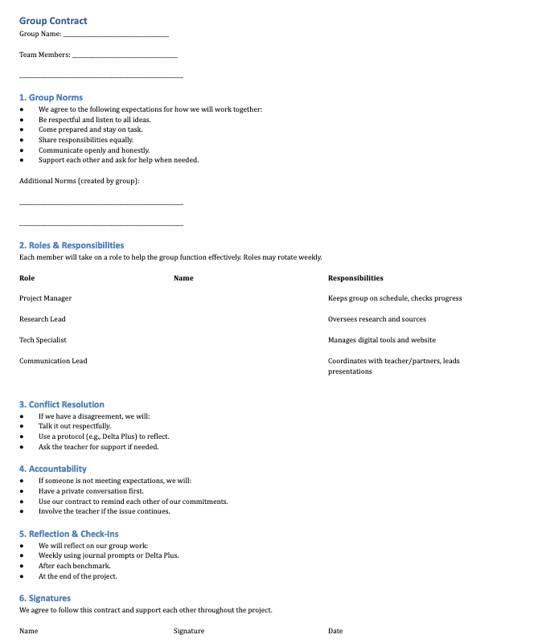
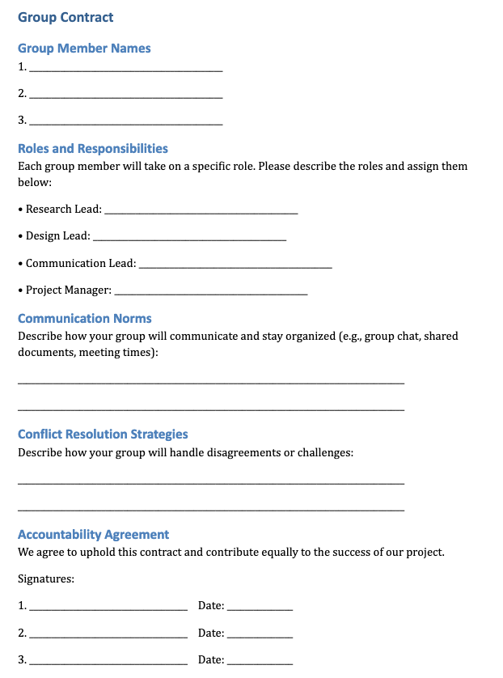

Have a group contract

Slide 61
Productive Collaborative Time Cont.
3. Use Time-Boxed Work Sessions
Structure collaborative time with clear start and end goals (e.g., “By the end of this session, your team should finalize your slogan and sketch your design.”).
Use timers or visual cues to keep students on track.
4. Implement Daily or Weekly Check-ins
Quick stand-up meetings (5–10 minutes) where each group shares:
What they accomplished
What they’re working on next
Any blockers or questions

Slide 62
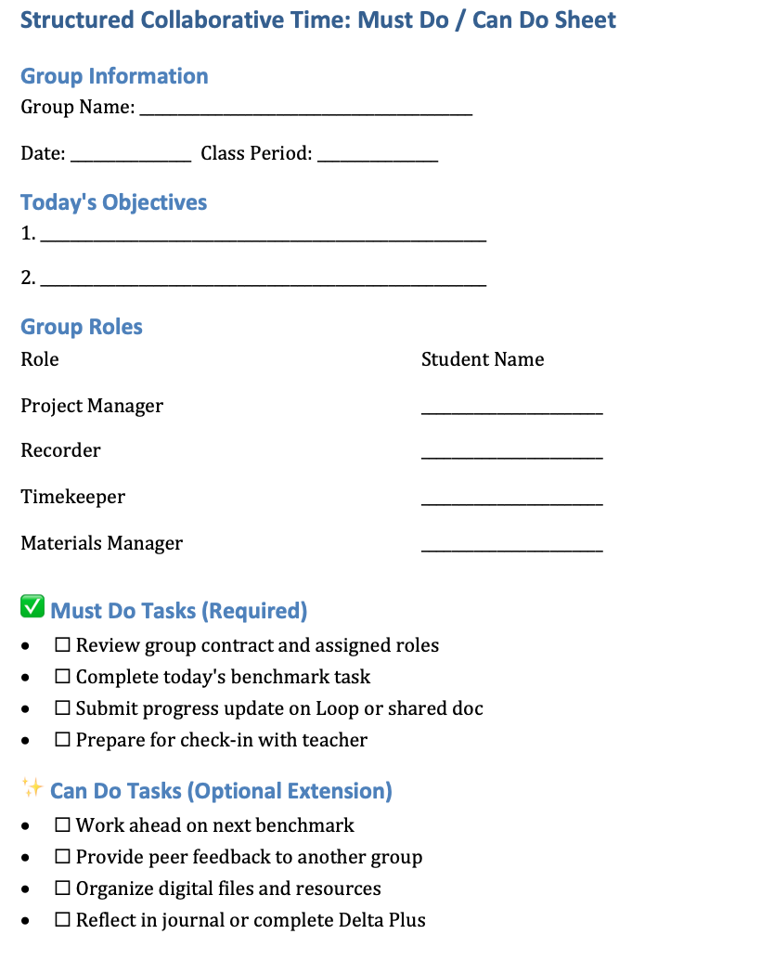
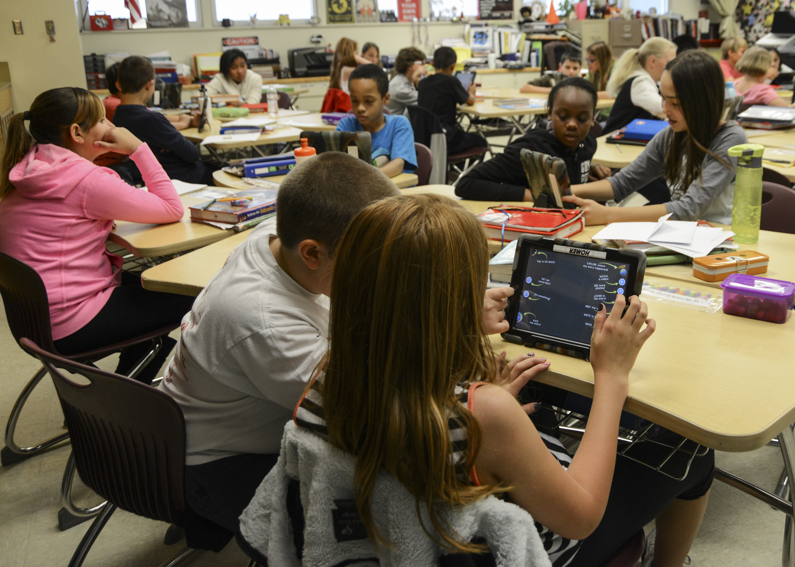
Structure time

Slide 63
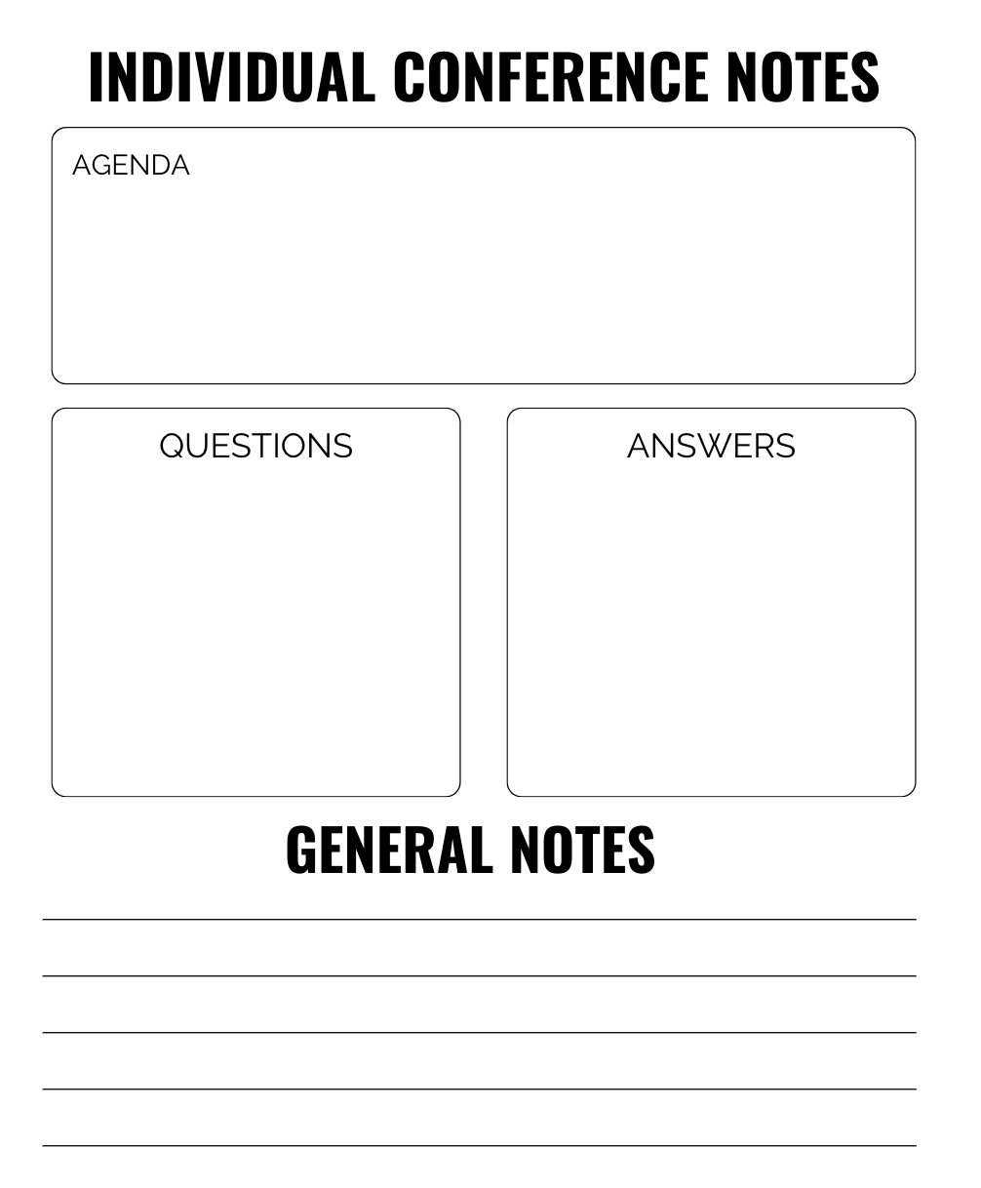
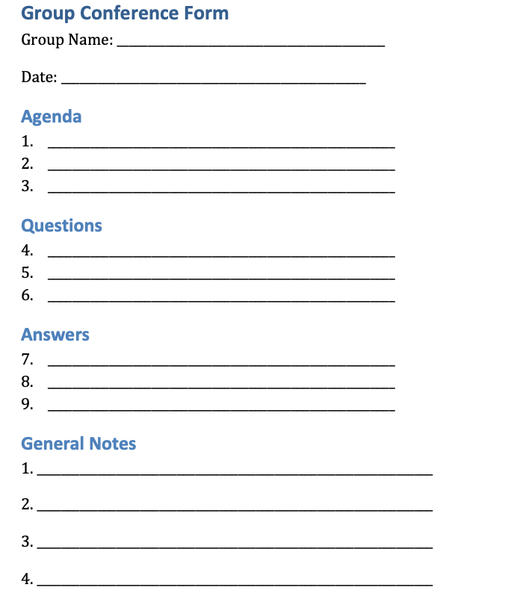
Individual/Group Conferences
Notes:
You want to move from the role of teacher to facilitator
”Go from a sage on the stage to Clide the Guide”
Don’t sit behind your desk and think that the magic will happen on its own→ get your steps in, formatively assess, check in, conference
Have students conference with each other with group meetings

Slide 64
Productive Collaborative Time Cont.
5. Use Collaboration Tools
Microsoft Loop (already in your unit) is great for tracking tasks and communication.
Shared Google Docs or Slides for co-editing and feedback.
6. Build in Reflection Time
Use Delta Plus or journal prompts to reflect on how collaboration is going.
Ask: “What did your team do well today?” and “What could we improve next time?”
7. Monitor and Support
Circulate during group time to observe, coach, and redirect as needed.
Use a collaboration rubric to assess and guide team dynamics.

Slide 65
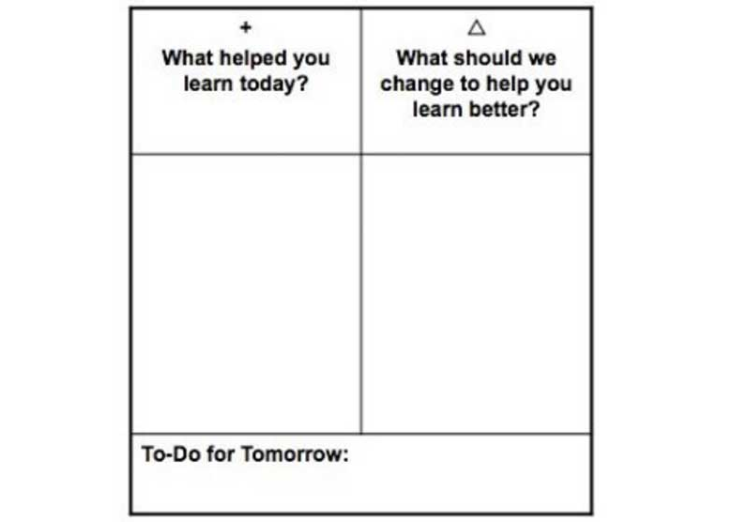
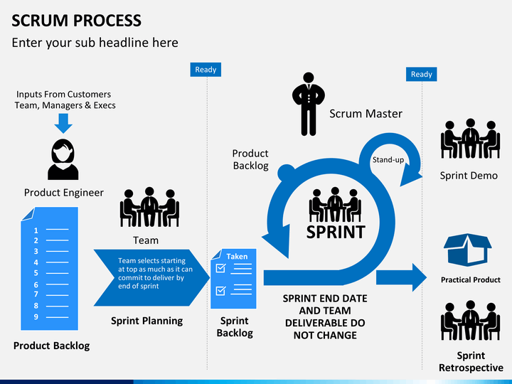
Protocol Examples
Delta Plus
Scrum

Slide 66

Student Led Activities

Slide 67
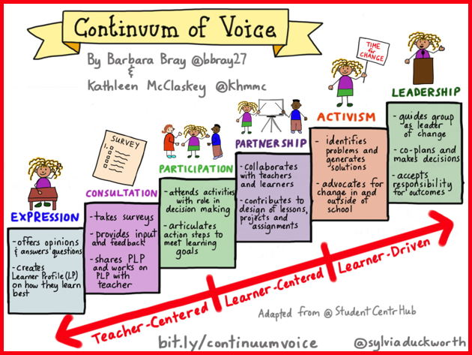
Give Voice and Choice through Student-Led Learning Activities

Slide 68
Giving students voice and choice in education can lead to:
Increased likelihood that students will experience self-worth, engagement, and purpose in school.
Greater motivation and engagement.
Empowerment to become self-directed learners.
Opportunities to find and develop unassessed or unknown voices and skills.
Better preparation to make responsible decisions, advocate for themselves, and decide their own course of action.

Slide 69
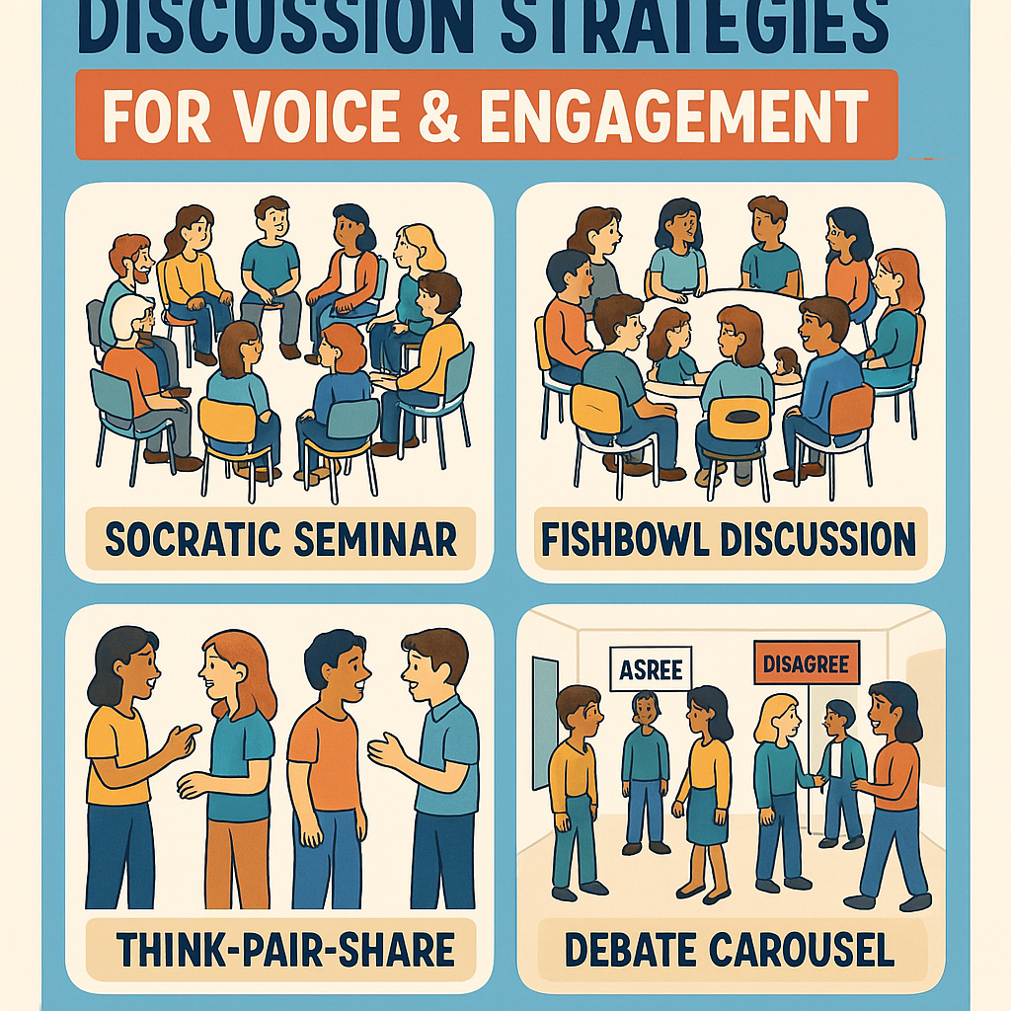
Student-Led Learning Activities
Student-Led Discussions
Socratic Seminars: Students prepare and lead a discussion around a key economic issue or ethical dilemma.
Fishbowl Debates: Inner circle debates while outer circle observes and gives feedback.

Slide 70
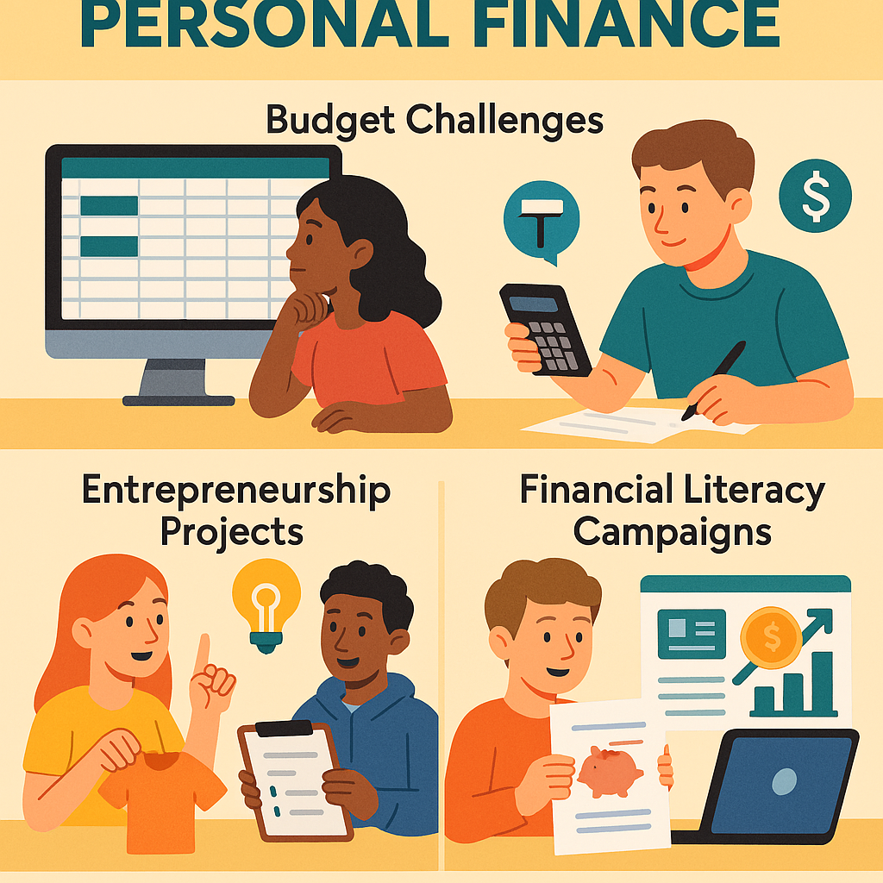
Student-Led Learning Activities:
Student-Designed Projects
Budget Challenges: Students create and manage a personal or family budget based on real-world constraints.
Entrepreneurship Projects: Students design a business plan, pitch it, and simulate launching a product or service.
Financial Literacy Campaigns: Students create materials to teach peers about credit, saving, or investing.

Slide 71
Student-Led Learning Activities:
Peer Teaching
Mini-Lessons: Students research a concept (e.g., compound interest, inflation) and teach it to the class.
Finance Fridays: A rotating student presents a current event in economics or finance and leads a short discussion.

Slide 72
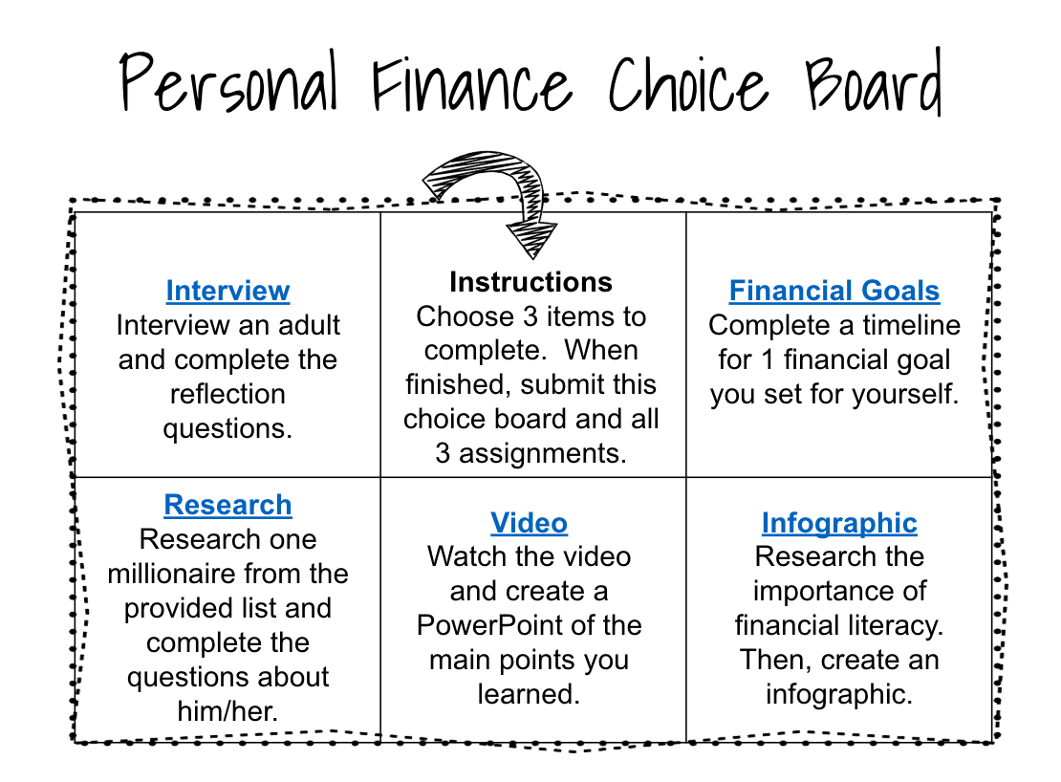
Student-Led Learning Activities
Choice-Based Learning
Menu Boards or Learning Contracts: Students choose how they want to demonstrate understanding (e.g., infographic, podcast, skit).
Passion Projects: Students explore a personal finance topic that matters to them and present findings.

Slide 73

Student-Led Learning Activities
Stock Market Game: Students research and invest in stocks, tracking performance over time.
Case Studies and Scenarios: Students act out financial decision-making situations (e.g., buying a car, applying for a loan).
Simulations

Slide 74
Lesson Examples
💸 1. “You Just Turned 18” Simulation
Scenario:
“You just turned 18. You have a part-time job, a checking account, and a credit card offer in the mail. What do you do next?”
Activity:
Students receive a “starter pack” with a fictional income, expenses, and financial choices. They must make decisions about rent, transportation, savings, and credit.
Why it works:
It’s personal, realistic, and immediately gets them thinking about financial responsibility.
🏠 2. Budget Breakdown Mystery
Scenario:
“Why can’t this person make ends meet?”
Present a fictional monthly budget that doesn’t balance. Students work in teams to identify the problem and propose solutions.
Why it works:
It introduces budgeting, critical thinking, and teamwork right away.

Slide 75

Why Voice and Choice is Important?
https://www.youtube.com/watch?v=xBGGAQsHG8E&t=13s

Slide 76
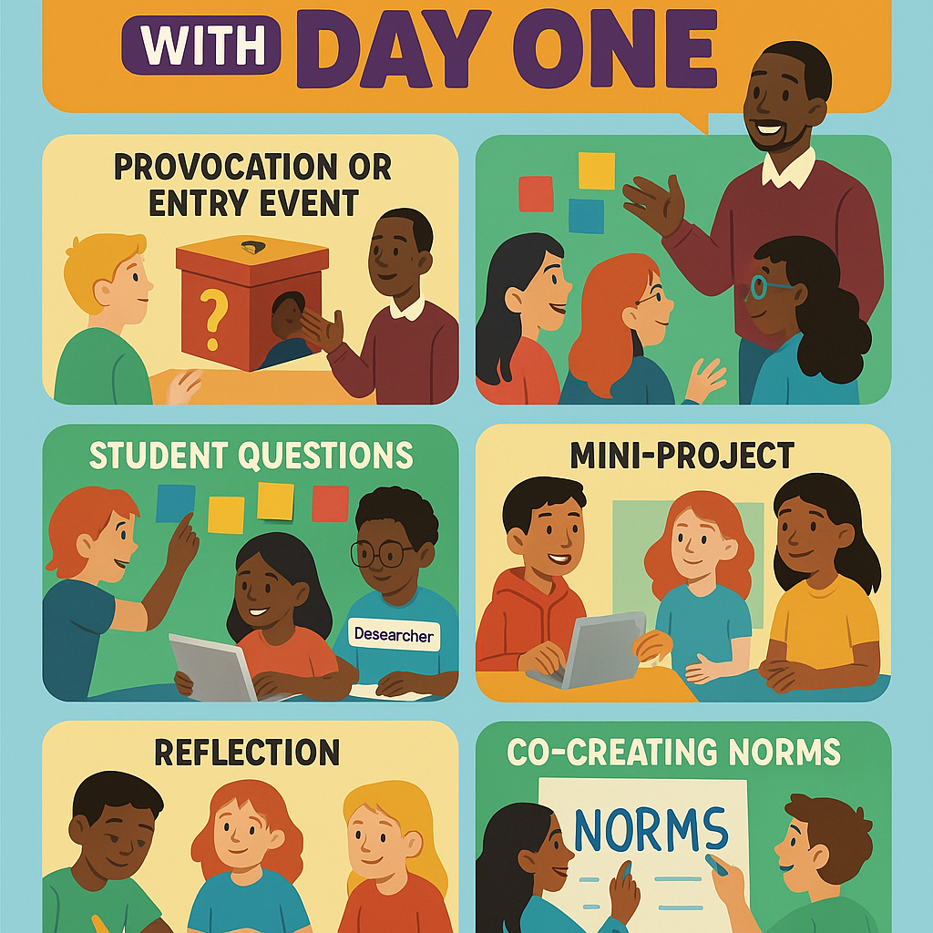
Bonus: Using PBL to Shift Your Classroom

Slide 77
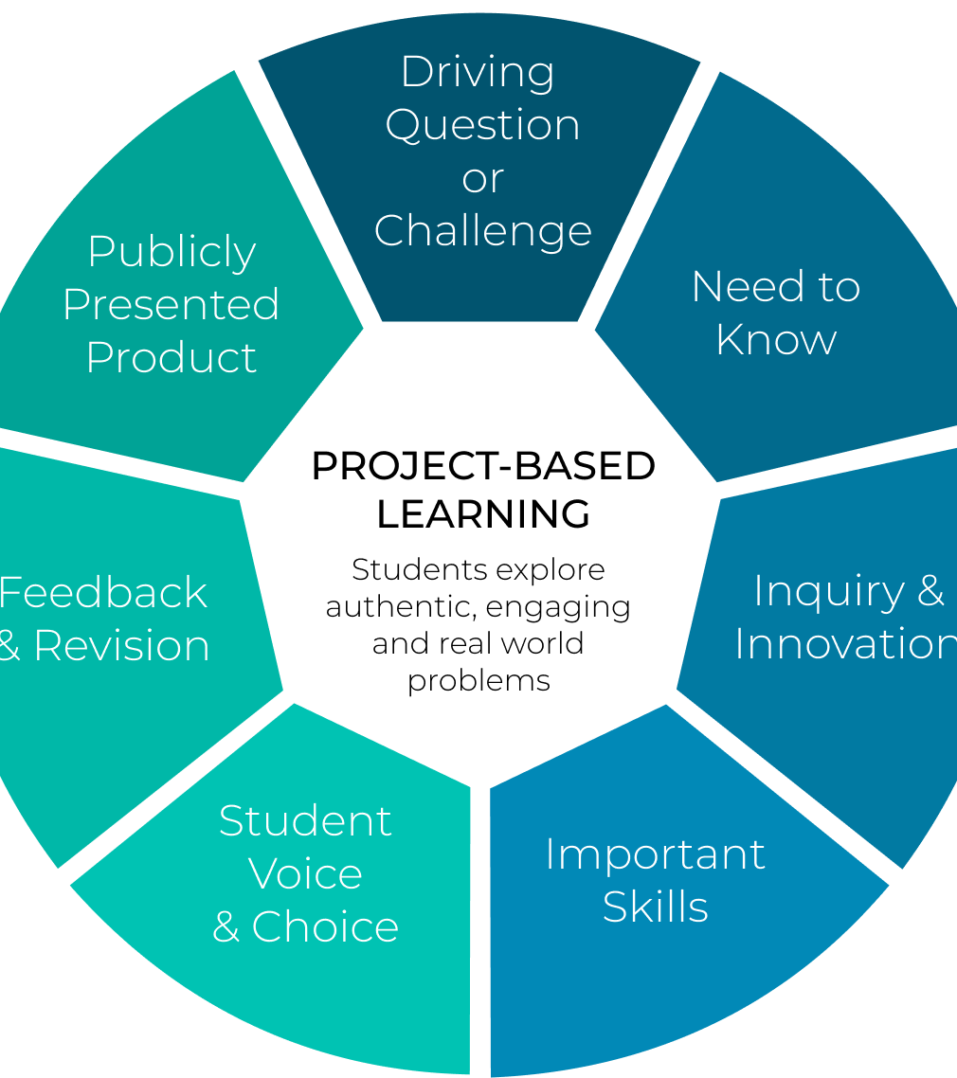
How PBL can shift your classroom?

Slide 78
What is PBL?
PBL stands for Project-Based Learning
teaching method where students learn by actively engaging in real-world and meaningful projects.
In PBL, students:
Explore authentic problems or challenges
Work over an extended period of time
Collaborate in teams or individually
Create a public product or presentation
Reflect on their learning and process

Slide 79
What is the difference between PBL and PrBL?
Feature | Project-Based Learning (PBL) | Problem-Based Learning (PrBL)
Focus | Creating a product or presentation | Solving a specific problem
Driving Force | A driving question that leads to a project | A complex, real-world problem that needs a solution
End Goal | A public product shared with an audience | A solution or explanation, often shared in discussion
Duration | Often longer-term (1–4 weeks or more) | Often shorter-term (a few days to a week)
Student Role | Students manage the project, make choices, and create something tangible | Students investigate, analyze, and propose solutions
Assessment | Based on process, product, collaboration, and presentation | Based on reasoning, research, and problem-solving process
Teacher Role | Facilitator and coach throughout the project | Guide who supports inquiry and reflection
Key Differences Between PBL and PrBL

Slide 80
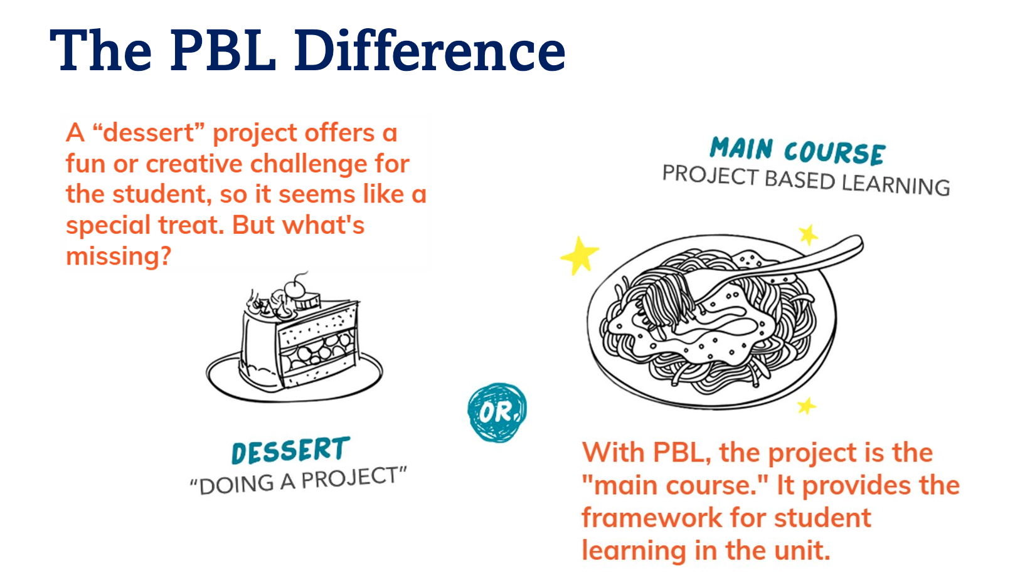
What is PBL?

Slide 81
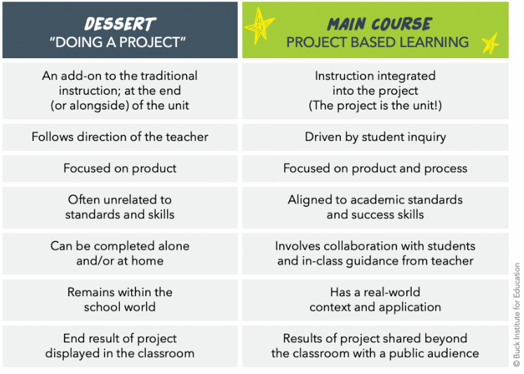
To Learn More about the PBL Difference:
Video: PBL Explained from PBLWorks
Video: What is PBL? from Magnify Learning
Video: What is the difference between Project Based Learning and a project? from Magnify Learning
Article: “Doing a Project” vs. Project-Based Learning from PBLWorks
Article: “What is Project-Based Learning?” from Magnify Learning\

Slide 82

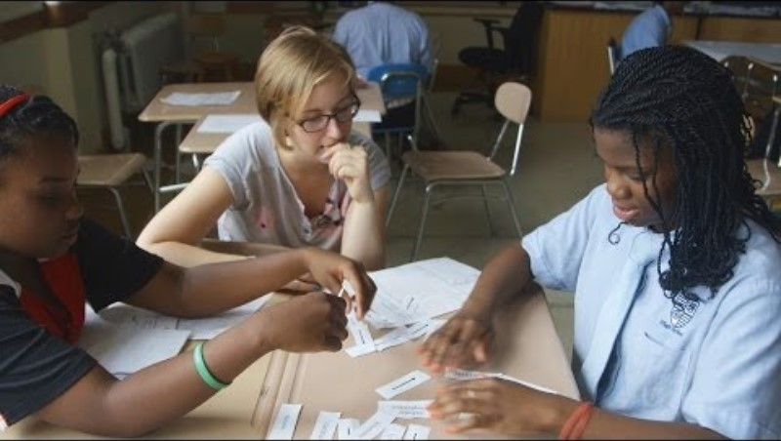
Keys to Rigorous Project-Based Learning
Real-world connections
Core to Learning
Structured Collaboration
Student Driven
Multifaceted Assessment
Notes:
Refer back to the video and Key Components of PBL shown before the breakout session.
Let participants know they will have the opportunity to explore more examples and elements of PBL on their own in the next activity.

Slide 83
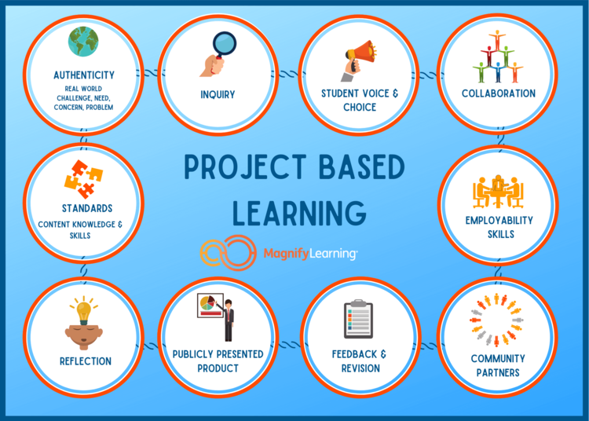
To Learn More About the PBL Components:
Web Article: 7 Essential Elements of Project-Based Learning - Literacy in Focus
Web Article: Essential Project Design Elements PBLWorks
Video: PBL by Design from John Spencer
Article: Key Elements of PBL Education World

Slide 84





Go- To Resources for PBL
Click on Each Icon to Learn More

Slide 85
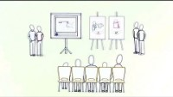

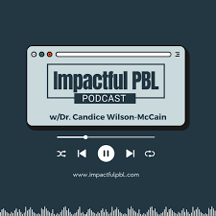

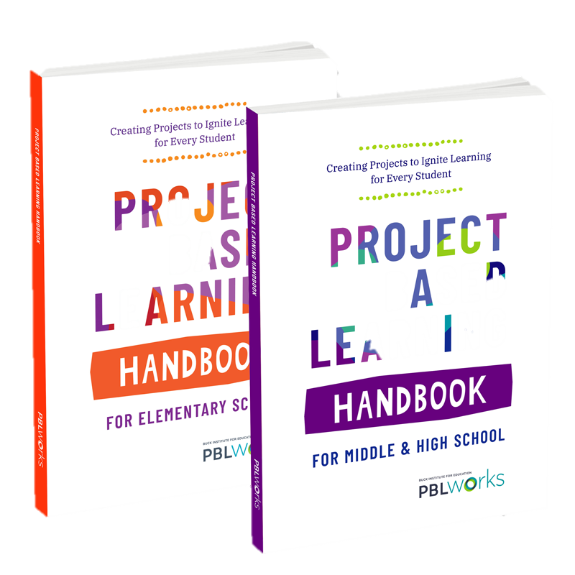




Click on Images To Learn More
Videos
Podcasts
Books
Web Articles & Blogs
Notes:
Resource slide for those interested in learning more about PBL on their own after the PD session.

Slide 86
Presenter
Dr. Amanda Price
priceaj@calvertnet.k12.md.us
https://www.linkedin.com/in/amanda-price-ph-d-72b887ab/

Slide 87


Slide 88
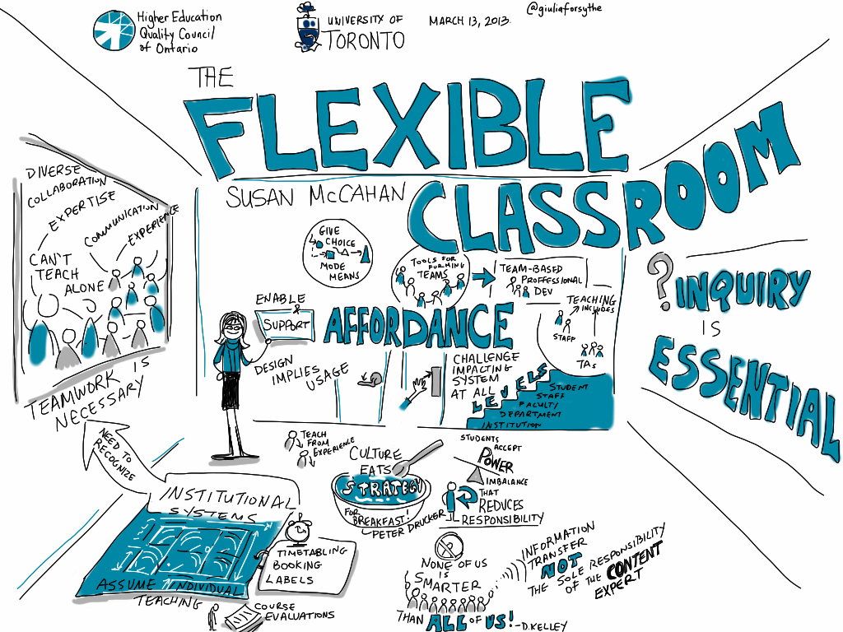
Thank you
Dr. Amanda Price
priceaj@calvertnet.k12.md.us
https://www.linkedin.com/in/amanda-price-ph-d-72b887ab/

