Slide 1




Ruth Cookson
Senior Manager, Educational Content
The Council for Economic Education

Slide 2
Agenda
Personal Finance Skills – Decision-Making and Cost / Benefit Analysis
Managing Your Money
Uncle Sam Takes a Bite – Taxes
Credit Reports and Credit Scores
Investing Risks and Tolerance

Slide 3
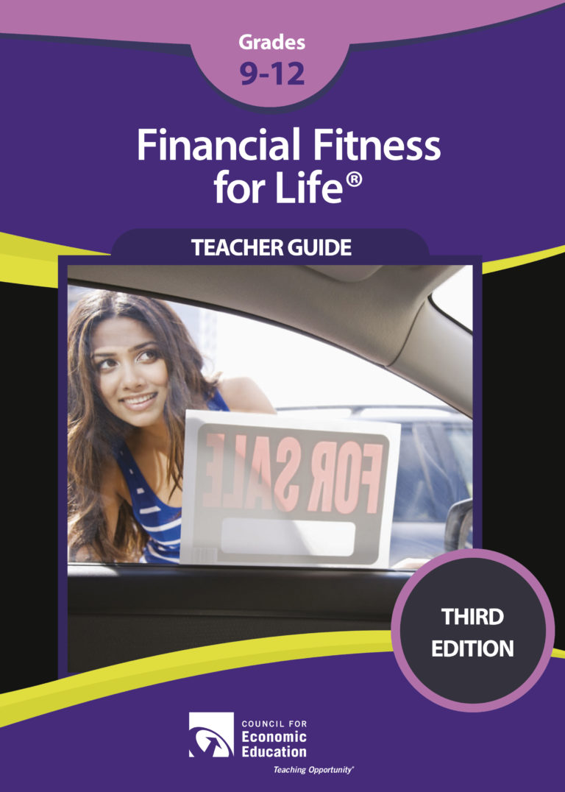
Financial Fitness for Life
Lessons 2 and 3
Decision-Making Skills

Slide 4
Purpose of a Decision-Making Model
To better understand the choices people faced in the past
To analyze the outcomes of the decisions that people have already made
To see a problem from a variety of perspectives and consider the consequences before a choice is made

Slide 5


Definitions
&
Vocabulary

Slide 6
Definitions
Benefit: A benefit is what satisfies your wants. Benefits are what is gained when an action is taken or a choice is made.

Slide 7
Definitions
Cost: A cost is what you give up when you decide to do something. Costs are the effort, loss, or sacrifice necessary to achieve or obtain something.
Opportunity Cost: What is given up when a choice is made. Your second choice.

Slide 8
Opportunity Cost
Whenever you make a choice, you are actually making
two choices.
This is because whenever you choose to do one thing, you are also choosing not to do something else.
What you choose not to do is your opportunity cost.

Slide 9
Why are these skills important?
Economic decision-making focuses on considering the costs and benefits of a choice BEFORE the decision is made.

Slide 10
Why are these skills important?
They can help our students to think about ALL the possibilities and consequences before they make their choice.

Slide 11
Why are these skills important?
Thinking critically –
analyzing why a choice was made in the past
or considering the costs and benefits before a choice is made in the future
teaches our students an important life skill.

Slide 12
HANDOUTS: PAGE 2
Problem:
PACED Decision-Making Model

Slide 13
PACED Decision-Making Model
Tool to use when deciding among
various choices or alternatives.
Use this tool to consider the costs and benefits of each alternative using the factors (criteria) that are most important to you.

Slide 14



Which college should you attend?
You’ve decided on an economics major, filled out your applications and been accepted at your top three choices for college.
But you’re having a very difficult time making a choice and need some help making this decision.
Big City U
Small Private College
Elite U

Slide 15
How do you decide?
PACED
    Identify the Problem
    List Alternatives or choices
    State the Criteria – What’s most important?
    Evaluate
    Decide

Slide 16
P: STATE THE PROBLEM
Problem: Which college should you attend?

Slide 17
A: LIST THE ALTERNATIVES
Problem: Which college should you attend?
Big City U
Small Private
College
Elite U

Slide 18
C: STATE THE CRITERIA
Problem: Which college should you attend?
Low cost
High quality
education
Close to
home
Big City U
Small Private
College
Elite U

Slide 19
E: EVALUATE THE ALTERNATIVES
Rate On A Scale From 3 (Best) to 1 (Worst)
Problem: Which college should you attend?
Low cost
High quality
education
Close to
home
Big City U
2
2
3
Small Private
College
2
3
2
1
3
1
Elite U

Slide 20
E: EVALUATE THE ALTERNATIVES
ADD UP THE NUMBERS
Problem: Which college should you attend?
Low cost
High quality
education
Close to
home
Big City U
2
2
3
= 7
Small Private
College
2
3
2
= 7
1
3
1
= 5
Elite U

Slide 21
E: EVALUATE THE ALTERNATIVES
ADD UP THE NUMBERS
What if one criteria is more important than the others?
Problem: Which college should you attend?
x2
Low cost
High quality
education
Close to
home
Big City U
2
2
3
= 7
Small Private
College
2
3
2
= 7
1
3
1
= 5
Elite U

Slide 22
D: MAKE A DECISION
What if one criteria is more important than the others?
Problem: Which college should you attend?
x2
Low cost
High quality
education
Close to
home
2
?
= 9
2
3
Big City U
4
Small Private
College
2
3
2
= 10
6
1
3
1
= 8
Elite U
6

Slide 23
What was my opportunity cost?
What was given up when I made my choice?
D: MAKE A DECISION
Problem: Which college should you attend?
x2
Low cost
High quality
education
Close to
home
Big City U
2
4
3
= 9
Small Private
College
2
6
2
= 10
1
6
1
= 8
Elite U

Slide 24
Opportunity Cost
All tools must include an intentional analysis of what is given up when making a choice!
After each decision ask:
What is my opportunity cost?

Slide 25
PACED Decision Grid
What apartment should I rent?
What are the costs and benefits of different forms of business organizations?
Which car should I buy?
Where should I invest my money?

Slide 26
PACED Grid: Teaching Tips
  Have students determine criteria in groups, or decide as a class.
  Make sure the criteria wording is “positive” - what you want instead of what you don’t want
  Don’t forget the opportunity cost.
  When grading, there is no right or wrong answer. Turn this into a writing prompt and have students defend their answers instead. It’s about the process.

Slide 27
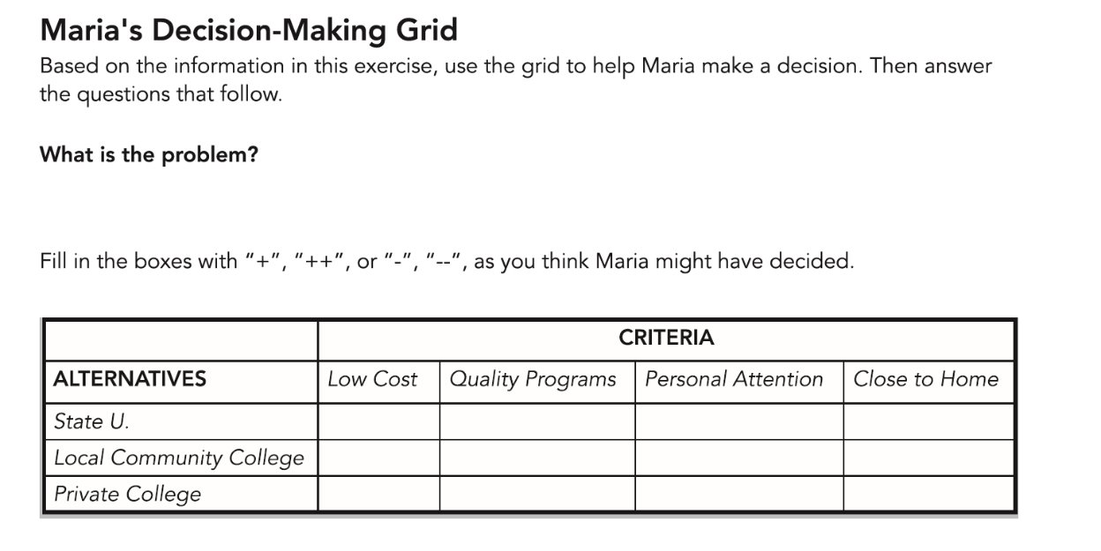
Lesson 3: Teaching Tips

Slide 28
Name
Title
Camden National Bank

Slide 29
Financial Fitness for Life
Lesson 7:
Uncle Sam Takes A Bite

Slide 30
HANDOUTS: PAGE 3
Miquel and Anna Green use the standard deduction of $24,000 allowed for a married couple when paying their federal income tax.
Why the standard deduction?
    No children.
    With a combined income of $84,000.
    They enjoy living in a rental near downtown.

Slide 31
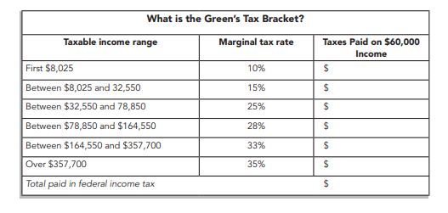
Calculating Progressive Taxes
How do you
know this is a
Progressive
income tax?
The Green Family makes $84,000 a year – what is their marginal tax rate?
28%

Slide 32
Calculating Progressive Taxes
Why are the Greens paying taxes on $60,000 when their income is $84,000?
How much will they be paying in taxes?
$11,343.75 (NOT $15,000)

Slide 33
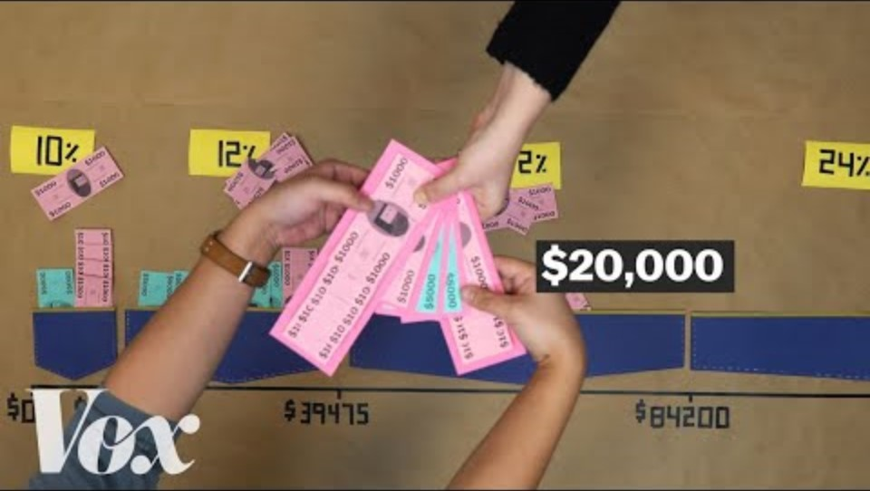
Tax Basics: Marginal Tax Code (Federal Tax)
How Do Taxes Actually Work | Humprey Yang
How marginal tax rates actually work, explained with a cartoon | Vox
Notes:
https://www.youtube.com/watch?v=VJhsjUPDulw End at 2:20 – only used when filled in the smaller ones

Slide 34

Calculating Progressive Taxes
$802.50
$3,678.75
$6,862.50
$11,343.75
Taxable income range Taxes paid at that income range
$8,025 – $0 = $8,025
10% of $8,025 = $802.50
$32,550 – $8,025 = $24,525
15% of $24,525 = $3,678.75
$60,000 – $32,550 = $27,450
25% of $27,450 =$6,862.50

Slide 35
Calculating Progressive Taxes
$802.50
$3,678.75
$6,862.50
$11,343.75
Making $84,000 – The Green Family has a Marginal Tax rate of 28%
Paying $11,343.75 in taxes – what is their Effective tax rate?
$11,343.75 ÷ $84,000 =
13.5%

Slide 36

Calculating Progressive Taxes
Taxes Tic Tac Toe ​
https://econedlink.org/resources/taxes-tic-tac-toe/​
​
Video: Standard vs. Itemized Deductions https://www.youtube.com/watch?v=QP8PU0IAG7I​
TurboTax simulation, where students practice filing taxes alongside a fictional user - Antonio Davis. https://intuit4education.app.intuit.com/home/simulation/turbotax/practicing_exploring_taxes​
5-part simulation that goes more in-depth https://turbotax.everfi.com/tax-curriculum/

Slide 37
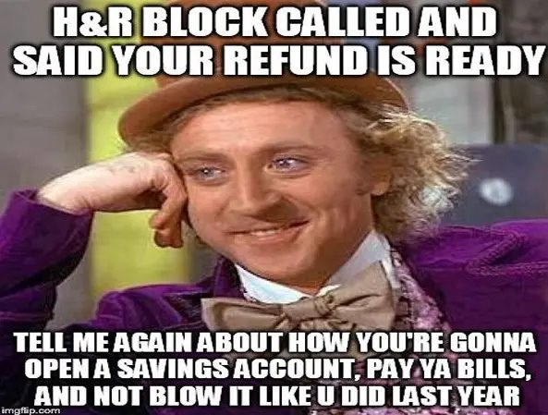

Slide 38

Budgeting Tools
https://www.practicalmoneyskills.com/en/resources/financial-calculators/budget-goals.html

Slide 39
Financial Fitness for Life
Lesson 8:
Managing Your Money

Slide 40
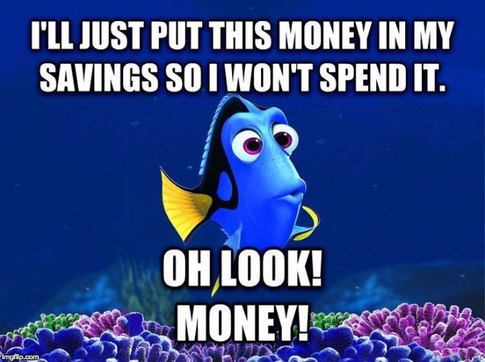

Slide 41
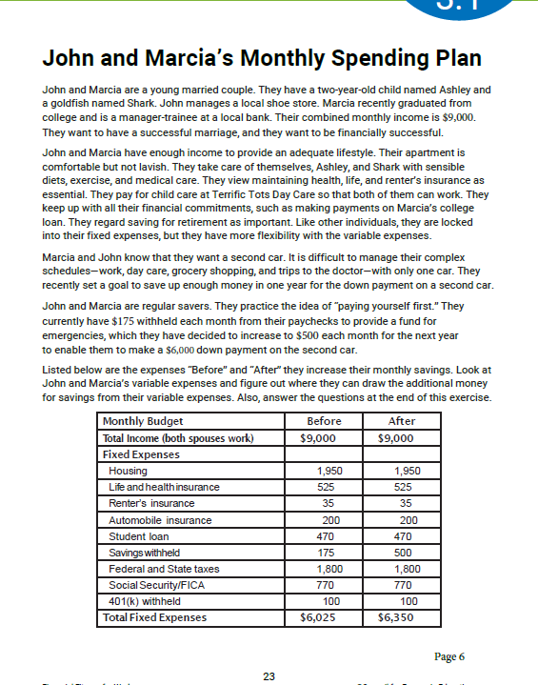
HANDOUTS: PAGE 4-5

Slide 42
Read about John and Marsha, their daughter Ashley, and their goldfish, Shark.
John and Marsha’s Monthly Savings Plan
As you read about their lives, circle all of their expenses listed in the paragraphs above the chart.
Underline their savings goal for the next year. What do they want to buy?
How are they going to adjust their savings to reach that goal?

Slide 43
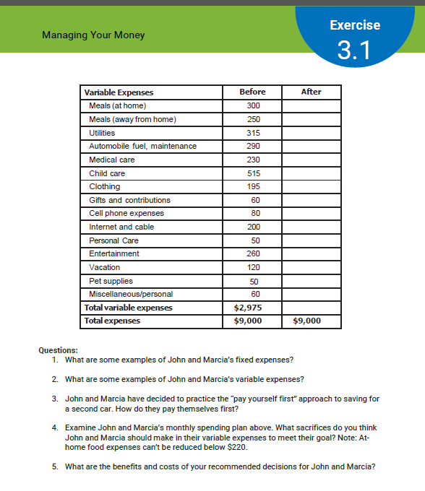
HANDOUTS: PAGE 5
Work with a neighbor to determine how John and Marsha will adjust their VARIABLE expenses to reach their goal of a downpayment for a second car.
How will you advise them to cut their variable expenses by $325 to reach their goal?

Slide 44

The Magic of Compound Interest
HANDOUTS: PAGE 6
CEE’s Compound Interest Calculator https://econedlink.org/resources/compound-interest-calculator/
How much of their paychecks were John and Marcia setting aside for their retirement?
How much money will they have saved by the age of 65 if they started saving at age 20?
Let’s go to the Calculator!
Www.tinyurl.com/compound-CEE

Slide 45
Online Activities and Videos
Budget Odyssey Game
https://econedlink.org/resources/budget-odyssey-classifying-expenses/
Student Budget Analysis
https://econedlink.org/resources/student-budget-analysis-calculator/
Video - Money Management and Budgeting
https://econedlink.org/resources/budgeting-video-and-quiz/

Slide 46
Financial Fitness for Life
Lesson 12:
Making Credit Choices

Slide 47
Bell Ringers
A friend asks to borrow a significant amount of
money from you.
What factors do you think you might
consider when making that decision?

Slide 48

THE THREE Cs of Credit –
Capacity, Character, and Collateral

Slide 49
1.
Capacity
Considers the individual’s ability to repay the loan

Slide 50
Capacity
What is the individual’s ability to repay the loan?
Factors include:
Amount and sources of income
Steadiness of income (e.g., years with the same employer and/or stable dividend income)
Amount of monthly living expenses (including debt, alimony, or child support)
Number of dependents
Level of education training

Slide 51
2.
Character
Considers the individual’s reliability to repay the loan

Slide 52
Character
Is the person reliable with his/her use of credit?
Credit score (which measures an individual’s credit risk-based bill payment history, length of time using credit and open balances as a percentage of their limits and other measures)​
Years of living at the same address​
Criminal record​
Quality of character and references​
Credit score is an indicator of character

Slide 53
3.
Collateral
Considers the individual’s assets that could be used to repay the loan

Slide 54
Collateral
What assets could be sold to repay the loan?
Factors include:
Amount of financial assets (e.g., savings, stock and bond holdings, and/or 401(k)/403(b) account balance)​
Market value of real assets (e.g., land, homes, cars, boats, electronics, jewelry, antiques and/or precious metals)

Slide 55
HANDOUTS: PAGES 8-11
“Sharp Financial Advisors”
You run a small consulting business, giving advice to people who are thinking about applying for credit.
For a small fee, you offer your customers advice on whether they should apply for a loan.
Your business has been successful because you understand the advantages and disadvantages of using credit.

Slide 56
What do you recommend?
Client 1
Client 2
Client 3
Client 4
Client 5

Slide 57
Using Credit
Advantages
Disadvantages
Credit can help people acquire valuable assets
Credit can help people lead happier lives
Credit can help people in an emergency
People may use too much credit in relation to their income
Credit requires borrowers to pay interest
Misuse can threaten ability to qualify for loans in the future
Significant consequences for not repaying loans

Slide 58
Financial Fitness for Life
Lesson 13:
Credit Reports and Credit Scores

Slide 59


Slide 60
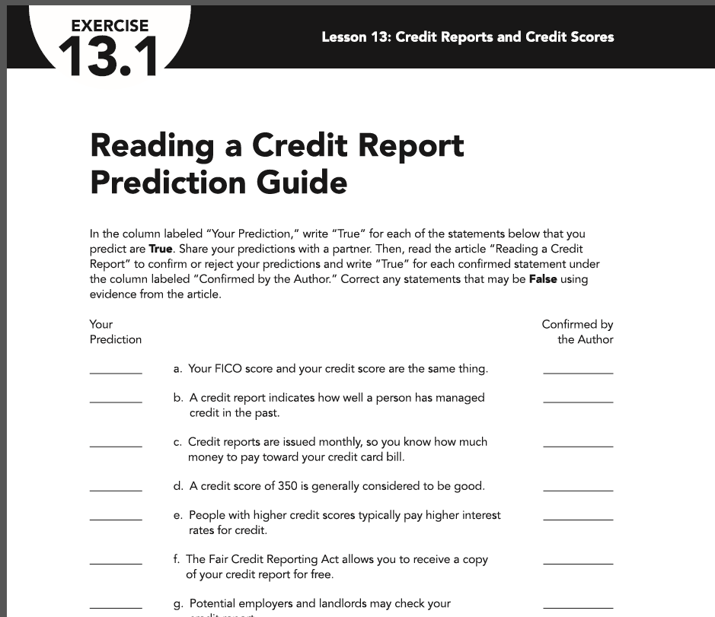
How Much Do You Know?
HANDOUTS: PAGE 12
Fill out the
left side column.
Check your
answers with the
video.

Slide 61
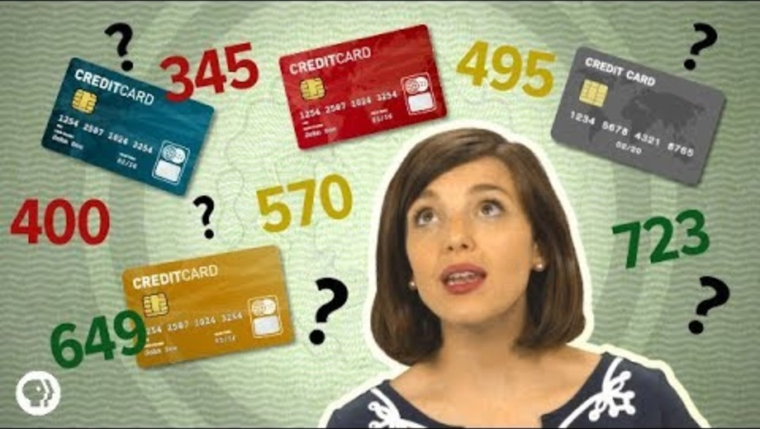
What Goes Into Your Credit Score?
Notes:
https://www.youtube.com/watch?v=ozbGWLtZdoY

Slide 62
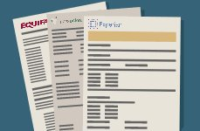
What is in a Credit Report?
Personal Data
Employment History
Public Records (liens, judgments, secured loans, foreclosures, bankruptcies, etc.)
Collection Accounts (defaults and lateness)
Credit Information (open accounts, date account was opened, payment status)
Inquiries (approved requests and others seeking credit information)

Slide 63
Length of Information on a Credit Report
Type | Limitation
Closed Accounts in Good Standing | 10 Years
Suits & Judgments | 7 Years
Tax Liens – Paid | 7 Years from Payment
Tax Liens – Unpaid | No Limitation
Late Payments | 7 Years
Debt Collections | 7 Years
Hard Credit Inquiries | 2 Years
Bankruptcy (Chapter 13, 7) | 7, 10 Years

Slide 64
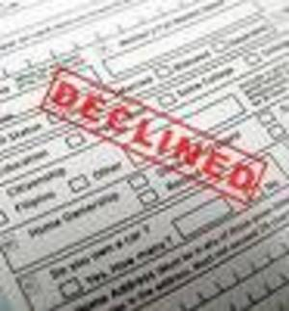
Why is a Credit Score Important?
  A poor credit score can affect a person’s ability to:
    Obtain credit cards, car loans and mortgages
    Qualify for utility and cell phone services with no down payment or substantial security deposit.
    Rent or lease a house or apartment.
    Get a good rate on your car, life, and health insurance.
    Get a job!

Slide 65
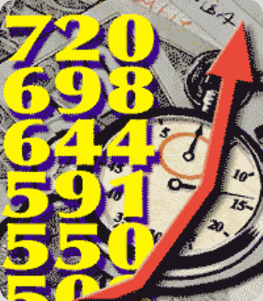
Most credit scoring models don’t consider:
Race, gender, or age
Income
Education
Marital status
Job or length of employment
Whether you've been turned down for credit
Length of time at your current address
Information not contained in your credit report
HOWEVER: A lender may consider some of these factors
when deciding whether to approve a loan application

Slide 66

Distribution of FICO
Fair Isaac reports that the American public's credit scores break out along these lines:
How Borrowers Rank | FICO Delinquency Rates
Up to 499 2% | Up to 499 87%
500 to 549 5% | 500 to 549 71%
550 to 599 8% | 550 to 599 51%
600 to 649 12% | 600 to 649 31%
650 to 699 15% | 650 to 699 15%
700 to 749 18% | 700 to 749 5%
750 to 799 27% | 750 to 799 2%

Slide 67
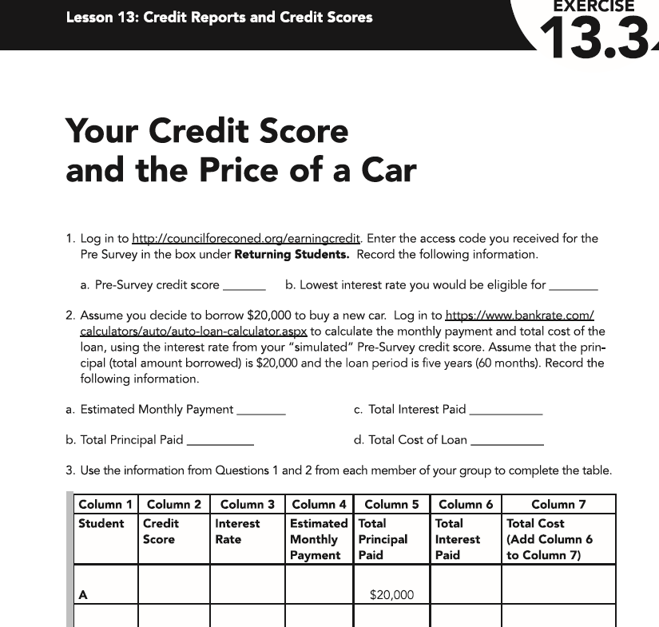

HANDOUTS: PAGE 13
Exercise 13.3
Your Credit Score and the Price of a Car
Log in to http://councilforeconed.org/earningcredit
https://tinyurl.com/earning-credit

Slide 68
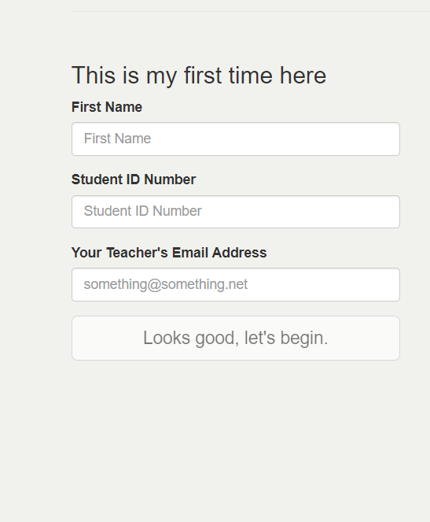
Exercise 13.3
Your Credit Score and the Price of a Car
HANDOUTS: PAGE 13
Record the first score on your handout.
Click onward
Choose the interest that corresponds to your credit score. Record your interest rate on your handout.
Select Loan
Click onward and
Keep going and record the “Future” credit score

Slide 69
Group Discussion Questions
In the computer simulation:
What behaviors caused some students to have lower credit scores?
What behaviors caused some students to have higher credit scores?
What could individuals with low simulated credit scores do to improve these credit scores?
Now think about the categories used to calculate an actual credit score and your answers for when you are 30 years old.
What kinds of behaviors would result in a low score, representing a high risk?
What kinds of things can each individual do in the future to ensure that your real credit score is high?

Slide 70
How can I improve my credit score?
Pay bills on time.
Borrow only what you must.
Try to pay more than the monthly minimum.
Apply for and use only a few credit cards.
Report lost or stolen credit cards immediately
Stay employed.
Keep loans to a minimal percentage of your income.
Avoid bankruptcy.
Review your credit reports yearly for accuracy.
Contact lenders immediately if you have any problem.

Slide 71

https://www.practicalmoneyskills.com/en/teach/lesson_plans/grades_9_12.html

Slide 72
Spot the Credit Crisis
Working as a team, discuss the scenarios on the activity sheet and determine how and why each scenario would impact their credit.
HANDOUTS: PAGES 14-16

Slide 73
Spot the Credit Crisis
Scenario 1: You want to purchase a new vehicle and you have your heart set on a brand-new SUV. You take out a loan to pay for the car, but after six months you begin to fall behind on payments and incur late fees.
Scenario 2: You’ve been eager to buy a new cell phone for months, and now you’re ready to make it happen. You use your credit card to purchase the phone, and you set up automatic billing to pay the monthly expenses. At the end of each month, you pay the credit card bill in full.

Slide 74
Spot the Credit Crisis
Scenario 3: Your first semester of college, you take out a small loan to help pay for books. Despite being busy, you get a parttime job. Although you don’t have to pay your loan back until you graduate, you’ve saved enough by the end of the semester, and you will pay off the loan in full.
Scenario 4: You just got the keys to your first apartment. You also have a new credit card with a $4,000 limit and you use it to furnish your new place. Before you know it, you’ve bought a TV, a couch and a dining room table. When you get the credit card bill, you realize you’ve spent your full credit limit of $4,000.

Slide 75
Spot the Credit Crisis
Scenario 5: You’re planning a trip to Disney World with friends over winter break. You get a credit card offer in the mail that lets you earn airline miles for every $1 you spend, plus bonus miles for opening a new account. Even though you opened three other credit cards this year, you jump on the opportunity and sign up immediately because you haven’t bought your flight to Florida yet.

Slide 76
Financial Fitness for Life
Lesson 21:
There is no Free Lunch In Investing

Slide 77

Risk vs. Reward
Imagine that there is a board on the floor, eight feet long and four inches wide. I’ll give you $1.00 to walk across it. How many would try?

Slide 78

Risk vs. Reward
That board is now a balance beam, 5 ft off the ground. I’ll give you $1.00 to walk across it.
$100?

Slide 79

Risk vs. Reward
That board is now a rope, 1000 ft in the air.
I’ll give you $100 to walk across it.
$1,000?
$1 million?

Slide 80


Slide 81
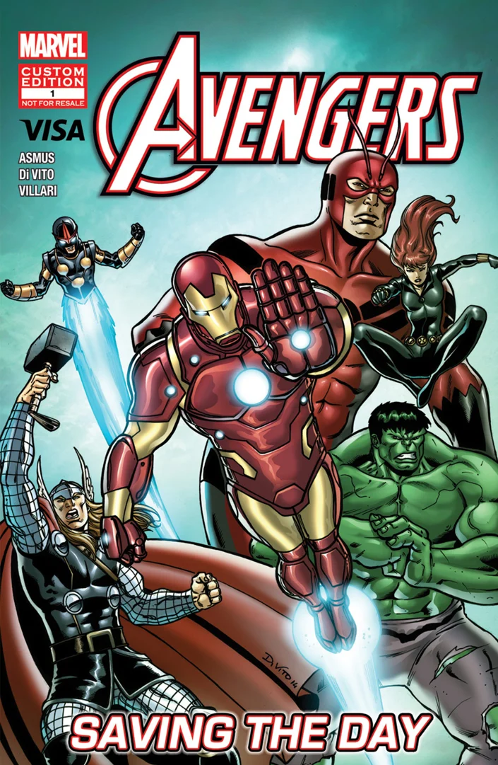
Sell, Hold, or Trade?
Should Jack sell, hold, or trade his comic book?
HANDOUTS: PAGE 17

Slide 82
The Pyramid of Risk and Rewards
Highest Risk: Highest Potential Return or Loss
Speculative Stocks
Individual Stocks
Stock Mutual Funds
Blue Chip Stocks
Corporate Bonds
Money Market Mutual Funds
U.S. Government Securities
Certificates of Deposit
Savings Accounts
HANDOUTS: PAGE 18
Lowest Risk: Lowest Potential Return or Loss
Light Blue: Investments are based more on growth and speculation.
Medium Blue: Investments are based primarily focused on income and growth.
Dark Blue: Investments are primarily focused on security and protection of funds.

Slide 83
Risk Pyramid
Very High Risk
Junk bonds,
junk-bond funds,
penny stocks, options
High Risk
Growth stocks, growth funds,
aggressive-growth mutual funds
Moderate Risk
Income funds, balanced mutual funds,
bond funds, municipal bonds,
corporate bonds, blue-chip stocks
Very Low Risk
Treasury bills, certificates of deposit, money market
funds, FDIC-insured savings accounts

Slide 84

EconEdLink

Slide 85
5 Risks
Liquidity
Inflation
Financial
Market
Fraud
HANDOUTS: PAGE 18-21

Slide 86
Inflation Risks
Inflation erodes the purchasing power of income that does not increase along with it.
When you invest, you want to protect the quantity of goods and services purchased in the future. This involves determining the real return on your investment.

Slide 87
Real Rates of Return
A certificate of deposit pays 5 percent in one year. This is the nominal rate of return.
Prices across the U.S. economy increase at 3 percent. That is everything, on average, increases by 3 percent. So, a $1.00 today takes $1.03 to buy the same thing in one year.
The real rate of return is 2 percent (=5%-3%)

Slide 88
Long Periods
In general, longer periods increase the likelihood of unanticipated inflation benefiting some at the expense of others.
Future inflation decreases the purchasing power of your initial investment (if a creditor) unless protected.
Consider protecting the value of your investment as the need for that protection against inflation increases.

Slide 89
Financial Risks
There is a financial risk that the business or government in which you invest will not be able to return your investment and/or pay the promised return.
Businesses, local governments, and state agencies can and do declare bankruptcy.
Assess that risk. Know if they’re insured. (Look at FDIC.)
U.S. Treasury Bonds are some of the least risky.

Slide 90


Fraud Risks
If it sounds too good to be true, it usually is!
Fraud risk involves dishonesty, misrepresentation, and the threat of theft.
Emails, solicitation calls, social media personal messages, and other outreach efforts promising $1 million deposited in your bank account or asking for a social security number to manage a transfer of funds often leads into fraud.
Protect yourself. Do nothing.
This Photo by Unknown Author is licensed under CC BY-SA

Slide 91
Rank the Risks and Returns
Mattress | Low Risk | Medium Risk | High Risk
Liquidity | 1 | 2 | 3
Inflation | 1 | 2 | 3
Financial | 1 | 2 | 3
Market | 1 | 2 | 3
Fraud | 1 | 2 | 3
Expected Return | Low | Medium | High
$1000
HANDOUTS: PAGE 18 - 21

Slide 92
Rank the Risks and Returns
Savings Account | Low Risk | Medium Risk | High Risk
Liquidity | 1 | 2 | 3
Inflation | 1 | 2 | 3
Financial | 1 | 2 | 3
Market | 1 | 2 | 3
Fraud | 1 | 2 | 3
Expected Return (10 year) | Low | Medium | High
$1000

Slide 93
Rank the Risks and Returns
Certificate of Deposit | Low Risk | Medium Risk | High Risk
Liquidity | 1 | 2 | 3
Inflation | 1 | 2 | 3
Financial | 1 | 2 | 3
Market | 1 | 2 | 3
Fraud | 1 | 2 | 3
Expected Return (10 year) | Low | Medium | High
$1000

Slide 94
Rank the Risks and Returns
U.S. Treasury Bond (Securities) | Low Risk | Medium Risk | High Risk
Liquidity | 1 | 2 | 3
Inflation | 1 | 2 | 3
Financial | 1 | 2 | 3
Market | 1 | 2 | 3
Fraud | 1 | 2 | 3
Expected Return (10 year) | Low | Medium | High
$1000

Slide 95
Rank the Risks and Returns
Money Market Mutual Fund | Low Risk | Medium Risk | High Risk
Liquidity | 1 | 2 | 3
Inflation | 1 | 2 | 3
Financial | 1 | 2 | 3
Market | 1 | 2 | 3
Fraud | 1 | 2 | 3
Expected Return (10 year) | Low | Medium | High
$1000

Slide 96
Rank the Risks and Returns
Corporate Bond | Low Risk | Medium Risk | High Risk
Liquidity | 1 | 2 | 3
Inflation | 1 | 2 | 3
Financial | 1 | 2 | 3
Market | 1 | 2 | 3
Fraud | 1 | 2 | 3
Expected Return (10 year) | Low | Medium | High
$1000

Slide 97
Rank the Risks and Returns
Stocks | Low Risk | Medium Risk | High Risk
Liquidity | 1 | 2 | 3
Inflation | 1 | 2 | 3
Financial | 1 | 2 | 3
Market | 1 | 2 | 3
Fraud | 1 | 2 | 3
Expected Return (10 year) | Low | Medium | High
$1000

Slide 98
Rank the Risks and Returns
Stock Market Mutual Fund | Low Risk | Medium Risk | High Risk
Liquidity | 1 | 2 | 3
Inflation | 1 | 2 | 3
Financial | 1 | 2 | 3
Market | 1 | 2 | 3
Fraud | 1 | 2 | 3
Expected Return (10 year) | Low | Medium | High
$1000

Slide 99
S&P 500 Before/After Pandemic
Be diversified across investments, recognizing the risks and returns
Buy and hold
$1000 would have dropped to $660 if sold in March, 2020
$1000 would have returned to $1000 if held until Aug, 2020

Slide 100
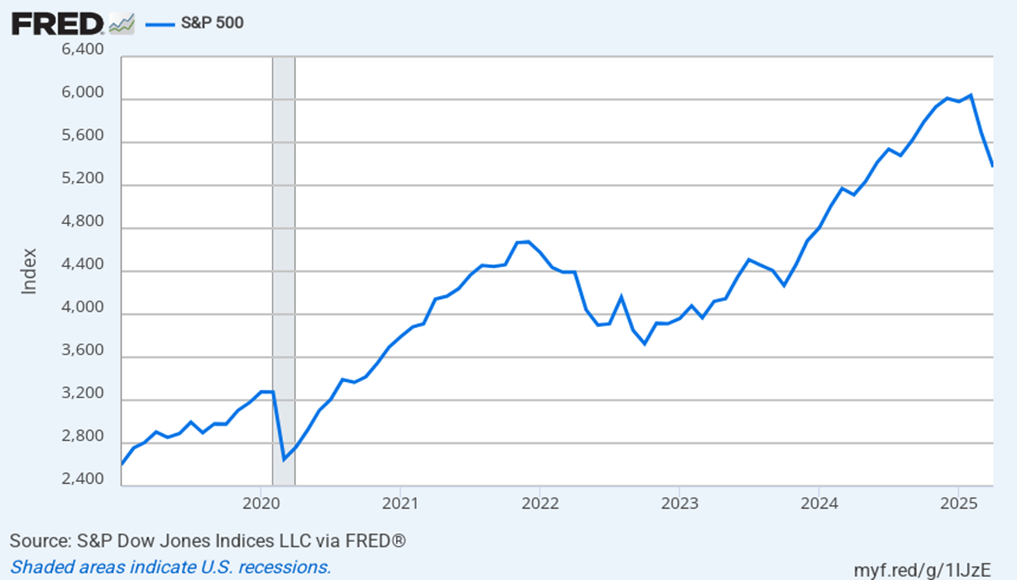

Slide 101
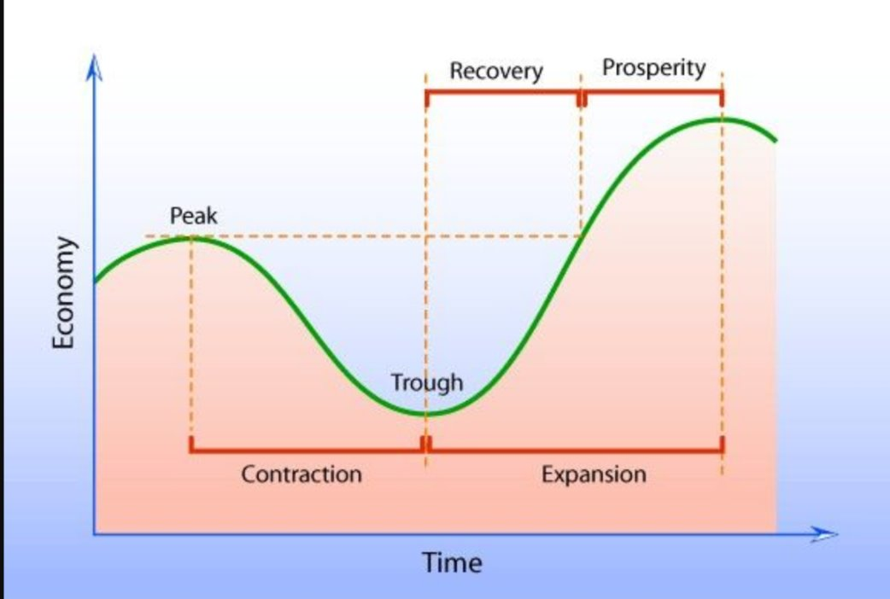

Slide 102

There is No Free Lunch in Investing
Investments involve risk. That is, there is a possibility that the investor will receive a positive or negative return in the future.
The greater the risk, the greater the potential for reward or loss.
All choices involve some type of risk with some having higher degrees of risk than others.
Investments generate returns. Through saving and/or investing in other vehicles, well-diversified investment portfolios produce interest income, dividend income, and capital gains – on average
Choose strategically. Be informed.

Slide 103
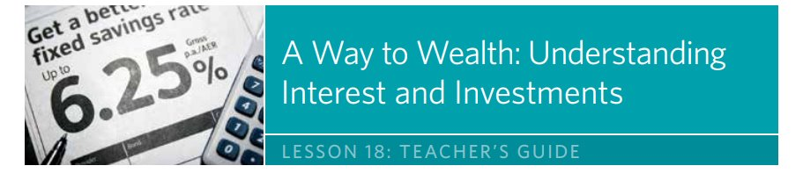
HANDOUTS: PAGE 22

Slide 104
What Should John Do?
John receives $1,000 as a graduation gift from his grandparents. Rather than spend it, he decides to invest it in a two-year bond that earns 3% simple interest. John doesn’t need access to the money right away because he wants to save it for when he’s ready to buy a home in about 10 years. Is the bond a wise investment for John? Why or why not? What other investment options does John have?
If you had the choice between investing $1,000 in a mutual fund that earns 7.5% compound interest or a bond that earns simple interest at 7.5%, which would you prefer and why?

Slide 105

Are these collectibles a good investment? Explain your answer using the risk vocabulary that you learned today.
Notes:
https://www.youtube.com/watch?v=xAKznUoQa-I
Start at 3:31

Slide 106


Slide 107
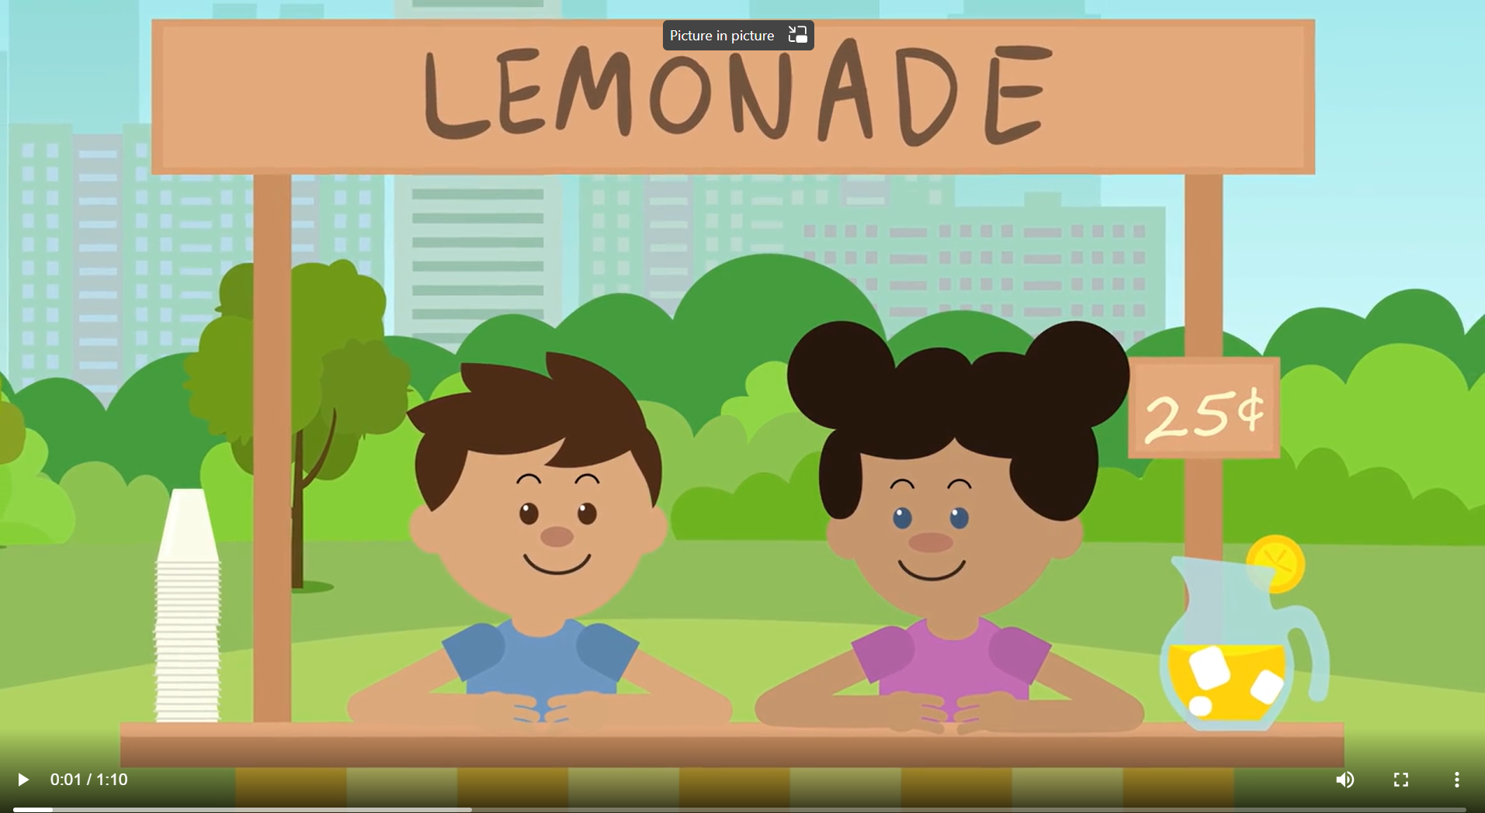

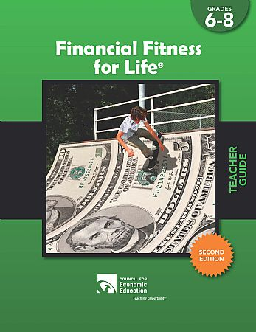
Supporting Educators
Educator Professional Development
Through our affiliate network, online platform, and our annual conference, we offer free virtual and live sessions to train educators on CEE’s engaging content and resources
Free Online
Resources
Our online platform offers lessons, videos, activities, and tools that educators at all grade levels can use in their classrooms
CEE Publications
CEE offers a full suite of resources, curricula and teacher guides from kindergarten through AP courses

Slide 108
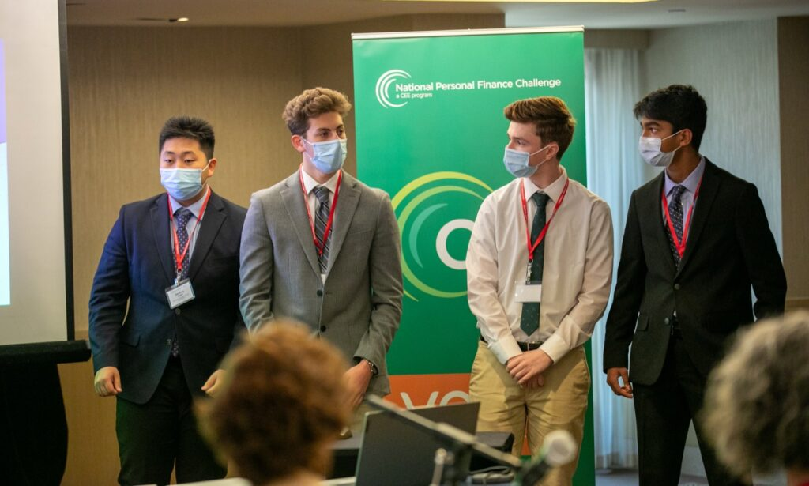


Engaging Students
National Personal Finance Challenge
15,000 high school students annually compete at the state-level for the chance to advance to the national case study finals, bringing personal finance to life in a unique and engaging way.
National Economics Challenge
7,500 high school students annually compete to advance to the national finals – structured as a quiz bowl and featured on CNBC.
Invest in Girls
CEE’s Invest in Girls program seeks to create the next generation of financially literate girls and open pathways to finance careers for high-school students identifying as girls, with a focus on those from under-resourced communities.
Notes:
Link to the 2023 Highlight/Recap video:
NPFC - 2023 National Personal Finance Challenge Recap (youtube.com)
NEC - 2023 National Economics Challenge Recap (youtube.com)

Slide 109

CEE’s Annual Conference

Slide 110












Free Personal Finance Program for High School Girls
Invest in Girls (a program of CEE) invites your high school students to learn about personal finance in a supportive all-girl environment! IIG instructors will teach students the basics of personal finance, how to invest, and help them build professional skills. These programs are online and free to attend.
Share this sign up link with your students
Or visit investingirls.org/for-students/

Slide 111
EconEdLink Membership
Access all of CEE’s free resources directly on EconEdLink.org! To receive these new professional development benefits, become an EconEdLink member. As a member, you will now be able to:
Access to hundreds of free resources – videos, games, lessons, webinars
Easily download presentations, lesson plan materials, and activities
Save resources to your EconEdLink dashboard for easy access to the event

Slide 112
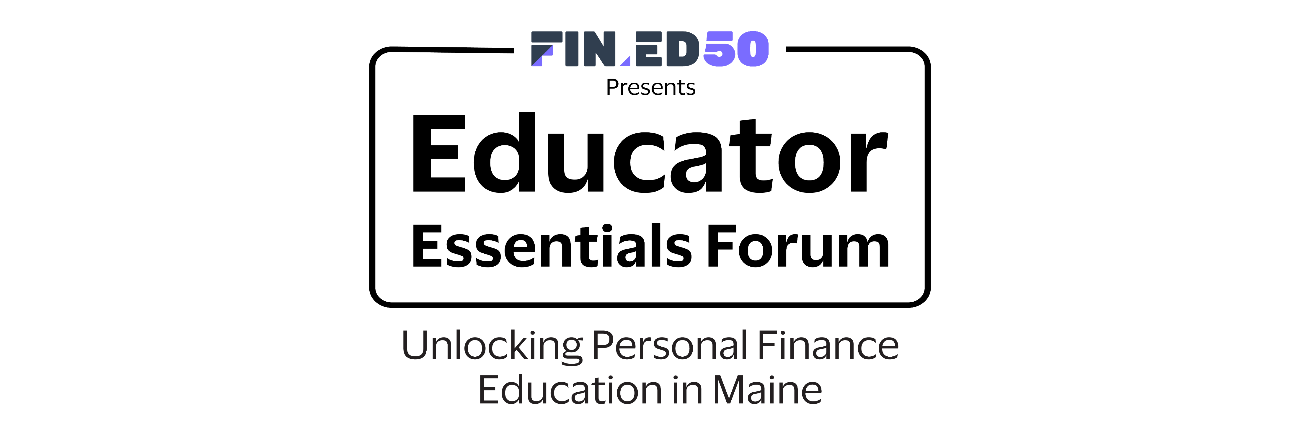

THANK YOU!

