Slide 1
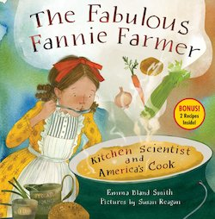
The Fabulous Fannie Farmer: Kitchen Scientist and America's Cook
by Emma Bland Smith
Book Synopsis: When Fannie Farmer learned to cook in the late 1800s, recipes could be silly. They might call for “a goodly amount of salt” or “a lump of butter.” Despite this problem, Fannie loved cooking, so when polio prevented her from going to college, she became a teacher at the Boston Cooking School. She’d noticed that precise measurements and specific instructions ensured that cakes rose instead of flopped, and doughnuts fried instead of burned. Students liked Fannie’s approach so much that she wrote a cookbook. Despite skepticism from publishers, Fannie’s book was a recipe for success.
Publisher: Boyds Mills Press
Copyright Date: 2024
Reading Level: 3.0
Interest Level: 2-5
Fannie Farmer- March 13, 1857-January 15, 1915

Slide 2
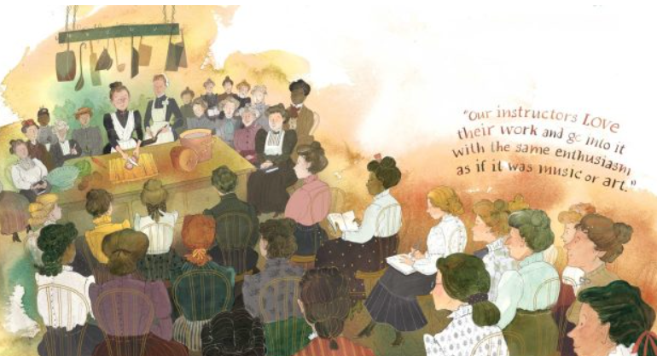
The first Julia Child or Martha Stewart?

Slide 3
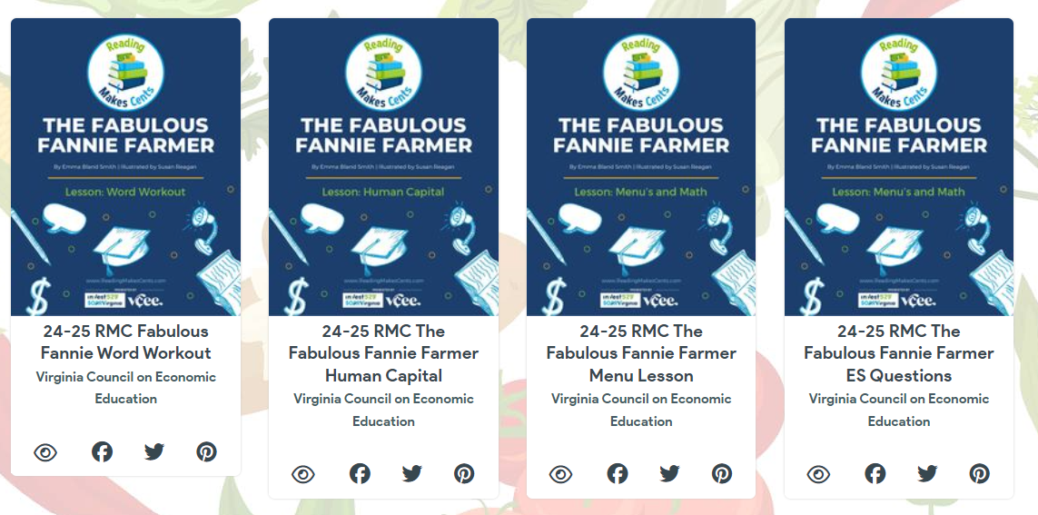
https://simplebooklet.com/rmcfanniefarmerlessons

Slide 4
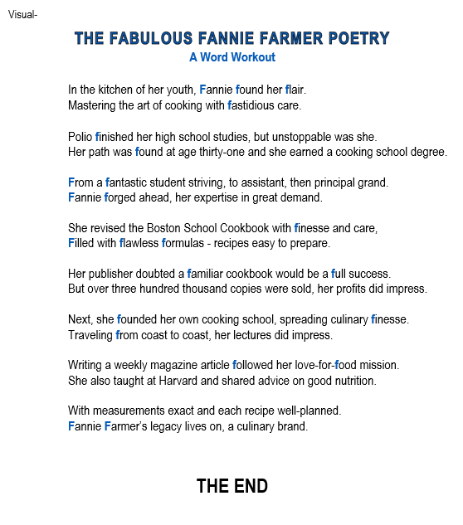
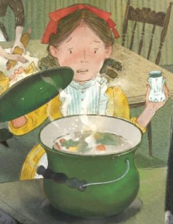
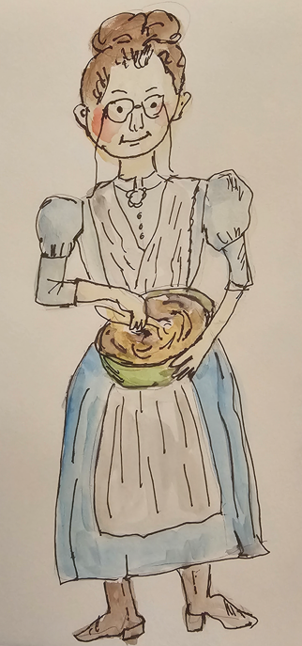
Lesson-Word Workout

Slide 5
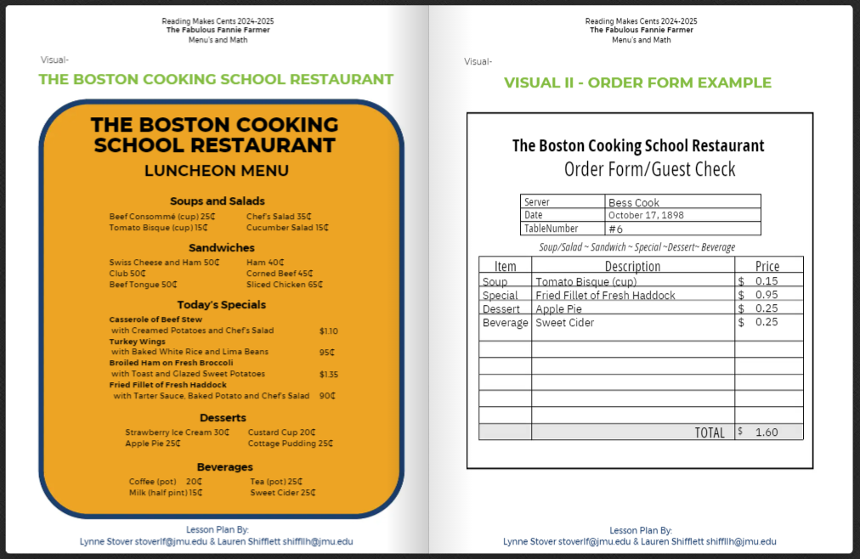
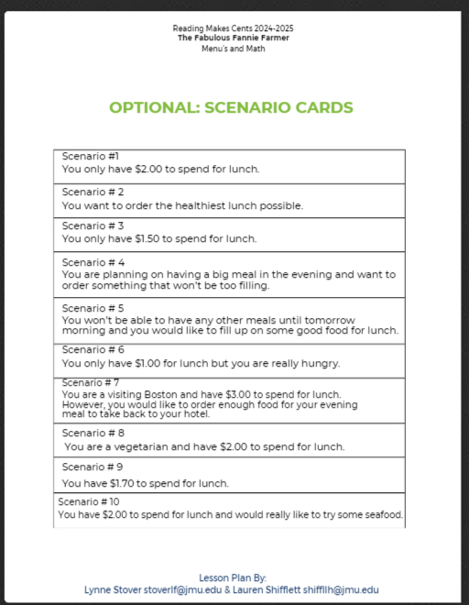
Middle School Lesson
The Boston Cooking School Restaurant

