Slide 1


Connect the Dots:
Calculate Saving
and Spending

Slide 2
Apply the concepts of discount price and sale price to real-life situations.
Calculate percentages using personal finance examples.
Middle School Review Exercise
Objectives:

Slide 3

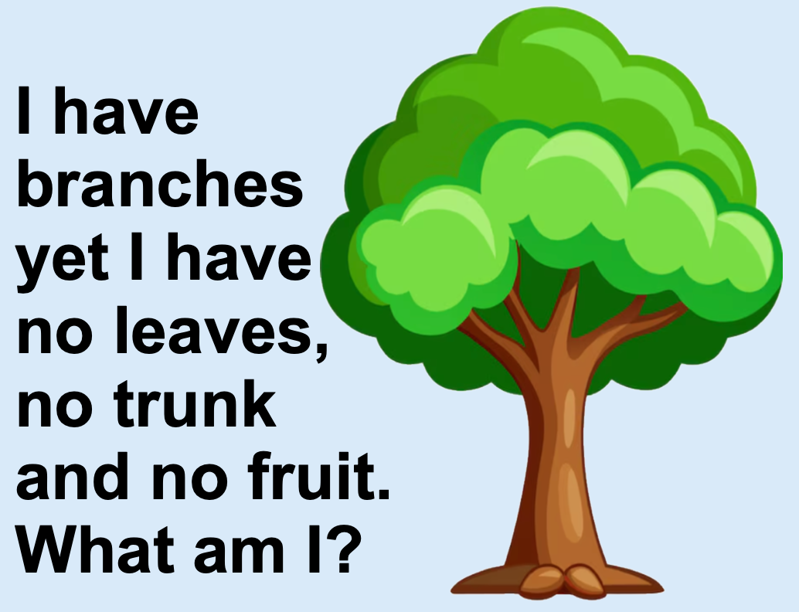
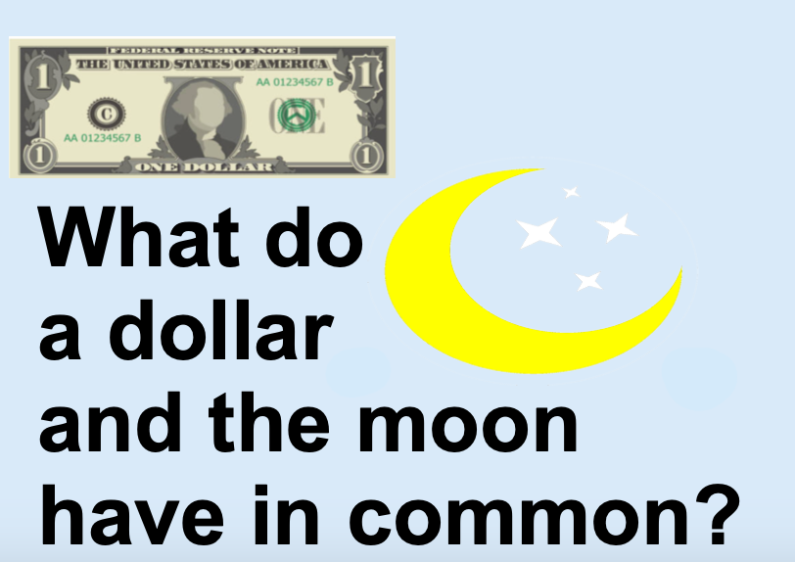
Here are two riddles
Can you solve them?
Notes:
“Which would you rather?” question. What information is needed to make a decision? Use waterfalling in chat if online or have everyone answer at once if in person.
Answer to the riddles – A bank has branches but no leaves, trunk or fruit. Both a dollar and the moon have 4 quarters.

Slide 4
Warm Up:
"Imagine your favorite store is having a huge sale — everything is marked down! What’s the first thing you’d rush to buy, and why?"
Notes:
Lead students to a discussion on discounts and sales. How big of a sale would it have to be to be considered “huge”? What percentage discounts?

Slide 5
Solve each of the given problems, one by one, on a separate sheet of paper (or a device).
After each answer is found connect the corresponding dots with their answer.
  Find the answer to Problem #1. Draw a line to the answer to Problem #2.
  Keep drawing lines to the next number until you reach the end.
Following the numbers in order and connecting the dots with your pencil to see what you have made!
Directions:

Slide 6

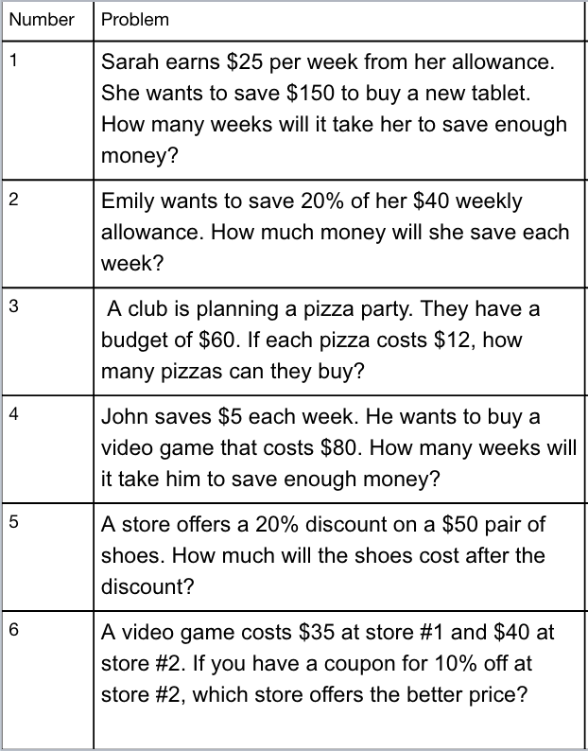
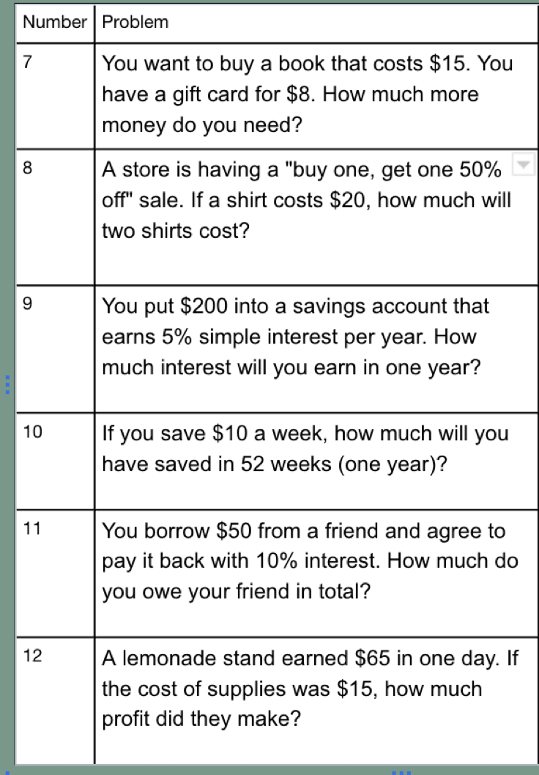
Problems to solve

Slide 7
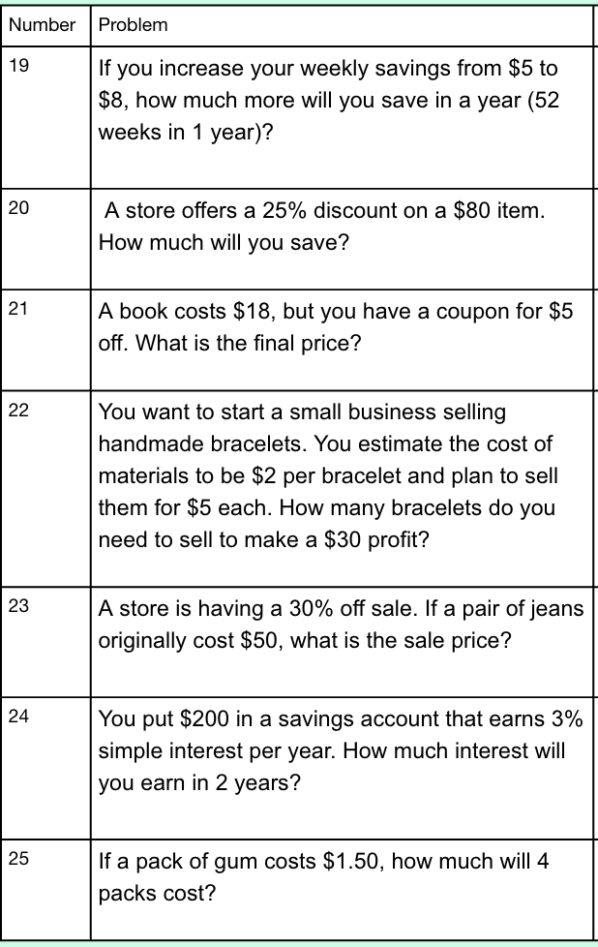
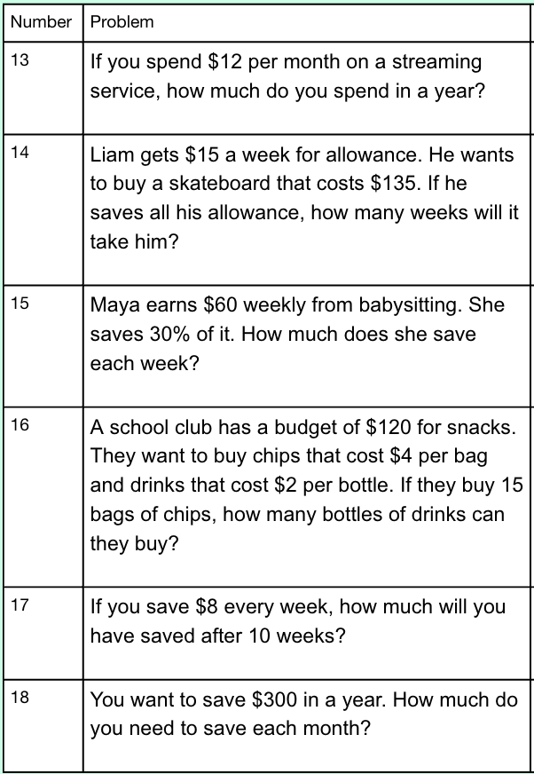
Problems to solve

Slide 8

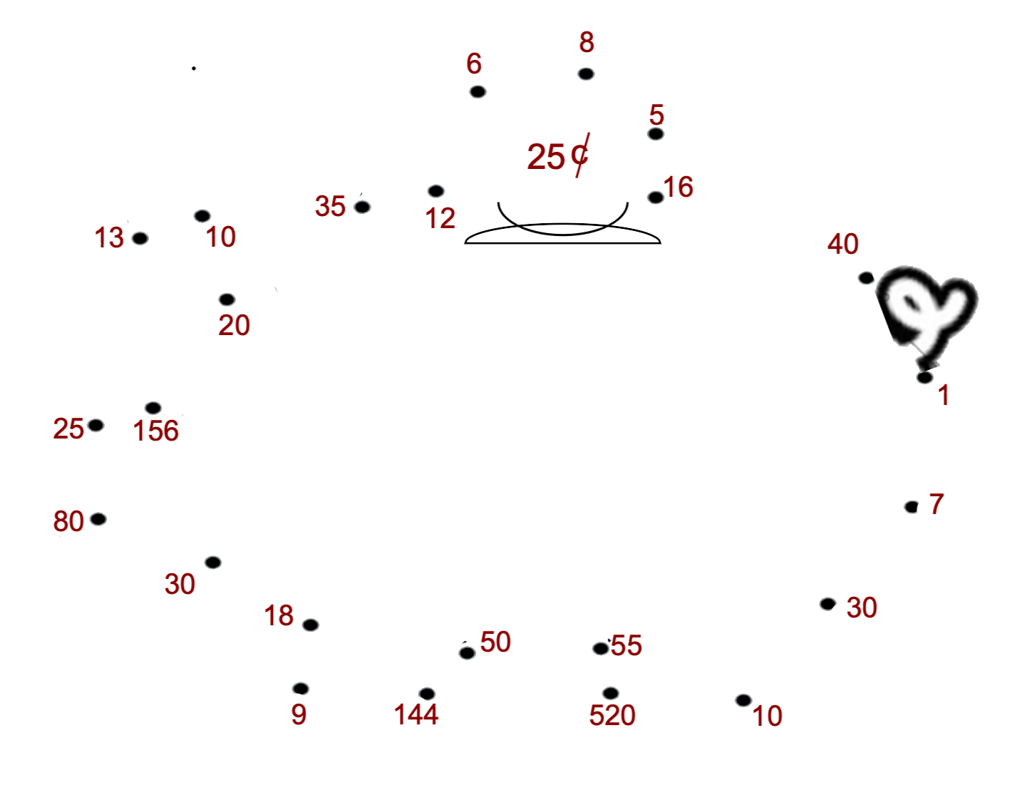

Slide 9
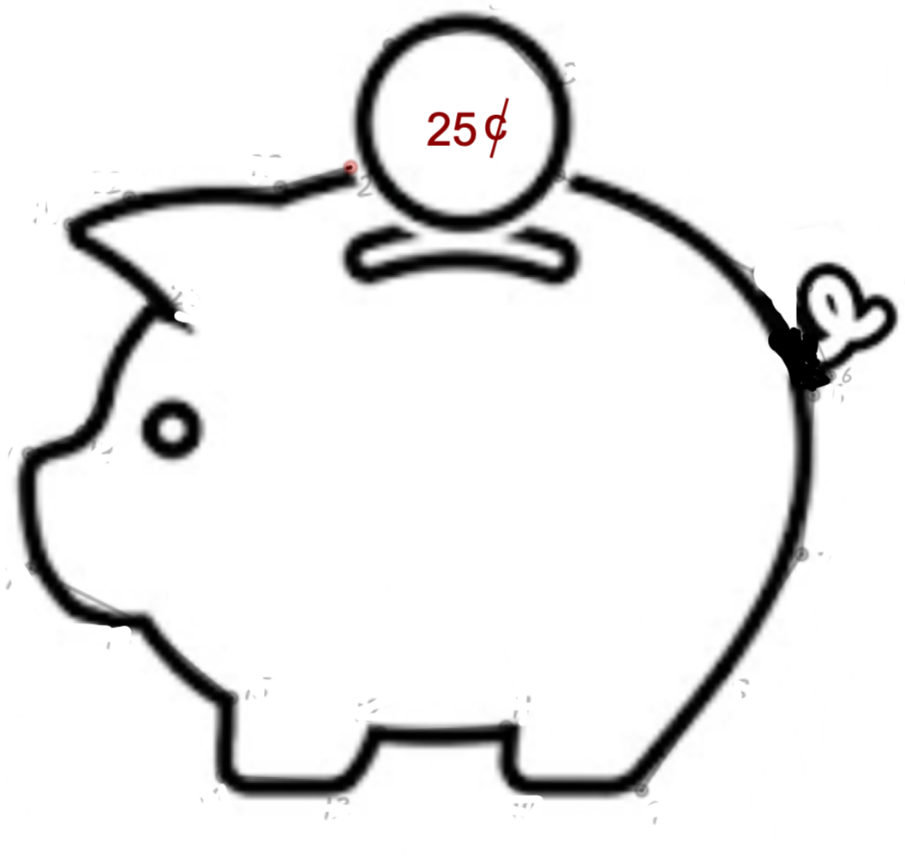
Solution

Slide 10
Exit Ticket
Why is it important to be able to calculate percentages when you are out shopping?

