Slide 1

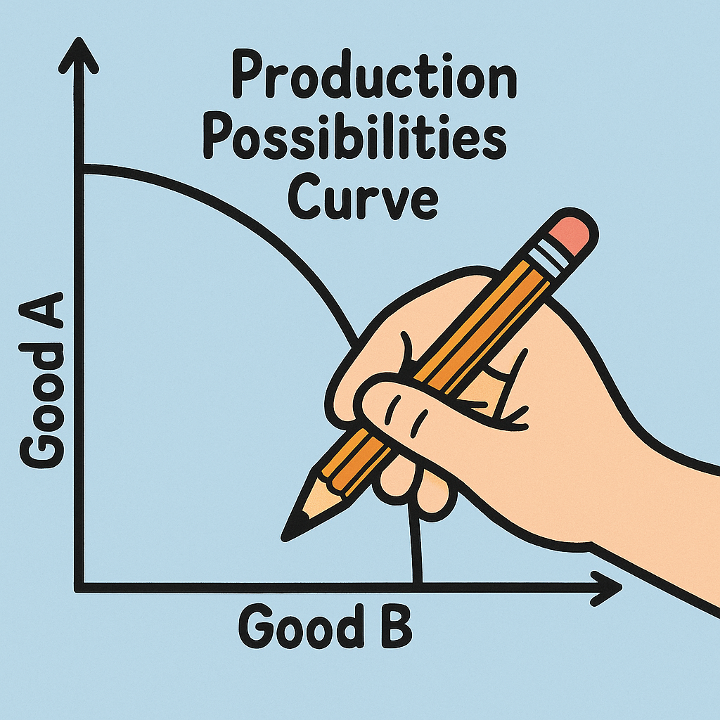
Plotting Potential
Production:
Hands on with PPC

Slide 2
Producing Goods
Groups: You will have 10 minutes to make as many bookmarks and posters as you can with the available resources.
USE ALL THE AVAILABLE RESOURCES
You need to make a combination of both products.
Product criteria: Posters = a full 8 ½ x 11 page
Bookmarks = 4 per 8 ½ x 11 sheet.

Slide 3
Producing Goods
Each product must have a saying and be decorated in some way – not just words on the page.
Here are some suggestions for poster/bookmark sayings:
“Opportunity Cost: Skipping Netflix to Study Economics”
“Talk to the Invisible Hand”
“Scarcity: the Reason There’s No Pizza Left”
“Money Talks. Mine Mostly Says Goodbye”
“Make Good Choices: Consider the Costs and Benefits”

Slide 4
Create a Production Possibilities Graph
Draw a production possibilities graph with one axis labeled bookmarks and the other axis labeled posters.
Brainstorm how many posters your group would make if they were ONLY making posters, and how many bookmarks they would make if they were ONLY making bookmarks.
Graph the three points (only posters, posters and bookmarks, only bookmarks) and draw the curve that connects the three points.
Quantity of
Posters
Quantity of Bookmarks
Notes:
Teacher note: If they have 10 pieces of paper, they would make 10 Posters and 0 Bookmarks, 40 Bookmarks and 0 Posters, and the third number is their actual production. So graph should be labeled to 40 on bookmark axis and 10 on poster axis.

Slide 5
What Shifts the PPC?
Change in resources
Change in technology

Slide 6
PPC Scenarios
Quantity of
Capital
Goods
Quantity of Consumer Goods

Slide 7
The country was in a recession when new technology was developed that doubled the productivity of producing both consumer goods (like food) and capital goods (like machinery).
Notes:
ANSWER: Red dot below PPC curve; yellow dot on curve. This shifts the PPC outward, reflecting an increase in the economy’s productive capacity.

Slide 8
2. The country was experiencing full employment when an earthquake destroyed factories and infrastructure.
Notes:
ANSWER: Red dot on curve; yellow dot below curve This would shift the PPC inward, indicating a reduction in overall production capacity.

Slide 9
3. The country was at full employment when oil, a key natural resource became scarce.
Notes:
ANSWER: Red dot on curve; yellow dot below curve, PPC shifts inward

Slide 10
4. The country is at full employment when a new large natural gas reserve is discovered which increases energy availability for production, expanding the economy’s capacity to produce goods and services.
Notes:
ANSWER: red dot on curve; yellow dot on curve closer to capital; PPC shift outward

Slide 11
5. The country was experiencing full employment when an epidemic reduced workforce participation, limiting the economy’s ability to produce goods.
Notes:
ANSWER: red dot on curve; yellow dot below curve; PPC shift inward

Slide 12
6. The economy is at full employment. Industry officials decide to allocate more resources to capital goods rather than consumer goods.
Notes:
ANSWER: Red dot on curve; yellow dot on curve closer to capital goods; PPC curve
does not shift

Slide 13
Production Possibilities Curve
2 Lies and a Truth

Slide 14
Scenario 1
The Production Possibilities Curve (PPC) illustrates the trade-offs between two goods that an economy can produce, given limited resources and technology. The curve shows the maximum possible output combinations for the two goods when resources are fully and efficiently utilized. Points on the curve represent efficient production, while points inside the curve indicate underutilization, and points outside are unattainable with current resources. The PPC also highlights the concept of opportunity cost, as choosing more of one good results in less of the other.
Which statement is true?
Points outside the PPC represent efficient production.
The PPC demonstrates that opportunity cost is zero when switching production between goods.
Points on the PPC represent efficient production choices.
Notes:
Correct answer is statement 3

Slide 15
Scenario 2
The Production Possibilities Curve (PPC) is a graphical representation that shows the different combinations of two goods or services an economy can produce, given fixed resources and technology. By illustrating the trade-offs between these goods, the PPC highlights how scarce resources are allocated. The curve demonstrates the concept of increasing opportunity cost: as production of one good increases, the opportunity cost of producing additional units of that good rises. Points along the curve indicate maximum efficiency, while points within the curve suggest resources are not fully utilized.
Which statement is true?
Points within the PPC show the economy is maximizing its resources.
The PPC curve illustrates that increasing production of one good raises the opportunity cost of the other.
The PPC assumes resources and technology are constantly changing
Notes:
Correct answer is statement 2

Slide 16
Scenario 3
The Production Possibilities Curve (PPC) is a graphical representation that shows the trade-offs between producing two different goods in an economy with limited resources. The curve illustrates the concept of opportunity cost, where increasing production of one good results in decreased production of another due to resource constraints. When an economy operates on the PPC, it is using resources efficiently, while points inside the curve indicate inefficiency. Economic growth or technological advances can shift the PPC outward, allowing for more production of both goods.
Which statement is true?
Points inside the PPC indicate efficient use of resources.
The PPC can shift outward if there is an improvement in technology.
The PPC shows unlimited production capabilities for any economy.
Notes:
Correct answer is statement 2

Slide 17
Scarcity and the Production Possibilities Curve
Scarcity necessitates choice.
The Production Possibilities Curve is opportunity cost shown in graphic form.
Producing more of one thing means producing less of another. (Trade-off)
It does not show you where you SHOULD be on the PPC, only the options that you have.
We are using scarce resources for one thing (Posters, for example), and giving up the chance to use them for our second choice (Bookmarks, for example).

