Slide 1

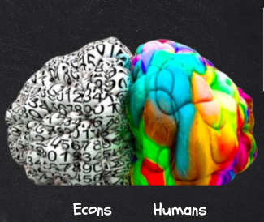

Teaching
BEHAVIORAL ECONOMICS
in your
Classroom

Slide 2
Certificate Requirements
To earn professional development hours for webinars, you must:
Watch a minimum of 45-minutes and you will automatically receive a professional development certificate via e-mail within 24 to 48 hours.

Slide 3
Objectives
You will be able to:
Understand how behavioral economics can offer answers to the limitations of traditional economics thinking.
Show how cognitive biases create irrationality in human choice-making.
Implement various classroom experiments in behavioral economics to demonstrate specific biases.
Implement classroom assessment projects that incorporate behavioral economics into their economics courses.

Slide 4

Presenter
Kevin Magnani
Kevin_Magnani@wrsd.net

Slide 5
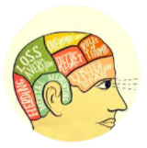
Session Agenda
Brief overview of the study of Behavioral Economics
Samples of cognitive behavioral bias experiments you can conduct in the classroom
How to relate and connect these biases to solving economic issues in the real world.
Sample lesson plans and assessment assignment to use in your classroom
Video resources to view in your classroom.

Slide 6

National Standards
STANDARD 3: SAVING
STANDARD 4: INVESTING
STANDARD 6: MANAGING RISK
https://www.councilforeconed.org/policy-advocacy/k-12-standards/

Slide 7

National Standards
STANDARD 1: SCARCITY
STANDARD 2: DECISION MAKING
STANDARD 4: INCENTIVES
STANDARD 8: ROLE OF PRICES
https://www.councilforeconed.org/policy-advocacy/k-12-standards/

Slide 8
1 - What is
Behavioral
Economics?

Slide 9
Behavioral Economics - Defined
Warm-Up PLC Discussion:
In the Breakout Room, discuss two educational questions about economics:
How do you teach your students to “Think Like An Economist” at the beginning of the year? What do you tell them it entails?”
What would you provide to your students as a working definition for BEHAVIORAL ECONOMICS?

Slide 10
What is Behavioral Economics?
Behavioral economics uses an understanding of human psychology to account for why people deviate from rational action when they’re making decisions.
Behavioral economics believes psychology can offer assistance as to why rational economic projections and outcomes do not always occur.
Introduces cognitive biases that show explains irrational behavior and bounded rationality.

Slide 11
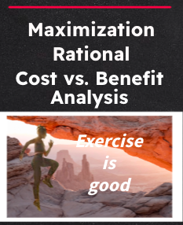
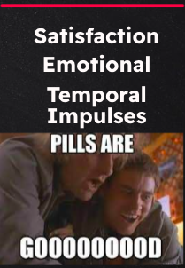
Traditional vs. Behavioral Economics
TRADITIONAL ECONOMICS
BEHAVIORAL
ECONOMICS
Simply put....
Sometimes we aren't always rational creatures!

Slide 12
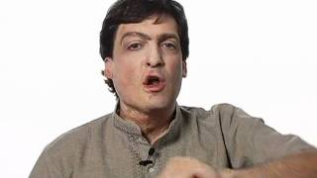
DAN ARIELY
Professor of Psychology and Behavioral Economics at Duke University and a founding member of the Center for Advanced Hindsight.

Slide 13
Behavioral Economics Biases
Behavioral Economics studies “biases” or flaws that cause irrational behavior and decision-making.
These biases can help economist explain failed policies and laws.
Introducing these biases in class through fun experiments can help students understand why economic predictions and policies are not always absolute

Slide 14
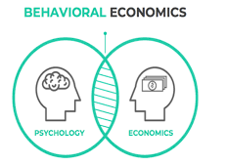
2 - Classroom
Experiments

Slide 15

Lesson #1 - Anchoring Bias Experiment
1. Make any 3-digit number out of these three digits, using each one only one time. 1 5 9
2. Convert your created number into dollars by adding $$. Write that dollar value number down 15 times on a piece of paper.
3. Now say the dollar value number to yourself 15-20 times in a row.
4. Make a quick jingle or song that mentions that dollar value
5. Now write down how much you think the retail price is of this product (based on Amazon price)

Slide 16
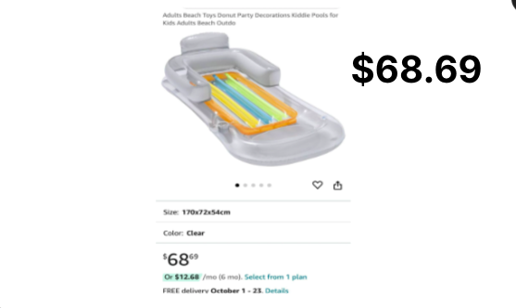
Lesson #1 - Collecting the Data
(In a classroom, we would record the data on a chart below)
1 | 5 | 9
Any of you who created a 3-digit number beginning with #1, please write in the chat how much you believe the float costs.
Any of you who created a 3-digit number beginning with #5, please write in the chat how much you believe the float costs.
Any of you who created a 3-digit number beginning with #9, please write in the chat how much you believe the float costs.
Retail Price

Slide 17
Lesson #1 - Interpreting the Data & Bias
SAMPLE DATA RESULTS FROM CLASSROOM
1 | 5 | 9
$29.00
$40.00
$85.00
$49.50
$50.00
$25.00
$99.00
$74.99
$68.00
ANCHORING EFFECT: People placing more weight or importance in a decision on the first piece of information they are exposed to seeing. Those with larger numbers in their head estimated highest price.

Slide 18

Lesson #1 - Anchoring Bias Assessment
Lesson Assessment Assignment
Discussion or Written Response: Provide two examples of Anchoring tactics used in retail sales or marketing and explain how the bias is being used to increase sales
Pair and Share: Share out with a partner a time in which you believe you allowed the anchoring bias impact your economic decisions.
EconEdLink Full Lesson Plan

Slide 19
Lesson #2 - Loss Aversion Experiment
Select a student volunteer.
2. Present the following directions and choices:
A) roll one die.
B) If it landed odd (1,3,5) they received $20.
C) If it landed even (2,4,6) they would need to pay $10. D) Or they choose not to play and receive $2 for simply
listening to the offer.
By show of hands, how many would roll the die?
How many of you would decline and take the $2?
Dice Roll Simulator

Slide 20

Lesson #2 - Collecting & Interpreting the Data
Have students record the data and interpret the bias as follows.
Have students manipulate the odds by adding a second die or adding best 2 out of 3 rolls
Have students change the payout amount keeping the same risk from $20 to $30.
Have students make subgroups by age or gender to see if the bias is more prevelant in one group over another.
LOSS AVERSION
We tend to hate losing something we have more than we enjoy gaining something new. We hate to lose more than we like to win.
Moneyball - 2011

Slide 21
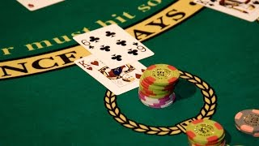

Lesson #2 - Loss Aversion Assessment
Lesson Assessment Assignment
Critical Thinking Worksheet
EconEdLink Full Lesson Plan

Slide 22
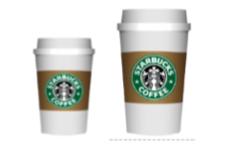
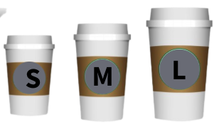
Lesson #3 - Decoy/Nudge Experiment
1. Take a look at the two options. Write in the chat which would you choose if you had to purchase one of them.
L
S
$2.50 $5.00
2 Now take a look at the three options below. Write in the chat which would you choose if you had to purchase one of them.
$2.50 $4.50 $5.00

Slide 23
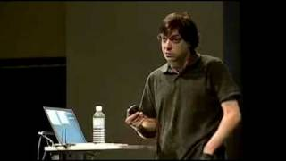
Lesson #3 - Decoy/Nudge Experiment
Decoy Principle / Nudge Theory
A third unappealing option can nudge or persuade us into choosing a certain choice by making it look more appealing.
Dan Ariely-Pricing the Economist TED Talk

Slide 24
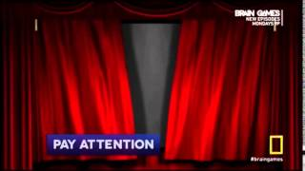
Lesson #3 - Decoy/Nudge Assessment
CLASS DISCUSSION
or WRITTEN PROMPT
First watch the “Brain Games- Decoy Effect” video.
Discuss or write about a time in which you feel you were prone to give into nudge or decoy theory.

Slide 25

3 - End-of -Unit
Assessments

Slide 26
Group Assessment - Cognitive Biases
Use this assignment for a short end-of-the-unit group formative assessment that uses critical thinking, collaboration and real world application:
IT’S YOUR STORE!

Slide 27

4 - Video Resources

Slide 28
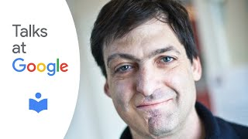
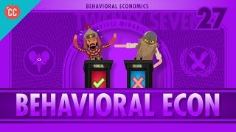
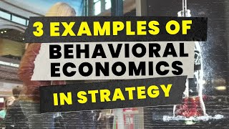
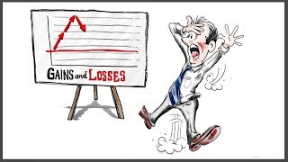
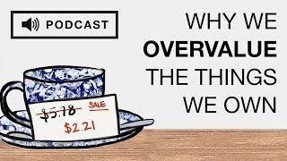
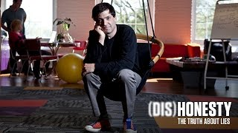
Helpful Videos for the lessons
Predictabily Irrational | Dan Ariely |
Talks at Google
Crash Course Economics
3 Examples Of Behavioral
Economics In Strategy
Loss Aversion: Concepts Unwrapped - Univ. of Texas
The Endowment Effect (Podcast)
Dishonesty: The Truth About Lies (trailer) - Full documentary on Amazon Prime and Netflix

Slide 29
Contact Us
Kevin Magnani
Kevin_Magnani@wrsd.net

Slide 30
The 2024 John Morton Excellence in the Teaching of Economics Awards
  This prestigious award honors K-12 teachers of any subject who use exemplary teaching techniques that improve their students’ economic understanding, in and out of the classroom. Each year CEE awards one teacher for Elementary School (Grades K-5), Middle/Junior High School (Grades 6-8), and High School (Grades 9-12)
  Each winner will receive:
    $1,000 cash prize
    An opportunity to co-facilitate a session at CEE’s 63rd Financial Literacy & Economic Education Conference on September 27-28, 2024 in Cleveland, Ohio & recognition of your achievement during the Awards Luncheon (Registration, travel, and accommodation expenses covered by CEE)
    Recognition on the CEE website and in CEE’s EconEdLink November newsletter
  Teachers can apply themselves or be nominated for this award by a teaching colleague, department chair, principal, superintendent, or CEE state affiliate (state council or university-based center for economic education). Applications and nominations for 2024 awards will be accepted until Friday, June 21, 2024 at 11:59 PM EST.
APPLY OR NOMINATE SOMEONE TODAY!

Slide 31


Slide 32
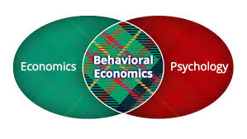
Thank you

