Slide 1
Scott Campbell
SCampbell@councilforeconed.org
Pennsylvania Personal Finance Standards

Slide 2
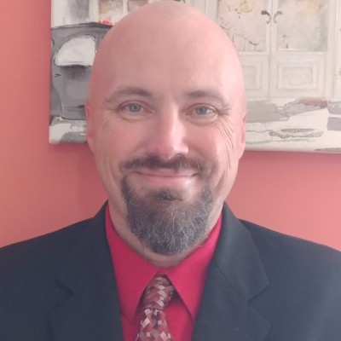
Welcome and Introductions​
Scott Campbell, Pennsylvania Director, CEE
15 years combined as a classroom teacher and principal
13 years combined in educational consulting roles
6 years as an adjunct faculty member at Penn State University

Slide 3
Agenda
What is CEE and the New PA Standards for Personal Finance?
How CEE can help support schools with resources?
Notes:
Review the agenda. Ensure that the agenda is customized for your group. Feel free to add times for each module to lay out the entire day.

Slide 4
What is CEE and the New Pennsylvania Standards for Personal Finance?

Slide 5
What do you already know about the new Pennsylvania Standards for Personal Finance?
Why do you think that these new standards were created?
​
Notes:
This is a great place to start out by getting teachers talking to each other and the share out and debrief will be valuable because it gives the presenter a good idea of what prior knowledge participants have about the standards. Give three minutes for collaboration before sharing out.

Slide 6

​Council for Economic Education
Our Mission
To equip K-12 students with the tools and knowledge of personal finance and economics so that they can make better decisions for themselves, their families, and their communities.
Notes:
Share the mission of the organization. Feel free to tie the mission directly into the specifics of the needs of the group of educators that are being trained in order to increase the value of the training session.

Slide 7

​Council for Economic Education
Our Challenge
In America we spend billions of dollars helping our children master reading, writing and arithmetic, but teaching financial literacy is often overlooked. We send them out into the world lacking the basic skills to prosper in life: understanding personal finance and economics.
DID YOU KNOW…
Those with low levels of financial literacy were 5X more likely to be unable to cover one month of living expenses than people with high financial literacy levels.
And yet only 22.7% of high school students are guaranteed to receive a personal finance education.
Nearly ¼ of millennials spend more money than they earn
67% of Gen Y have less than 3 months worth of emergency funding
Notes:
Share the Challenge of the organization. This is a good place to dig into that because of this challenge, the state of PA has enacted new standards and we are here to help schools to meet those new standards.

Slide 8

​Council for Economic Education
Our Impact!
https://youtu.be/8fdC9fv9lq4
Notes:
https://youtu.be/8fdC9fv9lq4
Let participants know that we are going to come back to some of the competitions and other opportunities that exist after discussing the new standards. Leave this video with the fact that we will review these, but we just want you to be aware of all of our great work to get students involved and excited about personal finance and economics.

Slide 9
2025-2026 School Year – The Goal
Provide Training to Teachers and Leaders across Pennsylvania to help them to understand the new standards and how they can meet them.
Provide Resources to Teachers and Leaders across Pennsylvania to meet all the requirements of the new standards
Current Discussions for Upcoming PD
IU 18 – Luzerne IU – Currently Planning on specific dates for professional development
IU 6 – Riverside IU – Initial meeting next week to determine PD needs
IU 17 Blast IU – Initial meeting next week to determine PD needs
IU 3 – Allegheny IU – Initial meeting on Friday to determine PD needs
Notes:
Link to Standards: https://www.pa.gov/content/dam/copapwp-pagov/en/stateboard/documents/about-the-board/board-actions/2024/personal%20finance%20standards.pdf
Link to SAS Portal: https://www.pdesas.org/Page/Viewer/ViewPage/81/#:~:text=The%20new%20Pennsylvania%20Academic%20Standards%20for%20Personal%20Finance%20describe%20personal,can%20manage%20their%20personal%20finances.
There is a lot of information to share here. Start by taking participants to the SAS Portal Page. On the next slide, you will go live and discuss the FAQs so teachers know the expectations for the standards

Slide 10
​Pennsylvania Personal Finance Standards
When – Starting the 2026-2027 School Year
K-12 Standards
Link to Standards: https://tinyurl.com/4mrj8thj
Link to SAS Portal: https://tinyurl.com/3uckcs8k
Notes:
Link to Standards: https://www.pa.gov/content/dam/copapwp-pagov/en/stateboard/documents/about-the-board/board-actions/2024/personal%20finance%20standards.pdf
Link to SAS Portal: https://www.pdesas.org/Page/Viewer/ViewPage/81/#:~:text=The%20new%20Pennsylvania%20Academic%20Standards%20for%20Personal%20Finance%20describe%20personal,can%20manage%20their%20personal%20finances.
There is a lot of information to share here. Start by taking participants to the SAS Portal Page. On the next slide, you will go live and discuss the FAQs so teachers know the expectations for the standards

Slide 11
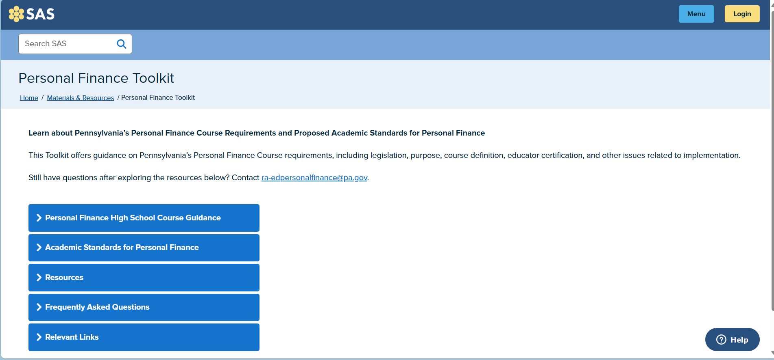
SAS – Personal Finance Toolkit
Notes:
Take teachers live to the personal finance toolkit and go through each of the five tabs – please note that depending on your participants, you may not cover one or more of the tabs. Make sure to cover the FAQs thoroughly because they have a profound impact on who can teach the course as well as what a high school course looks like. Please give time for questions as you work your way through the resources and ensure that teachers can access this page as well to follow along.

Slide 12
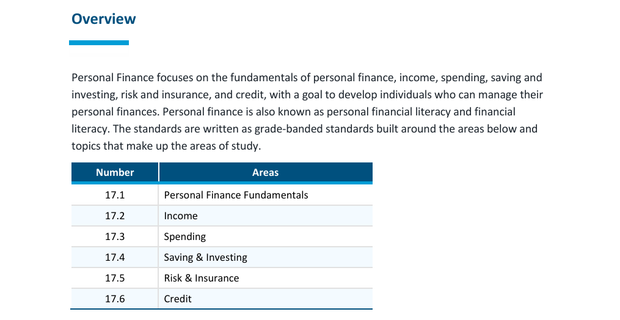
Overview of the Personal Finance Standards
Notes:
Next, take participants into the standards document. First, ensure that everyone can access the site. Begin by going over the way the standards are organized and let participants know that they will next have an opportunity to dive in and explore the standards on their own.
Ask participants: Are these items that you are already teaching in your own classes?
What do you suppose the standards will say about what students are supposed to know at your particular grade level.

Slide 13
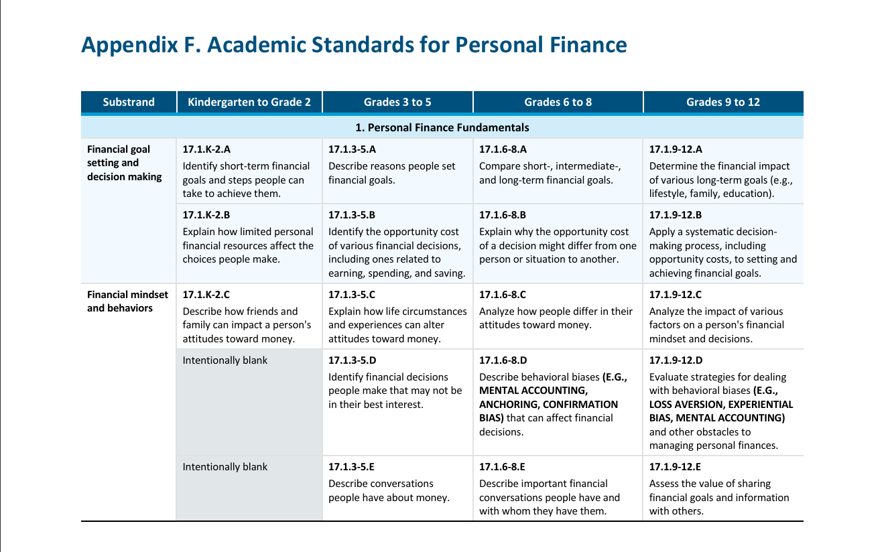
The Standards​
Notes:
Ask participants to go to the start of the standards. Use the Financial goal setting and decision making standards as an example and have participants look at just that standard. Give participants five minutes to work with a partner to review those standards.
What do you notice?
How does and knowledge and skills increase for students throughout the progression?
Is this something that you are already teaching in your class?
Where would this concept fit if you were to cover this in your class?
What will the implications be of ensuring that you cover this topic at some point during the year?
Allow groups to share out their answers to these questions. Be prepared for discussing on what grade level something will fit as well as what subject fits best.

Slide 14
New or important vocab found within the standards
Grades K-2 – Financial Resources, Financial Goals, Financial Institution, Deposit, Income, Entrepreneurship, Saving Money, Charity, Borrowing, Private Information, Spending
Grades 3-5 – Earning, Spending, Saving, Financial Goals, Financial Decisions, Income, Financial Institutions, Entrepreneurship, Supplemental Income, Household Spending, Budget, Payment, Credit Cards, Debit Cards, Cash, Checks, Gift Cards, Taxes, Fundraising, Types of Insurance, Credit, Interest, Fees
Notes:
After the debrief, transition to some terms found within the standards that participants might not be as familiar with. Use this to check on participant level of comfort with these terms. Does anything jump out at you as not being a term that you are familiar with? The next slide continues with the same terms for grades 6-12. Hide this slide if it is not applicable to the grade level of your participants.

Slide 15
Important terms for the new standards​
Grades 6-8: Financial Goals, Opportunity Cost, Mental Accounting, Anchoring, Confirmation Bias, Personal Finances, Hourly Wage, Salary, Commission, tips, piecework, Scholarships, Grants, Savings, Military Service, Apprenticeships, Self-Employment, Gross Pay, Net Pay, Payroll Deductions, Product Claim, Unit Price, Personal Budget, Gift Card, Debit Card, Credit Card, Mobile Payments, Sales Tax, Personal Savings Plan, Interest Rates, Simple and Compound Interest, Investing, Stocks, Dividends, Assets, Debt, Risk Tolerance, Insurance, Warranties, Service Contracts, Premiums, Policyholders, Annual Percentage Rate, Personally Identifiable Information
Notes:
Only use this page is grades 6-8 are in the session. Hide if not needed.

Slide 16
Important Terms for the New Standards​
Grades 9-12: Opportunity Costs, Loss Aversion, Experiential Bias, Mental Accounting, Credit Unions, Brokerage Firms, Financial Technology, Wills, Power of Attorney, Beneficiaries, Consumer Protection Agencies, Federal Financial Regulators, Passive and Active Income, Investments, Retirement Plans, Financial Aid, Labor Markets, Independent Contractor, Taxes, Payroll Deductions, Budgeting Approaches, Mortgages, Leases, Assets, Liabilities, Excise and Property Taxes, Money Market Accounts, Certificates of Deposit, Stocks, Bonds, Mutual Funds, Financial Advisors, Investment Portfolio, Benchmark Indices, IRA Roth, Herding, Choice Overload, Insurance, Medicaid, Medicare, Unemployment, Identity Theft, Credit Cards, Secured and Unsecured Loans, Credit Reports
Notes:
Note that you would only use this page in grades 9-12 are in the sessions. Hide if not needed.

Slide 17
Programs Sponsored by CEE for Students
Notes:
Note that which programs are shared with participants will depend upon the grade levels represented in the training. Hide any slides that are not needed.

Slide 18
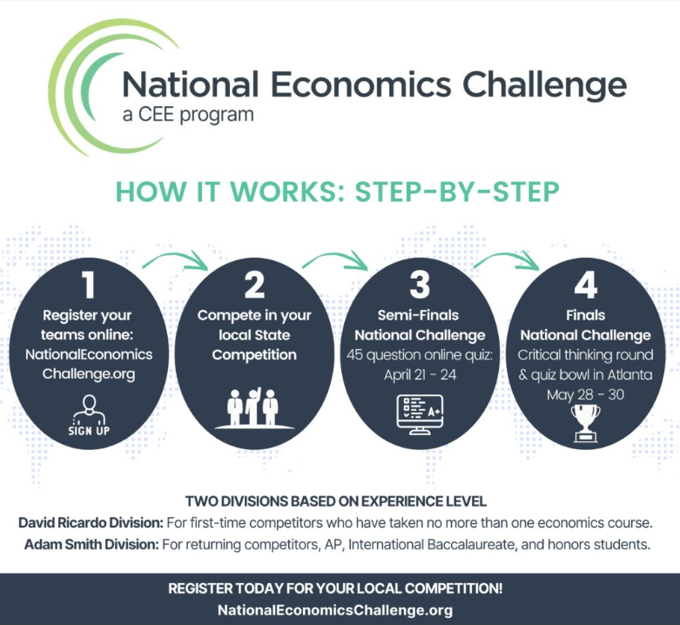
The National Economics Challenge
Notes:
You have the option here to share the slide as well as going live to the site. Feel free to have teachers navigate to the site as well. Make sure that participants know that you can be a resource for them with any questions that they have about the challenge. If time allows – share the video from CNBC on the last competition. National Economics Challenge: Here are some of the questions in this year's contest
Note to swap out slide with new dates when available
Note that this is for grades 9-12 only.

Slide 19
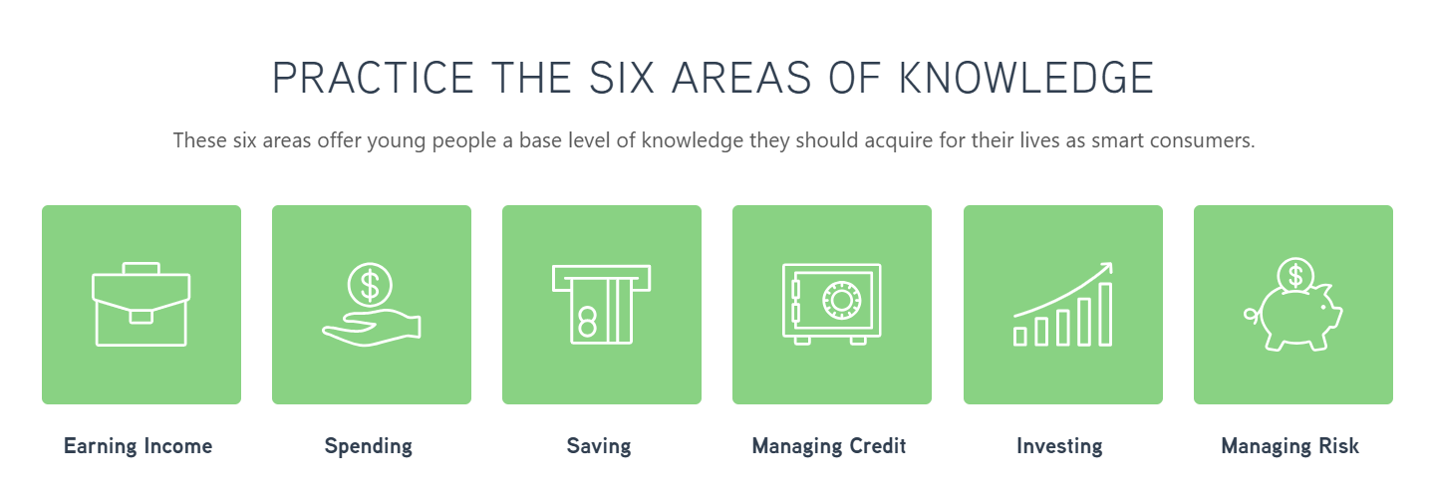
The National Personal Finance Challenge
Notes:
You have the option here to share the slide as well as going live to the site. Feel free to have teachers navigate to the site as well. Make sure that participants know that you can be a resource for them with any questions that they have about the challenge.
If you have time, this is a short video about the challenge: https://youtu.be/Zznbm8uutCk
Use this time to briefly go over the challenge. Share dates for participants if they are available yet.
Note that this is for grades 9-12 as well

Slide 20

​Invest In Girls
Financial knowledge is for everyone – and girls are no exception
The mission of Invest in Girls is to usher in the next generation of financially literate girls and increase the number of women working in finance and financially related fields.
IIG’s innovative model combines personal finance education with career exploration in a supportive environment—and it works. After participating in the Invest in Girls program, survey results show that girls’ confidence in personal finance topics more than doubled.
Notes:
Use this slide to briefly discuss the Invest in Girls Program. This is high school as well so hide if not needed. Encourage participants if they are interested to explore the program further on the website and reach out to you with additional questions: Link to site: https://www.councilforeconed.org/programs/for-students/invest-in-girls/

Slide 21
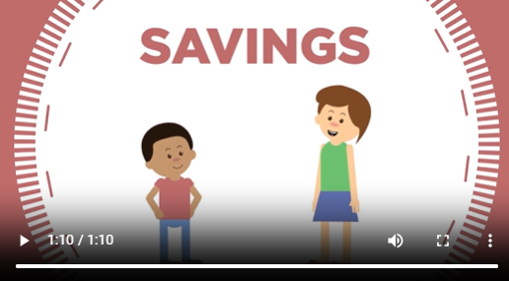
​Family Fun Night
Notes:
Use this slide to briefly discuss the Family Fun Night. This is K-8 so hide if not needed. Encourage participants if they are interested to explore the program further on the website and reach out to you with additional questions: Link to site: Family Financial Education Resources & Activities | CEE
It would be good to show the video from the site because it is very short and sums up the value of the program.

Slide 22
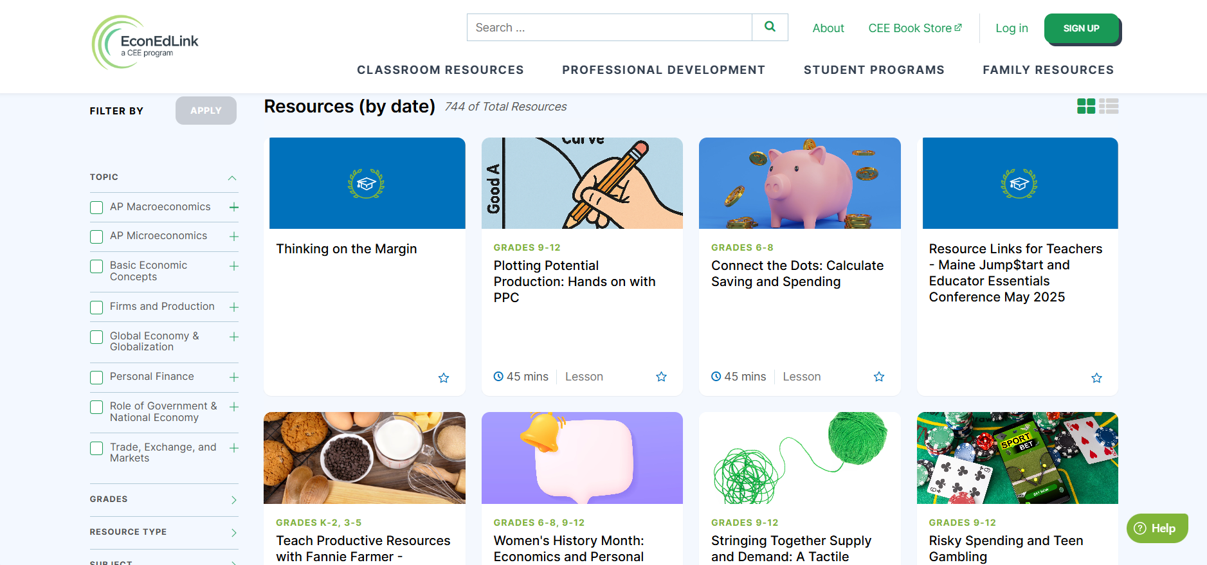
​EconEdLink Resources
Let’s take a look at the K-12 resources and activities found on the EconEdLink Site!
https://econedlink.org/resources/
Notes:
EconEdLink site. K-12 resource. Give teachers a chance to navigate live to the site

Slide 23
Find Your Perfect Lesson
Filters for Lessons Include:
  Topic
  Grade
  Resource Type
  Subject
  Standard (Please note that the new PA standards alignment is not available yet on the site)
Notes:
This is your opportunity to walk through how to use the filters live on the site.
Start by briefly going through each of the filters
Review each of the options for each filter
Ask a teacher for a topic or standard that they would like to find a lesson for
Walk the teachers through the process of finding a lesson – Let them know that on the next slide they will have an opportunity to practice themselves
Demonstrate taking a specific standard from the new PA standards and walk through the process to show the participants the options available in EconEdLink to cover the standard.

Slide 24

​CEE Personal Finance Course
Let’s take a look at the resources and activities found within the CEE Personal Finance Course
Notes:
Placeholder to add the link to get into the course. Give teachers a chance to navigate live to the site

Slide 25

Financial Fitness for Life
Resources available K-12
Use the workbook and spend the next few minutes perusing the lessons and activities
Use your new PA State Standards to make connections between the FFFL lessons and the standards
Be prepared to discuss how you could use this resource for your own classroom
Notes:
Present the Financial Fitness for Life Resources. You can also navigate to the page to show the options. If hard copy materials are available, you can distribute these at the same time. If time allows, give participants up to 15 minutes to peruse the resources. Suggest that they use the PA standards to help make connections

Slide 26

​Your Task
Work with your team to align your curriculum and prepare a plan for how you will address the PA Standards in Personal Finance.
Be prepared to share at the end of the session to present your plan to the group.
Notes:
Teams should break up the lesson into three parts. It’s helpful to have the team work together in planning the lesson, however, it is fine if you want to use the option of each person planning their part individually. Stress for participants that 20 minutes is not a lot of time, but not to panic as it is not meant to be perfect and more about the strategies that are used, how they will engage students and how they are addressing the standard.

Slide 27
​Step 1 – What Resources are You Using?
I am using CEE Resources for the purpose of meeting the new PA State Standards
EconEdLink: K-12 Resources
CEE Personal Finance Course: 9-12
Financial Fitness for Life: K-12
I am using current resources for the purpose of meeting the new PA State Standards
Notes:
Pose this question for the group as it will help guide the activity. Have a discussion to ensure that you have an understanding of what their plan is before they start. Be prepared for a group that is planning a hybrid approach where they are using some of our materials and some of their own.
Also, be prepared for a mixed group from different schools that may take differing approaches to this activity and module.

Slide 28
​Step 2 – What Grades and Courses Will You Be Using to Address the New PA Standards
I know what courses and grade levels are teaching each of the new PA Standards
I do not know what courses and grade levels are teaching each of the new PA Standards
High School Economics – 9-12
High School Professional Finance – 9-12
Elementary and Middle School Math – K-8
Elementary and Middle School Social Studies – K-8
Other
Notes:
For this next part, you are going to want to talk to your participants about if they already have a plan for where these standards will be addressed. You may need to be flexible here if they do not know yet – You may need to facilitate a group planning session first to go through the PA Standards to make this determination. Making this determination will be a key before starting to make alignment decisions.

Slide 29
​Step 3 – It’s Planning Time!
Work with your team to align your curriculum
You have the option to use our graphic organizer or a document of your choice – Note that the document is in word form in case you want to make any adjustments to the layout
I am available to answer any questions throughout the planning process
You have one hour for this activity
Be prepared to share with the whole group at the end of the planning session key take-aways from your work
Notes:
This activity is listed as being an hour but could be longer or shorter if needed. Realistically the group should have at least an hour to do this work. Remember that different groups may have different approaches to align their curriculum.

Slide 30
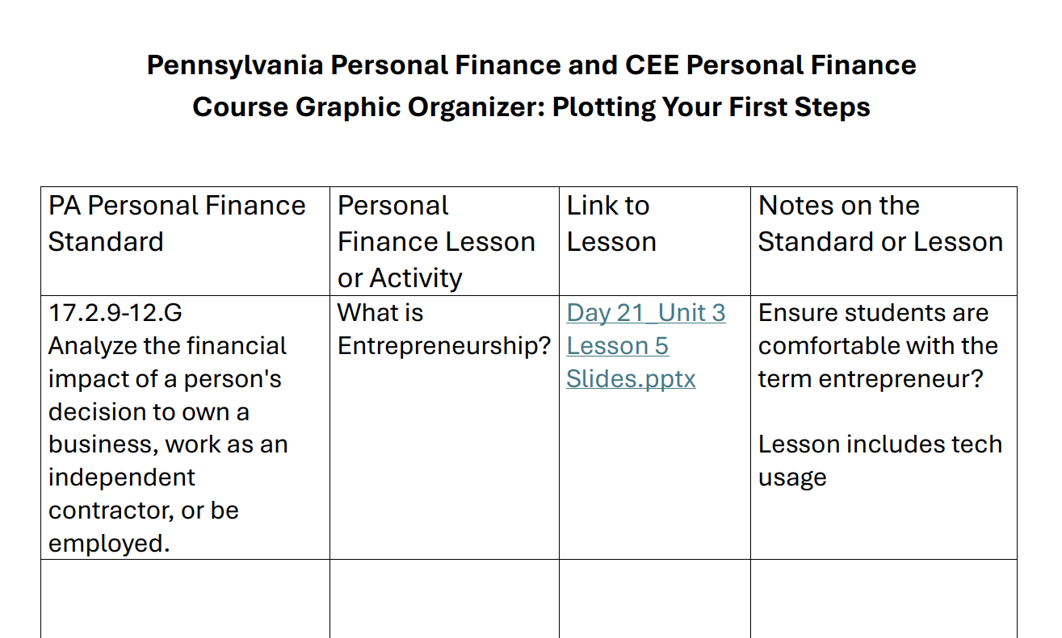
Notes:
Show the graphic organizer to demonstrate what this should look like before letting participants start
Give 20 minutes for this activity or if you have more you can have participants work on more than one standard.

Slide 31
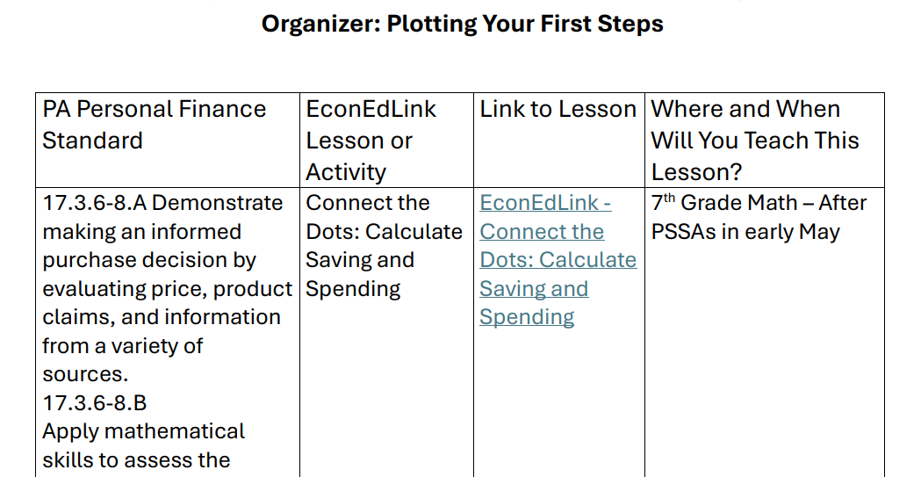
Notes:
Show the graphic organizer to demonstrate what this should look like before letting participants start. A great question here might be about unit rate because a school may specifically want to have this lesson taught and standard covered at the same time and during the same grade level with Unit Rate is taught. PA says unit rate is 6th and 7th grade
Give 20 minutes for this activity or if you have more you can have participants work on more than one standard.

Slide 32
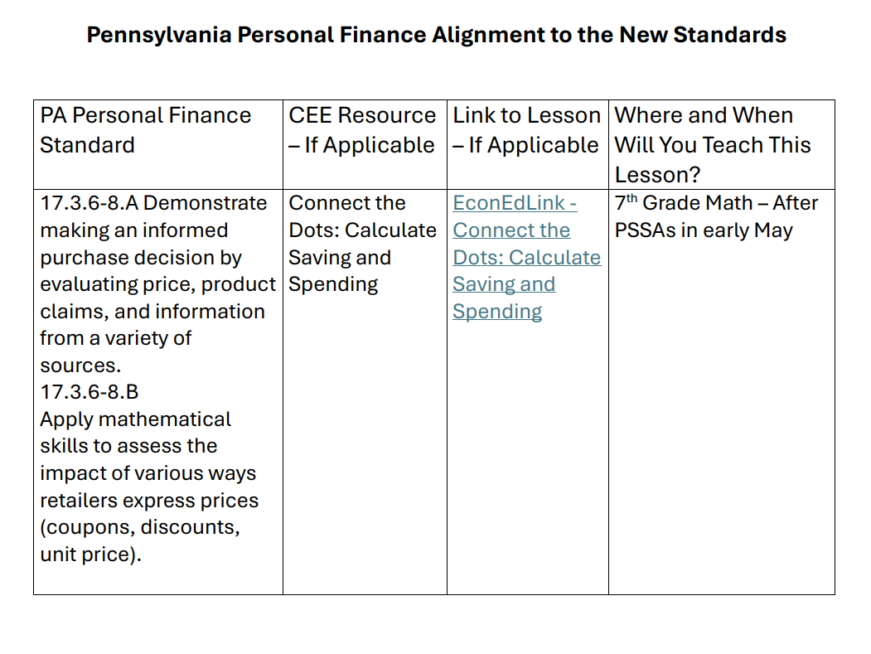

Slide 33

Before You Go
Share one thing that you learned from today
Where is your comfort level now with teaching the new PA Standards for Personal Finance?
What additional information or support do you need?

Slide 34

Notes:
Introduce participants to the upcoming conference in New Orleans. Let them know about the possibility of a scholarship for the event.

Slide 35
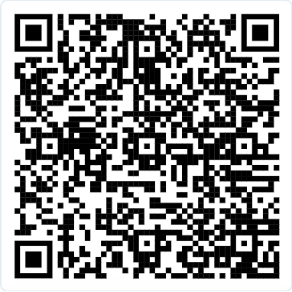

Slide 36
Questions?
Notes:
Use this opportunity for questions. Alternatively, this slide can be used to go around and have participants share one thing that they have learned from today’s training.

Slide 37
Thank You!
SCampbell@councilforeconed.org
Notes:
Leave this slide up as participants leave to ensure that they have an opportunity to record your contact information if they haven’t done so already.

