Slide 1



Can you
Allocate Ethically?

Slide 2

Can you
Allocate Ethically?

Slide 3


Presenter
John Kruggel has over 15 years of experience at the K-12 level.
He is currently the director of the JMU Center for Economic Education and a lecturer for JMU’s Economics Department.
He serves on the Network Advisory Committee for CEE and the Executive Board for the National Association of Economic Educators.
kruggejb@jmu.edu

Slide 4
Session Agenda
Overview of the Ethics, Economics and Social Issues Curriculum
Lesson Spotlight: Can you Allocation Ethically?
Wrap Up and Questions

Slide 5
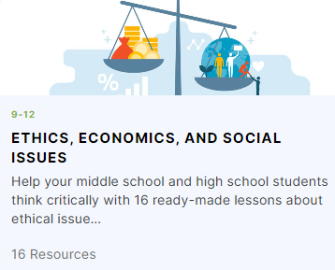
NEW Curriculum on EconEdLink!
“Help your students to think critically about ethical issues and understand why ideas of right and wrong are vital to economic decision making.”
Middle school and high school lessons

Slide 6
NEW Curriculum on EconEdLink!
ALL LESSONS:
Focus on active learning.
Include ready to use PPT slides.
Include all terms/definitions needed.
Include references so teachers can do a deep dive on the topics.
Focus on allowing discussions of timely topics that often don’t have simple solutions.
Are available on EconEdLink.

Slide 7



Thanks Sponsors!

Slide 8
Authors, Contributors, and Editors
Project manager: Jamie Wagner (Director, UNO CEE)
Authors: Chris Cannon (Chief Program Officer, GCEE), Stephen Day (Director, VCU CEE), Chandler Jordan (Executive Director, SCEE), Matt Pierson (Associate Director, NCEE), Jamie Wagner, John Kruggel (Director, JMU CEE).
Editors: Jennifer Davidson (President, NCEE), Chris Caltabiano (Chief Program Officer, CEE), Ruth Cookson (Senior Manager, Educational Content, CEE).

Slide 9
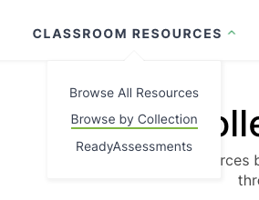
New Lessons
Where can I find these lessons?
The lessons are on EconEdLink in the Collections by Topic category.
No fee to sign up!!!
Click here for the dropdown
Click here for the lessons

Slide 10
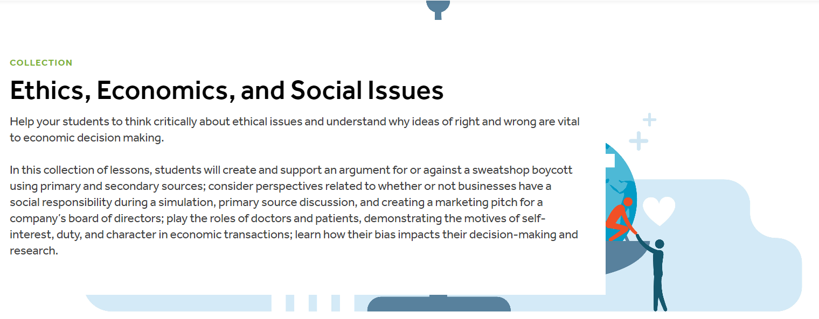
Ethics, Economics and Social Issues

Slide 11
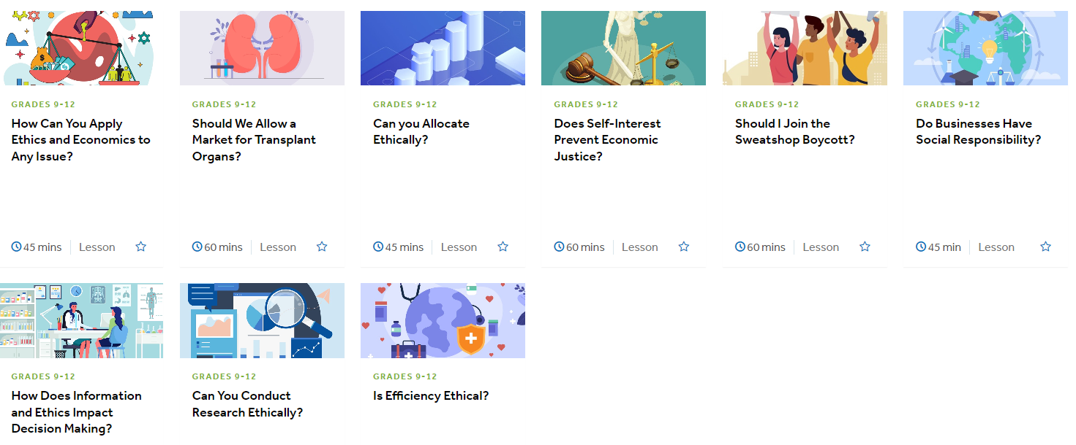
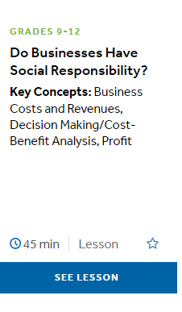
Ethics, Economics and Social Issues

Slide 12
Can you
Allocate Ethically?

Slide 13
Objective
You will be able to:
Identify several methods of resource allocation.
Evaluate allocation methods.
Apply allocation methods to a real-world scenario.

Slide 14
National Standards
Standard 1: Scarcity - Productive resources are limited. Therefore, people cannot have all the goods and services they want; as a result, they must choose some things and give up others.
Standard 2: Decision Making - Effective decision making requires comparing the additional costs of alternatives with the additional benefits. Many choices involve doing a little more or a little less of something: few choices are “all or nothing” decisions.
Standard 3: Allocation - Different methods can be used to allocate goods and services. People acting individually or collectively must choose which methods to use to allocate different kinds of goods and services.
Standard 4: Incentives - People usually respond predictably to positive and negative incentives.
https://www.councilforeconed.org/wp-content/uploads/2012/03/voluntary-national-content-standards-2010.pdf

Slide 15
Important Vocabulary
Decision making is reaching a conclusion after considering alternatives and their results.
Incentives are something that motivates or encourages one to do something.
Scarcity is the condition of not being able to have all the goods and services that one wants.
Allocation of Resources is the process of diving goods and service into shares or portions.

Slide 16

Teaching with Superstore (TRT: 1:32)

Slide 17
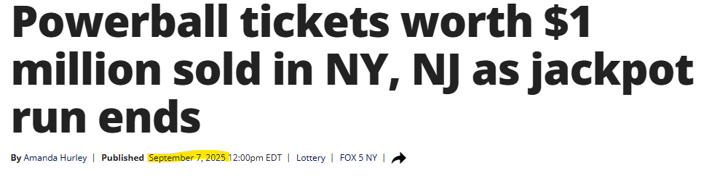
WE WON!!!!
How are we going to allocate the winnings?!?!
Share out the ways in the chat.
Be creative.

Slide 18
Visual 4.1: Allocation Options
Allocation Options | Examples
Rationing | Divide the item equally among all the students in the group.
Lottery | Draw straws or roll dice to determine who gets the item.
Favoritism Based on Achievement | Have a race and the winner gets the item. Give the item to the student with the highest grade.
Favoritism Based on Need | Give the item to the person who needs it the most. Give the item to the student who is the hungriest or has the lowest grades.
Brute Force | Have a fistfight and the winner gets the item.
Price | Allow one student to offer others in the group cash payment for the item.
First-Come, First-Served | Give the item to the first person who asks for it.
Characteristic | Give someone an item based on their age, race, sex, etc.

Slide 19

Obligatory Use of Taylor Swift

Slide 20
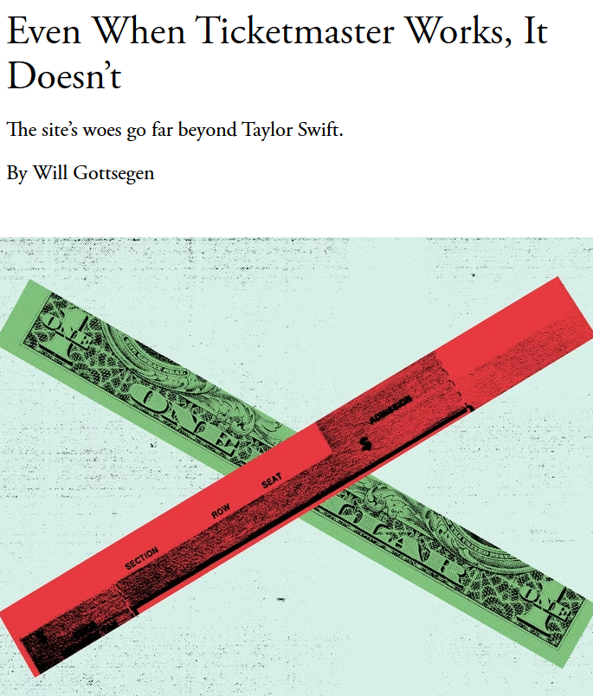

Even When Ticketmaster Works, It Doesn’t
Notes:
https://www.theatlantic.com/technology/archive/2023/01/ticketmaster-taylor-swift-presale-issue-live-nation/672869/

Slide 21
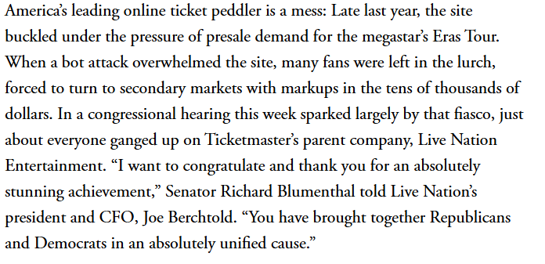
Basics:
Notes:
https://www.theatlantic.com/technology/archive/2023/01/ticketmaster-taylor-swift-presale-issue-live-nation/672869/

Slide 22


Activity 4.1 Questions
What created the scarcity problem in the article?
What method of allocation was used?
What were the outcomes of some of these methods?
Are there any issues or concerns with the allocation method that was used?

Slide 23
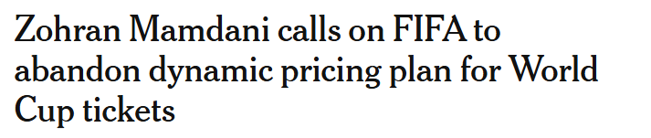
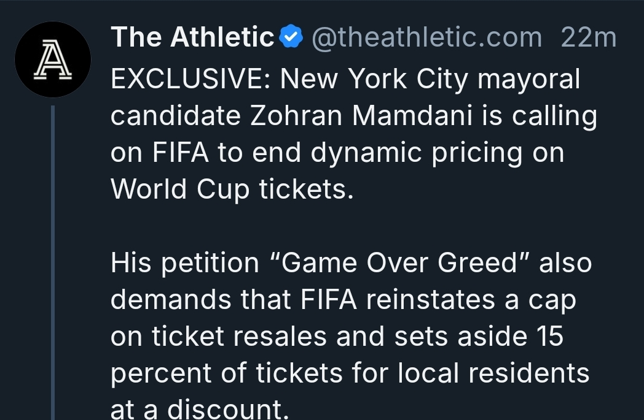
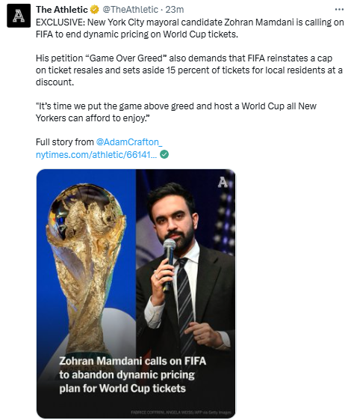
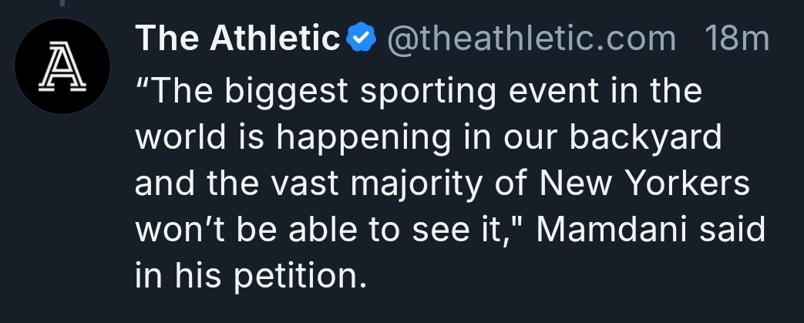

Slide 24
Outcome-Based Ethical Decisions
Outcome-based ethics
A decision to act or not act should be directed towards producing the greatest good for the greatest number of people.
Occasional injury to individuals is therefore an acceptable risk.

Slide 25
Allocation in History
THINK: Each student would receive a historical event and be given time to think about which of the allocation methods were used during the event.
PAIR: Once everyone has had time, we would then pair students to share their events with each other and confirm that they agree with the allocation method selected by their partner.
SHARE: Post the event and under each designed allocation method around the room and have students gallery walk.

Slide 26

Allocation in History Activity

Slide 27
Allocation in History - Example(s)
Due to the COVID-19 pandemic, Clorox disinfecting wipes and many other clearing products were difficult, if not impossible to find. Stores that had these products in stock often set limits on the number of products consumers could buy.
Allocation Options
Rationing
Lottery
Favoritism Based on Achievement
Favoritism Based on Need
Brute Force
Price
First-Come, First-Served
Characteristic

Slide 28
Allocation in History - Pair Questions
With your partner, answer the follow questions about each event:
  What is the issue of scarcity?
  What method of allocation was used?
  What were the outcomes of this method?
  Considering outcome-based ethics, was this the best allocation method or one that benefited the most or the intended people?
  Is there a better allocation method that would help eliminate some of the problems listed?

Slide 29
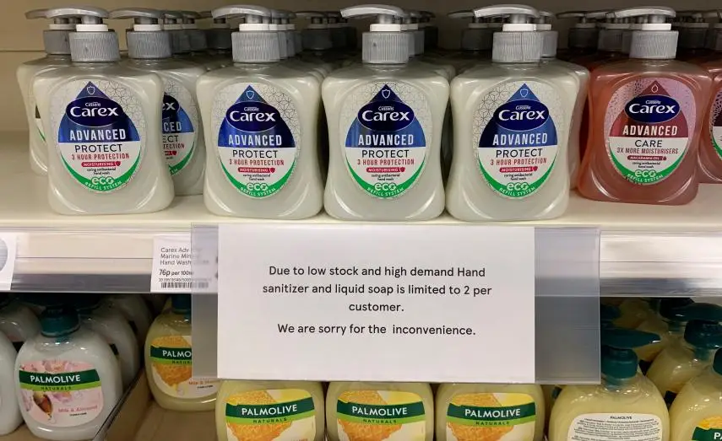
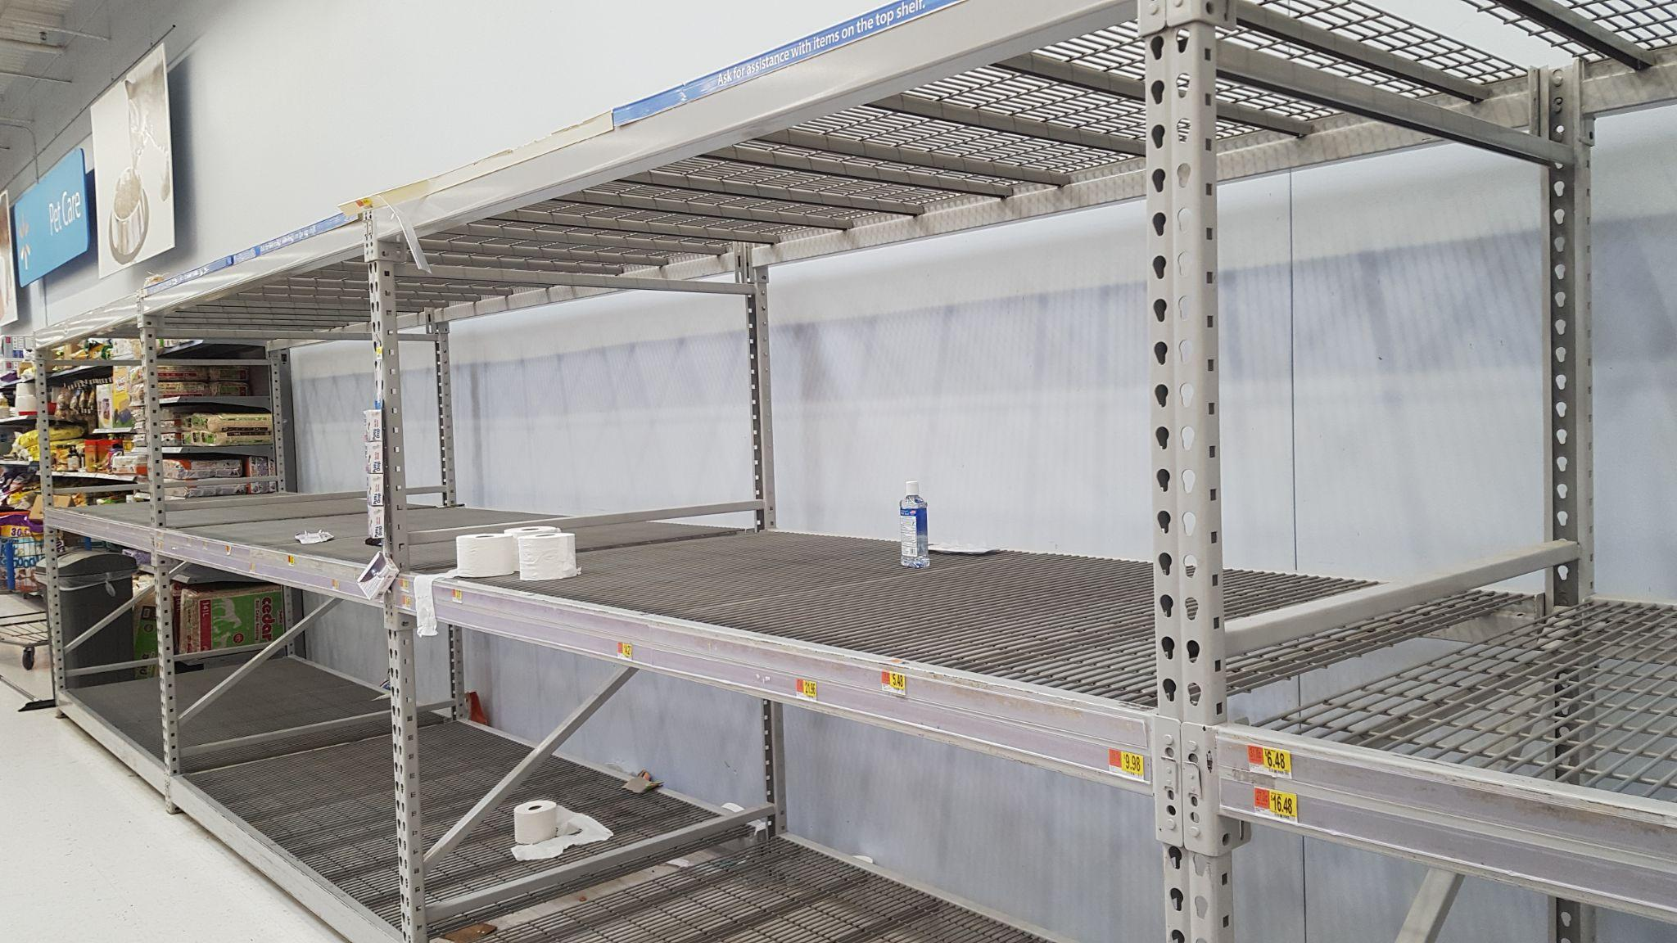

Slide 30
Allocation in History - Example(s)
In February 2021, a winter storm hit North America and nearly 10 million people lost power. This storm was particularly bad in Texas, where the massive power failure led to water, food, and heat shortages. Residents were left without power, water, etc. for days, surviving only on what they had purchased prior to the storm.
Allocation Options
Rationing
Lottery
Favoritism Based on Achievement
Favoritism Based on Need
Brute Force
Price
First-Come, First-Served
Characteristic

Slide 31
Allocation in History - Pair Questions
With your partner, answer the follow questions about each event:
  What is the issue of scarcity?
  What method of allocation was used?
  What were the outcomes of this method?
  Considering outcome-based ethics, was this the best allocation method or one that benefited the most or the intended people?
  Is there a better allocation method that would help eliminate some of the problems listed?

Slide 32

Why Price Gouging Laws Hurt the Most Vulnerable

Slide 33
Allocation in History - Example(s)
Prior to retailers offering discounts through November and online, shoppers would line up at 3 a.m. or earlier on Black Friday (the Friday after Thanksgiving) to get the best deals on holiday gifts, such as televisions, computers, popular toys, etc.
Allocation Options
Rationing
Lottery
Favoritism Based on Achievement
Favoritism Based on Need
Brute Force
Price
First-Come, First-Served
Characteristic

Slide 34
Allocation in History - Pair Questions
With your partner, answer the follow questions about each event:
  What is the issue of scarcity?
  What method of allocation was used?
  What were the outcomes of this method?
  Considering outcome-based ethics, was this the best allocation method or one that benefited the most or the intended people?
  Is there a better allocation method that would help eliminate some of the problems listed?

Slide 35

Black Friday Shoppers (2010) The Salt Lake Tribune

Slide 36
Allocation in History - Example(s)
During the Vietnam War all names of American men of draft-age were collected by the Selective Service System. Most men who were drafted were from poor and working-class families that were not eligible for a college deferment, have political connections, or had a medical deferment.
Allocation Options
Rationing
Lottery
Favoritism Based on Achievement
Favoritism Based on Need
Brute Force
Price
First-Come, First-Served
Characteristic

Slide 37
Allocation in History - Pair Questions
With your partner, answer the follow questions about each event:
  What is the issue of scarcity?
  What method of allocation was used?
  What were the outcomes of this method?
  Considering outcome-based ethics, was this the best allocation method or one that benefited the most or the intended people?
  Is there a better allocation method that would help eliminate some of the problems listed?

Slide 38
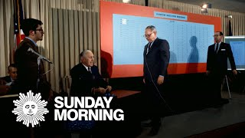
The 1969 Draft Lottery CBS Sunday Morning

Slide 39
Allocation in History - Example(s)
Susette Kelo sued the city of New London, Connecticut, for violating her civil rights after the city tried to acquire her house’s property through eminent domain so that the land could be used for a redevelopment plan. The Supreme Court ruled in Kelo vs New London that the city of New London could take privately-owned land in order to turn it over to a private developer.
Allocation Options
Rationing
Lottery
Favoritism Based on Achievement
Favoritism Based on Need
Brute Force
Price
First-Come, First-Served
Characteristic

Slide 40
Allocation in History - Pair Questions
With your partner, answer the follow questions about each event:
  What is the issue of scarcity?
  What method of allocation was used?
  What were the outcomes of this method?
  Considering outcome-based ethics, was this the best allocation method or one that benefited the most or the intended people?
  Is there a better allocation method that would help eliminate some of the problems listed?

Slide 41

Eminent Domain: The Kelo Case (Izzit)

Slide 42
Allocation in History - Example(s)
China leases pandas for about a million dollars a year to zoos across the United States. Even when the Smithsonian National Zoological Park in Washington, D.C. successfully bred a panda cub, Tai Shan, because the parents are on loan from China, the plana must be turned over to his parents’ homeland.
Allocation Options
Rationing
Lottery
Favoritism Based on Achievement
Favoritism Based on Need
Brute Force
Price
First-Come, First-Served
Characteristic

Slide 43
Allocation in History - Pair Questions
With your partner, answer the follow questions about each event:
  What is the issue of scarcity?
  What method of allocation was used?
  What were the outcomes of this method?
  Considering outcome-based ethics, was this the best allocation method or one that benefited the most or the intended people?
  Is there a better allocation method that would help eliminate some of the problems listed?

Slide 44
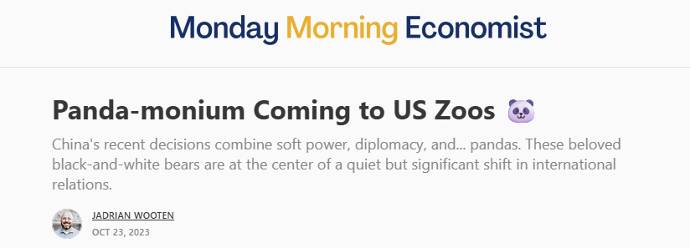
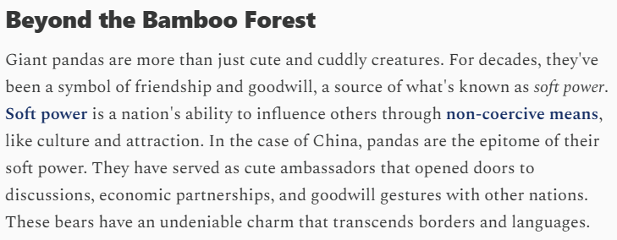
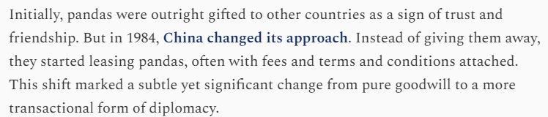
https://www.mondayeconomist.com?r=fu2cg

Slide 45
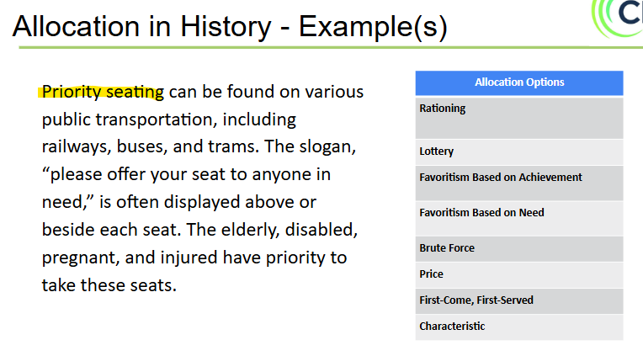
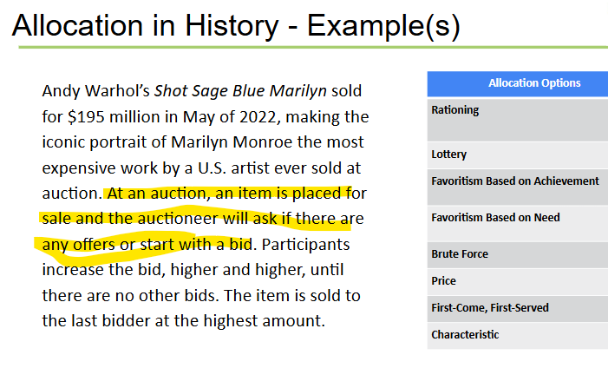
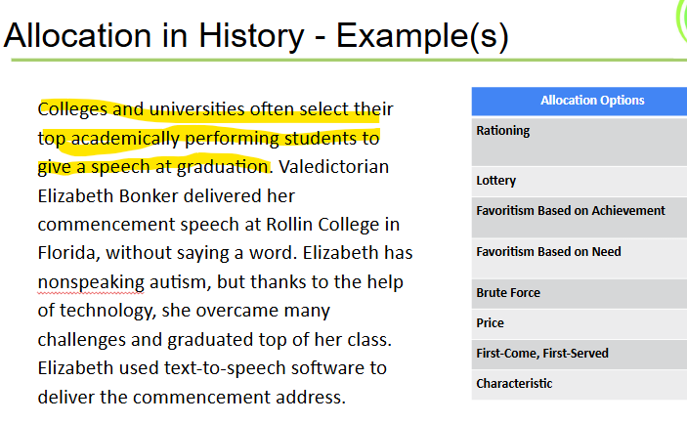
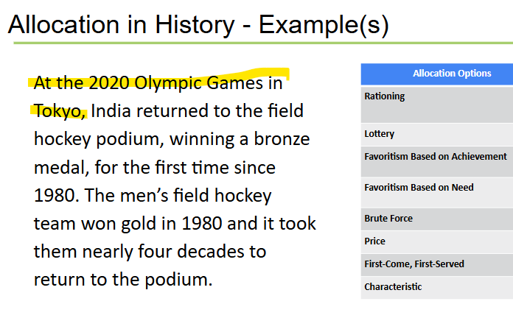

Slide 46

Assessments

Slide 47

Assessment: Allocation in the Workplace
You are the manager of a new boutique coffee shop and art gallery called Frame of Mind. Your immediate task is to complete the training of your three new employees and get them on the schedule. You have already shown them how to prepare the different coffee drinks and helped them become familiar with the artwork in the gallery and the artists whose work is on display. Now, you need to determine their schedule.
Describe how you apply each of the allocation options below to determine the three new employees’ schedule. Does that option work? Why or why not?
In the end, which allocation option do you think is most equitable to the three new employees? Explain your reasoning.

Slide 48
Assessment: Multiple Choice Questions
Which allocation method is most efficient and most responsive to the preferences of consumers who have income (money) to spend?
  First come/first served
  Price
  Rationing
  Lottery
Allocation methods help answer the economic question of
a. who should receive goods and services.
b. what goods and services should be produced.
c. how goods and services should be produced.
d. where goods and services should be produced.
Which allocation method could potentially exploit or harm a vulnerable person, such as a child, elderly, or sick person, the most?
a. Lottery
b. Favoritism Based on Need
c. Rationing
d. Favoritism Based on Achievement

Slide 49
Assessment: Short Answer Questions
Would it be equitable to give everyone in this class the same grade regardless of performance? What effect would this have? What allocation method should be used instead?
It is not generally considered equitable for people to pay different prices for goods and services, but many stores offer discounts based on age, education level, military service, etc. Do you think that is okay and why? What allocation method is being used?
As a student, you may receive discounts on food, clothing, and activities. The same goes for a senior discount when you're over 65 years old or military discount if you have served in the Armed Forces. Using the allocation methods discussed, make an argument against the use of discounts. Do you agree or disagree with this argument? Why?

Slide 50
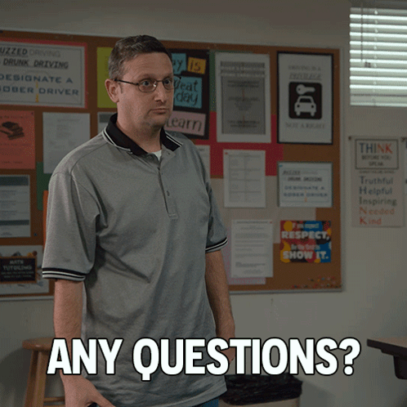
Questions?

Slide 51


Slide 52
THANK YOU!

