Slide 1


Career Exploration Using a Career Fair Format

Slide 2
Certificate Requirements
To earn professional development hours for webinars, you must:
Watch a minimum of 45-minutes and you will automatically receive a professional development certificate via e-mail within 24 to 48 hours.

Slide 3
Objectives
You will be able to:
Identify several ways for your students to research and explore careers
Explore methods in which to support students with resume building, interview skills, and job offer analysis
Consider a myriad of ways students can connect and share about the career research and interests

Slide 4
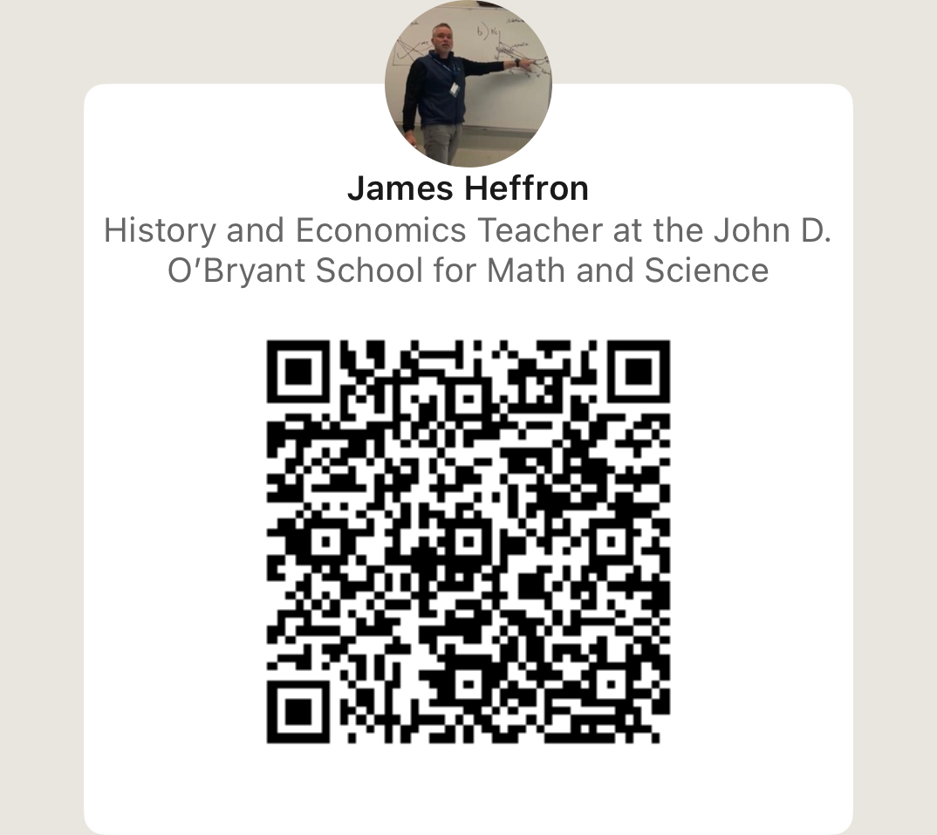
Presenter(s)
James Heffron
Jheffron@bostonpublicschools.org
www.linkedin.com/in/james-heffron-b54499a9

Slide 5
Session Agenda
Do Now and Intro
Career Search and Breakout Room
Career Fair/Presentation Options
Extension Options

Slide 6

National Standards
Evaluate the costs and benefits of investing in additional education or training
Identify different types of jobs and careers where wages and salaries depend on a worker’s productivity and skills
Explain why wages or salaries vary among employees in different types of jobs and among workers in the same jobs
https://www.councilforeconed.org/policy-advocacy/k-12-standards/

Slide 7

National Standards
8.M.4 Workers allocate their time, a scarce resource, between work (earning income) and leisure (enjoying activities). People have different preferences over their “work-life balance” choices.
8.M.5 People’s incomes are influenced by the choices they make about education, training, skill development, careers, and other things that impact their productivity. People with lower levels of education and skills face fewer employment options and reduced earnings potential.
https://www.councilforeconed.org/policy-advocacy/k-12-standards/

Slide 8
Do Now and Intro

Slide 9
Do Now
Think back to when you were 18 years old, what did you want to be when you grew up?
Perhaps based on your own experiences, or not, what is the most important thing you would want students taking away from a mini-unit on career exploration?
Notes:
Post thoughts in comments
Having taught this a few times now I think the biggest takeaway is having students think about transferable skills that will give them the option of transitioning from one profession to another throughout their working lives—things change, interests change—what you like now you may not be that into five, ten, fifteen years from now

Slide 10
2 – Career Research
Notes:
This was the meat of the work for me. I wanted students to explore and hear about as many careers as possible. There were three main online sources we used for this research which I will review in the next few slides. Let’s start with the Bureau of Labor Statistics

Slide 11
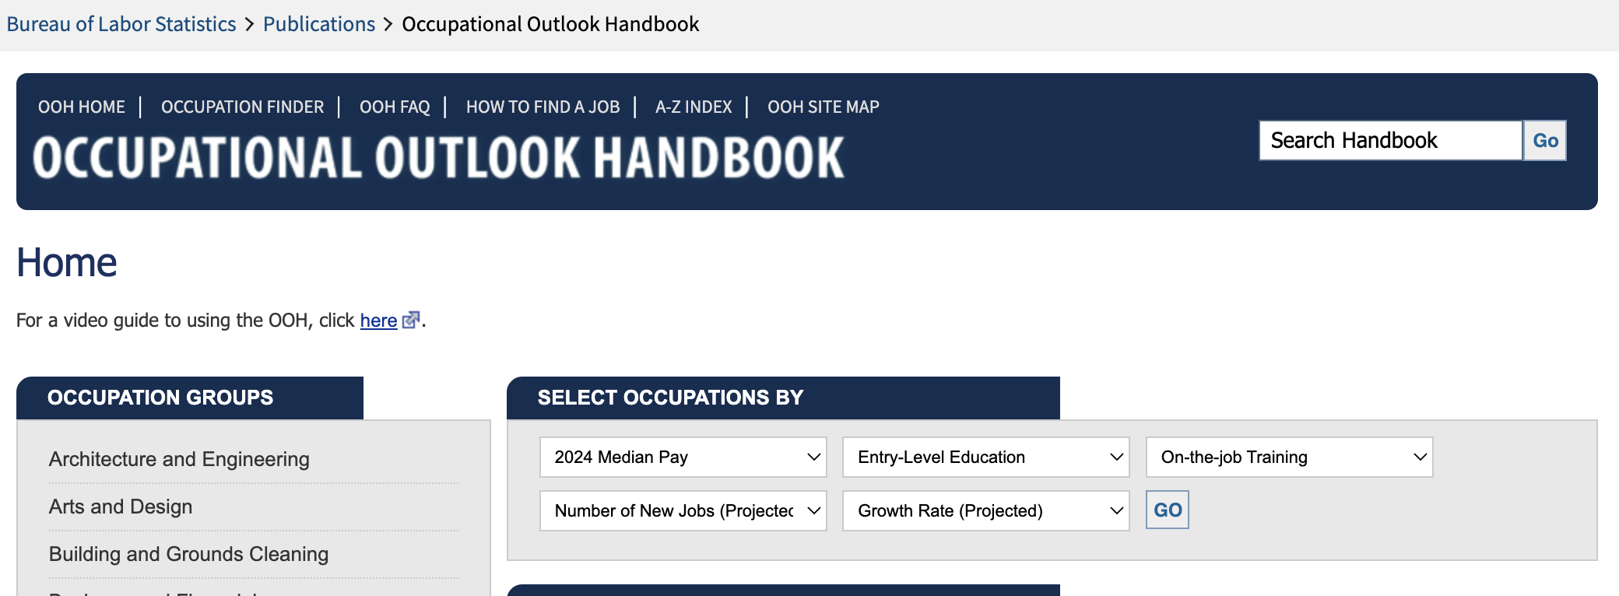
Bureau of Labor Statistics (BLS)
https://www.bls.gov/ooh/
identify 4 or 5 data points that would be important for our students to consider.
Notes:
Provide link to Bureau of labor statistics—put in the chat-- and have participants peruse the site a bit on their own
after a few minutes ask folks to identify 4 or 5 data points that would be important for our students to consider--pop them in the chat
Breakout groups: If you were going to create a graphic organizer for students using this site, what would be the categories/data points you would want students to capture?
Return back and share out

Slide 12
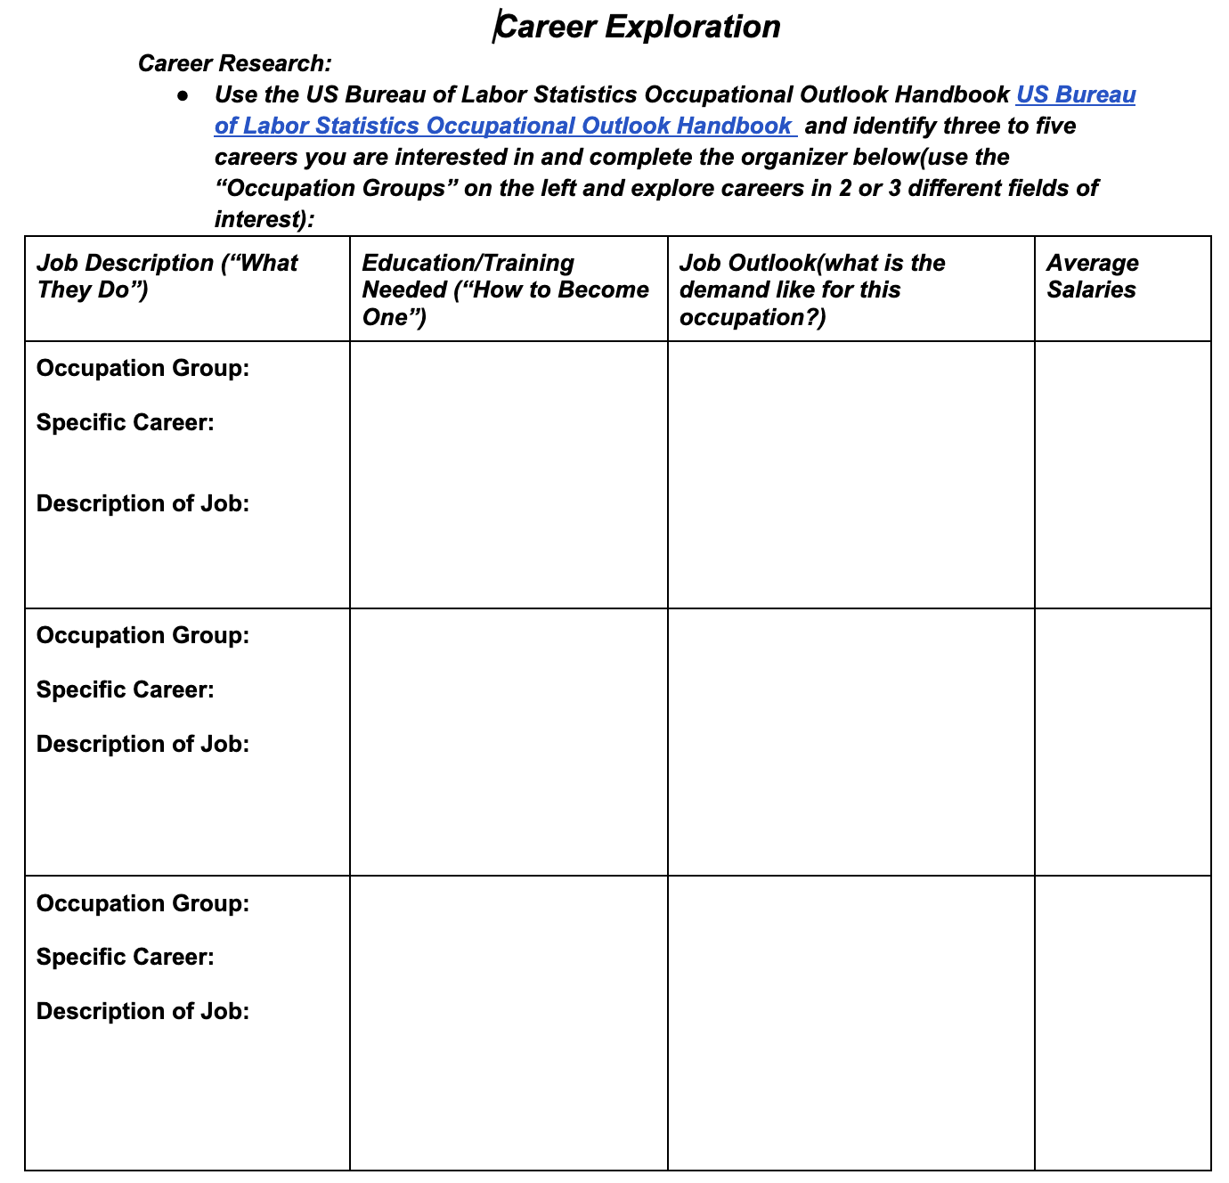
Student Organizer
Career Exploration Organizer for Students:
In class I handed out this form two-sided and wrote down an occupation for them to research--I wanted to expose them to one that may not choose on their own.
They were then placed in groups with classmates who had different careers and they shared out
In the same groups they researched a 2nd career of their choice as long as it wasn’t the same as someone else in their group
after researching this 2nd career, they shared out to the group--at this point they would have been exposed to 8 different careers
I also posted this on google classroom for them to research another career for HW
https://docs.google.com/document/d/1h6RmIsxumBN22BNCPU1zR_SlXpOBk40ejLNYmATwQwE/edit?tab=t.0
Notes:
the big ones I went with were Occupation groups, job description, education/training/certs, job outlook, salaries

Slide 13
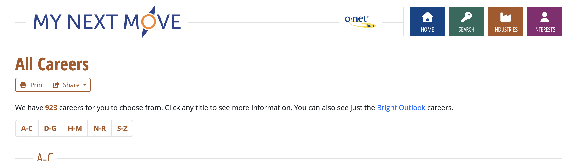
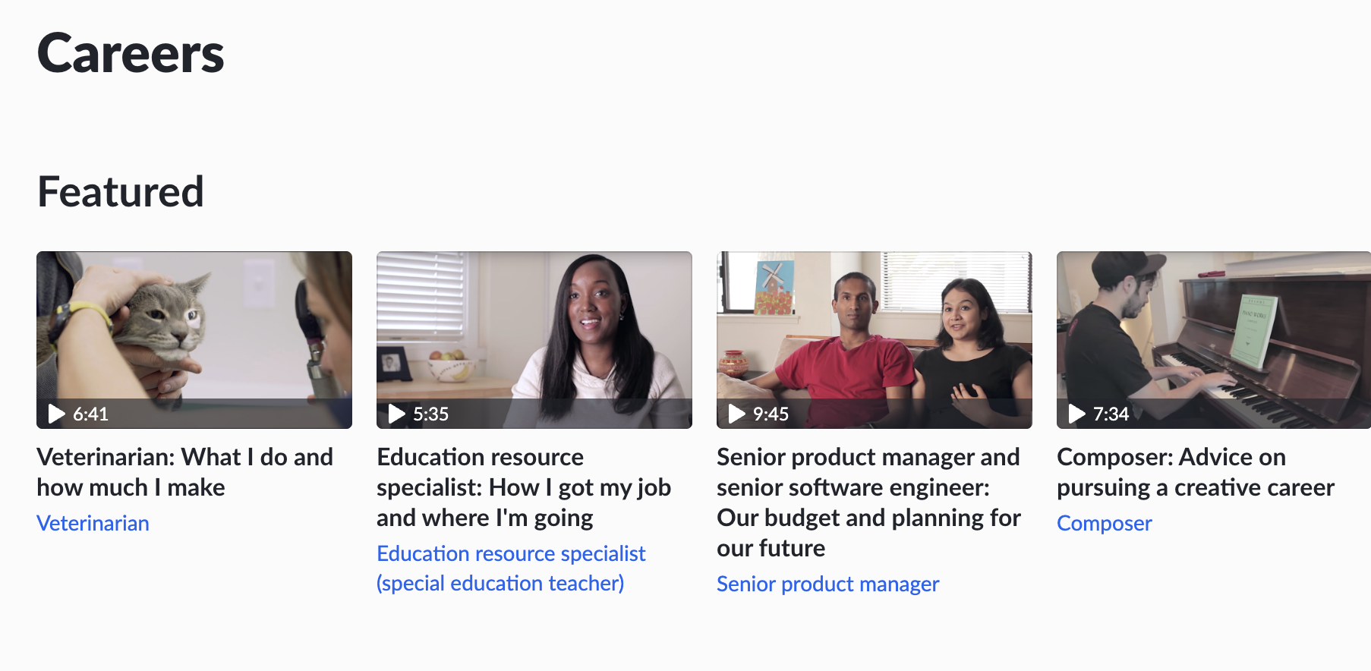
Other Sources for Career Searches
https://www.mynextmove.org/find/browse?c=0
Khan Academy: https://www.khanacademy.org/college-careers-more/career-content
Rank the three sites in order of preference (in the chat)
Notes:
Ask participants to take a few minutes and review these two sites: post these two links in the chat
after some time for participants to check the sites out, ask question: which one do they prefer and why--call on a few participants to share out what they liked or disliked about the sites
My Next Move is developed and maintained by the National Center for O*NET Development, under the sponsorship of the US Department of Labor/Employment and Training Administration (USDOL/ETA) through a grant to the North Carolina Department of Commerce.

Slide 14
Career Fair/Student Presentations

Slide 15
This can be as big or small as you want
present your slide deck to a small group of classmates
present in a career fair format during their class period; invite other classes in to view the careers
full scale career fair; in a large space for a few hours where the student body can file through
Size and Scope
Notes:
For me, time and resources are limited--it is not a stand alone personal finance class. the demonstration of understanding for this changes from year to year. Last year I did a small scale fair in the library and invited a few 11th grade classes in to view. This year I missed a few days with COVID so I had to adjust and we did small group presentation in class.

Slide 16
Students work in teams of 3-4
The presentations are focused on an “Occupation Group” instead of a single career
groups have ample time to create a tri-fold board, a one-page informational sheet and an informative slide deck
groups have time to reach out to adults in that career field and ask for them to stand at their table during the fair
Have all 11th/12th graders visit the career fair
My Ideal Career Fair
Notes:
Because I have about 80 students in my three Economics class, the groups would be easier to manage for the career fair itself AND you would not have repeats
I like Occupation Groups b/c it allows for more exposure to different careers and even if two groups have the same occupation group their poster will look different
a note on career selection--because some careers are very popular with our students you would need to figure out how they can select their careers; with small groups you can have the groups select their top three choices and then assign them one of their top three so there is a nice mix for the career fair.
Remember, whatever you are doing works. Any exposure to careers is a positive thing for students so do not shy away from this because you do not want to do the big fair. That’s fine, just do a day or two where they are researching careers and sharing out with groups. The bottom line is getting student curious about potential careers and understanding the path to get there.

Slide 17
Guest Speaker Opportunities:
Resume Building Workshop--does your building or district have a career specialist? Reach out to them!
Interview Workshop--Reach out to your local Chamber of Commerce for volunteers from local businesses
Myriad of Career lessons--check out CEE and NGPF
NGPF has a whole curriculum unit that you can pick and choose from(I used the career offer lesson from this site)
Extension Ideas
Notes:
For a resume workshop I have our building’s career specialist lead us through a resume building workshop
For the Interview workshop, I reached out to the Chamber of Commerce for a volunteer from a local business--HR department might be best to talk about interview questions and job benefits
There is a lot you can do with this; it can be as big or small as you want. Any of it will be beneficial to your students.

Slide 18
Resources
Notes:
put all links here to make it handy

Slide 19
Thank you

