Slide 1



Cost, Benefit, and Beyond: Strengthening Critical Thinking Through Decision-Making Models
The Photo by PhotoAuthor is licensed under CCYYSA.

Slide 2
Certificate Requirements
To earn professional development hours for webinars, you must:
Watch a minimum of 45-minutes and you will automatically receive a professional development certificate via e-mail within 24 to 48 hours.

Slide 3
Objectives
You will be able to:
Introduce economic vocabulary and concepts to your students
Use a cost benefit model to strengthen critical thinking
Use a PACED Decision making model to strengthen critical thinking

Slide 4
Presenter(s)
Joel Nick - Farmington High School
nickj@fpsct.org
In the chat – write your name and indicate what and where you teach and if you have started school yet

Slide 5

Session Agenda
Introduction of Economics Terms
Introduction of Decision-Making Model: Cost - Benefit Analysis
Introduction of PACED Decision-Making Model

Slide 6

National Standards
Decision-making is integrated throughout the standards. Factual content is presented as Standards, while the Learning Outcomes include a progression of learning levels designed to encourage critical thinking and application of the knowledge content to specific age-appropriate decisions.
Consumers incur costs and realize benefits when searching for information related to the purchase of goods and services. (CS 2 Spending 12-5)
https://www.councilforeconed.org/policy-advocacy/k-12-standards/

Slide 7

National Standards
To produce the profit-maximizing level of output and hire the optimal number of workers, and other resources, producers must compare the marginal benefits and marginal costs of producing a little more with the marginal benefits and marginal costs of producing a little less. (Content Standard 2 - Decision - Making Benchmark - 12)
https://www.councilforeconed.org/policy-advocacy/k-12-standards/

Slide 8
Economics Starter
Which of these next two pictures relates more closely to economics?
In the chat, indicate your answer by typing #1 or #2.

Slide 9

#1 Is this closer to a definition of Economics?

Slide 10

#2 Is this closer to a definition of Economics?

Slide 11
Which pic fits economics better?
1 2

Slide 12
#2 WINNER!?!

Slide 13
Definition of Economics
The study of how individuals, institutions and society
make decisions when faced
with a scarcity of resources.

Slide 14
Decision making when faced with scarcity!

Slide 15
Scarcity – Possible Class DQ’s
What do you want?
Why don’t you have it right now?
What are you willing to give up to get what you want?

Slide 16
What is scarcity?
Scarcity exists when resources are limited and people’s wants are unlimited.
Scarcity forces people to make choices about the use of resources.

Slide 17
ECONOMIC
DECISION MAKING
MODELS

Slide 18
Purpose of a Decision-Making model:
to better understand the choices people
faced in the past
to analyze the outcomes of the decisions
that people have already made
to see a problem from a variety of perspectives and consider the consequences before a choice is made

Slide 19
Vocabulary

Slide 20
Vocabulary
Cost: A cost is what you give up when you decide to do something. Costs are the effort, loss, or sacrifice necessary to achieve or obtain something.

Slide 21
Vocabulary
Benefit: A benefit is what satisfies your wants. Benefits are what is gained when an action is taken or a choice is made.

Slide 22
Incentives - actions or rewards that encourage people to act.
When incentives change, behavior changes in predictable ways.
Consequences – the outcome of an action. Some consequences are unintended!

Slide 23
Why are these concepts and skills important?
Economic decision-making focuses on considering the costs and benefits of a choice BEFORE the decision is made.

Slide 24
Why are these concepts and skills important?
They can help our students to think about ALL the possibilities and consequences before they make their choice. Or they can evaluate past choices more clearly.

Slide 25
Why are these skills important?
Thinking critically –
analyzing why a choice was made in the past
or considering the costs and benefits before a choice is made in the future
teaches our students an important life skill.

Slide 26
TOOLS FOR ECONOMIC DECISION-MAKING
Cost – Benefit Analysis
PACED Decision Making Model

Slide 27

Opportunity Cost
All tools must include an intentional analysis of what is
given up when making a choice!

Slide 28
Opportunity Cost
Whenever you make a choice, you are actually making two choices.
This is because whenever you choose to do one thing, you are also choosing not to do something else.
What you choose not to do is your opportunity cost.

Slide 29
Tool #1: Cost – Benefit Analysis
Personal Example - Any
Costs | Benefits

Slide 30
Cost – Benefit Decision Grid
Tool used for deciding whether or not an action should be taken by comparing its benefits and costs.
Use when a “Yes or No” decision needs to be made.
Importance of Tool
For Future Decisions – gives you time to consider less obvious factors that may be important to the outcome
For Past Decisions – provides context for the decision - helping to understand why the action was taken and evaluate whether the best decision was made.

Slide 31
Tool #1: Cost – Benefit Analysis Example
Should I attend this College?
Weigh the Costs and Benefits
Costs | Benefits

Slide 32
Tool #1: Cost – Benefit Analysis Example
Should I attend this College?
Add a benefit ( +) or a cost ( – ) in the chat.
Costs | Benefits

Slide 33
Tool #1: Cost – Benefit Analysis
Attend college?
Weigh the Costs and Benefits
Costs | Benefits
Did the benefits of my choice outweigh the costs?
What was given up when I made my choice?

Slide 34
Tool #1: Cost – Benefit Analysis Content Examples -
Describe how effective decision-making requires comparing the additional costs and additional benefits
Comparing the costs and benefits of different forms of business organizations
Compare the costs and benefits of purchasing vs. leasing a vehicle
Compare the advantages and disadvantages of renting vs. purchasing a home

Slide 35

Cost – Benefit Decision Grid
Costs Negative Incentives | Benefits Positive Incentives
Should Jayden rent an apartment?

Slide 36

Cost – Benefit Decision Grid
Jayden needs your advice.
She is graduating in June and wants to move out of the house and get her own apartment.

Slide 37

Cost – Benefit Decision Grid
She has a full-time job lined up and is going to community college part-time.
She is looking forward to being on her own, away from her 3 younger siblings and isn’t interested in sharing a place.
The rent is not a problem but she is worried about all the responsibility that comes with moving out on her own.

Slide 38

Cost – Benefit Decision Grid
Help Jayden fill out a cost-benefit decision grid, making sure to weigh the costs and benefits.
Should she get her own apartment?

Slide 39
Cost – Benefit Decision Grid
Should Jayden rent an apartment? Add a benefit ( +) or a cost ( – ) in the chat.
Costs Negative Incentives | Benefits Positive Incentives

Slide 40
Cost – Benefit Decision Grid
Should Jayden rent an apartment?
Costs Negative Incentives | Benefits Positive Incentives
Must do all chores, bill paying, etc.
She’s looking forward to being an adult
and all the responsibilities that come
with being on her own.
Lonely, might miss family
What happens if she loses her job?
Quiet place to study, no interruptions
She can do what she wants

Slide 41
Cost – Benefit Decision Grid
Should Jayden rent an apartment?
DOES THE CHART TELL YOU WHAT THE RIGHT CHOICE IS?
Costs Negative Incentives | Benefits Positive Incentives
What was given up when I made my choice? (Opportunity Cost)
JAYDEN SHOULD EXAMINE THE COSTS AND BENEFITS OF EACH CHOICE
AND CHOOSE THE ONE THAT WOULD MAKE HER HAPPIER.
Has to do all chores, bill paying, etc
She’s looking forward to being an adult
and all the responsibilities that come
with being on her own.
Lonely, might miss her family
What happens if she loses her job?
Quiet place to study, no interruptions
She can do what she wants

Slide 42

Which US city listed is the MOST affordable
(has the LOWEST cost of living?)
A. New Orleans
B. Detroit
C. Cleveland
D. Chicago

Slide 43
Which US city listed is the MOST affordable
(has the LOWEST cost of living?)
A. New Orleans
B. Detroit
C. Cleveland
D. Chicago

Slide 44

Visual Capitalist has great, current data.
You can use their visuals to have fun in class.
This Photo by Unknown Author is licensed under CC BY-SA
Notes:
City Data

Slide 45
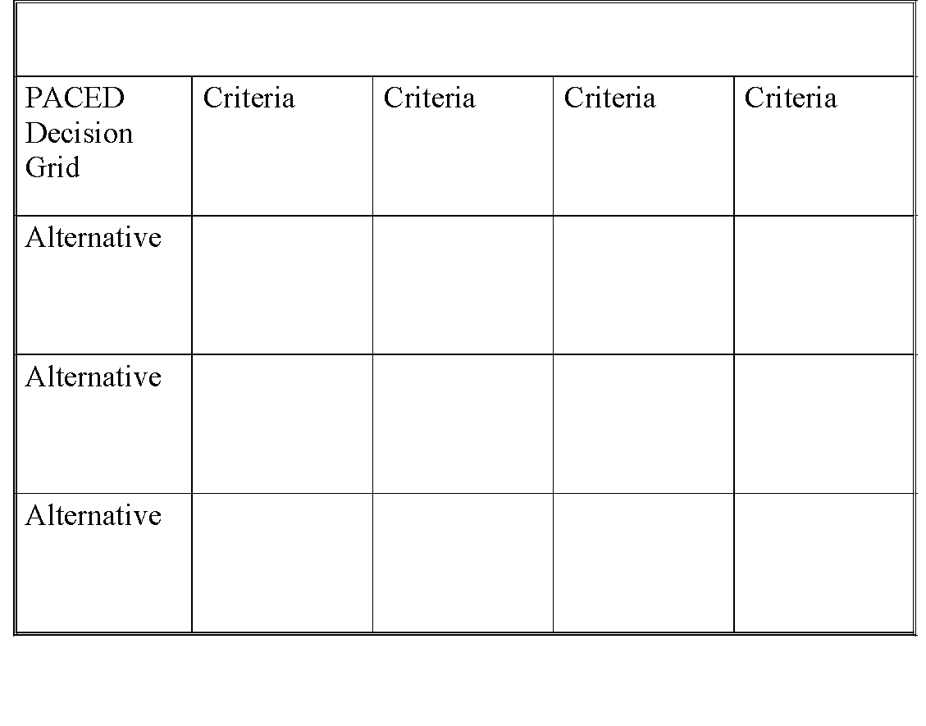
Problem:
PACED Decision-Making Model

Slide 46
PACED Decision-Making Model
Tool to use when deciding among
various choices or alternatives.
Use this tool to consider the costs and benefits of each alternative using the factors (criteria) that are most important to you.

Slide 47



Which college should you attend?
You’ve decided on an economics major, filled out your applications and been accepted at your top three choices for college.
But you’re having a very difficult time making a choice and need some help making this decision.
Big City U
Small Private College
Elite U
Notes:
Big city – a large university with over 30,000 students with graduate and undergraduate programs but Some undergraduate classes have over 200 students. Tuition is reasonable Close to hometown
Small Private College – ony has 3,000 students, 200 miles from home. Classes are small, students get a lot of attention. Business school and economics program are highly ranked nationaly. Tuition is expensive, but small private college is giving me a scholarship so the cost would be the same as Big City U
Elite U – dream school, favorite nobel winning economist teaches here, 2000 miles from home, prestigious but with the price tag to match. I will need to take out loans to go here.

Slide 48

How do you decide?
PACED
    Identify the Problem
    List Alternatives or choices
    State the Criteria – What’s most important?
    Evaluate
    Decide

Slide 49
Opportunity Cost
All tools must include an intentional analysis of what is given up when making a choice!
After each decision ask:
What is my opportunity cost?

Slide 50
Which College to Attend?
Problem: Which college should you attend?

Slide 51
A: LIST THE ALTERNATIVES
Problem: Which college should you attend?
Big City U
Small Private
College
Elite U

Slide 52
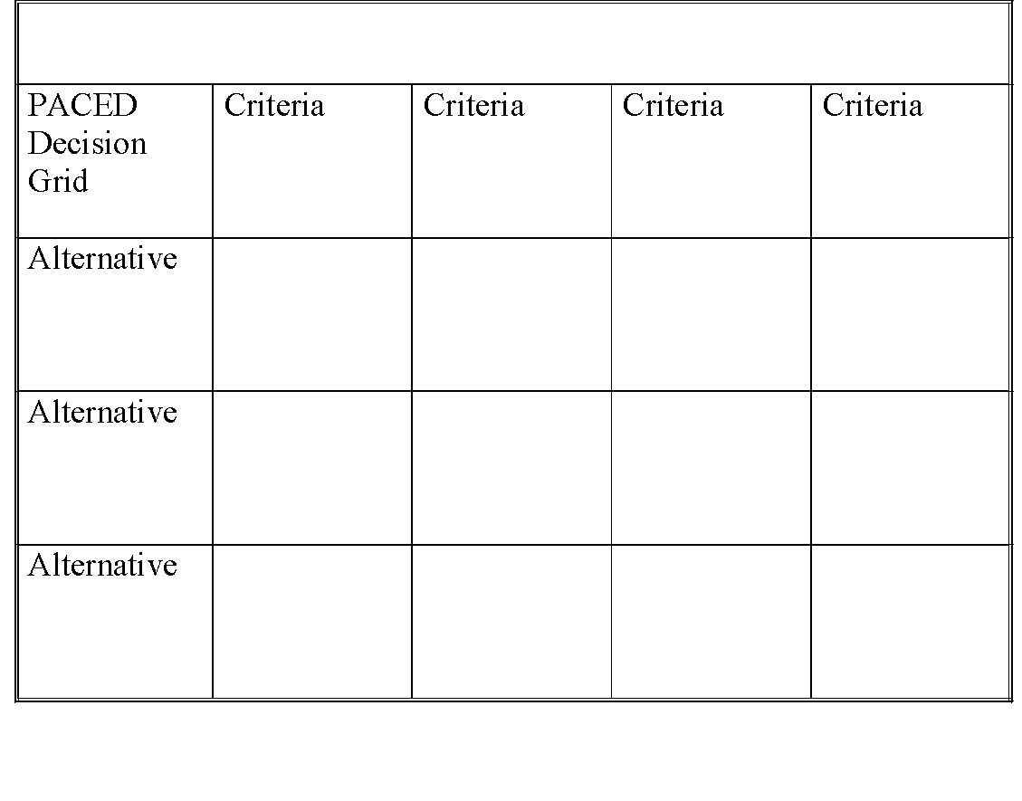
C: STATE THE CRITERIA
Problem: Which college should you attend?
Low cost
High quality
education
Close to
home
Big City U
Small Private
College
Elite U
Notes:
I stop and ask what is important in deciding what college they want to go to.. And then I explain that this is my criteria – yours will be different.
Low cost tuition because family is not wealthy and don’t want loans
High quality education particularily in the field of economics
Close to home because you would miss your family and friends if you were far away

Slide 53
E: EVALUATE THE ALTERNATIVES
Rate On A Scale From 3 (Best) to 1 (Worst)
Problem: Which college should you attend?
Low cost
High quality
education
Close to
home
2
2
3
Big City U
2
Small Private
College
3
2
1
3
1
Elite U
Notes:
My numbers are different than your numbers. What you think is important in making the decision is different than what I think is important. You can’t grade students on getting the correct numbers… its about the process. Stress that – its’ about the process.

Slide 54
EVALUATE THE ALTERNATIVES
ADD UP THE NUMBERS
Problem: Which college should you attend?
Low cost
High quality
education
Close to
home
Big City U
2
2
3
= 7
3
= 7
Small Private
College
2
2
Elite U
1
3
1
= 5

Slide 55
EVALUATE THE ALTERNATIVES
ADD UP THE NUMBERS
Problem: Which college should you attend?
x2
What if one criteria is more important than the others?
Low cost
High quality
education
Close to
home
Big City U
2
2
3
= 7
3
= 7
Small Private
College
2
2
Elite U
1
3
1
= 5

Slide 56
EVALUATE THE ALTERNATIVES
ADD UP THE NUMBERS
Problem: Which college should you attend?
x2
What if one criteria is more important than the others?
Low cost
High quality
education
Close to
home
Big City U
2
4
3
= 9
6
= 10
Small Private
College
2
2
Elite U
1
6
1
= 10

Slide 57

D: MAKE A DECISION
Problem: Which college should you attend?
x2
Low cost
High quality
education
Close to
home
Big City U
2
4
3
= 9
Small Private
College
2
6
= 10
2
1
6
1
= 8
Elite U

Slide 58
PACED Decision Grid
Content Examples (Economics, Personal Finance)
How should we spend a budget surplus in our town?
What are the costs and benefits of different forms of business organizations?
Which car should I buy?
Where should I invest my money?

Slide 59



Franklin’s Decision
Franklin is an 11th grade student who has to make a decision about what to do after school.
Help him make a decision that would make him
and his mother happy.

Slide 60
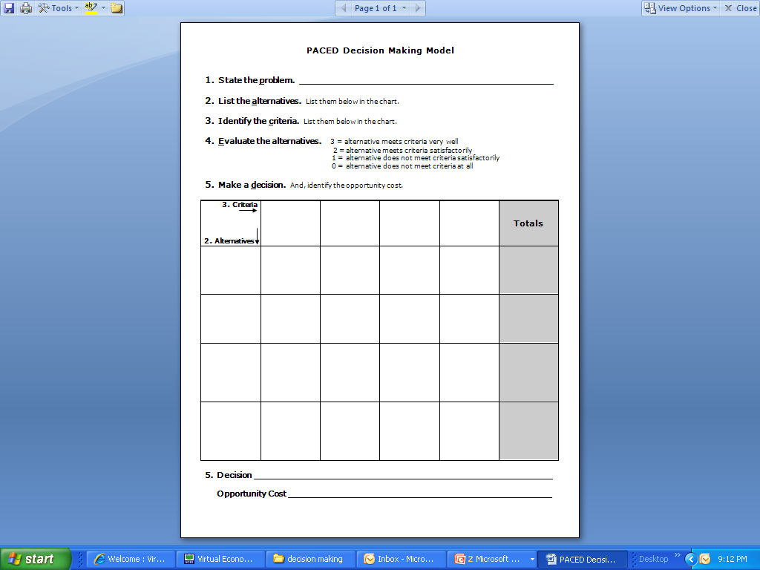


What should Franklin do after school?
SAFE
$$
FUN
?
Use as writing prompt.

Slide 61

Clarifications or questions?

Slide 62

Thank you and enjoy your school year!

Slide 63
Thank you to Erin Heald and the CEE.
Thank you to Arley Pekrul, my Department Leader

Slide 64
Resources:
-Council for Economic Education (CEE)
-Foundation for Economic Education (FEE)
-Federal Reserve Education
-Visual Capitalist
If we have a bit of time, I would like to browse through the CEE website

Slide 65
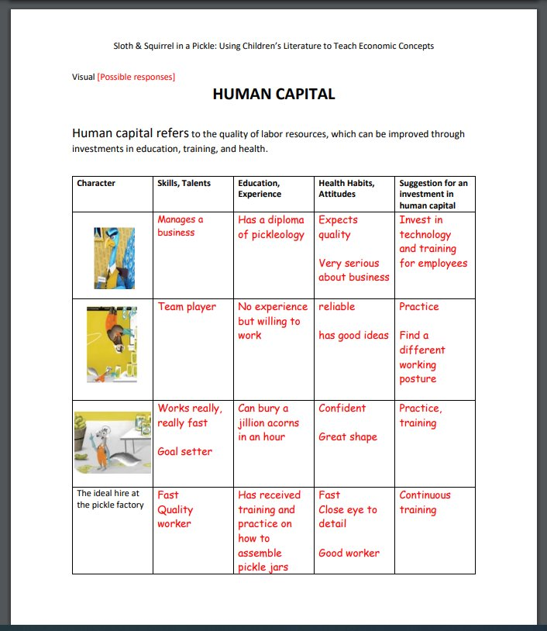
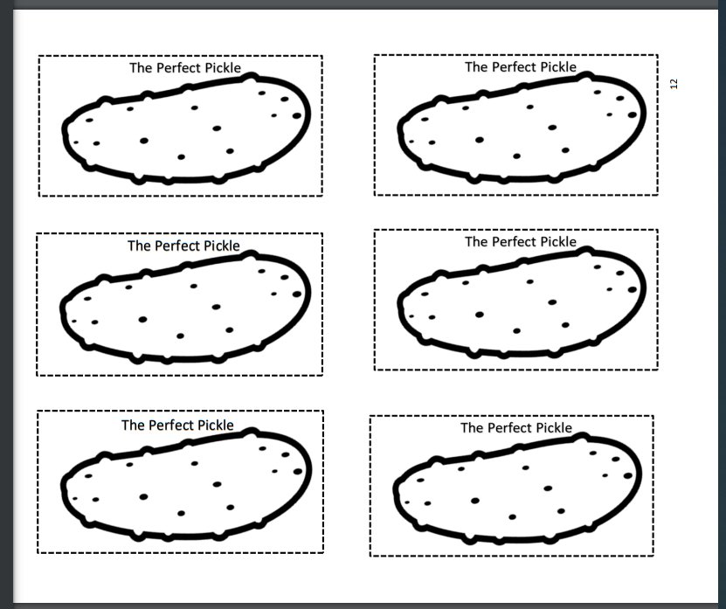
Title
Lesson Plan
[Describe the lesson]

Slide 66
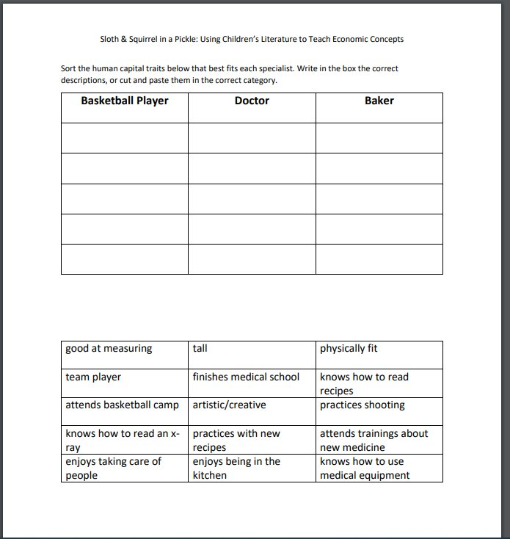
Title
Assessments
[Describe types of assessments]

Slide 67

[INSERT FEATURED IMAGE OF WEBINAR SESSION]
2 - Agenda Title

Slide 68



Contact Us
Name
Email Address
Social Handles
Name
Email Address
Social Handles
Name
Email Address
Social Handles

Slide 69
The 2024 John Morton Excellence in the Teaching of Economics Awards
  This prestigious award honors K-12 teachers of any subject who use exemplary teaching techniques that improve their students’ economic understanding, in and out of the classroom. Each year CEE awards one teacher for Elementary School (Grades K-5), Middle/Junior High School (Grades 6-8), and High School (Grades 9-12)
  Each winner will receive:
    $1,000 cash prize
    An opportunity to co-facilitate a session at CEE’s 63rd Financial Literacy & Economic Education Conference on September 27-28, 2024 in Cleveland, Ohio & recognition of your achievement during the Awards Luncheon (Registration, travel, and accommodation expenses covered by CEE)
    Recognition on the CEE website and in CEE’s EconEdLink November newsletter
  Teachers can apply themselves or be nominated for this award by a teaching colleague, department chair, principal, superintendent, or CEE state affiliate (state council or university-based center for economic education). Applications and nominations for 2024 awards will be accepted until Friday, June 21, 2024 at 11:59 PM EST.
APPLY OR NOMINATE SOMEONE TODAY!

Slide 70


Slide 71
[INSERT FEATURED IMAGE OF WEBINAR SESSION]
Thank you

