Slide 1
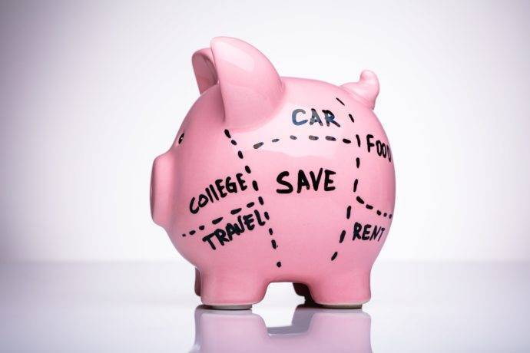
Spending on a Budget
Notes:
https://financialwellness.utah.edu/blog/posts/2022/aug-blog-budget.php. Financial Wellness Center, Student Affairs, The University of Utah. Budgeting for the Upcoming School Year. Jackson Lunt, August 10, 2022.

Slide 2

Presenter
Dan Feins
drdsfeins@gmail.com
linkedin.com/in/daniel-feins-69391924

Slide 3
Poll
What is the number one obstacle you meet when teaching Personal Finance?
Math
Vocabulary
Apathy
Relevance
Time

Slide 4
Objectives
You will be able to:
Explain the purpose of a budget and key budgeting concepts.
Differentiate between gross pay and net pay.
Classify fixed vs. variable expenses and analyze a sample budget.

Slide 5

National Standards
Standard I – Earning Income, 8-5a., “Differentiate between gross and net pay.”
Standard II – Spending, 12-1c., “Explain methods of adjusting a budget for unexpected expenses or emergencies.”
https://www.councilforeconed.org/policy-advocacy/k-12-standards/

Slide 6

Session Agenda
Why teach Personal Finance to High School students?
Purpose of a Budget
Income and Expenses
Sample Budget

Slide 7

1 - Why teach Personal Finance?

Slide 8
Why teach Personal Finance?
“[Our students] are on the brink of adulthood … entering that phase of life where not a day will go by where they don’t think about money – how to make it, how to save it, how to spend it.”
– John Pelletier, Director of the Center for Financial Literacy at Champlain College, quoted in CBS Evening News, Eye on America, “Why more high schoolers are taking financial literacy classes.”
Notes:
https://www.youtube.com/watch?v=rZN2N9lH9K0

Slide 9

2 – Purpose of a Budget

Slide 10
Purpose of a Budget
Plan for your money
You tell your money where it’s going …
Instead of your money telling you where it went.
Your thoughts?
Money management
Scarcity

Slide 11

3 – Income and Expenses

Slide 12
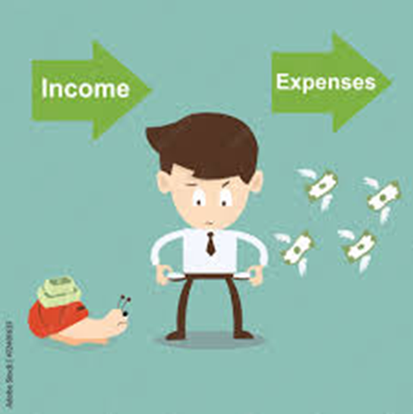
Income and Expenses
Two Elements of a Budget

Slide 13

Income and Expenses
Income = Money coming in
Wages from employment
Gifts
Student Financial Aid
Interest / Dividends from financial investments

Slide 14

Income and Expenses
Income from wages (employment)
Gross Income
Net Income

Slide 15
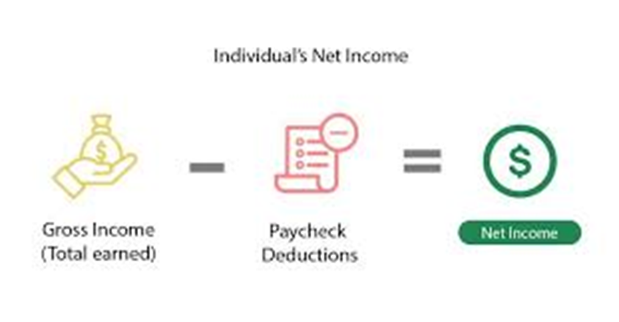
Income and Expenses
Net Income = Gross Income - Deductions

Slide 16
Income and Expenses
Expenses = Money going out
School Supplies
Activities
Bills
Entertainment
Food / Restaurants

Slide 17
Expenses
Fixed Expenses
Variable Expenses
Constant
Don’t change or don’t change often
An expense that is easy to predict
Inconsistent
Change often
Hard to predict because they are irregular

Slide 18




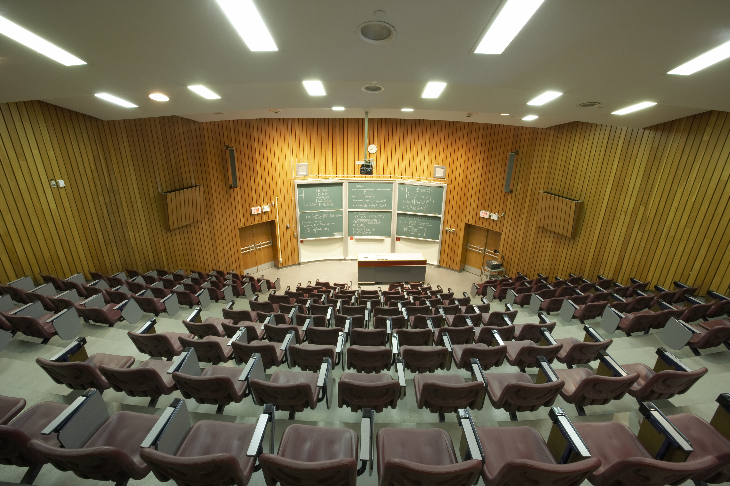

Expenses
Fixed Expenses
Variable Expenses

Slide 19
Income and Expenses
Expenses – Your Turn
Each student gets a sheet of paper with “Fixed” one side and “Variable” on the other
For each example, students are asked to consider whether the expense of fixed or variable
  They then hold up their sign

Slide 20
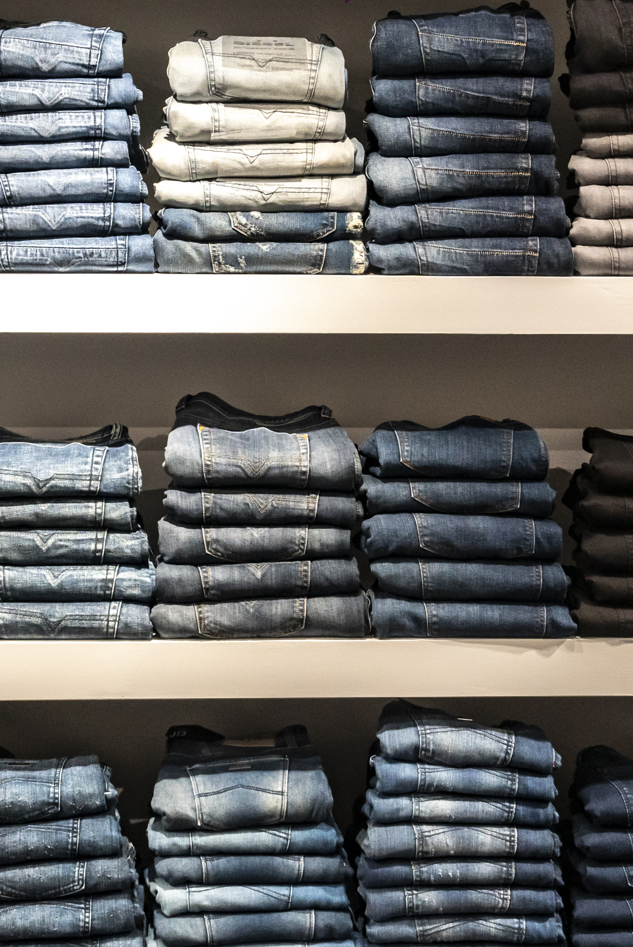
Income and Expenses
Expenses – Your Turn
Clothing

Slide 21

Income and Expenses
Expenses – Your Turn
Cellphone

Slide 22


Income and Expenses
Expenses – Your Turn
Concert

Slide 23

Income and Expenses
Expenses – Your Turn
Insurance

Slide 24

Income and Expenses
Expenses – Your Turn
Hospital Visit

Slide 25


Income and Expenses
Expenses – Your Turn
Subscriptions

Slide 26





Income and Expenses
Expenses – Your Turn
School Supplies and Activities

Slide 27
4 – Sample Budget

Slide 28
Sample Budget
Exercise 8.3, “John and Marcia: Monthly Spending Plan.” Financial Fitness for Life, 3rd Edition, Council for Economic Education, 2019.
Break out groups
10 minutes to work through the budget and agree on recommendations
Come back together and see if we have commonality (maybe even consensus)
Top student answers
  Magazines and Newspapers
  Gifts and Contributions
  Vacation
  Meals (away from home)

Slide 29
Questions?

Slide 30
Contact Me
Dan Feins
drdsfeins@gmail.com
linkedin.com/in/daniel-feins-69391924

Slide 31
Thank you

